Slide 1
OPT8241
Hyan
2018/08/25

Slide 2
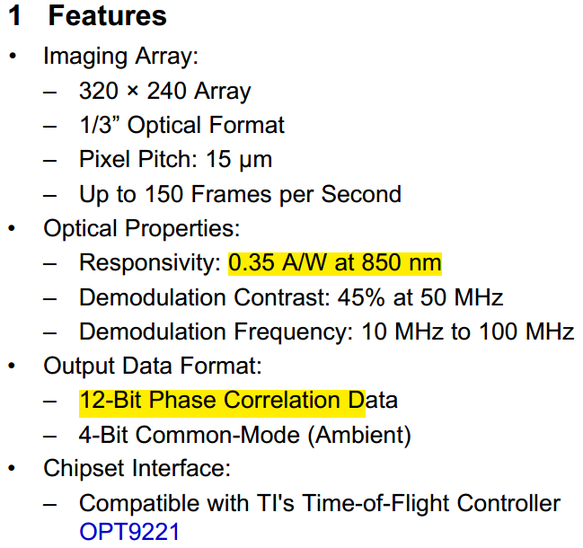
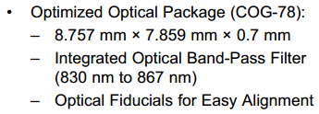
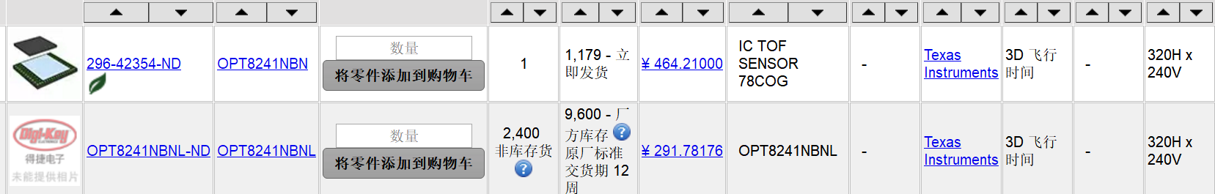
Basic Features

Slide 3
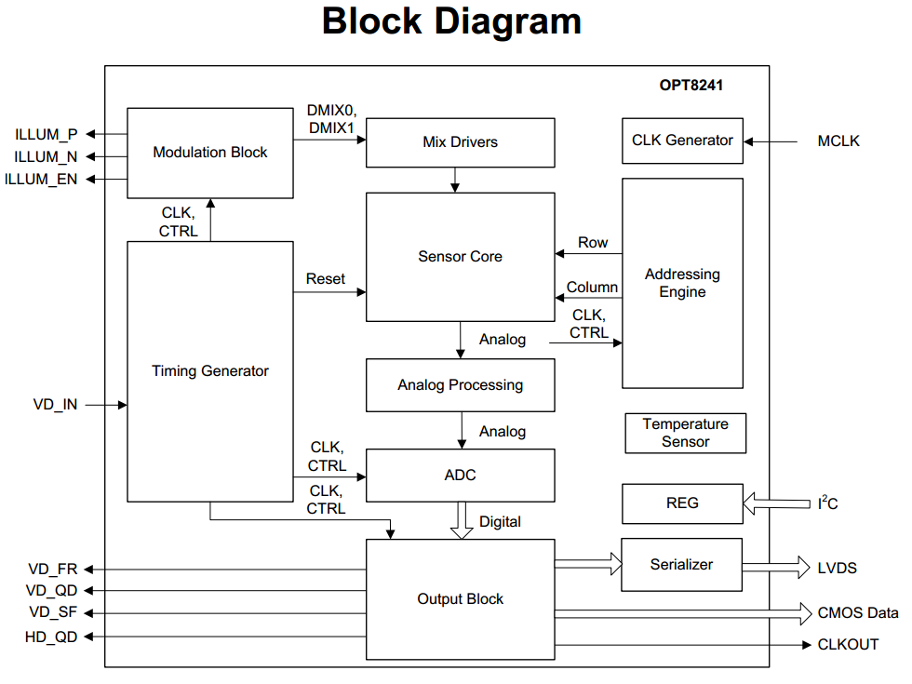
Functional Block Diagram

Slide 4
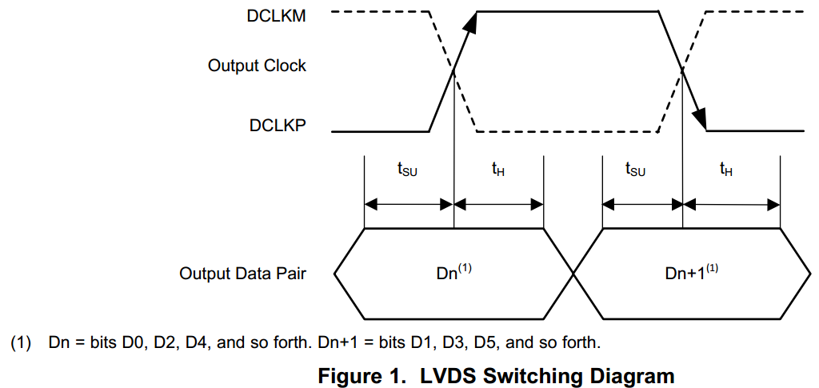
LVDS Data Output Timing

Slide 5
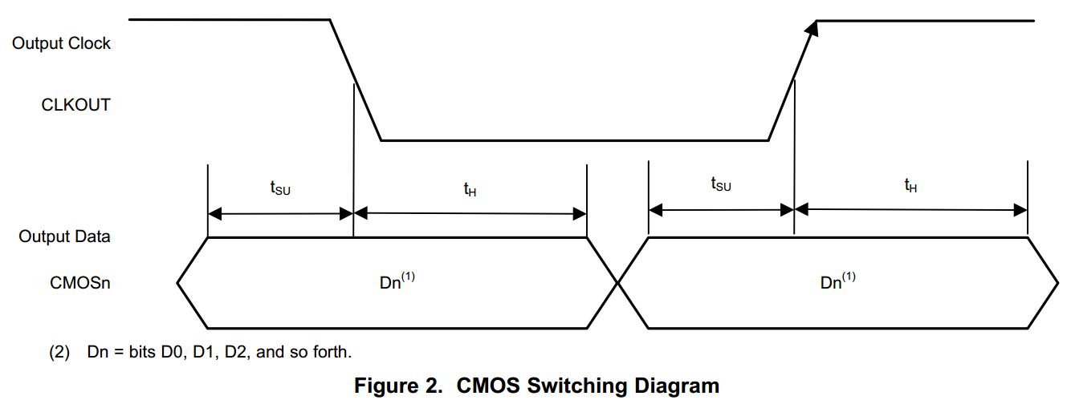
CMOS Switching Timing

Slide 6
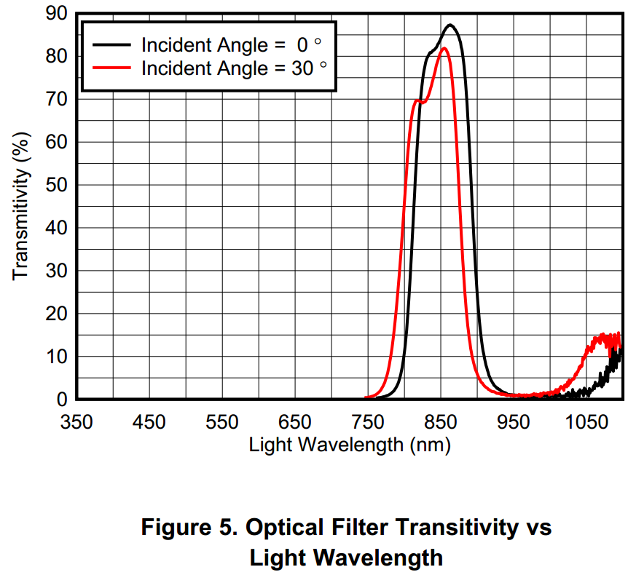
Optical Filter

Slide 7
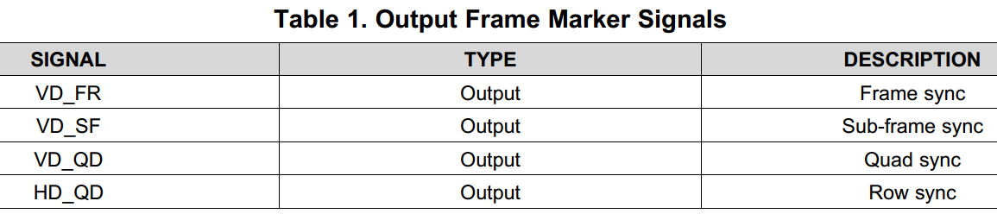
Frame Marker Signals

Slide 8
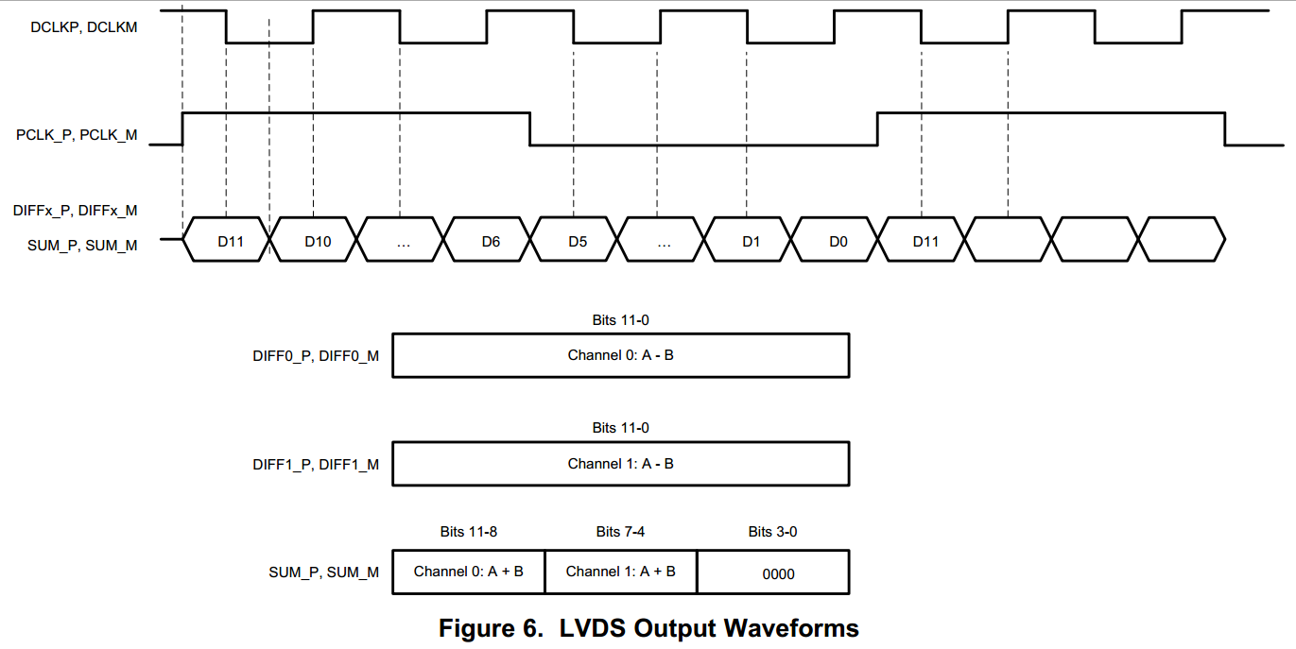
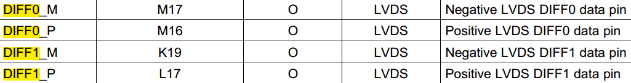
Serializer and LVDS Output Interface

Slide 9
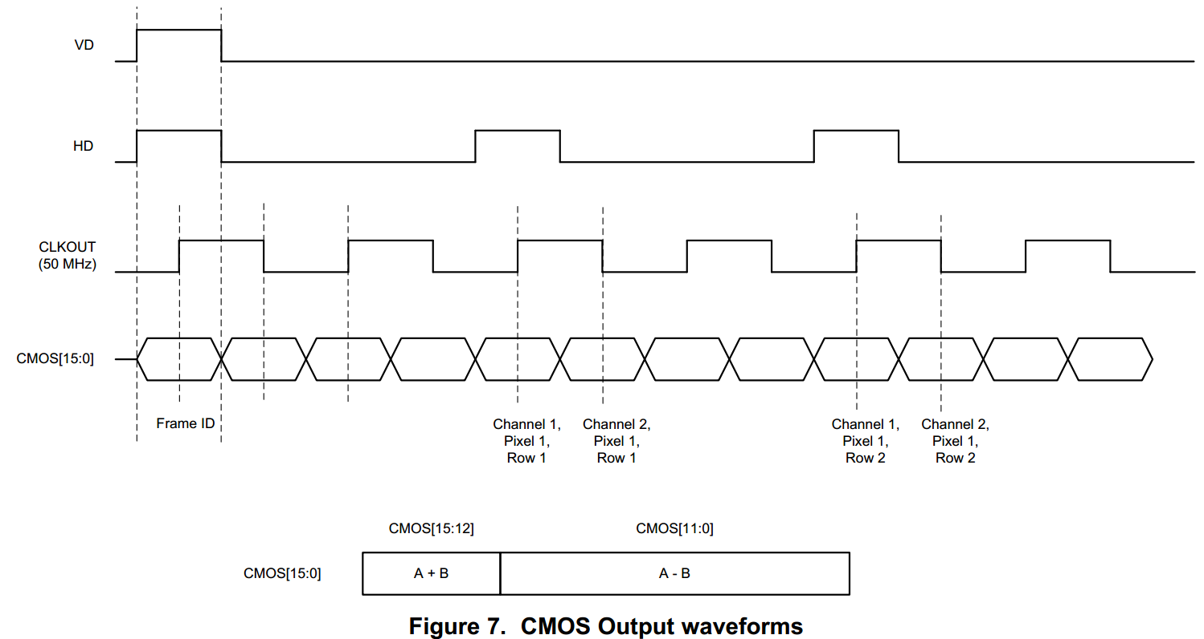
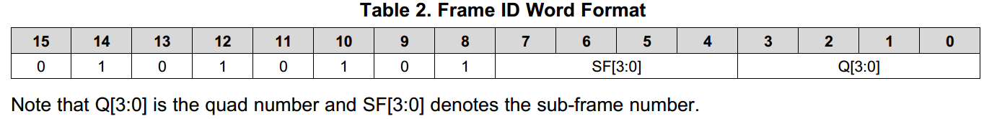
Parallel CMOS Output Interface

Slide 10
Block Diagram

Slide 11
Block Diagram

Slide 12
Block Diagram

Slide 13
Block Diagram

Slide 14
Block Diagram

