Slide 1
EDA Project
Dizzy Englmaier
Chavely Albert Fernandez
September 2025

Slide 2

Our client
Jacob Phillips
Buy a house:
Unlimited Budget
No waterfront
Golf
Big lot
tennis court, pool
4+ bathrooms
historic
or
smaller house nearby

Slide 3
Data overview
King County Housing Data, containing information about home sales in King County (USA)
21597 rows
21 columns
number of houses
Information about the house
house id
price
# of bathrooms
footage of the home
footage of the lot
footage of the basement
if has a view to a waterfront
built Year
zip code
latitude
longitude

Slide 4
Number of data missing in every column:
Conditions used for our client:
Big lot
(tennis court and pool)
4800 + 13500 sq ft
≈ 18,300 sq ft <= out. area
id 0
bedrooms 0
bathrooms 0
sqft_living 0
sqft_lot 0
floors 0
waterfront 2391
view 63
condition 0
grade 0
sqft_above 0
sqft_basement 452
yr_built 0
yr_renovated 3848
zipcode 0
lat 0
long 0
sqft_living15 0
sqft_lot15 0
date 0
price 0
Not consider missing values
out. area = size(lot) - size(living) - size(basement)
historic
Assume it’s 0
build year < 1975
No waterfront
waterfront = 0
4+ bathrooms
bathrooms > 4

Slide 5
Hypothesis to test

Slide 6
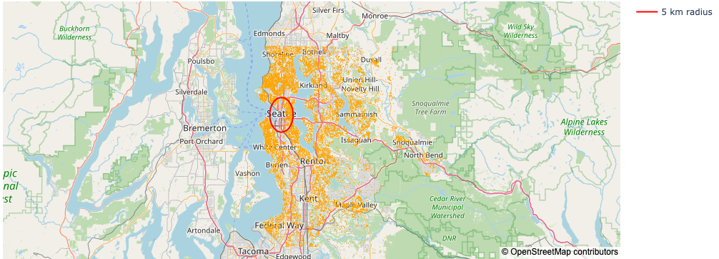
How the proximity to Seattle influences the price of houses?
Houses that are 5km away from the center of Seattle are 20% cheaper than houses inside a 5km radius from the center
mean price: 735390.2$
mean price: 527473.25$
28.27% cheaper

Slide 7
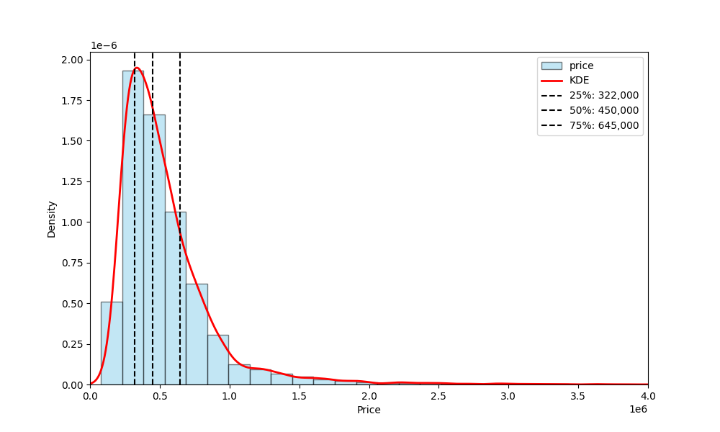
2. Which houses are close to a golf course?
The most expensive 25% of houses are in zip codes that always have at least one golf course
5371 houses

Slide 8
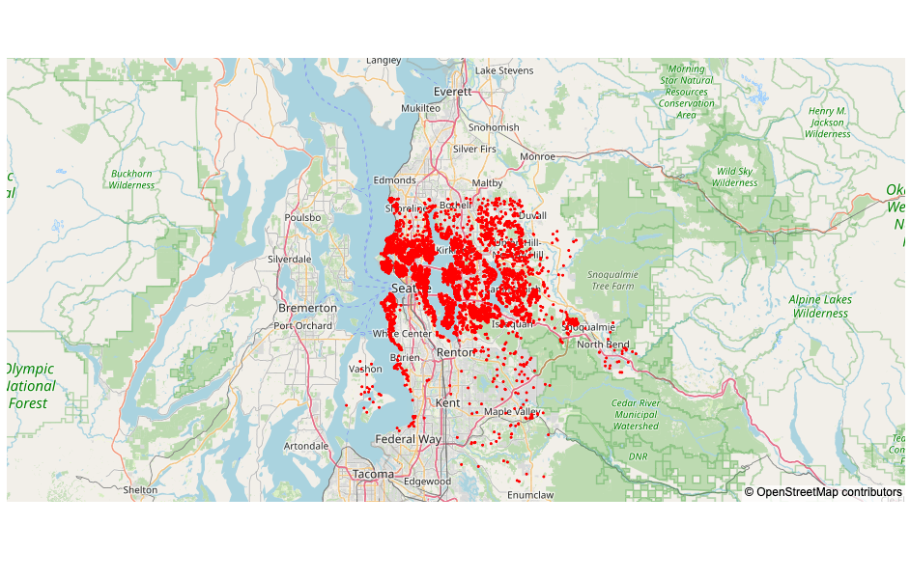
2. Which houses are close to a golf course?
Zip codes
98053, 98007, 98126, 98040, 98119, 98112, 98052, 98117, 98115,
98166, 98070, 98105, 98008, 98004, 98005, 98075, 98010, 98199,
98102, 98077, 98177, 98103, 98027, 98107, 98109, 98006, 98056,
98034, 98033, 98144, 98074, 98028, 98122, 98059, 98116, 98038,
98024, 98125, 98065, 98106, 98136, 98178, 98029, 98118, 98072,
98092, 98133, 98155, 98045, 98022, 98146, 98003, 98042, 98019,
98014, 98039, 98058, 98031, 98023, 98011, 98001, 98198, 98188
Location of 25% more expensive houses

Slide 9
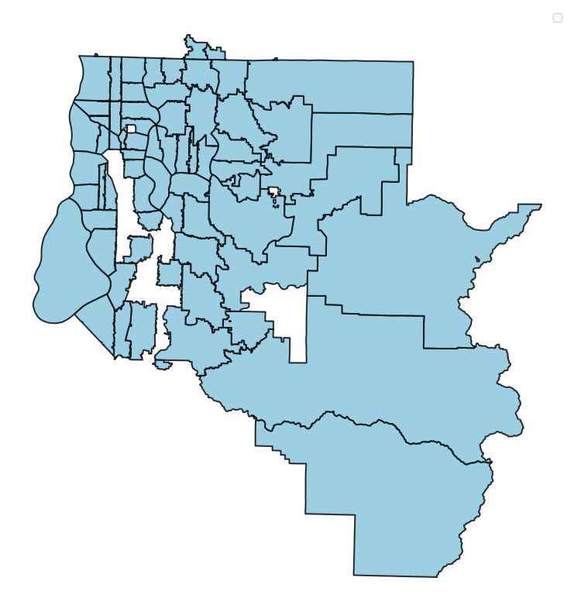
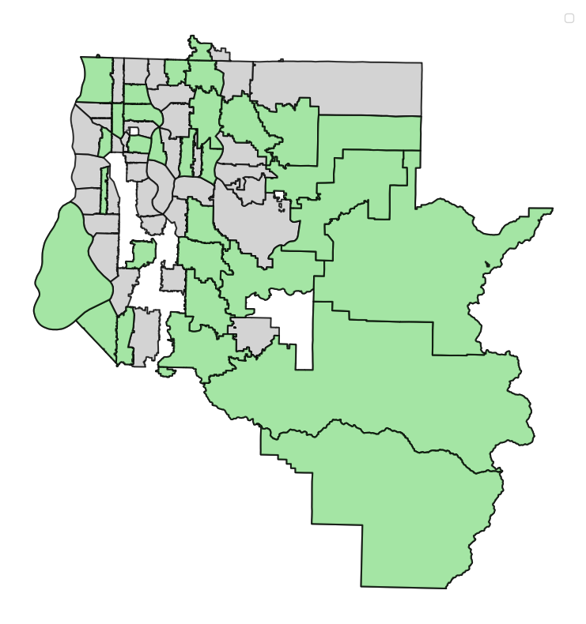
Zip codes including at least one of the 25% more expensive houses
Zip codes including at least one of the 25% more expensive houses AND a golf court
no golf course
VS
The most expensive 25% of houses are in zip codes that always have at least one golf course
(28/63)

Slide 10
houses that meet the clients conditions are in the top 25% of house prices
3. How expensive are the houses that meet the client conditions in comparison to the King County?
Houses that meet the conditions are in the top 25% of house prices
Total amount of houses that meet the conditions: 26
→ 22 houses are in top 25%

Slide 11
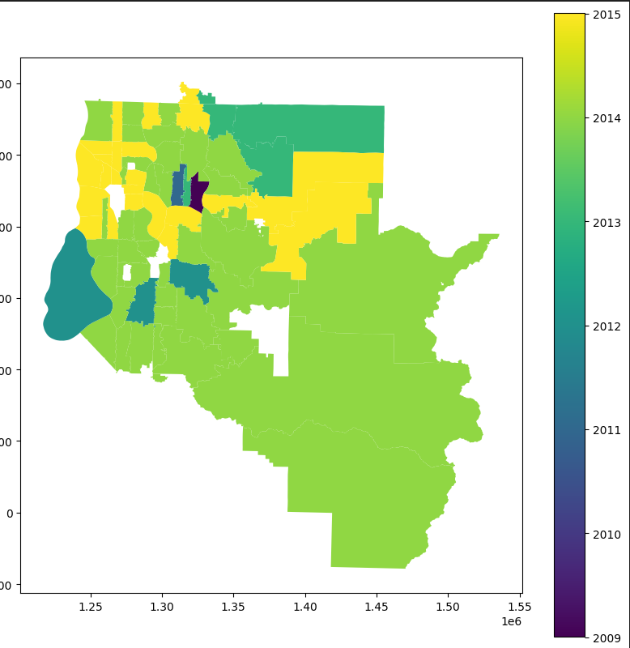
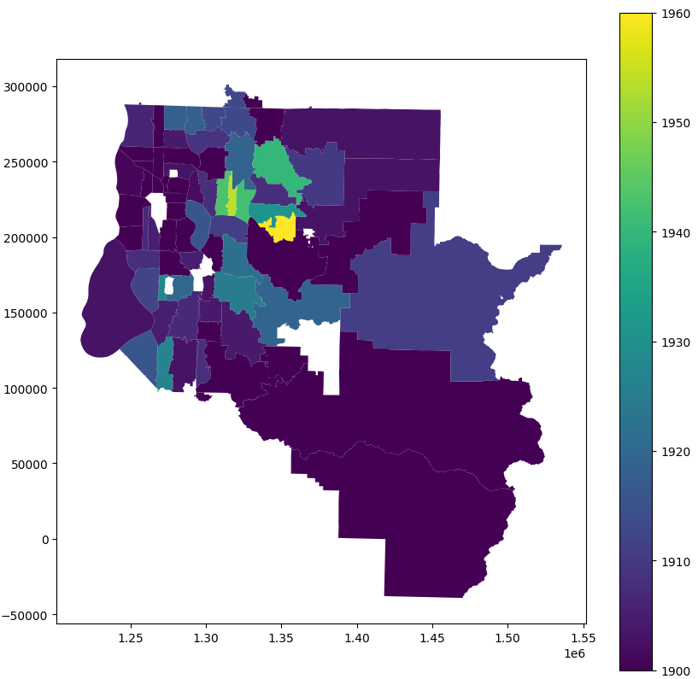
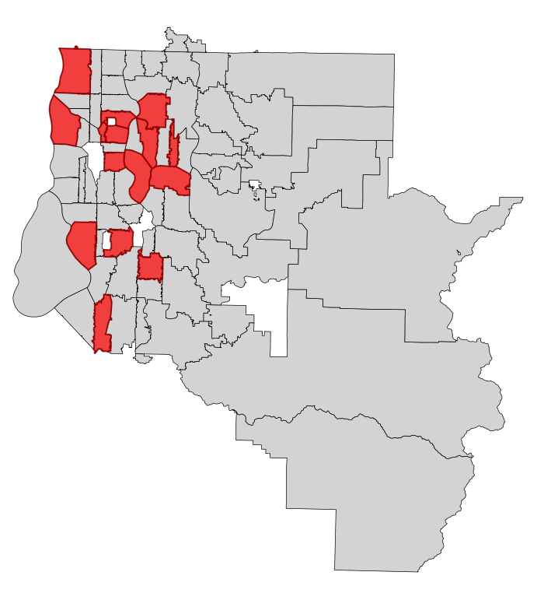
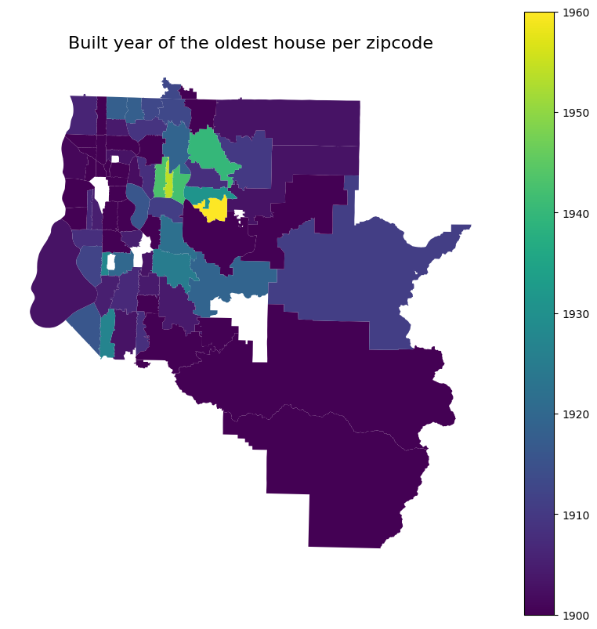
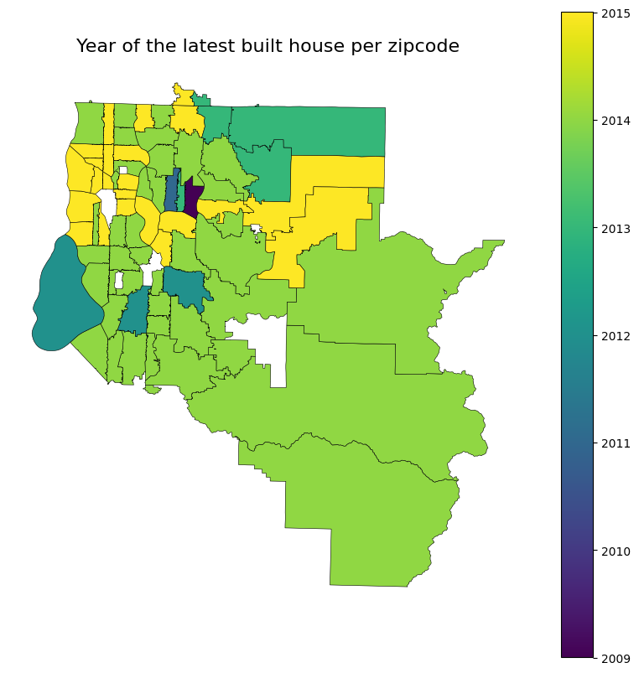
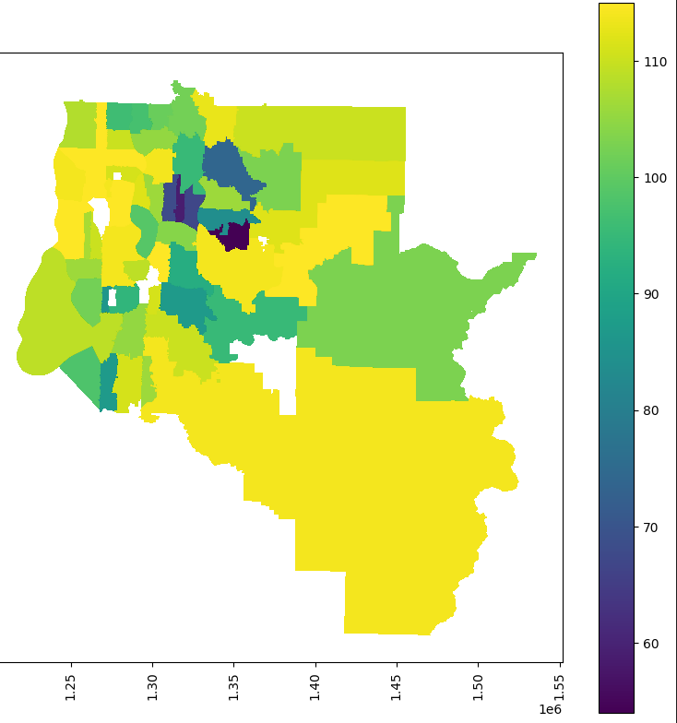
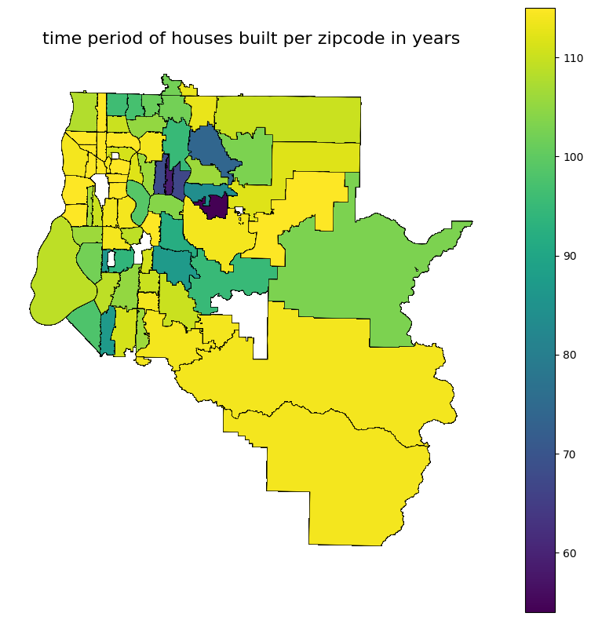
WIP
zipcodes of the 26 possible houses
4. Are neighborhoods (zipcodes) build in the same time frame?

Slide 12
WIP
zipcodes of the 26 possible houses
4. Are neighborhoods (zipcodes) build in the same time frame?

Slide 13
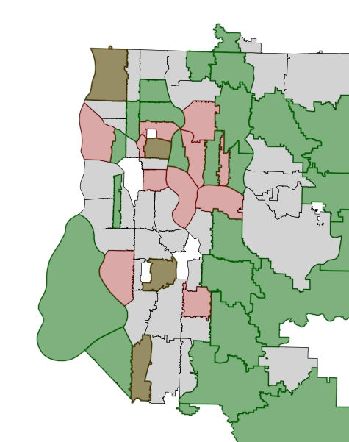
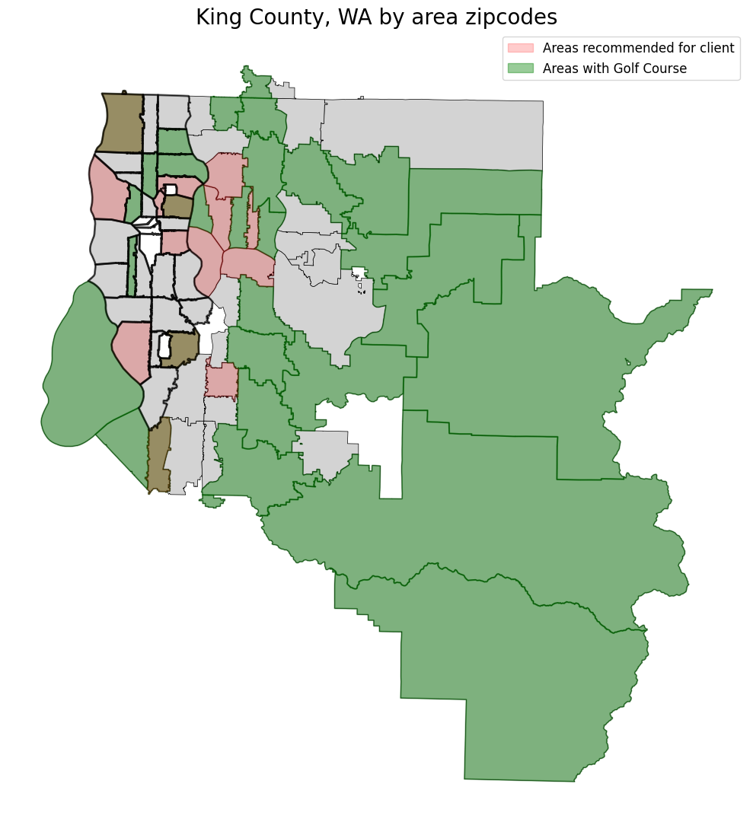
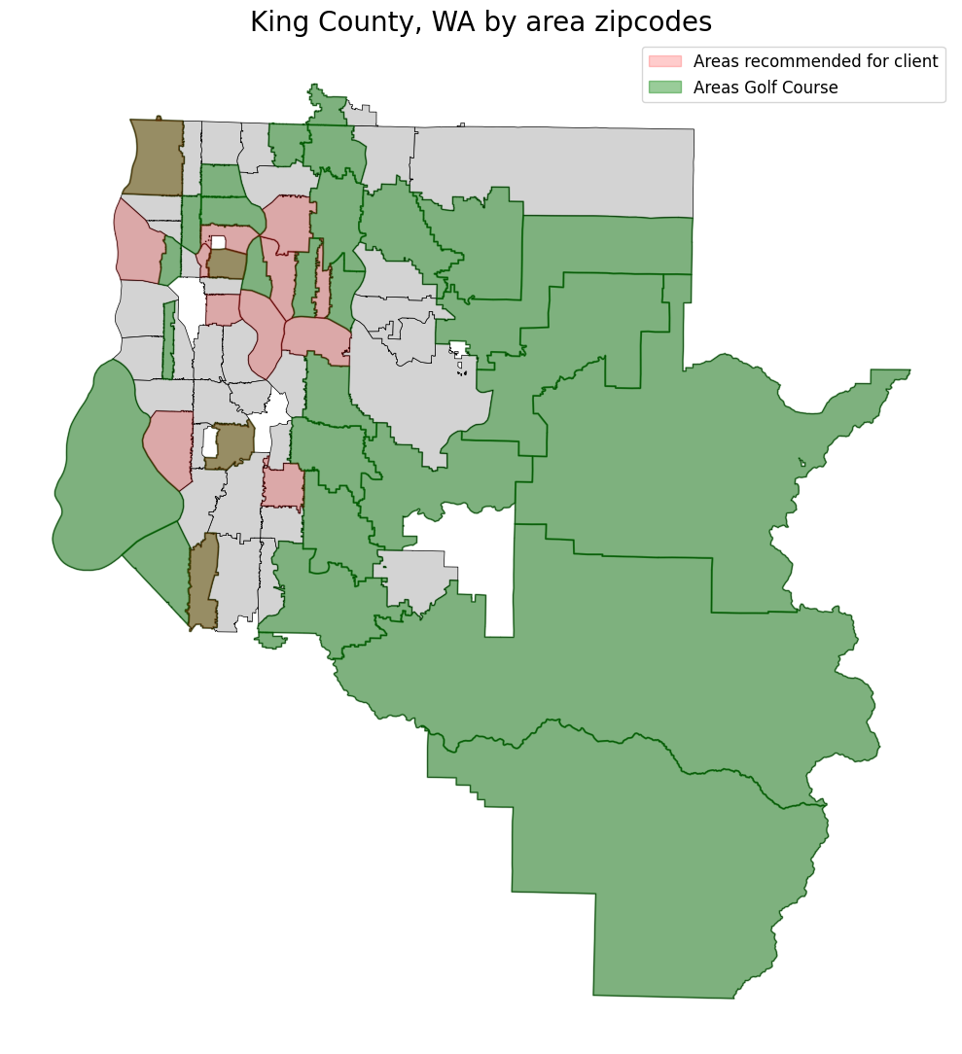

Insights and recommendations for the client

Slide 14
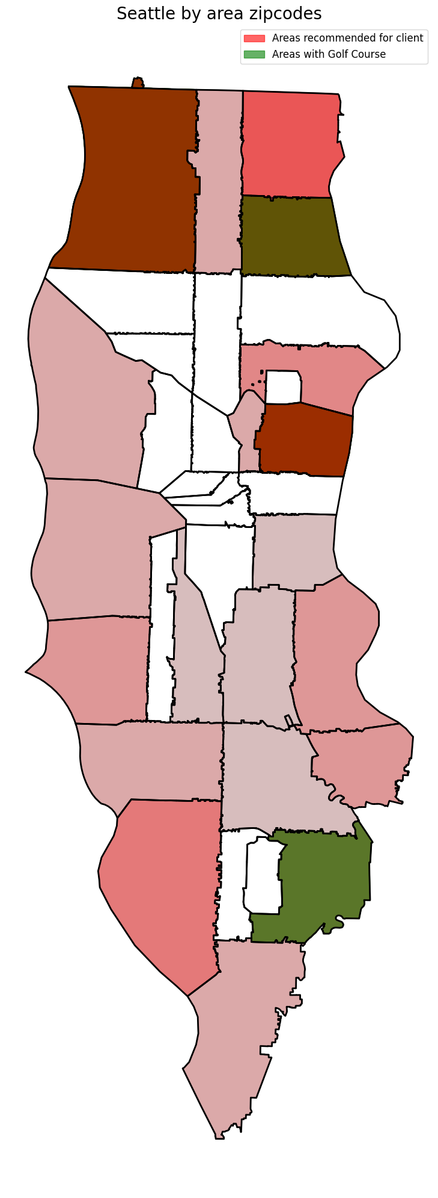
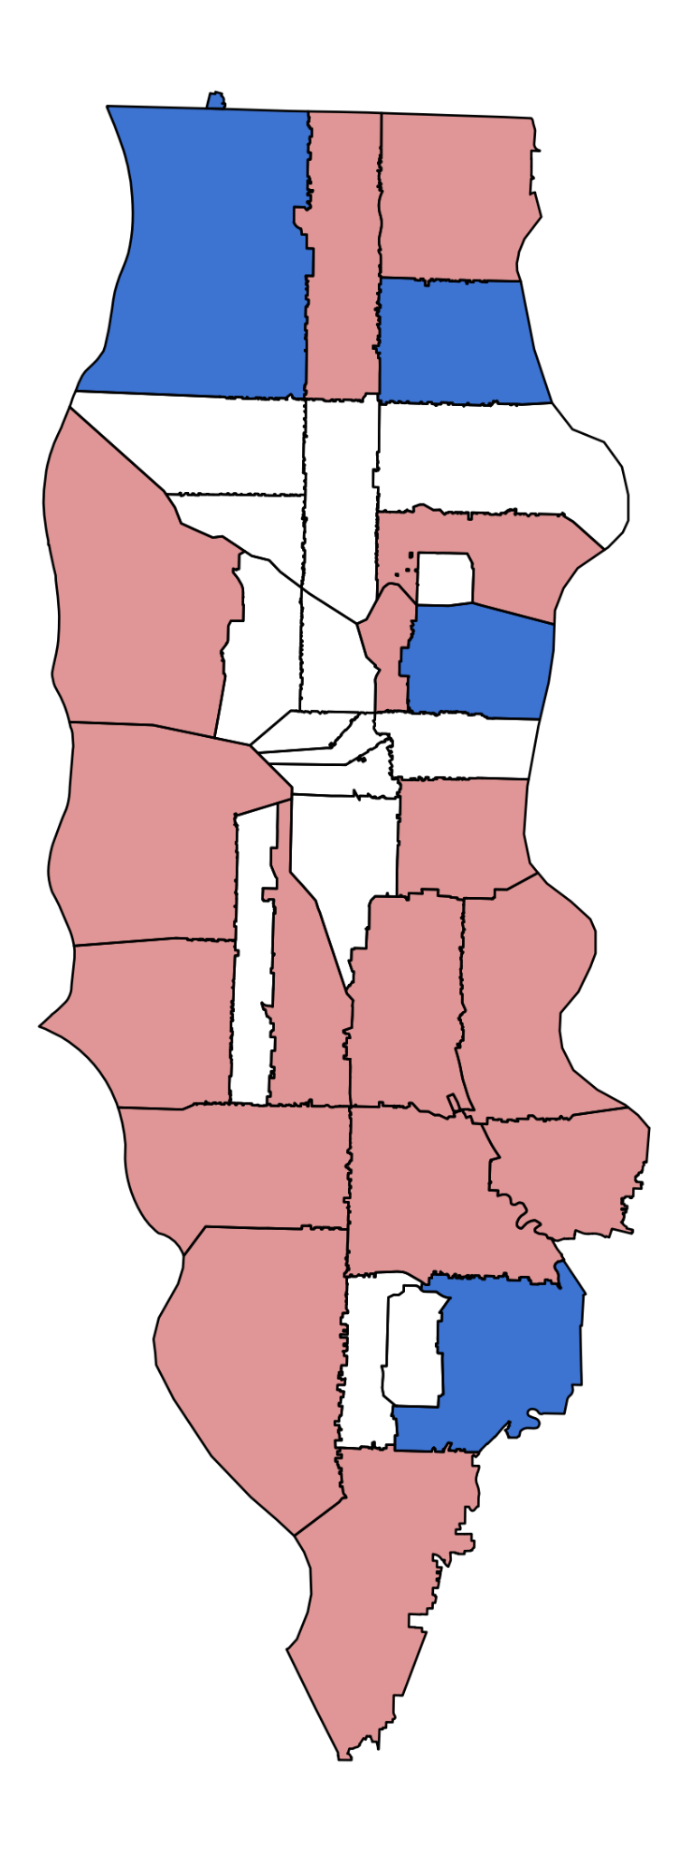
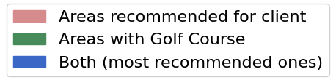
Seattle by area Zip codes
condition : 3+ bathrooms
zipcodes:
in Seattle: 98177, 98112, 98188
with 3+ bathrooms: 98125
outside: 98003

Slide 15
Thank you for your attention!

