Slide 1
Parallel prefix sum computation
Lecture 7

Slide 2
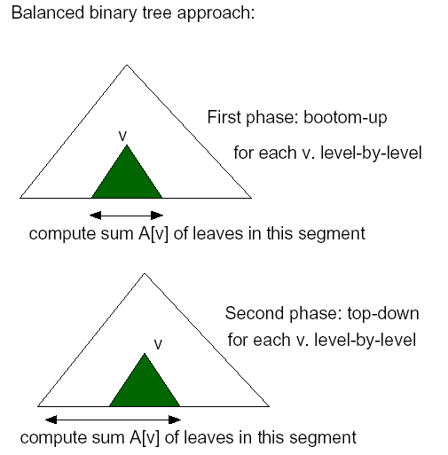
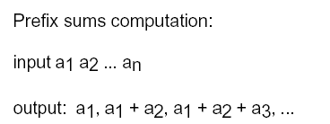
Prefix sum

Slide 3
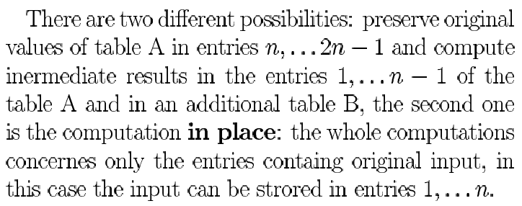

Slide 4
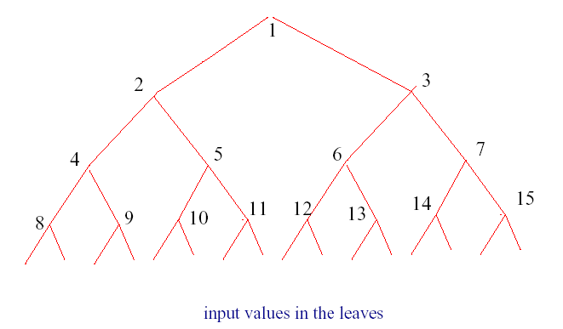
Assume that input is A[n], A[n+1],…,A[2n-1]
The left and right son of a node i is now given by a simple formula 2i and 2i+1, respectively.
Parallel prefix sums computation
Phase1: for k=m-1 down to 0 do
for all 2^{k} ≤j<2^{k+1} in parallel do
A[j]:=A[2j]+A[2j+1]
B[0]:=A[1]
Phase2: for k=0 to m do
for all 2^{k} ≤ j<2^{k+1} in parallel do
iff odd(j) then B[j]:=B[(j-1)/2]
else B[j]:=B[j/2]-A[j+1]
output table B[n…(2n-1)]

Slide 5
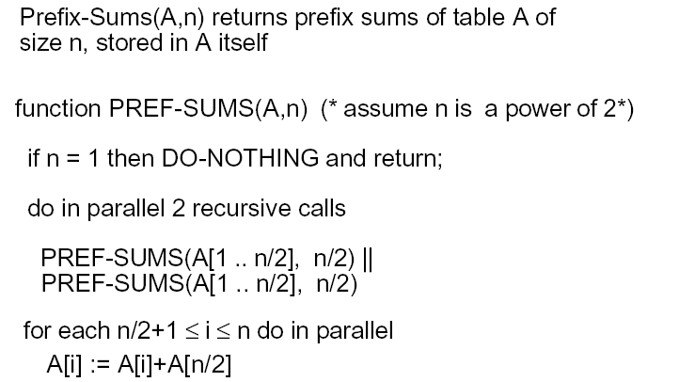
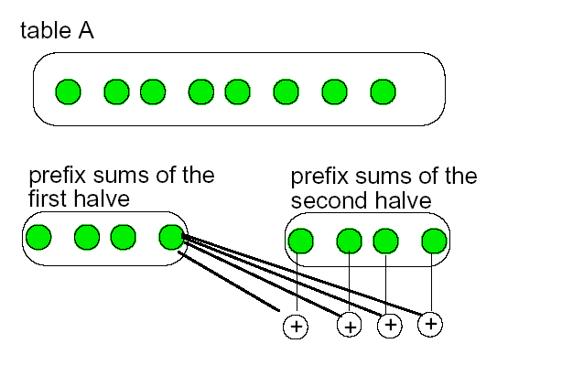
Recursive divide and concur approach
PREF-SUMS(A[1..n/2],n/2) ||
PREF-SUMS(A[n/2..n],n/2)

Slide 6
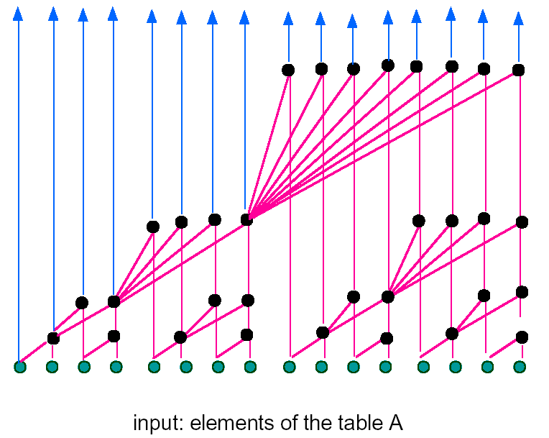
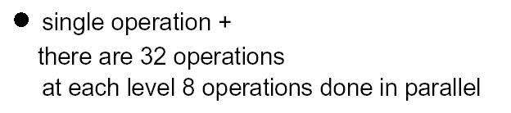
Recursive divide and concur algorithm as arithmetic circuit

Slide 7
List prefix
for each processor i do
y[i] ← x[i]
while exist i | next[i]≠NIL do
for each processor i do
if next[i] ≠ NIL then
y[next[i]] ← y[i] + y[next[i]]
next[i] ← next[next[i]]
y[i]= x[1]+ x[2]+…+ x[i]

Slide 8
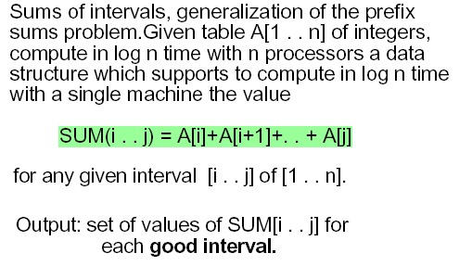

Slide 9
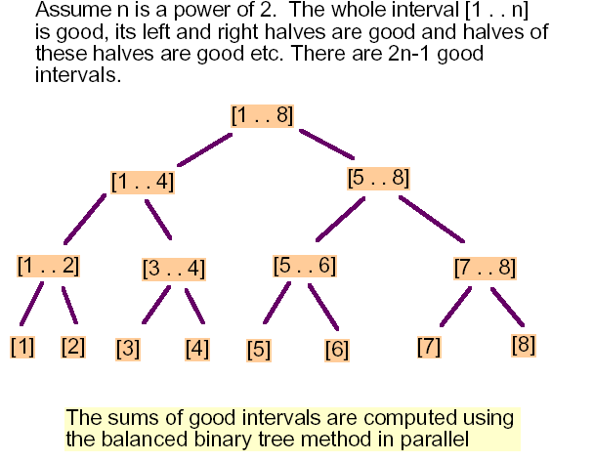
The first phase

Slide 10
The second phase
The second phase of the algorithm now assigns a processor to each of the (in general not ‘good’) intervals [l(i)..r(i)] and proceeds to find a decomposition of the interval into ‘good’ intervals.
Lets consider decomposition of [1..7] into ‘good’ intervals, were ‘good’ intervals are enclosed in rectangles.
[1..7]
[1..4]
[5..7]
[5..6]
[7..7]
[7..7]

