Slide 1
Intelligent User Experience
Developing a child-driven online education environment for third world countries
Notes:
HALLO!

Slide 2
Paper presentation
A short introduction
Proposed system
Child-Driven education by Sugata Mitra
“CAPSI for Teaching Mathematics in an OLE” by Brinkman et al.
“Manipulation of non-verbal interaction style and demographic embodiment to increase anthropomorphic computer character credibility” by Cowell and Stanney.
Conclusions

Slide 3

Proposed System
The problem
Education in the third world
Lack of (experienced) teachers
Lack of materials(Books, schools)
Our solution
OLE for third world countries
Focus on age group 9-12
Group learning
Social interaction encouraged
Notes:
40% of school-age children in Africa do not attend school
Not enough teachers, and a lot of them are inexperienced or uneducated themselves
Another problem is the lack of materials, not just books and schools, but also very simple things such as pen and paper

Slide 4
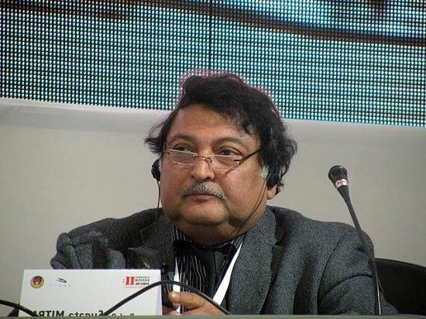
Inspiration
TED Talk by Sugata Mitra
World renowned Indian education researcher
“Granny-effect”
“Hole in the wall” Project
Notes:
What inspired us to try and tackle such a difficult problem
Wanted to something on education, Lennaert sent us a video, TED, organization that holds conferences, brightest minds.
Currently a professor at Newcastle University
Talks about granny-effect, improving understanding, without background knowledge, by asking simple questions
Well known for his hole in the wall project, let him explain it himself. Short excerpt from TED talk. VIDEO!

Slide 5

Visual intermezzo

Slide 6
Paper on online learning
Case study on the effect of CAPSI’s in an OLE
Comparing the same course with different teaching methods
CAPSI approach with self-tests, instructional videos, lectures for motivation.
Information gathering through surveys, interviews etc.
Notes:
Paper describses a case study…
Studied the effects by comparing 2 terms, term 1 discrete mathematics, term 2 statistics
The principles of PSI can be summarized as “(1) mastery learning, (2) self-pacing, (3) a
stress on the written word, (4) student proctors, and (5) the use of lectures to motivate rather
than to supply essential information

Slide 7
Online learning
What have we learned?
Advantages
Low cost
Increased student satisfaction
Engages more students
Grades less dependent on learning approach
Disadvantages
Computer availability required
Less social interaction
Notes:
From the paper we were able to draw the following conclusions about the advantages and disadvantages of Online learning. Obviously, not all of these conclusions are applicable to our domain.
Many student proctors, taking less valuable time from professor. Recycling instructional videos. Obviously positive for our system.
Satisfaction, correlates with student engagement. Students who are happy with the teaching method are more likely to be actively involved in a course
2 learning approaches, surface and deep learning. Traditional lecture method, deep learning students performed much better. Less prevalent in CAPSI based course, not much of our concern
Even though use of discussion board was encouraged, researches noticed less social interaction for CAPSI based course

Slide 8
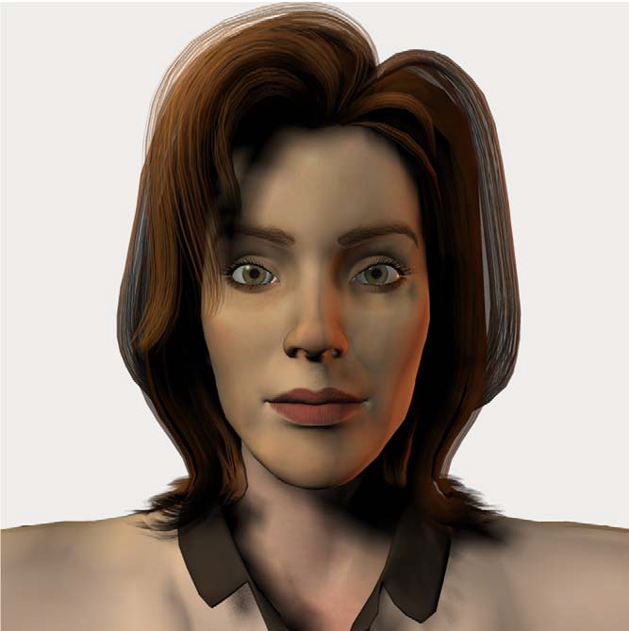
Non-verbal communication
Portraying a credible façade

Slide 9


What do we use it for?
Emblems
Illustrators
Affect display
Regulators
Adaptors

Slide 10

Categories
Facial expression
Eye contact
Gestures
Paralanguage
Posture

Slide 11
Experiment
Four agents:
No non-verbal behaviour
Face
Face and body
Non-Trusting behaviour

Slide 12
Experiment Results
Facial behaviour improved the interaction
Adding bodily behaviour had little effect
Non-trusting behaviour negatively influenced the interaction

Slide 13
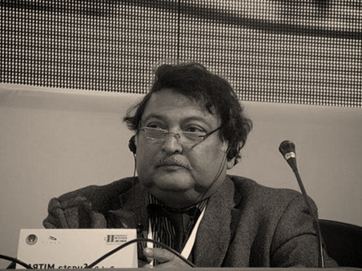
Back to our system
Online learning system with an avatar
Focus in the design should be on facial expression
Realistic and trusting behaviour
Granny system?

Slide 14
Questions/remarks?

