Slide 1
Intelligent User Experience
Developing a child-driven online education environment for third world countries

Slide 2
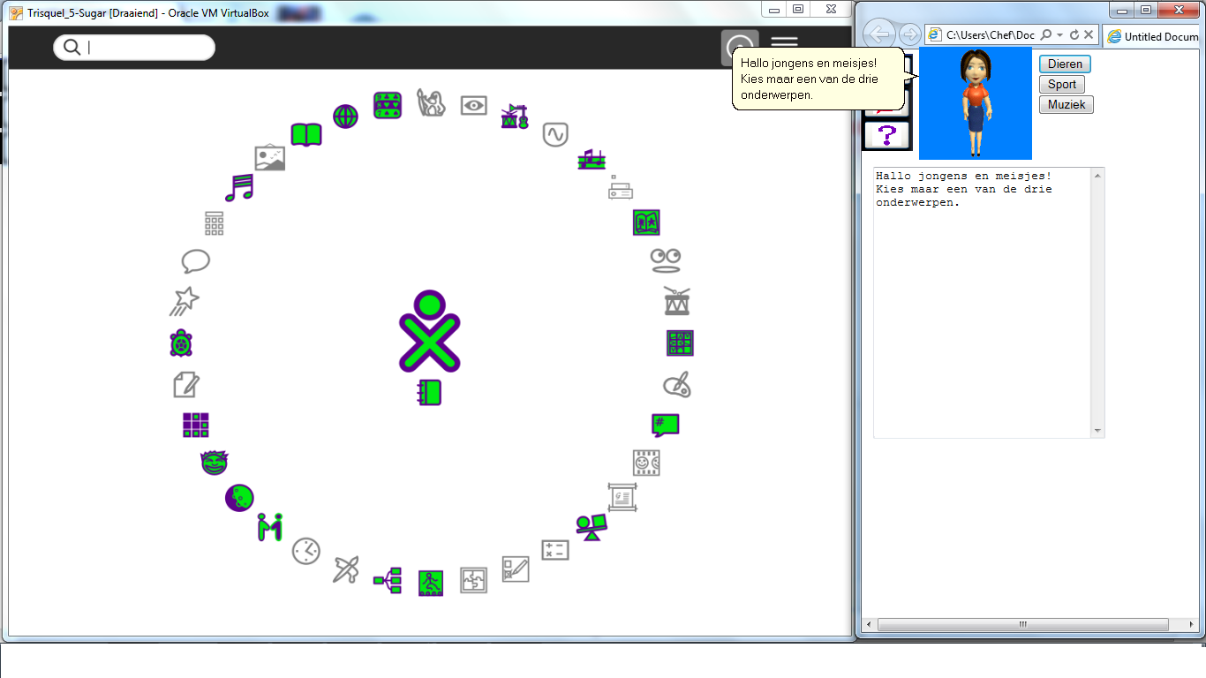
Pilot version

Slide 3
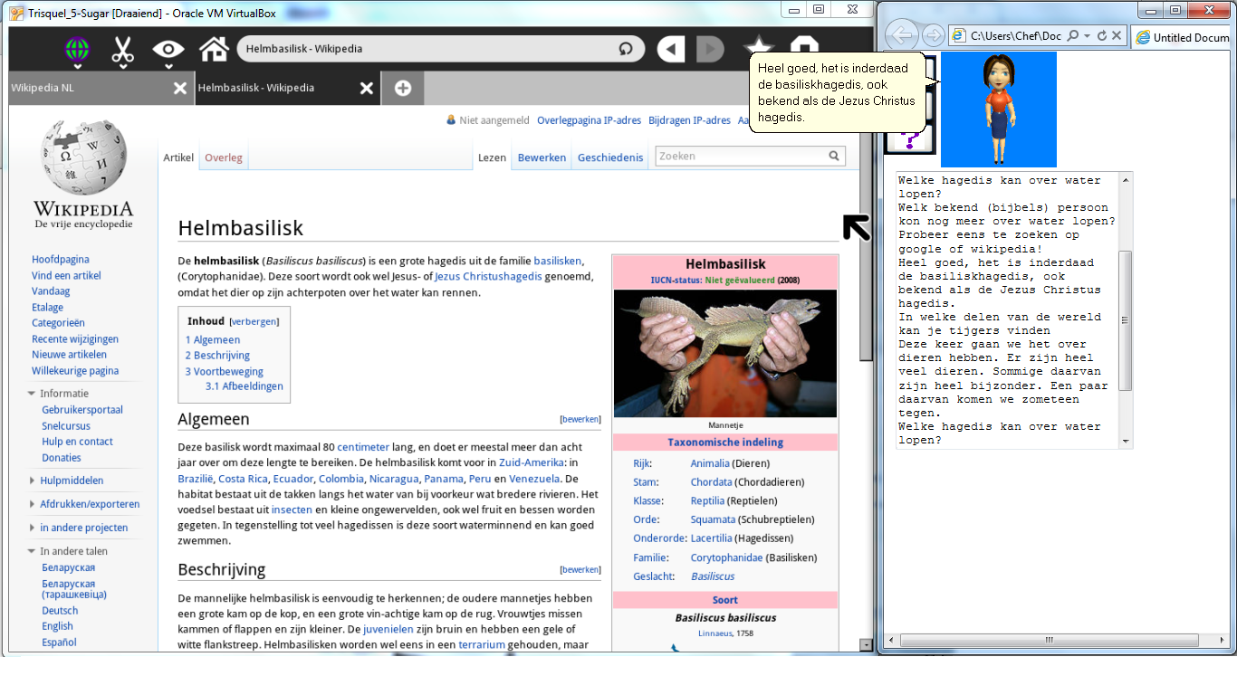
Pilot version

Slide 4
Pilot version
Implemented in a browser frame with JavaScript
Microsoft Agent Scripting Helper used as engine
Full-body avatar, has to be changed to face only
Target OS run inside a virtual machine

Slide 5
Test results and general feedback
Three individuals and two groups of two persons each from TU Delft used as a focus group
The interaction with program was evaluated positively
The avatar needs to be improved

Slide 6
Detailed feedback
Avatar is associated with a student, not a teacher (is it me?)
Hints are given too fast
Appearance of new text is often not detected
Individuals focus on questions themselves; groups also study the topics and generally work better
Minor interface remarks

Slide 7
Future work
Create an integrated 3D-environment (i.e. in Vizard)
Update UX according to the remarks
Use face-only avatar with rich facial expressions
Improve text-to-speech
Create teacher and administration interfaces
Do beta-testing with bigger focus groups of proper ages
Improve the challenges

