Slide 1
Spread Dynamics of Rumours vs. Facts
Do rumours really travel faster during breaking-news events?
PHEME-9 Dataset · 6,040 reply cascades · 6 breaking-news events
Data Science Group Project · ETH Zürich · 2026

Slide 2
Motivating question
Vosoughi, Roy & Aral (Science, 2018) found that false news travels farther, faster, deeper, and more broadly than truth on Twitter.
But does this hold during breaking-news events specifically?
During breaking news, facts haven't been established yet. Unverified claims fill the information vacuum. This is precisely when misinformation is most dangerous — and most plausible.
Our approach
→ PHEME-9: journalist-annotated reply cascades from 9 breaking-news events on Twitter
→ Measure cascade speed, reach, and structure across four veracity classes
→ Propose and test a verifiability mechanism to explain why speed differences exist
Reference: Vosoughi, Roy & Aral (2018). The spread of true and false news online. Science, 359(6380).

Slide 3
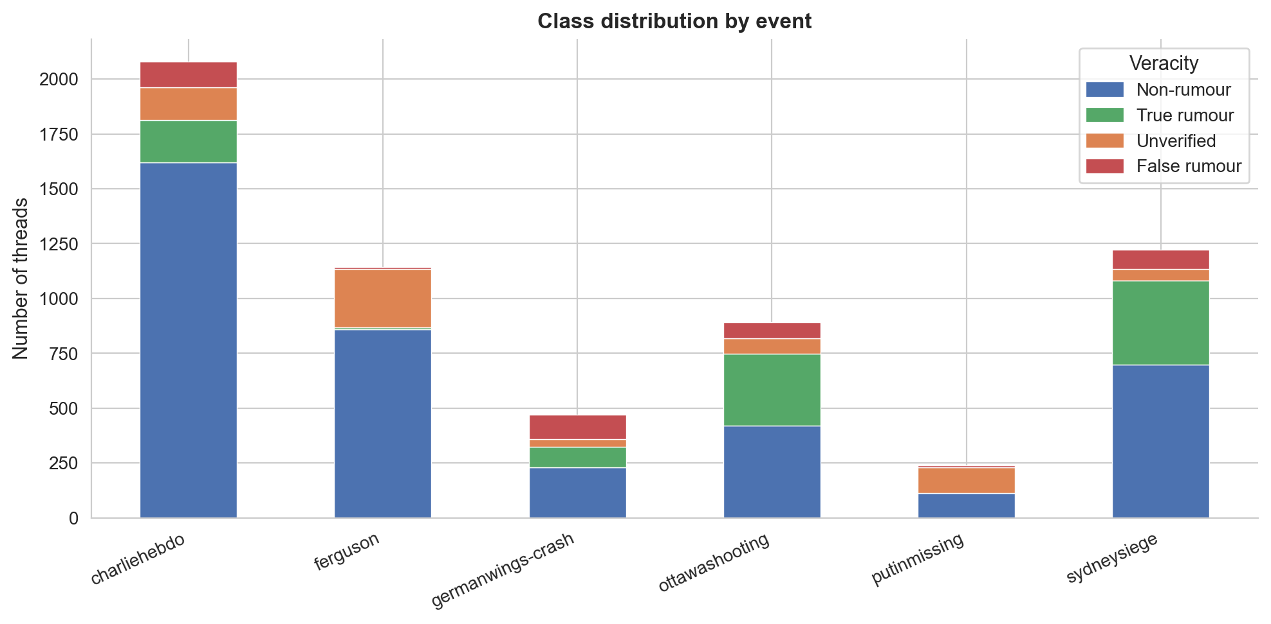
Dataset: PHEME-9
6,040
reply cascades
after event filtering
6
breaking-news events
retained (3 dropped)
≈ 100k
tweets total
source + replies
Non-rumours dominate every event — this is signal, not sampling artefact. Most breaking-news content is factual commentary around a rumour core.
Zubiaga et al. (2016). Analysing How People Orient to and Spread Rumours in Social Media. PLOS ONE.

Slide 4
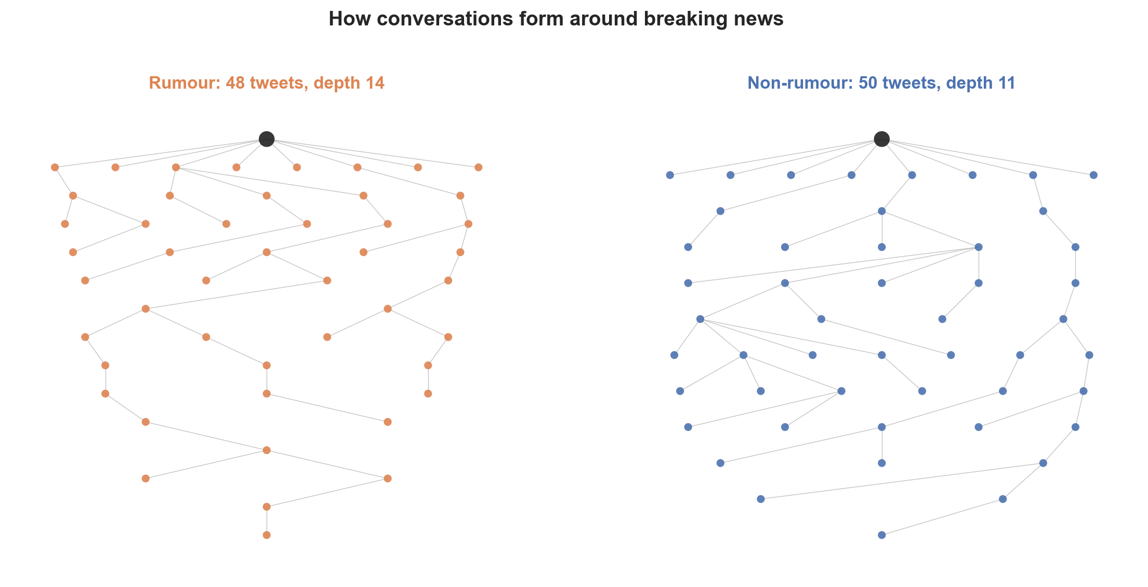
What a cascade looks like
Each node is a tweet. The black root is the original post; edges are direct replies. We measure how fast, how far, and what shape these trees take.

Slide 5
Methodology
SPEED
REACH
STRUCTURE
• Time to first reply
• Cascade size (# tweets)
• Structural virality (Goel 2016)
• Time to half-cascade
• Max depth
• Broadcast ratio
• Replies in first hour
• Max breadth
• Branching factor
• Unique users
Statistical approach
→ Mann-Whitney U + Cliff's δ effect size — non-parametric, appropriate for heavy-tailed distributions
→ Benjamini-Hochberg FDR correction across all simultaneous tests
→ Per-event stratification — never pool across events with very different sizes/compositions
→ Consistency scoring: a finding must hold in ≥ 3 eligible events to be reported

Slide 6
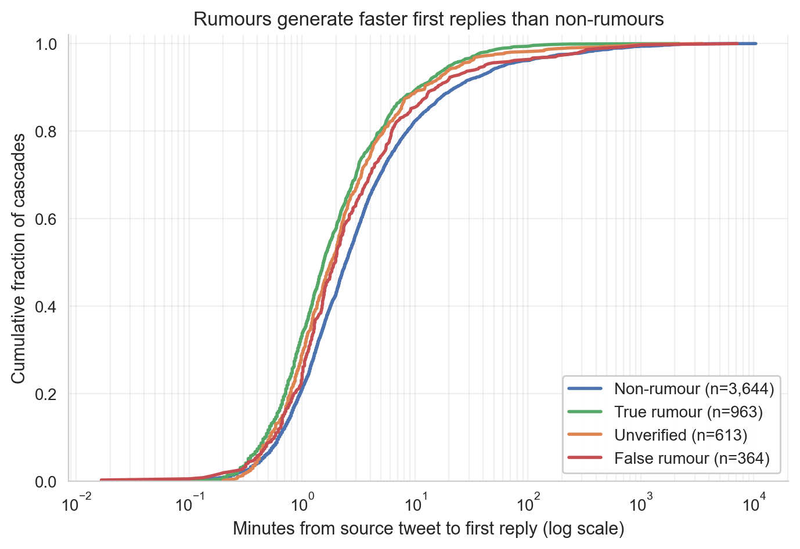
Finding 1 — Rumours generate first replies faster
Effect size
−0.26
Cliff's δ (unverified vs non-rumour)
pooled p < 0.001
−0.17
Cliff's δ (true vs non-rumour)
pooled p = 0.045
Negative δ = rumours reach first reply faster than non-rumours. Both unverified and true rumours show the effect.
Cliff's δ interpretation: |δ| < 0.15 negligible · ≥ 0.15 small · ≥ 0.33 medium

Slide 7
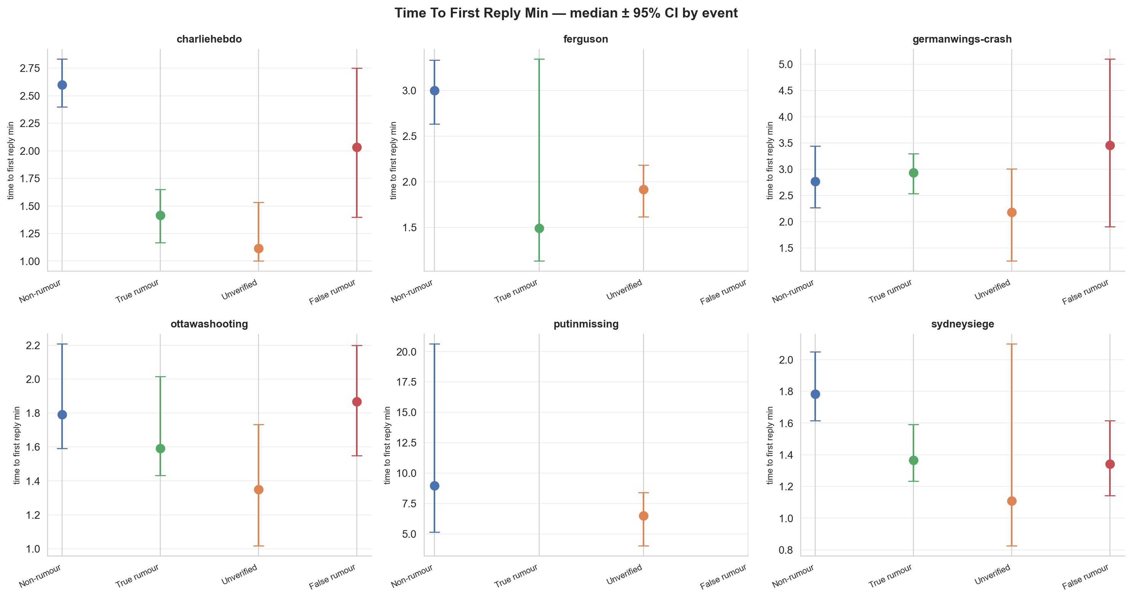
The speed effect is consistent across events
Why this matters
A pooled p-value could be driven by a single large event.
Non-rumours are consistently slower to receive first replies across charliehebdo, ottawashooting, sydneysiege, and others.
95% bootstrap CIs do not overlap in most events — the per-event medians are precisely estimated.
Pattern holds in 2 of 6 eligible events at BH-corrected p < 0.05 for time-to-first-reply (3/6 for time-to-half-cascade).

Slide 8
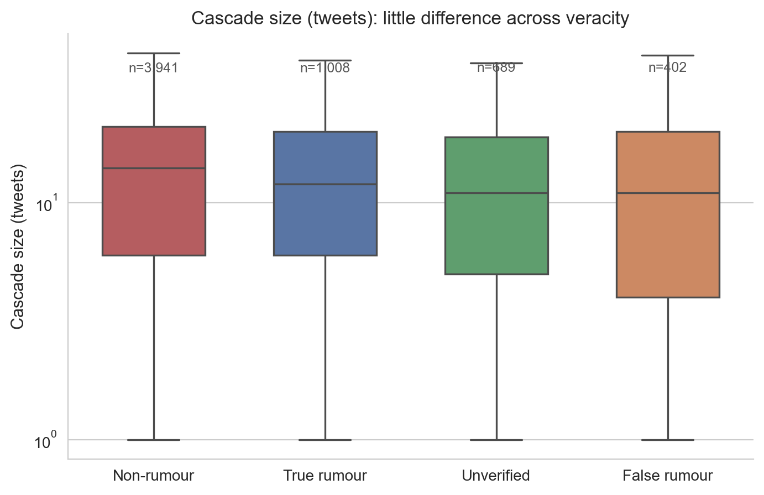
Null result — Rumours do not reach more people
What this means
Vosoughi (2018) found that false news reaches more people.
We do not replicate this for breaking-news reply cascades.
Cascade sizes (median 10–14 tweets) are comparable across all four veracity classes.
The Vosoughi finding may be specific to the retweet network or to non-breaking-news contexts.
Implication: rumours engage faster, but the conversation stays local — they do not diffuse farther.

Slide 9
Why are rumours faster? — A verifiability mechanism
Hypothesis: claims that are hard to verify generate faster engagement because readers cannot suppress sharing via a quick mental fact-check.
Step 1 · Rumours are less verifiable
Step 2 · Less verifiable → faster reply
A TF-IDF + logistic regression classifier trained on FEVER (145k Wikipedia fact-verification claims) scores each tweet for how linguistically verifiable it is at posting time.
Threads in the least-verifiable quartile (Q1) receive their first reply in 1.87 min median vs 2.55 min for Q4. Spearman ρ = 0.09–0.10, p < 10⁻¹².
→
Caveat: ρ = 0.09 is a weak effect. The ~40-second median difference is statistically reliable (n = 5,747) but practically modest. Verifiability is a contributing factor, not the primary driver.
Classifier: FEVER (Thorne et al., NAACL 2018) · ROC-AUC ≥ 0.80 on FEVER dev split

Slide 10
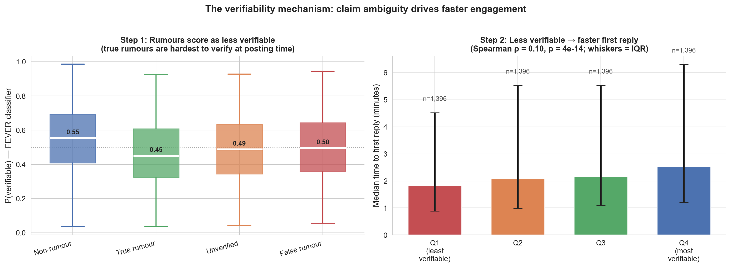
Verifiability mechanism — Evidence
Left: rumour classes score lower on P(verifiable) than non-rumours. True rumours are hardest to verify — even correct claims were linguistically ambiguous at posting time. Right: monotone increase — less verifiable → faster first reply across all four quartiles.

Slide 11
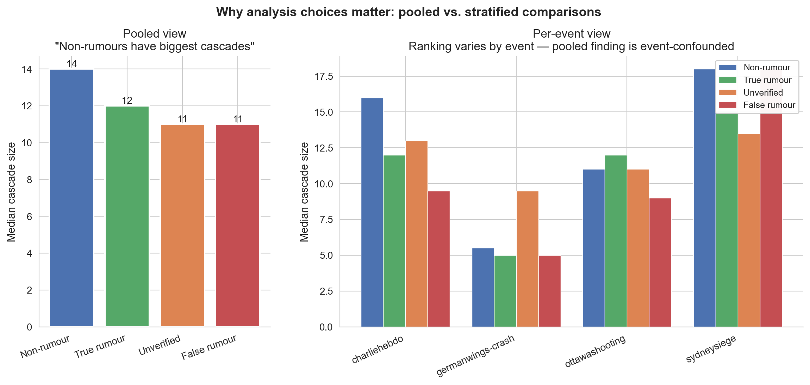
Methodological note — Why per-event analysis matters
A pooled analysis would conclude 'non-rumours have the biggest cascades'. But the per-event view shows rankings vary by event — the pooled finding is event-confounded. We use per-event stratified tests throughout to avoid this artefact.

Slide 12
Summary of findings
Finding
Direction
Effect size
Interpretation
Speed: time to first reply
rumour < non-rumour
Cliff's δ = −0.26
Rumours attract replies significantly faster
Speed: time to half-cascade
rumour < non-rumour
Cliff's δ = −0.32
Speed advantage persists through the cascade
Reach: cascade size
null result
—
Rumours do not reach more users overall
Structure: depth vs. size
null result
—
No distinct structural signature for rumours
Verifiability → speed
less verifiable → faster
Spearman ρ = 0.09–0.10
Claim ambiguity predicts faster engagement (p < 10⁻¹²)
True rumours
least verifiable class
Cliff's δ = −0.22
Even correct claims were hard to verify at posting time

Slide 13
Limitations & scope
Dataset size & scope
PHEME contains ~6,400 threads across 9 events — small by modern standards. Results may not generalise beyond English-language breaking-news Twitter.
Reply trees, not retweet networks
We measure conversational depth (who replies to whom), not diffusion breadth (who retweets). Vosoughi's 'reach' finding is about retweet chains, which we cannot replicate here.
Snapshot data
Cascades were collected at a fixed point in time. Later replies, which could change speed and size rankings, are not captured.
Verifiability classifier transfer
The FEVER classifier was trained on Wikipedia sentences. Transfer to informal tweet language is imperfect; ρ = 0.09 is weak. The score is a proxy, not ground truth.
Annotation quality
Veracity labels are journalist-curated (high precision, limited recall). Many threads remain 'unverified' not because they are rumours, but because the fact was never definitively established.

Slide 14
References
Vosoughi, S., Roy, D., & Aral, S. (2018). The spread of true and false news online. Science, 359(6380), 1146–1151.
Zubiaga, A., Liakata, M., Procter, R., Wong Sak Hoi, G., & Tolmie, P. (2016). Analysing How People Orient to and Spread Rumours in Social Media. PLOS ONE, 11(6).
Thorne, J., Vlachos, A., Christodoulopoulos, C., & Mittal, A. (2018). FEVER: a large-scale dataset for Fact Extraction and VERification. NAACL-HLT.
Goel, S., Anderson, A., Hofman, J., & Watts, D. J. (2016). The structural virality of online diffusion. Management Science, 62(1), 180–196.
Nielsen, R. K., & McConville, R. (2022). MuMiN: A Large-Scale Multilingual Multimodal Fact-Checked Misinformation Social Network Dataset. Findings of ACL.
Romano, J., Kromrey, J. D., Coraggio, J., & Skowronek, J. (2006). Appropriate statistics for ordinal level data: Should we really be using t-test and Cohen's d for evaluating group differences on the NSSE? Florida Association of Institutional Research.

