Slide 1


Decision Tool
Glider Selection Dashboard
“Help Me Decide”
PROJECT TEAM & CONTRIBUTORS
Ehsan Abdi (Akvaplan-niva)
Anne Simonis (Estuary & Ocean Science Center, SFSU)
Kasey Castello (Scripps, UC San Diego)
Héloïse Frouin-Mouy (University of Miami, NOAA SEFSC)

Slide 2
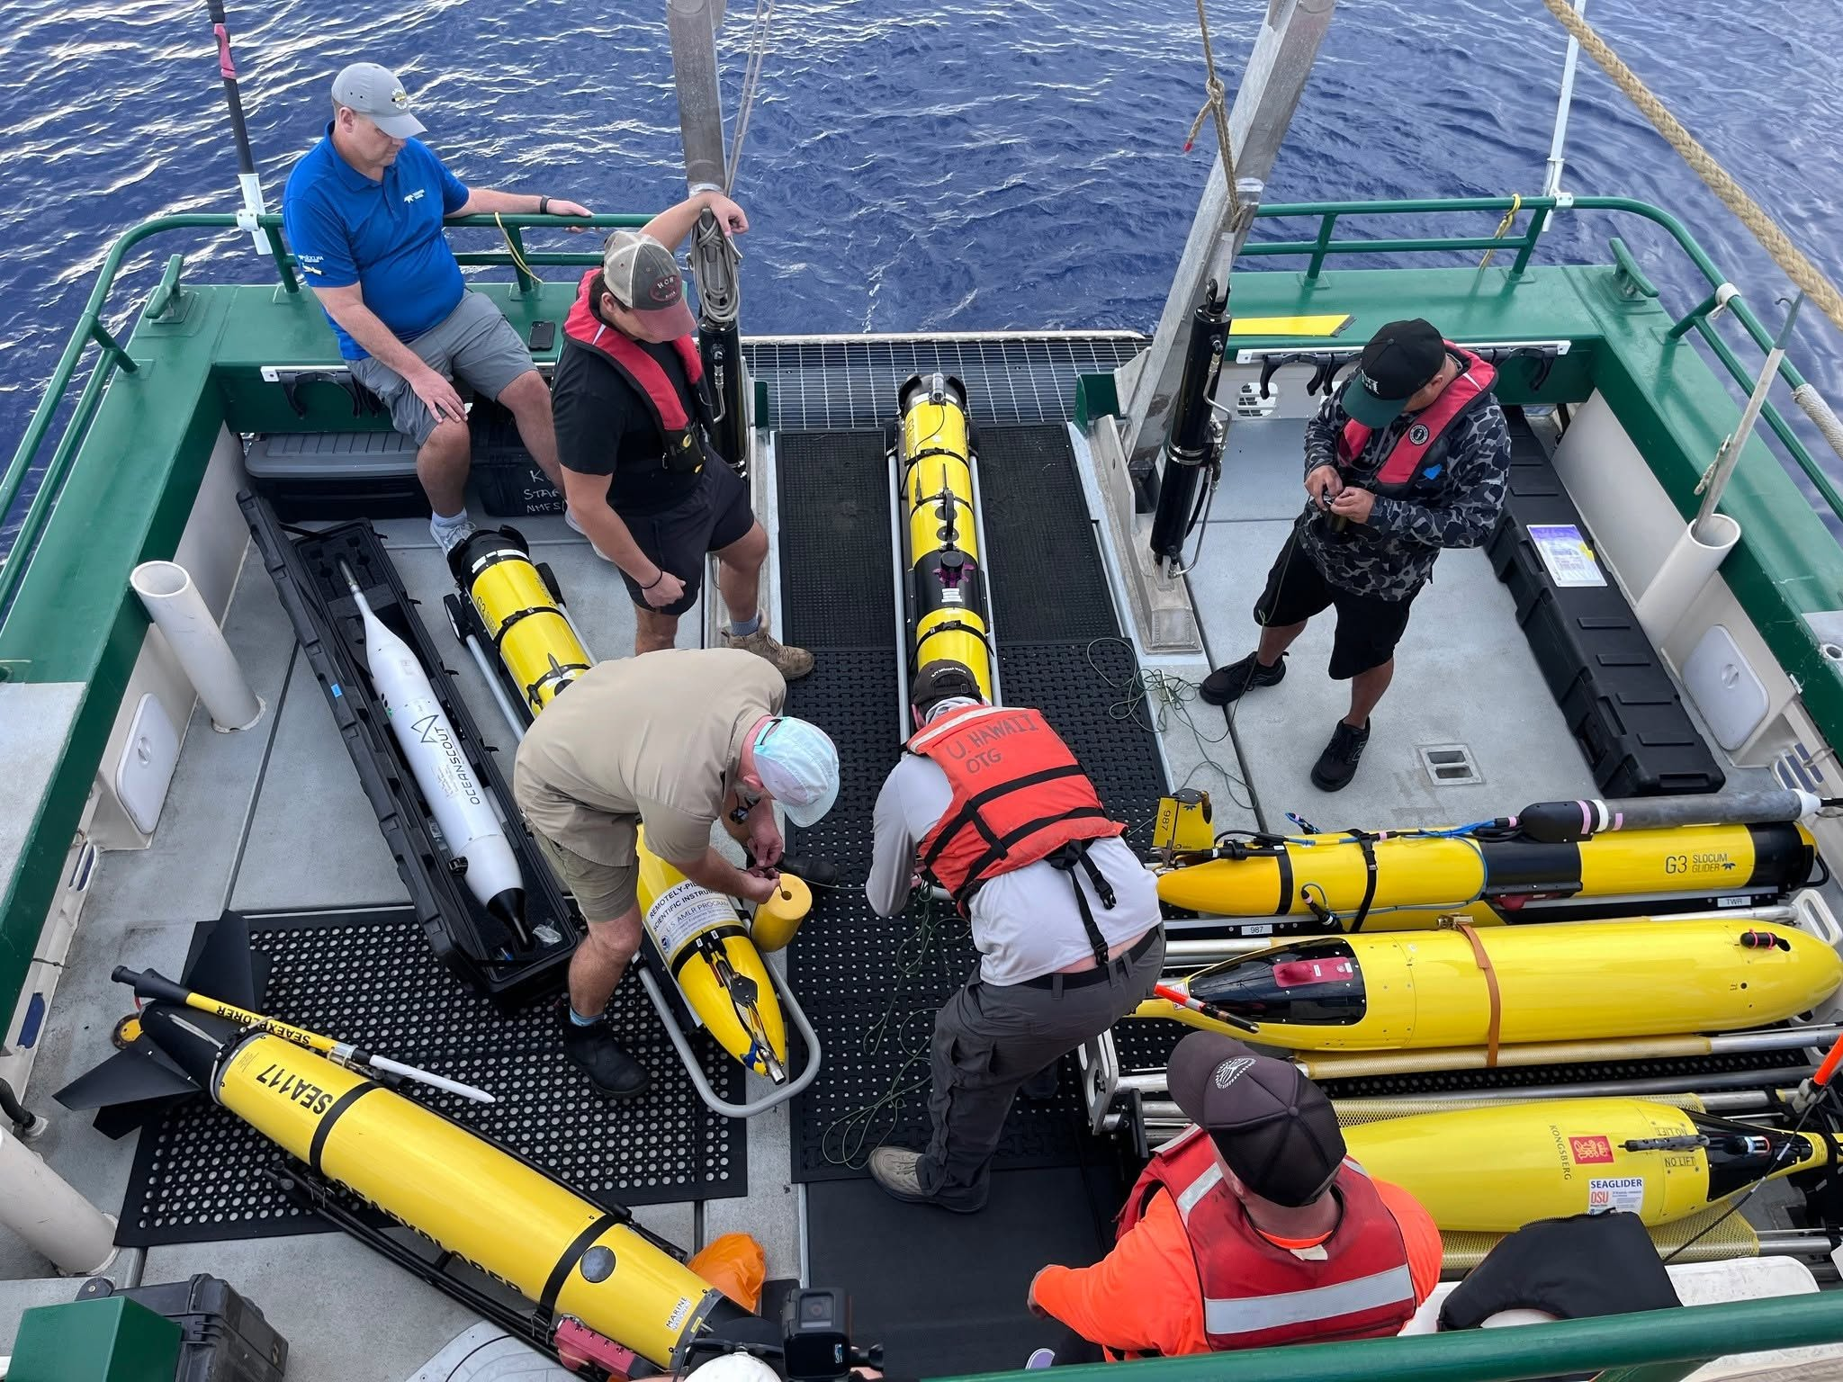
Decision Tool
Background/Justification
dashboard
Glider Selection Dashboard
Develop a Glider Selection Dashboard that brings together information from the Glider Rodeo, glider manufacturers, and relevant datasets to help users determine which glider platform and configuration would be best suited for a particular mission.
psychology
Interactive Decision-Support
Learn more about glider options available and the different PAM systems. Move beyond simply providing a catalogue of available gliders and instead create an interactive decision-support tool.

Slide 3
Methods
Brainstorm dashboard features as a group
Data obtained from manufacturer
Selection tools created in Quarto hosted via GitHub pages
  Started with NOAA PAM template
  Python — pandas, openpyxl, xarray, netCDF4
  JavaScript — Plotly (2-D and gl3d 3-D), Leaflet + Leaflet.draw (maps), Turf.js (geometry)
Leveraged AI tools for website design
Collaborative feedback & editing
External data and services
  GMRT Synthesis — bathymetry fetched live for any drawn polygon
  Esri World Ocean Base — basemap tiles
  Glider Playground (Orlando Prugel-Bennett, National Oceanography Centre, Apache-2.0) — the 3-D seafloor view follows its approach

Slide 4



Use of AI
ChatGPT was used for Study Design Tool, Debugging
data extraction, analysis code, plotting, the website itself
Gemini was used to create visual for presentation slides.

Slide 5
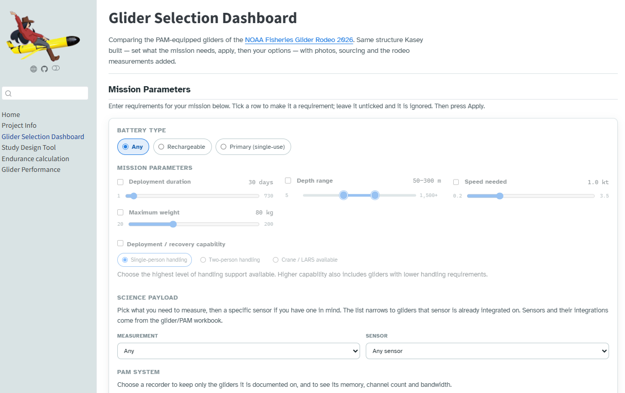
Results
Link

Slide 6
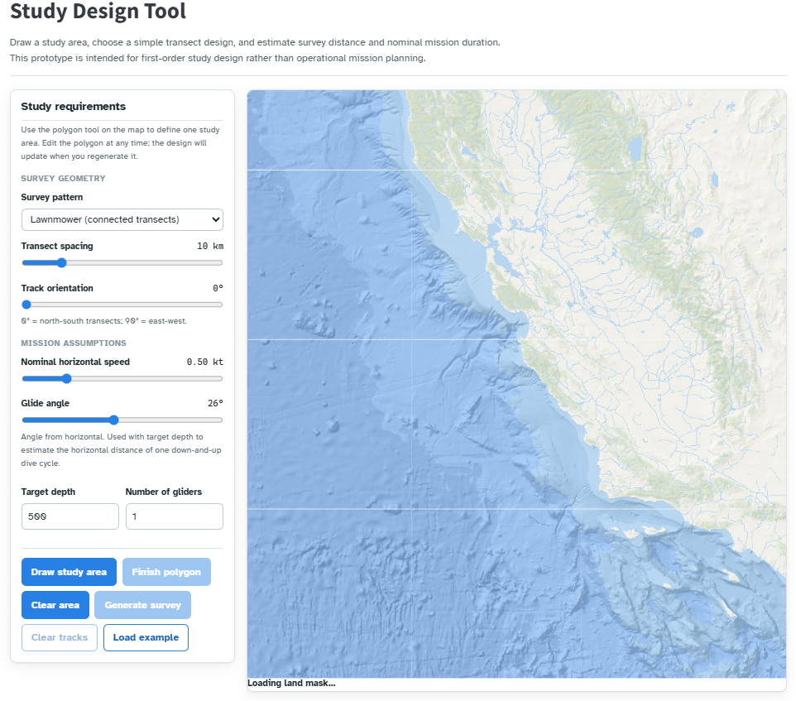
Results
Link

Slide 7
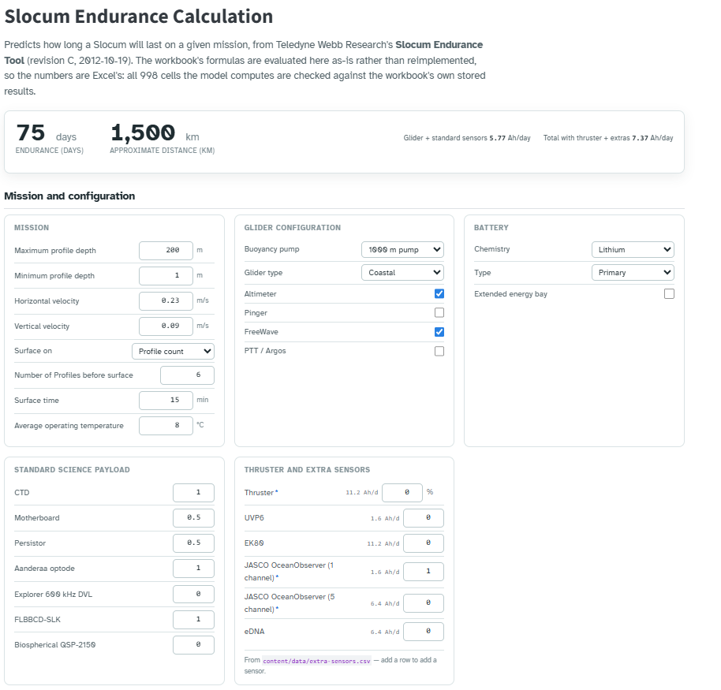
Results
Link

Slide 8
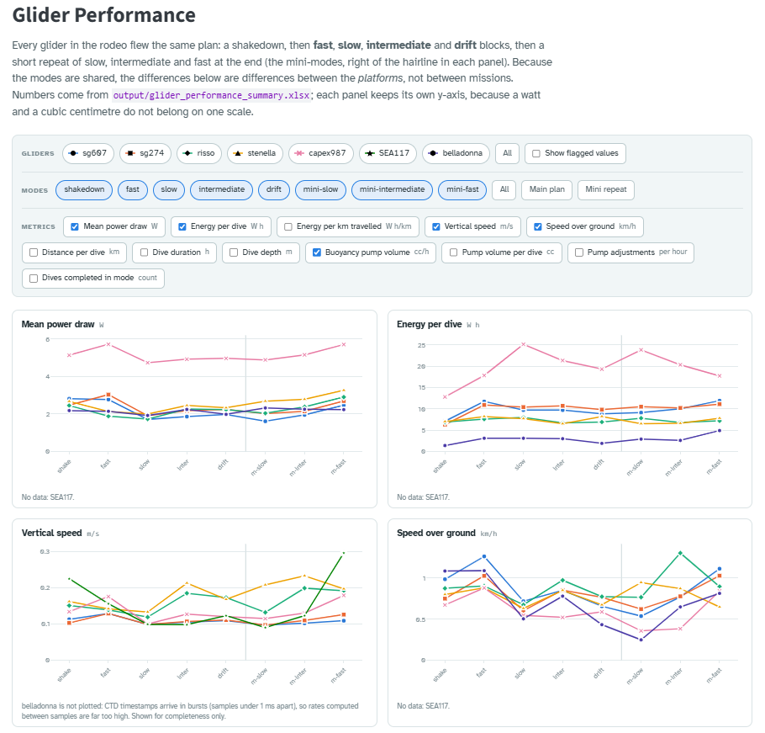
Results
Link

Slide 9
Lessons Learned

Slide 10
Next Steps
Endurance calculation for Seaglider
Study design tool needs attention, testing, and feedback
Import and Export waypoints from the Study Design Tool for glider missions
Import data to the data viewer from additional glider missions.

Slide 11
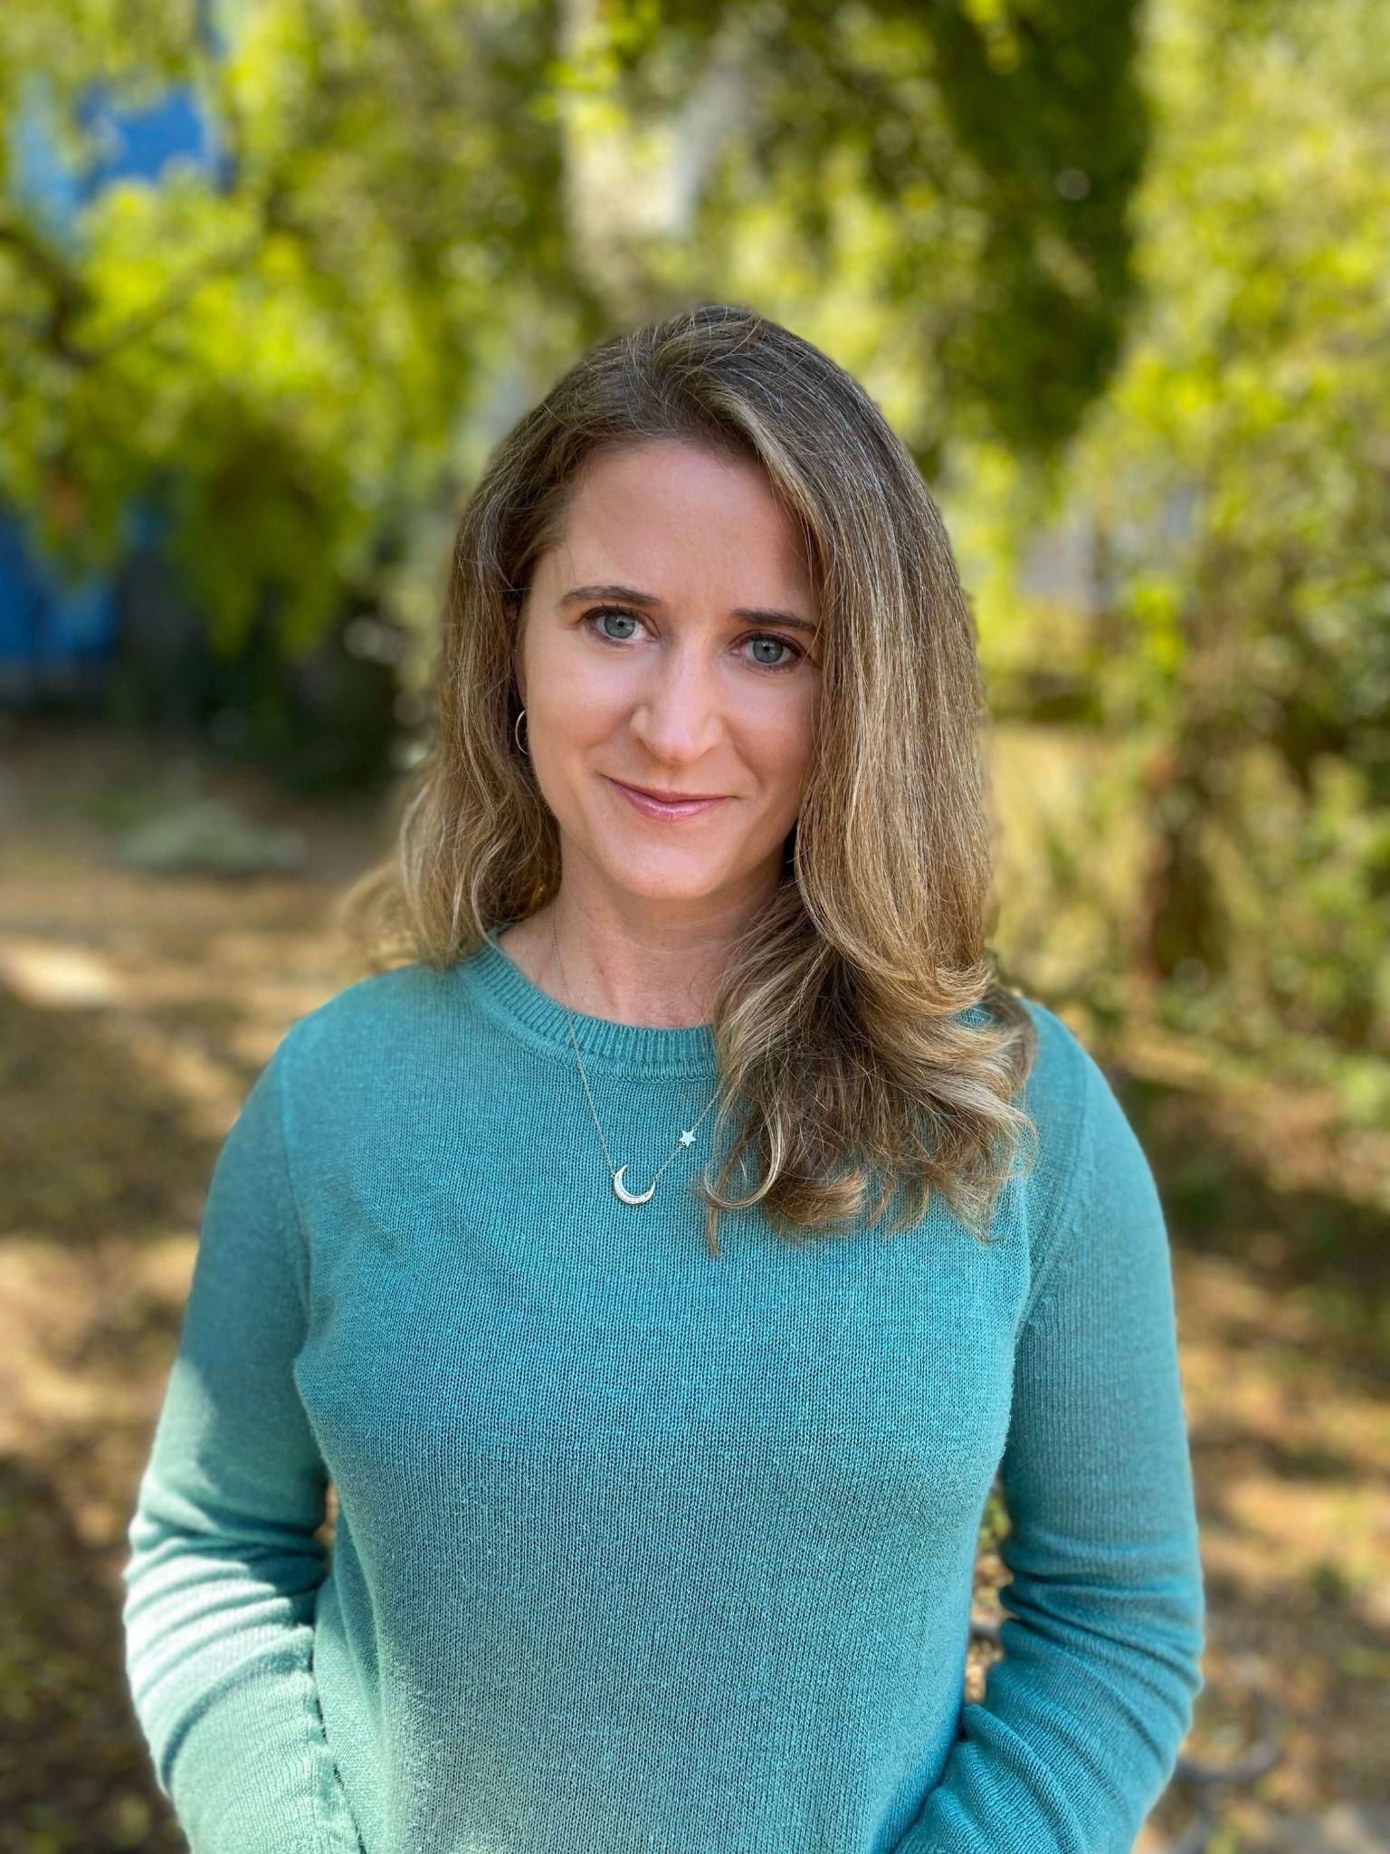
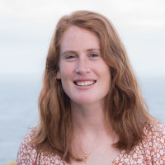
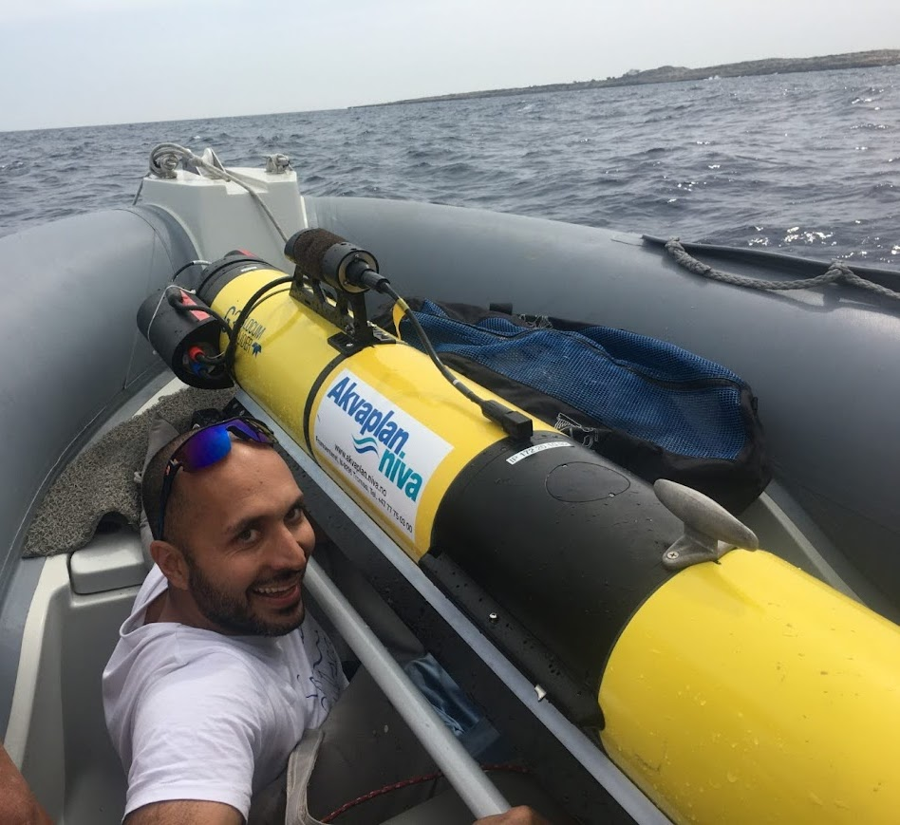
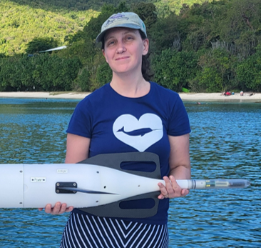
Acknowledgements
Shannon Rankin
Selene Fregosi
Kourtney Burger
Openscapes
Glider Rodeo Team
Glider Rodeo Funders
NOAA Fisheries
Aquaview
Anne Simonis
Kasey Castello
Ehsan Abdi
Héloïse Frouin-Mouy

Slide 12
Schedule - time limits for each slide
Intro: 1 min
Background/Justification: 2 min
Methods: 2 min
Use of AI: 1 min
Results: 5 min
Lessons Learned: 2
Next steps: seaglider endurance calculator
Acknowledgements: 1

