Slide 1
CS 1090A Final Project
Eva Harris, Shay Li, David Soucie, Ethan Aidam, Sam Burgess

Slide 2
Table of Contents
01
04
02
05
03
06
Background and Motivation - Ethan
Forest Models- Shay
Random forest, gradient boost, mixture of experts
EDA - David
Bayesian Hierarchical Model - Eva
Linear Models - Sam
Conclusions - Eva
simple, multiple, interaction terms, polynomial term, OLS, Ridge, Lasso

Slide 3
01
Background and Motivation

Slide 4
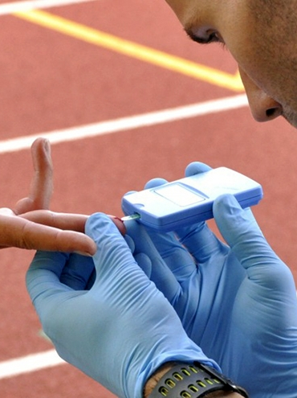
Background and Motivation
Blood Lactate Testing:
Gold standard for measuring fatigue in endurance athletics
Requires drawing blood → messy, time-consuming, disrupts training
Proposal:
Wearables already track HR, cadence, power, etc., but not blood lactate
Need for a non-invasive way to monitor lactate levels
Notes:
In endurance sports, the gold standard for measuring fatigue is the blood lactate test. It’s a reliable indicator of how an the body responds to intense effort—but it comes with a major drawback: it requires drawing blood which is messy, time-consuming, and disruptive to training.
At the same time, athletes already generate a plenty of performance data from wearable devices—things like heart rate, cadence, and power output. These metrics are easy to capture continuously and non-invasively. But blood lactate, despite being so valuable, isn’t directly measured by any wearable technology.
This gap raises an important question: Can we estimate blood lactate levels without ever drawing blood?

Slide 5
Problem Statement
Which modeling approach best predicts blood lactate levels from non-invasive physiological data: a linear or non-linear framework?
Notes:
Thus, our project aims to identify which modeling approach is most effective at predicting blood lactate levels over time using only non-invasive data.

Slide 6
02
Dataset Description

Slide 7
Dataset Description
Captures the physiological response of single cyclist to high-intensity cycling exercise over 3 days, in the form of a repeated lactate-threshold test.
Variable | Description | Units
Time | Second of measurements | Seconds
Power | Cycling power output | Watts
VO2 (dropped) | Oxygen consumption | O2/min
Cadence | Cycling cadence | RPM
Lactate | Blood lactate concentration | mmol/L
Respiration Frequency | Rate of respiration during activity | Breaths per minute
Heart Rate | Measured heart rate | Beats per minute
Saturation | Blood oxygen saturation | Percentage (%)
Day | Day on which data was collected | 1, 2, or 3

Slide 8
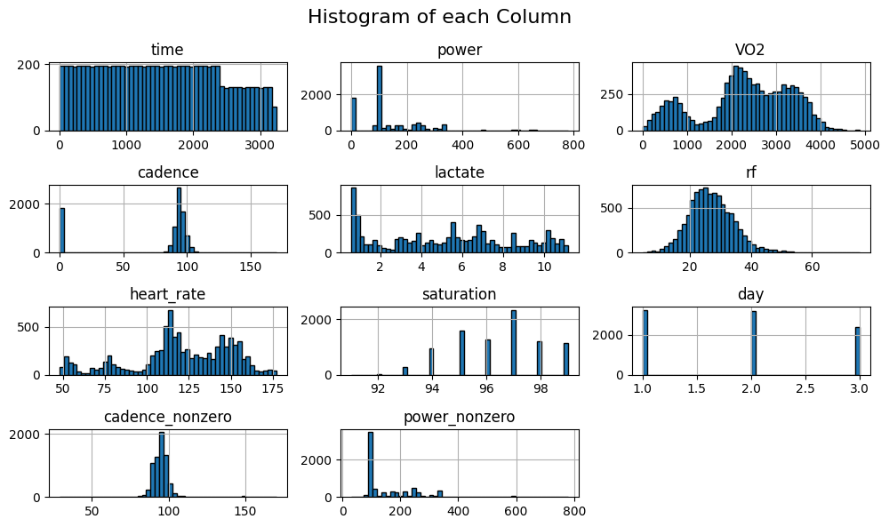
Visualizations - Histograms

Slide 9
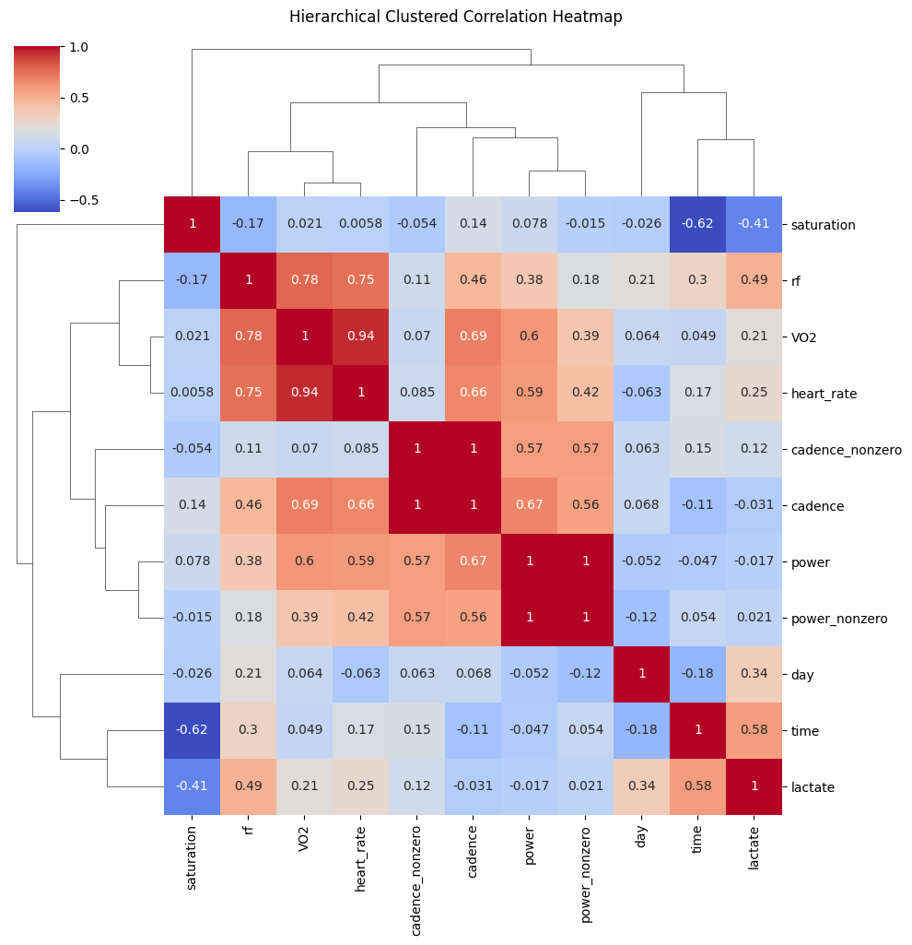
Visualizations - Correlation Matrix
Notes:
Our hierarchical clustered correlation heatmap highlights several clear structure patterns in the data.
- Heart rate, respiratory frequency (`rf`), cadence, and power cluster together. his reflects a shared underlying exercise intensity signal. As workload increases, these physiological measures tend to rise in tandem (e.g., heart rate–rf ≈ 0.75, cadence–power ≈ 0.67).
- Time and lactate form a separate cluster with a moderately strong positive correlation (≈ 0.58). This indicating that lactate accumulation increases over the course of the workout, consistent with fatigue and metabolic by-product build-up during sustained effort.
- Saturation stands apart from most variables and is negatively correlated with time (≈ −0.62) and lactate (≈ −0.41). This suggests that oxygen saturation tends to decline as exercise progresses and lactate rises.
The structure reinforces the idea that while multiple predictors reflect a common intensity dimension, lactate and saturation capture downstream physiological consequences over time, motivating models that allow time-dependent structure and partial pooling (e.g., hierarchical effects by day in `Section 6`) rather than treating all predictors as independent signals.

Slide 10
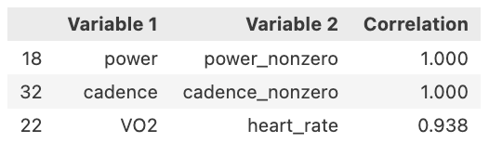
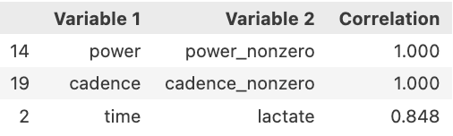
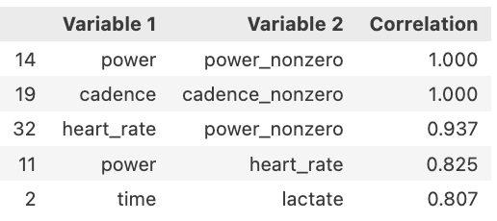
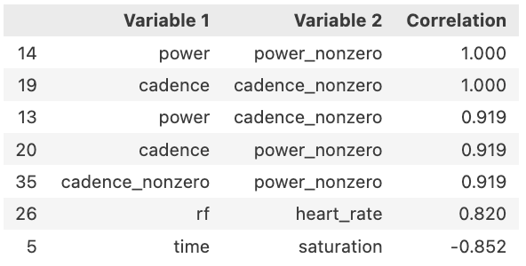
Intra-day corr to be mindful of
By standard machine learning practice, I will now use a threshold correlation of $0.8$ to capture potential multicollinearity.
Day 2
Entire df – dropped VO2 after this (see code file for further info)
Day 1
Day 3

Slide 11
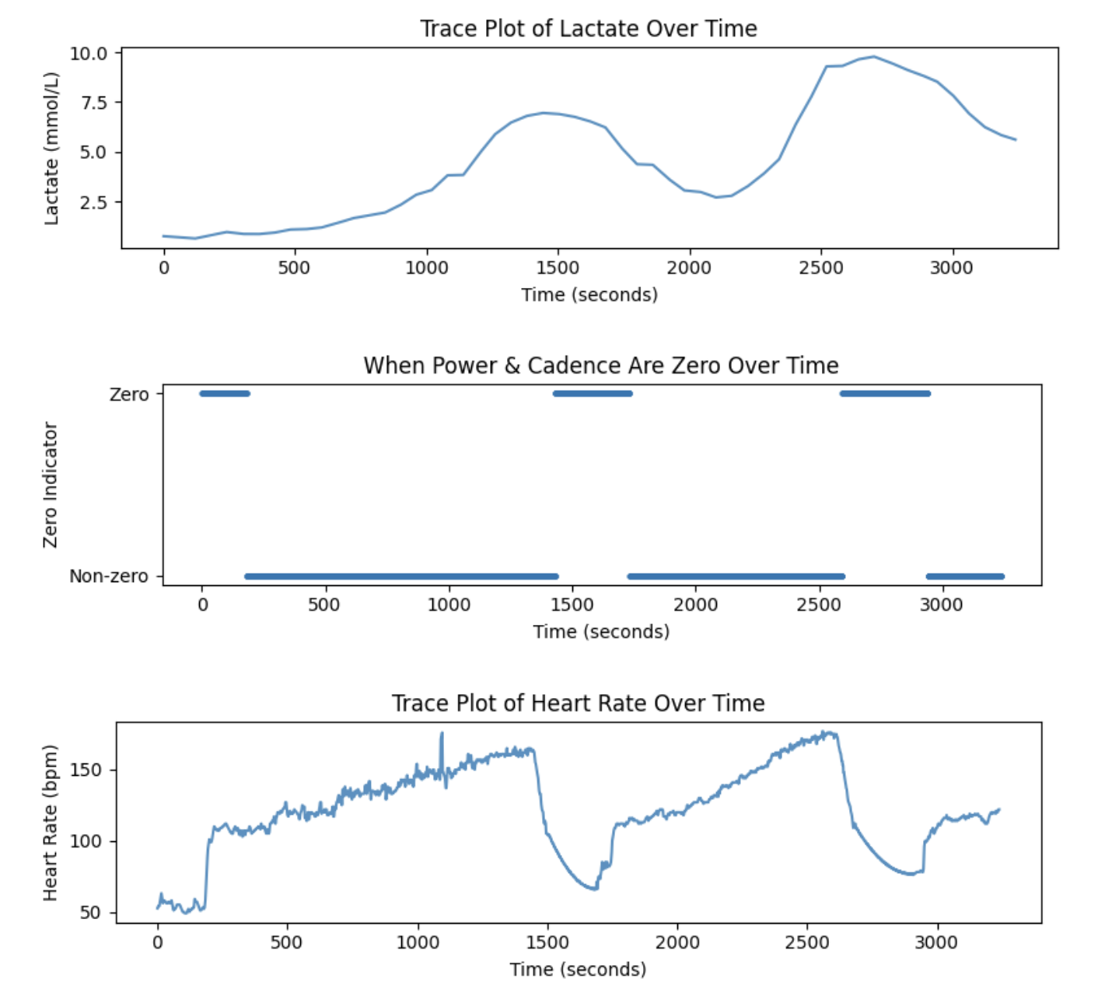
This plot demonstrates that there are points in which the athlete was at rest through the piece
In the next couple slides, we see that the athletes heart rate and other metrics rise and fall at different points between the testing days. We did our best to handle this accordingly. It tells us that we should implement models such a random forest or a mixture of experts to account for this variation, rather than assuming a single unified relationship across all days of testing.

Slide 12
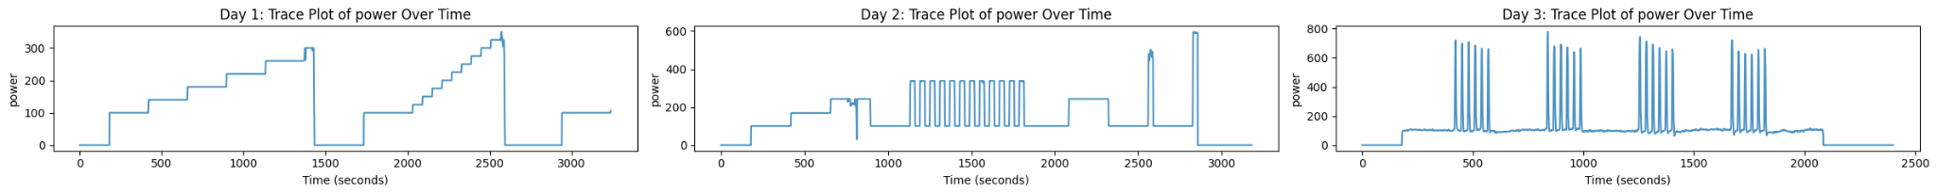
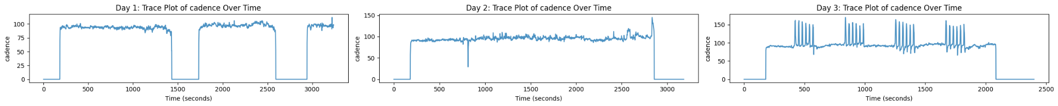
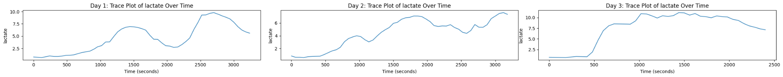
Visualizations - Trace Plots
3.2.1 - Mechanical Output
#### 3.2.2 - Metabolism
This is our response variable (lactate)

Slide 13
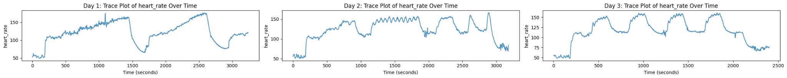
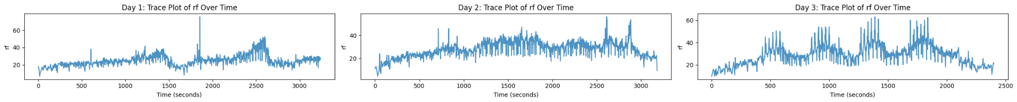
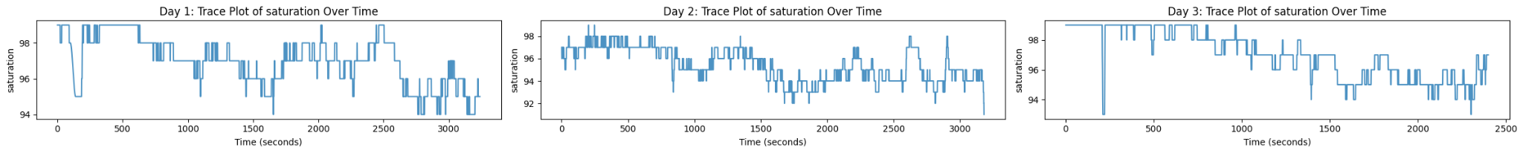
Visualizations - Trace Plots
3.2.3 - Cardio Response

Slide 14
Data Issues
Collinearity:
Several variables show significant collinearity, which may lead to overfitting issues and poor generalizations in some models
Zeros (power, cadence):
0 values in power and cadence alongside trace plots of heart rate and rf suggest that the athlete is at rest during certain periods of the test
This could potentially skew the data with generalizations that aren’t useful for predicting lactate during activity
Scale Differences
The scale of many of the variables is significantly different, with large variance in range
This can potentially affect certain models, especially those that may use higher-level polynomial regressions
Outliers:
Many of the variables have a significant number of outliers, which could potentially impact model performance.

Slide 15
Pre-Processing
Collinear Variable Removal
Most collinearity was handled during feature selection, however, due to its especially high collinearity with other easier to measure features, the “VO2” variable was dropped
Zero-value removal:
To test the generalizability of the data with and without rest periods, a new column “cadence_nonzero” and “power_nonzero” was created to act as a boolean mask for filtering out rows in which the athlete is at rest
Scaling:
A StandardScaler is applied to every scalar feature, normalizing the ranges of each variable
Outliers:
Given that none of our models had significant issue with generalizing with outliers, none were removed.

Slide 16
03
Linear Models

Slide 17
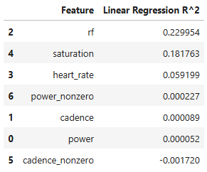
Model
R²
1. SIMPLE LINEAR REGRESSION (rf)
0.230
Respiratory frequency
Helps with feature selection, but clearly one feature is not enough to predict.

Slide 18
Model
R²
1. SIMPLE LINEAR REGRESSION (rf)
0.230
2. MULTI LINEAR REGRESSION (rf, sat, hr)
0.359
Better than the simple model, but clearly we could have more complexity.

Slide 19
Model
R²
1. SIMPLE LINEAR REGRESSION (rf)
0.230
2. MULTI LINEAR REGRESSION (time, rf, sat)
0.359
3. INTERACTION TERMS (time, rf, sat)
0.437
Better than multilinear, but could still be improved.

Slide 20
Model
R²
1. SIMPLE LINEAR REGRESSION (rf)
0.230
2. MULTI LINEAR REGRESSION (rf, sat, hr)
0.359
3. INTERACTION TERMS (rf, sat, hr)
0.437
4. Polynomial (rf, sat, hr)
0.449
Polynomial Model performed better, though still not perfect

Slide 21
04
Trees

Slide 22
Decision Tree -
Can capture complex patterns missed by linear/polynomial models
TRAIN R-squared: 0.961
TEST R-squared: 0.893
PROS
Massive improvement in R-squared.
CONS
Overfitting!

Slide 23
Random Forest -
Usually overfits less than DT.
TRAIN R-squared: 0.991.
TEST R-squared: 0.939.
PROS
Improvement in R-squared.
CONS
Still overfitting!

Slide 24
Gradient Boosting -
Usually outperforms RF
TRAIN R-squared: 0.945.
TEST R-squared: 0.910.
CONS
Worse R^2.
PROS
Technically less over-fitting

Slide 25
Try Mixture of Experts?
Perhaps there are distinct diff. clusters in the dataset (implied by EDA), each with their own overfitted RF model, to not overfit overall.

Slide 26
Mixture of Experts Results
TRAIN R-squared: 0.991.
TEST R-squared: 0.939.
Very good R-squared, similar to Random Forest… Making “clusters” for different experts is not useful.

Slide 27
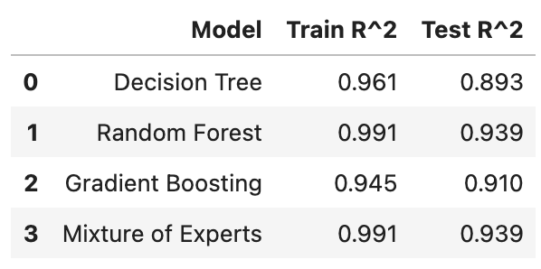
Model Comparisons
RF and Mixture of Experts best R-squared.

Slide 28
Feature Importance
power, rf, saturation - important
heart_rate, cadence - less important

Slide 29
Bayesian Hierarchical Model
An exploration of Oxygen Saturation: Our most important predictor
Why?
Training sessions differed across days (e.g., long steady efforts vs. burst-style intervals).
Both intercepts and slopes were allowed to vary by day. This allows for:
Day-specific baseline lactate levels
Day-specific sensitivity of lactate to saturation
Partial Pooling:
Group-level priors share information across days.
Improves stability relative to fitting completely separate models per day.
Explicitly accounts for heterogeneity in training protocols.

Slide 30
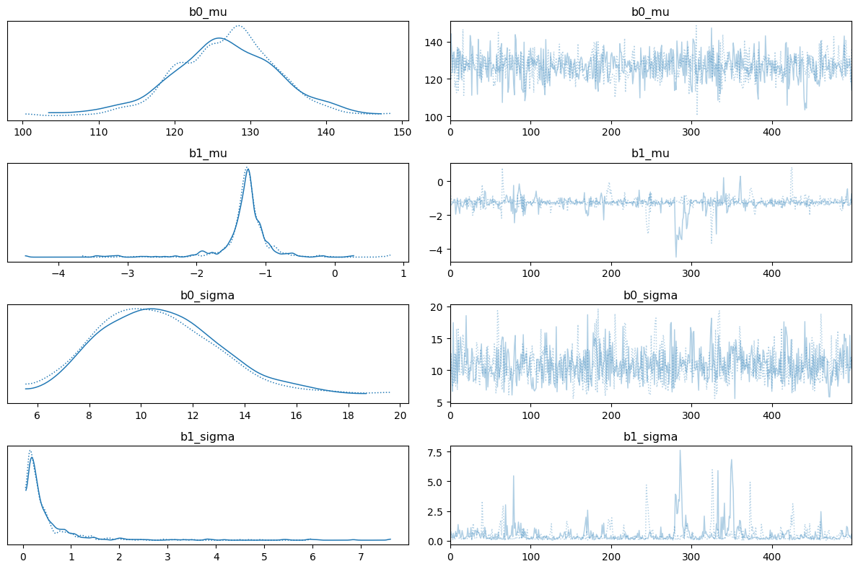
An exploration of Oxygen Saturation: Our most important predictor

Slide 31
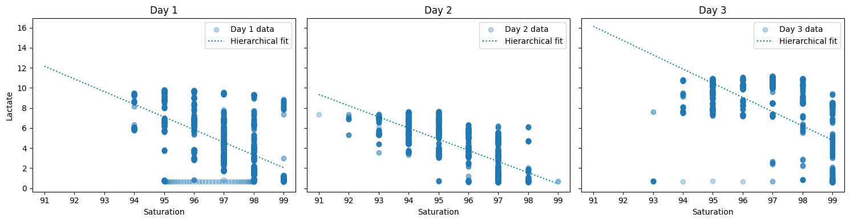
Bayesian Hierarchical Model
An exploration of Oxygen Saturation: Our most important predictor

Slide 32
06
Conclusions

Slide 33
Conclusions
Our problem statement question asked whether a linear or non-linear framework would best predicts blood lactate levels from non-invasive physiological data.
The models with the best $R^2$ performance were Random Forest, Gradient Boosting, Decision Tree and and Mixture of Experts. These are all nonlinear ensemble learning methods that combine multiple models to capture complex, non-additive relationships in the data.
Notes:
Which modeling approach best predicts blood lactate levels from non-invasive physiological data: a linear or non-linear framework?
nonlinear, ensemble learning methods

