Slide 1
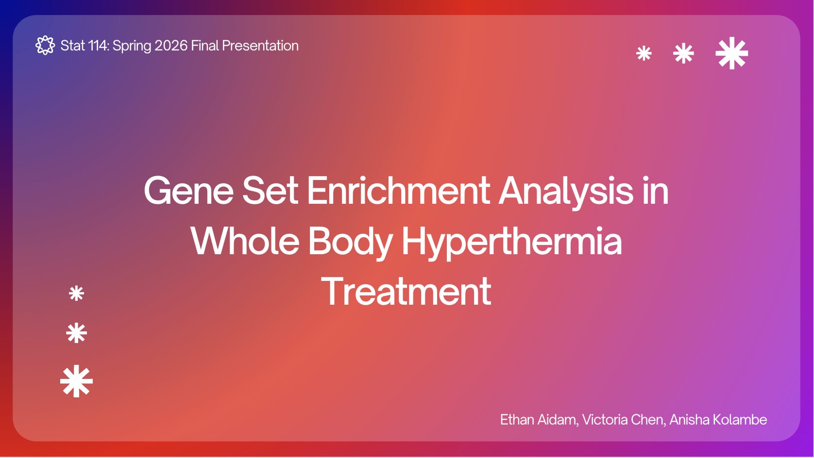

Slide 2
Stat 114: Spring 2026 Final Presentation
Roadmap
1
3
Results + Vizualizations
Biological Background
4
2
Takeaways + Conclusion
GSEA +
Statistical Review
Ethan Aidam, Victoria Chen, Anisha Kolambe

Slide 3
Stat 114: Spring 2026 Final Presentation
Our GSEA Pipleline:
Shell Scripts, Data Cleaning, R Plots + Analysis
Ethan Aidam, Victoria Chen, Anisha Kolambe

Slide 4
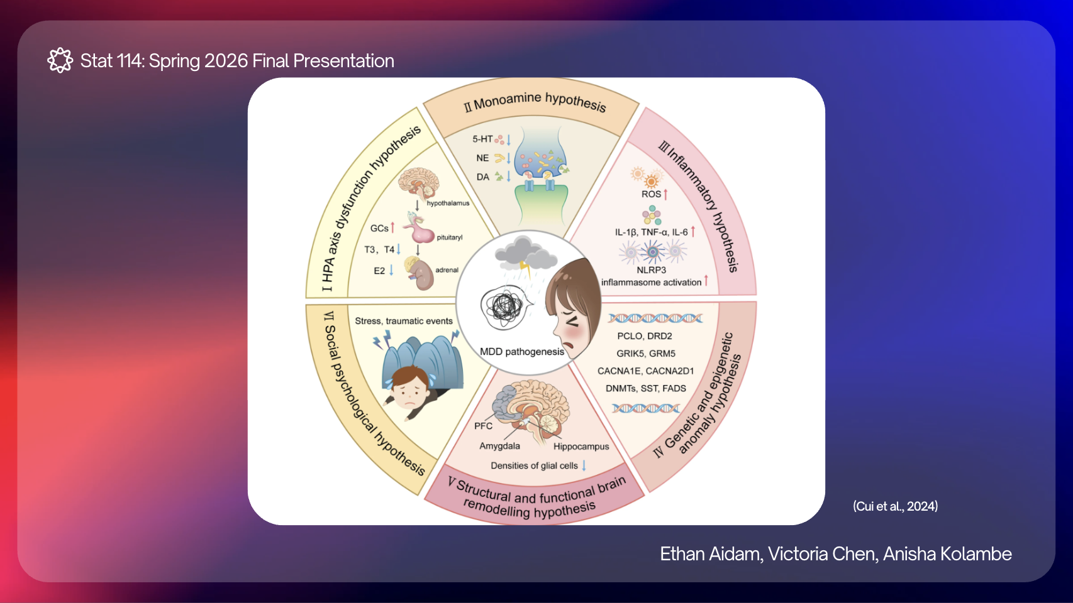

Slide 5
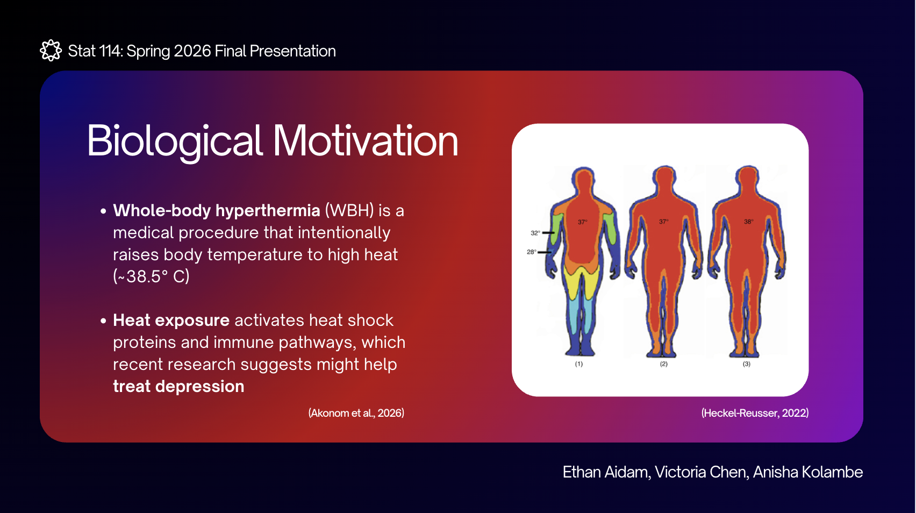
Notes:
victoria

Slide 6
Stat 114: Spring 2026 Final Presentation
How Does GSEA Help?
POTENTIAL EXPLORATORY PATHWAYS
The effects of heat exposure on individual genes in WBH are very small
However, by analyzing groups of related genes/biological pathways, a significant pattern might appear
This matches the context in which GSEA is typically used - detecting small expression fold changes across many genes
Cellular Response to Heat
Chaperone Mediated Protein Folding
Dopamine Transport*
Serotonin Transport*
*indicates novel relationships not yet explored in paper
Ethan Aidam, Victoria Chen, Anisha Kolambe

Slide 7
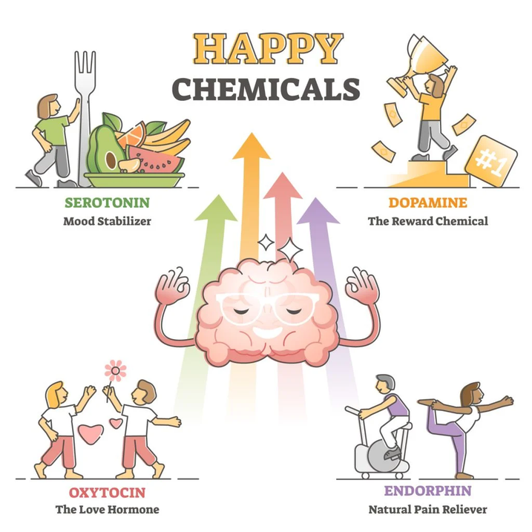
Stat 114: Spring 2026 Final Presentation
Focus Pathways
Akonom and colleagues identified heat shock, immune response, and interleukin 6 production pathways as enriched in the WBH condition
But how might this affect mood-relevant targets like dopamine or serotonin → so-called “happy chemicals”?
Major Depressive Disorder is linked to deficits in dopamine and serotonin circuits
(Simply Psychology)
Ethan Aidam, Victoria Chen, Anisha Kolambe

Slide 8
Stat 114: Spring 2026 Final Presentation
Focus Pathways
If WBH helps treat depression, we expect
1. Serotonin and dopamine pathways are themselves enriched in WBH condition
OR . . .
2. Indirectly benefit from the robust associations of heat shock, protein folding
WBH
1
Dopamine/
Serotonin
Intermediate Pathways
2
(Simply Psychology)
Ethan Aidam, Victoria Chen, Anisha Kolambe

Slide 9
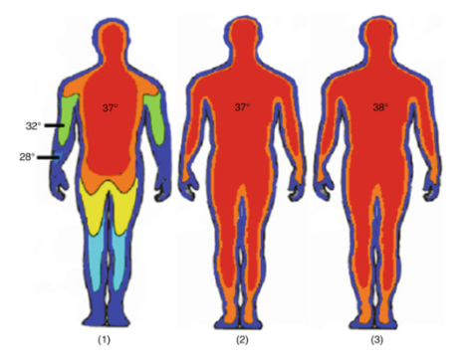
Stat 114: Spring 2026 Final Presentation
Biological Motivation
Whole-body hyperthermia (WBH) is a medical procedure that intentionally raises body temperature to high heat (~38.5° C)
Heat exposure activates heat shock proteins and immune pathways, which recent research suggests might help treat depression
(Akonom et al., 2026)
(Heckel-Reusser, 2022)
Ethan Aidam, Victoria Chen, Anisha Kolambe

Slide 10

Stat 114: Spring 2026 Final Presentation
RANK GENES BASED ON LOG2FOLD CHANGE
What is ?
CALCULATE ENRICHMENT SCORE
GSEA is a computational tool that identifies if a set of genes is overrepresented in a biological dataset
Calculating “enrichment scores” helps determine whether the gene is linked to a known biological pathway
COMPUTE P-VALUES W/ PERMUTATION TEST
PLOT AND INTERPRET DATA
Ethan Aidam, Victoria Chen, Anisha Kolambe

Slide 11




Stat 114: Spring 2026 Final Presentation
Enrichment Score (ES)
Consider a list of NR ranked genes, L = {g1, g2, . . . , gN}, and an independent gene set, S, consisting of NH genes.
For each position i = 1, 2, . . . , N we compute the fraction of genes that are in S (call these “hits”) and the fraction of genes that aren’t in S (call these “misses”)
where,
An “enrichment score” is defined as follows:
(Subramanian et al., 2005)
Ethan Aidam, Victoria Chen, Anisha Kolambe

Slide 12
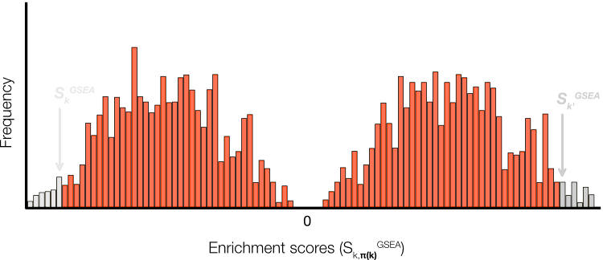
Stat 114: Spring 2026 Final Presentation
Phenotype Permutation
To assess significance, the observed ES is compared to a null distribution ESNULL with random phenotypes.
Significance Testing
1. Randomly shuffle phenotypes and recompute the ES
2. Repeat this 1,000 times to generate a distribution of null scores (ESₙᵤₗₗ).
3. Calculate the p-value from the fraction of values greater or equal to the observed ES within the null distribution
(Subramanian et al., 2005)
Ethan Aidam, Victoria Chen, Anisha Kolambe

Slide 13

Stat 114: Spring 2026 Final Presentation
Normalized Enrichment Score (NES)
Normalized Enrichment Scores (NES) allows us to compare ES across gene sets of different sizes.
We normalize each ES by dividing by the expected value of the corresponding null distribution.
Ethan Aidam, Victoria Chen, Anisha Kolambe

Slide 14



Stat 114: Spring 2026 Final Presentation
More On Null Distributions
ES is positive for enrichment at the top of the ranked list and negative for enrichment at the bottom of the list, which produces two different null distributions for each set S. Thus, for Normalized Enrichment Scores (NES) and p-values, we derive them from the null distribution corresponding with the sign of the observed ES for each set.
Ethan Aidam, Victoria Chen, Anisha Kolambe

Slide 15
Stat 114: Spring 2026 Final Presentation
Multiple Testing Correction:
Benjamini Hochberg (BH) + Storey’s Method
Ethan Aidam, Victoria Chen, Anisha Kolambe

Slide 16
Stat 114: Spring 2026 Final Presentation
Why Do We Need Correction?
Ex.
In our paper, researchers are simultaneously testing thousands of genes and biological pathways for enrichment
If we used the standard threshold p < 0.05, it would be easy for about 5% of tests to be significant purely by chance, because so many were examined
Testing 20,000 genes ->
20,000 x 0.05 = 1,000 expected false positives by chance alone
This leads to an inflated false discovery rate that needs correcting through BH or Storey’s
Ethan Aidam, Victoria Chen, Anisha Kolambe

Slide 17
Stat 114: Spring 2026 Final Presentation
FDR = False Positives / Total Significant Results
Benjamini-Hochberg vs. Storey’s Method
1. Rank p-values from smallest → largest
2. For each rank, compute kα/m where k = rank, α = desired FDR, and m = # tests
3. Find the largest p-value that is less than or equal to kα/m, everything below that passes!
*The paper found that pathways with low FDR were more reliable signals related to WBH treatment effects.
1. Unlike BH, where m0 = m, estimate π0 to be m0/m, the proportion of truly null tests
2. Then, the FDR estimate is adjusted accordingly to get kα/mπ0 as the threshold
3. If many pathways show signal, π0 < 1
*Storey’s is less conservative than BH, which in turn is less conservative than FWER tests like Bonferonni
Ethan Aidam, Victoria Chen, Anisha Kolambe

Slide 18
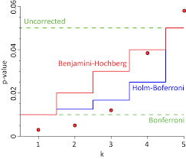
Stat 114: Spring 2026 Final Presentation
FDR vs. FWER, Paper Findings
FDR-adjusted Analysis (q < 0.05)
88 significantly enriched biological processes
E.g., Heat shock, immune signalling, etc.
Higher sensitivity/less strict method of control
FWER-adjusted Analysis (p < 0.05)
Only 17 significantly enriched processes
Strongest: protein folding, cellular heat response
Conservative, retains most robust associations
(Marek Gierliński)
Ethan Aidam, Victoria Chen, Anisha Kolambe

Slide 19
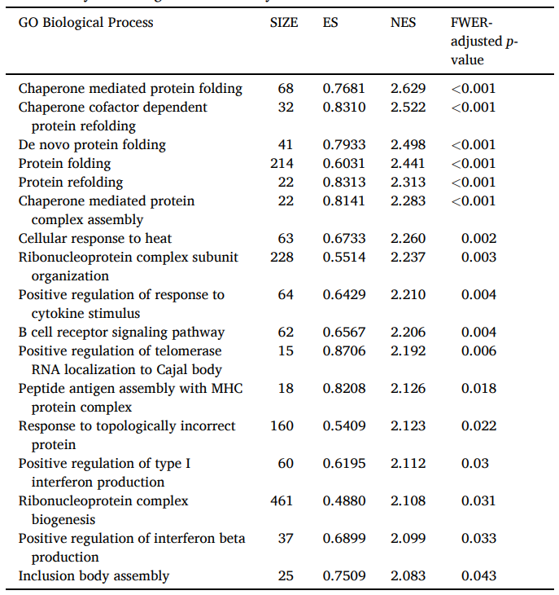
Stat 114: Spring 2026 Final Presentation
Paper Methodology
Trimmed Reads using using Cutadapt (v2.1)
NCBI GRCh38 alignment via HISAT2 (v2.1.0)
Counts generated by Rsubread (v2.0.1)
NCBI RefSeq annotation
RRcov with PCA
DESeq2 normalization, DEG analysis, and ranking
88 BPs upregulated
(Akonom et al., 2026)
Ethan Aidam, Victoria Chen, Anisha Kolambe

Slide 20
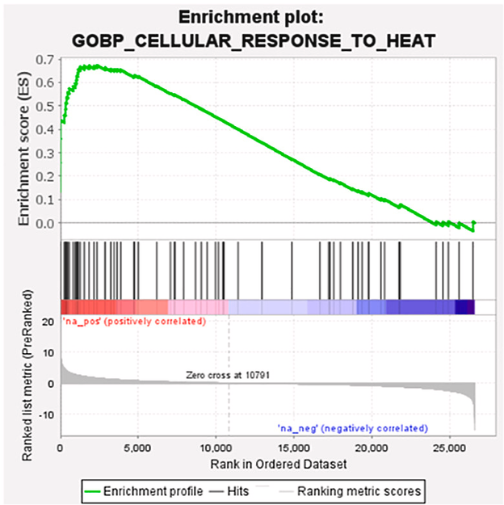
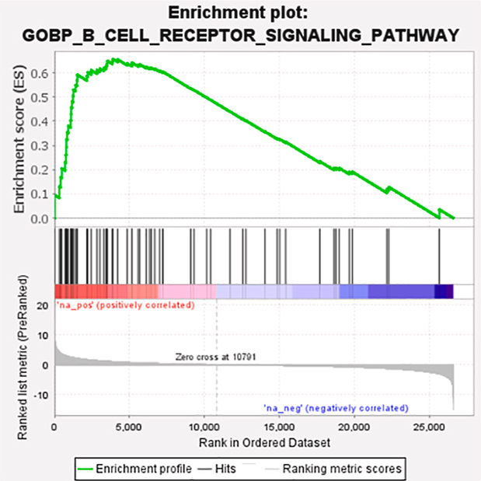
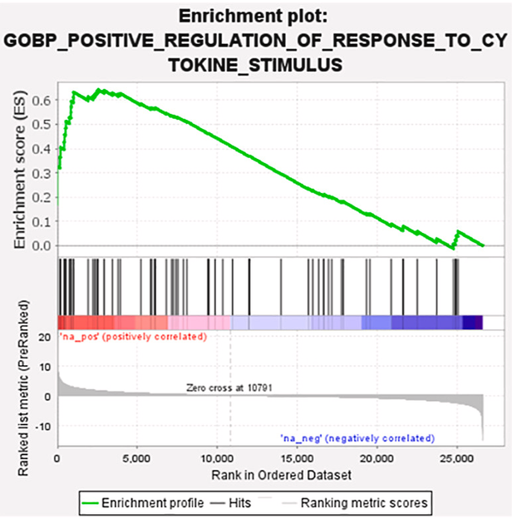
Stat 114: Spring 2026 Final Presentation
GSEA Results
(Akonom et al., 2026)
Ethan Aidam, Victoria Chen, Anisha Kolambe

Slide 21

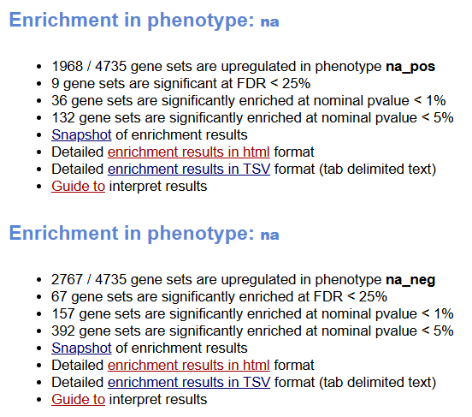
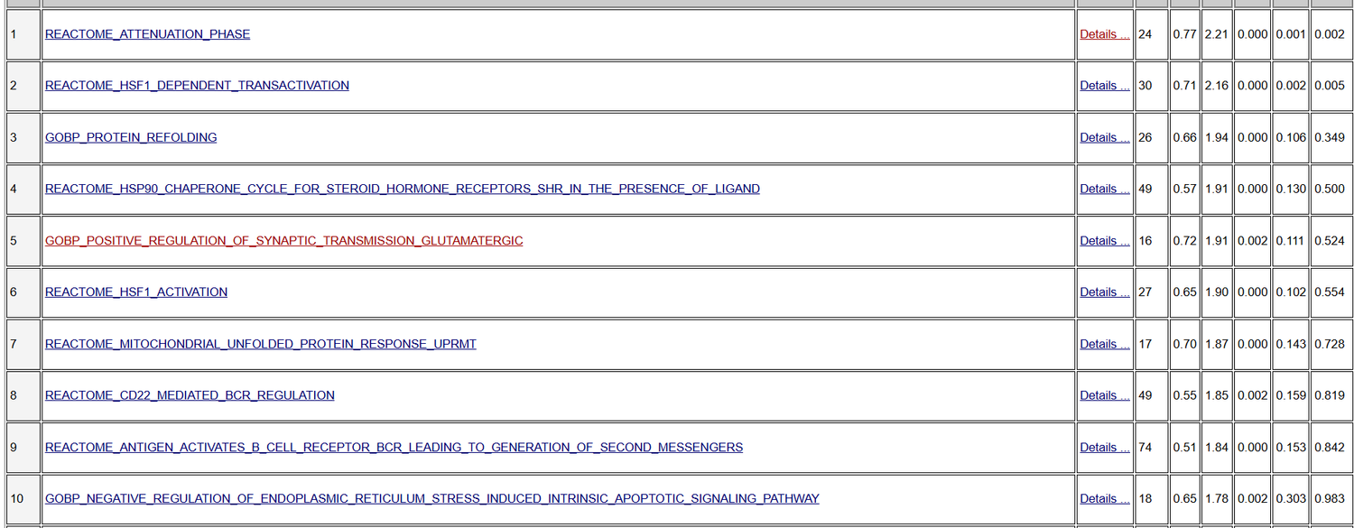
Stat 114: Spring 2026 Final Presentation
GSEA Results (App)
Ethan Aidam, Victoria Chen, Anisha Kolambe

Slide 22
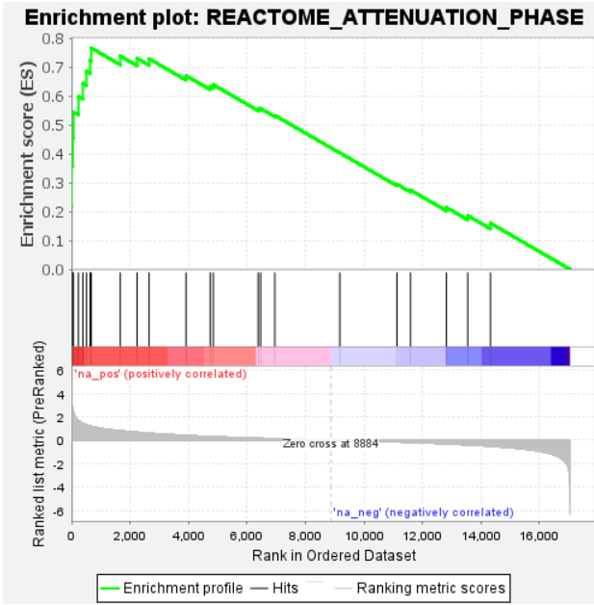
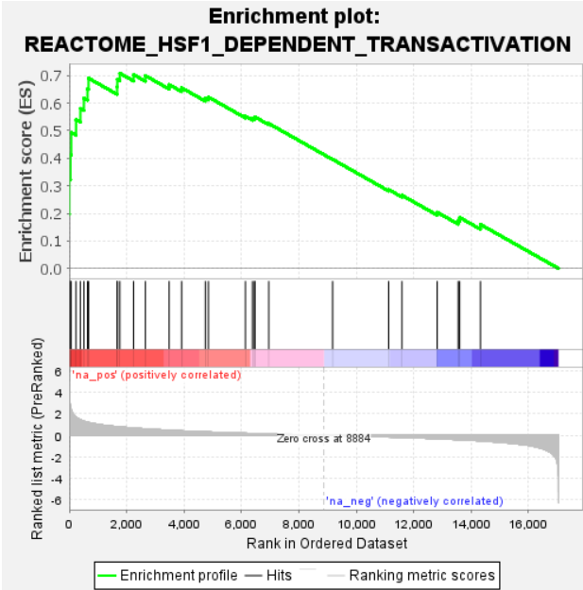
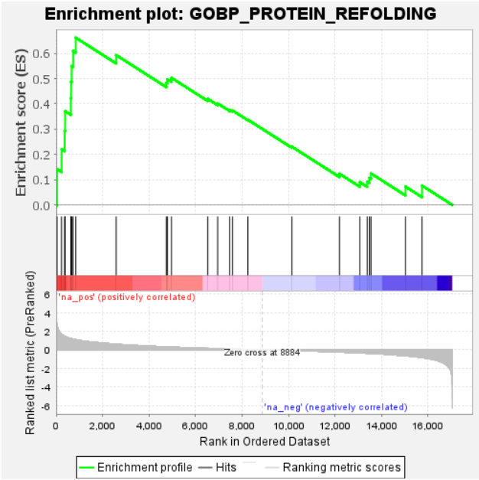
Stat 114: Spring 2026 Final Presentation
GSEA Results (DESeq2)
Ethan Aidam, Victoria Chen, Anisha Kolambe

Slide 23
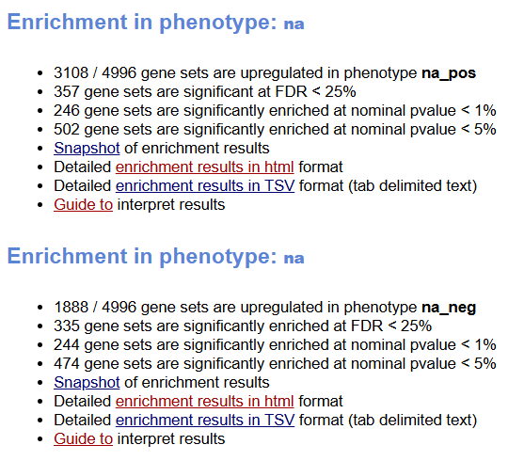
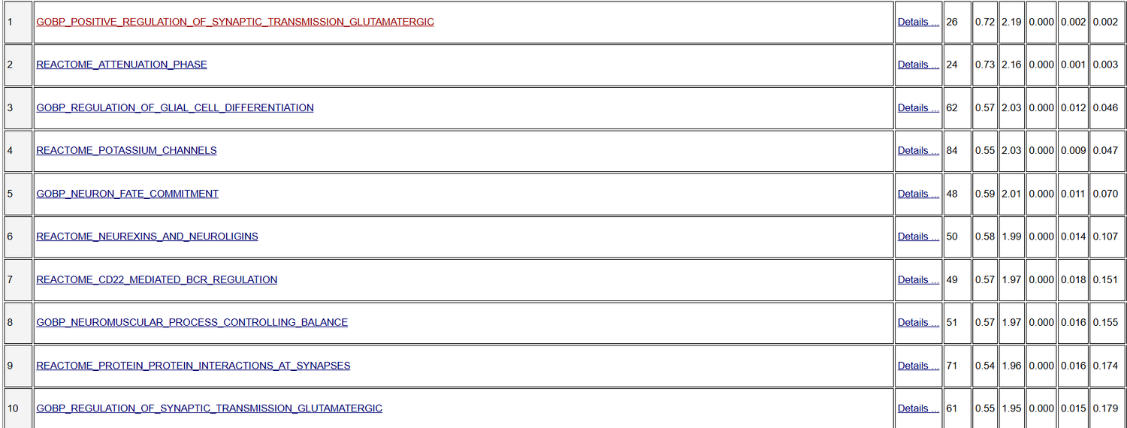
Stat 114: Spring 2026 Final Presentation
GSEA Results (EdgeR)
Ethan Aidam, Victoria Chen, Anisha Kolambe

Slide 24
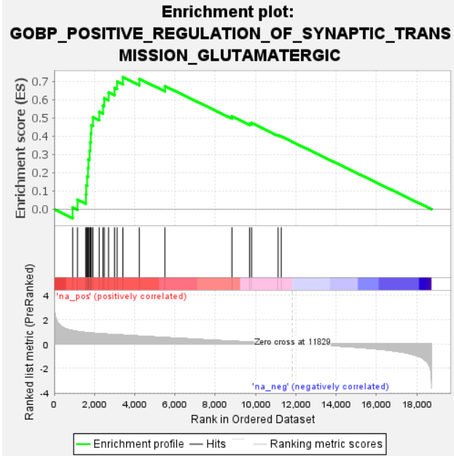
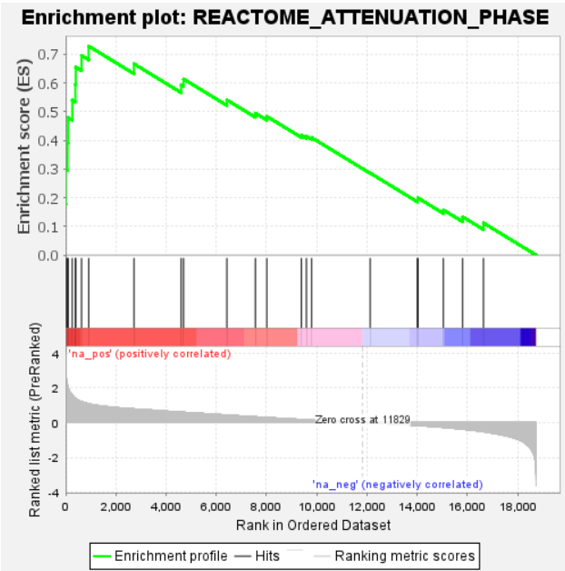
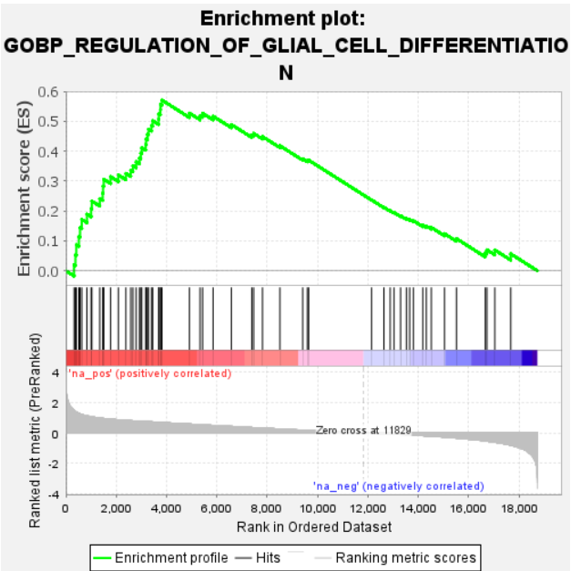
Stat 114: Spring 2026 Final Presentation
GSEA Results (EdgeR)
Ethan Aidam, Victoria Chen, Anisha Kolambe

Slide 25
Stat 114: Spring 2026 Final Presentation
Code/Vignette Overview:
Shell Scripts + R Data Analysis
Ethan Aidam, Victoria Chen, Anisha Kolambe

Slide 26
Stat 114: Spring 2026 Final Presentation
LOAD RAW STAR COUNT MATRIX
I. Data Organization
ASSIGN SAMPLES TO SHAM OR WBH
FILTER BY CPM + RUN DESEQ2
CREATE GENE LIST RANKED BY FOLD CHANGE
Ethan Aidam, Victoria Chen, Anisha Kolambe

Slide 27
Stat 114: Spring 2026 Final Presentation
DEFINE GENE SETS FOR BIO PATHWAYS
II. GSEA Pipeline
CREATE ENRICHMENT SCORE FUNCTION
RUN PERMUTATION TEST
PLOT + ANALYZE GSEA RESULTS
Ethan Aidam, Victoria Chen, Anisha Kolambe

Slide 28
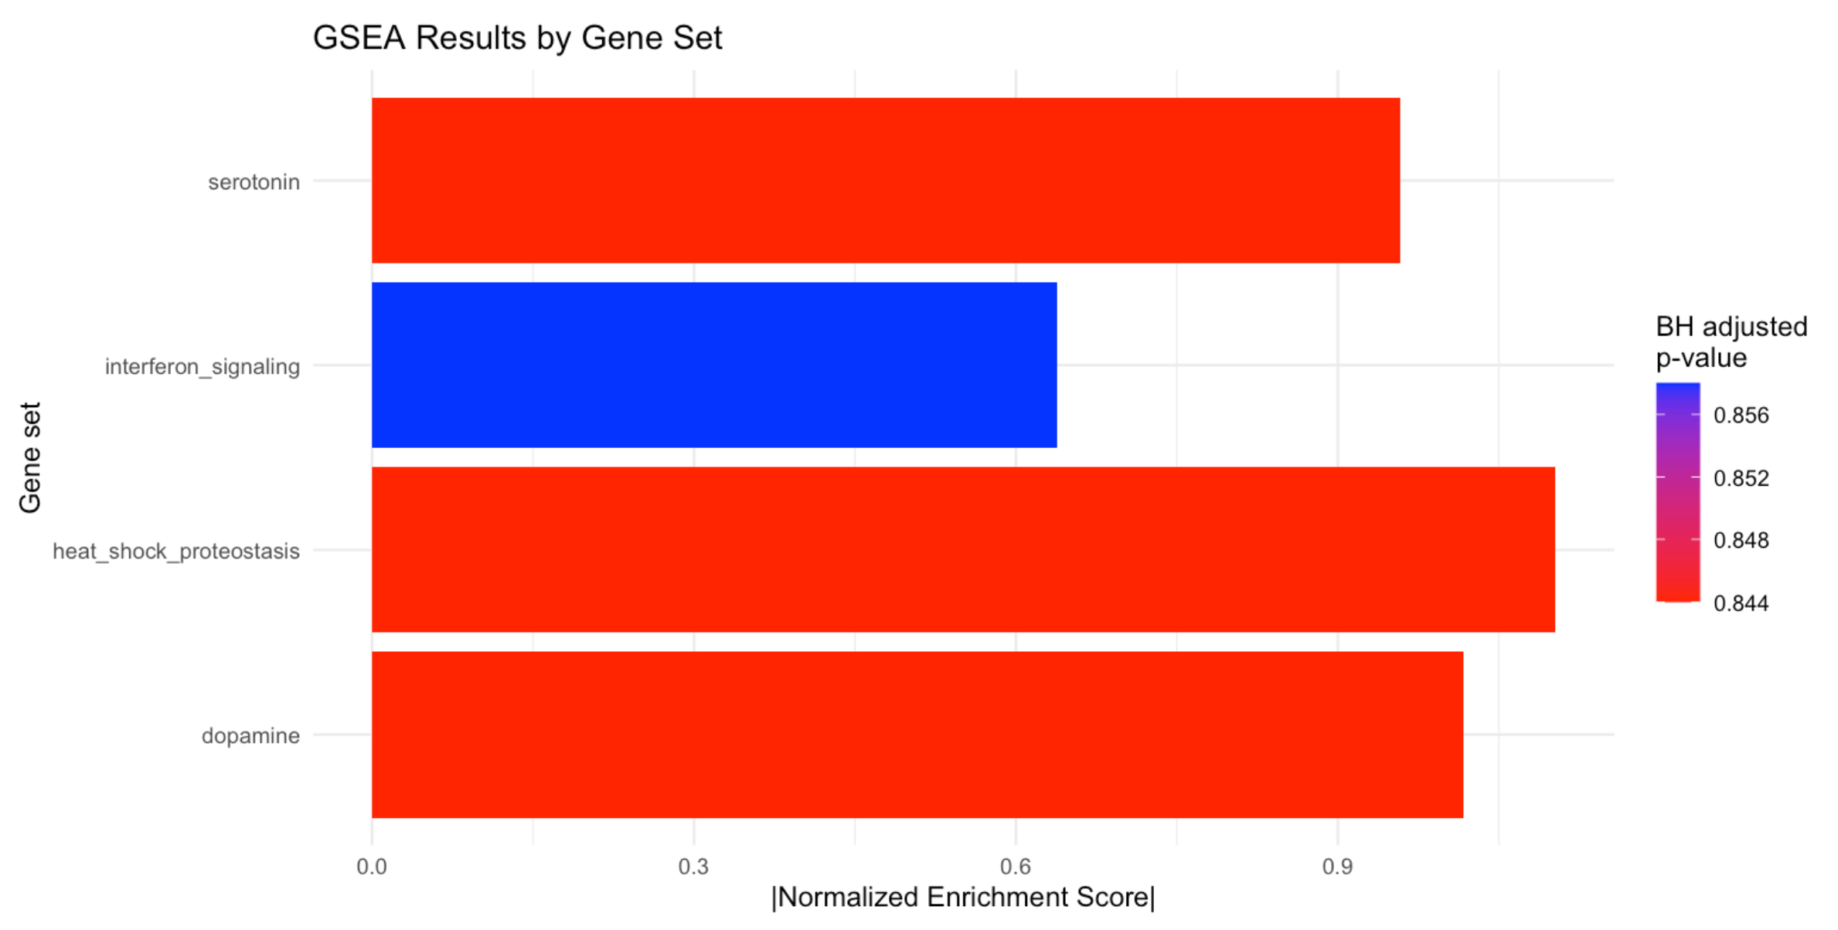
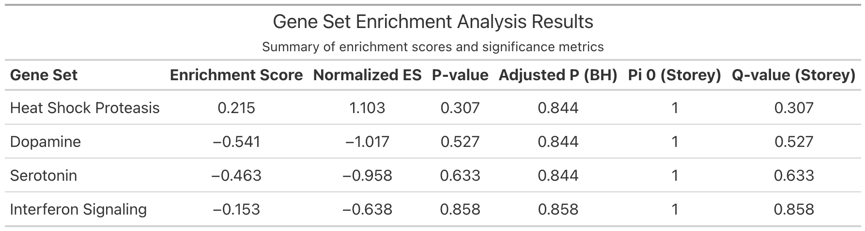
Stat 114: Spring 2026 Final Presentation
Serotonin
Results
Interferon Signaling
NES + Summary Table
Heat Shock Proteostasis
Dopamine
GSEA Results by Gene Set
Ethan Aidam, Victoria Chen, Anisha Kolambe

Slide 29
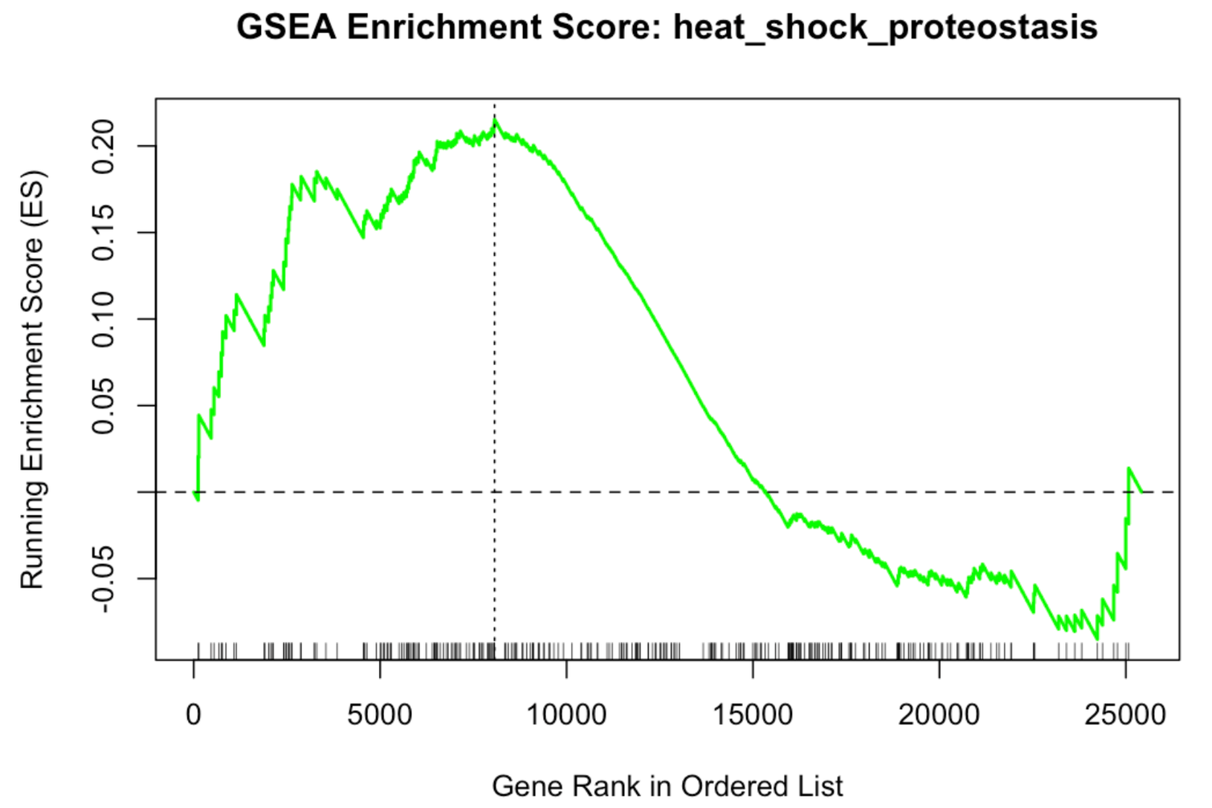
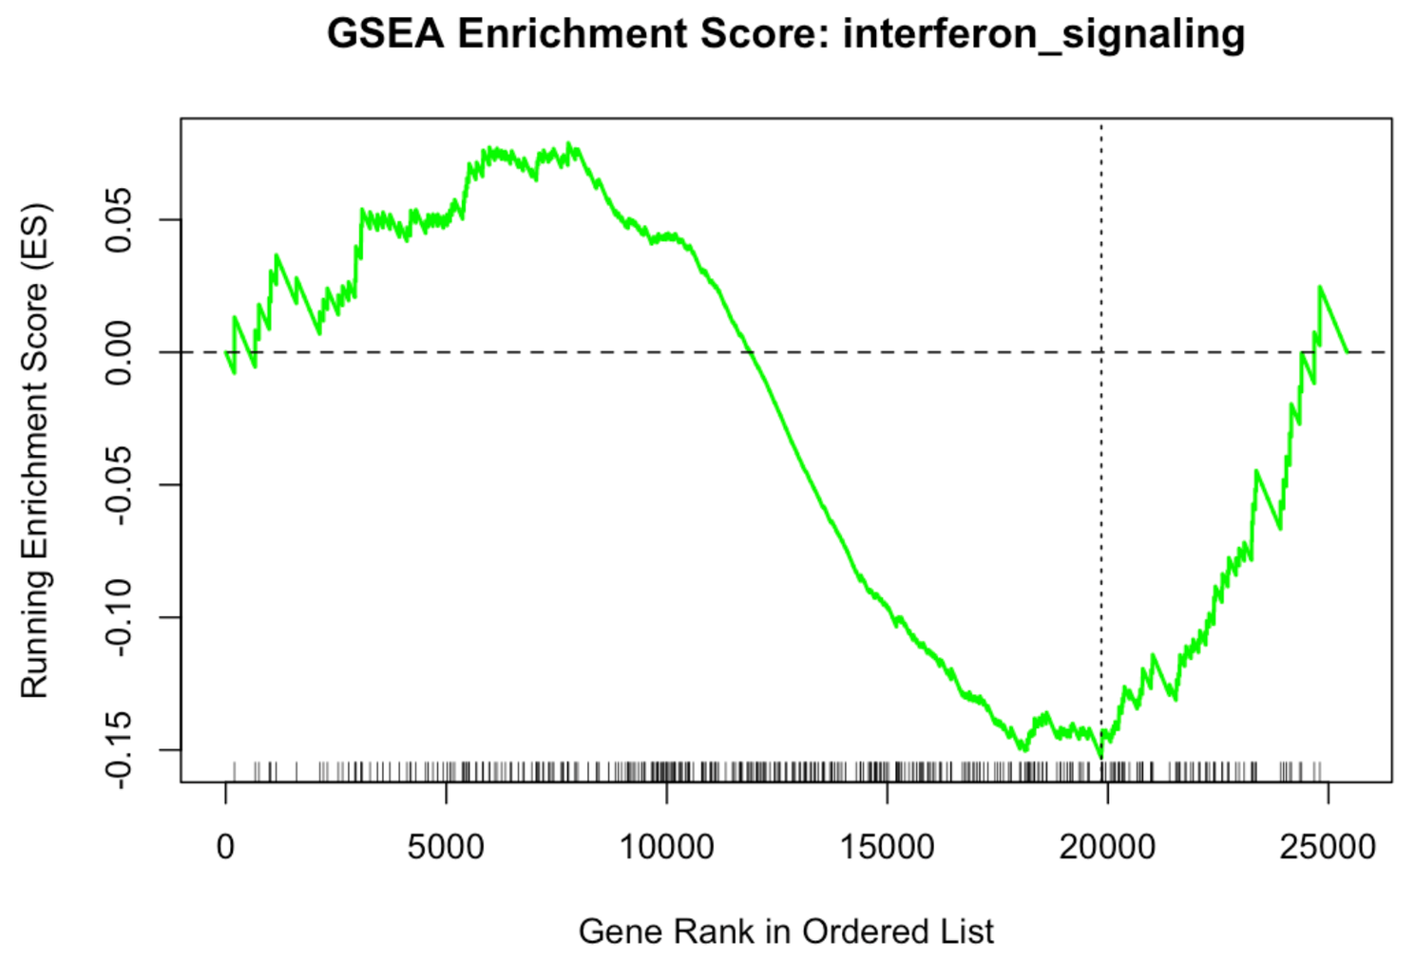
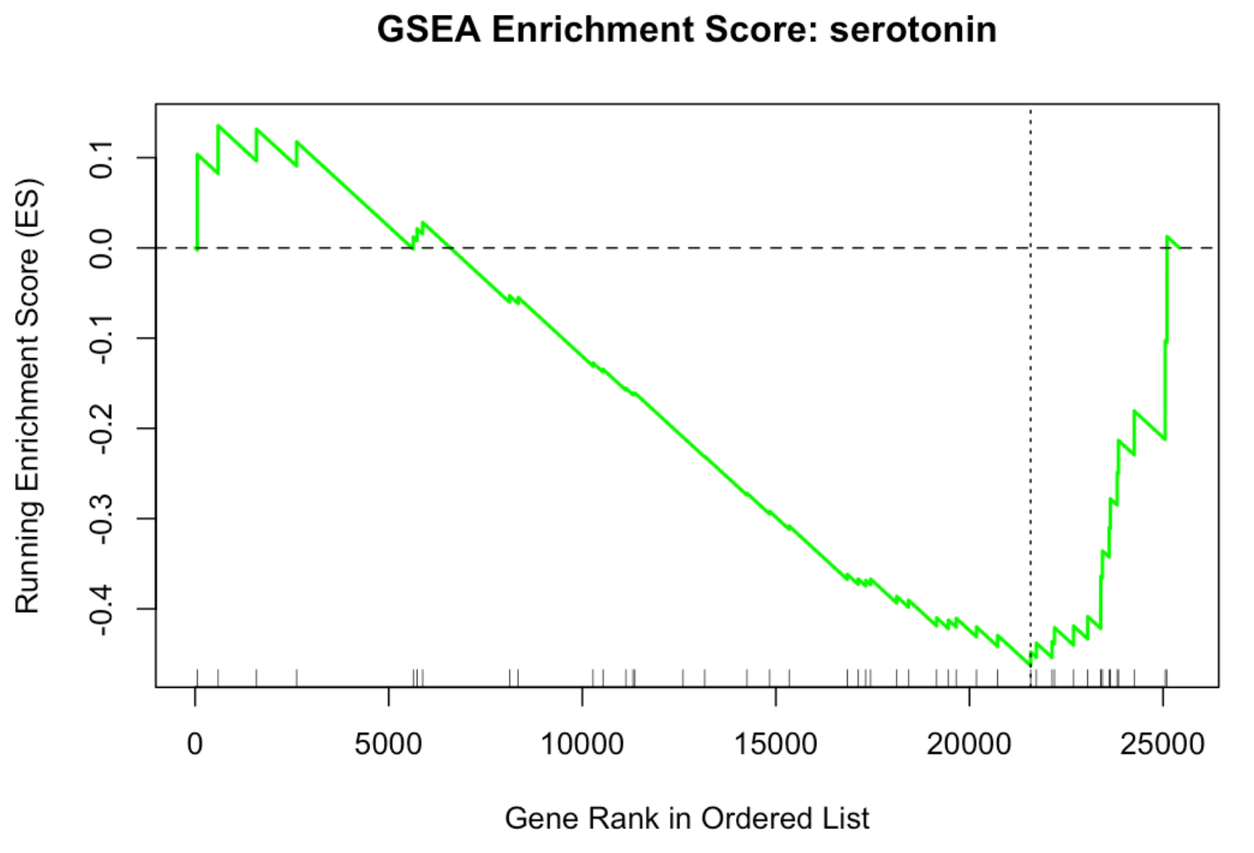
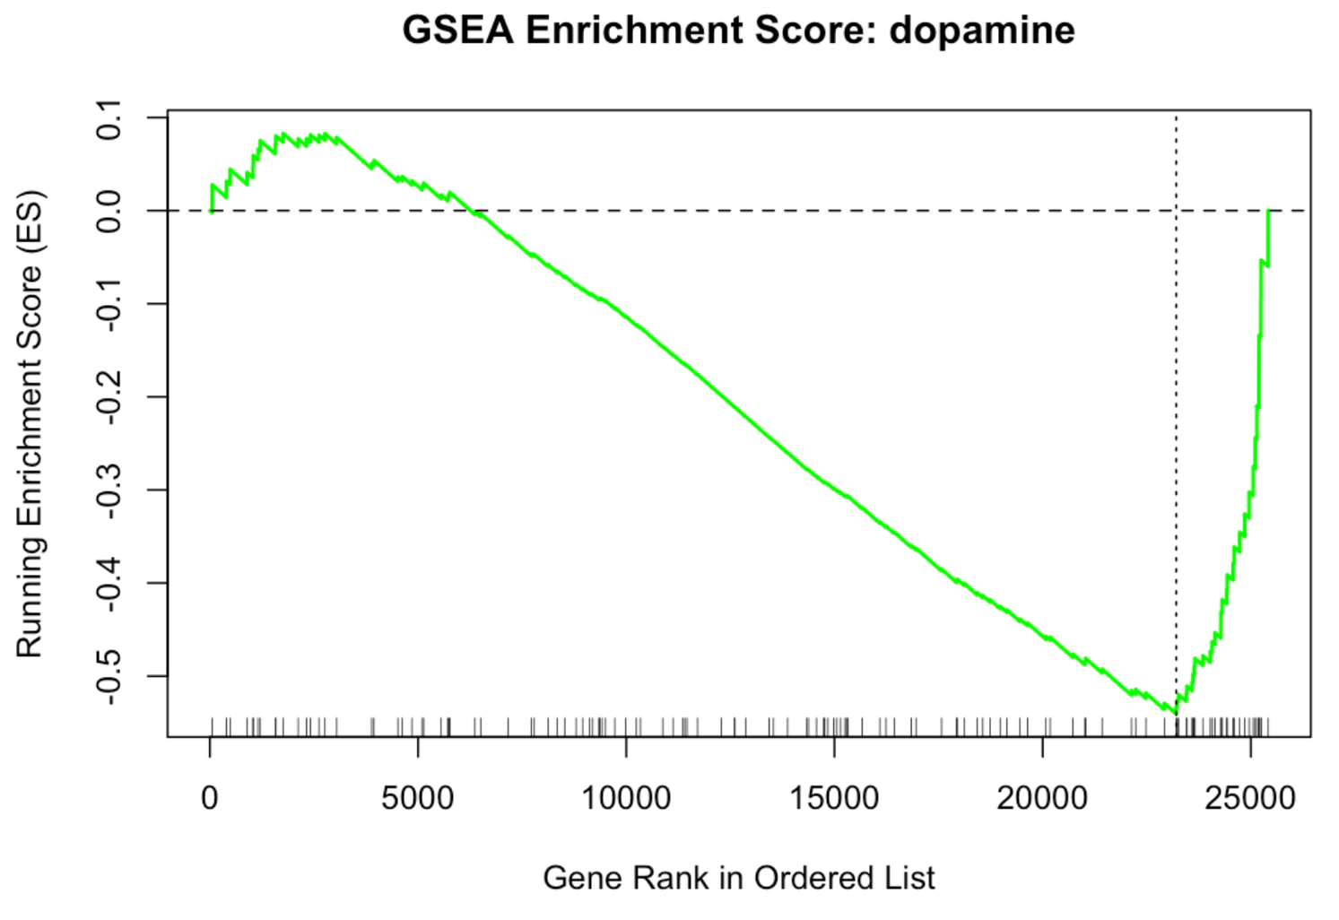
Stat 114: Spring 2026 Final Presentation
Results
Enrichment Plots
Heat Shock Proteostasis shows a large early peak while Interferon Signaling, Serotonin, and Dopamine show late valleys after initial shallow peaks which is reflected in their final enrichment scores.
Ethan Aidam, Victoria Chen, Anisha Kolambe

Slide 30
Stat 114: Spring 2026 Final Presentation
References
Akonom, T. N., Allen, M. A., Begay, T. K., Mason, A. E., Cole, S. P., Raison, C. L., & Lowry, C. A. (2026). Whole-blood transcriptomic response to whole-body hyperthermia in participants with major depressive disorder. Brain, Behavior, & Immunity - Health, 54, 101225. https://doi.org/10.1016/j.bbih.2026.101225
Cui, L., Li, S., Wang, S. et al. Major depressive disorder: hypothesis, mechanism, prevention and treatment. Sig Transduct Target Ther 9, 30 (2024). https://doi.org/10.1038/s41392-024-01738-y
Heckel-Reusser, S. (2022). Whole-body hyperthermia (Wbh): Historical aspects, current use, and future perspectives. In P. Vaupel (Ed.), Water-filtered Infrared A (wIRA) Irradiation (pp. 143–154). Springer International Publishing. https://doi.org/10.1007/978-3-030-92880-3_11
Subramanian, A., Tamayo, P., Mootha, V. K., Mukherjee, S., Ebert, B. L., Gillette, M. A., Paulovich, A., Pomeroy, S. L., Golub, T. R., Lander, E. S., & Mesirov, J. P. (2005). Gene set enrichment analysis: A knowledge-based approach for interpreting genome-wide expression profiles. Proceedings of the National Academy of Sciences, 102(43), 15545–15550. https://doi.org/10.1073/pnas.0506580102
Ethan Aidam, Victoria Chen, Anisha Kolambe

