Slide 1
Last Mile Health:
LMD 2.0 Agent
TGHI
LMD 2.0 Agent
05/02/2026
Eleanor Nkera, Wesley Ekes, Adam Mohamed, Ethan Aidam

Slide 2

01
Problem Statement
TGHI
LMD 2.0 Agent
05/02/2026
Notes:
Wesley

Slide 3

Last Mile Health is filling primary healthcare gaps in remote communities worldwide
Last Mile Health (LMH) partners with governments to build strong community health systems that equip professional community health workers to provide essential primary healthcare in the world’s most remote communities.
Currently working with rural communities in Ethiopia, Liberia, Malawi, and Sierra Leone.
https://lastmilehealth.org/what-we-do/
Notes:
Wesley

Slide 4

Supporting ~30,000
Keeping Track
Last Mile Data Portal (LMD 2.0)
community health workers who extend primary healthcare to almost 52 million people across 4 countries.
To manage the data and reporting needs, a cloud-based next generation data management platform Last Mile Data Portal (LMD 2.0) was developed to track LMH organizational and programmatic efforts over time and make data-driven decisions using key performance indicators (KPIs).
LMH is currently developing an AI Assistant to help users perform analysis in the portal.
https://lastmilehealth.org/impact/
https://main.d1plpcqrwoe4au.amplifyapp.com/docs/about-lmd2
Notes:
Wesley

Slide 5
Current Issues With LMD 2.0 Agentic System
Text-Only Responses (No Visualizations)
Latency
Initial query execution takes ~1-2 minutes due to run, disrupting user workflow and reducing system usability; creating a perception of unreliability, potentially limiting adoption
No support for generating/interpreting data visualizations (e.g. Power BI dashboards); limits usability for data-driven decision making and automated insight generation
Lacks Contextual Understanding
Lack Connection to Chatting Apps
No metadata management system to guide queries; model lacks awareness of relevant tables/views in the database; responses may be incomplete or based on incorrect data sources
Not integrated with tools like Slack, Teams, (etc.); limits accessibility and real-time usability for teams; prevents seamless workflow integration into daily operations
Notes:
Wesley

Slide 6

02
LMD 2.0 Agent Architecture
TGHI
LMD 2.0 Agent
05/02/2026
Notes:
Adam

Slide 7
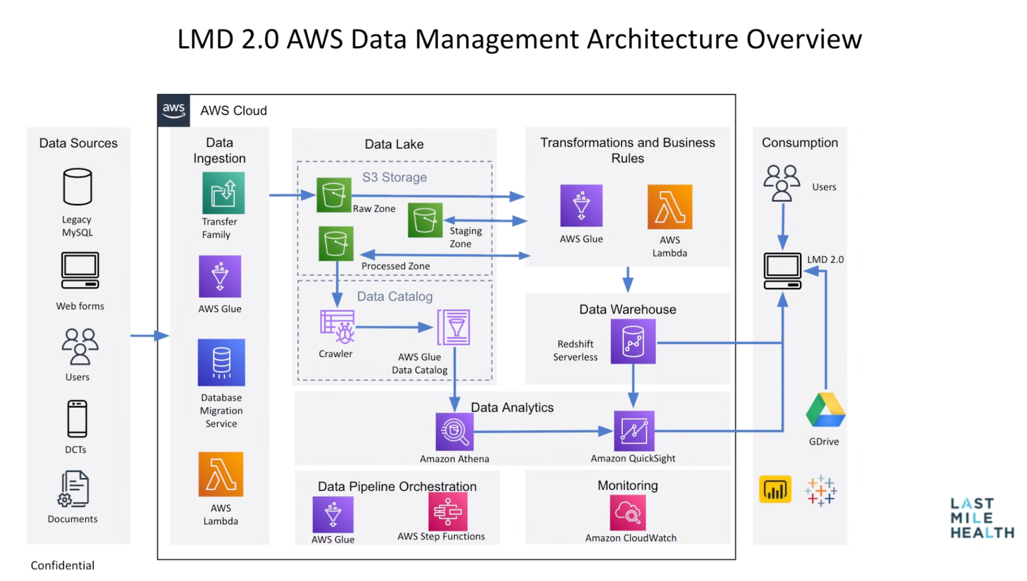
LMD 2.0 Architecture
Your Name
Your Project
DD/MM/20XX
The Last Mile Data Portal (LMD 2.0) leverages AWS architecture to ingest diverse data sources into an S3 data lake, where it is processed and cataloged using AWS Glue and Lambda. Processed data is then structured and stored in Amazon Redshift Serverless, serving as the core data warehouse for analytics and downstream applications. The AI agent accesses this structured data from the Redshift Data Warehouse to generate insights, automate analysis, and support decision-making.
Notes:
Adam

Slide 8
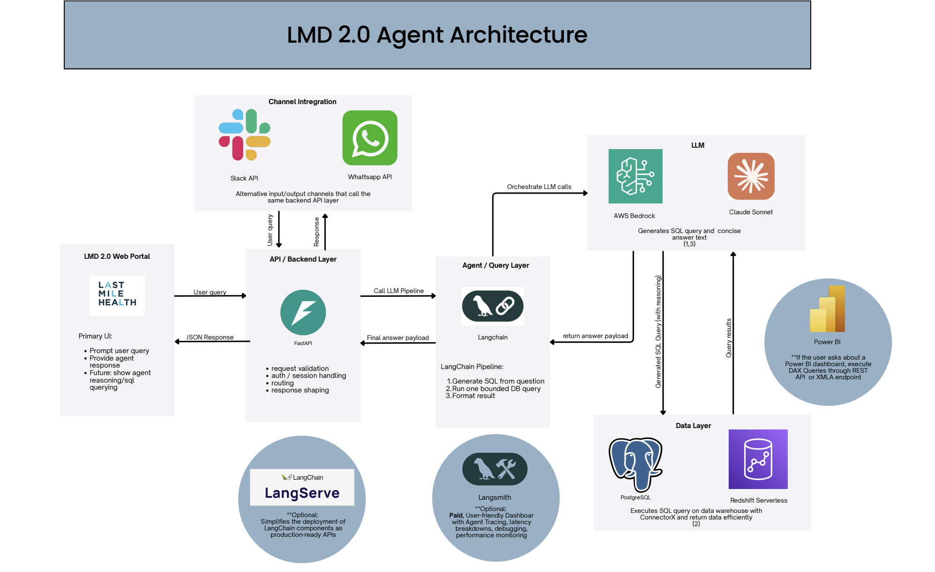
AI Agent Architecture
Let’s learn about Mercury
Mercury is the closest planet to the Sun and the smallest one in the Solar System. This planet’s name has nothing to do with the liquid metal
Let’s take a look at Venus
Venus has a beautiful name and is the second planet from the Sun. It’s hot and is the second-brightest natural object in the night sky
Notes:
Adam

Slide 9

03
Progress + Demo
TGHI
LMD 2.0 Agent
05/02/2026
Notes:
Eleanor

Slide 10
01
02
03
04
05
06
07
Week by week development
Initial AI agent demonstration and overviewed LMD architecture
Onboarding to Github + n8n + AWS Bedrock + LMD + Slack
Researched ways to improve latency and integrate new features
Implemented local fixes and compared with production latency
Debugged errors with database connection and incorrect credentials
Integrated agent into Slack channel with n8n
Reviewed progress and evaluated future development directions

Slide 11
We worked on improving latency and integrating with slack.
Reduced Latency
Slack Integration
Our agent takes <1 min compared to 1-2 min of the starting agent for query to response time.
Query examples:
How many healthcare workers completed training in Malawi?
What global scale metrics are available?
What global scale metrics are available?
We were able to create a workflow that integrates slack and our agent.
Connected through Slack API
Created graph-based workflow using n8n.io
Agent waits for user query on “lmd-agent” channel and responds with insights from the Redshift Database
Notes:
Eleanor/Adam
Slack integration
Also experimenting with using n8n for overall workflow, and for the slack integration we attempted to get it set up there.
It’s unfortunately an added cost, but gives a no code solution which can be easier

Slide 12
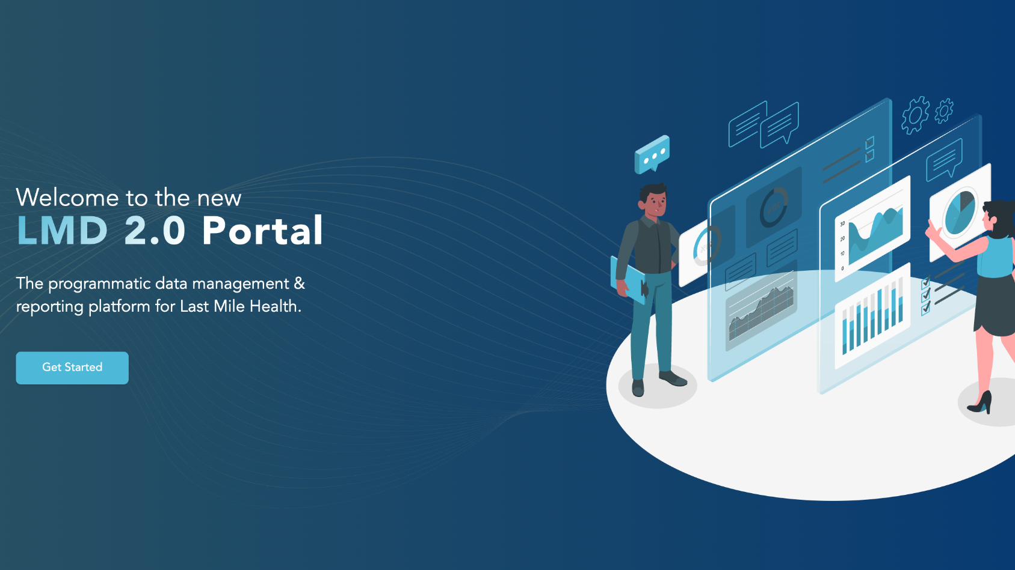
Demo of Agent: http://localhost:3000/
Notes:
Eleanor

Slide 13
04
Conclusions
TGHI
LMD 2.0 Agent
05/02/2026
Notes:
Eleanor

Slide 14
Takeaways and Obstacles
Evaluating Frameworks
Handling Credentials
Assessed and selected appropriate technologies (n8n, LangChain, PostgreSQL) to align with project goals.
Developed an understanding of securely connecting APIs and data services using authentication methods such as API keys and credentials.
Debugging
Strengthened ability to identify, diagnose, and resolve technical issues across integrated systems and workflows.
Notes:
Eleanor

Slide 15
Future Directions
Reinforcement Learning
Create Visualizations from Data
Incorporate user feedback mechanisms (e.g., thumbs up/down in the agent UI) to iteratively fine-tune model responses and improve alignment with user preferences.
Develop functionality to transform structured data into intuitive visualizations, enabling clearer insights and more effective decision-making.

Slide 16



Thank_ you_
TGHI
LMD 2.0 Agent
05/02/2026
Questions?

