Slide 1
Introduction to Linux kernel driver programming
The Linux kernel device model

Slide 2
Authors and license
Authors
  Michael Opdenacker,
  Thomas Petazzoni,
  Bootlin: kernel and embedded Linux engineering company
  https://bootlin.com
License
  Creative Commons Attribution – Share Alike 4.0
  https://creativecommons.org/licenses/by-sa/4.0/
  Document sources: https://github.com/e-ale/Slides

Slide 3
Need for a device model
For the same device, need to use the same device driver on multiple CPU architectures (x86, ARM…), even though the hardware controllers are different.
Need for a single driver to support multiple devices of the same kind.
This requires a clean organization of the code, with the device drivers separated from the controller drivers, the hardware description separated from the drivers themselves, etc.

Slide 4
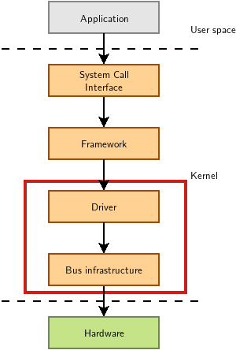
Driver: between bus infrastructure and framework
In Linux, a driver is always interfacing with:
a framework that allows the driver to expose the hardware features in a generic way.
a bus infrastructure, part of the device model, to detect/communicate with the hardware.
Let’s focus on the bus infrastructure for now

Slide 5
Device model data structures
The device model is organized around three main data structures:
The struct bus_type structure, which represent one type of
bus (USB, PCI, I2C, etc.)
The struct device_driver structure, which represents one driver capable of handling certain devices on a certain bus.
The struct device structure, which represents one device connected to a bus
The kernel uses inheritance to create more specialized versions of struct device_driver and struct device for each bus subsystem.

Slide 6

The bus driver
Example: USB. Implemented in drivers/usb/core/
Creates and registers the bus_type structure
Provides an API to register and implement adapter drivers
(here USB controllers), able to detect the connected devices and allowing to communicate with them.
Provides an API to register and implement device drivers (here USB device drivers)
Matches the device drivers against the devices detected by the adapter drivers.
Defines driver and device specific structures, here mainly struct usb_driver and struct usb_interface

Slide 7
USB bus example
A single driver for compatible devices, though connected to buses with different controllers.

Slide 8
Device drivers (1)
Need to register supported devices to the bus core.
Example: drivers/net/usb/rtl8150.c
static struct usb_device_id rtl8150_table[] = {{ USB_DEVICE(VENDOR_ID_REALTEK, PRODUCT_ID_RTL8150) },{ USB_DEVICE(VENDOR_ID_MELCO, PRODUCT_ID_LUAKTX) },{ USB_DEVICE(VENDOR_ID_MICRONET, PRODUCT_ID_SP128AR) },{ USB_DEVICE(VENDOR_ID_LONGSHINE, PRODUCT_ID_LCS8138TX) },[…]
{}
};
MODULE_DEVICE_TABLE(usb, rtl8150_table);

Slide 9
Device drivers (2)
Need to register hooks to manage devices (newly detected or removed ones), as well as to react to power management events (suspend and resume)
static struct usb_driver rtl8150_driver = {
.name = "rtl8150",
.probe = rtl8150_probe,
.disconnect = rtl8150_disconnect,
.id_table = rtl8150_table,
.suspend = rtl8150_suspend,
.resume = rtl8150_resume
};

Slide 10
Device drivers (3)
The last step is to register the driver structure to the bus core.
static int __init usb_rtl8150_init(void)
{
return usb_register(&rtl8150_driver);
}
static void __exit usb_rtl8150_exit(void)
{
usb_deregister(&rtl8150_driver);
}
module_init(usb_rtl8150_init);
module_exit(usb_rtl8150_exit);
Note: this code has now been replaced by a shorter module_usb_driver() macro.
Now the bus driver knows the association between the devices and the device driver.

Slide 11
Work in the probe() function
probe() is called for each newly matched device
Initialize the device
Prepare driver work: allocate a structure for a suitable framework, allocate memory, map I/O memory, register interrupts…
When everything is ready, register the new device to the framework.

Slide 12
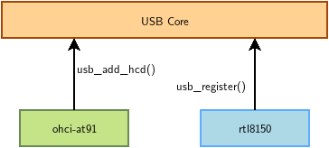
At driver loading time
The USB adapter driver that corresponds to the USB controller registers itself to the USB core
The rtl8150 USB device driver registers itself to the USB core
The USB core now knows the association between the vendor/product IDs of rtl8150 and the struct usb_driver structure of this driver

Slide 13
When a device is detected

Slide 14
The model is recursive
Adapter drivers are device drivers too!

Slide 15
Platform devices and drivers
Want to use the Device Model for devices that are not on buses that can auto-detect devices (very frequent in embedded systems)
Examples: UARTs, flash memory, LEDs, GPIOs, MMC/SD, Ethernet…
Solution:
Provide a description of devices
Manage them through a virtual bus: the platform bus.
Drive the platform devices

Slide 16
Describing non-detectable devices
Description through a Device Tree (on ARM, PowerPC, ARC…)
In arch/arm/boot/dts/ on ARM
Two parts:
  Device Tree Source (.dts)
  One per board to support in the Linux kernel
  Advantage: no need to write kernel code to support a new board
  (if all devices are supported).
  Device Tree Source Includes (.dtsi)
  Typically to describe devices on a particular SoC,
  or devices shared between similar SoCs or boards
Other method for describing non-detectable devices: ACPI
(on x86 platforms). Not covered here.

Slide 17
Declaring a device: .dtsi example
Label
Node name
...
i2c0: i2c@44e0b000 {
compatible = "ti,omap4-i2c";
#address-cells = <1>;
#size-cells = <0>;
ti,hwmods = "i2c1";
reg = <0x44e0b000 0x1000>;
interrupts = <70>;
status = "disabled";
};
...
Compatible drivers
Node
properties
HW register start
address and range
Present but not
used by default
From arch/arm/boot/dts/am33xx.dtsi

Slide 18
Instantiating a device: .dts example
&i2c0 {
pinctrl-names = "default";
pinctrl-0 = <&i2c0_pins>;
status = "okay";
clock-frequency = <400000>;
tps: tps@24 {
reg = <0x24>;
};
baseboard_eeprom: baseboard_eeprom@50 {
compatible = "at,24c256";
reg = <0x50>;
#address-cells = <1>;
#size-cells = <1>;
baseboard_data: baseboard_data@0 {
reg = <0 0x100>;
};
};
};
Pin muxing configuration
(routing to external package pins)
Phandle
(reference
to label)
Enabling this device, otherwise ignored
Node property: frequency
List of devices on
i2c0
I2C bus identifier
From arch/arm/boot/dts/am335x-boneblue.dts

Slide 19
Pin multiplexing
Modern SoCs have too many hardware blocks compared to physical pins exposed on the chip package.
Therefore, pins have to be multiplexed
Pin configurations are defined in the Device Tree
Correct pin multiplexing is mandatory
to make a device work from an electronic point of view.

Slide 20
DT pin definitions
&am33xx_pinmux {
...
i2c0_pins: pinmux_i2c0_pins {
pinctrl-single,pins = <
AM33XX_IOPAD(0x988, PIN_INPUT_PULLUP | MUX_MODE0) /* (C17) I2C0_SDA.I2C0_SDA */
AM33XX_IOPAD(0x98c, PIN_INPUT_PULLUP | MUX_MODE0) /* (C16) I2C0_SCL.I2C0_SCL */
>;
};
…
};
...
&i2c0 {
pinctrl-names = "default";
pinctrl-0 = <&i2c0_pins>;
status = "okay";
clock-frequency = <400000>;
...
};
Register offset corresponding
to a given package pin
Allows to select
a given SoC signal
Package pin
name
SoC signal
name
Configures the pin:
input, output, drive
strengh, pull up/down...
From arch/arm/boot/dts/am335x-boneblue.dts

Slide 21
DT: matching devices and drivers
Platform drivers are matched with platform devices that have the same compatible property.
static const struct of_device_id omap_i2c_of_match[] = {
{
.compatible = "ti,omap4-i2c",
.data = &omap4_pdata,
},
{
…
};
…
static struct platform_driver omap_i2c_driver = {
.probe = omap_i2c_probe,
.remove = omap_i2c_remove,
.driver = {
.name = "omap_i2c",
.pm = OMAP_I2C_PM_OPS,
.of_match_table = of_match_ptr(omap_i2c_of_match),
},
};
From drivers/i2c/busses/i2c-omap.c

Slide 22
Usage of the platform bus
Like for physical buses, the platform bus is used by the driver to retrieve information about each device
static int omap_i2c_probe(struct platform_device *pdev)
{
...
struct device_node *node = pdev→dev.of_node;
struct omap_i2c_dev *omap;
...
irq = platform_get_irq(pdev, 0);
…
omap = devm_kzalloc(&pdev->dev, sizeof(struct omap_i2c_dev), GFP_KERNEL);
...
mem = platform_get_resource(pdev, IORESOURCE_MEM, 0);
omap->base = devm_ioremap_resource(&pdev->dev, mem);
u32 freq = 100000; /* default to 100000 Hz */
…
of_property_read_u32(node, "clock-frequency", &freq);
…
return 0;
}
From drivers/i2c/busses/i2c-omap.c

Slide 23
Device tree bindings
Device tree bindings provide a specification of properties that a driver expects in a DT
Bindings are available in Documentation/devicetree/bindings in kernel sources.
To know how to set device properties, look for a binding for the same compatible string:
$ git grep “ti,omap4-i2c” Documentation/devicetree/bindings/

Slide 24
Another bus example: I2C

Slide 25
I2C drivers: probe() function
static int mma7660_probe(struct i2c_client *client,
const struct i2c_device_id *id)
{
int ret;
struct iio_dev *indio_dev;
struct mma7660_data *data;
indio_dev = devm_iio_device_alloc(&client->dev, sizeof(*data));
if (!indio_dev) {
dev_err(&client->dev, "iio allocation failed!\n");
return -ENOMEM;
}
data = iio_priv(indio_dev);
data->client = client;
i2c_set_clientdata(client, indio_dev);
mutex_init(&data->lock);
data->mode = MMA7660_MODE_STANDBY;
indio_dev->dev.parent = &client->dev;
indio_dev->info = &mma7660_info;
indio_dev->name = MMA7660_DRIVER_NAME;
indio_dev->modes = INDIO_DIRECT_MODE;
indio_dev->channels = mma7660_channels;
indio_dev->num_channels = ARRAY_SIZE(mma7660_channels);
ret = mma7660_set_mode(data, MMA7660_MODE_ACTIVE);
if (ret < 0)
return ret;
ret = iio_device_register(indio_dev);
if (ret < 0) {
dev_err(&client->dev, "device_register failed\n");
mma7660_set_mode(data, MMA7660_MODE_STANDBY);
}
return ret;
}
device structure for the i2c bus
needed to communicate with the device
Framework (here iio) structure for each device
Per device structure. Used by the driver
to store references to bus and framework structures, plus its own data (locks, wait queues, etc.)
Allocation of the framework structure. This structure also contains the per device structure (data)
Reference to the bus structure stored in the framework structure.
Reference to the framework structure stored in the bus structure.
Enabling the device (i2c reading and writing)
Register a new framework device when everything is ready (device now accessible in user-space)
Disabling the device in case of failure
From drivers/iio/accel/mma7660.c

Slide 26
I2C drivers: remove() function
sstatic int mma7660_remove(struct i2c_client *client)
{
struct iio_dev *indio_dev = i2c_get_clientdata(client);
iio_device_unregister(indio_dev);
return mma7660_set_mode(iio_priv(indio_dev), MMA7660_MODE_STANDBY);
}
Same i2c device structure as in probe()
Get back the framework structure.
Needed to unregister the framework
device from the system
Unregister the framework
device from the system
Now that user-space can’t access the device any more, disable the device.
From drivers/iio/accel/mma7660.c

Slide 27
I2C driver registration
static const struct i2c_device_id mma7660_i2c_id[] = {
{"mma7660", 0},
{}
};
MODULE_DEVICE_TABLE(i2c, mma7660_i2c_id);
static const struct of_device_id mma7660_of_match[] = {
{ .compatible = "fsl,mma7660" },
{ }
};
MODULE_DEVICE_TABLE(of, mma7660_of_match);
static const struct acpi_device_id mma7660_acpi_id[] = {
{"MMA7660", 0},
{}
};
MODULE_DEVICE_TABLE(acpi, mma7660_acpi_id);
static struct i2c_driver mma7660_driver = {
.driver = {
.name = "mma7660",
.pm = MMA7660_PM_OPS,
.of_match_table = mma7660_of_match,
.acpi_match_table = ACPI_PTR(mma7660_acpi_id),
},
.probe = mma7660_probe,
.remove = mma7660_remove,
.id_table = mma7660_i2c_id,
};
module_i2c_driver(mma7660_driver);
Matching by name (mandatory for I2C)
Matching by compatible property (for DT)
Matching by ACPI ID (for ACPI systems - x86)
From drivers/iio/accel/mma7660.c

Slide 28
Driver development advise
Look for code for devices similar to yours
Read the code.
You can use Elixir (https://elixir.bootlin.com/)
Always read code from the bottom up. You see the big picture first, and then progressively how the details are implemented.

Slide 29
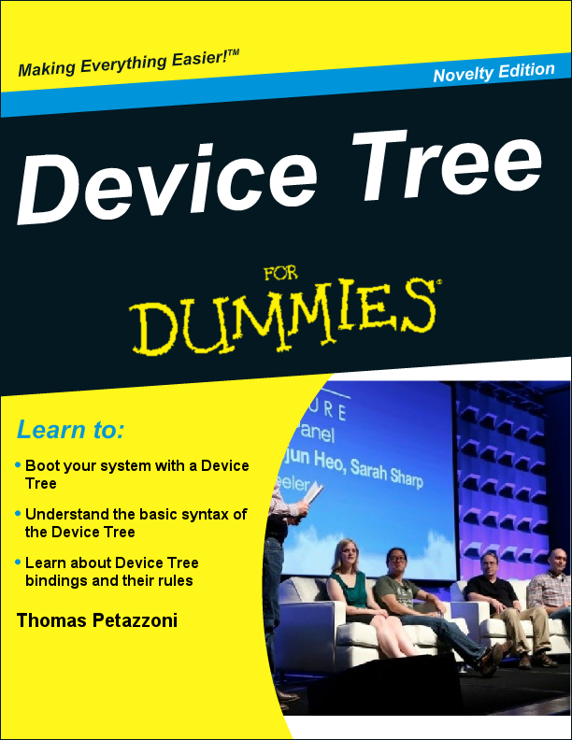
Further reading
Bootlin’s kernel and driver development training materials for full details
https://bootlin.com/training/kernel/
Device Tree for Dummies presentation
Thomas Petazzoni (Apr. 2014)
http://j.mp/1jQU6NR

