Slide 1



Building an SPI Device Driver

Slide 2


Authors and license
Authors
  Michael Welling
  QWERTY Embedded Design, LLC
  www.qwertyembedded.com
License
  Creative Commons Attribution – Share Alike 4.0
  https://creativecommons.org/licenses/by-sa/4.0/

Slide 3
What is SPI?
SPI (Serial Peripheral Interface) is a full duplex synchronous serial master/slave bus interface.
De facto standard first developed at Motorola in the 1980s.
A SPI bus consists of a single master device and possibly multiple slave devices.
Typical device interface
  SCK – serial clock
  MISO – master in slave out
  MOSI – master out slave in
  CSn / SSn – chip select / slave select
  IRQ / IRQn – interrupt

Slide 4
What is SPI?
SPI Master
SPI Slave
SCK
SCK
MOSI
MOSI
MISO
MISO
CSn0
CSn
CSn1
CSn
CSn2
CSn

Slide 5
Example SPI devices
Analog converters (ADC, DAC, CDC)
Sensors (inertial, temperature, pressure)
Serial LCD
Serial Flash
Touchscreen controllers
FPGA programming/interface

Slide 6
SPI Modes
SPI Mode is typically represented by (CPOL, CPHA) tuple
  CPOL – clock polarity
    0 = clock idles low
    1 = clock idles high
  CPHA – clock phase
    0 = data latched on falling clock edge, output on rising
    1 = data latched on rising clock edge, output on falling
Mode (0, 0) and (1, 1) are most commonly used.
Sometimes listed in encoded form 0-3.

Slide 7
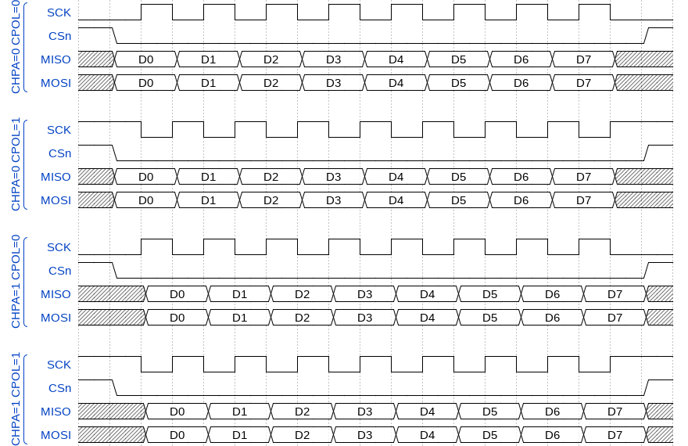
SPI Modes

Slide 8
Linux SPI Subsystem
First developed in early 2000s (2.6 ERA) based on the work of several key developers in including:
David Brownell
Russell King
Dmitry Pervushin
Stephen Street
Mark Underwood
Andrew Victor
Vitaly Wool

Slide 9
Linux SPI Subsystem
Past maintainers of the Linux SPI subsystem:
David Brownell
Grant Likely
Current maintainer:
Mark Brown

Slide 10
Linux SPI Mailinglist
List: linux-spi; ( subscribe / unsubscribe )
Info:
This is the mailing list for the Linux SPI subsystem.
Archives:
http://marc.info/?l=linux-spi
Footer:
---
To unsubscribe from this list: send the line "unsubscribe linux-spi" in
the body of a message to majordomo@vger.kernel.org
More majordomo info at http://vger.kernel.org/majordomo-info.html

Slide 11
Controller Drivers
Controller drivers are used to abstract and drive transactions on an SPI master.
The host SPI peripheral registers are accessed by callbacks provided to the SPI core driver. (drivers/spi/spi.c)
struct spi_controller

Slide 12
Controller Drivers
Allocate a controller
  spi_alloc_master()
Set controller fields and methods
  mode_bits - flags e.g. SPI_CPOL, SPI_CPHA, SPI_NO_CS,
SPI_CS_HIGH, SPI_RX_QUAD, SPI_LOOP
  .setup() - configure SPI parameters
  .cleanup() - prepare for driver removal
  .transfer_one_message()/.transfer_one() - dispatch one msg/transfer (mutually exclusive)
Register a controller
  spi_register_master()

Slide 13
Protocol Drivers
For each SPI slave you intend on accessing, you have a protocol driver. SPI protocol drivers can be found in many other Linux driver subsystems (iio, input, mtd).
Messages and transfers are used to communicate to slave devices via the SPI core and are directed to the respective controller driver transparently.
A struct spi_device is passed to the probe and remove functions to pass information about the host.

Slide 14
Protocol Drivers
Transfers
  A single operation between master and slave
  RX and TX buffers pointers are supplied
  Option chip select behavior and delays
Messages
  Atomic sequence of transfers
  Argument to SPI subsystem read/write APIs

Slide 15
struct spi_device
struct spi_device {
struct device dev;
struct spi_controller * controller;
struct spi_controller * master;
u32 max_speed_hz;
u8 chip_select;
u8 bits_per_word;
u16 mode;
int irq;
void * controller_state;
void * controller_data;
char modalias;
int cs_gpio;
struct spi_statistics statistics;
};
Controller side proxy for an SPI slave device. Passed to the probe and remove functions with values based on the host configuration.

Slide 16
struct spi_device
#define SPI_CPHA 0x01 /* clock phase */
#define SPI_CPOL 0x02 /* clock polarity */
#define SPI_MODE_0 (0|0) /* (original MicroWire) */
#define SPI_MODE_1 (0|SPI_CPHA)
#define SPI_MODE_2 (SPI_CPOL|0)
#define SPI_MODE_3 (SPI_CPOL|SPI_CPHA)
#define SPI_CS_HIGH 0x04 /* chipselect active high? */
#define SPI_LSB_FIRST 0x08 /* per-word bits-on-wire */
#define SPI_3WIRE 0x10 /* SI/SO signals shared */
#define SPI_LOOP 0x20 /* loopback mode */
#define SPI_NO_CS 0x40 /* 1 dev/bus, no chipselect */
#define SPI_READY 0x80 /* slave pulls low to pause */
#define SPI_TX_DUAL 0x100 /* transmit with 2 wires */
#define SPI_TX_QUAD 0x200 /* transmit with 4 wires */
#define SPI_RX_DUAL 0x400 /* receive with 2 wires */
#define SPI_RX_QUAD 0x800 /* receive with 4 wires */

Slide 17
struct spi_driver
struct spi_driver {
const struct spi_device_id * id_table;
int (* probe) (struct spi_device *spi);
int (* remove) (struct spi_device *spi);
void (* shutdown) (struct spi_device *spi);
struct device_driver driver;
};

Slide 18
struct spi_driver
Example:
static struct spi_driver myspi_driver = {
.driver = {
.name = "myspi_spi",
.pm = &myspi_pm_ops,
.of_match_table = of_match_ptr(myspi_spi_of_match),
},
.probe = myspi_spi_probe,
.id_table = myspi_spi_id_table,
};
module_spi_driver(myspi_driver);

Slide 19
Controller Devicetree Binding
The SPI controller node requires the following properties:
- compatible - Name of SPI bus controller following generic names recommended practice.
In master mode, the SPI controller node requires the following additional properties:
- #address-cells - number of cells required to define a chip select address on the SPI bus.
- #size-cells - should be zero.
Optional properties (master mode only):
- cs-gpios - gpios chip select.
- num-cs - total number of chipselects.
So if for example the controller has 2 CS lines, and the cs-gpios
property looks like this:
cs-gpios = <&gpio1 0 0>, <0>, <&gpio1 1 0>, <&gpio1 2 0>;

Slide 20
Controller Devicetree Binding
Example:
spi1: spi@481a0000 {
compatible = "ti,omap4-mcspi";
#address-cells = <1>;
#size-cells = <0>;
reg = <0x481a0000 0x400>;
interrupts = <125>;
ti,spi-num-cs = <2>;
ti,hwmods = "spi1";
dmas = <&edma 42 0
&edma 43 0
&edma 44 0
&edma 45 0>;
dma-names = "tx0", "rx0", "tx1", "rx1";
status = "disabled";
};

Slide 21
Slave Node Devicetree Binding
SPI slave nodes must be children of the SPI controller node.
In master mode, one or more slave nodes (up to the number of chip selects) can
be present.
Required properties are:
- compatible - Name of SPI device following generic names recommended practice.
- reg - Chip select address of device.
- spi-max-frequency - Maximum SPI clocking speed of device in Hz.

Slide 22
Slave Node Devicetree Binding
All slave nodes can contain the following optional properties:
- spi-cpol - Empty property indicating device requires inverse clock polarity (CPOL) mode.
- spi-cpha - Empty property indicating device requires shifted clock phase (CPHA) mode.
- spi-cs-high - Empty property indicating device requires chip select active high.
- spi-3wire - Empty property indicating device requires 3-wire mode.
- spi-lsb-first - Empty property indicating device requires LSB first mode.
- spi-tx-bus-width - The bus width that is used for MOSI. Defaults to 1 if not present.
- spi-rx-bus-width - The bus width that is used for MISO. Defaults to 1 if not present.
- spi-rx-delay-us - Microsecond delay after a read transfer.
- spi-tx-delay-us - Microsecond delay after a write transfer.

Slide 23
Slave Node Devicetree Binding
Example:
&spi1 {
#address-cells = <1>;
#size-cells = <0>;
status = "okay";
pinctrl-names = "default";
pinctrl-0 = <&spi1_pins>;
myspi@0 {
compatible = "mycompany,myspi";
spi-max-frequency = <2000000>;
spi-cpha;
...
reg = <0>;
};
...
};

Slide 24
Platform Registration
struct spi_board_info {
char modalias;
const void * platform_data;
const struct property_entry * properties;
void * controller_data;
int irq;
u32 max_speed_hz;
u16 bus_num;
u16 chip_select;
u16 mode;
};

Slide 25
Platform Registration
Example:
static struct spi_board_info spi_board_info[] = {
{
.modalias = "myspi",
.platform_data = &myspi_info,
.irq = MYIRQ,
.max_speed_hz = 2000000,
.chip_select = 2,
…..
},
};

Slide 26
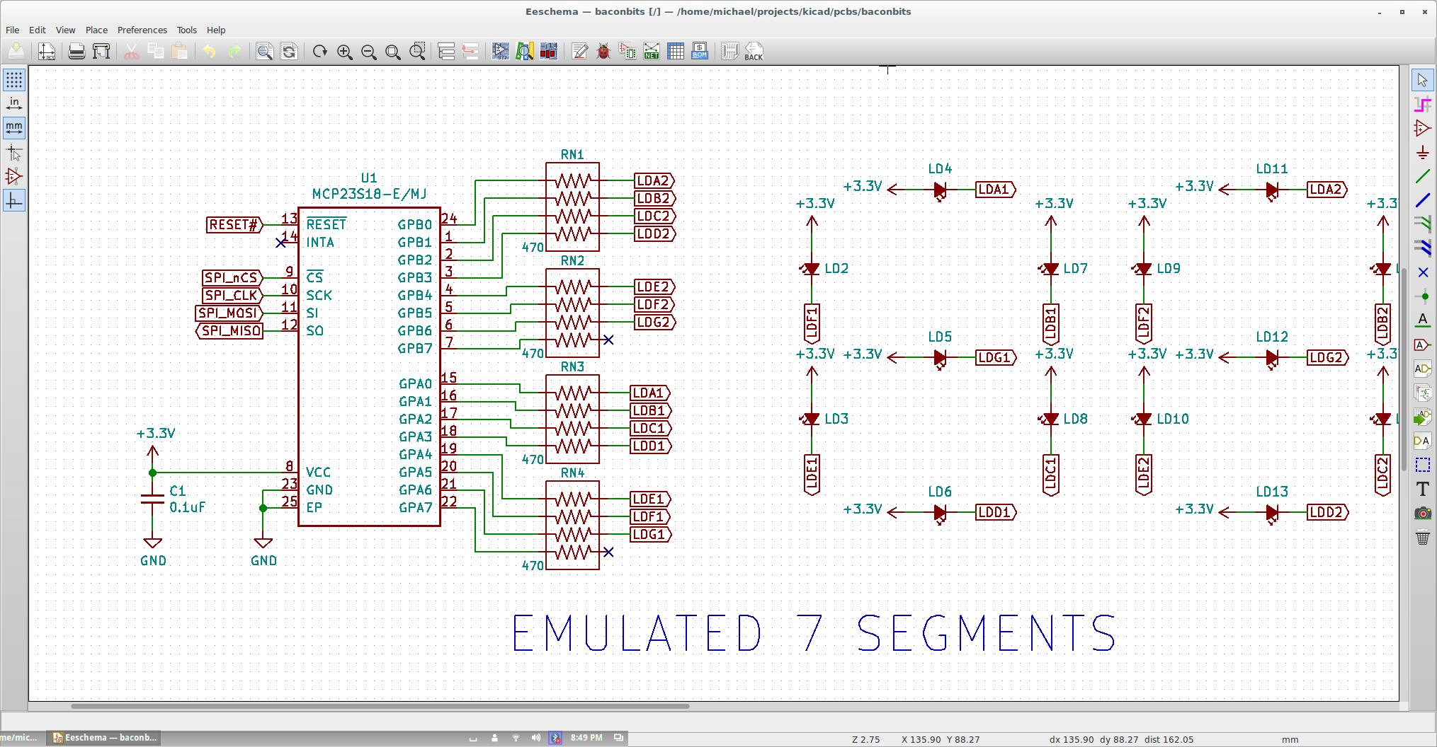
Baconbits SPI Hardware

Slide 27
Questions?

Slide 28
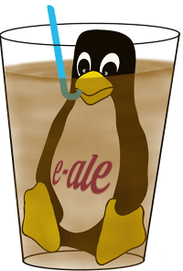
Thank you!

