Slide 1



E-ALE ELC 2018
Learn Bitbake with Yocto Project
Tom King
Behan Webster
The Linux Foundation
Mar 15, 2018
(CC BY-SA 4.0)

Slide 2
The URL for this presentation
https://goo.gl/RcmEqL

Slide 3
Yocto/Openembedded Terms
Yocto Project is a large collaboration project
OpenEmbedded is providing most metadata
Bitbake is the build tool
Poky is the Yocto Project's reference distribution
Poky contains a version of bitbake and oe-core from which you can start your project

Slide 4
Yocto Project Overview
Collection of tools and methods enabling
  Rapid evaluation of embedded Linux on many popular off-the-shelf boards
  Easy customization of distribution characteristics
Supports x86, ARM, MIPS, Power
Based on technology from the OpenEmbedded Project
Layer architecture allows for
easy re-use of code
other layers
meta-yocto-bsp
meta-poky
meta (oe-core)

Slide 5
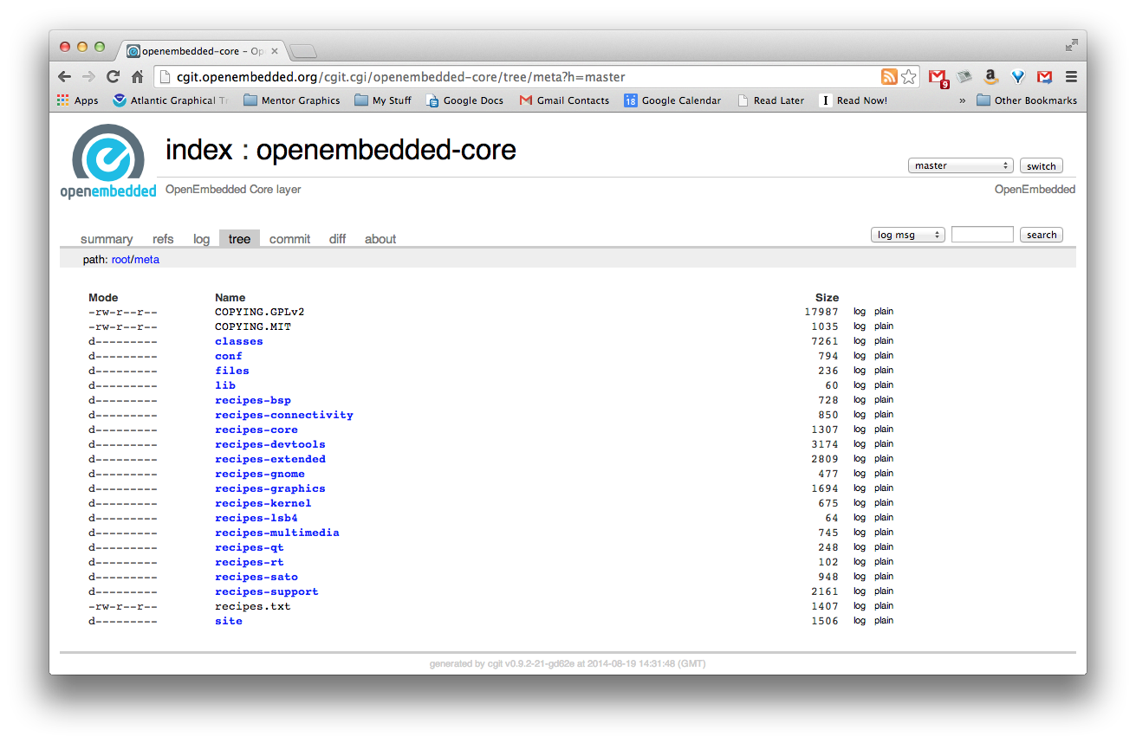
Yocto is based on OpenEmbedded-core
Metadata describing approximately 1000 "core" recipes used for building boot images. Includes support for graphics, Qt, networking, kernel recipes, tools, much more.

Slide 6
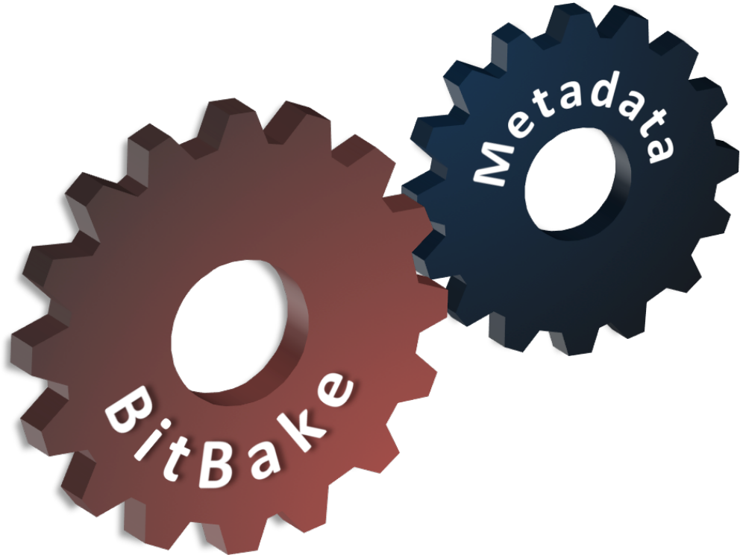
What is Bitbake?
Bitbake
  Powerful and flexible build engine (Python)
  Reads metadata
  Determines dependencies
  Schedules tasks
Metadata – a structured collection of "recipes" which tell BitBake what to build, organized in layers
Notes:
Concepts
© 2014 Mentor Graphics Corporation
Mentor Embedded Linux Training

Slide 7
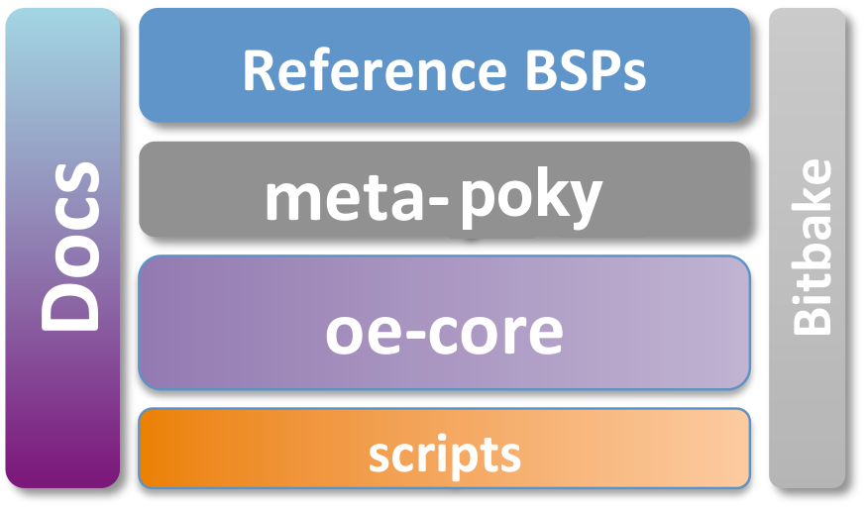
Poky Reference Distro
Contains core components
  Bitbake tool: A python-based build engine
  Build scripts (infrastructure)
  Foundation package recipes (oe-core)
  meta-poky (Contains distribution policy)
  Reference BSPs
  Yocto Project documentation

Slide 8
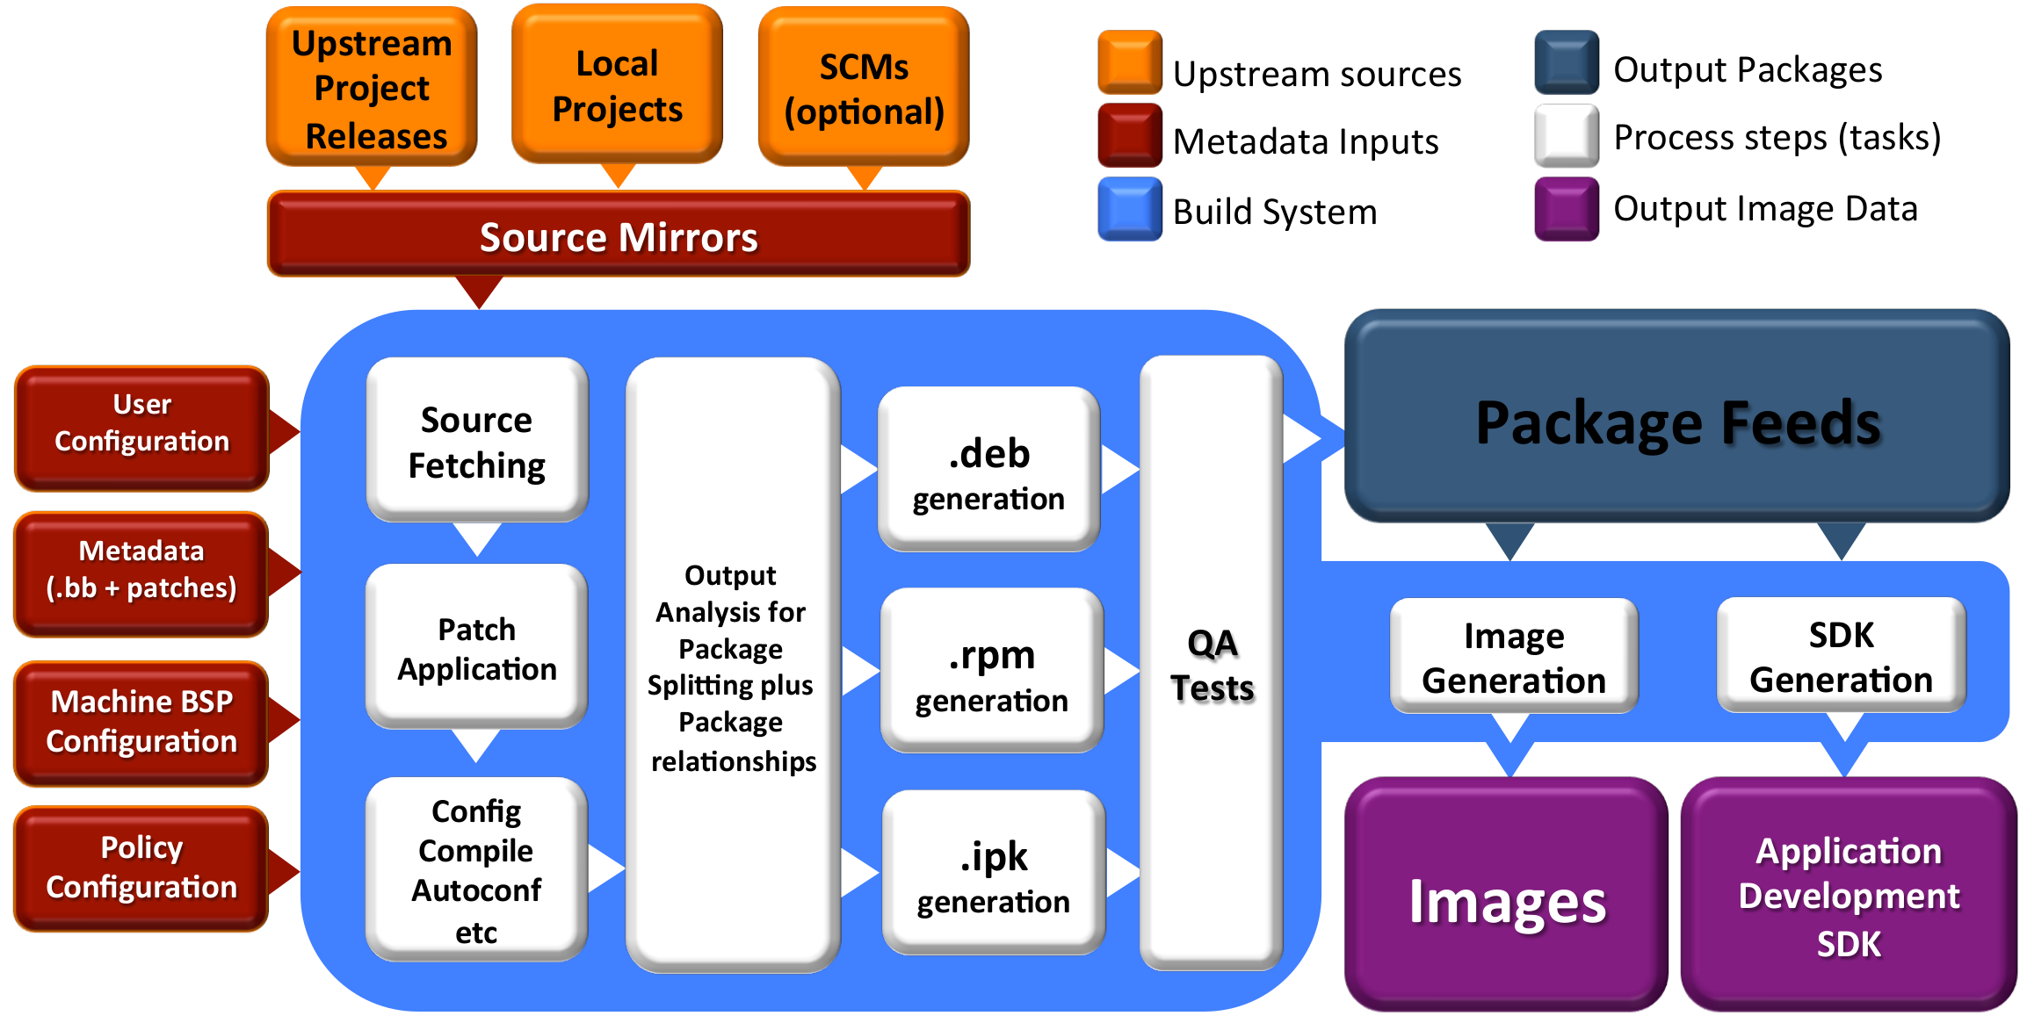
Build System Workflow

Slide 9
BITBAKE
This section will introduce the concept of the bitbake build tool and how it can be used to build recipes

Slide 10
Metadata and bitbake
Most common form of metadata: The Recipe(*.bb files)
A Recipe provides a “list of ingredients” and “cooking instructions”
Defines settings and a set of tasks used by bitbake to build binary packages
busybox
Metadata
glibc
BitBake
sysvinit
coreutils
libgtk
Notes:
Concepts
© 2014 Mentor Graphics Corporation
Mentor Embedded Linux Training

Slide 11
What is Metadata?
Metadata exists in four general categories:
Recipes (*.bb)
  Usually describe build instructions for a single package
PackageGroups (special *.bb)
  Often used to group packages together for a FS image
Classes (*.bbclass)
  Inheritance mechanism for common functionality
Configuration (*.conf)
  Drives the overall behavior of the build process
Notes:
Concepts
© 2014 Mentor Graphics Corporation
Mentor Embedded Linux Training

Slide 12
Other Metadata
Append files (*.bbappend)
  Define additional metadata for a similarly named .bb file
  Can add or override previously set values
Include files (*.inc)
  Files which are used with the include directive
  Include files are typical found via the BBPATH variable
Notes:
Concepts
© 2014 Mentor Graphics Corporation
Mentor Embedded Linux Training

Slide 13
OE-CORE Breakdown
*.bb: 828
*.bbappend: 69
packagegroup*: 24
*.bbclass: 188
*.conf: 98
*.inc: 275

Slide 14
Introduction to Bitbake
Bitbake is a task executor and scheduler
By default the build task for the specified recipe is executed
$ bitbake myrecipe
You can indicate which task you want run
$ bitbake -c clean myrecipe
$ bitbake -c cleanall myrecipe
You can get a list of tasks with
$ bitbake -c listtasks myrecipe
Notes:
Concepts
© 2014 Mentor Graphics Corporation
Mentor Embedded Linux Training

Slide 15
Bitbake is a Task Scheduler
Bitbake builds recipes by scheduling build tasks in parallel
$ bitbake recipe
This looks for recipe_*.bb in BBFILES
Each recipe defines build tasks, each which can depend on other tasks
Recipes can also depend on other recipes, meaning more than one recipe may be built
Tasks from more than one recipe are often executed in parallel at once on multi-cpu build machines

Slide 16
Building Recipes
By default the highest version of a recipe is built (can be overridden with DEFAULT_PREFERENCE or PREFERRED_VERSION metadata)
$ bitbake myrecipe
You can specify the version of the package you want built (version of upstream source)
$ bitbake myrecipe-1.0
You can also build a particular revision of the package metadata
$ bitbake myrecipe-1.0-r0
Or you can provide a recipe file to build
$ bitbake -b mydir/myrecip.bb
Notes:
Concepts
© 2014 Mentor Graphics Corporation
Mentor Embedded Linux Training

Slide 17
Building Images
When you do a really big build, running with --continue (-k) means bitbake will proceed as far as possible after finding an error
$ bitbake -k core-image-minimal
  When running a long build (e.g. overnight) you want as much of the build done as possible before debugging issues
Running bitbake normally will stop on the first error found
$ bitbake core-image-minimal
We'll look at debugging recipe issue later...
Notes:
Concepts
© 2014 Mentor Graphics Corporation
Mentor Embedded Linux Training

Slide 18
Running Bitbake: Default Tasks*
do_fetch
Locate and download source code
do_unpack
Unpack source into working directory
do_patch
Apply any patches
do_configure
Perform any necessary pre-build configuration
do_compile
Compile the source code
Installation of resulting build artifacts in WORKDIR
do_install
do_populate_sysroot
Copy artifacts to sysroot
do_package_*
Create binary package(s)
Note: to see the list of all possible tasks for a recipe, do this:
$ bitbake -c listtasks <recipe_name>
*Simplified for illustration
Notes:
Fetch: where and how to download source code
Packages: each recipe by default produce 4 packages: binary package, doc package, dev package (.h, .so, .a), debug package (binary contain symbolic for debugging)
Setscene:
Concepts
© 2014 Mentor Graphics Corporation
Mentor Embedded Linux Training

Slide 19
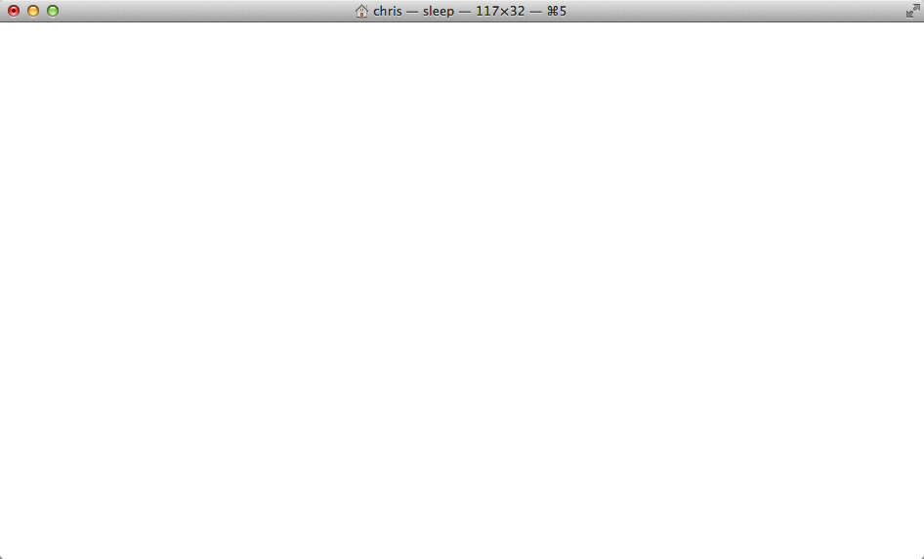
Running Bitbake: Task Log
$ bitbake hello
NOTE: Running task 337 of 379 (ID: 4, hello_1.0.0.bb, do_fetch)
NOTE: Running task 368 of 379 (ID: 0, hello_1.0.0.bb, do_unpack)
NOTE: Running task 369 of 379 (ID: 1, hello_1.0.0.bb, do_patch)
NOTE: Running task 370 of 379 (ID: 5, hello_1.0.0.bb, do_configure)
NOTE: Running task 371 of 379 (ID: 7, hello_1.0.0.bb, do_populate_lic)
NOTE: Running task 372 of 379 (ID: 6, hello_1.0.0.bb, do_compile)
NOTE: Running task 373 of 379 (ID: 2, hello_1.0.0.bb, do_install)
NOTE: Running task 374 of 379 (ID: 11, hello_1.0.0.bb, do_package)
NOTE: Running task 375 of 379 (ID: 3, hello_1.0.0.bb, do_populate_sysroot)
NOTE: Running task 376 of 379 (ID: 8, hello_1.0.0.bb, do_packagedata)
NOTE: Running task 377 of 379 (ID: 12, hello_1.0.0.bb, do_package_write_ipk)
NOTE: Running task 378 of 379 (ID: 9, hello_1.0.0.bb, do_package_qa)
*Output has been formatted to fit this slide.
*Simplified for illustration
Notes:
Fetch: where and how to download source code
Packages: each recipe by default produce 4 packages: binary package, doc package, dev package (.h, .so, .a), debug package (binary contain symbolic for debugging)
package_qa: collections of "sanity" checks including cross-compile badness such as cross-binaries linked to host libs, valid paths in .pc/.la files, other common errors, etc. See insane.bbclass
Concepts
© 2014 Mentor Graphics Corporation
Mentor Embedded Linux Training

Slide 20
SSTATE CACHE
Several bitbake tasks can use past versions of build artefacts if there have been no changes since the last time you built them
do_packagedata | Creates package metadata used by the build system to generate the final packages
do_package | Analyzes the content of the holding area and splits it into subsets based on available packages and files
do_package_write_rpm | Creates the actual RPM packages and places them in the Package Feed area
do_populate_lic | Writes license information for the recipe that is collected later when the image is constructed
do_populate_sysroot | Copies a subset of files installed by do_install into the sysroot in order to make them available to other recipes

Slide 21
Simple recipe build from sstate cache*
$ bitbake -c clean hello
$ bitbake hello
NOTE: Running setscene task 69 of 74 (hello_1.0.0.bb, do_populate_sysroot_setscene)
NOTE: Running setscene task 70 of 74 (hello_1.0.0.bb, do_populate_lic_setscene)
NOTE: Running setscene task 71 of 74 (hello_1.0.0.bb, do_package_qa_setscene)
NOTE: Running setscene task 72 of 74 (hello_1.0.0.bb, do_package_write_ipk_setscene)
NOTE: Running setscene task 73 of 74 (hello_1.0.0.bb, do_packagedata_setscene)
*Output has been formatted to fit this slide.
*Simplified for illustration
Notes:
Fetch: where and how to download source code
Packages: each recipe by default produce 4 packages: binary package, doc package, dev package (.h, .so, .a), debug package (binary contain symbolic for debugging)
Setscene:
Concepts
© 2014 Mentor Graphics Corporation
Mentor Embedded Linux Training

Slide 22
RECIPES
This section will introduce the concept of metadata and recipes and how they can be used to automate the building of packages

Slide 23
What is a Recipe?
A recipe is a set of instructions for building packages, including:
  Where to obtain the upstream sources and which patches to apply (this is called “fetching”)
    SRC_URI
  Dependencies (on libraries or other recipes)
    DEPENDS, RDEPENDS
  Configuration/compilation options
    EXTRA_OECONF, EXTRA_OEMAKE
  Define which files go into what output packages
    FILES_*

Slide 24
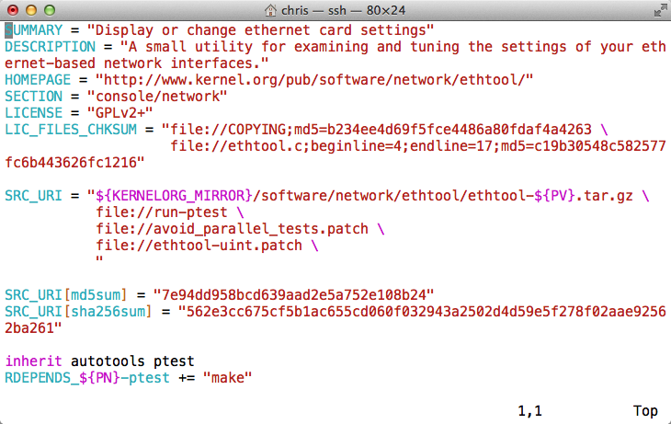
Example Recipe – ethtool_3.15.bb

Slide 25
What can a Recipe Do?
Build software from source code:
  Host tools, compiler, utilities
  Target Bootloader, Kernel, etc
  Target Libraries, interpreters, etc
  Target Userspace applications
Package Groups
Full System Images

Slide 26
Examining Recipes: bc
Look at 'bc' recipe:
Found in
poky/meta/recipes-extended/bc/bc_1.06.bb
  Uses LIC_FILES_CHKSUM and SRC_URI checksums
  Note the DEPENDS build dependency declaration indicating that this package depends on flex to build

Slide 27
Examining Recipes: bc.bb
SUMMARY = "Arbitrary precision calculator language"
HOMEPAGE = "http://www.gnu.org/software/bc/bc.html"
LICENSE = "GPLv2+ & LGPLv2.1"
LIC_FILES_CHKSUM = "file://COPYING;md5=94d55d512a9ba36caa9b7df079bae19f \
file://COPYING.LIB;md5=d8045f3b8f929c1cb29a1e3fd737b499 \
file://bc/bcdefs.h;endline=31;md5=46dffdaf10a99728dd8ce358e45d46d8 \
file://dc/dc.h;endline=25;md5=2f9c558cdd80e31b4d904e48c2374328 \
file://lib/number.c;endline=31;md5=99434a0898abca7784acfd36b8191199"
SECTION = "base"
DEPENDS = "flex"
SRC_URI = " ${GNU_MIRROR}/bc/bc-${PV}.tar.gz \
file://fix-segment-fault.patch "
SRC_URI[md5sum] = "d44b5dddebd8a7a7309aea6c36fda117"
SRC_URI[sha256sum] = "4ef6d9f17c3c0d92d8798e35666175ecd3d8efac4009d6457b5c99cea72c0e33"
inherit autotools texinfo update-alternatives
ALTERNATIVE_${PN} = "dc"
ALTERNATIVE_PRIORITY = "100"
BBCLASSEXTEND = "native"

Slide 28
Building upon bbclass
Use inheritance for common design patterns
Provide a class file (.bbclass) which is then inherited by other recipes (.bb files)
inherit autotools
  Bitbake will include the autotools.bbclass file
  Found in a classes directory via the BBPATH

Slide 29
Examining Recipes: flac
Look at 'flac' recipe
Found in
poky/meta/recipes-multimedia/flac/flac_1.3.2.bb
  Inherits from both autotools and gettext
  Customizes autoconf configure options (EXTRA_OECONF) based on "TUNE" features
  Breaks up output into multiple binary packages
    See PACKAGES var. This recipe produces additional packages with those names, while the FILES_* vars specify which files go into these additional packages

Slide 30
Examining Recipes: flac.bb
SUMMARY = "Free Lossless Audio Codec"
DESCRIPTION = "FLAC stands for Free Lossless Audio Codec, a lossless audio compression format."
HOMEPAGE = "https://xiph.org/flac/"
BUGTRACKER = "http://sourceforge.net/p/flac/bugs/"
SECTION = "libs"
LICENSE = "GFDL-1.2 & GPLv2+ & LGPLv2.1+ & BSD"
LIC_FILES_CHKSUM = "file://COPYING.FDL;md5=ad1419ecc56e060eccf8184a87c4285f \
file://src/Makefile.am;beginline=1;endline=17;md5=09501c864f89dfc7ead65553129817ca \
file://COPYING.GPL;md5=b234ee4d69f5fce4486a80fdaf4a4263 \
file://src/flac/main.c;beginline=1;endline=18;md5=09777e2934947a36f13568d0beb81199 \
file://COPYING.LGPL;md5=fbc093901857fcd118f065f900982c24 \
file://src/plugin_common/all.h;beginline=1;endline=18;md5=f56cb4ba9a3bc9ec6102e8df03215271 \
file://COPYING.Xiph;md5=b59c1b6d7fc0fb7965f821a3d36505e3 \
file://include/FLAC/all.h;beginline=65;endline=70;md5=64474f2b22e9e77b28d8b8b25c983a48"
DEPENDS = "libogg"
SRC_URI = "http://downloads.xiph.org/releases/flac/${BP}.tar.xz"
SRC_URI[md5sum] = "454f1bfa3f93cc708098d7890d0499bd"
SRC_URI[sha256sum] = "91cfc3ed61dc40f47f050a109b08610667d73477af6ef36dcad31c31a4a8d53f"
(con't next page)

Slide 31
Examining Recipes: flac.bb (con't)
(con't from previous page)
CVE_PRODUCT = "libflac"
inherit autotools gettext
EXTRA_OECONF = "--disable-oggtest \
--with-ogg-libraries=${STAGING_LIBDIR} \
--with-ogg-includes=${STAGING_INCDIR} \
--disable-xmms-plugin \
--without-libiconv-prefix \
ac_cv_prog_NASM="" \
"
EXTRA_OECONF += "${@bb.utils.contains("TUNE_FEATURES", "altivec", " --enable-altivec", " --disable-altivec", d)}"
EXTRA_OECONF += "${@bb.utils.contains("TUNE_FEATURES", "core2", " --enable-sse", "", d)}"
EXTRA_OECONF += "${@bb.utils.contains("TUNE_FEATURES", "corei7", " --enable-sse", "", d)}"
PACKAGES += "libflac libflac++ liboggflac liboggflac++"
FILES_${PN} = "${bindir}/*"
FILES_libflac = "${libdir}/libFLAC.so.*"
FILES_libflac++ = "${libdir}/libFLAC++.so.*"
FILES_liboggflac = "${libdir}/libOggFLAC.so.*"
FILES_liboggflac++ = "${libdir}/libOggFLAC++.so.*"

Slide 32
Grouping Local Metadata
Sometimes sharing metadata between recipes is easier via an include file
include file.inc
  Will include .inc file if found via BBPATH
  Can also specify an absolute path
  If not found, will continue without an error
require file.inc
  Same as an include
  Fails with an error if not found

Slide 33
Examining Recipes: ofono
Look at 'ofono' recipe(s):
Found in
poky/meta/recipes-connectivity/ofono/ofono_1.19.bb
  Splits recipe into common .inc file to share common metadata between multiple recipes
  Sets a conditional build configuration options through the PACKAGECONFIG var based on a DISTRO_FEATURE (in the .inc file)
  Sets up an init service via do_install_append()
  Has a _git version of the recipe (not shown)

Slide 34
Examining Recipes: ofono.bb
require ofono.inc
SRC_URI = "\
${KERNELORG_MIRROR}/linux/network/${BPN}/${BP}.tar.xz \
file://ofono \
"
SRC_URI[md5sum] = "a5f8803ace110511b6ff5a2b39782e8b"
SRC_URI[sha256sum] = "a0e09bdd8b53b8d2e4b54f1863ecd9aebe4786477a6cbf8f655496e8edb31c81"
CFLAGS_append_libc-uclibc = " -D_GNU_SOURCE"

Slide 35
Examining Recipes: ofono.inc
HOMEPAGE = "http://www.ofono.org"
SUMMARY = "open source telephony"
DESCRIPTION = "oFono is a stack for mobile telephony devices on Linux. oFono supports speaking to telephony devices through specific drivers, or with generic AT commands."
LICENSE = "GPLv2"
LIC_FILES_CHKSUM = "file://COPYING;md5=eb723b61539feef013de476e68b5c50a \
file://src/ofono.h;beginline=1;endline=20;md5=3ce17d5978ef3445def265b98899c2ee"
inherit autotools pkgconfig update-rc.d systemd bluetooth
DEPENDS = "dbus glib-2.0 udev mobile-broadband-provider-info"
INITSCRIPT_NAME = "ofono"
INITSCRIPT_PARAMS = "defaults 22"
PACKAGECONFIG ??= "\
${@bb.utils.filter('DISTRO_FEATURES', 'systemd', d)} \
${@bb.utils.contains('DISTRO_FEATURES', 'bluetooth', 'bluez', '', d)} \
"
PACKAGECONFIG[systemd] = "--with-systemdunitdir=${systemd_unitdir}/system/,--with-systemdunitdir="
PACKAGECONFIG[bluez] = "--enable-bluetooth, --disable-bluetooth, ${BLUEZ}"
(con't next page)

Slide 36
Examining Recipes: ofono.inc
(con't from previous page)
EXTRA_OECONF += "--enable-test"
SYSTEMD_SERVICE_${PN} = "ofono.service"
do_install_append() {
install -d ${D}${sysconfdir}/init.d/
install -m 0755 ${WORKDIR}/ofono ${D}${sysconfdir}/init.d/ofono
# Ofono still has one test tool that refers to Python 2 in the shebang
sed -i -e '1s,#!.*python.*,#!${bindir}/python3,' ${D}${libdir}/ofono/test/set-ddr
}
PACKAGES =+ "${PN}-tests"
RDEPENDS_${PN} += "dbus"
RRECOMMENDS_${PN} += "kernel-module-tun mobile-broadband-provider-info"
FILES_${PN} += "${systemd_unitdir}"
FILES_${PN}-tests = "${libdir}/${BPN}/test"
RDEPENDS_${PN}-tests = "python3 python3-pygobject python3-dbus"

Slide 37
WHEN THINGS GO WRONG
Some useful tools to help guide you when something goes wrong

Slide 38
Bitbake Environment
Each recipe has its own environment which contains all the variables and methods required to build that recipe
You've seen some of the variables already
  DESCRIPTION, SRC_URI, LICENSE, S, LIC_FILES_CHKSUM, do_compile(), do_install()
Example
  S = "${WORKDIR}"
  What does this mean?

Slide 39
Examine a Recipe's Environment
To view a recipe's envrionment
$ bitbake -e myrecipe
Where is the source code for this recipe"
$ bitbake -e virtual/kernel | grep “^S=”
S="${HOME}/yocto/build/tmp/work-shared/qemuarm/kernel-source"
What file was used in building this recipe?
$ bitbake -e netbase | grep “^FILE=”
FILE="${HOME}/yocto/poky/meta/recipes-core/netbase/netbase_5.3.bb"

Slide 40
Examine a Recipe's Environment (cont'd)
What is this recipe's full version string?
$ bitbake -e netbase | grep “^PF=”
PF="netbase-1_5.3-r0"
Where is this recipe's BUILD directory?
$ bitbake -e virtual/kernel | grep “^B=”
B="${HOME}/yocto/build/tmp/work/qemuarm-poky-linux-\
gnueabi/linux-yocto/3.19.2+gitAUTOINC+9e70b482d3\
_473e2f3788-r0/linux-qemuarm-standard-build"
What packages were produced by this recipe?
$ bitbake -e virtual/kernel | grep “^PACKAGES=”
PACKAGES="kernel kernel-base kernel-vmlinux kernel-image \ kernel-dev kernel-modules kernel-devicetree"

Slide 41
BitBake Log Files
Every build produces lots of log output for diagnostics and error chasing
  Verbose log of bitbake console output:
    Look in …/tmp/log/cooker/<machine>
$ cat tmp/log/cooker/qemuarm/20160119073325.log | grep 'NOTE:.*task.*Started'
NOTE: recipe hello-1.0.0-r0: task do_fetch: Started
NOTE: recipe hello-1.0.0-r0: task do_unpack: Started
NOTE: recipe hello-1.0.0-r0: task do_patch: Started
NOTE: recipe hello-1.0.0-r0: task do_configure: Started
NOTE: recipe hello-1.0.0-r0: task do_populate_lic: Started
NOTE: recipe hello-1.0.0-r0: task do_compile: Started
NOTE: recipe hello-1.0.0-r0: task do_install: Started
NOTE: recipe hello-1.0.0-r0: task do_populate_sysroot: Started
NOTE: recipe hello-1.0.0-r0: task do_package: Started
NOTE: recipe hello-1.0.0-r0: task do_packagedata: Started
NOTE: recipe hello-1.0.0-r0: task do_package_write_rpm: Started
NOTE: recipe hello-1.0.0-r0: task do_package_qa: Started
NOTE: recipe ypdd-image-1.0-r0: task do_rootfs: Started

Slide 42
BitBake Per-Recipe Log Files
Every recipe produces lots of log output for diagnostics and debugging
Use the Environment to find the log files for a given recipe:
$ bitbake -e hello | grep “^T=”
T="${HOME}yocto/build/tmp/work/armv5e-poky-linux-gnueabi/hello/1.0.0-r0/temp"
Each task that runs for a recipe produces "log" and "run" files in
${WORKDIR}/temp

Slide 43
BitBake Per-Recipe Log Files
$ cd ${T} (See definition of T in previous slide)
$ find . -type l -name 'log.*'
./log.do_package_qa
./log.do_package_write_rpm
./log.do_package
./log.do_fetch
./log.do_populate_lic
./log.do_install
./log.do_configure
./log.do_unpack
./log.do_populate_sysroot
./log.do_compile
./log.do_packagedata
./log.do_patch
These files contain the output of the respective tasks for each recipe

Slide 44
BitBake Per-Recipe Log Files
$ cd ${T} (See definition of T in previous slide)
$ find . -type l -name 'run.*'
./run.do_fetch
./run.do_patch
./run.do_configure
./run.do_populate_sysroot
./run.do_package_qa
./run.do_unpack
./run.do_compile
./run.do_install
./run.do_packagedata
./run.do_populate_lic
./run.do_package
./run.do_package_write_rpm
These files contain the commands executed which produce the build results

Slide 45
LAYERS
This section will introduce the concept of layers and how important they are in the overall build architecture

Slide 46
Layers
Metadata is provided in a series of layers which allow you to override any value without editing the originally provided files
A layer is a logical collection of metadata in the form of recipes
A layer is used to represent oe-core, a Board Support Package (BSP), an application stack, and your new code
All layers have a priority and can override policy, metadata and config settings of layers with a lesser priority

Slide 47
Layer Hierarchy
Developer layer(s)
Commercial layers (OSV or middleware)
UI/GUI layer
BSP layer
meta-poky
meta (oe-core)

Slide 48
Notes on using Layers
When doing development with Yocto, do not edit files within the Poky source tree
Use a new custom layer for modularity and maintainability
Layers also allow you to easily port from one version of Yocto/Poky to the next version
http://layers.openembedded.org <<---- This site is your friend

Slide 49
Board Support Packages
BSPs are layers to enable support for specific hardware platforms
Defines machine configuration variables for the board (MACHINE)
Adds machine-specific recipes and customizations
  Boot loader
  Kernel config
  Graphics drivers (e.g, Xorg)
  Additional recipes to support hardware features

Slide 50
IMAGES
This section will introduce the concept of images; recipes which build embedded system images

Slide 51
What is an Image?
Building an image creates an entire Linux distribution from source
  Compiler, tools, libraries
  BSP: Bootloader, Kernel
  Root filesystem:
    Base OS
    services
    Applications
    etc

Slide 52
Extending an Image
You often need to create your own Image recipe in order to add new packages or functionality
With Yocto/OpenEmbedded it is always preferable to extend an existing recipe or inherit a class
The simplest way is to inherit the core-image bbclass
You add packages to the image by adding them to IMAGE_INSTALL

Slide 53
A Simple Image Recipe
Create an images directory
$ mkdir -p ${HOME}/yocto/build/meta-ypdd/recipes-core/images
Create the image recipe
$ vi ${HOME}/yocto/build/meta-ypdd/recipes-core/images/ypdd-image.bb
DESCRIPTION = "A core image for YPDD"
LICENSE = "MIT"
# Core files for basic console boot
IMAGE_INSTALL = "packagegroup-core-boot"
# Add our desired packages
IMAGE_INSTALL += "psplash dropbear"
inherit core-image
IMAGE_ROOTFS_SIZE ?= "8192"

Slide 54
LAB

Slide 55
BUILDING A FULL EMBEDDED IMAGE WITH Bitbake

Slide 56
Workflow
Download Yocto Project sources:
$ mkdir e-ale ; cd e-ale
$ wget http://downloads.yoctoproject.org/releases/yocto/yocto-2.3.2/poky-pyro-17.0.2.tar.bz2
$ tar xf poky-pyro-17.0.2.tar.bz2
  Can also use git and checkout a known branch e.g. morty
$ git clone -b pyro git://git.yoctoproject.org/poky.git
Build one of the reference Linux distributions:
$ source poky/oe-init-build-env build
  Check/Edit local.conf for sanity (e.g. modify MACHINE = "qemux86" or MACHINE = "qemuarm")
$ bitbake -k core-image-minimal
Run the image under emulation:
$ runqemu qemuarm
Profit!!! (well… actually there is more work to do...)

Slide 57
Host System Layout
$HOME/e-ale/
|---build (or whatever name you choose)
Project build directory
|---downloads (DL_DIR)
Downloaded source cache
|---poky (Do Not Modify anything in here*)
Poky, bitbake, scripts, oe-core, metadata
|---sstate-cache (SSTATE_DIR)
Binary build cache
* We will cover how to use layers to make changes later

Slide 58
Poky(reference) Layout
$HOME/e-ale/poky/
|---LICENSE
|---README
|---README.hardware
|---bitbake/ (The build tool)
|---documentation/
|---meta/ (oe-core)
|---meta-poky/ (Yocto distro metadata)
|---meta-yocto-bsp/ (Yocto Reference BSPs)
|---oe-init-build-env (Project setup script)
|---scripts/ (Scripts and utilities)
meta-yocto-bsp
meta-poky
oe-core (meta)
Note: A few files have been items omitted to facility the presentation on this slide

Slide 59
Setting up a Build Directory
Start by setting up a build directory
  Local configuration
  Temporary build artifacts
$ cd $HOME/e-ale/
$ source ./poky/oe-init-build-env build
Replace build with whatever directory name you want to use for your project
You need to re-run this script in any new terminal you start (and don’t forget the project directory)

Slide 60
Build directory Layout
$HOME/e-ale/build/
|---bitbake.lock
|---cache/ (bitbake cache files)
|---conf/
| |--bblayers.conf (bitbake layers)
| |--local.conf (local configuration)
| `--site.conf (optional site conf)
`---tmp/ (Build artifacts)
Note: A few files have been items omitted to facility the presentation on this slide

Slide 61
Configuring Layers
Layers are added to your build by inserting them into the BBLAYERS variable within your bblayers file
$HOME/e-ale/build/conf/bblayers.conf
BBLAYERS ?= " \
${HOME}/e-ale/poky/meta \
${HOME}/e-ale/poky/meta-poky \
${HOME}/e-ale/poky/meta-yocto-bsp \
"

Slide 62
Configure local.conf
local.conf setup:
  Configure build by editing local.conf
  $HOME/e-ale/build/conf/local.conf
    Select appropriate MACHINE type (target)
    Set shared downloads directory (DL_DIR)
    Set shared state directory (SSTATE_DIR)
MACHINE = "qemuarm"
DL_DIR ?= "$HOME/e-ale/DOWNLOADS"
SSTATE_DIR ?= "$HOME/e-ale/SSTATE"
PACKAGE_CLASSES ?= "package_deb"
INHERIT += "rm_work"

Slide 63
Building an Embedded Image
This builds an entire embedded Linux distribution
Choose from one of the available Images
The following builds a minimal embedded target
$ bitbake -k core-image-minimal
On a fast computer the first build may take the better part of an hour on a slow machine multiple ...
The next time you build it (with no changes) it may take as little as 5 mins (due to the shared state cache)

Slide 64
Booting Your Image with QEMU
The runqemu script is used to boot the image with QEMU
It auto-detects settings as much as possible, enabling the following command to boot our reference images:
$ runqemu qemuarm [nographic]
  Use nographic if using a non-graphical session (ssh), do not type the square brackets
Replace qemuarm with your value of MACHINE
Your QEMU instance should boot
Quit by closing the qemu window
If using “nographic”, kill it from another terminal:
$ killall qemu-system-arm

Slide 65
Build and Boot Your Custom Image
Verify that dropbear ssh server is present
$ which dropbear
If you used the graphical invocation of QEMU using VNC viewer, you will see the splash screen on boot.

Slide 66
BUILD AN APPLICATION
Adding a "hello world" application to our custom image

Slide 67
Building an Application
General procedure:
  Write hello world application (hello.c)
  Create recipe for hello world application
  Modify image recipe to add hello world application to your image
What follows is the example of a simple one C file application
(Building a more complicated recipe from a tarball would specify how to find the upstream source with the SRC_URI)

Slide 68
Add Application Code
For a simple one C file package, you can add the hello application source to a directory called files in the hello package directory
$ mkdir -p ${HOME}/e-ale/hello-recipe/files
$ vi ${HOME}/e-ale/hello-recipe/files/hello.c

Slide 69
Application Code
$ vi hello-recipe/files/hello.c
#include <stdio.h>
int main(int argc, char **argv) {
printf("Hello World\n");
return 0;
}

Slide 70
Add Application Recipe
Write hello world recipe
Create directory to hold the recipe and associated files
$ mkdir -p ${HOME}/e-ale/hello-recipe
  (We actually did this already in the previous step)
Create hello_1.0.bb (next slide)
$ vi ${HOME}/e-ale/hello-recipe/hello_1.0.bb

Slide 71
Application Recipe
$ vi ${HOME}/e-ale/hello-recipe/hello_1.0.bb
DESCRIPTION = "Hello World example"
LICENSE = "MIT"
LIC_FILES_CHKSUM = "file://${COREBASE}/meta/COPYING.MIT;md5=3da9cfbcb788c80a0384361b4de20420"
S = "${WORKDIR}"
SRC_URI = "file://hello.c"
do_compile() {
${CC} ${CFLAGS} ${LDFLAGS} hello.c -o hello
}
do_install() {
install -d -m 0755 ${D}/${bindir}
install -m 0755 hello ${D}/${bindir}/hello
}

Slide 72
Embedded Linux Development with Yocto Project
Training from The Linux Foundation
Want to learn how to use Yocto Project like a Pro?
https://training.linuxfoundation.org/
Embedded Linux Platform Development with Yocto Project
http://bit.ly/eldyocto

Slide 73
TIPS HINTS AND OTHER RESOURCES
The following slides contain reference material that will help you climb the Yocto Project learning curve

Slide 74
Common Gotchas When Getting Started
Working behind a network proxy? Please follow this guide:
  https://wiki.yoctoproject.org/wiki/Working_Behind_a_Network_Proxy
Do not try to re-use the same shell environment when moving between copies of the build system
oe-init-build-env script appends to your $PATH, it's results are cumulative and can cause unpredictable build errors
Do not try to share sstate-cache between hosts running different Linux distros even if they say it works

Slide 75
Project Resources
The Yocto Project is an open source project, and aims to deliver an open standard for the embedded Linux community and industry
Development is done in the open through public mailing lists: openembedded-core@lists.openembedded.org, poky@yoctoproject.org, and yocto@yoctoproject.org
And public code repositories:
http://git.yoctoproject.org and
http://git.openembedded.org
Bug reports and feature requests
http://bugzilla.yoctoproject.org

Slide 76
Tip: ack-grep
Much faster than grep for the relevant use cases
Designed for code search
Searches only relevant files
  Knows about many types: C, asm, perl
  By default, skips .git, .svn, etc.
  Can be taught arbitrary types
Perfect for searching metadata

Slide 77
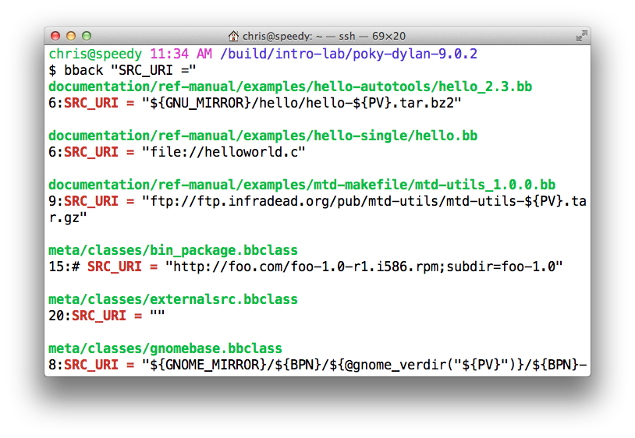
Tip: ack-grep
alias bback='ack-grep --type bitbake'

Slide 78
TIP: VIM Syntax Highlighting
https://github.com/openembedded/bitbake/tree/master/contrib/vim
Install files from the above repo in ~/.vim/
Add "syntax on" in ~/.vimrc
$ tree ~/.vim/
/Users/chris/.vim/
├── ftdetect
│ └── bitbake.vim
├── ftplugin
│ └── bitbake.vim
├── plugin
│ └── newbb.vim
└── syntax
└── bitbake.vim

Slide 79
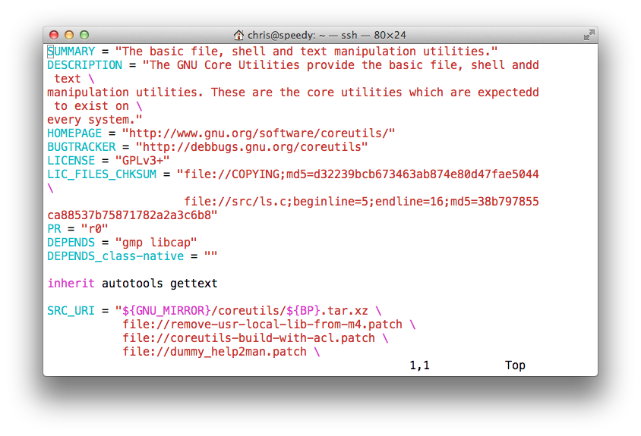
TIP: VIM Syntax Highlighting

Slide 80
The other boards ...

Slide 81
dragonboard in one Slide
The dragonboard uses a 3rd-party repository.
Download repo tool:
$ mkdir -p ${HOME}/bin
$ curl https://storage.googleapis.com/git-repo-downloads/repo > ${HOME}/bin/repo
$ chmod a+x ${HOME}/bin/repo
$ export PATH=${HOME}/bin:${PATH}
Download the repositories with repo:
$ mkdir oe-qcom && cd oe-qcom
$ repo init -u https://github.com/96boards/oe-rpb-manifest.git -b pyro
$ repo sync
$ source setup-environment # SELECT the dragonboard
Build the image:
$ bitbake core-image-minimal
Profit!!! (well… actually there is more work to do...)

Slide 82
YP for the beaglebone
The following section introduces the beaglebone as example hardware.

Slide 83
PocketBeagle in one Slide
Download poky tool:
$ mkdir -p ${HOME}/myproject
$ cd ${HOME}/myproject
$ wget -nd -c "http://downloads.yoctoproject.org/releases/yocto/yocto-2.3.2/poky-pyro-17.0.2.tar.bz2"
$ tar -xf poky-pyro-17.0.2.tar.bz2
Configure:$
$ source poky-morty-17.0.2/oe-init-build-env mybuild
$ echo 'MACHINE = "beaglebone" ' >> conf/local.conf
Build the image:
$ bitbake core-image-minimal
Profit!!! (well… actually there is more work to do...)

Slide 84
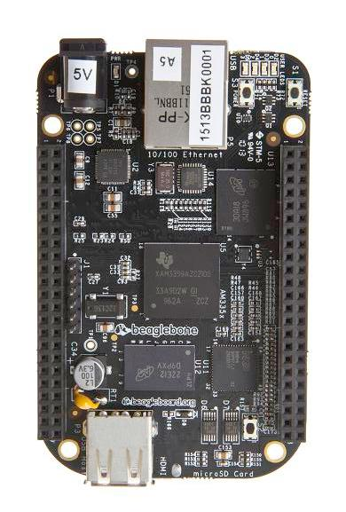
beaglebone

Slide 85
End
HAVE FUN and thank you for joining !

Slide 86
BITBAKE
REFERENCE

Slide 87
Recipe Operators
A = “foo” (late assignment)
B ?= “0t” (default value)
C ??= “abc” (late default)
D := “xyz” (Immediate assignment)
A .= “bar” “foobar” (append)
B =. “WO” “W00t” (prepend)
C += “def” “abc def” (append)
D =+ “uvw” “uvw xyz” (prepend)

Slide 88
More Recipe Operators
A = “foo”
A_append = “bar” “foobar”
B = “0t”
B_prepend = “WO” “W00t”
OVERRIDES = “os:arch:machine”
A = “abc”
A_os = “ABC” (Override)
A_append_arch = “def” (Conditional append)
A_prepend_os = “XYZ” (Conditional prepend)

Slide 89
Bitbake Variables/Metadata
These are set automatically by bitbake
  TOPDIR – The build directory
  LAYERDIR – Current layer directory
  FILE – Path and filename of file being processed
Policy variables control the build
  BUILD_ARCH – Host machine architecture
  TARGET_ARCH – Target architecture
  And many others...

Slide 90
Build Time Metadata
PN – Pakage name (“myrecipe”)
PV – Package version (1.0)
PR – Package Release (r0)
P = “${PN}-${PV}”
PF = “${PN}-${PV}-${PR}”
FILE_DIRNAME – Directory for FILE
FILESPATH = "${FILE_DIRNAME}/${PF}:\
${FILE_DIRNAME}/${P}:\
${FILE_DIRNAME}/${PN}:\
${FILE_DIRNAME}/files:${FILE_DIRNAME}

Slide 91
Build Time Metadata
TOPDIR – The build directory
TMPDIR = “${TOPDIR}/tmp”
WORKDIR = ${TMPDIR}/work/${PF}”
S = “${WORKDIR}/${P}” (Source dir)
B = “${S}” (Build dir)
D = “${WORKDIR}/${image}” (Destination dir)
DEPLOY_DIR = “${TMPDIR}/deploy”
DEPLOY_DIR_IMAGE = “${DEPLOY_DIR}/images”

Slide 92
Dependency Metadata
Build time package variables
  DEPENDS – Build time package dependencies
  PROVIDES = “${P} ${PF} ${PN}”
Runtime package variables
  RDEPENDS – Runtime package dependencies
  RRECOMMENDS – Runtime recommended packages
  RSUGGESTS – Runtime suggested packages
  RPROVIDES – Runtime provides
  RCONFLICTS – Runtime package conflicts
  RREPLACES – Runtime package replaces

Slide 93
Common Metadata
Variables you commonly set
  SUMMARY – Short description of package/recipe
  HOMEPAGE – Upstream web page
  LICENSE – Licenses of included source code
  LIC_FILES_CHKSUM – Checksums of license files at time of packaging (checked for change by build)
  SRC_URI – URI of source code, patches and extra files to be used to build packages. Uses different fetchers based on the URI.
  FILES – Files to be included in binary packages

