Slide 1
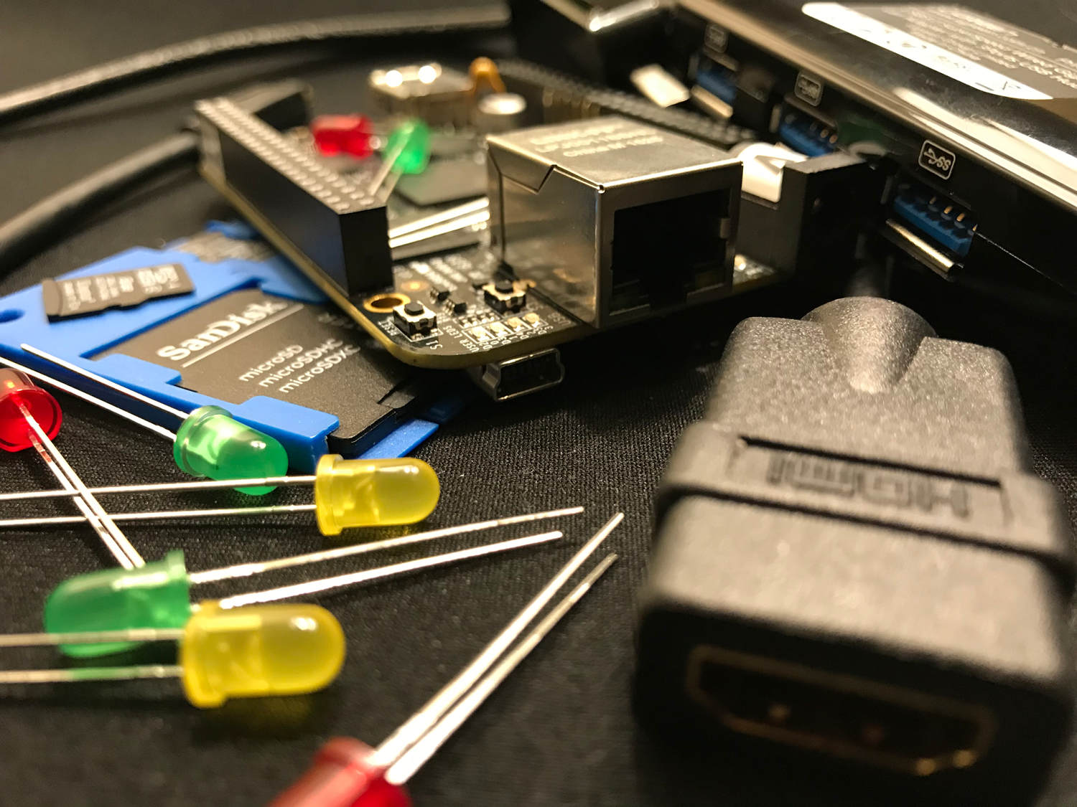
Building Images with
Yocto Project

Slide 2
What is the Yocto Project?
A Linux Foundation project that helps you build your own custom Linux distribution, from source to installable image
A collection of tools to make building your own custom Linux distribution easier
“yocto” is the smallest unit prefix in the SI system (10⁻²⁴)

Slide 3
What is Open Embedded?
A build system, using the “bitbake” tool, to create a Linux distribution
  Inspired by Gentoo portage system
A long time ago, in a galaxy far far away, it was what came to be known as Open Embedded Classic
A not for profit organization which aims to champion embedded Linux

Slide 4
What is poky?
“poky” is the reference distribution used to make sure the Yocto Project is “all systems normal”
A conveniently and legally different name for something that sounds the same as a chocolate dipped cookie stick popular in Japan
Not an equine companion to a green clay-mation character from a popular children’s Saturday morning show that sounds like it might be not so fast

Slide 5
What is poky?
bitbake
openembedded-core
meta-yocto
combolayer
poky

Slide 6
What is poky?
$ tree -L 1 poky
poky
├── bitbake
├── documentation
├── LICENSE
├── meta
├── meta-poky
├── meta-selftest
├── meta-skeleton
├── meta-yocto-bsp
├── oe-init-build-env
├── README.hardware
├── README.LSB
├── README.poky
└── scripts

Slide 7
Building Images

Slide 8
What do we mean by “image”?
/boot (and boot loader)
kernel (and kernel modules)
rootfs
  /etc
  /var
  /usr

Slide 9
Cloning our tools and metadata
git clone bitbake
OR
git clone openembedded-core
git clone poky
git clone meta-foo

Slide 10
Setting up our build environment
Without any options
. ./poky/oe-init-build-env
MACHINE ??= “qemux86”
TOP_DIR = “./build”

Slide 11
Typical Image Building Commands
$ bitbake core-image-minimal
minimal bootable image
small partitions, not for on-target development
$ bitbake core-image-base
more typical basic “server” or console image
$ bitbake core-image-full-cmdline
more tools (editors)
$ bitbake core-image-sato
reference graphical desktop

Slide 12
Layer Bootcamp

Slide 13
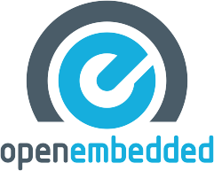
Why layers?
Open Embedded Classic
  monolithic repository with everything
  and the kitchen sink
Needed
  Flexibility
  Modularity
  Distributed
Classic

Slide 14
Levels of Abstraction
DISTRO
musl
systemd
x11
MACHINE
kernel
bootloader
drivers
IMAGE
console
graphics
automotive
RECIPE
scripts
applications
libraries
support
Thank you to Stephano Cetola for this content

Slide 15
Layers of Abstraction
DISTRO
“Distro layer”
meta-my-distro
X11
or wayland
systemd
or sysvinit
HARDWARE
“BSP layer”
meta-my-arm
LCD
bt / wifi / nfc
automotive
SOFTWARE
“Application layer”
meta-my-apps
demos
customer app
support tools
CONCEPT
“Functional layer”
meta-my-extra
manufacturing
OTA updates
Support tools
Borowed from/Inspired by Stephano Cetola

Slide 16
What is a layer?
Special organization of metadata and configuration files
meta-skeleton
├── conf
│ ├── layer.conf
│ ├── multilib-example2.conf
│ └── multilib-example.conf
├── COPYING.MIT
├── recipes-core
│ └── busybox
├── recipes-kernel
│ ├── hello-mod
│ └── linux
├── recipes-multilib
│ └── images
└── recipes-skeleton
├── service
└── useradd

Slide 17
Distro layer
meta-e-ale-distro
├── conf
│ ├── bblayers.conf.sample
│ ├── distro
│ │ ├── e-ale.conf
│ │ └── e-ale-tiny.conf
│ ├── layer.conf
│ └── local.conf.sample
├── COPYING.MIT
├── README
└── recipes-core
└── base-files
├── base-files
│ ├── issue
│ └── issue.net
└── base-files_%.bbappend

Slide 18
BSP layer
meta-e-ale-bsp
├── conf
│ ├── layer.conf
│ └── machine
│ ├── include
│ │ ├── ti33x.inc
│ │ └── ti-soc.inc
│ └── pocketbeagle.conf
├── COPYING.MIT
├── README
├── recipes-bsp
│ └── u-boot
│ ├── u-boot
│ │ └── ...
│ └── u-boot_2018.01.bbappend
├── recipes-kernel
│ └── linux
│ ├── linux-pocketbeagle
│ │ ├── ...
│ │ └── defconfig
│ └── linux-pocketbeagle_4.14.bb
└── wic
└── pocketbeagle-yocto.wks

Slide 19
How to create a layer?
$ bitbake-layers create-layer meta-foo
Manually
  Clone/Copy another layer
  Keep it consistent (Distro vs. BSP vs. Application)

Slide 20
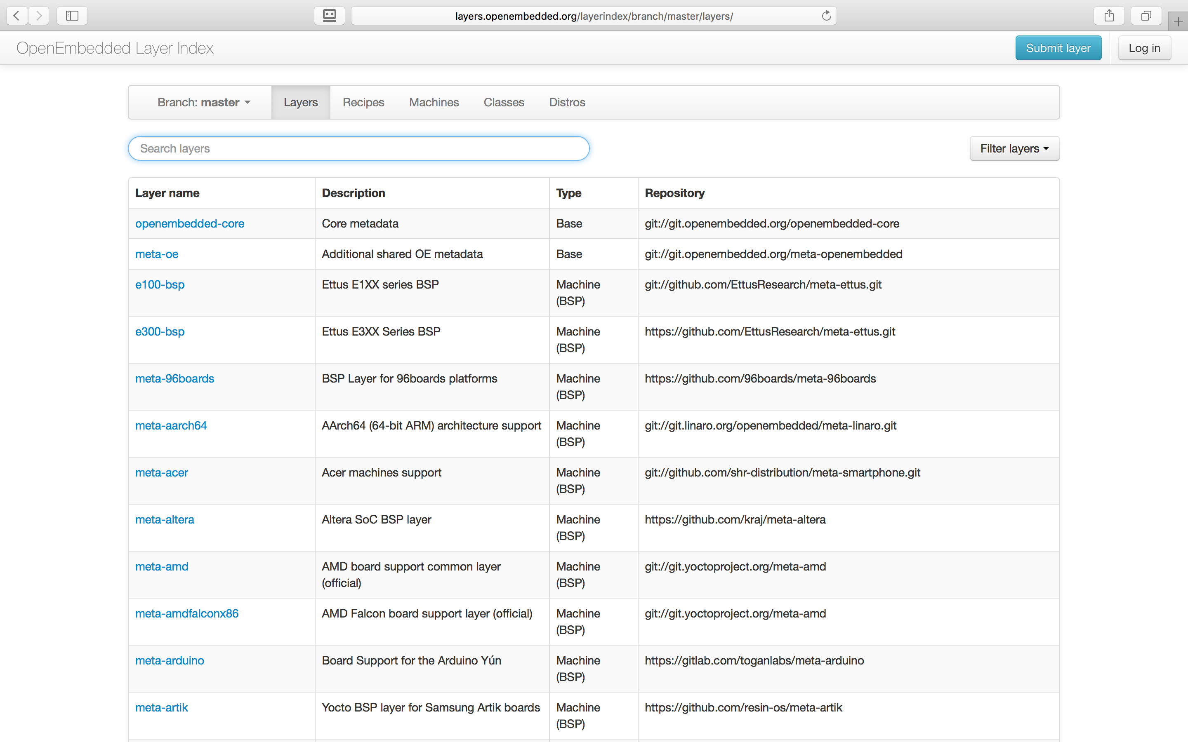
What layers are out there?
Layer index - http://layers.openembedded.org/
Searchable:
  Layers
  Machines
  Recipes
  Classes

Slide 21
Application Developer Workflow Tools

Slide 22
Eclipse IDE plugin
eclipse-yocto (formerly eclipse-poky)
  Autotools
  Cmake
  Makefile
  GDB
Later in 2018 (2.6): Leveraging Containers

Slide 23

CROPS Docker Containers
CROss PlatformS
“Containers Run Other Peoples’ Software”
Docker containers which support
  Windows**
  Mac**
  Linux
Based on supported Distributions
  Fedora, Debian, Ubuntu
Types of containers
  yocto-base
  yocto-builder
  eoky-container
  esdk-container
**with Samba container (Linux file system)

Slide 24
CROPS presentation
ELC 2017
“Cross Platform Enablement for the Yocto Project with Containers”
Randy Witt, Intel
PDF
  https://elinux.org/images/9/94/2017_ELC_-_Yocto_Project_Containers.pdf
YouTube
  https://www.youtube.com/watch?v=JXHLAWveh7Y

Slide 25
SDK (Software Development Kit)
“Toolchain”
Create your own
$ bitbake image -c populate_sdk
Use Yocto Project releases
  https://downloads.yoctoproject.org/releases/yocto/yocto-2.4.2/toolchain/

Slide 26
eSDK (Extensible Software Development Kit)
Create your own
$ bitbake image -c populate_sdk_ext
Use Yocto Project releases
  https://downloads.yoctoproject.org/releases/yocto/yocto-2.4.2/toolchain/
  Look for files with “ext” in the filename

Slide 27
https://www.yoctoproject.org/docs/2.4.2/sdk-manual/sdk-manual.html
Feature | Standard SDK | Extensible SDK
Toolchain | Yes | Yes*
Debugger | Yes | Yes*
Size | 100+ MBytes | 1+ Gbytes (or 300+ Mbytes for minimal w/toolchain)
devtool | No | Yes
Build Images | No | Yes
Updateable | No | Yes
Managed Sysroot** | No | Yes
Installed Packages | No*** | Yes****
Construction | Packages | Shared State
* Extensible SDK will contain the toolchain and debugger if SDK_EXT_TYPE is "full" or
SDK_INCLUDE_TOOLCHAIN is "1", which is the default.
** Sysroot is managed through use of devtool. Thus, it is less likely that you will corrupt
your SDK sysroot when you try to add additional libraries.
*** Runtime package management can be added to the standard SDK but it is not supported by
default.
**** You must build and make the shared state available to extensible SDK users for "packages"
you want to enable users to install.

Slide 28
eSDK presentation
ELC 2017
“Yocto Project Extensible SDK:Simplifying Workflow for Application Developers”
Henry Bruce, Intel
PDF
  https://elinux.org/images/7/7a/2017_ELC_Henry_Bruce.pdf
YouTube
  https://www.youtube.com/watch?v=d3xanDJuXRA

Slide 29
System Integrator / Build System Workflow Tools

Slide 30
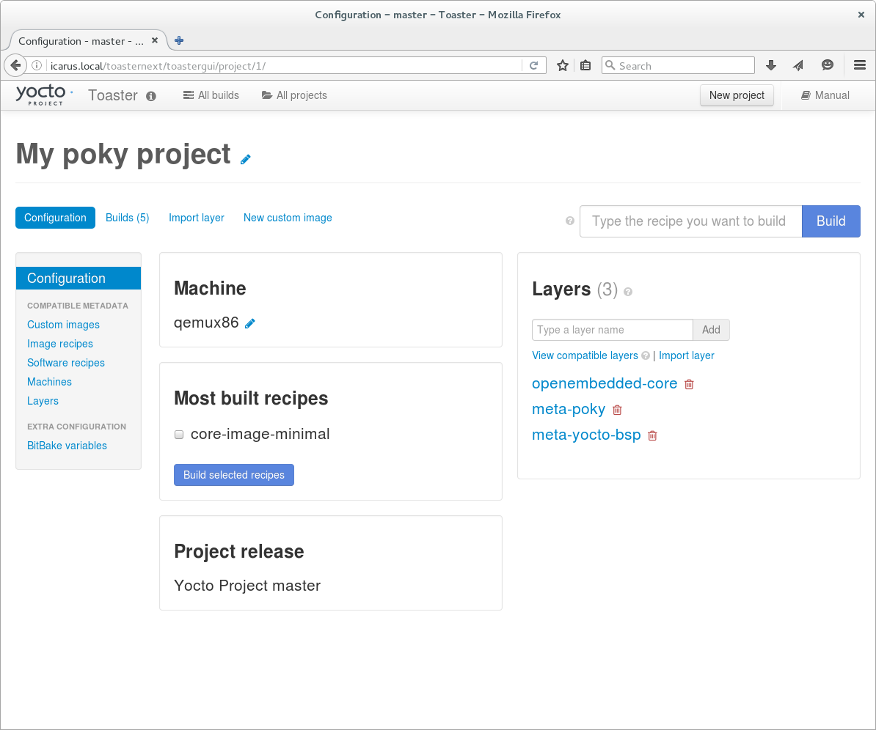
Toaster
Web UI tool to build and customize images

Slide 31
devtool
Developer tool to help minimize repetitive tasks
Great self-documentation
$ devtool [cmd] help
Common commands
$ devtool add my-app <URI to source>
$ devtool modify other-app
$ devtool upgrade existing-recipe

Slide 32
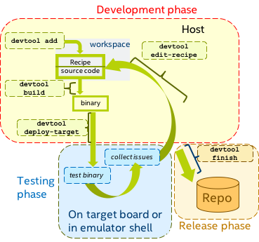
Typical devtool workflow
Add
Build
Test
Edit?
Commit

Slide 33
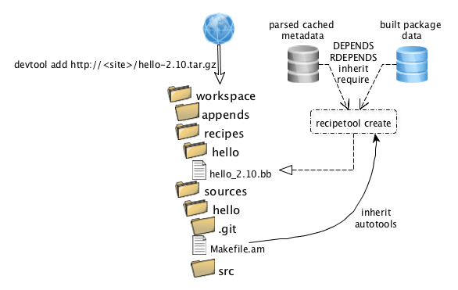
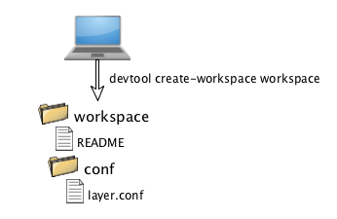
Overview of how devtool works

Slide 34
devtool presentation
ELC 2017
“Using Devtool to Streamline Your Yocto Project Workflow”
Tim Orling, Intel
PDF
  https://elinux.org/images/e/e2/2017_ELC_--_Using_devtool_to_Streamline_your_Yocto_Project_Workflow.pdf
YouTube
  https://www.youtube.com/watch?v=CiD7rB35CRE

Slide 35
Auto Upgrade Helper (AUH)
Script that automatically updates recipes using devtool
Can build for multiple architectures
  qemux86_musl, qemux86_64, qemuarm, qemumips, etc
Can run tests (testimage and/or ptests)
http://git.yoctoproject.org/cgit/cgit.cgi/auto-upgrade-helper/

Slide 36
Questions?

Slide 37

Thank you!

