Slide 1



Slide Title 54pt

Slide 2




Slide 3


Slide 4
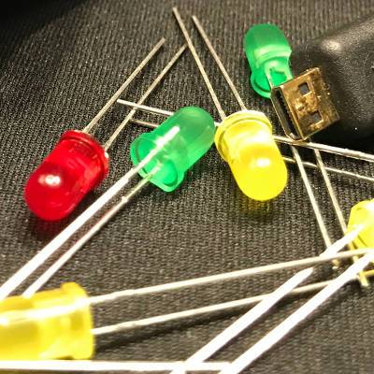
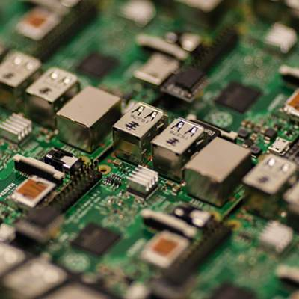
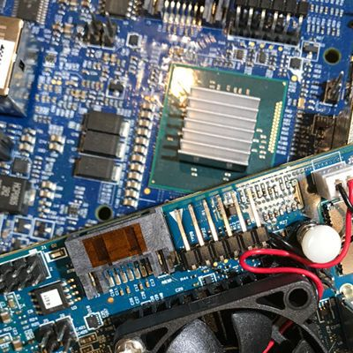

Slide 5
Questions?

Slide 6

Thank you!

