Slide 1




Introduction to
Linux Kernel Modules
and Kbuild

Slide 2



What the heck is a kernel module?

Slide 3
What is a kernel module?
A way to dynamically add code (or data) to a running kernel
Subsequently to optionally remove that same code
A way to automatically load only the drivers we need
A way to provide a choice between multiple modular drivers
A way to architect kernel code in a modular way

Slide 4
Aren’t modules and drivers the same thing?
While most drivers are written as modules
Not all modules are drivers
A kernel module is the simplest way of adding a payload of bytes to the kernel (whether code or data)
A module can implement a driver, or library code, or a kprobe, or whatever you can dream up you want to add to a kernel...

Slide 5
A Simple module
#include <linux/module.h>
#include <linux/init.h>
static int __init my_init(void)
{
pr_info("Hello: module loaded at 0x%p\n", my_init);
return 0;
}
static void __exit my_exit(void)
{
pr_info("Bye: module unloaded from 0x%p\n", my_exit);
}
module_init(my_init);
module_exit(my_exit);
MODULE_AUTHOR("A GENIUS");
MODULE_LICENSE("GPL v2");
Static functions
Return codes
module_init()
module_exit()
__init attribute
__exit attribute
NOTE: Output edited for brevity

Slide 6
The anatomy of a module (ELF file)
$ arm-linux-gnueabihf-objdump -x trivial.ko
1 .text 00000000 00000000 00000000 00000058 2**0
CONTENTS, ALLOC, LOAD, READONLY, CODE
2 .init.text 00000030 00000000 00000000 00000058 2**2
CONTENTS, ALLOC, LOAD, RELOC, READONLY, CODE
3 .exit.text 00000024 00000000 00000000 00000088 2**2
CONTENTS, ALLOC, LOAD, RELOC, READONLY, CODE
9 .rodata.str1.4 00000042 00000000 00000000 00000138 2**2
CONTENTS, ALLOC, LOAD, READONLY, DATA
11 .data 00000000 00000000 00000000 00000180 2**0
CONTENTS, ALLOC, LOAD, DATA
NOTE: Output edited for brevity

Slide 7
__Init code and __initdata
static int some_data __initdata = 1 ;
void __init somefunc (void) { ... }
[0.841689] Freeing unused kernel memory: 424k freed
NOTE: Output edited for brevity

Slide 8
Modules and licensing
License | Meaning | Tainted
GPL | GNU Public License V2 or later | No
GPL v2 | GNU Public License V2 | No
GPL and additional rights | GNU Public License V2 rights and more | No
Dual BSD/GPL | GNU Public License V2 or BSD License | No
Dual MPL/GPL | GNU Public License V2 or MPL License | No
Dual MIT/GPL | GNU Public License V2 or MIT License | No
Proprietary | Not GPL compatible | Yes

Slide 9
Taint bits
#define TAINT_PROPRIETARY_MODULE 0
#define TAINT_FORCED_MODULE 1
#define TAINT_CPU_OUT_OF_SPEC 2
#define TAINT_FORCED_RMMOD 3
#define TAINT_MACHINE_CHECK 4
#define TAINT_BAD_PAGE 5
#define TAINT_USER 6
#define TAINT_DIE 7
#define TAINT_OVERRIDDEN_ACPI_TABLE 8
#define TAINT_WARN 9
#define TAINT_CRAP 10
#define TAINT_FIRMWARE_WORKAROUND 11
#define TAINT_OOT_MODULE 12
#define TAINT_UNSIGNED_MODULE 13
#define TAINT_SOFTLOCKUP 14
#define TAINT_LIVEPATCH 15
#define TAINT_AUX 16
NOTE: Output edited for brevity

Slide 10
Exporting Symbols
The kernel has an in-kernel linker
All symbols are considered static by default
You must explicitly export symbols with EXPORT_SYMBOL()
You can also elect to EXPORT_SYMBOL_GPL()
Or use EXPORT_SYMBOL_GPL_FUTURE()
There are also other EXPORT_SYMBOL_* macros

Slide 11
KBuild
The kernel build system is called Kbuild
Sub directories have simple Makefiles
Simple configuration system called Kconfig
Graphical menuconfig (and others) for Kconfig
Most other embedded code bases use it

Slide 12
KBuild
.config
  CONFIG_FOO=m ← Configure foo as module
Makefile
  obj-$(CONFIG_FOO) += foo.o ← module/builtin
  obj-y += bar.o ← builtin
  obj-$(CONFIG_BLAH) += blah/ ← Subdirectory

Slide 13
KConfig
A language to describe configuration options for Kbuild
Attributes of type, defaults, help, dependencies, selects, conditionals

Slide 14
KConfig
config FOO
    tristate “one line description of config option”
    default m
    depends BLAH
    select FLOOP
    select BAR if !BAZ
    help
      This is a multiline long help.

Slide 15
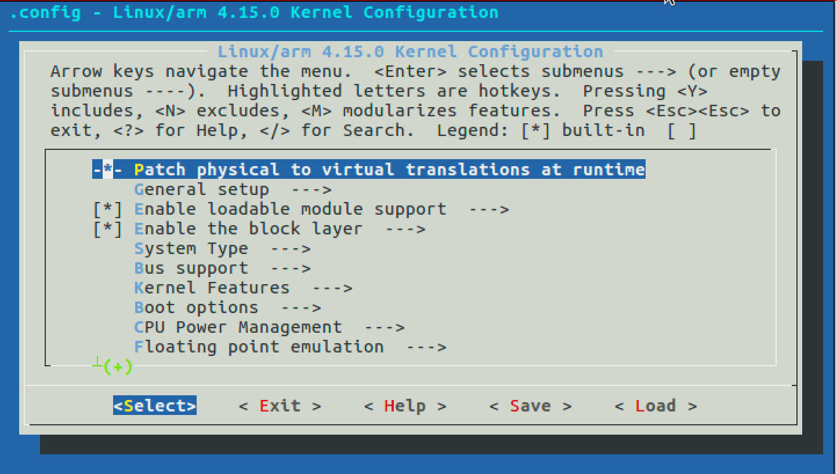
menuconfig

Slide 16
Menuconfig
Up/Down moves through selections
Left/Right moves through bottom selections
Enter goes into “→” subdirectories
Space toggles values
Y/N/M allows you to choose values
“/” allows to search options by name

Slide 17
Bulding a module in tree
Add your code into the tree
Add yourself to Kconfig
Add configuration to .config with menuconfig
make will then build the kernel and your module

Slide 18
Bulding a module out-of-tree
KROOT=/path/to/relevant/kernel/headers
make -C $KROOT M=$(pwd) modules
Use the make system in $KROOT
Build the modules in the local directory

Slide 19
Cross compiling a module
Set ARCH to the architecture you want to build
Set CROSS_COMPILE to the compiler triplet
make -C $ROOT M=$(pwd) ARCH=arm \
CROSS_COMPILE=arm-linux-gnueabihf- modules

Slide 20
Installing a module
Copies a module to /usr/modules/$(uname -r)
make -C $ROOT M=$(pwd) ARCH=arm modules_install

Slide 21
insmod
Insert a module into a running kernel
Invokes the in-kernel linker to link the module into the kernel using the kernel symbol table
$ sudo insmod /path/to/modulename.ko <options>
Modules are files with the modulename ending in .ko

Slide 22
lsmod
List currently loaded modules
Top module was most recently loaded
Lists size, reference count, and optional dependencies
debian@beaglebone:~$ lsmod
Module Size Used by
Evdev 13811 1
uio_pdrv_genirq 4205 0
uio 11036 1 uio_pdrv_genirq
usb_f_mass_storage 51462 2

Slide 23
rmmod
Remove a module by name (not filename)
You can remove more than one module at a time, but the order matters if there are dependencies
$ rmmod foo
$ rmmod bar blah

Slide 24
depmod
Builds dependency files for all modules used by modprobe
$ ls -1 /lib/modules/$(uname -r)
modules.alias
modules.builtin
modules.dep
modules.order
modules.symbols

Slide 25
modprobe
A “smart” insmod
Will load module pre-dependencies
Allows you to set persistent options (and more)
Uses /etc/modprobe.conf and /etc/modprobe.d
Used by udevd to load drivers

Slide 26
Modprobe configuration
/etc/modprobe.d/foo.conf
blacklist bar
options blah option1=value option2=value … alias genericname foo

Slide 27
modinfo
Shows module metadata
root@beaglebone:~# modinfo uio
filename: /lib/modules/4.9.82-ti-r102/kernel/drivers/uio/uio.ko
license: GPL v2
depends:
intree: Y
vermagic: 4.9.82-ti-r102 SMP preempt mod_unload \
modversions ARMv7 p2v8

Slide 28
dmesg
dmesg shows kernel in-memory log buffer.
Using the “-w” option does a “tail” of the log
root@beaglebone:~# dmesg -w

Slide 29
Questions?

Slide 30

Thank you!

