Slide 1
GDB Debugging in Both User and Kernel Space
Mike Anderson
mailto://mike@theptrgroup.com

Slide 2
What We Will Talk About…
The GNU Project, GCC and gdb
Native vs. cross debugging
Compiling for debugging
gdb CLI, TUI and gdbfront-ends
Getting help, scripts and macros
Launching, loading and running applications
Attaching to a running application
Breakpoints, watchpoints, catchpoints and more
gdbserver and its options
Setting up for kernel debugging
Running the kernel with kgdb

Slide 3
The GNU Project and GCC
The ostensible goal of the GNU Project was to create a Un*x clone without any AT&T sources
  GNU’s Not Unix
First, there was the GNU C compiler (gcc)
  Later there was a C++ version (g++)
  Architected as a front-end language parser and a back-end code generator
  Also added numerous binutils such as the linker, librarian, etc.
gcc was originally targeted as an OS bring-up tool and was completely command-line driven
As more language front-ends were added, it became GCC
  GNU Compiler Collection
    Front ends for C, C++, Objective-C, FORTRAN, Ada and Go with associated libraries like libstdc++, etc.
Community supported and peer reviewed with support from major silicon manufacturers

Slide 4
GDB
The GNU debugger (gdb) was built as a source debugger for GCC
  gdb supports Ada, Assembly, C/C++, D, FORTRAN, Go, Objective-C, OpenCL, Modula-2, Pascal and Rust
    No direct Python or Java support (gcj was dropped from GCC in 2017)
Also designed to be run from a CLI
  But, there are numerous GUI front-ends to gdb

Slide 5
Native vs. Cross Debugging
This mirrors the development approach
  Native means it’s running on the platform your debugging the code on
  Cross debugging is running gdb on a host computer and talking to the code via a connection to, typically, a foreign CPU architecture
Native debugging may leave you with using the CLI if there isn’t enough horsepower or hardware on the target to run a window manager or VNC
Cross debugging allows you to use the horsepower of your development host to run the debugger while the code runs on the target via a helper application
  Cross debugging adds connection latency and complexity
    The ease of use of the GUI front end may be worth it

Slide 6

Compiling for Debugging
gdb will typically require the source code to be
specially compiled for debugging
  You can still debug non-debug code if you really like
  assembly language
Uses the DWARF debugging standard file format
  The debugging information can be extracted from the
  executable using objcopy or strip
To build the code with debugging enabled, we use the -g option to the compiler
  But, there are several levels of debug information we can include
Source: dwarfstd.org

Slide 7
GDB Debug Levels
-g0 will explicitly produce no debug information
-g1 produces minimal information, enough for making back traces, but no information about local variables and no line numbers
-g2 default debug level when not specified. Typically this will produce symbols, line numbers etc needed for symbolic debugging
  This is the default for the -g option to the compiler
-g3 includes extra information, such as all the macro definitions present in the program

Slide 8
Example Compile for GDB
Example compilation to enable debugging
$ arm-linux-gnueabi-gcc –g3 –o hello helloWorld.c
Example for examining the debug info in ELF header
$ arm-linux-gnueabi-objdump -h hello
…
24 .comment 0000002a 00000000 00000000 00000a97 2**0
CONTENTS, READONLY
25 .debug_aranges 00000020 00000000 00000000 00000ac1 2**0
CONTENTS, READONLY, DEBUGGING
26 .debug_pubnames 00000031 00000000 00000000 00000ae1 2**0
CONTENTS, READONLY, DEBUGGING
27 .debug_info 00000179 00000000 00000000 00000b12 2**0
CONTENTS, READONLY, DEBUGGING
28 .debug_abbrev 000000d4 00000000 00000000 00000c8b 2**0
CONTENTS, READONLY, DEBUGGING
29 .debug_line 000003ea 00000000 00000000 00000d5f 2**0
CONTENTS, READONLY, DEBUGGING
30 .debug_frame 00000090 00000000 00000000 0000114c 2**2
CONTENTS, READONLY, DEBUGGING
31 .debug_str 000000ea 00000000 00000000 000011dc 2**0
CONTENTS, READONLY, DEBUGGING
32 .debug_loc 00000058 00000000 00000000 000012c6 2**0
CONTENTS, READONLY, DEBUGGING
33 .debug_macinfo 00009e52 00000000 00000000 0000131e 2**0
CONTENTS, READONLY, DEBUGGING

Slide 9
Running GDB CLI
When gdb is built from source, we will specify the host and target environments
  Allows for Windows x Linux, x86 host x ARM target, etc.
When running gdb from the CLI, we can just use the gdb command:
GNU gdb (Ubuntu 7.11.1-0ubuntu1~16.5) 7.11.1
Copyright (C) 2016 Free Software Foundation, Inc.
License GPLv3+: GNU GPL version 3 or later <http://gnu.org/licenses/gpl.html>
This is free software: you are free to change and redistribute it.
There is NO WARRANTY, to the extent permitted by law. Type "show copying"
and "show warranty" for details.
This GDB was configured as "x86_64-linux-gnu".
Type "show configuration" for configuration details.
For bug reporting instructions, please see:
<http://www.gnu.org/software/gdb/bugs/>.
Find the GDB manual and other documentation resources online at:
<http://www.gnu.org/software/gdb/documentation/>.
For help, type "help".
Type "apropos word" to search for commands related to "word".
(gdb)

Slide 10
Running gdb in TUI Mode
TUI mode is a text-based user interface that separates out the program text from the gdb command line
More clear cut than using the typical CLI, but maybe not as good as the GUIs for gdb like ddd
You can start gdb in TUI mode using the –TUI command line argument
You can switch in and out of TUI mode using
<CTRL> X A keyboard sequence

Slide 11
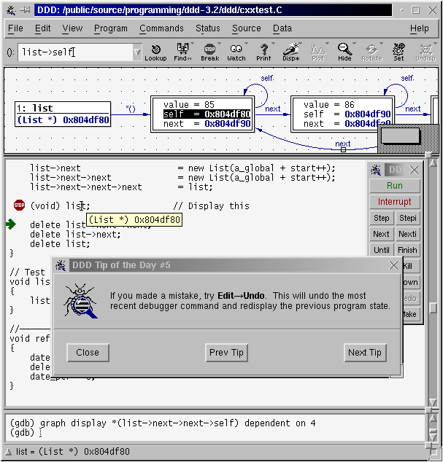
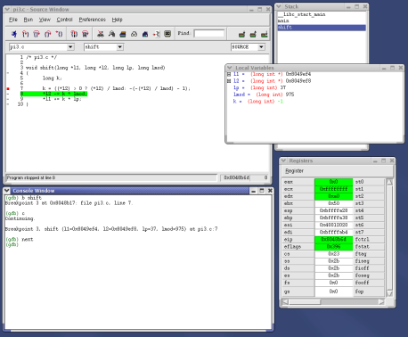
GDB GUIs
There are standalone and IDE-based
front ends to gdb
These include:
  ddd
    Data Display Debugger
      Also works with cross debugging
      http://www.gnu.org/software/ddd/
  insight
    Redhat-developed
    MDI GUI approach
    http://sourceware.org/insight/
IDE support includes Eclipse, Kdevelop,
Slickedit®, CodeWarrior®, Arriba® and more

Slide 12
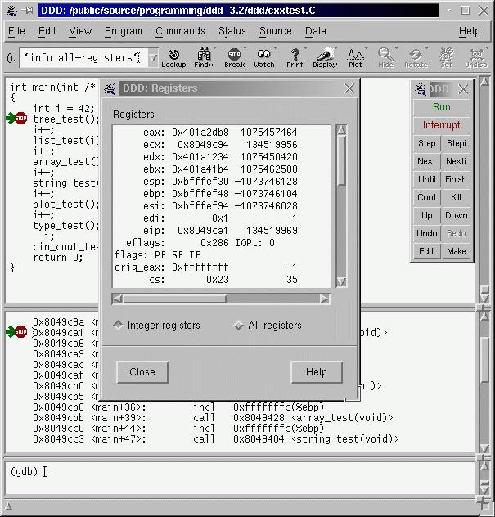
ddd Front End GUI
ddd is the GNU-supported graphical
interface for gdb
ddd supports:
  gdb, jdb, Python, Perl, TCL and PHP
You can automatically load the application
into gdb at invocation
ddd can be started with the
-debugger option to run a
gdb backend other than the
default gdb instance
$ ddd –debugger arm-linux-gnueabi-gdb myapp

Slide 13
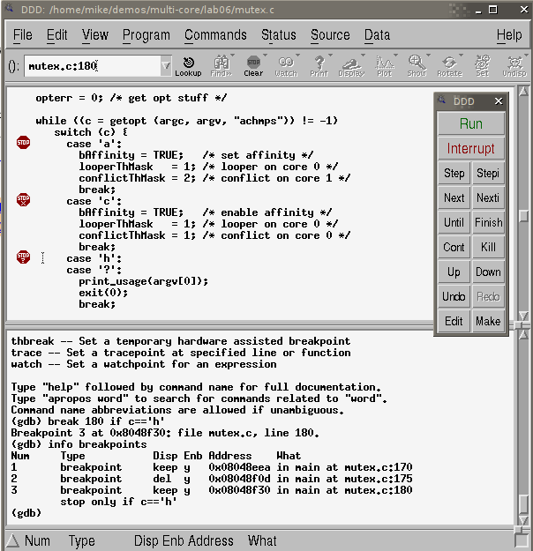
The ddd GUI
Main code window
Command Shortcuts
GDB command line

Slide 14
Getting Help in gdb
Whether using the CLI or the GUI, you should have access to the gdb command line
  It looks like (gdb)
You can use the help command at the (gdb) prompt for any query
Use the apropos <word> command to find which gdb commands might apply to your query
Throughout the gdb help output, you will see references to “the inferior”
  Yes, that’s your program – don’t get a complex about it!
    As far as gdb is concerned, your program is running under gdb’s control

Slide 15
Example Help Output
(gdb) help
List of classes of commands:
aliases -- Aliases of other commands
breakpoints -- Making program stop at certain points
data -- Examining data
files -- Specifying and examining files
internals -- Maintenance commands
obscure -- Obscure features
running -- Running the program
stack -- Examining the stack
status -- Status inquiries
support -- Support facilities
tracepoints -- Tracing of program execution without stopping the program
user-defined -- User-defined commands
Type "help" followed by a class name for a list of commands in that class.
Type "help all" for the list of all commands.
Type "help" followed by command name for full documentation.
Type "apropos word" to search for commands related to "word".
Command name abbreviations are allowed if unambiguous.

Slide 16
Command Definition and Macros
gdb has the ability to define your own commands/scripts
Use the define <name> command to define a sequence of gdb commands
  Enter each one line-by-line and finish with a single line “end”
    Useful for creating debugging command scripts that you can save for later use or just to save repeated typing
Use the document <name> to write documentation for your defined commands
  Again, enter each one line-by-line and finish with a single line “end”
There is also the ability to define C/C++ preprocessor macros using the macro define command
  Visible to all of the inferior’s source files

Slide 17
gdb Scripts
If it exists, gdb will execute all of the commands found in .gdbinit in the current directory
Useful for executing a sequence of gdb commands at gdb initialization
The -x command line option to gdb also allows for running scripts at gdb load time

Slide 18
Examining Code
Once the program is loaded in gdb, you can list any of the source files using the list command
  Options to list a LINENUM, FILE:LINENUM, FUNCTION, FILE:FUNCTION or *ADDRESS
You can specify the number of lines to list as a second parameter
  Defaults to 10 but can be changed with
  set listsize

Slide 19
Manipulating Internal Settings
gdb has dozens internal options like setting the radix, terminal type, command history size and more
  Use show on the gdb command line to see them all
You can change the options using the set command
  E.g., set output-radix 16 would set the display radix to hexidecimal

Slide 20
Load/Execute Your Code
If you don’t load the program from the command line, you can load additional files using the
file <filename> command
Once the code is loaded into gdb, you can execute it using the run command
You can pass parameters in the same command or you can use the set args command
  show args will allow you to see the arguments

Slide 21
Calling Functions Interactively
Once the code is loaded, you can actually call program functions from the gdb command line
  The syntax and parameter passing is based on the language the code is written in
The function will be called and the return will be printed and saved in the value history

Slide 22
Setting Variables
You can define new variables, set a register value or modify program variables using the
set VAR = EXP (or whatever the language equivalent is for your language)
  Expressions are any valid expression for the language
You can set a variable that uses the same name as a gdb command using the
set variable VAR = EXP syntax

Slide 23
Printing Expressions
Use the print EXP syntax to print any value from the current stack frame, globals or an entire file
Use $NUM to get the previous value of NUM
  You can refer back farther using $$NUM
Registers are accessed using the $<REGNAME> syntax
{TYPE}ADREXP refers to datum of data type {TYPE} located at address ADREXP
The @ symbol is a binary operator for treating consecutive data objects anywhere in memory as an array
  E.g., FOO@NUM gives an array whose first element is foo, whose second is stored in the memory adjacent to FOO, etc.

Slide 24
Printing Expressions #2
EXP may be preceded with a /FMT modifier where /FMT is a single character without a length modifier
Format letters are o(octal), x(hex), d(decimal), u(unsigned decimal), t(binary), f(float), a(address), i(instruction), c(char), s(string) and z(hex, zero padded on the left)
The specified number of objects of the specified size are printed according to the format
print can also dereference addresses ala
(gdb) print *ptr

Slide 25
The Difference Between Print and Display
There is another mechanism for displaying the value of a variable that that is the display command
Like print, display can show the variable with a format
However, display prints the variable’s value after every step
  Useful to see where a variable changes

Slide 26
Examine Memory at Address
If we have a known address in memory, such as a pointer, we can display the memory at that address
We can also use a format character but x also adds an additional character to indicate the size of the display
Size letters are b(byte), h(halfword), w(word), g(giant, 8 bytes)
E.g., (gdb) x /db &test

Slide 27
Setting Breakpoints
gdb supports several types of breakpoint
  Normal breakpoints b <lineno>
  Temporary breakpoints tbreak <lineno>
  Hardware breakpoints hbreak <lineno>
Often the gdb GUI frontends normally have a menu option for these
You can also set conditional breakpoints
  Beware of the overhead of these
(gdb) break <lineno> if <condition is true>

Slide 28
Setting Breakpoints #2
Use symbols to identify a breakpoint
(gdb) b main
Breakpoint 1 at 0x8048355: file watch.c, line 5
(gdb) run
Starting program:/home/pocket/debug/watch
Breakpoint 1, main() at watch.c:5
You can issue commands to be run when the breakpoint is hit
(gdb) After b main
(gdb) commands
Type commands to be executed when breakpoint 1 is hit, one per line
End with a line saying just “End”
> silent
> printf “ main started\n”
> cont
> end

Slide 29
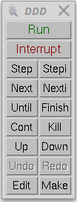
Stepping Through Code
gdb has a number of ways to step through
the code after encountering a breakpoint
Step – step one line and step into functions
Next – step one line and step over functions
Finish – you stepped into a function
accidentally and you want to finish
this routine
Stepi – step one assembly language instruction
and step into function calls
Nexti – step one assembly language instruction
but step over function calls

Slide 30
Attach to a Running Program
gdb has the ability to attach to a running program
$ gdb –p <process id>
This will stop the running program at its current execution point
You can then load the executable’s code and symbol table using the file command to load the source if it hasn’t already been loaded

Slide 31
Monitoring a Variable
Often, we’ll find ourselves with a variable that’s getting stepped on by something
  We’re just not sure where or when
To help locate these occurrences, gdb has an option known as a watchpoint
Uses a hardware breakpoint (if available)‏

Slide 32
Watchpoints
Force a program break when a selected variable’s value changes
Show old and new value and location in code that caused the change in value
(gdb) b main
(gdb) run
(gdb) watch x
(gdb) cont
Hardware watchpoint 2: x
Old value = 13451357
New value = 10
Main() at watch.c:10

Slide 33
Breaking on Events
gdb also has a means of breaking when certain events occur
  These include exceptions, calls to fork, loading shared libraries, signals, syscalls, unloading shared libraries, calls to exec and much more
We can also reinject a exception with the rethrow options

Slide 34
Catchpoints
Used for C++ catch and throw events as well as Ada failed assertions
(gdb) catch throw
(gdb) catch catch
Use tcatch for a one-time catch that is automatically deleted after the first time it’s caught

Slide 35
Deleting Breakpoints, Watchpoints, etc.
To list breakpoints, etc. use:
(gdb) info breakpoints
To delete a breakpoint, watchpoint or catchpoint use:
(gdb) delete [breakpoint]
Clear breakpoints associated with functions
(gdb) clear |function| line num | file:function | file:line |
At any point, you can use the help feature to understand your options e.g.,:
(gdb) help breakpoints
There are several good books, websites and manual pages on the features of gdb

Slide 36

Debugging with Optimization
Ideally, if you’re debugging code, you should disable any code optimization
  But, sometimes that is impossible due to in-lining of functions like in the kernel
You can debug optimized code
  However, be prepared for some odd behavior
  on the part of the debugger
    Variables might be removed
    The instruction pointer can go backwards
    The debug is still valid, but the behavior can be disconcerting
Source: blogspot.com

Slide 37
Accessing Local Variables
Show local symbols
(gdb) info locals
Show CPU registers
(gdb) info registers
Display stack back trace
(gdb) bt (backtrace)‏
Gives detailed information on the current stack frame
(gdb) info frame

Slide 38
Working with Signals via gdb
Show signals
(gdb) info signals
Prints a table of how signals and how gdb will handle each one
(gdb) info handle
Change the way gdb will handle the signal
  nostop – do not stop the program but still print that signal occurred
  stop – stop program when signal occurs (implies print as well)
  print – print a message when signal occurs
  noprint – do not mention the occurrence of the signal
  pass – allow your program to see the signal so it can be handled
  nopass – do not pass the signal to your program
(gdb) handle signal keywords
Delivers a SEGV signal to the current program
(gdb) signal SIGSEGV

Slide 39

Debugging Threads
Show active thread ids
(gdb) info threads
Select a thread by id
(gdb) thread n
Restrict breakpoint to a particular thread
(gdb) break <break ident> thread <id>
  Not specifying a thread ID will cause the breakpoint to apply to all threads
Restrict thread execution to current thread
(gdb) set scheduler-locking on | off
Source: optusnet.com.au

Slide 40

Generating “Core Dumps”
When an application terminates abnormally, a
core file can be generated
  core file - (n.) A file created when a program malfunctions
  and terminates. The core file holds a snapshot of
  memory, taken at the time the fault occurred. This file
  can be used to determine the cause of the malfunction
By default, this feature is disabled to preclude
“core droppings” in the file system
  Use:
  $ ulimit –c <max core file size in disk sectors>
  to re-enable core file generation
Source: heartrails.com

Slide 41
Checking Core Dumps Settings
First, check to see the default settings in your system
$ ulimit -a
core file size (blocks, -c) 0
data seg size (kbytes, -d) unlimited
scheduling priority (-e) 20
file size (blocks, -f) unlimited
pending signals (-i) 16382
max locked memory (kbytes, -l) 64
max memory size (kbytes, -m) unlimited
open files (-n) 1024
pipe size (512 bytes, -p) 8
POSIX message queues (bytes, -q) 819200
real-time priority (-r) 0
stack size (kbytes, -s) 8192
cpu time (seconds, -t) unlimited
max user processes (-u) unlimited
virtual memory (kbytes, -v) unlimited
file locks (-x) unlimited

Slide 42
Core Dump pid-centric Files
Generating separate core files per process when multiple applications die simultaneously
A proc entry already exists for this
/proc/sys/kernel/core_uses_pid
Turn it on by
$ sudo echo “1” > /proc/sys/kernel/core_uses_pid
Now, each process generating a core dump will have a corresponding file core.<pid> on rootfs

Slide 43
Using the Core File
Once you have a core file, you can use gdb to try to determine what went wrong
Load the core file using:
$ gdb <application name> -core <corefile>
gdb will load the application and will show you the point of failure
This will also work with most gdb front-ends
  eclipse
  ddd
  Insight

Slide 44
Core Dump Debugging Example #1
Application that produces a core dump
app1.c
/* global variables */
int value = 20;
int divide = 4;
int sum = 0;
int main(int argc, char *argv[])
{
volatile int result, x;
for(x = 0; x < NUM_ITERATIONS; x++)
{
printf("value = %d divide = %d sum = %d\n", value, divide, sum);
result = compute_it(value, divide);
sum += result;
divide++;
value--;
}
return 0;
}

Slide 45
Core Dump Debugging Example #2
/***************************************************************************
* compute_it - support routine
*
*/
int compute_it(int no1, int no2)
{
volatile int result;
#ifdef FP_ERROR /* Generate an arithmetic/floating point error */
volatile int diff;
diff = no1 - no2;
result = no1 / diff;
#else if /* Generate a segmentation violation error */
int * ptr;
*ptr = 0;
#endif
return result;
}

Slide 46
Core Dump Debugging Example #3
Build the application with debug info in the ELF
$ gcc -g3 -o app1 app1.c
Run the application and generate core file
$ ./app1
value = 20 divide = 4 sum = 0
Segmentation fault (core dumped)
Invoke gdb to analyze the core file
$ gdb app1 -core core

Slide 47
Core Dump Debugging Example #4
gdb command line console output
GNU gdb (Ubuntu 7.11.1-0ubuntu1~16.5) 7.11.1
Copyright (C) 2016 Free Software Foundation, Inc.
License GPLv3+: GNU GPL version 3 or later <http://gnu.org/licenses/gpl.html>
This is free software: you are free to change and redistribute it.
There is NO WARRANTY, to the extent permitted by law. Type "show copying"
and "show warranty" for details.
This GDB was configured as "x86_64-linux-gnu".
For bug reporting instructions, please see:
<http://www.gnu.org/software/gdb/bugs/>...
Reading symbols from /home/student/debug/linux_debug_perf_labs/lab02/app1...done.
[New Thread 15231]
warning: Can't read pathname for load map: Input/output error.
Reading symbols from /lib/libc.so.6...(no debugging symbols found)...done.
Loaded symbols for /lib/libc.so.6
Reading symbols from /lib64/ld-linux-x86-64.so.2...(no debugging symbols found)...done.
Loaded symbols for /lib64/ld-linux-x86-64.so.2
Core was generated by `./app1'.
Program terminated with signal 11, Segmentation fault.
#0 0x00000000004005d6 in compute_it (no1=20, no2=4) at app1.c:70
70 *ptr = 0;
(gdb)

Slide 48
Core Dump Debugging Example #5
Examine the core file for additional information
(gdb) info locals
result = 32637
ptr = 0x7f7d81d30250
(gdb) info frame
Stack level 0, frame at 0x7fff55ea7a20:
rip = 0x4005d6 in compute_it (app1.c:70); saved rip 0x400578
called by frame at 0x7fff55ea7a60
source language c.
Arglist at 0x7fff55ea7a10, args: no1=20, no2=4
Locals at 0x7fff55ea7a10, Previous frame's sp is 0x7fff55ea7a20
Saved registers:
rbp at 0x7fff55ea7a10, rip at 0x7fff55ea7a18

Slide 49
Core Dump Debugging Example #6
(gdb) info registers
rax 0x7f7d81d30250 140177025729104
rbx 0x14 20
rcx 0x400700 4196096
rdx 0x4 4
rsi 0x4 4
rdi 0x14 20
rbp 0x7fff55ea7a10 0x7fff55ea7a10
rsp 0x7fff55ea7a10 0x7fff55ea7a10
r8 0x1 1
r9 0x400700 4196096
r10 0x7fff55ea7030 140734634815536
r11 0x7f7d81a1c060 140177022500960
r12 0x400440 4195392
r13 0x7fff55ea7b30 140734634818352
r14 0x0 0
r15 0x0 0
rip 0x4005d6 0x4005d6 <compute_it+14>
eflags 0x10206 [ PF IF RF ]
cs 0x33 51
ss 0x2b 43
ds 0x0 0
es 0x0 0
fs 0x0 0
gs 0x0 0

Slide 50
Core Dump Debugging Example #7
(gdb) info stack
#0 0x00000000004005d6 in compute_it (no1=20, no2=4) at app1.c:70
#1 0x0000000000400578 in main (argc=1, argv=0x7fff55ea7b38) at app1.c:46
(gdb) info variables
All defined variables:
File app1.c:
int divide;
int sum;
int value;
Non-debugging symbols:
0x00000000004006d8 _IO_stdin_used
0x0000000000601018 __dso_handle
0x0000000000601028 completed.7382
0x0000000000601030 dtor_idx.7384
0x0000000000000008 __resp
0x0000000000000010 errno
0x0000000000000054 h_errno

Slide 51
What to Remember about Core Files
The key characteristic of a core file is that it is post mortem
  The application is already dead and no amount or wishing on your part will bring it back
Therefore, you are limited to examining the state of the software when the error occured

Slide 52
Cross Debugging
While many of today’s more modern development boards have sufficient RAM and CPU performance to support native debugging, you can often achieve a better experience using cross debugging
We will run gdb on the host and a debug agent on the target to facilitate debugging
We will use a connection between the target and host computer to enable cross debugging

Slide 53
Using gdb with Cross Debugging
As indicated earlier, gdb has the –debugger feature to allow us to specify an alternate back end for the debugger
  E.g., we can debug ARM code from an x86
We will need to use the target remote command in gdb to connect to a waiting debug agent

Slide 54
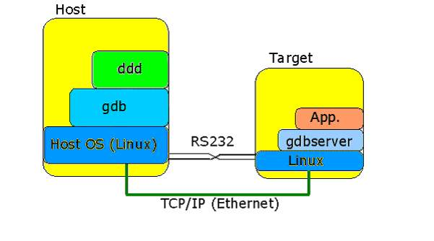
Remote Debugging with gdb/gdbserver
The DWARF debug format does
not change because we’re using an
alternate processor type
We will load the code to be debugged
into the local gdb session and then
connect with the remote gdbserver
  Communications with the gdbserver helps keep the gdb session in sync
The application to be debugged runs under the control of the gdbserver application
  Uses ptrace() functions to control starting and stopping of the target application
Source: codeproject.com

Slide 55
Debugging with gdb/gdbserver #2
Remote gdb debugging offers a flexible client/server design with many different target communications options
  Serial
    Has option to allow the target console to share the same serial port with the target console
  Network
  Direct hardware communications e.g., JTAG
It is possible to use the non-debug enabled code on the target as long as the gdb has access to a debug-enabled version of the exact same code
  Avoids memory footprint concerns on the target

Slide 56
gdb/gdbserver Cross Debug Example
For example:
  On the target:
$ gdbserver 192.168.7.1:1929 myapp &
  On the host:
(gdb) target remote 192.168.7.2:1929
gdbserver can attach to a running program
$ gdbserver hostIP:2345 --attach PID
Works within GUI-based front-ends as well
  You must tell gdb which back-end to use
$ ddd –debugger arm-linux-gnueabi-gdb myapp

Slide 57
gdb/gdbserver Debugging Options
target remote command options
  serial port device (/dev/ttyS0)‏
  tcp/ip address:port (e.g., 192.168.100.2:4000)‏
  udp/ip address:port (e.g., udp:192.168.100.2:4000)‏
Use set debug remote 1 to see packets sent to and from the agent
Once connected, a remote gdb/gdbserver session is just like a native gdb session

Slide 58
Running Your Program with gdbserver
If you’re using gdbserver, you can’t “run” you can only “continue”
  The program is already running under the control of the gdbserver helper
You can examine your program’s arguments using the show args command
  You can change the arguments for the next run using set args command

Slide 59
Debugging the Kernel with gdb
For many years, Linus fought against including a source debugger into the kernel
  “If you can’t debug with printk, you shouldn’t be in the kernel”
Much of this reluctance was due to the implementation of kgdb at the time
  It touched hundreds of files to patch the debugger in
Late in the 2.6 kernel series, a new kgdb lite version was developed and we finally got a debugger!

Slide 60
Compiling the Kernel with Debug Info
This will increase the size of the debug kernel image by about 30%
However, you don’t need to load the debug version of the kernel
  Load the non-debug version to the target, but use the debug version for the debugger/JTAG probe
Save off the vmlinux and System.map files because these are used by the debugger or by you to find key addresses
  The (b)zImage can be loaded on the target as normal

Slide 61
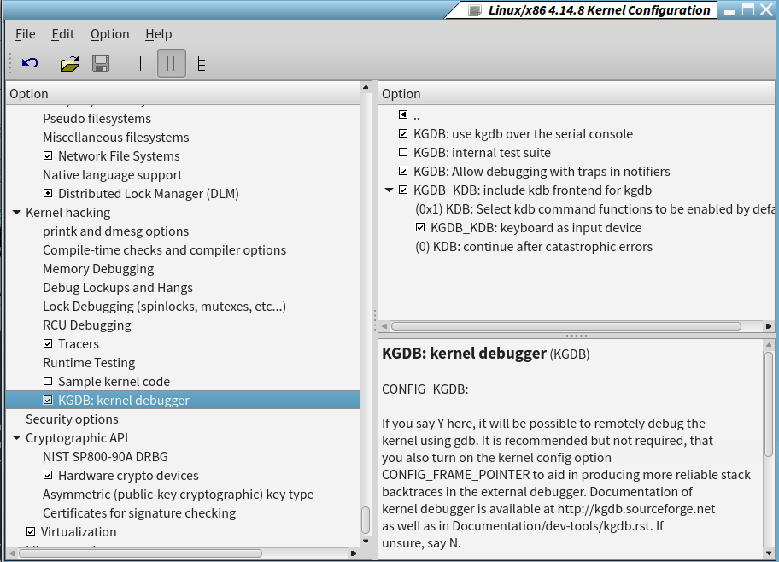
Enabling Debugging in the Kernel

Slide 62


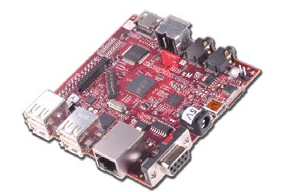
KGDB Lash up
KGDB supports debugging via the serial port
  The gdb debugger is running on a second machine using the vmlinux you compiled with debugging symbols
  You attach to the system being debugged using gdb’s
  target remote command
Network
Host
Target
Ethernet
RS-232
Sources: dell.com, beagleboard.org, netgear.com

Slide 63
Once Everything is Connected
Once everything is connected and the target remote command is entered on the debugger, you will reset the target with the new kernel
The boot cycle will stop until the kernel detects gdb on the other side
  Once connected, you can set breakpoints in the kernel and tell it to continue

Slide 64
Adding Device Driver Symbols
Statically linked driver symbols are already built into the kernel’s symbol table
  Simply set break points on the driver methods themselves
Dynamically loaded drivers require additional steps
  Load the driver as normal
    We need to find the addresses used by the driver

Slide 65
Debugging Loadable Modules
In order to debug a loaded module, we need to tell the debugger where the module is in memory
  The module’s information is not in the kernel image because that shows only statically-linked drivers
This information can typically be found in /proc/modules or /sys/module/<modulename>/sections/.text
We then use the add-symbol-file gdb command to add the debug symbols for the driver at the address for the loaded module
  (gdb)add-symbol-file ./mydriver.o 0x<addr>
How we proceed depends on where we need to debug

Slide 66
Debugging Loadable Modules #2
  If we need to debug the __init code, we need to set a breakpoint in the load_module() function
We’ll need to breakpoint just before the control is transferred to the module’s __init
  Somewhere around line 3438 of module.c (4.14.8 kernel):
/* Start the module */
if (mod->init != NULL)
ret = do_one_initcall(mod->init);
Once the breakpoint is encountered, we can walk the module address list to find the assigned address for the module

Slide 67
Adding Additional Breakpoints
Once you’ve added the module’s symbols, you can set breakpoints at the various entry points of the driver
(gdb) b mydriver_read
Other good breakpoint locations include:
  sys_sync
  panic
  oops_enter
When you hit the breakpoint, the debugger will drop to the source code and you can start single stepping code

Slide 68
Summary
Wow, that was a lot!
But, at this point, you should be pretty well aware of how to use gdb for both native and cross debugging
Just remember, if you don’t put the bugs in there to begin with, you don’t have to work so hard to get them out ☺

