Slide 1
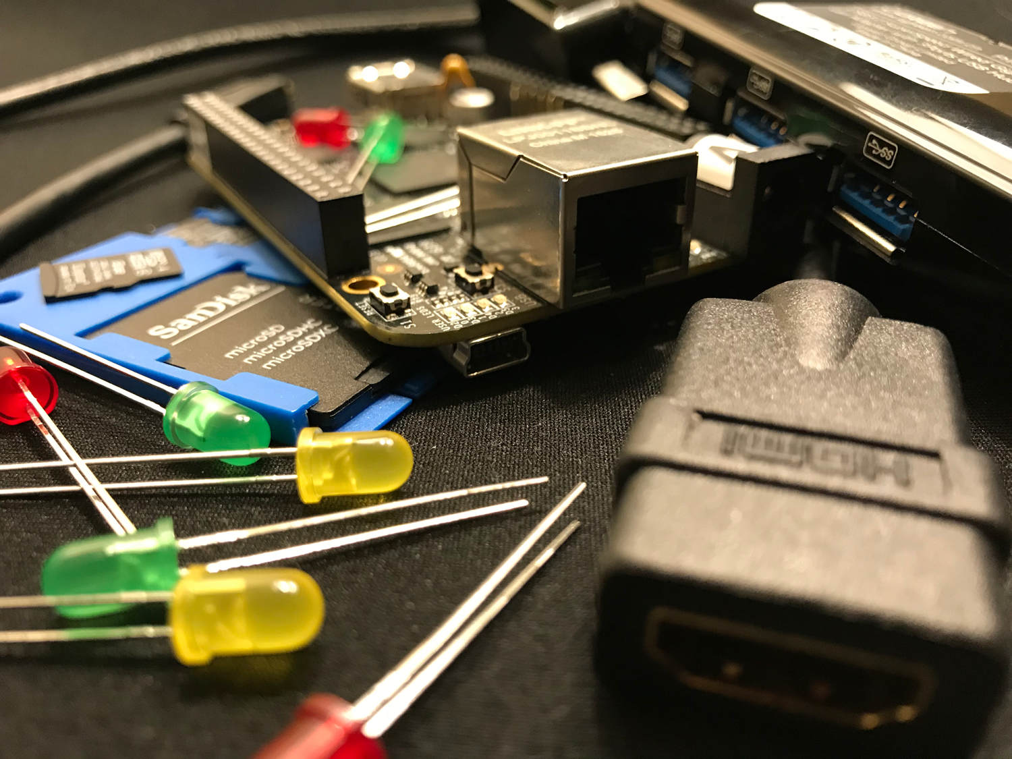
Building Images with
Yocto Project

Slide 2
What is the Yocto Project?
A Linux Foundation project that helps you build your own custom Linux distribution, from source to installable image
A collection of tools to make building your own custom Linux distribution easier
“yocto” is the smallest unit prefix in the SI system (10⁻²⁴)

Slide 3
What is Open Embedded?
A build system, using the “bitbake” tool, to create a Linux distribution
A long time ago, in a galaxy far far away, it was what came to be known as Open Embedded Classic
A not for profit organization which aims to champion embedded Linux

Slide 4
What is poky?
“poky” is the reference distribution used to make sure the Yocto Project is “all systems normal”
A conveniently and legally different name for something that sounds the same as a chocolate dipped cookie stick popular in Japan
Not an equine companion to a green clay-mation character from a popular children’s Saturday morning show that sounds like it might be not so fast

Slide 5
What is poky?
bitbake
openembedded-core
meta-yocto
combolayer
poky

Slide 6
What is poky?
$ tree -L 1 poky
poky
├── bitbake
├── documentation
├── LICENSE
├── meta
├── meta-poky
├── meta-selftest
├── meta-skeleton
├── meta-yocto-bsp
├── oe-init-build-env
├── README.hardware
├── README.LSB
├── README.poky
├── README.poky
└── scripts

Slide 7
Enough History we just want to build an image for our PocketBeagle!

Slide 8
What do we mean by “image”?
/boot (and boot loader)
kernel (and kernel modules)
rootfs
  /etc
  /var
  /usr

Slide 9
Cloning our tools and metadata
git clone bitbake
OR
git clone openembedded-core
git clone poky
git clone meta-foo

Slide 10
Setting up our build environment
Without any options
MACHINE ??= “qemux86”
. ./poky/oe-init-build-env
TOP_DIR = “./build”

Slide 11
Questions?

Slide 12

Thank you!

