Slide 1
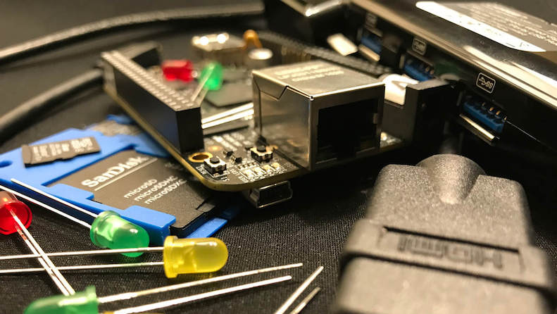


The Official E-ALE
BaconBits HW Kit

Slide 2
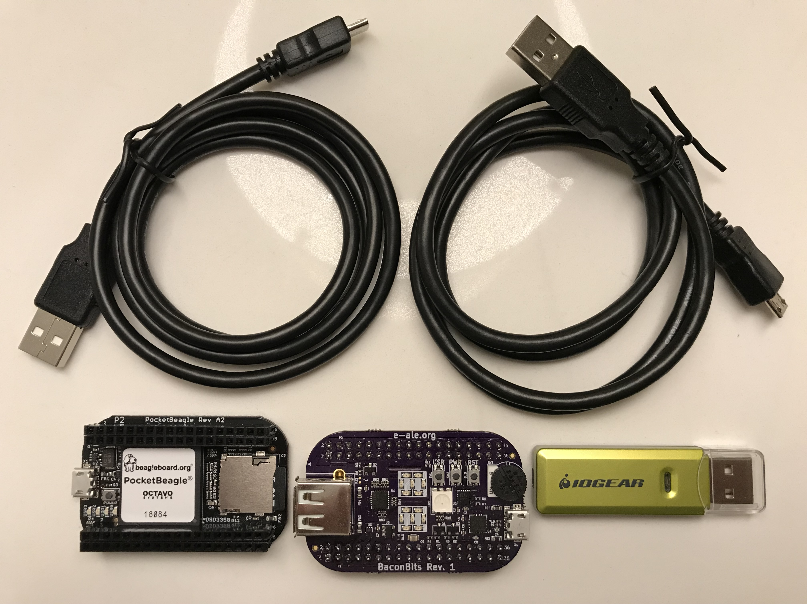

The HW Kit
2x micro USB cables
1 uSD card reader
1 Pocket BeagleBoard
1 BaconBits Cape
1 uSD card
1 uSD o SD adaptor

Slide 3
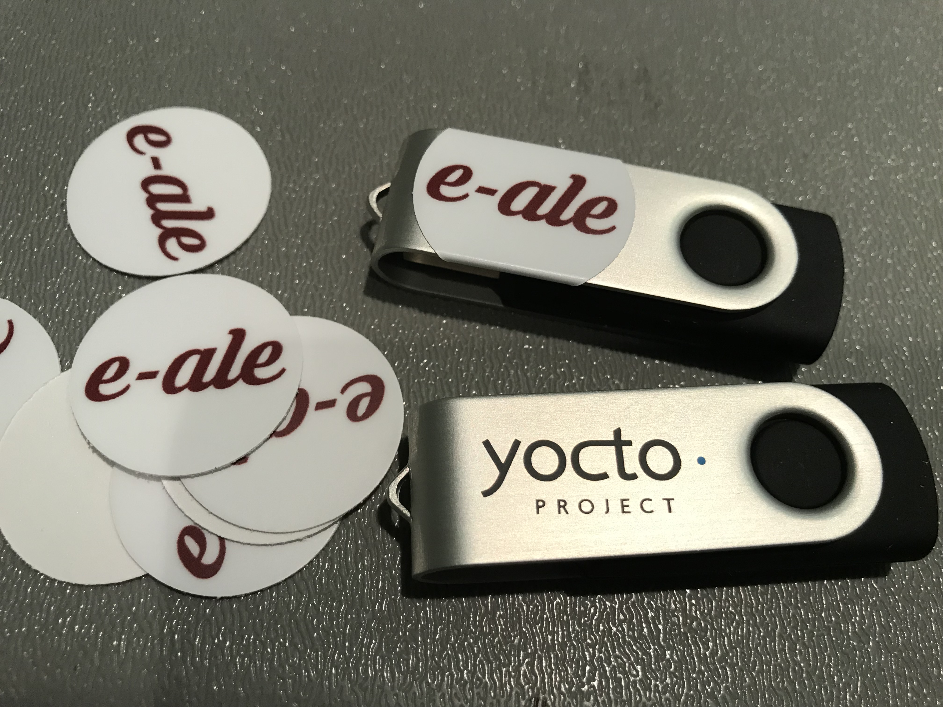
Slides on USB Key
4GB USB Key
Contains all the slides
Contains all the code
Yours to keep

Slide 4
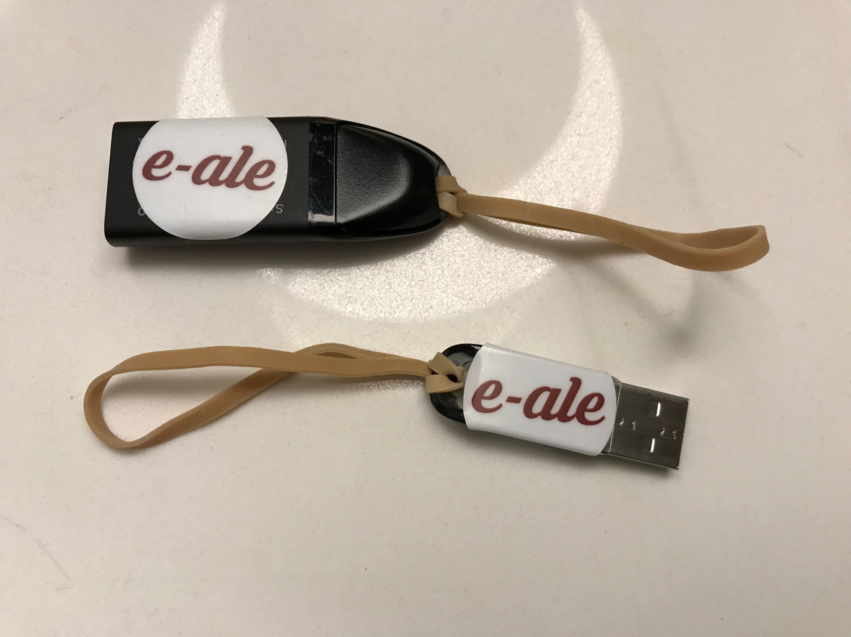
USB Keys with rubber bands
These USB Keys are for transferring Yocto Images only
We’d like to get these back when you’re finished please.

Slide 5
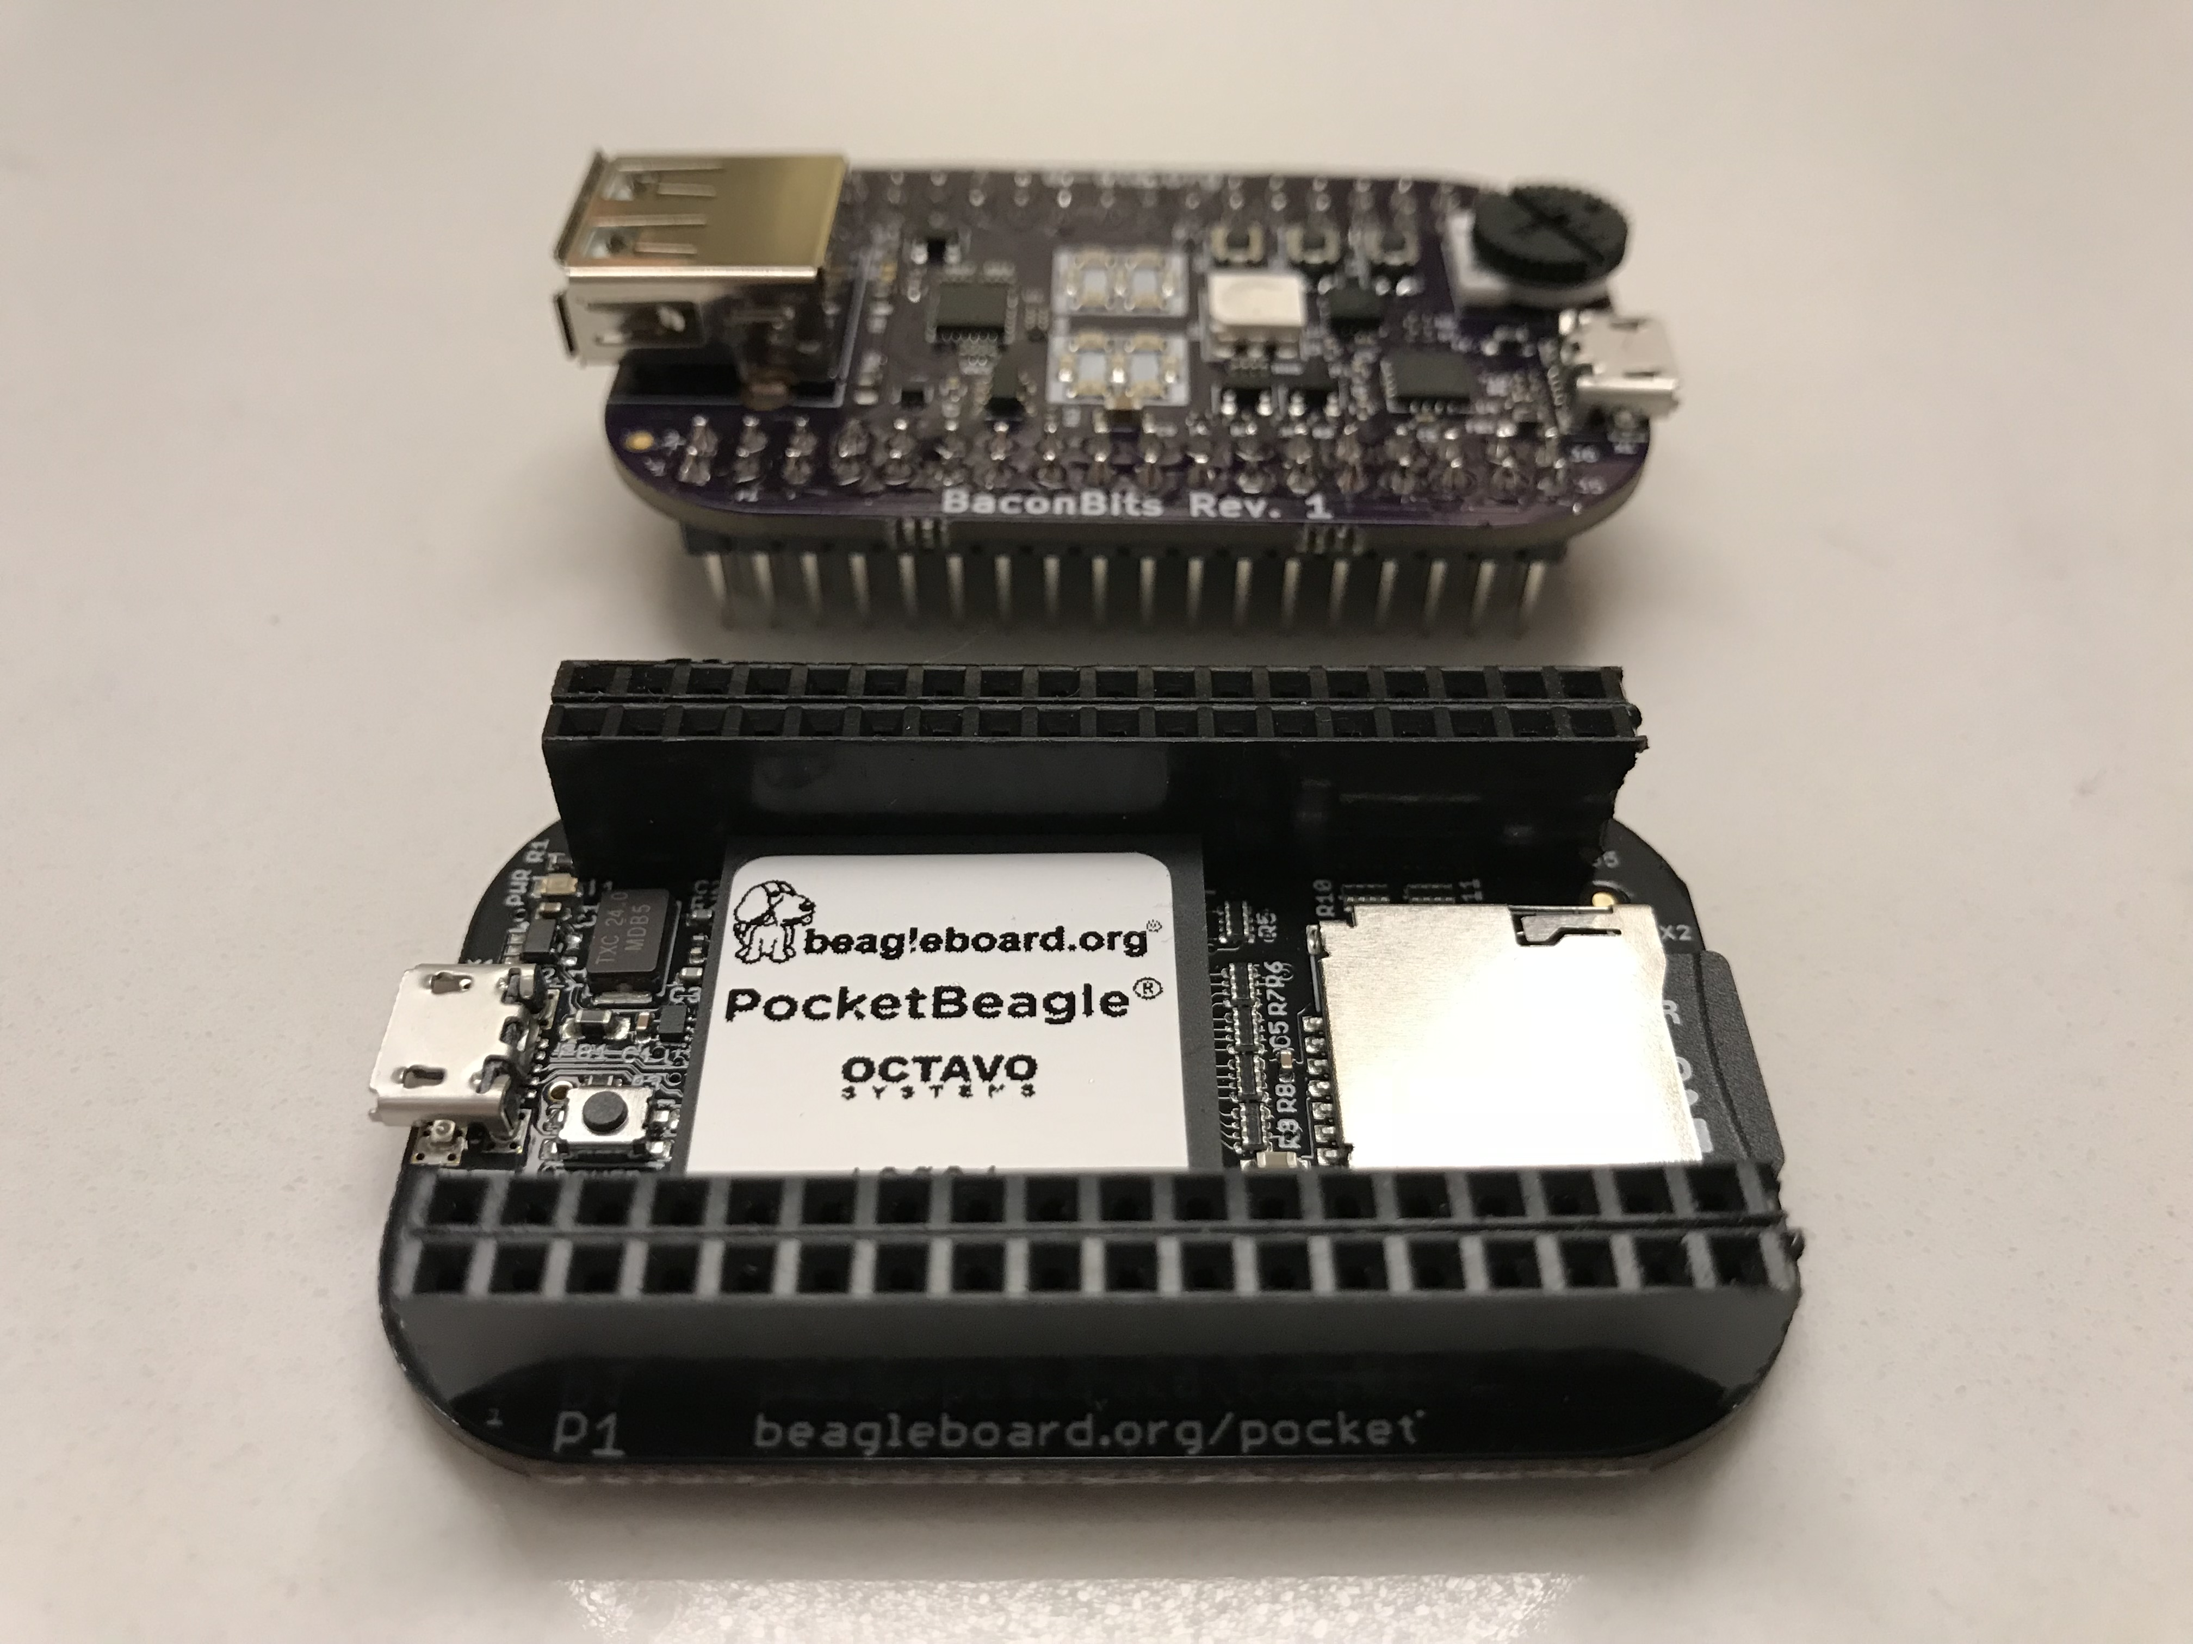
The Pocket Beagle
BaconBits cape
PocketBeagle Board

Slide 6
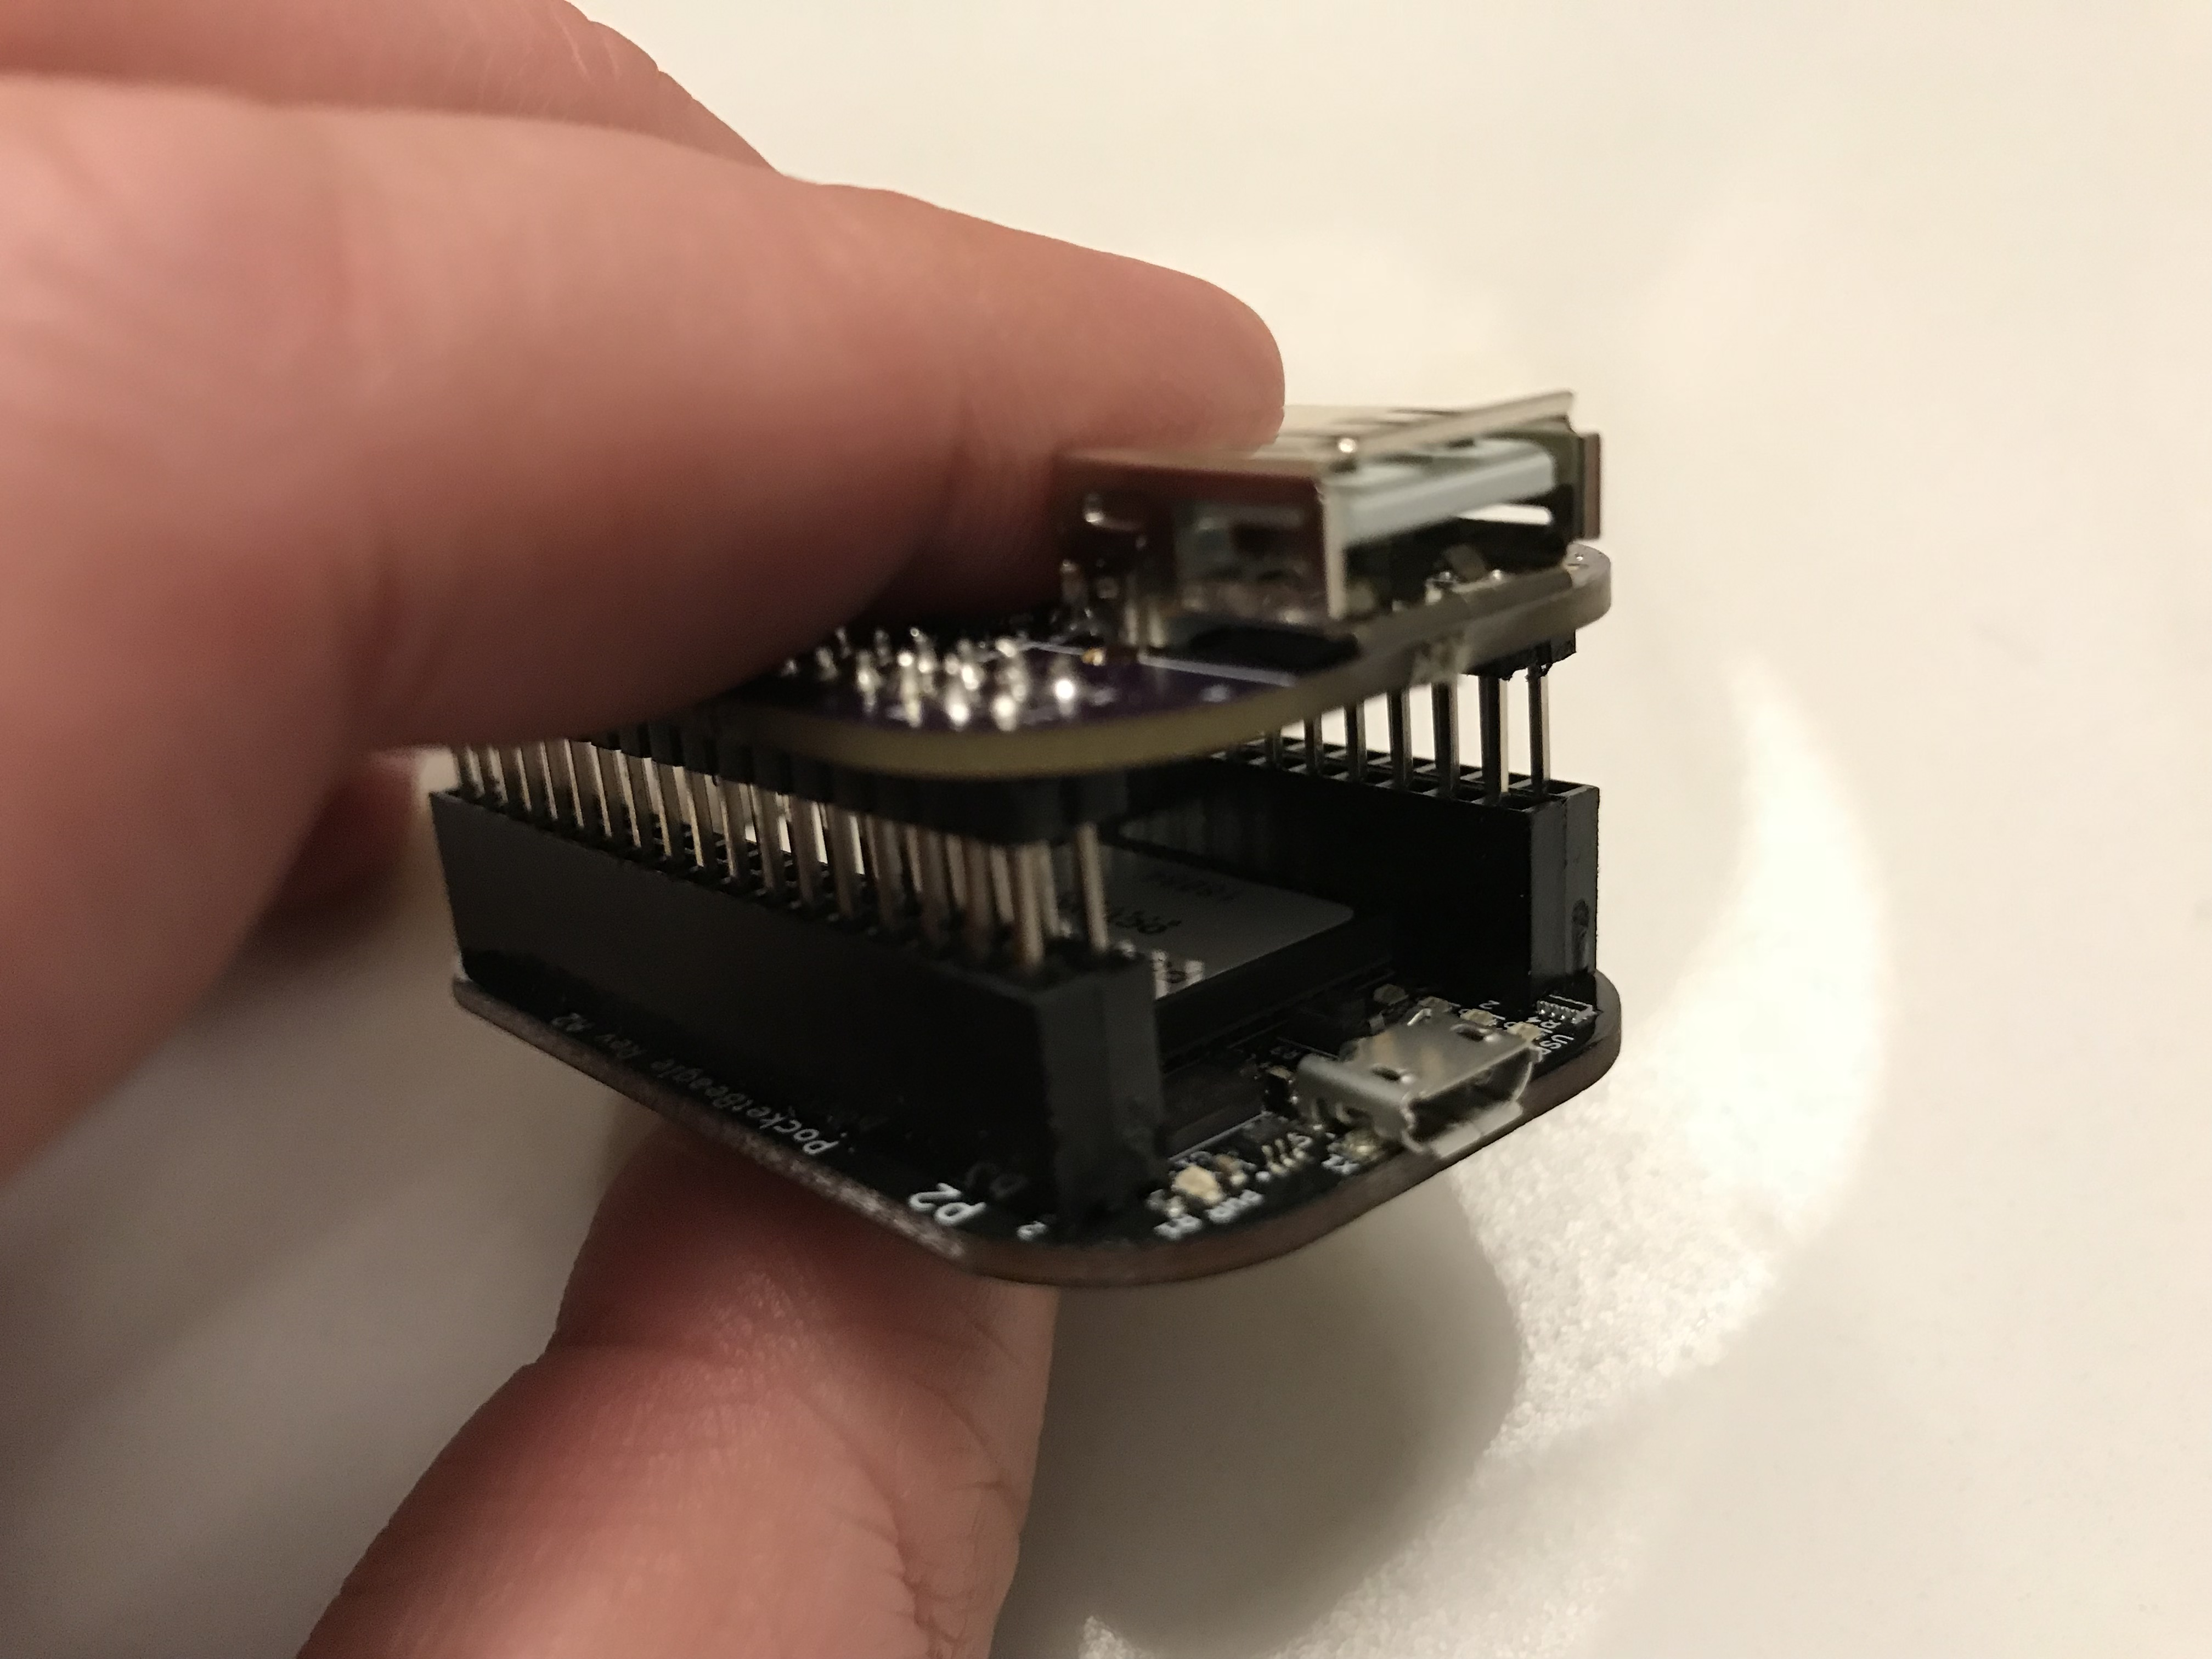
Attaching the cape
The USB type-A connector on the cape is at the same end as the micro USB port on the PocketBeagle Board

Slide 7
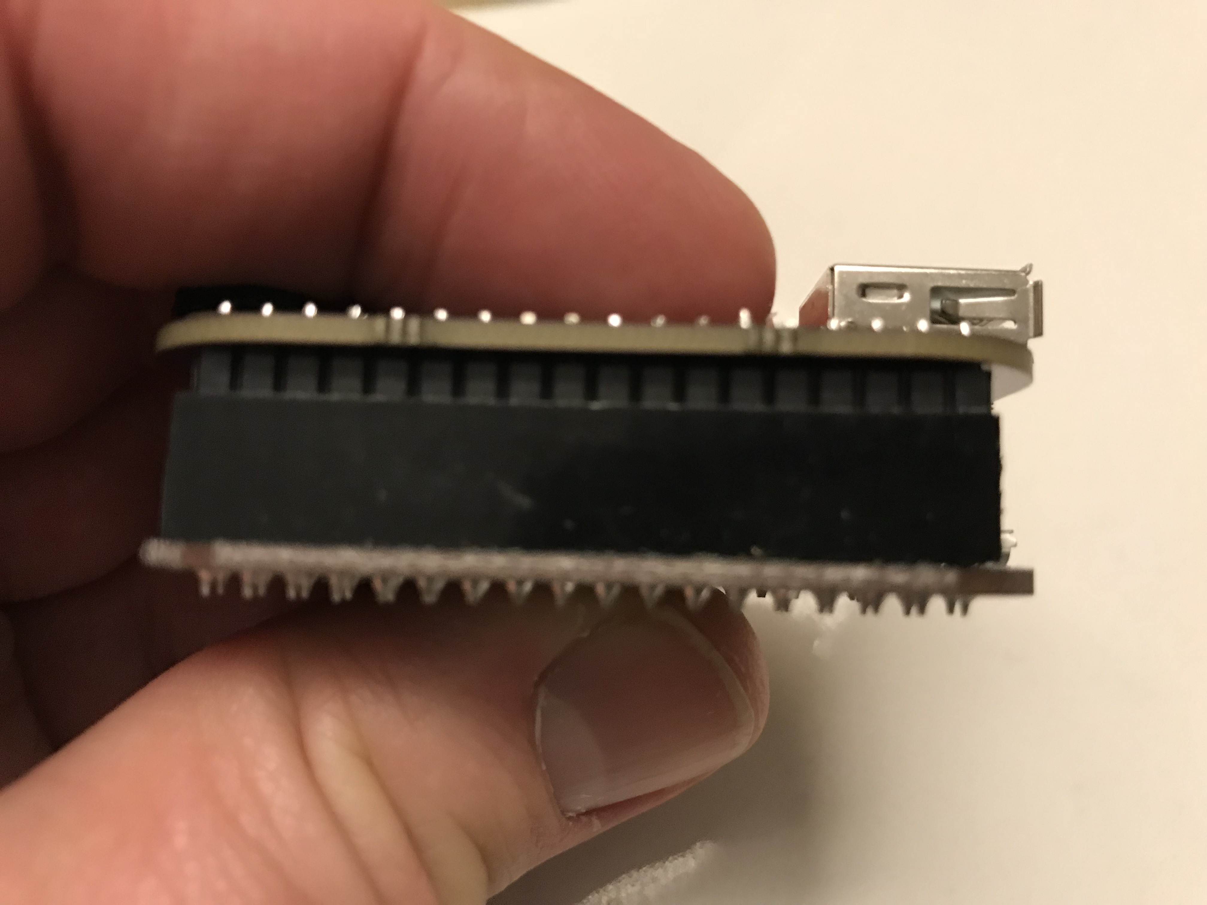
Attaching the cape
Align pins and push carefully together

Slide 8
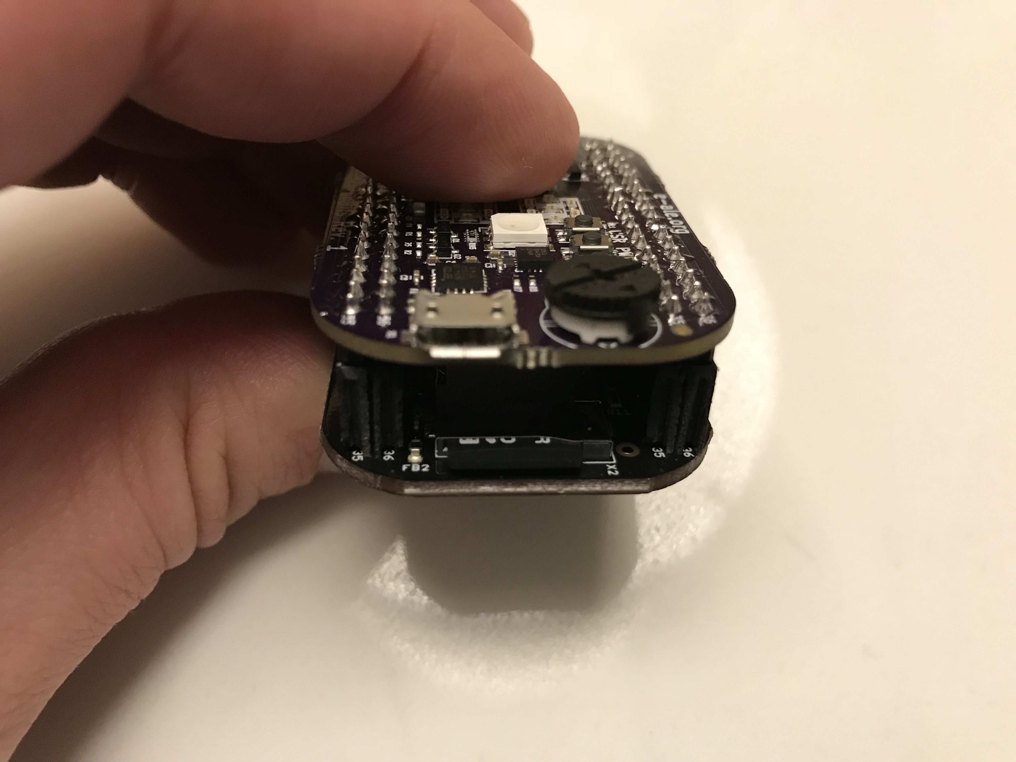
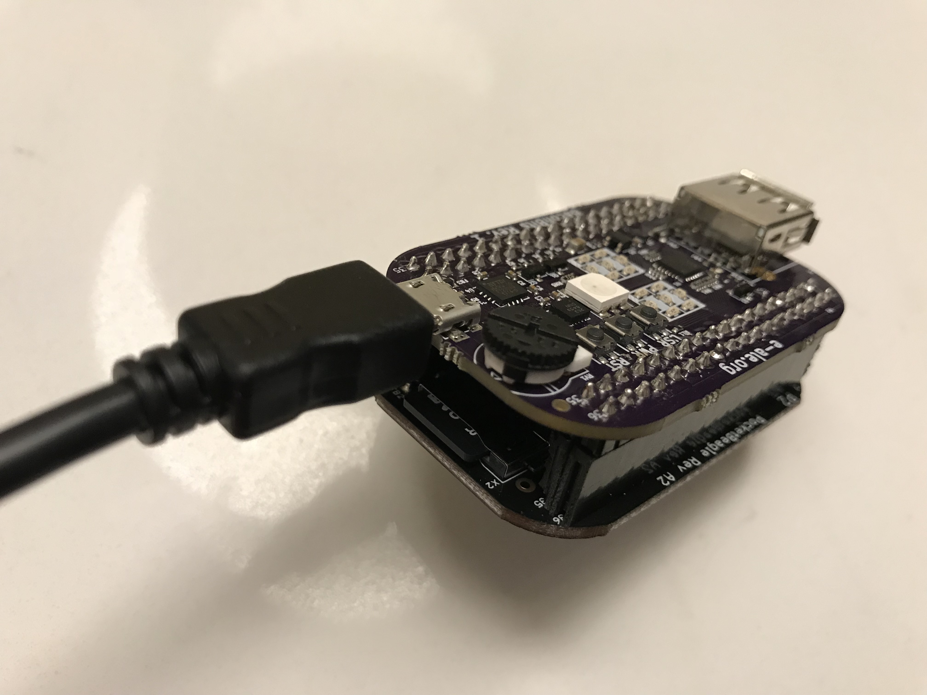
The console port
The micro USB-to-Serial console port on the cape, is over the uSD card reader

Slide 9
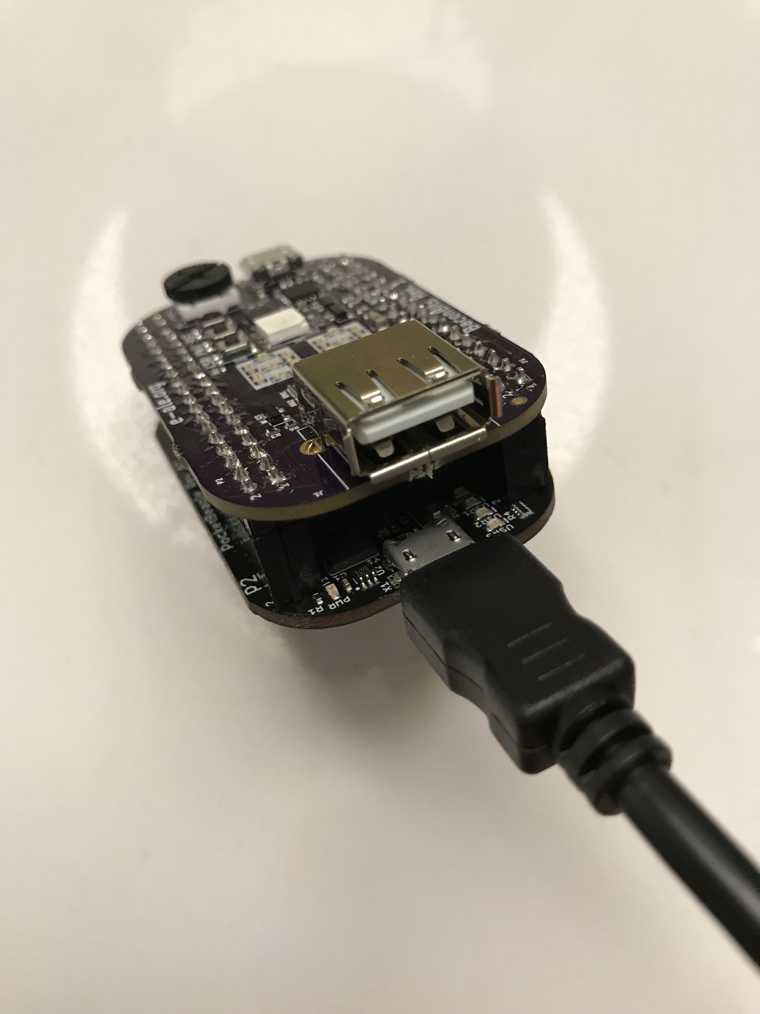
USB Networking
The micro USB port on the PoketBeagle is used for Ethernet over USB (CDC or RNDIS).

Slide 10
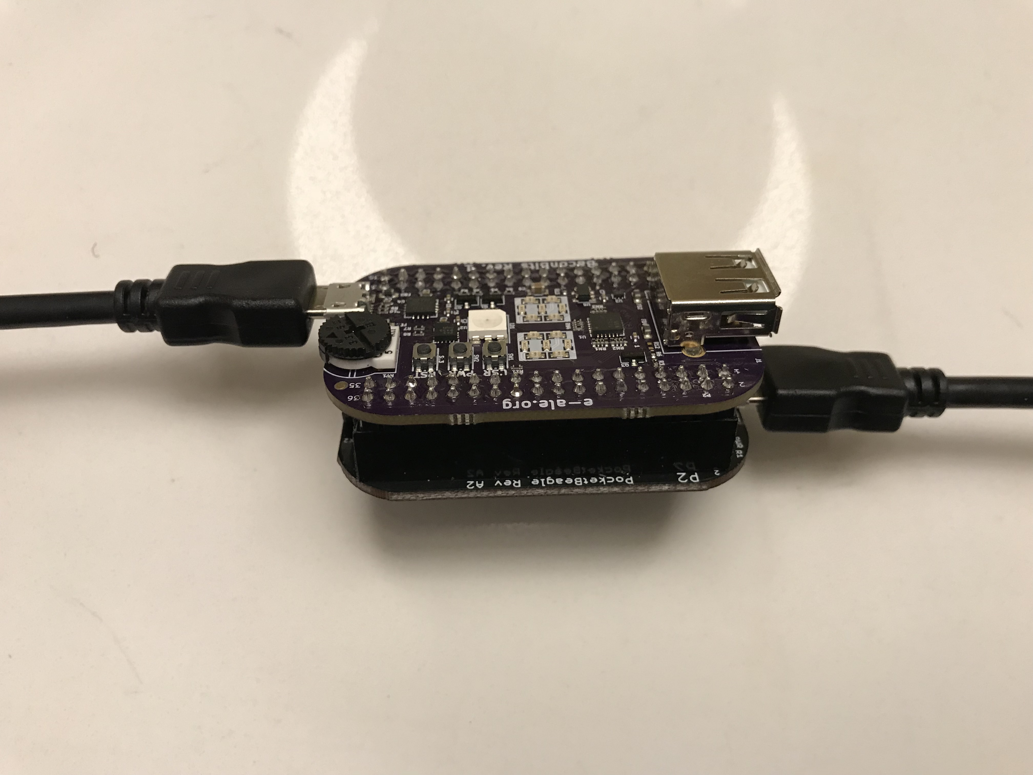
USB Power
The Pocket beagle can be powered from either micro USB port.
Both cables can be plugged in

