Slide 1




PocketBeagle Walk Through

Slide 2

PocketBeagle Walk Through
Friendly to novices and experts alike, the Beagle experience tracks mainline u-boot, Linux and Debian development, while augmenting it to enable development to start as quickly as possible. Attendees will get started interacting with the hardware via the command-line, shell scripts, Python and JavaScript. Attendees will be walked through the configuration details for the boot configuration, pin multiplexing, USB networking and other helper scripts they should get to know. Support and development processes within the BeagleBoard.org community will be covered. Exercises will pave the way for the other workshops to dive into their topic without needing to backtrack excessively on PocketBeagle-specific details.

Slide 3
Author and license
Author
  Jason Kridner
  Co-founder BeagleBoard.org, Texas Instruments Sitara apps
  https://beagleboard.org/about
License
  Creative Commons Attribution – Share Alike 4.0
  https://creativecommons.org/licenses/by-sa/4.0/

Slide 4
Outline
BeagleBoard.org overview
  History and objectives: non-profit focus on education, open to business, sustainable open source ie. not a loss-leader
  Experience vision
    Outline: boot, kernel, distro, IDEs (cloud9, node-red, bela, bone101)
    Gaps
    Today
  Hardware overview
What’s in the kit
  Setting up access
Programming demonstrations
  Command-line
  Shell script
  Python
  JavaScript
  PRU example
Questions from Hack Chat
Project examples
Labs

Slide 5
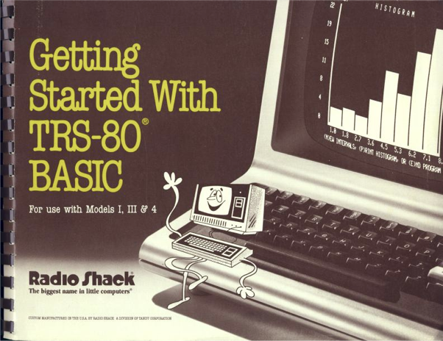
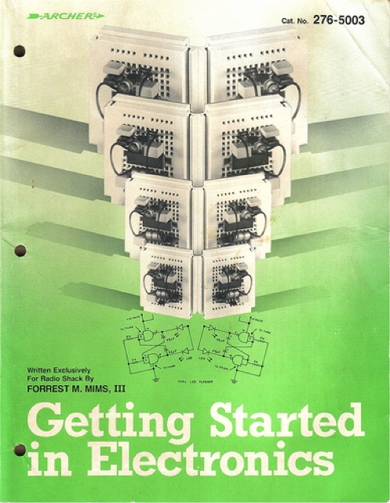
Inspiration from early PCs
How do people learn about embedded computers with so much ground to cover?
http://newcome.wordpress.com/2009/12/15/make-electronics-the-new-engineers-notebook/
http://www.sandywalsh.com/2012_07_01_archive.html

Slide 6



BeagleBoard.org’s Vision
Creating with electronics should be as easy as creating a web page
Appliances are better than applications
Open source software and hardware enable
  Collaboration on the problem
  Ability to understand and improve the fundamentals

Slide 7
BeagleBoard.org’s Objectives

Slide 8
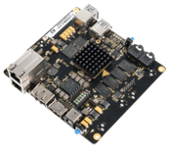
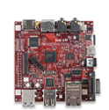
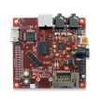

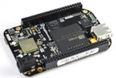

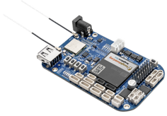
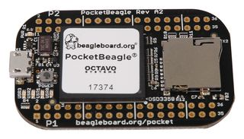
Board Roadmap
Fanless open computer (BeagleBoard)
$249
2008: Personally affordable BeagleBoard
Mint tin sized with industrial peripherals (BeagleBone)
$69
Application focused BeagleBones
$79
Smalls mint tin sized with super-flexible design - PocketBeagle
$25

Slide 9
Questions?

Slide 10

Thank you!

