Slide 1

Distributed TensorFlow: A performance evaluation
End-of-internship Seminar
Emanuele Bugliarello
emanuele.bugliarello@gmail.com
September 6, 2017 https://github.com/e-bug/distributed-tensorflow-benchmarks

Slide 2
Introduction
What is TensorFlow?
Google's open-source software library for Machine Learning
Best-supported client language: Python
Experimental interfaces for: C++, Java and Go
Why TensorFlow?
Portable & flexible → popular in industries and in research communities
Most CSCS clients choose TensorFlow as their Deep Learning library
Why distributed training?
Training a neural network can take an impractically long time on a single machine (even with a GPU)
Results
On 64 GPUs: ~80% scalability efficiency in Piz Daint & almost 90% in 8 8-GPU nodes

Slide 3
ToC
Introduction
TensorFlow overview
Distributed training in TensorFlow
Benchmarks
Conclusion and Future Work

Slide 4
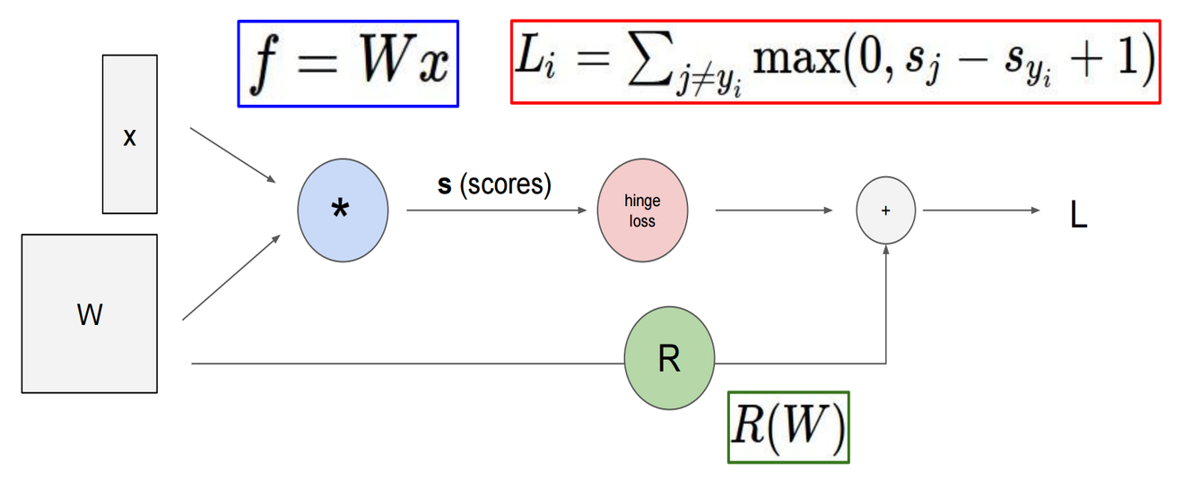
TensorFlow overview (1)
TensorFlow is based on data flow graphs
Nodes represent mathematical operations
Tensors move across the edges between nodes
Writing a TensorFlow application
Build computation graph
Run instances of that graph
Figure 1: Computational graph for regularized Multiclass SVM loss (CS231N, Stanford University)

Slide 5
TensorFlow overview (2)
Example: Linear Regression in TensorFlow
import matplotlib.pyplot as plt
import numpy as np
import tensorflow as tf
# =============================================== #
# LOAD DATA #
# =============================================== #
# Generate some data as y=3*x + noise
N_SAMPLES = 10
x_in = np.arange(N_SAMPLES)
y_in = 3*x_in + np.random.randn(N_SAMPLES)
data = list(zip(x_in, y_in))
f = w*x + b
L= (y - y_pred)²
x
*
+
y_pred
quadratic
loss
L
w
b
y
Figure 2: Computational graph for Linear Regression with squared loss

Slide 6
TensorFlow overview (3)
Example: Linear Regression in TensorFlow
# =============================================== #
# BUILD GRAPH #
# =============================================== #
simple_graph = tf.Graph()
with simple_graph.as_default():
# Generate placeholders for input x and output y
x = tf.placeholder(tf.float32, name='x')
y = tf.placeholder(tf.float32, name='y')
# Create weight and bias, initialized to 0
w = tf.Variable(0.0, name='weight')
b = tf.Variable(0.0, name='bias')
# Build model to predict y
y_predicted = x * w + b
# Use the square error as the loss function
loss = tf.square(y - y_predicted, name='loss')
# Use gradient descent to minimize loss
optimizer = tf.train.GradientDescentOptimizer(0.001)
train = optimizer.minimize(loss)
f = w*x + b
L= (y - y_pred)²
x
*
+
y_pred
quadratic
loss
L
w
b
y
Figure 2: Computational graph for Linear Regression with squared loss

Slide 7
TensorFlow overview (4)
Example: Linear Regression in TensorFlow
# =============================================== #
# EXECUTE GRAPH #
# =============================================== #
# Run training for N_EPOCHS epochs
N_EPOCHS = 5
with tf.Session(graph=simple_graph) as sess:
# Initialize the necessary variables (w and b here)
sess.run(tf.global_variables_initializer())
# Train the model
for i in range(N_EPOCHS):
total_loss = 0
for x_,y_ in data:
# Session runs train operation and fetches values of loss
_, l_value = sess.run([train, loss], feed_dict={x: x_, y: y_})
total_loss += l_value
print('Epoch {0}: {1}'.format(i, total_loss/N_SAMPLES))
# Output final values of w and b
w_value, b_value = sess.run([w, b])
f = w*x + b
L= (y - y_pred)²
x
*
+
y_pred
quadratic
loss
L
w
b
y
Figure 2: Computational graph for Linear Regression with squared loss

Slide 8
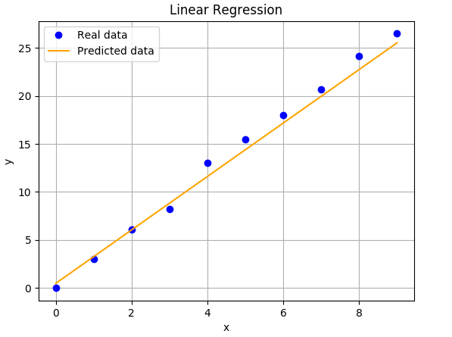
TensorFlow overview (5)
Example: Linear Regression in TensorFlow
# =============================================== #
# PLOT RESULTS #
# =============================================== #
print(w_value, b_value) # 2.89, 0.45
plt.plot(x_in, y_in, 'bo', label='Real data')
plt.plot(x_in, x_in*w_value + b_value, 'orange',
label='Predicted data')
plt.ylabel('y');plt.xlabel('x')
plt.title('Linear Regression')
plt.legend();plt.grid()
plt.show()
f = w*x + b
L= (y - y_pred)²
x
*
+
y_pred
quadratic
loss
L
w
b
y
Figure 2: Computational graph for Linear Regression with squared loss
Figure 3: Learned linear model

Slide 9
ToC
Introduction
TensorFlow overview
Distributed training in TensorFlow
Benchmarks
Conclusion and Future Work

Slide 10

Distributed training in TensorFlow (1)
Split the training of a neural network across multiple nodes
Most common approach: data parallelism
  Each node has an instance of the model and reads different training samples
  Also known as “between-graph replication” in TensorFlow
Processes can either be:
  Worker
    Runs the model
    Sends its local gradients to the PSs
    Receives updated variables back
  Parameter Server (PS)
    Hosts trainable variables
    Updates them with values sent by the Workers
PSs sum gradients to merge in one step what
each Worker has learned to reduce the loss
/job:worker/task:0
/job:worker/task:1
/job:ps/task:0
/job:ps/task:1
weights_1
weights_2
biases_1
biases_2

Slide 11
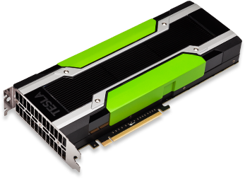

Distributed training in TensorFlow (2)
Workers need to send their updates to the correct Parameter Servers
  Use TensorFlow’s replica_device_setter for a deterministic variable allocation
Parameter Servers and Workers may coexist on the same machine
  Recommended when Workers run on GPUs
  Reduce the number of nodes
  Minimize network communications
/job:worker/task:0
/job:worker/task:1
/job:worker/task:0
/job:worker/task:1
/job:ps/task:0
/job:ps/task:1
/job:ps/task:0
/job:ps/task:1
weights_1
weights_2
biases_1
biases_2

Slide 12
Distributed training in TensorFlow (3)
Define cluster of nodes and the role of each of them (PS/Worker)
The following code snippet (https://clindatsci.com/blog/2017/5/31/distributed-tensorflow) would be executed on each machine in the cluster, but with different arguments
import sys
import tensorflow as tf
# Specify the cluster's architecture
cluster = tf.train.ClusterSpec(
{'ps': ['192.168.1.1:1111'],
'worker': ['192.168.1.2:1111','192.168.1.3:1111']})
# Parse command-line to specify machine
job_type = sys.argv[1] # job type: "worker" or "ps"
task_idx = sys.argv[2] # index job in the worker or ps list
# as defined in the ClusterSpec
# Create TensorFlow Server.
# This is how the machines communicate.
server = tf.train.Server(cluster, job_name=job_type,
task_index=task_idx)
# Parameter server is updated by remote clients.
# Will not proceed beyond this if statement.
if job_type == 'ps':
server.join()
else:
# Workers only
with tf.device(tf.train.replica_device_setter(
worker_device='/job:worker/task:'+task_idx,
cluster=cluster)):
# Build your model here
# as if you only were using a single machine
with tf.Session(server.target):
# Train your model here

Slide 13
Distributed training in TensorFlow (4)
Running distributed TensorFlow on Piz Daint
Write a Python script (TF_SCRIPT) accepting job_name, task_index, ps_hosts and worker_hosts TensorFlow flags
Write a Bash script like the following one; run_dist_tf_daint.sh will specify the cluster from allocated nodes
#!/bin/bash
#SBATCH --job-name=distributed_tf
#SBATCH --time=00:12:00
#SBATCH --nodes=8
#SBATCH --constraint=gpu
#SBATCH --output=distributed_tf.%j.log
# Arguments:
# $1: TF_NUM_PS: number of parameter servers
# $2: TF_NUM_WORKER: number of workers
# load modules
module load daint-gpu
module load TensorFlow
# set TensorFlow script parameters
export TF_SCRIPT="$HOME/project_dir/project_script.py"
export TF_FLAGS="--num_gpus=1 --batch_size=64
--num_batches=4 --data_format=NCHW"
# set TensorFlow distributed parameters
export TF_NUM_PS=$1 # 1
export TF_NUM_WORKERS=$2 # $SLURM_JOB_NUM_NODES
# export TF_WORKER_PER_NODE=1
# export TF_PS_PER_NODE=1
# export TF_PS_IN_WORKER=true
# run distributed TensorFlow
DIST_TF_LAUNCHER_DIR=$SCRATCH/run_dist_tf_daint_dir
cd $DIST_TF_LAUNCHER_DIR
./run_dist_tf_daint.sh

Slide 14
Distributed training in TensorFlow (5)
Round-robin variables
Greedy load balancing variables
replica_device_setter provides two load balancing strategies
Round-robin (default)
Greedy load balancing
/job:ps/task:0
/job:ps/task:1
/job:ps/task:2
weights_1
biases_1
weights_2
biases_2
/job:ps/task:0
/job:ps/task:1
/job:ps/task:2
greedy = tf.contrib.training.GreedyLoadBalancingStrategy(...)
with tf.device(
tf.train.replica_device_setter(ps_tasks=3,
ps_strategy=greedy)):
weights_1 = tf.get_variable('weights_1', [784, 100])
biases_1 = tf.get_variable('biases_1', [100])
weights_2 = tf.get_variable('weights_2', [100, 10])
biases_2 = tf.get_variable('biases_2', [10])
weights_1
biases_1
weights_2
biases_2

Slide 15
ToC
Introduction
TensorFlow overview
Distributed training in TensorFlow
Benchmarks
Conclusion and Future Work

Slide 16
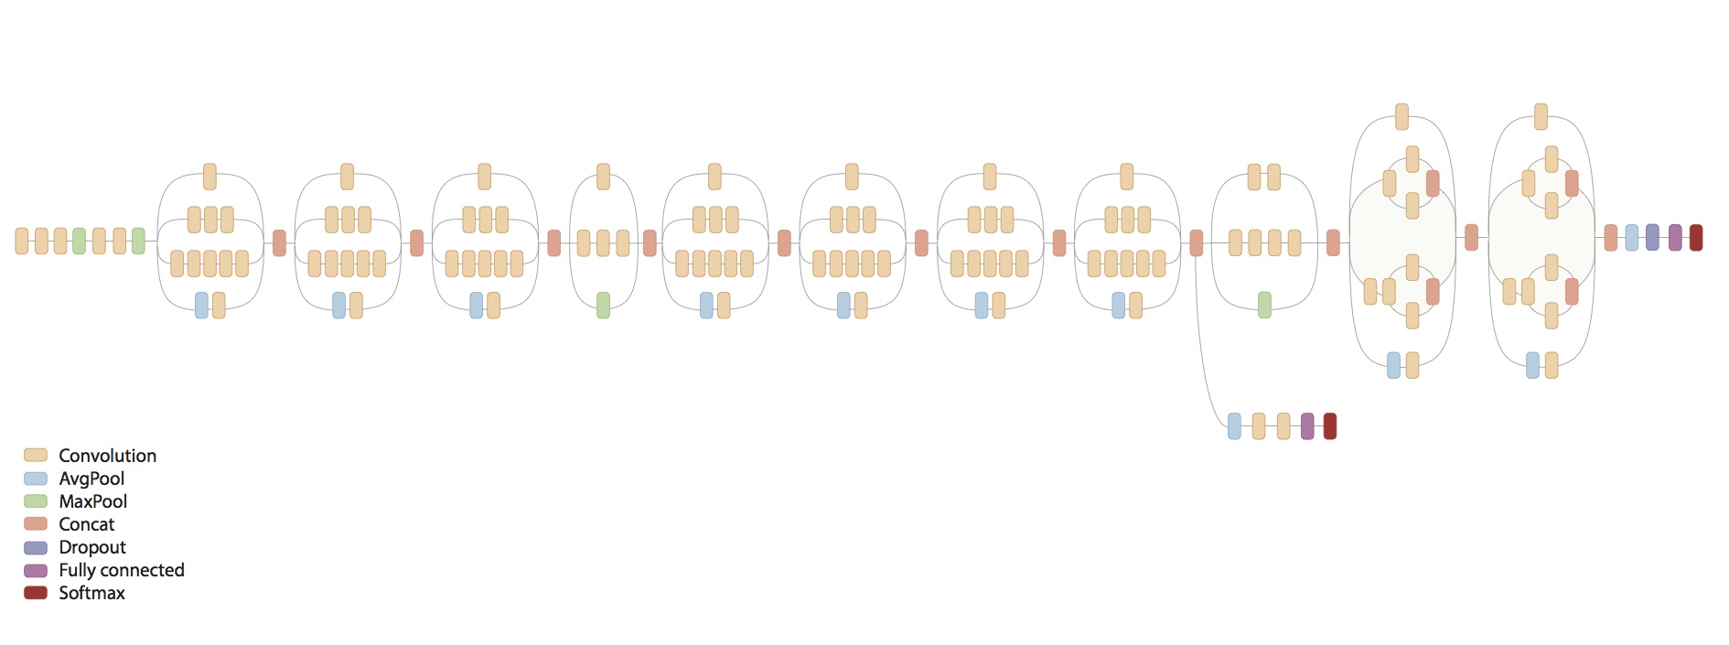
Benchmarks (1)
Model
  InceptionV3
    Neural Network for 1000-class image classification (ImageNet competition)
  Optimized code for benchmarks available
  from Google
Data set
  ImageNet: 1,280,000 images (144 GB)
TensorFlow 1.1.0
Performance metric
  Number of trained images per second

Slide 17
Benchmarks (2)
Methodology
  For each configuration of number of Workers and number of nodes
    Run with different number of Parameter Servers on synthetic data (no I/O access)
    Report best setting of number of Workers and number of PSs
    Run best setting on real data (with I/O access)
  Results repeatability
    Run each test 5 times and average times together (Google’s approach)
      Compare results with Google’s
      Limit impact on Piz Daint (200+ tests)
  For each test
    10 warmup steps
    Next 100 steps are averaged

Slide 18
Benchmarks (3)
Systems
  Piz Daint (NVIDIA Tesla P100 - 1 GPU per node)
  Amazon EC2 instances
    p2.xlarge (NVIDIA Tesla K80 - 1 GPU per node)
    p2.8xlarge (NVIDIA Tesla K80 - 8 GPUs per node)
Benchmarks from Google available at https://www.tensorflow.org/performance/benchmarks
  Google’s systems
    NVIDIA DGX-1 (NVIDIA Tesla P100 - 8 GPUs per node)
    Amazon p2.8xlarge (NVIDIA Tesla K80 - 8 GPUs per node)

Slide 19
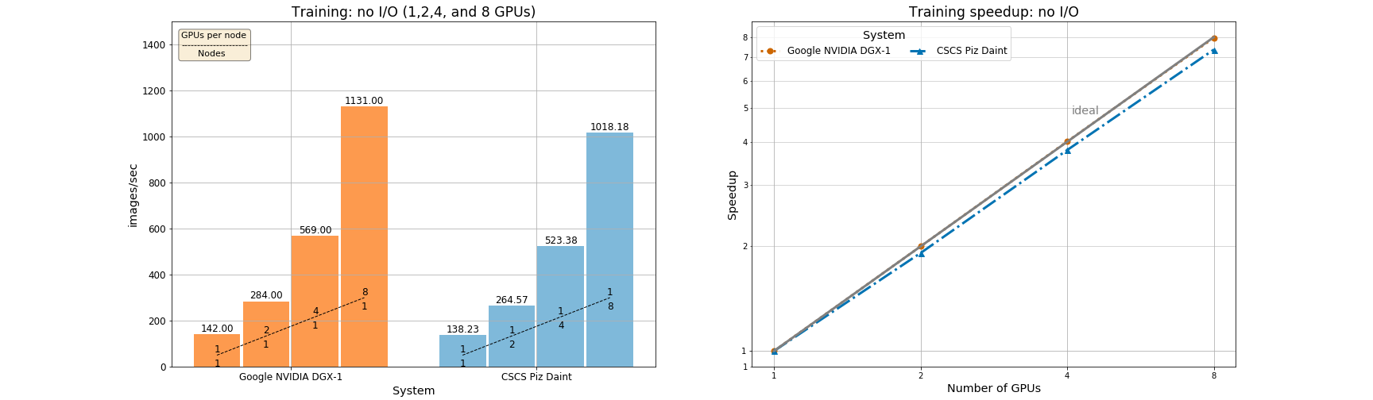
Benchmarks (4)
NVIDIA Tesla P100 - synthetic data (no I/O) - up to 8 GPUs
Scalability efficiency
99.56% on 8 GPUs in NVIDIA DGX-1
92.07% on 8 GPUs in Piz Daint
8 nodes in Piz Daint have similar performance as an NVIDIA DGX-1

Slide 20
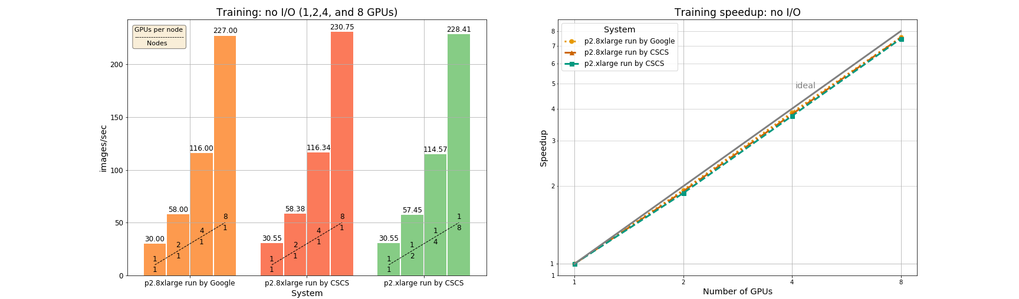
Benchmarks (5)
NVIDIA Tesla K80 - synthetic data (no I/O) - up to 8 GPUs
Scalability efficiency
94.58% and 94.44% on 8 GPUs in p2.8xlarge
93.45% on 8 GPUs in p2.xlarge
Up to 8 GPUs, compute bound application
Notes:
Compute bound (if compared to previous one, more powerful GPU --> higher perf, and 1 GPU per node still good!)

Slide 21
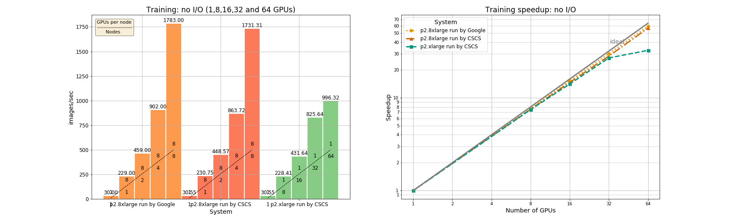
Benchmarks (6)
NVIDIA Tesla K80 - synthetic data (no I/O) - up to 64 GPUs
Scalability efficiency
92.86% and 88.55% on 64 GPUs in p2.8xlarge
50.96% on 64 GPUs in p2.xlarge
Intuition: inter-node network capacity reached with 64 GPUs in p2.xlarge

Slide 22
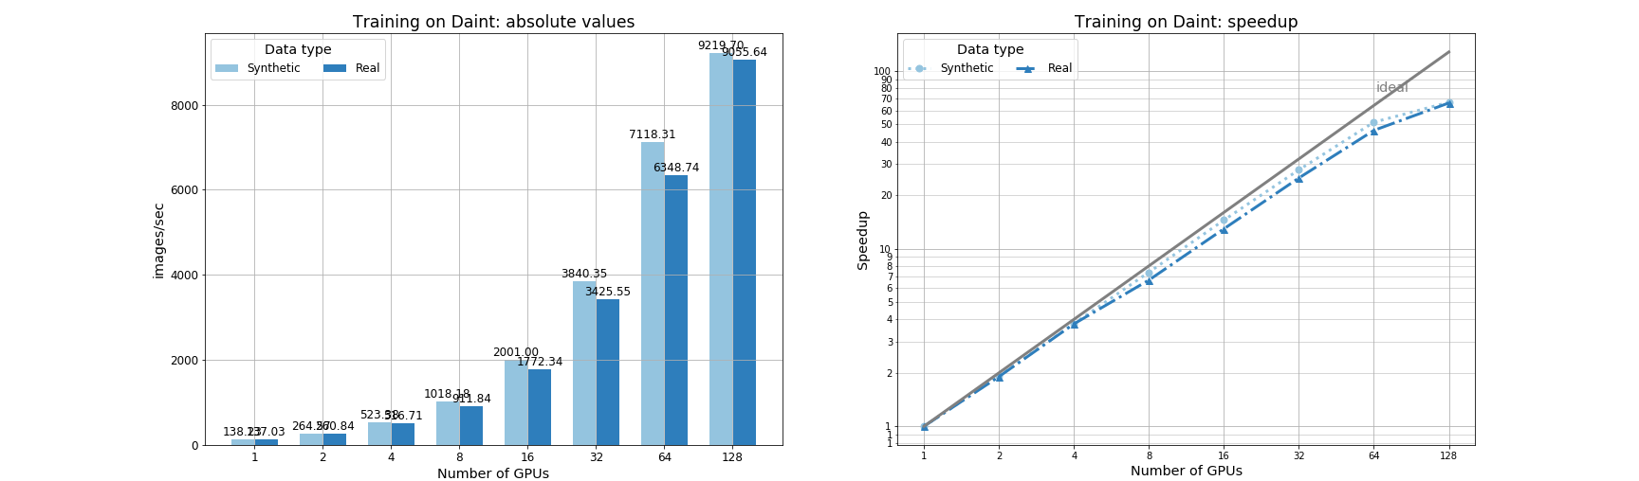
Benchmarks (7)
Piz Daint (NVIDIA Tesla P100) - synthetic and real data - up to 128 GPUs
Scalability efficiency
80.46% (synthetic) and 72.39% (real) on 64 GPUs
52.11% (synthetic) and 51.63% (real) on 128 GPUs
Intuition: inter-node network capacity reached with 128 nodes

Slide 23
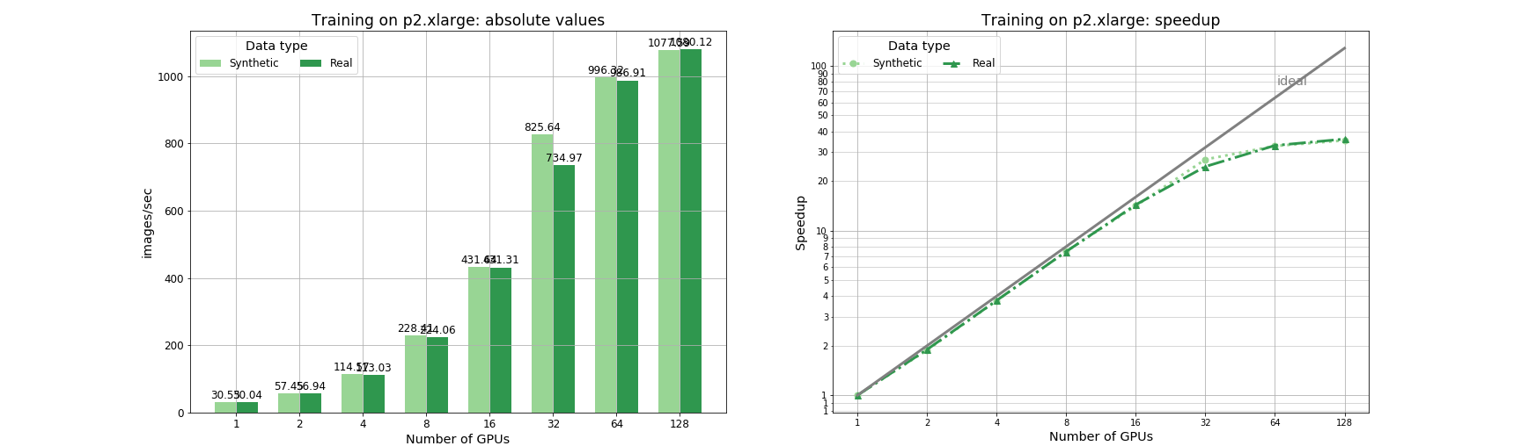
Benchmarks (8)
p2.xlarge (NVIDIA Tesla K80) - synthetic and real data - up to 128 GPUs
Scalability efficiency (local SSD on each node)
50.96% (synthetic) and 51.33% (real) on 64 GPUs
27.56% (synthetic) and 28.09% (real) on 128 GPUs
Intuition: inter-node network capacity reached with 64 nodes

Slide 24
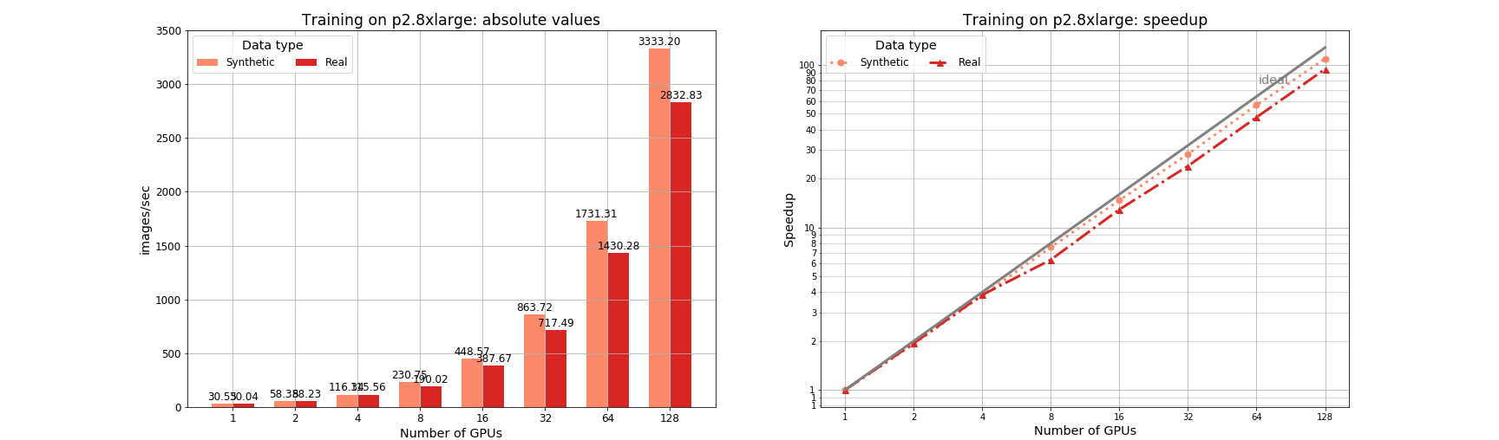
Benchmarks (9)
p2.8xlarge (8 * NVIDIA Tesla K80) - synthetic and real data - up to 128 GPUs
Scalability efficiency (local SSD on each node)
88.55% (synthetic) and 74.39% (real) on 64 GPUs
85.24% (synthetic) and 73.67% (real) on 128 GPUs
Intuition: inter-node network capacity not reached (only 16 nodes for 128 GPUs)

Slide 25
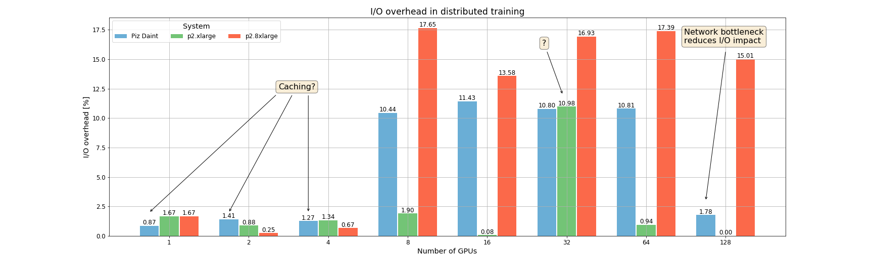
Benchmarks (9)
I/O overhead
~17% on p2.8xlarge when 8 GPUs per node are used
~1% on p2.xlarge
~11% on Piz Daint when 8 to 64 GPUs used, ~1.5% otherwise
Notes:
64*100*N_GPUs (~32 KB) = 200MB per GPU
>8 nodes ⇒ > 1 GB

Slide 26
ToC
Introduction
TensorFlow overview
Distributed training in TensorFlow
Benchmarks
Conclusion and Future Work

Slide 27
Conclusion
8 nodes in Piz Daint have similar performance to 1 NVIDIA DGX-1
Scalability for InceptionV3 in TensorFlow
  On Piz Daint
    Supposedly inter-node bandwidth capacity reached after 64 nodes
    I/O cost ~11%
  On a multi-GPU system
    Inter-node traffic algorithmically reduced by the number of GPUs per node (interconnect seems to have no real impact)
    Using local SSDs and 8 GPUs per node adds a constant ~17% I/O overhead (PCIe traffic)
    No benchmarks available for multiple NVIDIA DGX-1
  ⇒ Estimation according to the examined use case: Similar performance between 64 nodes on Piz Daint and 8 NVIDIA DGX-1 connected by a reasonable inter-node network
Future Work
Investigate impact of training accuracy in distributed setting (preliminary results)
Profile TensorFlow communication patterns
Analyze influence of number of PSs for single- and multi-GPU systems

Slide 28
Conclusion
8 nodes in Piz Daint have similar performance to 1 NVIDIA DGX-1
Scalability for InceptionV3 in TensorFlow
  On Piz Daint
    Supposedly inter-node bandwidth capacity reached after 64 nodes
    I/O cost ~11%
  On a multi-GPU system
    Inter-node traffic algorithmically reduced by the number of GPUs per node (interconnect seems to have no real impact)
    Using local SSDs and 8 GPUs per node adds a constant ~17% I/O overhead (PCIe traffic)
    No benchmarks available for multiple NVIDIA DGX-1
  ⇒ Estimation according to the examined use case: Similar performance between 64 nodes on Piz Daint and 8 NVIDIA DGX-1 connected by a reasonable inter-node network
Future Work
Investigate impact of training accuracy in distributed setting (preliminary results)
Profile TensorFlow communication patterns
Analyze influence of number of PSs for single- and multi-GPU systems
Thank you

