Slide 1

NoSQL: Graph Databases

Slide 2
Databases
Why NoSQL Databases?

Slide 3
Trends in Data

Slide 4
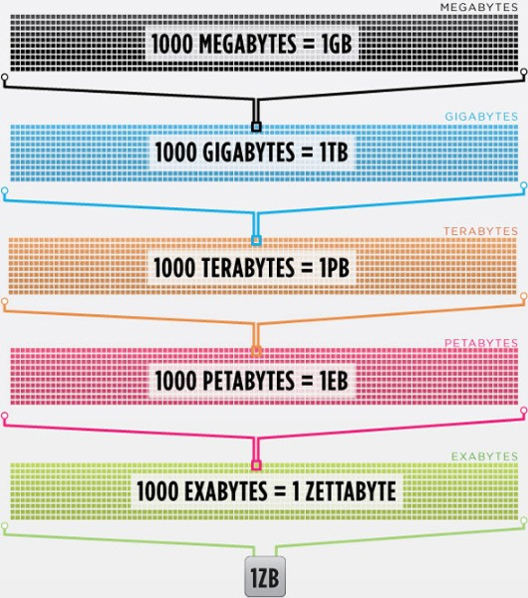
Data is getting bigger:
“Every 2 days we create as much information as we did up to 2003”
– Eric Schmidt, Google

Slide 5
Data is more connected:
Text
HyperText
RSS
Blogs
Tagging
RDF

Slide 6
Trend 2: Connectedness
GGG
Ontologies
RDF
Folksonomies
Tagging
Wikis
Information connectivity
UGC
Blogs
Feeds
Hypertext
Text Documents
Notes:
UGC = User Generated Content
GGG = Giant Global Graph (what the web will become)

Slide 7

Data is more Semi-Structured:
If you tried to collect all the data of every movie ever made, how would you model it?
Actors, Characters, Locations, Dates, Costs, Ratings, Showings, Ticket Sales, etc.

Slide 8
Architecture Changes Over Time
1980’s: Single Application
Application
DB

Slide 9
Architecture Changes Over Time
1990’s: Integration
Database Antipattern
Application
Application
Application
DB

Slide 10
Architecture Changes Over Time
2000’s: SOA
RESTful, hypermedia, composite apps
Application
Application
Application
DB
DB
DB

Slide 11
Side note: RDBMS performance
Salary list
Most Web apps
Social Network
Location-based services
Notes:
This is strictly about connected data – joins kill performance there.
No bashing of RDBMS performance for tabular transaction processing
Green line denotes “zone of SQL adequacy”

Slide 12
NOSQL
Not Only SQL

Slide 13
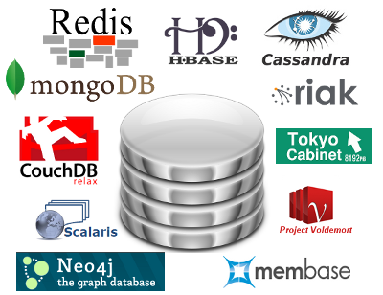
Less than 10% of the NOSQL Vendors

Slide 14
Key Value Stores
Came from a research article written by Amazon (Dynamo)
Global Distributed Hash Table
Global collection of key value pairs

Slide 15
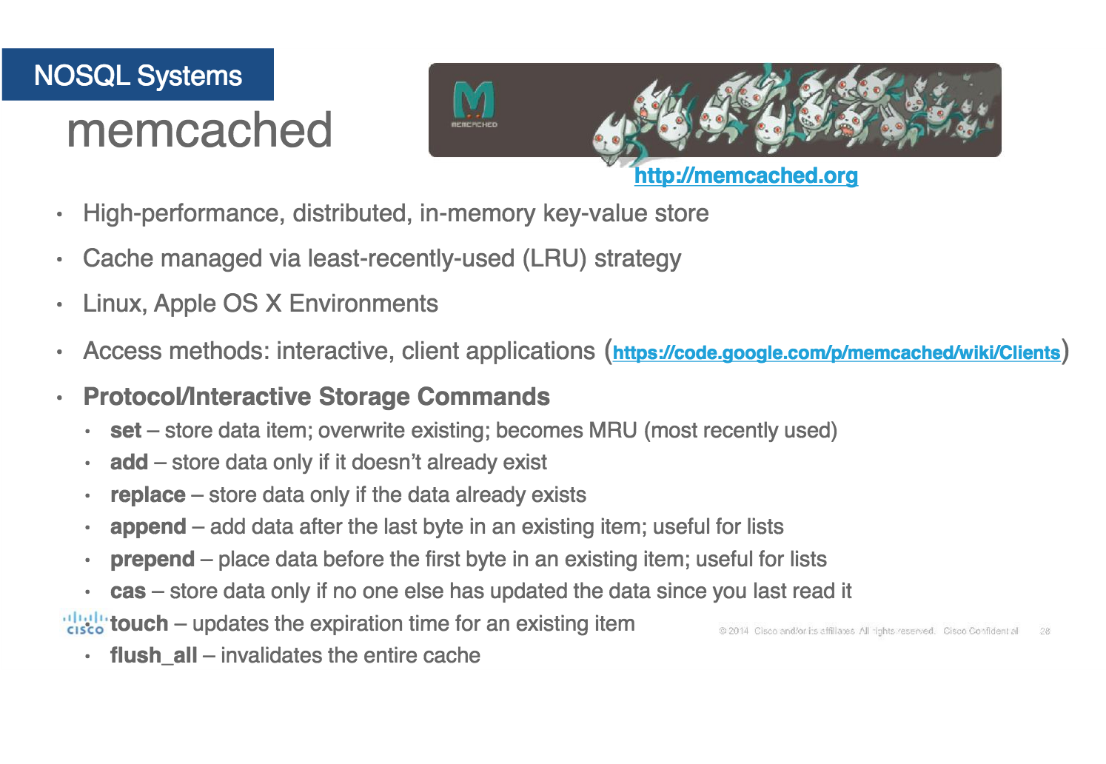
Four NOSQL Categories

Slide 16
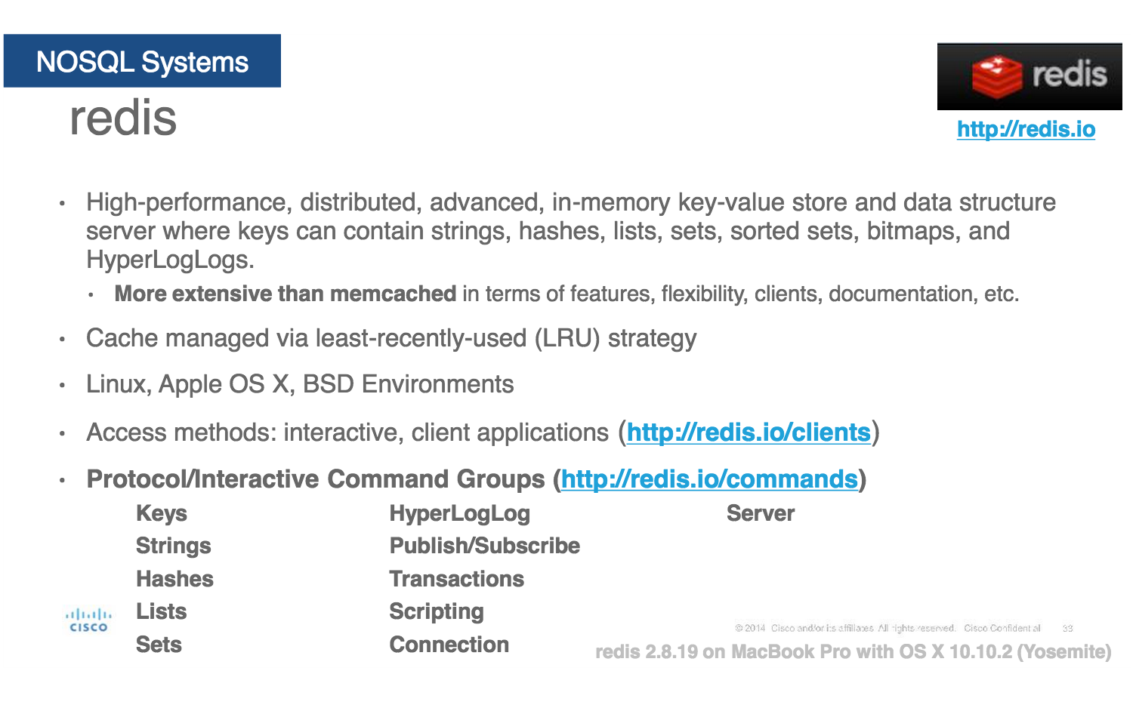
Key Value Stores
Most Based on Dynamo: Amazon Highly Available Key-Value Store
Data Model:
Global key-value mapping
Big scalable HashMap
Highly fault tolerant (typically)
Examples:
Redis, Riak, Voldemort
Notes:
Redis HyperLogLog is an algorithm that uses randomization in order to provide an approximation of the number of unique elements in a set using just a constant, and small amount of memory.

Slide 17
Key Value Stores: Pros and Cons
Pros:
Simple data model
Scalable
Cons
Poor for complex data

Slide 18
Column Family
Most Based on BigTable: Google’s Distributed Storage System for Structured Data
Data Model:
A big table, with column families
Every row can have its own schema
Helps capture more “messy” data
Map Reduce for querying/processing
Examples:
HBase, HyperTable, Cassandra

Slide 19
Column Family: Pros and Cons
Pros:
Supports Semi-Structured Data
Naturally Indexed (columns)
Scalable
Cons
Poor for interconnected data

Slide 20
Document Databases
Inspired by Lotus Notes
Collection of Key value pair collections (called Documents)

Slide 21
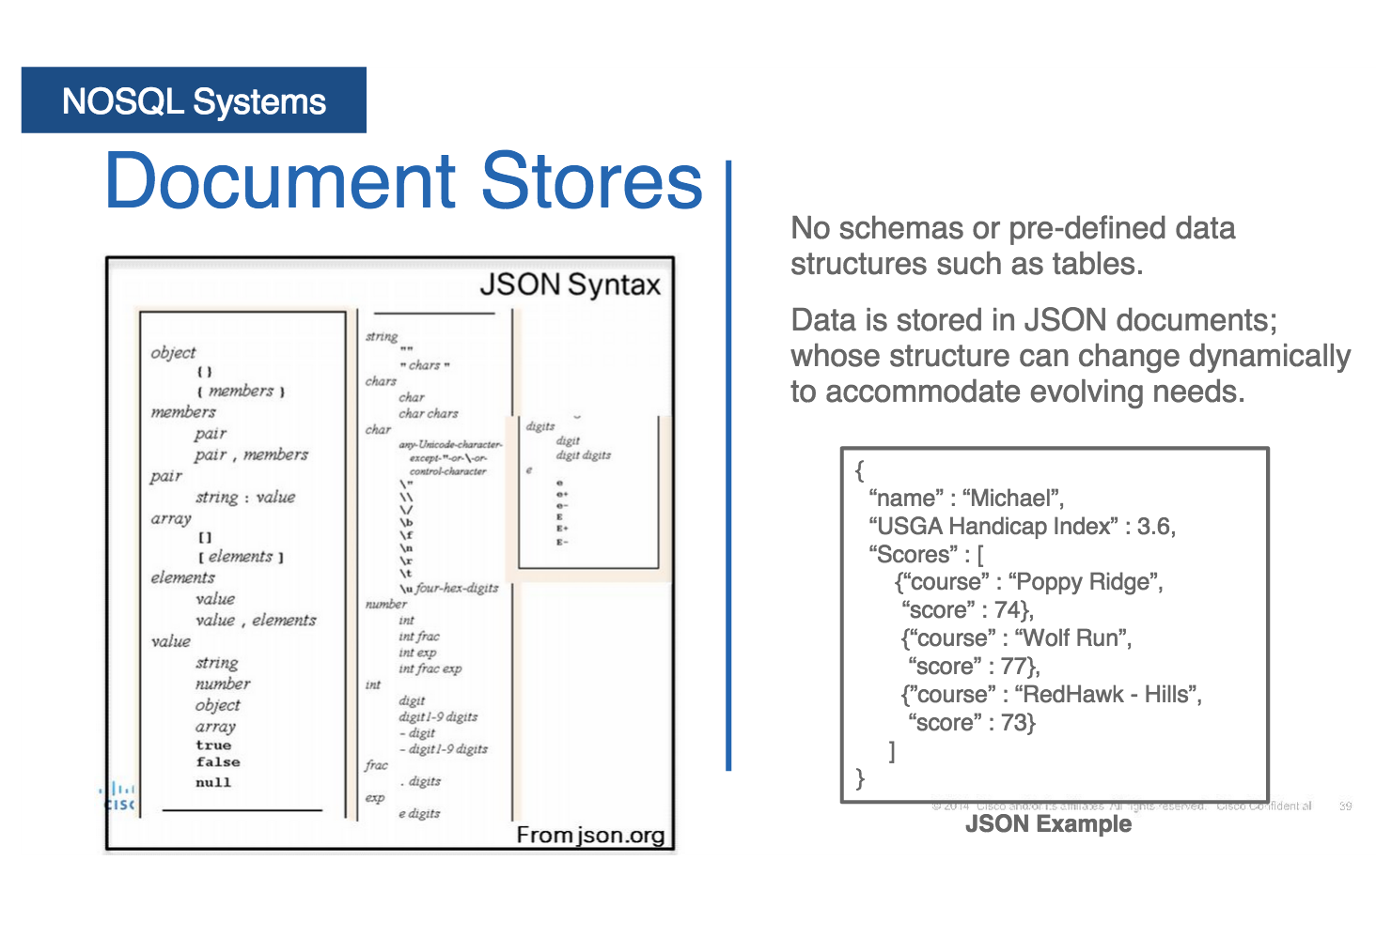
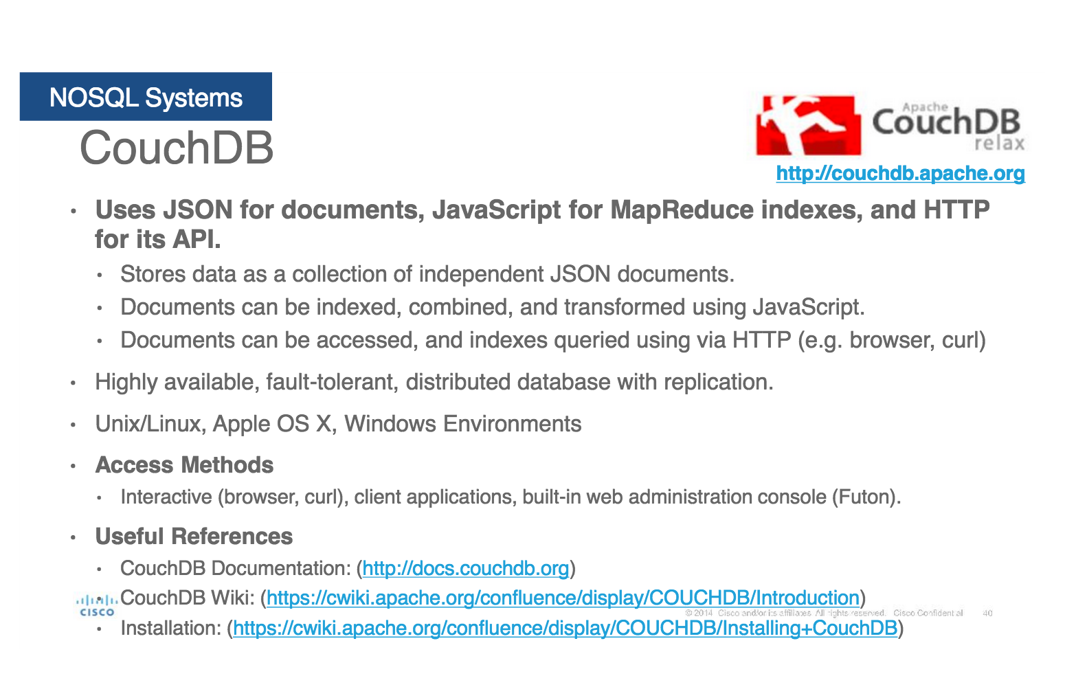
Document Databases
Data Model:
A collection of documents
A document is a key value collection
Index-centric, lots of map-reduce
Examples:
CouchDB, MongoDB

Slide 22
Document Databases: Pros and Cons
Pros:
Simple, powerful data model
Scalable
Cons
Poor for interconnected data
Query model limited to keys and indexes
Map reduce for larger queries

Slide 23
Graph Databases
Data Model:
Nodes and Relationships
Examples:
Neo4j, OrientDB, InfiniteGraph, AllegroGraph

Slide 24
Graph Databases: Pros and Cons
Pros:
Powerful data model, as general as RDBMS
Connected data locally indexed
Easy to query
Cons
Sharding ( lots of people working on this)
Scales UP reasonably well
Requires rewiring your brain
Notes:
Sharding is a way of scaling horizontally. A sharded database architecture splits a large database into several smaller databases. Each smaller component is called a shard.
Instead of storing all data on a single server, we distribute it across several servers.
This reduces the load on a single resource and instead distributes it equally across all the servers. This allows us to serve more requests and traffic from the growing number of customers while maintaining performance.
In regards to databases, this approach falls under a distributed database architecture, where the aim is to spread the total load across multiple database instances.

Slide 25
What are graphs good for?
Recommendations
Business intelligence
Social computing
Geospatial
Systems management
Web of things
Genealogy
Time series data
Product catalogue
Web analytics
Scientific computing (especially bioinformatics)
Indexing your slow RDBMS
And much more!

Slide 26
What is a Graph?

Slide 27

What is a Graph?
An abstract representation of a set of objects where some pairs are connected by links.
Object (Vertex, Node)
Link (Edge, Arc, Relationship)

Slide 28




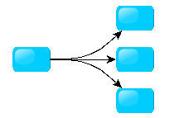
Different Kinds of Graphs
Undirected Graph
Directed Graph
Pseudo Graph
Multi Graph
Hyper Graph
Notes:
An undirected graph is one in which edges have no orientation. The edge (a, b) is identical to the edge (b, a).
A directed graph or digraph is an ordered pair D = (V, A)
A pseudo graph is a graph with loops
A multi graph allows for multiple edges between nodes
A hyper graph allows an edge to join more than two nodes

Slide 29



More Kinds of Graphs
Weighted Graph
Labeled Graph
Property Graph
Notes:
A weighted graph has a number assigned to each edge
A labeled graph has a label assigned to each node or edge
A property graph has keys and values for each node or edge

Slide 30
What is a Graph Database?
A database with an explicit graph structure
Each node knows its adjacent nodes
As the number of nodes increases, the cost of a local step (or hop) remains the same
Plus an Index for lookups

Slide 31
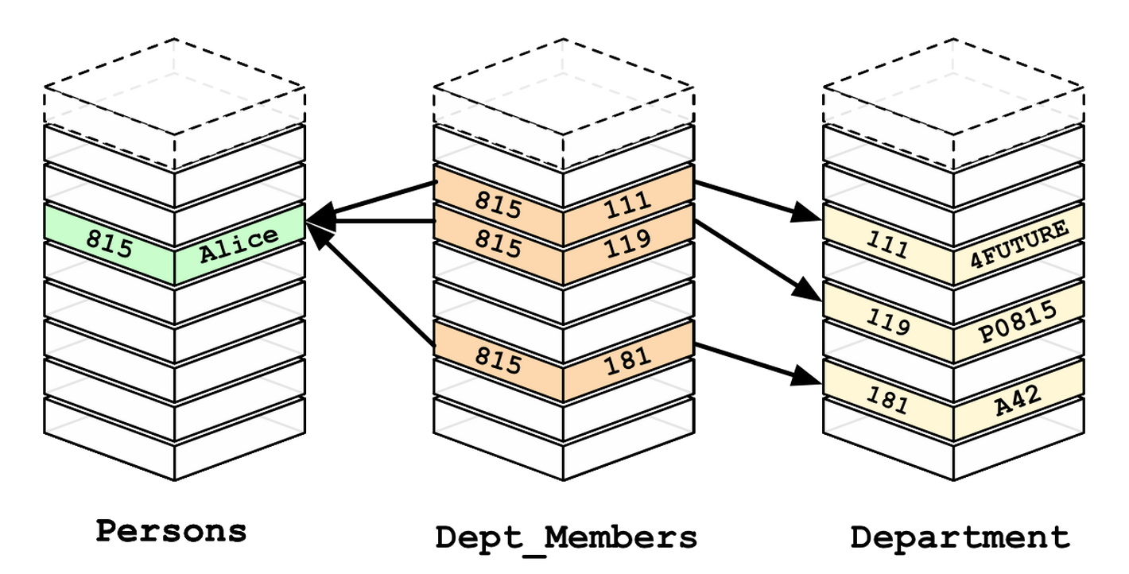
Relational Databases

Slide 32
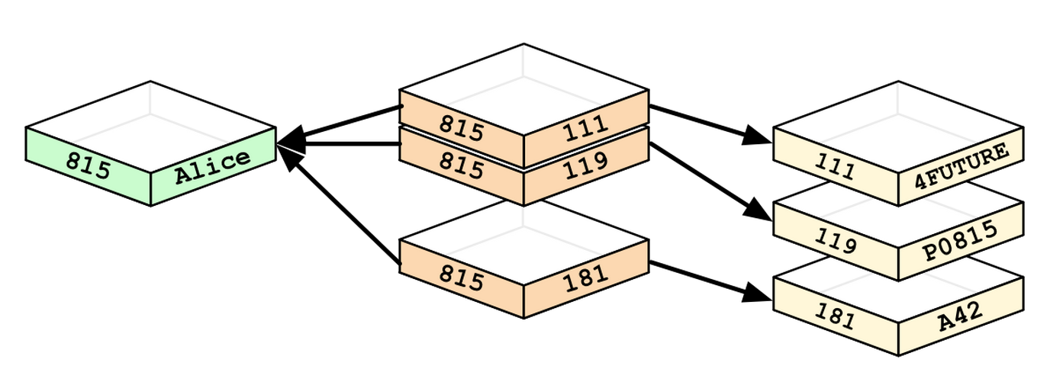
Graph Databases

Slide 33
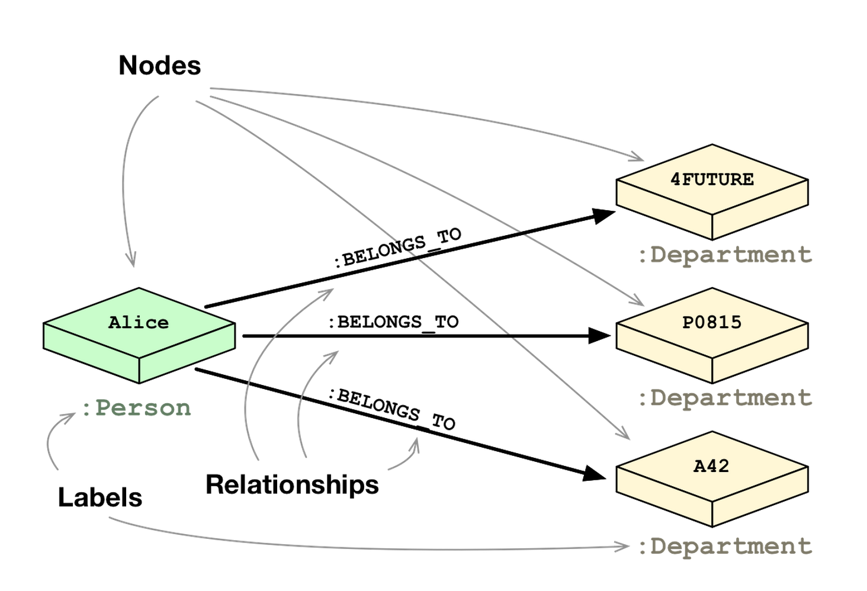

Slide 34
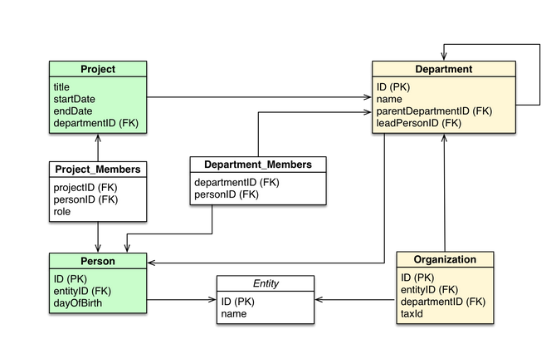

Slide 35
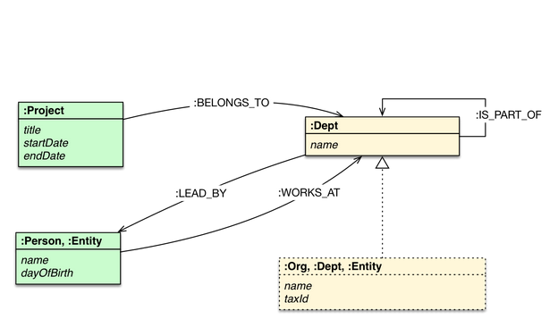

Slide 36
Neo4j Tips
Each entity table is represented by a label on nodes
Each row in an entity table is a node
Columns on those tables become node properties.
Join tables are transformed into relationships, columns on those tables become relationship properties

Slide 37
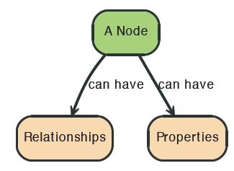

Node in Neo4j

Slide 38
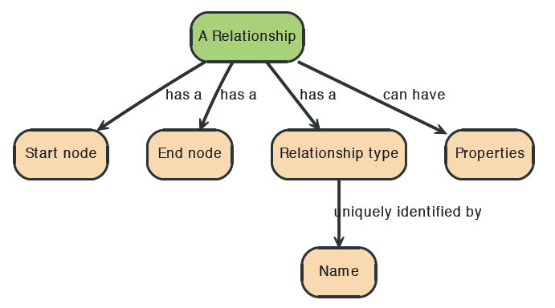
Relationships in Neo4j
Relationships between nodes are a key part of Neo4j.

Slide 39



Relationships in Neo4j

Slide 40
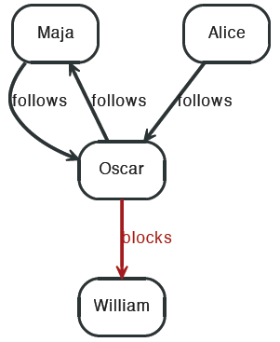


Twitter and relationships

Slide 41
Properties
Both nodes and relationships can have properties.
Properties are key-value pairs where the key is a string.
Property values can be either a primitive or an
array of one primitive type.
For example String, int and int[] values are valid for properties.

Slide 42
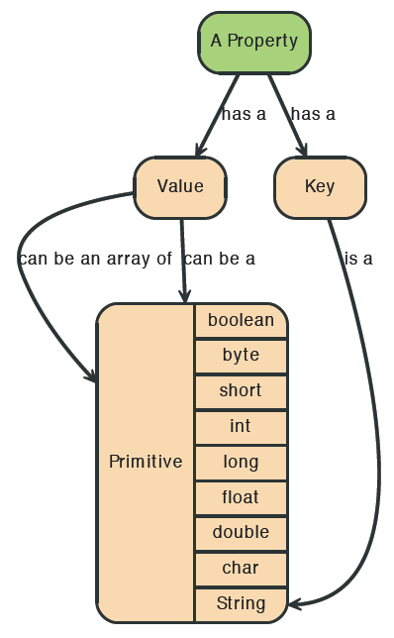
Properties

Slide 43
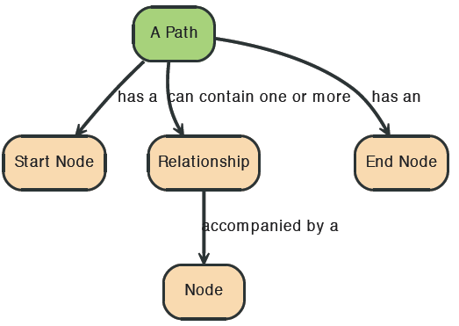

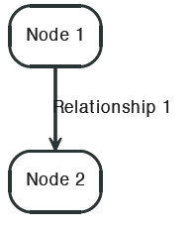
Paths in Neo4j
A path is one or more nodes with connecting relationships, typically retrieved as a query or traversal result.

Slide 44

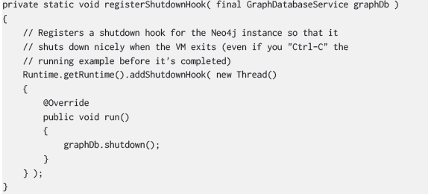
Starting and Stopping

Slide 45
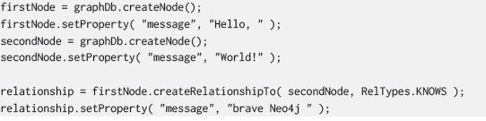
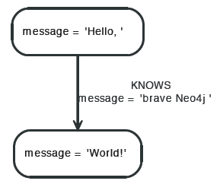
Creating a small graph

Slide 46

Print the data

Slide 47

Remove the data

Slide 48
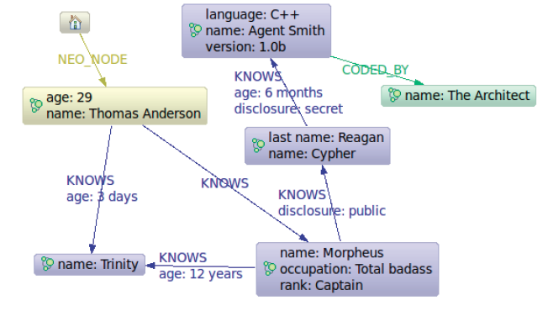
The Matrix Graph Database

