Slide 1
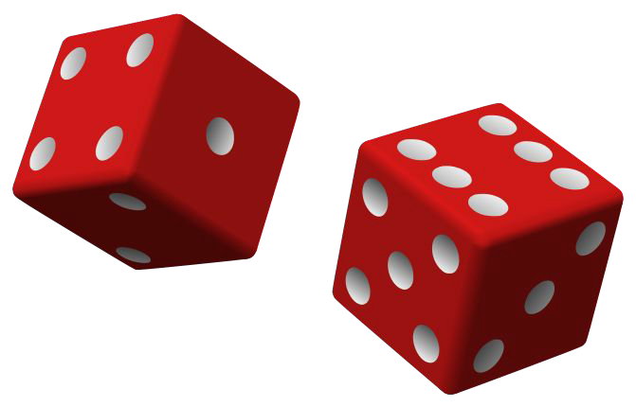
Naive Bayes
Isaac Osei Nyantakyi, PH.D

Slide 2
Naive Bayes - Introduction
Naive Bayes - (Sometime aka Stupid Bayes :) )
●Classification technique based on Bayes’ Theorem
●With “naive” assumption of independence among predictors.
●Easy to build
●Particularly useful for very large data sets
●Known to outperform even highly sophisticated classification
methods
a.e.g. Earlier method for spam detection
Machine Learning - Naive Bayes

Slide 3
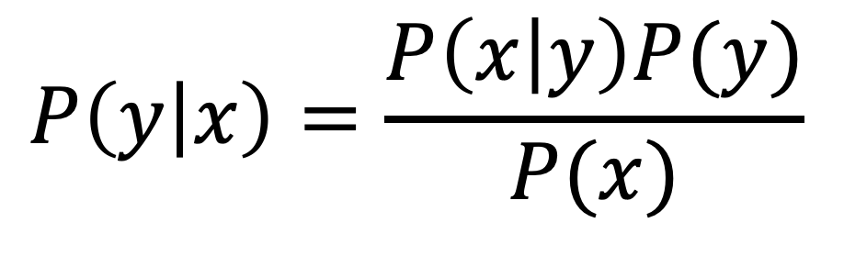
Introduction - Bayes theorem
● P(y|x) - the posterior probability of class (c, target) given predictor (x, attributes).
● P(y) - the prior probability of class.
● P(x|y) - is the likelihood which is the probability of predictor given class.
● P(x) - is the prior probability of predictor.
$$P\left(y | x\right)=\frac{P\left(x | y\right)P(y)}{P(x)}$$
Machine Learning - Naive Bayes

Slide 4
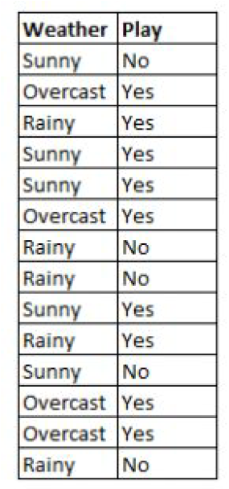
How Naive Bayes algorithm works
● We are training data set of weather and corresponding target variable ‘Play’ (suggesting
possibilities of playing).
● Now, we need to classify whether players will play or not based on weather condition.
Machine Learning - Naive Bayes

Slide 5
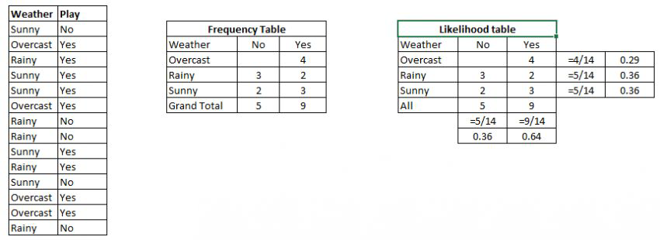
How Naive Bayes algorithm works
1. Convert the data set into a frequency table
2. Create Likelihood table by finding the probabilities like Overcast probability = 0.29 and
probability of playing is 0.64.
3. Now, use Naive Bayesian equation to calculate the posterior probability for each class.
The class with the highest posterior probability is the outcome of prediction.

Slide 6
How Naive Bayes algorithm works
Problem: Players will play if weather is sunny. Is this statement is correct?
Machine Learning - Naive Bayes

Slide 7
How Naive Bayes algorithm works
Problem: Players will play if weather is sunny. Is this statement is correct?
P(Yes | Sunny) = P( Sunny | Yes) * P(Yes) / P (Sunny)
Machine Learning - Naive Bayes

Slide 8
How Naive Bayes algorithm works
Problem: Players will play if weather is sunny. Is this statement is correct?
P(Yes | Sunny) = P( Sunny | Yes) * P(Yes) / P (Sunny)
Here we have
P (Sunny |Yes) = 3/9 = 0.33,
P(Sunny) = 5/14 = 0.36,
P( Yes)= 9/14 = 0.64
Machine Learning - Naive Bayes

Slide 9
How Naive Bayes algorithm works
Problem: Players will play if weather is sunny. Is this statement is correct?
P(Yes | Sunny) = P( Sunny | Yes) * P(Yes) / P (Sunny)
Here we have
P (Sunny |Yes) = 3/9 = 0.33,
P(Sunny) = 5/14 = 0.36,
P( Yes)= 9/14 = 0.64
Now, P (Yes | Sunny) = 0.33 * 0.64 / 0.36 = 0.60, (high probability)
Machine Learning - Naive Bayes

Slide 10
How Naive Bayes algorithm works
Problem: Players will play if weather is sunny. Is this statement is correct?
P(No | Sunny) = P( Sunny | No) * P(No) / P (Sunny)
Here we have
P (Sunny |No) = 2/5 = 0.4,
P(Sunny) = 5/14 = 0.36,
P( No)= 5/14 = 0.36
Now, P (No | Sunny) = 0.4 * 0.36 / 0.36 = 0.40, (low probability)
Machine Learning - Naive Bayes

Slide 11
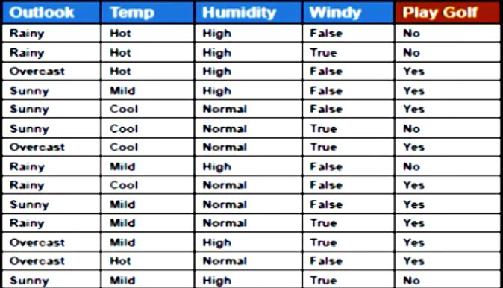
How Naive Bayes algorithm works
For Outlook = Rainy, Temp = Mild, Humidity = Normal, Windy = True, YES or No?
Problem2:
Rainy Mild Normal True ???
Machine Learning - Naive Bayes

Slide 12
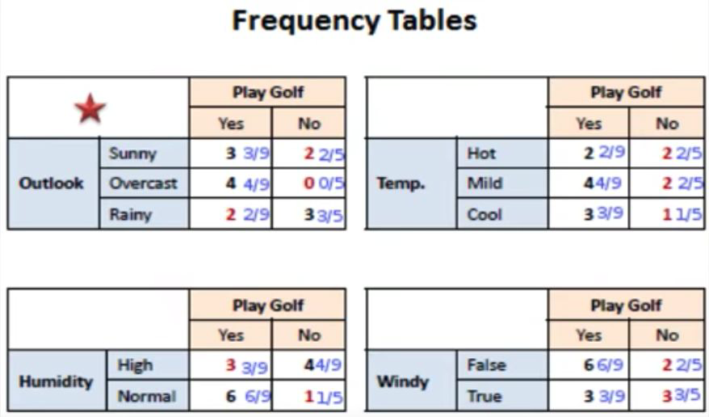
How Naive Bayes algorithm works
Lets prepare frequency tables of each feature
Machine Learning - Naive Bayes

Slide 13
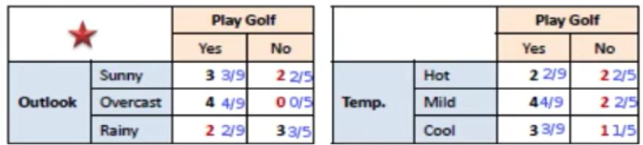
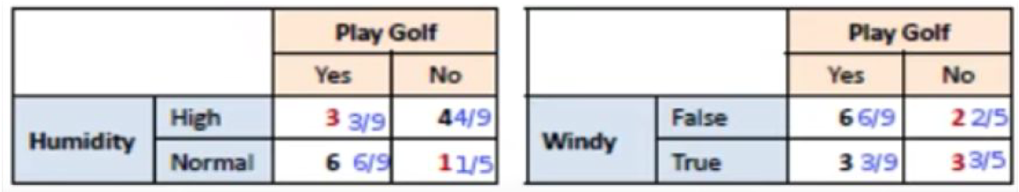
How Naive Bayes algorithm works
Problem2: For Outlook = Rainy, Temp = Mild, Humidity = Normal, Windy = True, YES or No?
Machine Learning - Naive Bayes

Slide 14
How Naive Bayes algorithm works
Problem2: For Outlook = Rainy, Temp = Mild, Humidity = Normal, Windy = True, YES or No?
Likelihood of yes = P(Outlook = Rainy|Yes) * P(Temp = Mild| Yes) * P(Humidity = Normal|Yes)*P(Windy = True|Yes)*P(Yes)
= ?
Machine Learning - Naive Bayes

Slide 15
How Naive Bayes algorithm works
Problem2: For Outlook = Rainy, Temp = Mild, Humidity = Normal, Windy = True, YES or No?
Likelihood of yes = P(Outlook = Rainy|Yes) * P(Temp = Mild| Yes) * P(Humidity = Normal|Yes)*P(Windy =True|Yes)*P(Yes)
= 2/9 * 4/9 * 6/9 * 3/9 * 9/14
= 0.0141
Machine Learning - Naive Bayes

Slide 16
How Naive Bayes algorithm works
Problem2: For Outlook = Rainy, Temp = Mild, Humidity = Normal, Windy = True, YES or No?
Likelihood of yes = P(Outlook = Rainy|Yes) * P(Temp = Mild| Yes) * P(Humidity = Normal|Yes)*P(Windy = True|Yes)*P(Yes)
= 2/9 * 4/9 * 6/9 * 3/9 * 9/14
= 0.0141
Likelihood of No = P(Outlook = Rainy|No) * P(Temp = Mild| No) * P(Humidity = Normal|No)*P(Windy = True|No)*P(No)
= 3/5 * 2/5 * 1/5 * 3/5 * 5/14
= 0.0103
Machine Learning - Naive Bayes

Slide 17
How Naive Bayes algorithm works
Problem2: For Outlook = Rainy, Temp = Mild, Humidity = Normal, Windy = True, YES or No?
Likelihood of yes = 0.0141
Likelihood of No = 0.0103
After Normalizaion,
Yes = 0.0141 / (0.0141 + 0.0103) = 0.58
No = 0.0103 / (0.0141 + 0.0103) = 0.42
Machine Learning - Naive Bayes

Slide 18
How Naive Bayes algorithm works
Problem2: For Outlook = Rainy, Temp = Mild, Humidity = Normal, Windy = True, YES or No?
YES
Machine Learning - Naive Bayes

Slide 19
Zero Frequency Problem
What if any of the count is 0?
●?
Machine Learning - Naive Bayes

Slide 20
Zero Frequency Problem
What if any of the count is 0?
●Add 1 to all counts
●It is a form of Laplace smoothing
●See https://en.wikipedia.org/wiki/Additive_smoothing
Machine Learning - Naive Bayes

Slide 21
Using Python
#Import Library of Gaussian Naive Bayes model
from sklearn.naive_bayes import GaussianNB
import numpy as np
#assigning predictor and target variables
X= np.array([[-3,7],[1,5], [1,2], [-2,0], [2,3], [-4,0], [-1,1], [1,1], [-2,2], [2,7], [-4,1],
[-2,7]])
y = np.array([3, 3, 3, 3, 4, 3, 3, 4, 3, 4, 4, 4])
#Create a Gaussian Classifier
model = GaussianNB()
# Train the model using the training sets
model.fit(X, y)
#Predict Output
predicted= model.predict([[1,2],[3,4]])
print(predicted)
See the Jupyter Notebook.
Machine Learning - Naive Bayes

Slide 22
Tips to improve the Naive Bayes Model
●If continuous features do not have normal distribution,
○we should use transformation or different methods to convert
●If test data set has zero frequency issue,
○apply smoothing techniques “Laplace smoothing”
●Remove correlated features,
○as the highly correlated features are voted twice in the model
○and it can lead to over inflating importance.
●Naive Bayes classifier has limited options for parameter tuning
●Can’t be ensembled - because there is no variance to reduce
Machine Learning - Naive Bayes

Slide 23
Variants
Gaussian:
● It is used in classification and it assumes that features follow a normal distribution.
Multinomial:
It is used for discrete counts.
Implements the naive Bayes algorithm for multinomially distributed data
It is one of the two classic naive Bayes variants used in text classification
Bernoulli:
The binomial model is useful if your feature vectors are binary (i.e. zeros and ones).
One application would be text classification with ‘bag of words’ model
where the 1s & 0s are “word occurs in the document”
and “word does not occur in the document” respectively.
http://scikit-learn.org/stable/modules/naive_bayes.html
Machine Learning - Naive Bayes

Slide 24
Applications
1.Real time Prediction:
○Naive Bayes is an eager learning classifier and it is sure fast.
Thus, it could be used for making predictions in real time.
2. Multi class Prediction:
○Well known for multi class prediction feature.
Machine Learning - Naive Bayes

Slide 25
Applications
1.Text classification/ Spam Filtering/ Sentiment Analysis:
○Mostly used in text classification
○Have higher success rate as compared to other algorithms.
○Widely used in Spam filtering (identify spam e-mail)
○and Sentiment Analysis
2. Recommendation System:
○Naive Bayes Classifier and Collaborative Filtering together
builds a Recommendation System that uses machine learning
and data mining techniques to filter unseen information and
predict whether a user would like a given resource or not
Machine Learning - Naive Bayes

Slide 26
Further references
●http://scikit-learn.org/stable/modules/naive_bayes.html
●https://en.wikipedia.org/wiki/Bayes%27_theorem
●https://en.wikipedia.org/wiki/Naive_Bayes_classifier
Machine Learning - Naive Bayes

