Slide 1




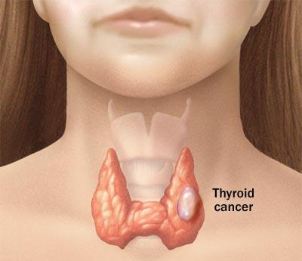



A CNN (CONVOLUTIONAL NEURAL NETWORK) MODEL PREDICTING DIFFERENT TYPES OF THYROID CANCER

Slide 2
INTRODUCTION
◆
The model detects three types of thyroid cancer using
convolutional neural network that works with ultrasound images data we used
◆
The types of the thyroid cancer that the model predict is:
Follicular Thyroid cancer(FTC), Medullary Thyroid Cancer(MTC),
Papillary Thyroid cancer(PTC) We used 298 ultra sound labelled images (FTC-100, MTC-99, PTC-
99) to train the model which is split to 80%(238) for training and
20% (60) for validation test The link of the data set used is here below:
◆
◆
https://huggingface.co/datasets/FangDai/Thyroid_Ultrasound_Ima
ges

Slide 3
MODEL ARCHITECTURE
◆
Step 1: To Load the Dataset : We used a public dataset from
Hugging Face with thyroid ultrasound images. We logged in with our Hugging Face token to access . Then Loaded all the images and Split them into 80% for training and 20% for testi ng
Step 2: Preparing the Images: Converted images to color
(RGB). Resized them to 224x224 pixels (same size). Divided
pixel values by 255 so the values are between 0 and 1
(normalization).
◆
◆
Step 3: Converting Data for Tensor Flow: We changed the
dataset format to Tensor Flow so that we could use it for
training the model.

Slide 4
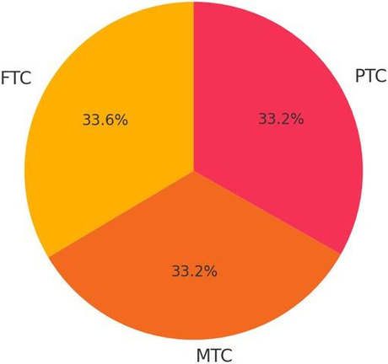
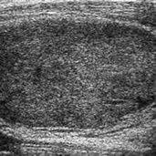
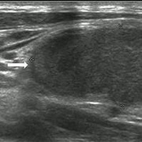
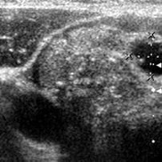
Dataset Snapshot
•
298 labelled ultrasound images Class balance — 100 FTC | 99 MTC | 99 PTC (≈ 33 % each) Split: 80 % train (238) • 20 % validation (60) Images resized to 224 × 224 px during preprocessing Balanced set → minimal class-bias in training
•
•
•
•
FTC
MTC
PTC

Slide 5
MODEL ARCHITECTURE(continuation)
◆
Step 4: Building the Model: we created a simple CNN (Convolutional Neural Network) with 3 layers that learn image features. And a final layer that predict one of the 3 cancer types.
1. Conv2D Layer 1 Function: Learns basic features (edges,
color changes).
2. Conv2D Layer 2 Function: Learns more complex features
(shapes, corners).
3. Conv2D Layer 3 Function: Learns high-level features
(tumor structure, texture).
◆
Each of these is followed by a pooling layer:
max_pooling2d, max_pooling2d_1, and
global_average_pooling2d respectively.

Slide 6
MODEL ARCHITECTURE(continuation)
◆
MaxPooling2D: Reduces the spatial size of the image while
keeping important features. This helps speed up learning and reduce noise.
GlobalAveragePooling2D: Greatly reduces the number of
parameters by averaging each feature map, which helps
prevent overfitting.
The final layer is Dense layer with softmaxactivation. This
layer has 3 neurons (one for each class: FTC, MTC, and PTC)
and uses the softmaxactivation function to output a
probability distribution across the 3 classes. The class with
the highest probability is the predicted class.
◆
◆

Slide 7
MODEL ARCHITECTURE(continuation)
◆
Step 5: Training the Model, we trained the model on the
training data. We used: Early stopping (to stop training if it stops improving). Model saving (to keep the best version). Learning rate control (to slow down learning if needed).
◆
Step 6: Testing the Model After training: we tested the
model on the 20% validation set, we checked how many
images it predicted correctly. We printed a report
showing how good the predictions were and we printed a
confusion matrix to see where it made mistakes.

Slide 8
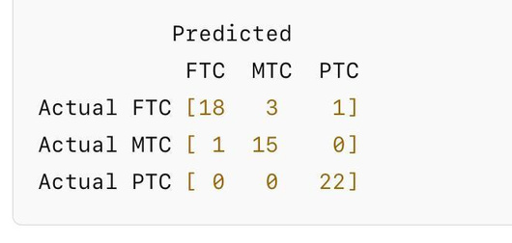
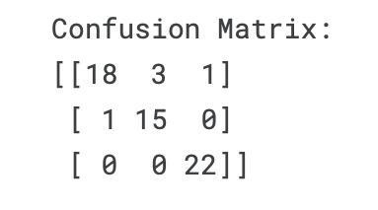
PREDICTION RESULT
◆
The results the model predicted out of the 20% for the
validation set is here below:
◆
Predicted FTC : 18 images were correctly classified as FTC, 3 were wrongly predicted as MTC, 1 was wrongly predicted as PTC.
Predicted MTC : 15 correctly classified as MTC, 1 wrongly
classified as FTC.
Predicted PTC : All 22 were correctly classified. No errors
here.
◆
◆

Slide 9
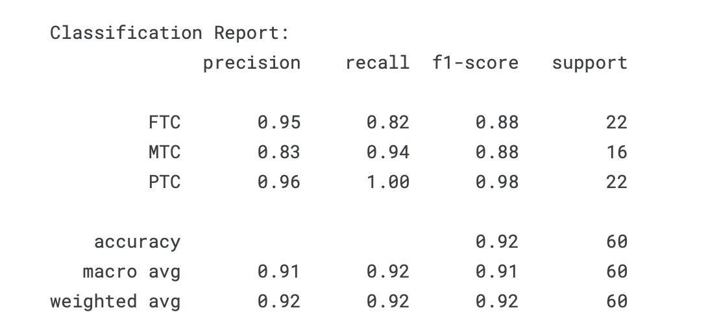
MODEL PERFORMANCE METRICS
◆
Precision: Of the samples predicted as a certain class, how many were actually correct?High precision means few false positives.
Recall: Of the actual instances of a class, how
many were correctly predicted?High recall
means few false negatives.
F1-Score : Harmonic mean of precision and recall.
Balances both false positives and false negatives.
Support : The number of true instances for each
class in the test set
Macro Avg(treats all classes equally)
◆
◆
◆
◆ 
◆
Weighted Avg(accounts for class imbalance)
Overall Performance: Accuracy : 0.92 → The
model correctly classified 92% of all 60 validation
set.

