Slide 1
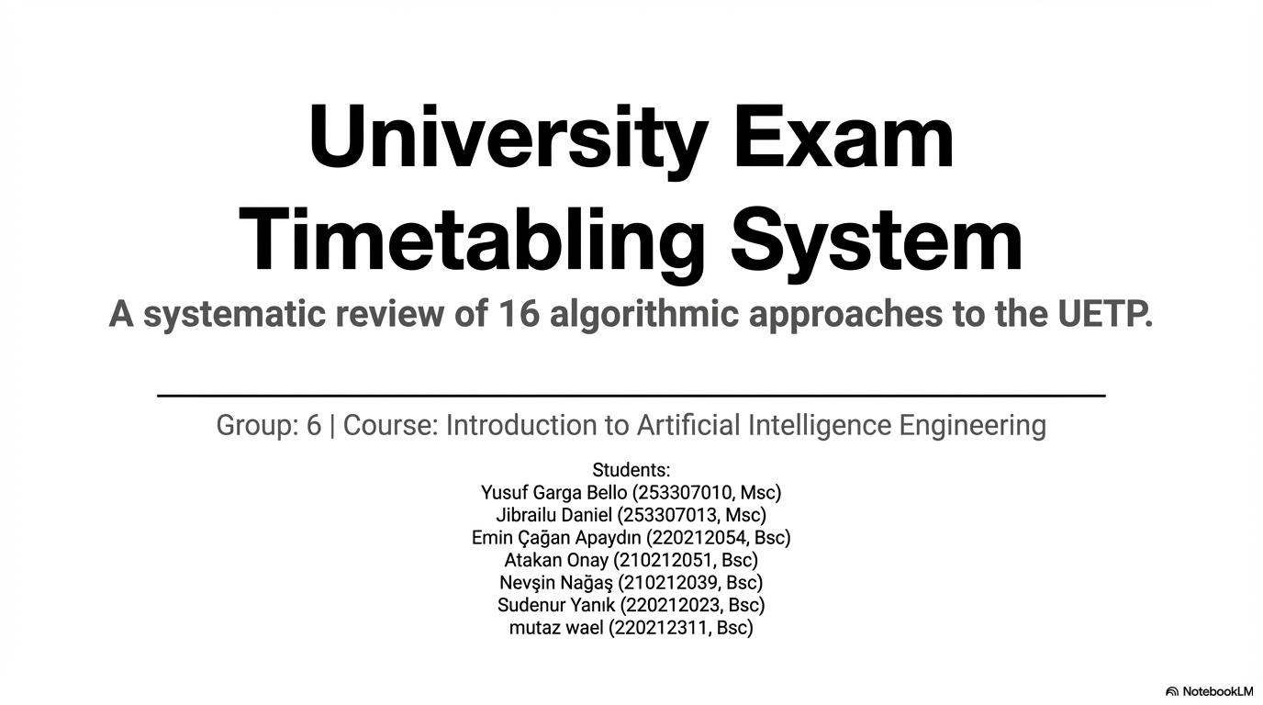
Fairness-Aware Constraint Satisfaction
Framework for University Exam Timetabling with
Dual-Role Instructor Conflict Modeling
(CSP)

Slide 2
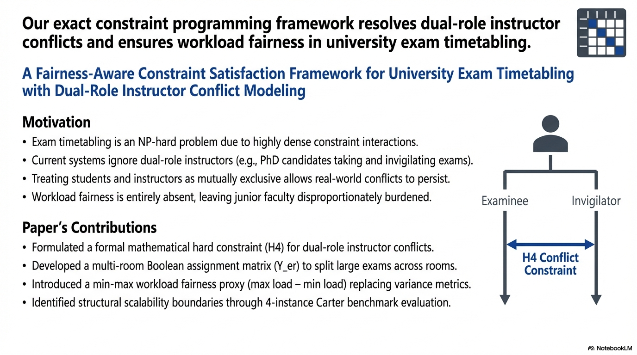

Slide 3
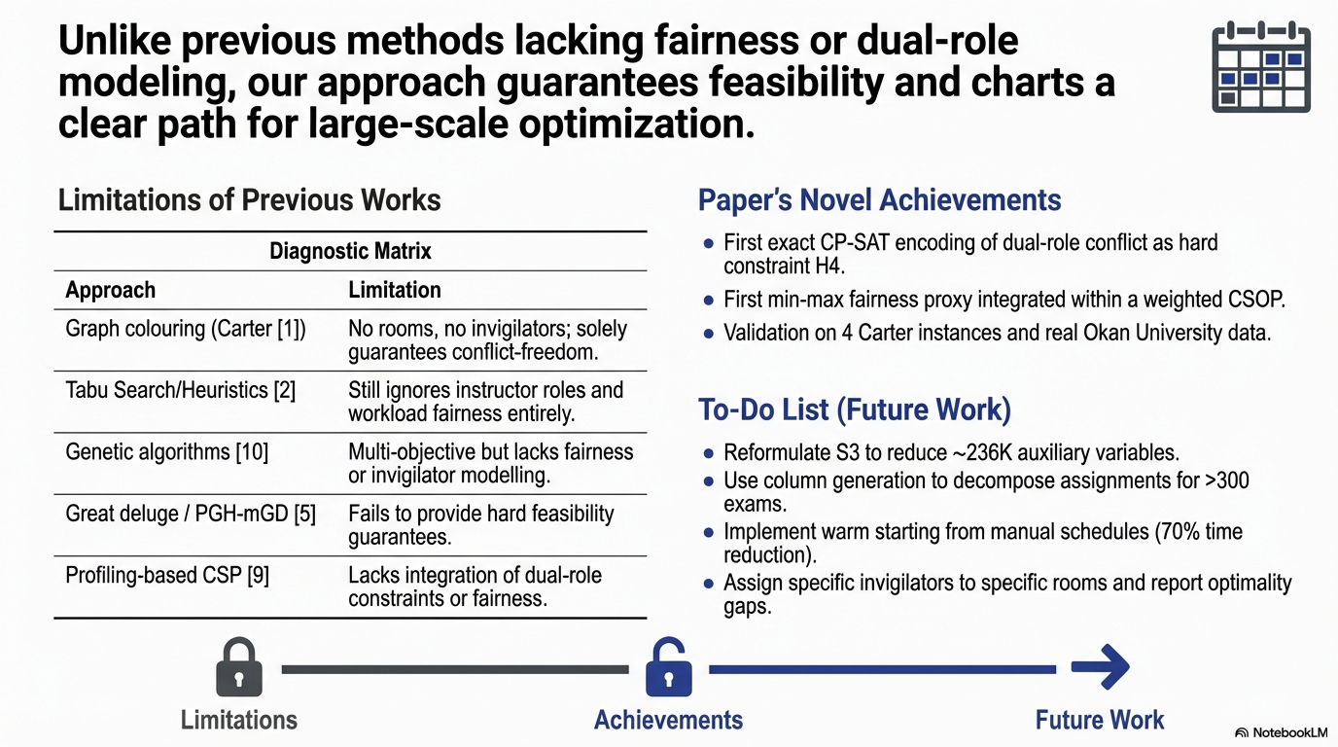

Slide 4
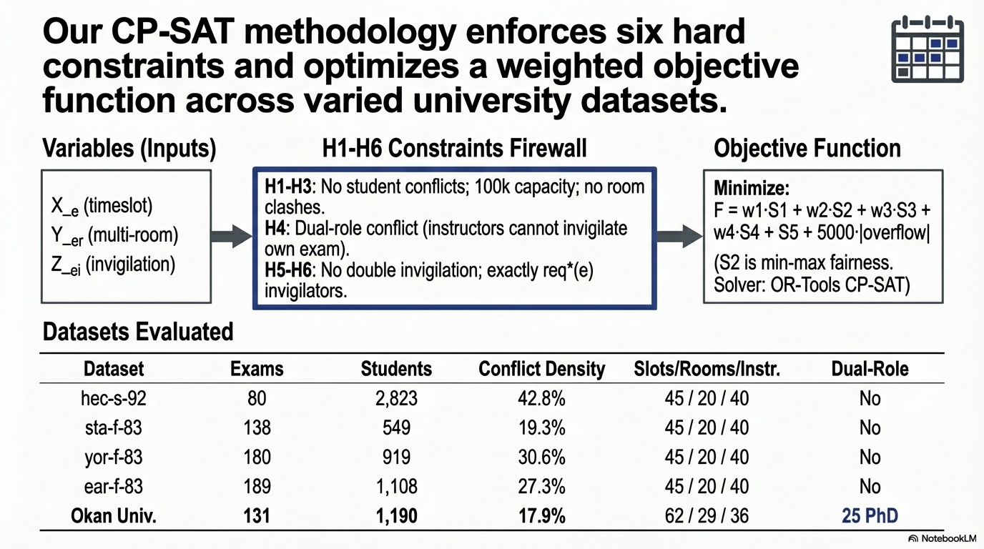

Slide 5
