Slide 1
GROUP 6: PRESENTATION
A Fairness-Aware Constraint
Satisfaction Framework
for University Exam Timetabling with
Dual-Role Instructor Conflict Modeling
Jibrailu Daniel · Yusuf Garga Bello · Emin Çağan Apaydın · Atakan Onay
Mutaz Wael · Nevşin Nagaş · Sudenur Yanık
Istanbul Okan University · Computer Engineering Dept. · Istanbul, Türkiye
131
36
25
0
Examinations
Instructors
Dual-Role PhD
Hard Violations
1 / 10

Slide 2
THE CHALLENGE
Why Existing Approaches Fall Short
NP-Hard
GAP 01
Missing Dual-Role Conflicts
PhD candidates (Instructors and Students)
CP Models Reviewed : disjoint groups
Comlan and Allohoumbo 2023
GAP 02
Room Assignment Decoupled
Existing CP benchmarks (Toronto/Carter)
Room Exclusion by most CP
Assignment afterward
GAP 03
Fairness as an Afterthought
Invigilators
Unequal workload balance
2 / 10

Slide 3
OUR CONTRIBUTIONS & MATHEMATICAL FORMULATION
THREE NOVEL CONTRIBUTIONS
MATHEMATICAL FORMULATION
① Novel Hard Constraint
H4: DUAL ROLE HARD CONSTRAINT
Formally encodes PhD candidate conflicts inside CP-SAT.
Realtime conflict detection
DECISION VARIABLES
Xe Timeslot assignment per exam
Yer Multi-room Boolean matrix
Zei Invigilator assignment
HARD CONSTRAINTS (H1-H6)
H1 No Student Time Conflict
H2 Room Capacity & Online Routing
H3 No Room Clash (reified Boolean)
H4 Dual-Role Instructor Conflict ← NOVEL
H5 No Double Invigilation
H6 Minimum Invigilator Count
② Novel CP Architecture
INTEGRATE MULTI-ROOM BOOLEAN MATRIX
One exam = multiple rooms
③ Novel Objective Function
MIN-MAX FAIRNESS OBJECTIVE
S2 = max(load) - min(load). Native CP-SAT encoding via add_max_equality — exact optimality guaranteed.
OBJECTIVE FUNCTION
min F = w1S1 + w2S2 + w3S3 + w4S4 + S5 + 5000·|overflow|
weights: w1=1 (preference) w2=5 (fairness) w3=2 (consec.) w4=3 (day-gap)
S2 = max(load) - min(load) min-max proxy, natively linearised in CP-SAT
3 / 5

Slide 4
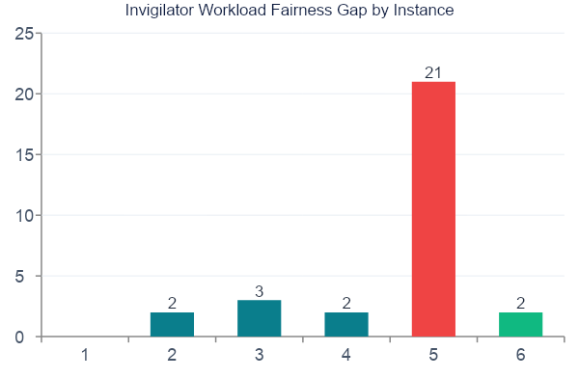
RESULTS AT A GLANCE
OPTIMAL
hec-s-92 solved to proven optimality in 14.3s (gap = 0)
NEAR-OPT
sta-f-83, yor-f-83, Univ. X all achieve gap ≤ 3
BOUNDARY
ear-f-83 gap = 21 under simultaneous slot+room saturation (structural, not solver failure)
ZERO H4
All 25 PhD dual-role violations prevented across every test instance
SCALE
7 / 10

Slide 5
CONCLUSION
FUTURE DIRECTIONS
✓
All hard constraints satisfied across every tested instance
1
AI & ML Integration
LLMs and GNNs to automatically generate contraints, predict good solution and speedup scheduling process
✓
Optimal fairness on hec-s-92 (gap = 0) in 14.3 s — provably
2
Scalability for Larger University
✓
Near-optimal fairness (gap 2–3) on sta-f-83, yor-f-83 & Univ. X
Develop a composition technique to handle 300+ exams without running out of memory
✓
Zero H4 violations: all 25 dual-role PhD candidates protected
THANK YOU
★
First CP hard constraint encoding dual-role conflicts in an exact solver
10 / 10

