Slide 1
Composing GPU inference energy
from a per-kernel database
YOLO26 n / s / m / l / x · NVIDIA A40 · fp32, 640 × 640 · batch 1 and 8
Goal
Predict the energy of one forward pass without measuring the model — look its building blocks up in a database.
E_{kernel} = E_{dyn} + P_{static} · t measured once per kernel
E_{sum} = Σ_{k} e_{k} ← the number in this report (all sequential kernels)
Ruofan Wu, Jeff Ma · 09/14/2026 · University of Michigan

Slide 2
Workflow: measure once, compose later
1
Capture
Run the model once, record every layer's real input tensors. Kernel key = module structure + input shape/dtype — position-independent, so the same block in two models is one row.
2
Measure in isolation
Static Power – 89.7W on A40
Zeus energy window: 50 warm-up calls, 1000-call calibration, 3 s cooldown, then 5 s of back-to-back calls. Store eₖ and tₖ.
2 s of forwards → synchronize → wait 1 s → 1 s Zeus window; only cycles that stay at P0 with ≥ 95 % SM clock are kept.
3
Compose
A model is a LEFT JOIN of its layer list onto the database. E_sum = Σ eₖ.

Slide 3
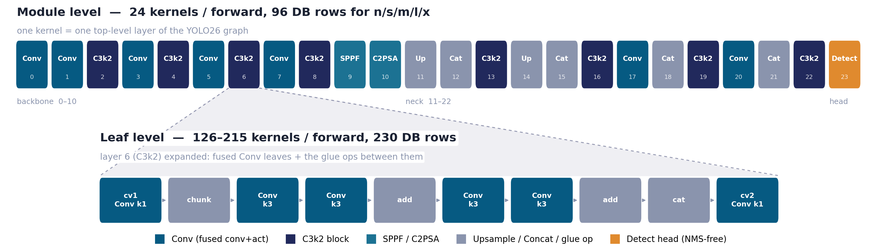
What counts as one kernel: two granularities
Same measurement protocol, same database, two different decompositions of the same forward pass

Slide 4
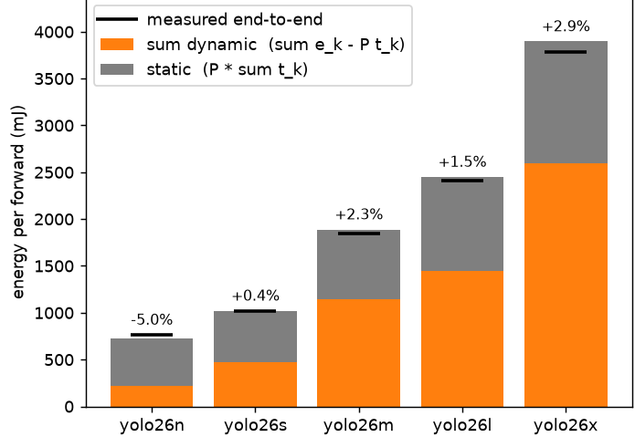
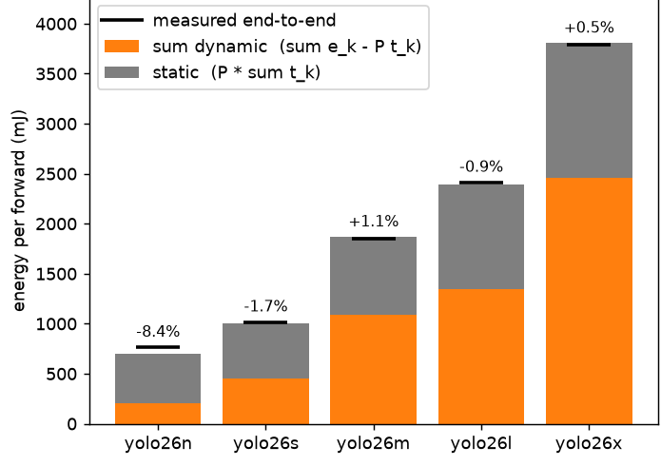
Batch 1: energy composes except for small ones
Σ eₖ against the measured forward energy, five model sizes
Module level
Leaf level
≤ 2.9 % / −5.0 %
≤ 1.7 % / −8.4 %
Energy composes well. The only large error is yolo26n at batch 1, where the model and input are small enough that execution is CPU launch-bound.

Slide 5
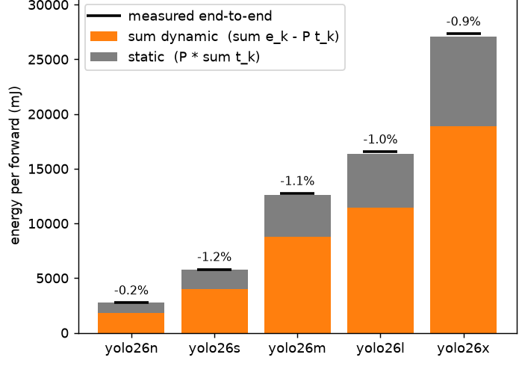
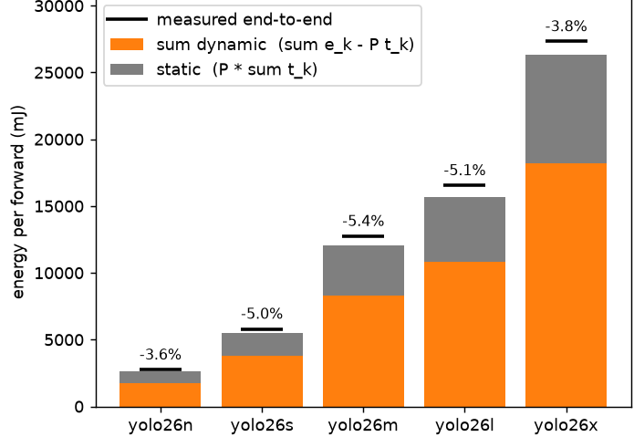
Batch 8: the leaf underestimates energy
Module level
Leaf level
within 1.2 %
3.6 – 5.4 % low
Leaf level underestimates energy overall. Back-to-back profiling runs hit in L2, cutting the memory traffic the kernel pays inside the model.

Slide 6
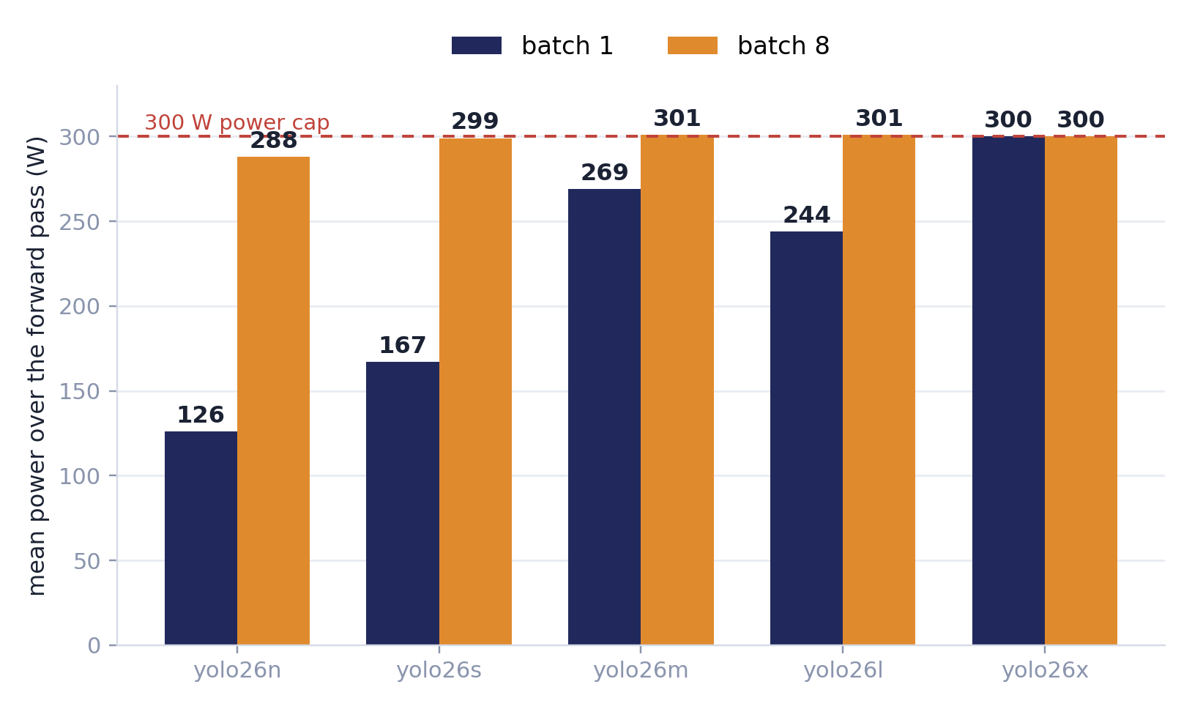
Span power-capped and non-capped regimes
Average power over one forward pass, measured end-to-end, five sizes at both batch sizes
Batch 1 spans 126 → 300 W
Power tracks how busy the GPU actually is: yolo26n is GPU-active only 32 % of the forward and sits at 126 W, yolo26x already saturates the cap.
Our configurations cover both power-capped and non-capped regimes, and energy composition holds across both.

Slide 7
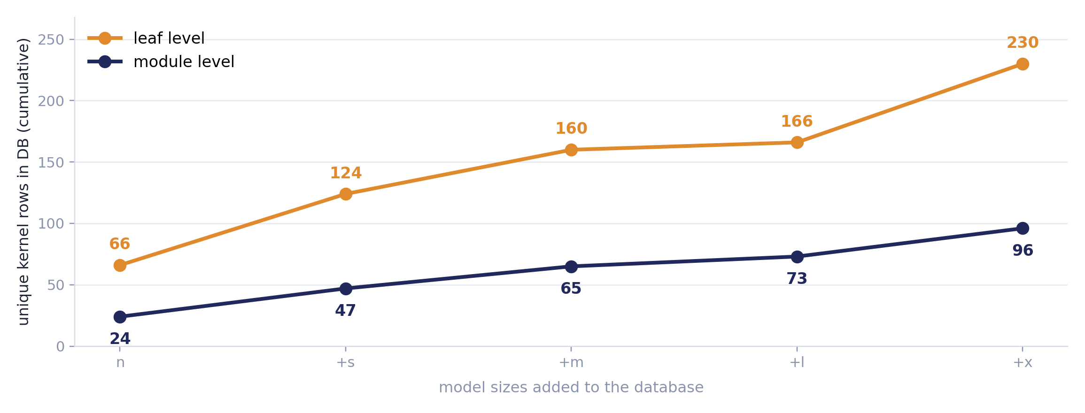
Database size
Unique rows needed to cover yolo26 n → s → m → l → x at each granularity
2.4× the rows for one family
What the extra rows buy
YOLO26 has ~45 distinct Conv shapes but only ~23 distinct layers.
Leaf rows are keyed by Conv shape, so they transfer to any architecture built from the same shapes; a module row is tied to YOLO26's C3k2 depth and width.

Slide 8
Potential next steps
1
2
Estimate kernels with Jigsaw
Re-measure with a cold cache
Yash's Jigsaw predicts a small glue/memory kernel's cost from its shape, so the database becomes a seed set plus a model rather than an exhaustive table: measure what cannot be estimated, estimate the rest.
We underestimate: leaf sums sit 3–9 % below the block measured as a unit, and the profiler GPU-time sums are low too — so it is GPU-side, not a launch artefact.
This is what makes the 230-row leaf level affordable once we move past one family.
Back-to-back iterations re-read the same input from a warm L2 (A40: 6 MB) with no competing traffic. Flush the cache between iterations and see whether the deficit closes.
Notes:
Error bars
Training

