Slide 1

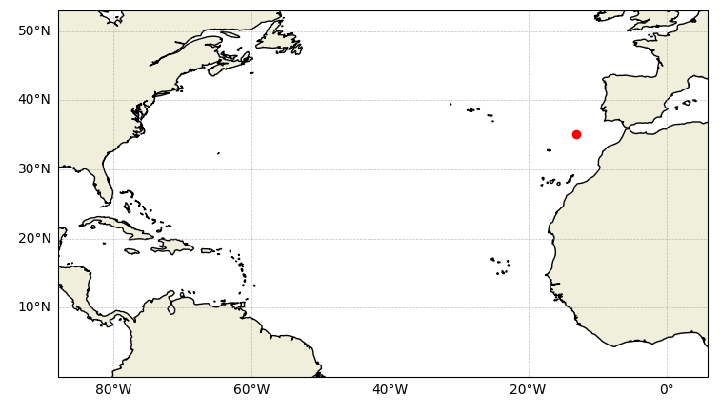
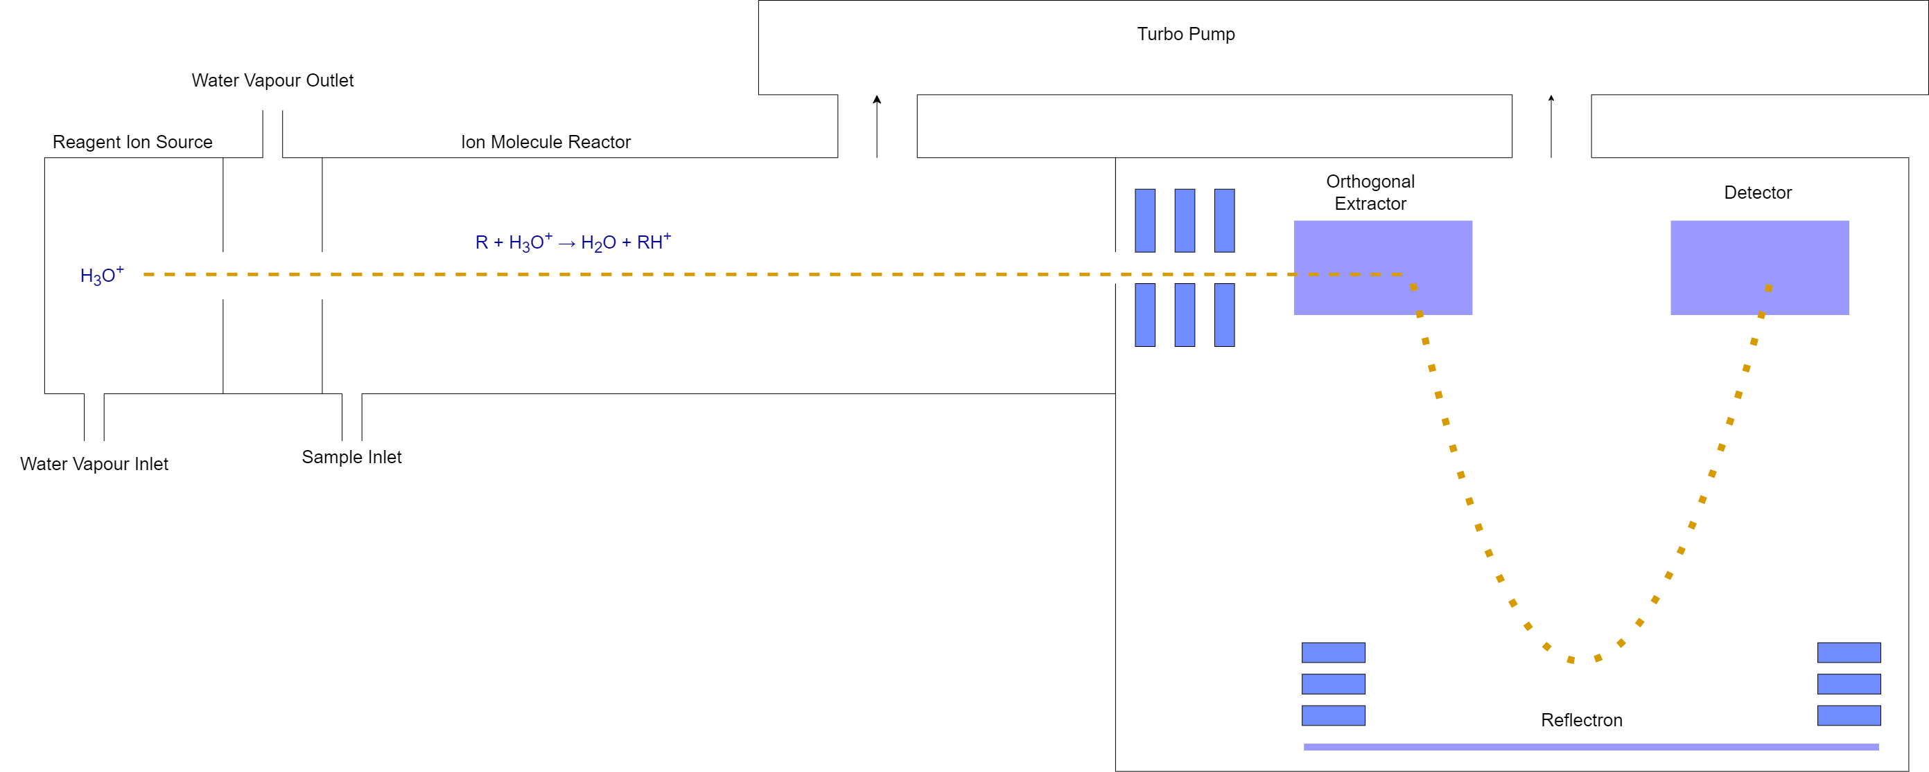
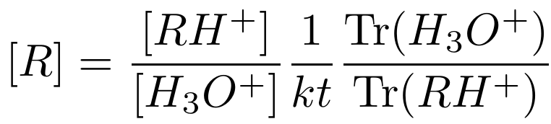
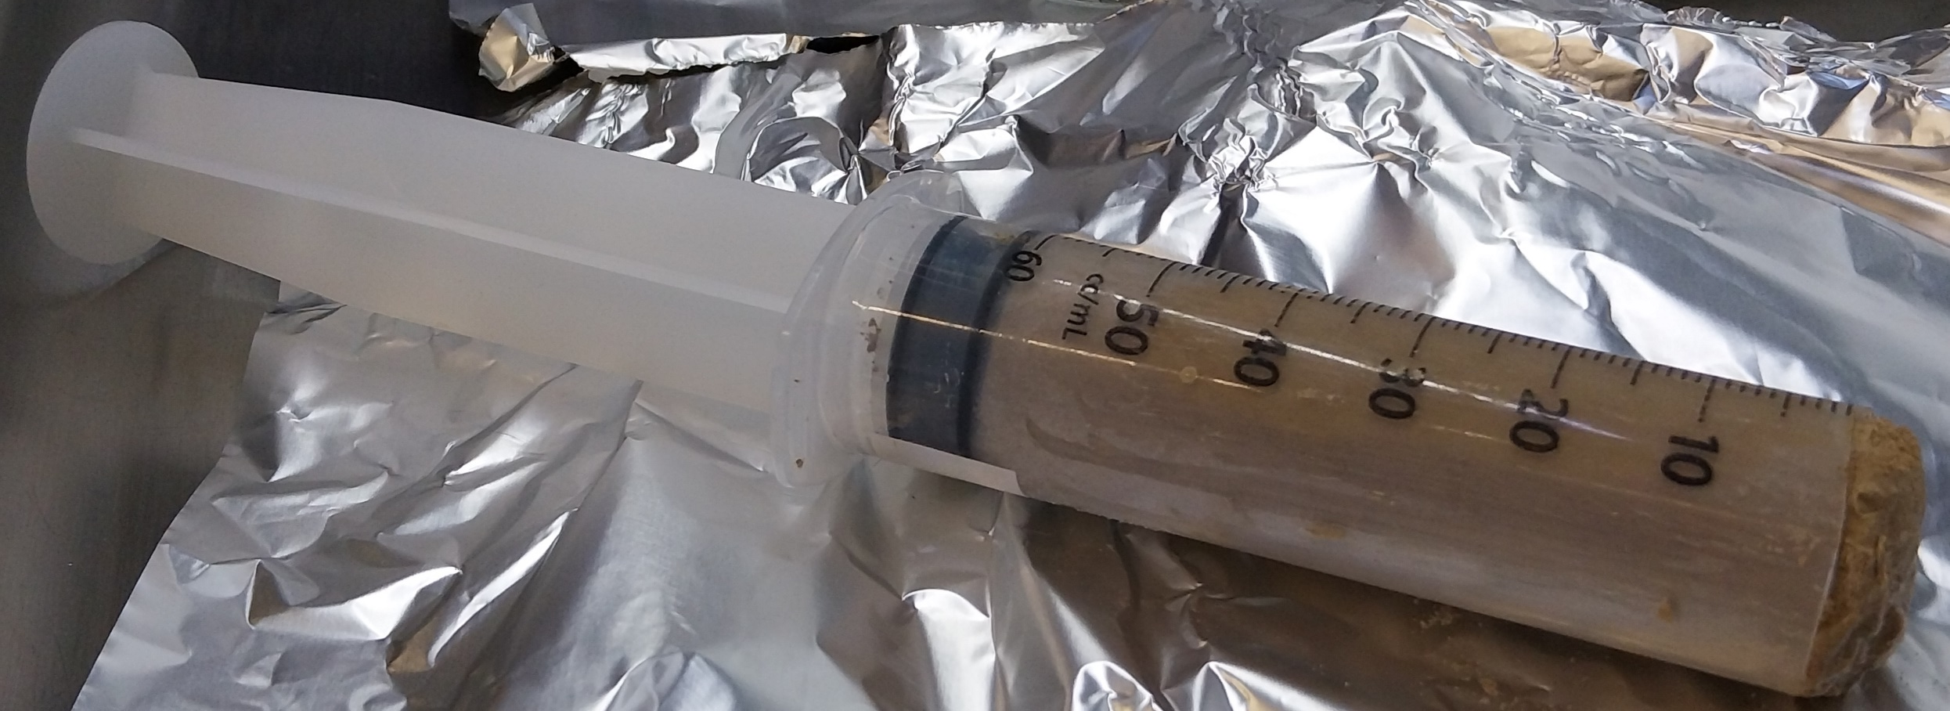
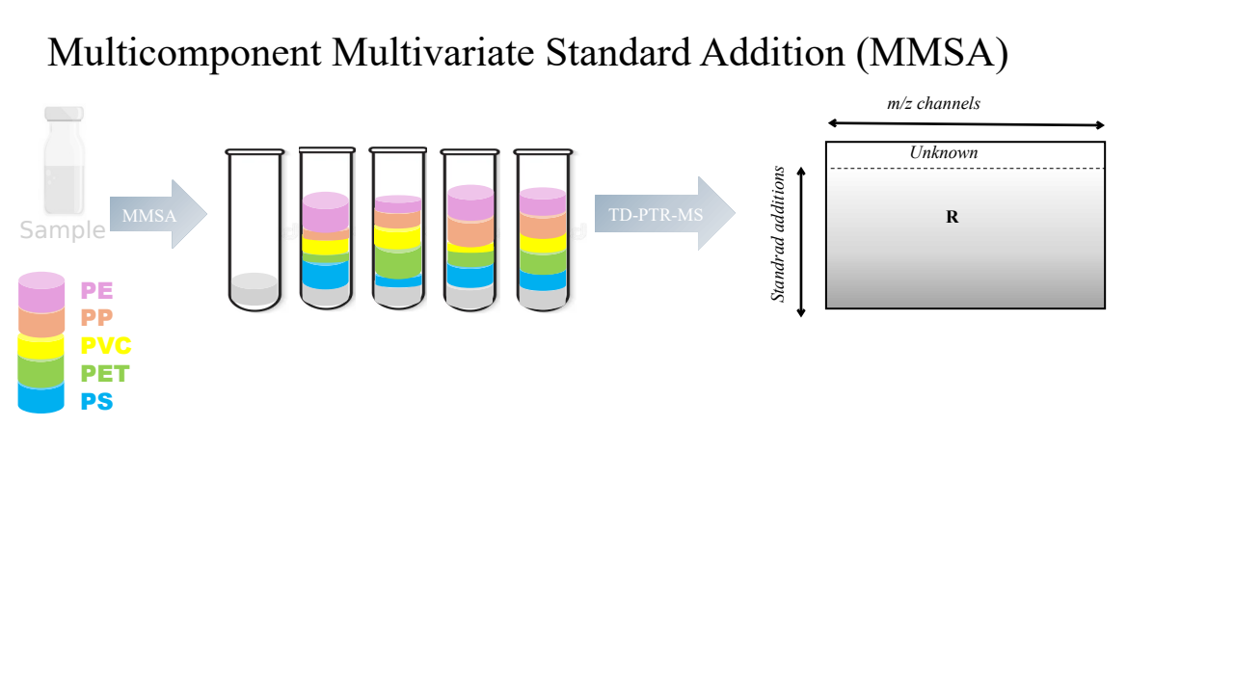
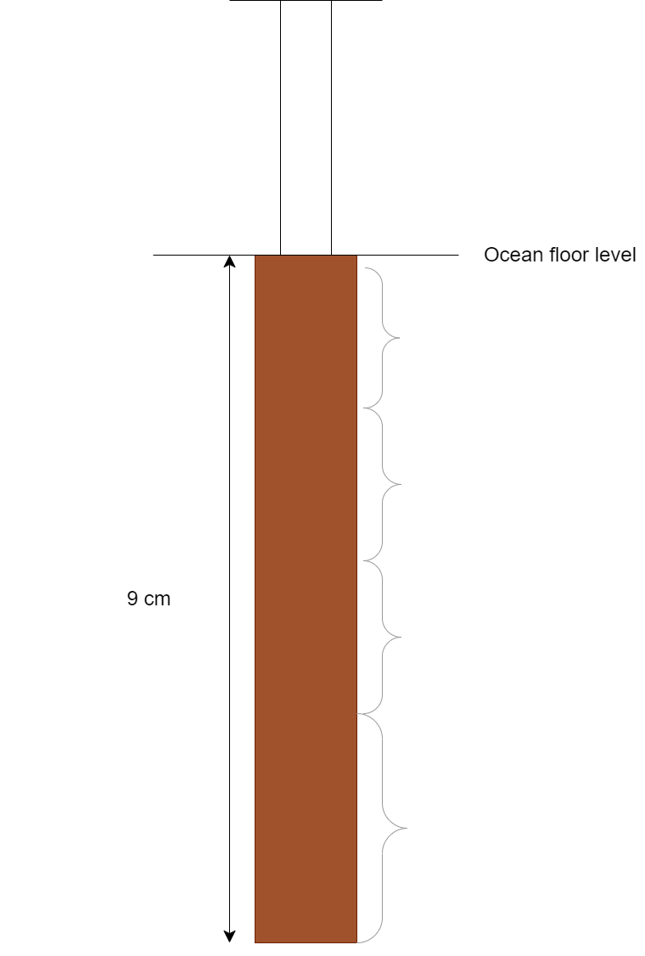
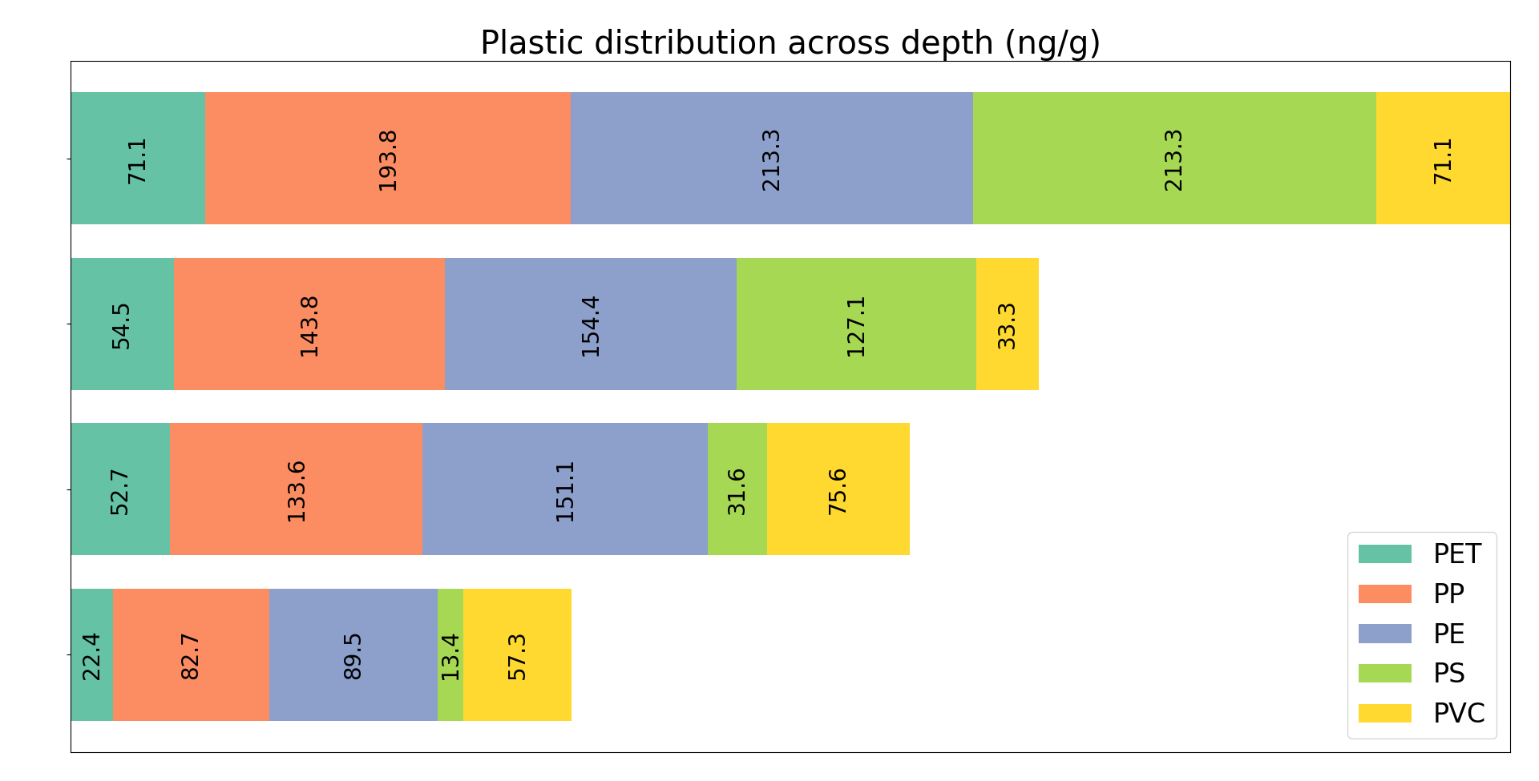
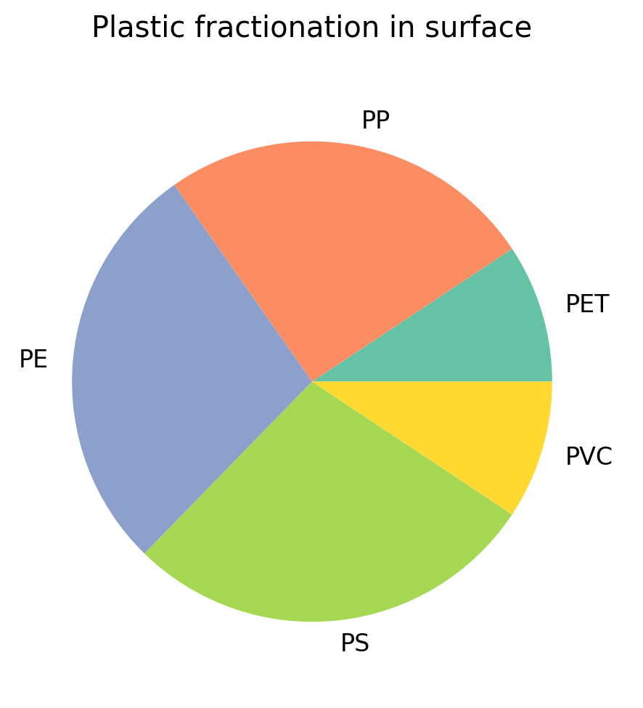
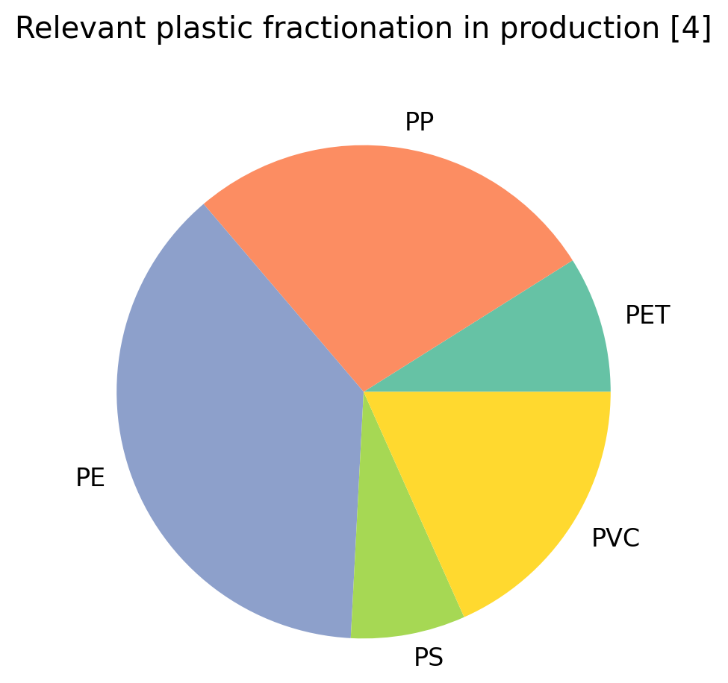
Nanoplastics on the Atlantic Sea Floor
Group 16: E.M. de Bie, H. W. Hildebrand, J. Gerlagh
o.w.a.debie@uu.nl; h.w.hildebrand@students.uu.nl; j.gerlagh@students.uu.nl;
Institute for Marine and Atmospheric Research Utrecht (IMAU)
Experimental Research Project 2024-2025;
Bachelor program Physics and Astronomy, Utrecht University
Introduction
Plastic pollution is a growing concern.
Nanoplastics (<1μm) in particular, because of the difficulties in their detection [1]
Nanoplastics can accumulate in the human body [2]
Some evidence points to negative health effects [2]
We have investigated nanoplastic concentration in a sediment core taken from the bottom of the Atlantic Ocean.
This was done using Proton Transfer Reaction — Mass Spectrometry (PTR-MS)
[3]
Method
The sample preparation was as follows:
Samples were separated.
Samples were dissolved in water and sonicated (shaken at high frequency).
Solutions were filtered.
Solutions were divided into 5 subsamples (in triplicate, so 15 per sample).
MMSA was performeded on the subsamples.
The subsamples were measured using PTR-MS.
PTR-MS
PTR-MS machines can protonate compounds in a sample
They can detect the mass of this charged molecule.
[2]
Results & Discussion
Nanoplastic concentration is lower the deeper we measure.
Significant amounts of nanoplastics are present in deeper layers, which were formed thousands of years ago.
There are relatively large amounts of PS in sediment closest to the surface.
The PVC concentration increases the deeper we measure.
Conclusion
The nanoplastics we detected deeper in the sediment could not have been deposited during the formation of those sediment layers. We must therefore conclude that they were brought there by a perturbation.
We cannot determine the mechanism nor the timing using this experiment. PVC seems to sink deeper into the sediment for some unknown reason.
PS may be more likely to aggregate, as we see its concentration fall steeply compared to other types.
References:
[1] Mintenig, S. M., Bäuerlein, P. S., Koelmans, A. A., Dekker, S. C., & Van Wezel, A. P. (2018). Closing the gap between small and smaller: towards a framework to analyse nano- and microplastics in aqueous environmental samples. Environmental Science Nano, 5(7), 1640–1649. https://doi.org/10.1039/c8en00186c
[2] Pinto da Costa, J., Santos, P. S. M., Duarte, A. C., Rocha-Santos, T. (2016). (Nano)plastics in the environment – Sources, fates and effects. Science of the Total Environment, (566-567), 15-26. https://doi.org/10.1016/j.scitotenv.2016.05.041https://doi.org/10.1016/j.scitotenv.2016.05.041
[3] Zeker, P.G. (2019). Proton Transfer Reaction Mass Spectrometry (PTR-MS) for Ambient and (Compliance) Source Testing Discussion . 2019 Air Quality Measurements Conference
[4] Plastics Europe. (2023, October 19). Plastics – the fast Facts 2023 • Plastics Europe. https://plasticseurope.org/knowledge-hub/plastics-the-fast-facts-2023/

Slide 2
