Slide 1
Sediment _ A
1) Pet = 20 ng/ ml
2) PP= 54.5 ng/ml
3) PE= 60 ng/ ml
4) PVC=60 ng /ml
5) PS= 20 ng /ml
Sediment _D
1) Pet = 15 ng/ ml
2) PP= 38 ng/ml
3) PE= 43 ng/ml
4) PS= 9 ng /ml
5) PVC=21.5 ng ml
3400 m Deep (L1)
35°05'42.5"N 13°03'09.0"W
Sediment _ B
1) Pet = 10 ng/ ml
2) PP= 37 ng/ml
3) PE= 40 ng/0.5 ml
4) PS= 6 ng / ml
5) PVC=25.6 ng / mls
Sediment _ C
1) Pet = 18 ng/ml
2) PP= 47.5 ng/ml
3) PE= 51 ng/ml
4) PVC = 42 ng/ml
5) PS = 11 ng/ml

Slide 2
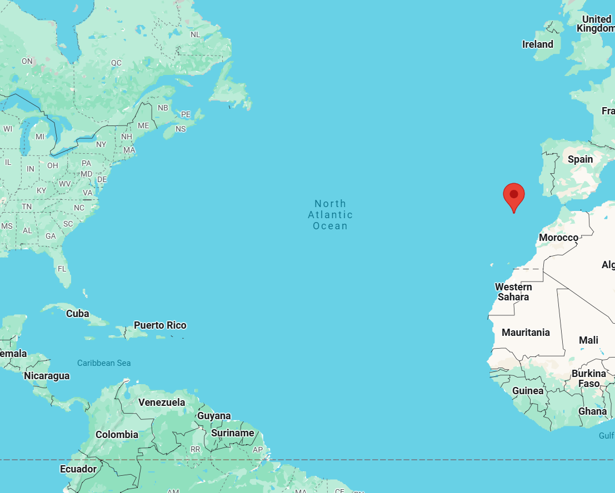
Deep water location 1
Ng/ml
[PS = 4.1 ;
PVC = 6.5;
PET = 5.7;
PE = 5.6;
PP = 6];

Slide 3


Multicomponent Multivariate Standard Addition (MMSA)
m/z channels
Unknown
MMSA
TD-PTR-MS
Sample
Standrad additions
R
PE
PP
PVC
PET
PS

