Slide 1

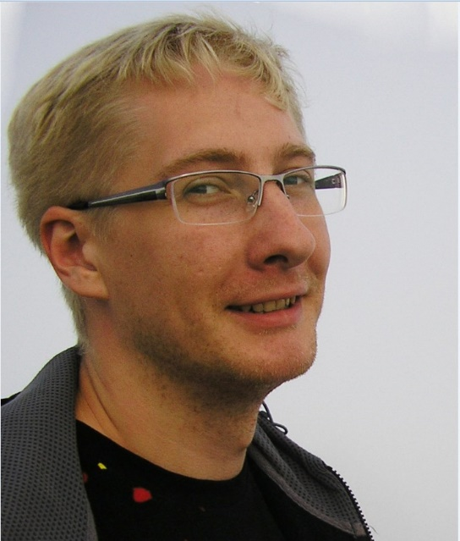

CI/CD for WebServers
DevOps course
Kharkiv-2020
Denisovich Evgeniy

Slide 2
Project content:
Project goals
Configuration and deployment of infrastructures
Setting up CI/CD pipeline

Slide 3




Project goals
Automatic data update on web servers
build
commit
webhook
deploy

Slide 4


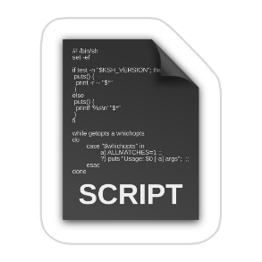






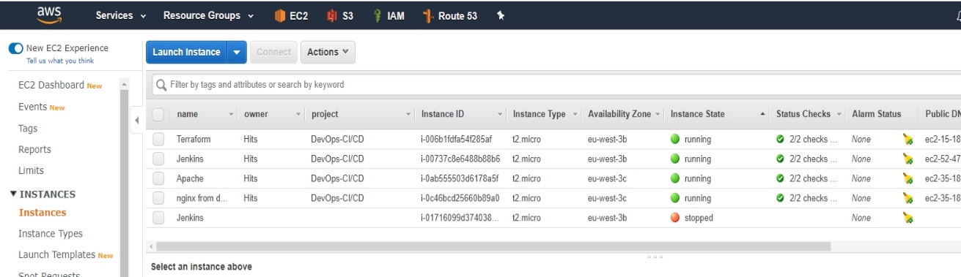





Configuration and deployment of infrastructures
.tf
.tf
.tf

Slide 5
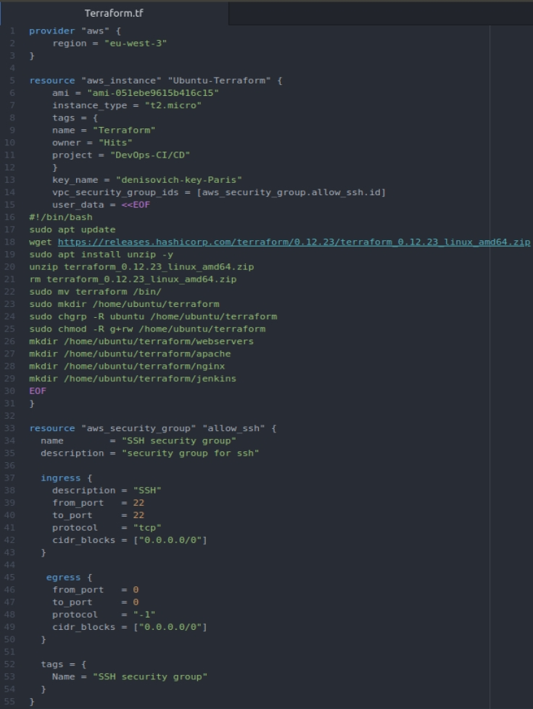
Configuration of EC2 Instance with Terraform

Slide 6
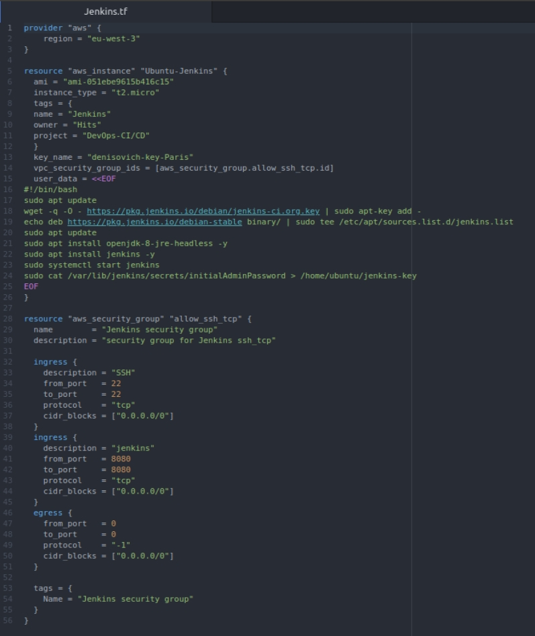
Configuration of EC2 Instance with Jenkins

Slide 7
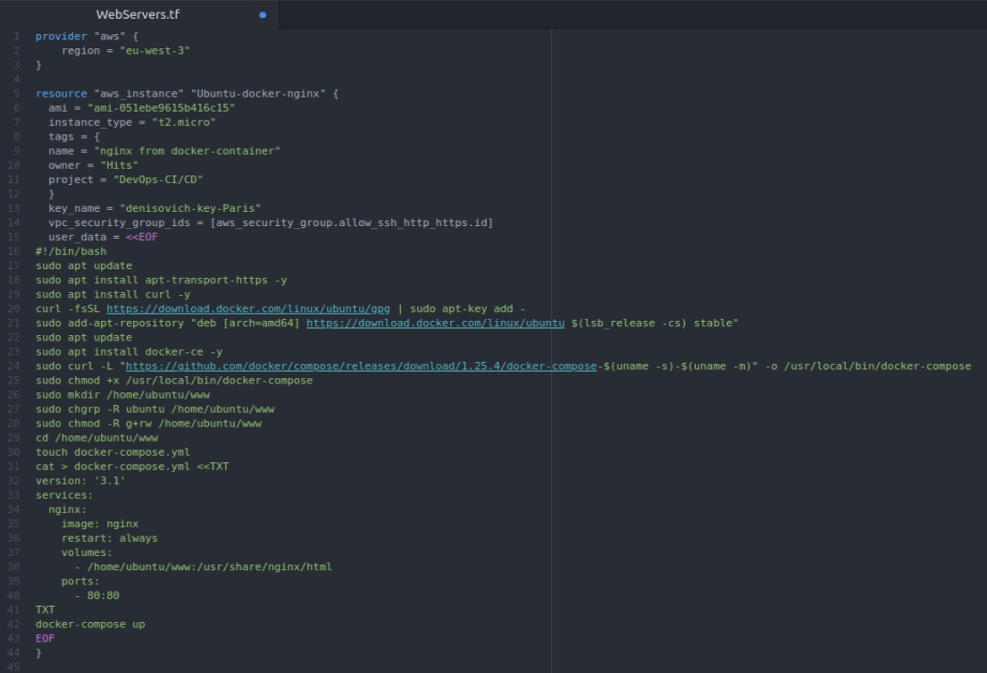
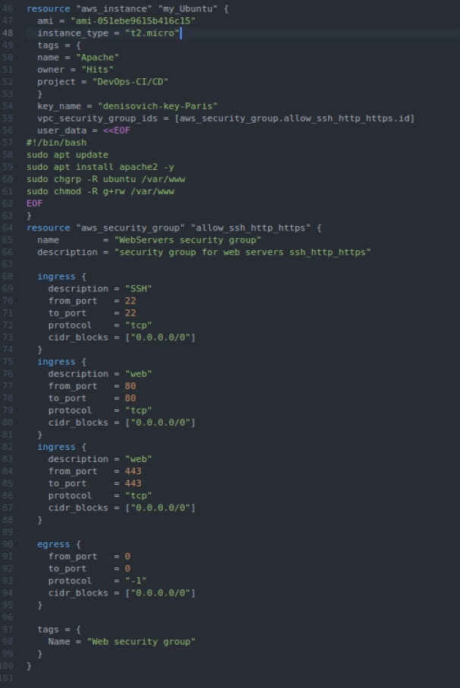
Configuration of EC2 Instances with WebServer Apache and WebServer NGINX in Docker container

Slide 8


Setting up CI/CD pipeline
build
deploy
commit
webhook
deploy

Slide 9
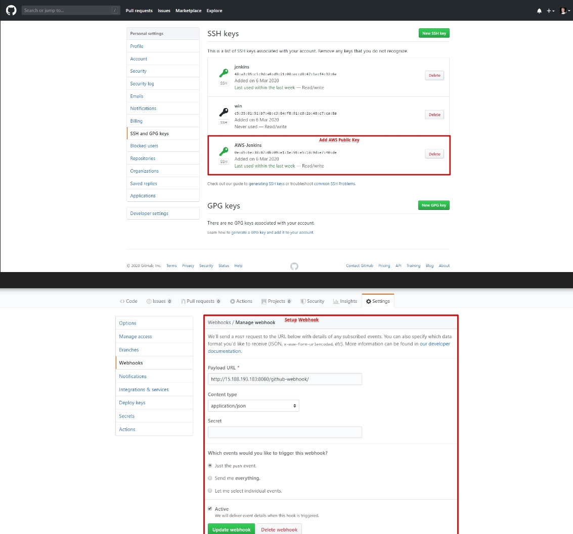
GitHub - Adding AWS public key and creating Webhook

Slide 10
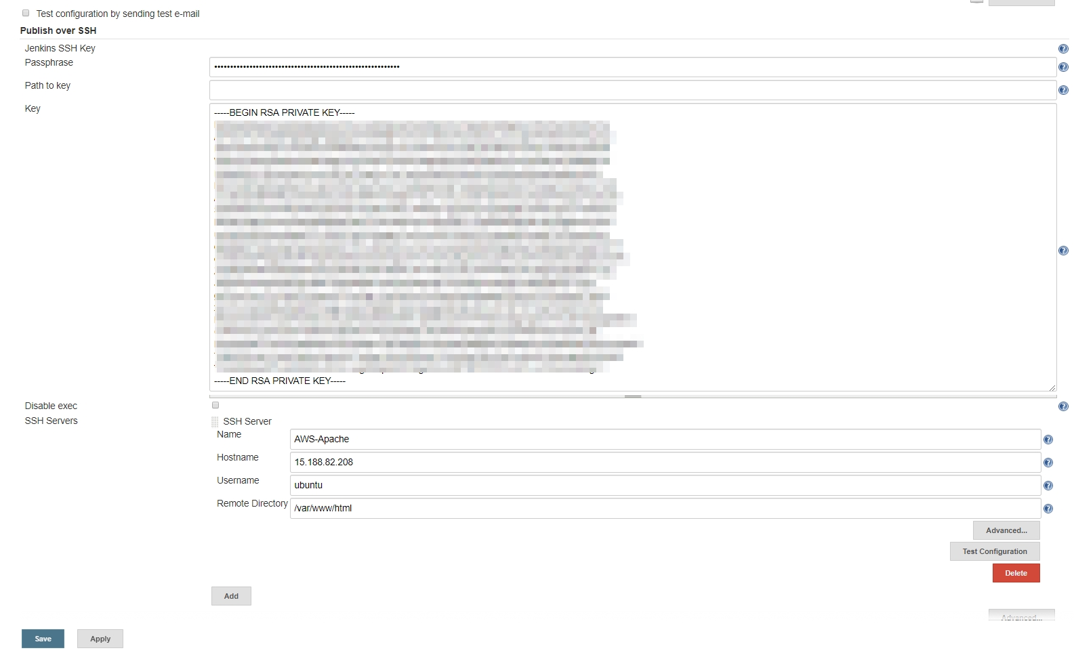
Configuration Jenkins: Installing and setting plugins

Slide 11
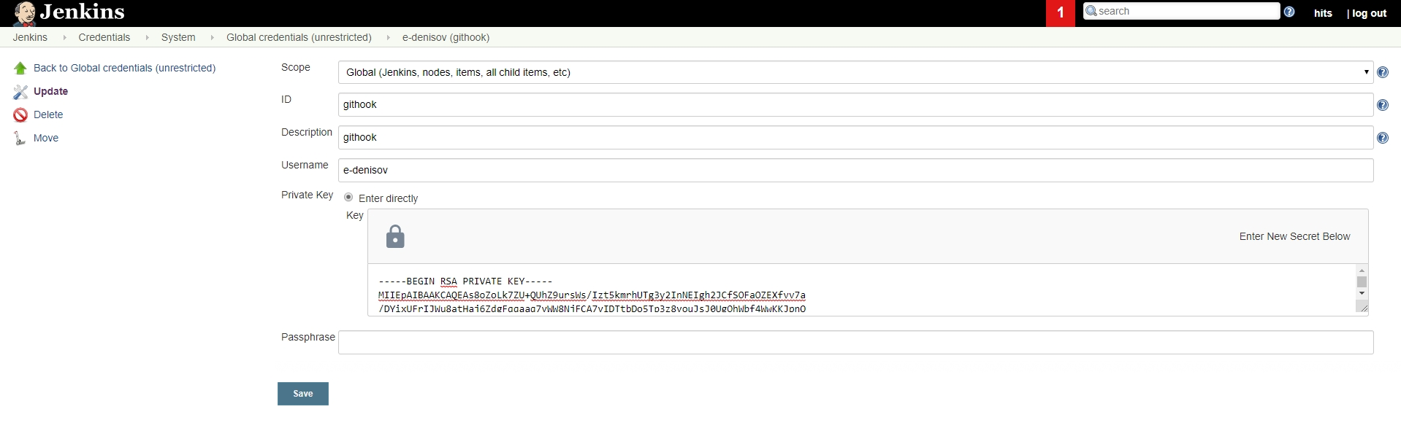
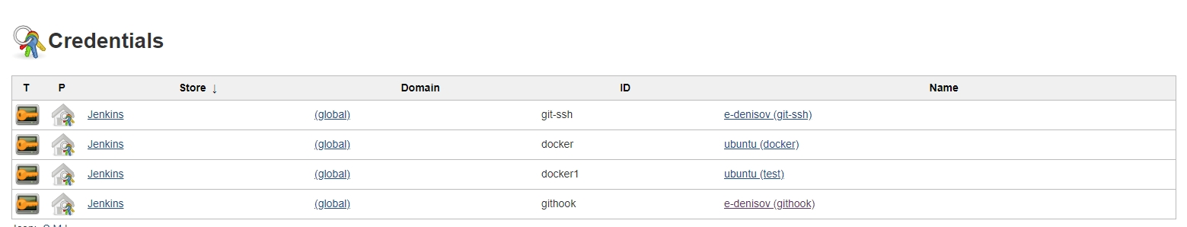
Configuration Jenkins: Setting credential

Slide 12
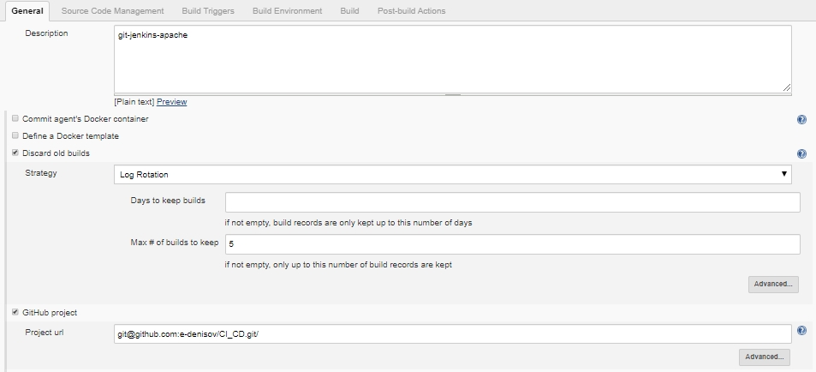
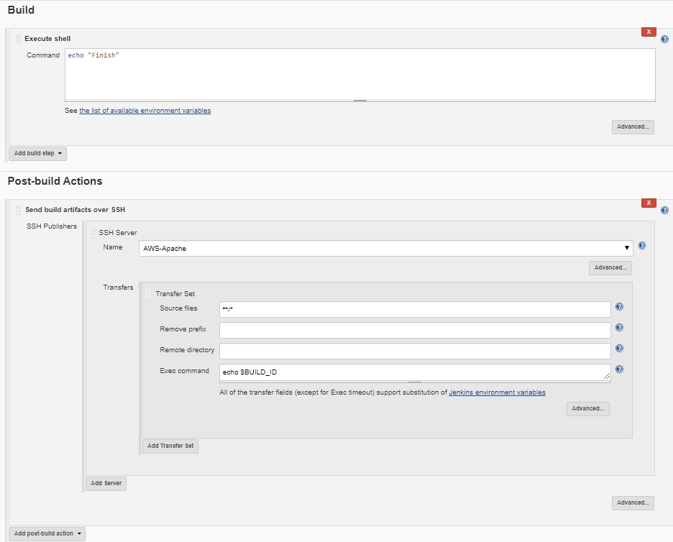
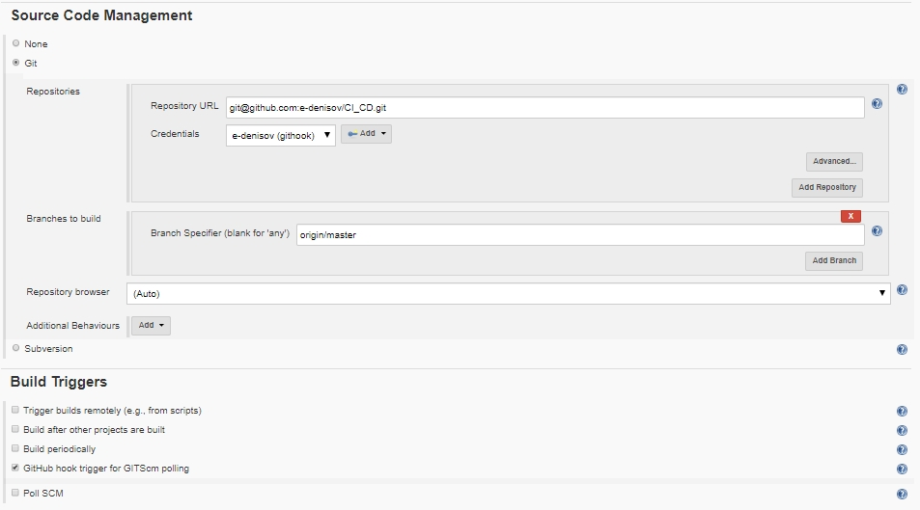
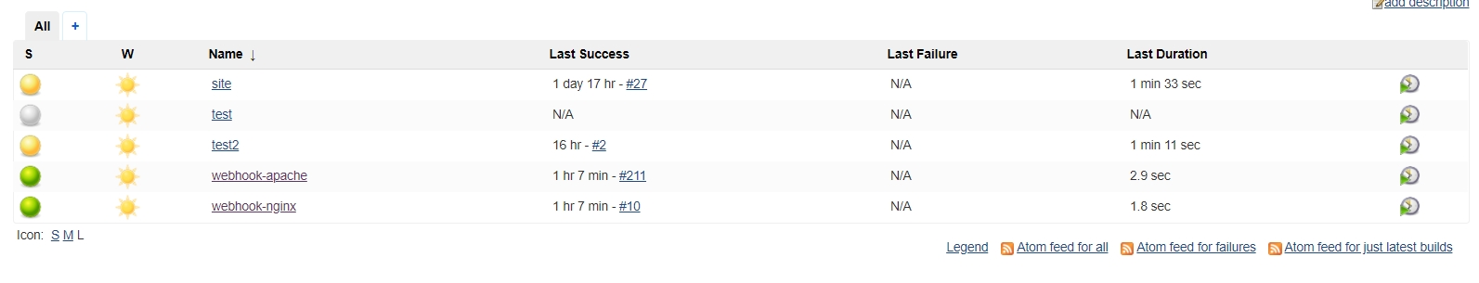
Configuration Jenkins: Creating jobs

Slide 13




Used:
Tools
OS
Services

Slide 14
Q & A

Slide 15
Thank you!

