Slide 1

Enhancing School Administration through Data-Informed Decision Making and Modern Technology
Eli Bansa – 3042020
Priscilla Adjei – 3019620

Slide 2

We will be discussing the following issues today:

Slide 3
Importance of efficient school administration
Financial decision making
Staff supervision
Assessment
Curriculum design
General goal setting

Slide 4
Issues in Conventional School Administration
Underutilization of modern technology.
Lack of data-informed decision-making.
Manual and time-consuming processes.
Impact:
Hinders administrative efficiency.
Limits ability to adapt to changing educational landscapes.
Affects quality of education and student competitiveness.

Slide 5
Data-informed Decision Making vs Intuition-Based Decision Making
Data-informed decision making makes use of historical data to guide decision making as opposed to intuition-based decision making which relies of past experiences and knowledge of the decision maker.
Objectivity(Fact)
Evidence-based
Bias
Inspires confidence in decision making (know your facts)

Slide 6
Solution: The Smart School Administrative System
Web-based
Utilization of Machine Learning (ML) to automate tasks.
Integration of ML algorithms for data-driven insights.
Enhancement of administrative efficiency and effectiveness.

Slide 7
Key features
Instant attendance tracking
Student emotion tracking.
Centralized student and staff management.
Finance management and forecasting.
Grade and teacher performance prediction.
Efficient timetable generation.

Slide 8
Objectives and Overall Performance
Use ML to automate administrative tasks.
Gain insights from collected data.
Enhance efficiency and effectiveness.

Slide 9
Overall performance objectives
Speed.
Security.
Scalability.
Responsiveness.
Easy data upload.

Slide 10
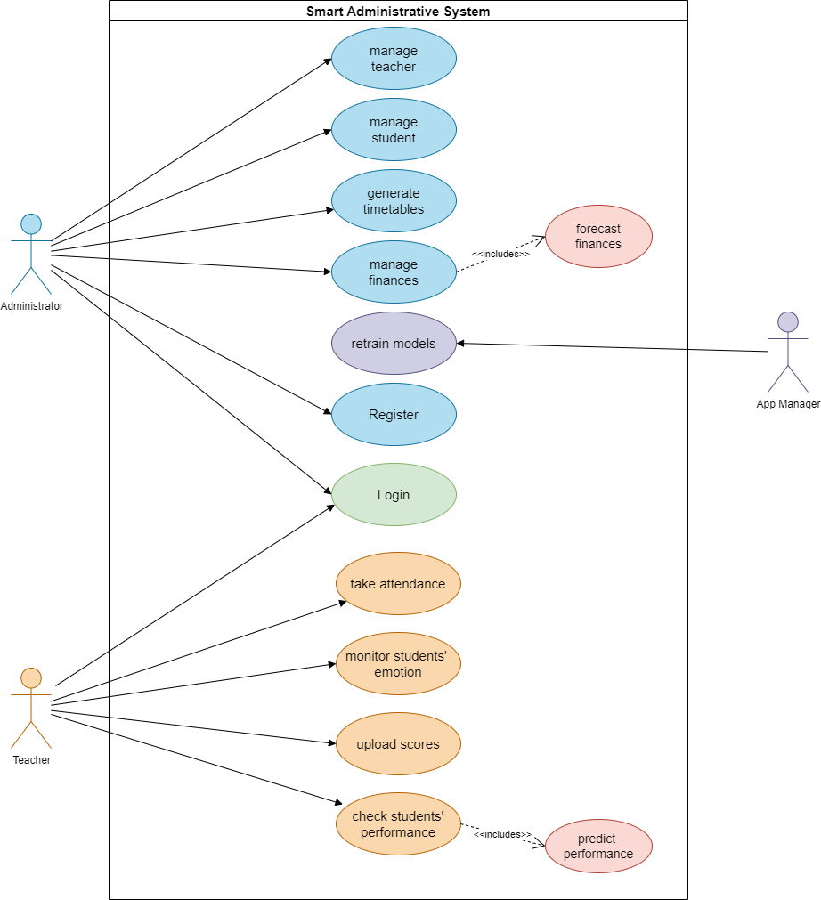
Application Flow

Slide 11
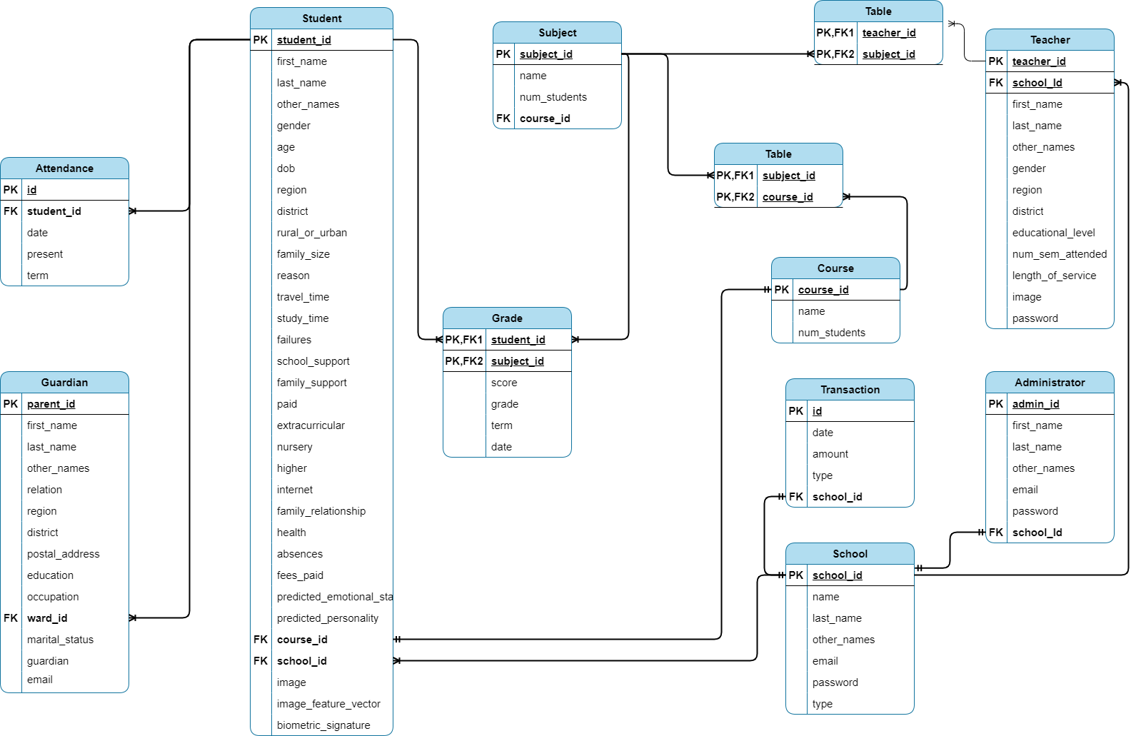

Slide 12
Conclusion
In conclusion, the Smart School Administrative System marks a pivotal moment in the evolution of education. By harnessing the power of technology and data, we've unlocked endless possibilities to streamline administrative tasks, improve decision-making, and ultimately enhance the educational experience for all.
As we embrace this new era, let us continue to innovate, collaborate, and inspire, knowing that the future of education has never looked brighter.

Slide 13
Thank You
Thank you for being a part of this transformative journey
God bless you all.

