Slide 1
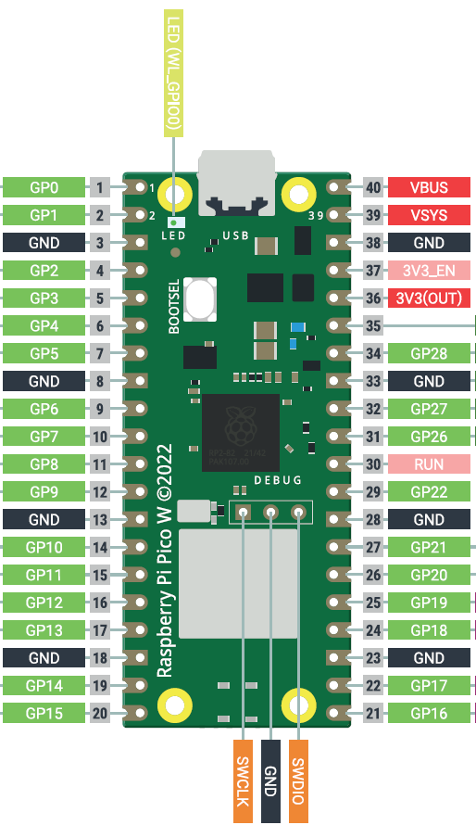
Battery holder (3 x AAA)
ON
+
OFF
Switch
-
Big breadboard +
+
-
Schottky diode
Big breadboard -
C
Phototransistor
E
C
Phototransistor
E
Motor signal
10kΩ resistor
Motor signal
10kΩ resistor
Servo signal

