Slide 1
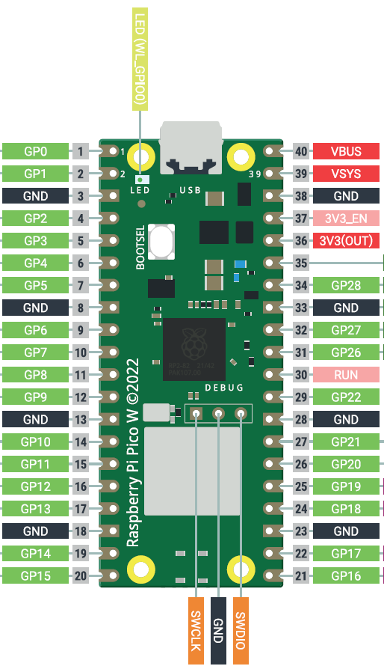
Battery holder (3 x AAA)
8 male-female jumpers
4 male-male jumper
OFF
+
ON
Switch
-
Big breadboard +
+
Big breadboard -
-
Schottky diode
C
Phototransistor L
E
C
E
Phototransistor R
Motor R signal
10kΩ resistor
Motor L signal
10kΩ resistor
Servo signal

Slide 2
-
Motor R
+
Big breadboard +
Servo
Big breadboard -
Motor R signal
-
PWM
+
Big breadboard +
L293D H-bridge
V_{SS}
I4
O4
G
G
O3
I3
E2
Big breadboard -
Servo signal
Big breadboard +
E1
I1
O1
G
G
O2
I2
V_{S}
Motor L signal
Big breadboard +
3 male-male jumpers
Big breadboard -
Big breadboard +
-
Motor L
+
12 male-male jumpers

Slide 3
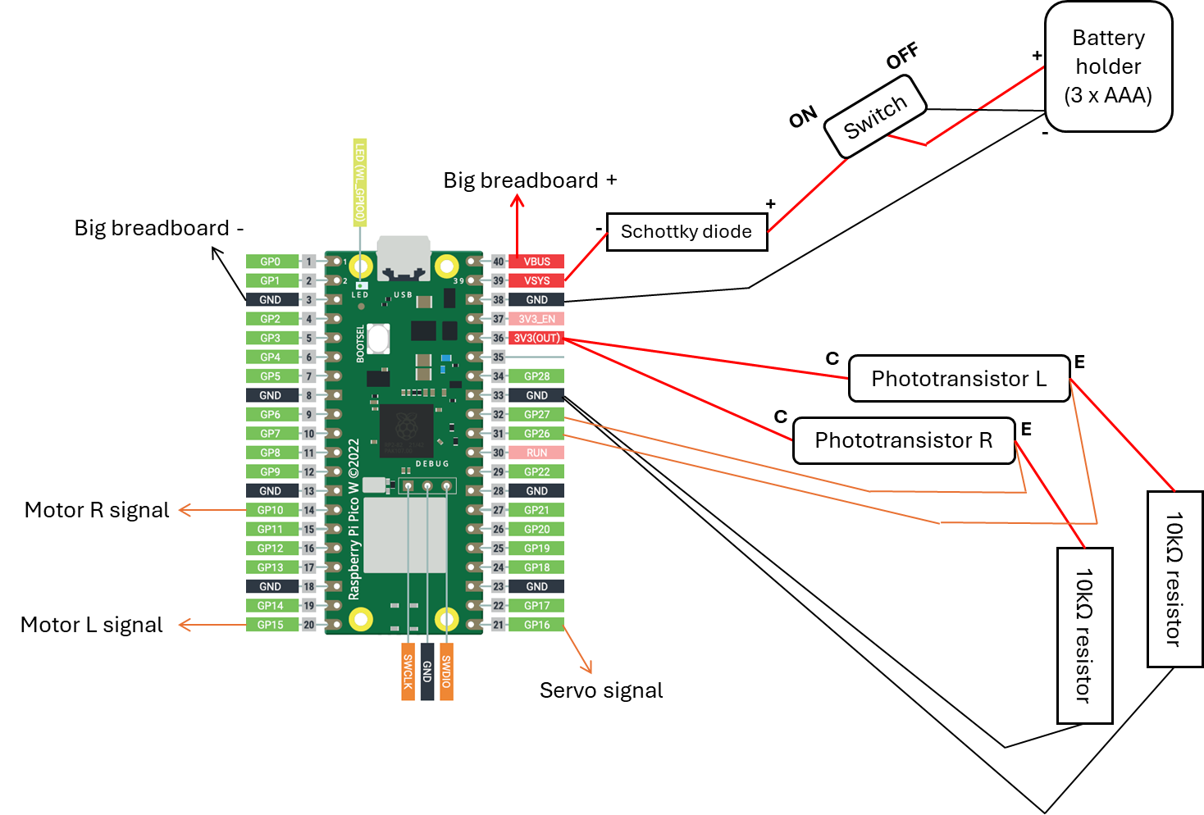
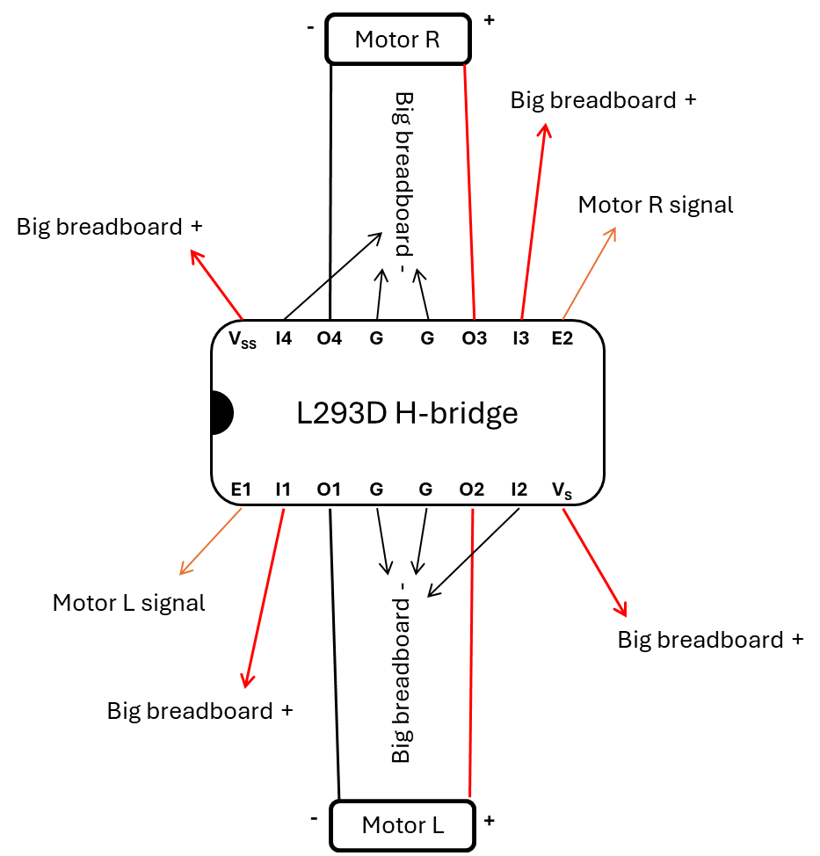
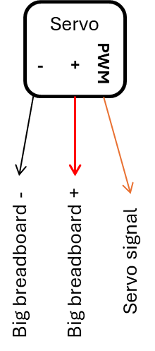

Slide 4
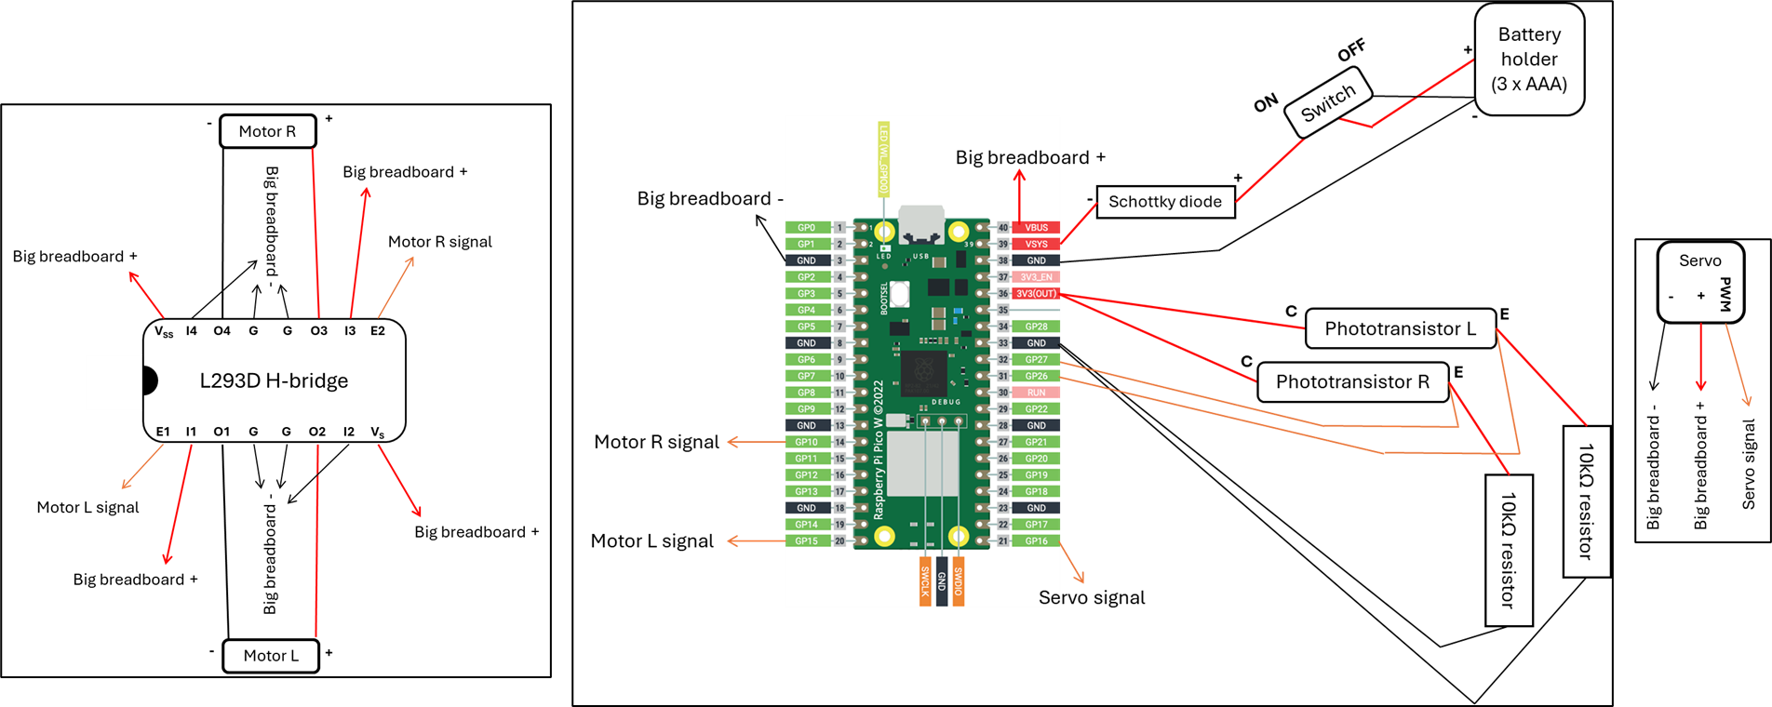

Slide 5


Slide 6
