Slide 1




Slide 2
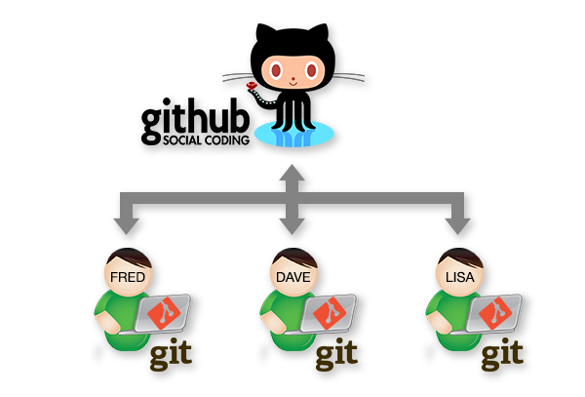
What is GitHub?
GitHub is a web-based version
control system that allows coders to
work collaboratively on projects.

Slide 3
What is Git? Git is your portal to Github.
Git is a piece of software that you install locally on your computer which handles 'version control' for you.

Slide 4
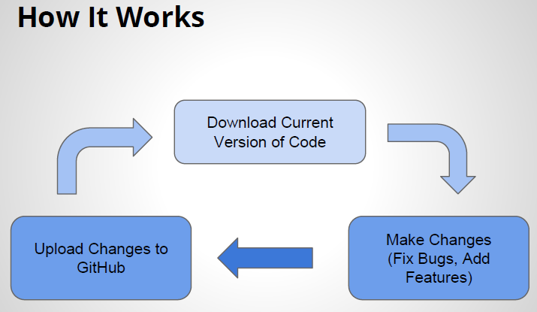

Slide 5


Slide 6
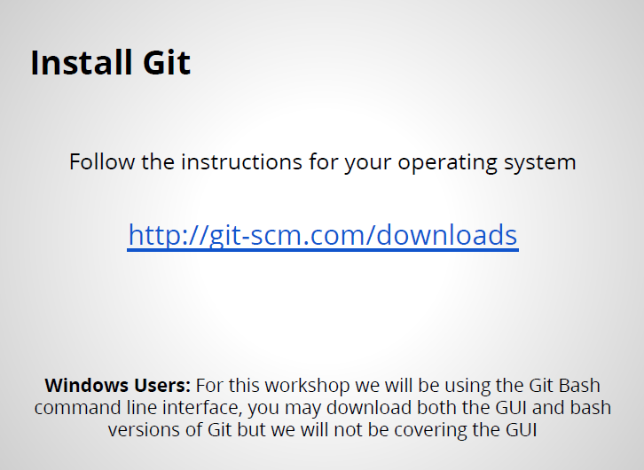

Slide 7
Set-Up Git
Open the terminal window and type the following commands:
$ git config --global user.name "Your User Name Here“
$ git config --global user.email "your_email@example.com"

Slide 8
Choose Your Repository
In search box type ‘FLC_isometricGame’
Click on the repository.
My user name is: e-ln1
You can browse around and explore for other repositories, etc.

Slide 9
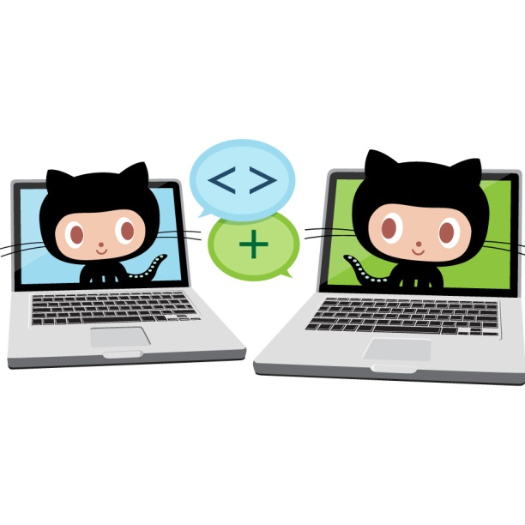
git clone
clone: copies down an existing repository from GitHub
$ git clone https://github.com/e-ln1/FLC_isometricGame.git

Slide 10
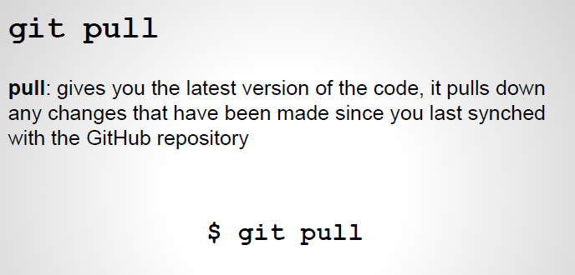
$ git pull https://github.com/e-ln1/FLC_isometricGame.git

Slide 11
Making Changes to the Game!
(adding a text file with your name and user name, etc.)
1. Navigate to “…[directory]/FLC_isometricGame
2. Create a file called yourname.txt (replacing “yourname” with your name)
To change directories, use the Linux cmd prompt commands in the Bash.
cd c://users/Lance/Documents/GitHub/FLC_isometricGame
Using GitBash will quickly educate you in basic Linux command line commands!

Slide 12
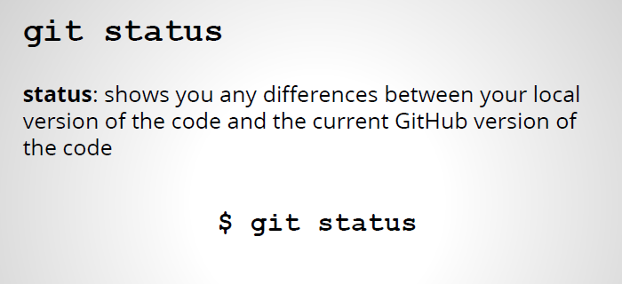
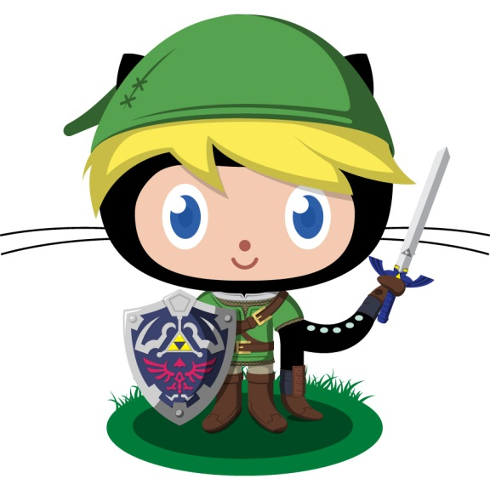

Slide 13

git add
add: adds a file to the staging area. The staging area is where changes we’ve made get ready to be uploaded to GitHub (but they haven’t been uploaded yet)
$ git add bio.txt

Slide 14

git commit
commit: saves all the changes in the staging area to the local repository
$ git commit -m ‘adds my bio and a change request msg’
The -m is the message flag, the string afterwards is what
other developers will see associated with your changes

Slide 15
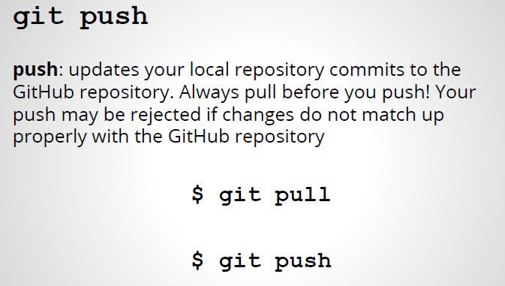
$ git push https://github.com/e-ln1/FLC_isometricGame.git

Slide 16
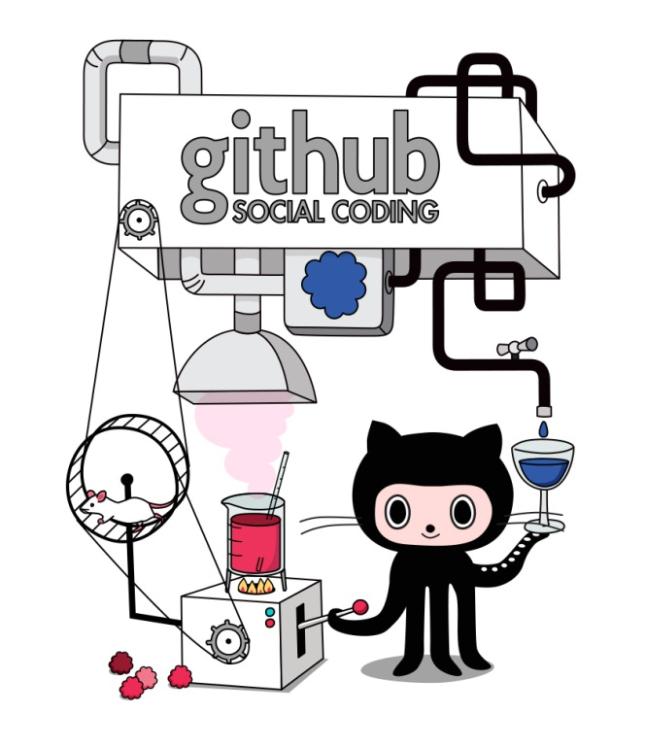
Reference
$ git clone <repository>
$ git pull <repository>
$ git status
$ git add <filename>
$ git rm <filename>
$ git commit -m ‘message about changes’
$ git push <repository>

