Slide 1
TSM

Slide 2
Overview
What is TSM?
Main Components of TSM
Account Lifecycle Events
Proactive Service Experience Workflows
Service Bridge

Slide 3
What is TSM?
TSM or Telecommunications Service Management is a suite of plugins on the ServiceNow platform that enhance operations for telecommunications companies.
We can:
Onboard and track customer accounts
Deploy process automations to resolve network outages
Connect customer issues, work requests, and more to drive process automations and promote efficiency

Slide 4
Main Components of TSM
There are 3 applications that come with the TSM plugins:
Account Lifecycle Events – provides an onboarding experience for customers
Proactive Service Experience Workflows – provides process automations to automatically resolve issues and notify customers of outages
Service Bridge – Collaborate with partners and vendors on incidents, tasks, and more

Slide 5

Account Lifecycle Events
The playbook helps drive this entire process.

Slide 6
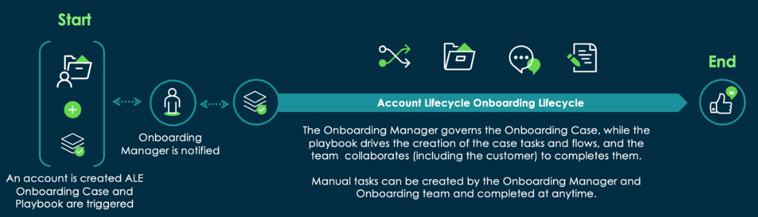
Account Lifecycle Event Workflow
The playbook helps drive this entire process.

Slide 7
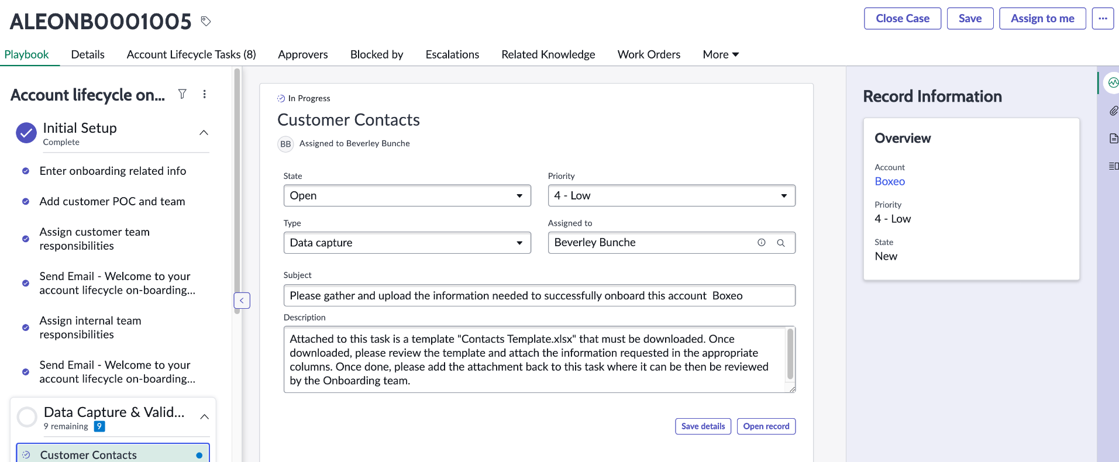
Playbook – Account Lifecycle Events application

Slide 8
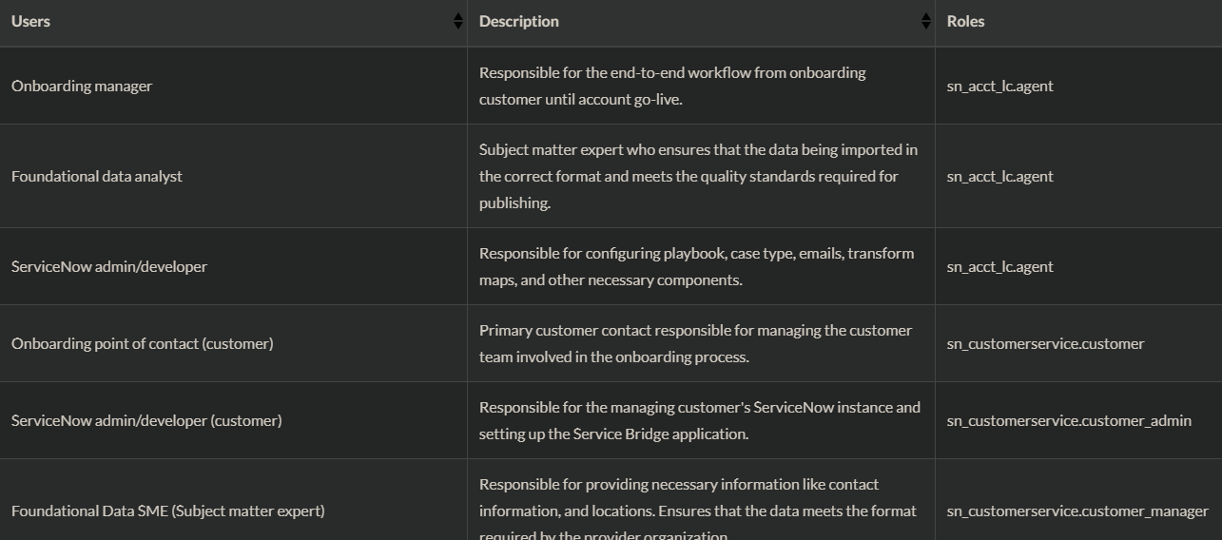
Account Lifecycle Events User Roles

Slide 9
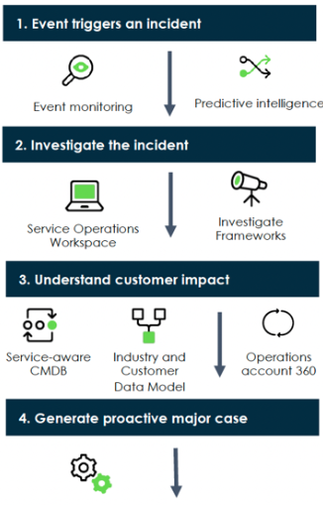
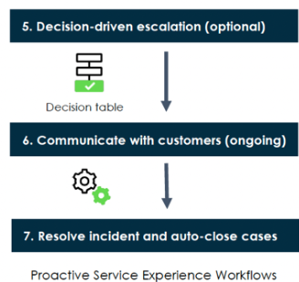
Proactive Service Experience Workflows
This application focuses on providing end-to-end customer support and analyzing customer impact.
Docs Link

Slide 10
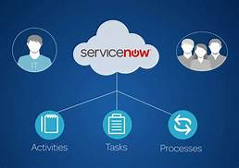
Service Bridge
Service Bridge provides a nearly turn-key experience for connecting multiple ServiceNow instances

Slide 11
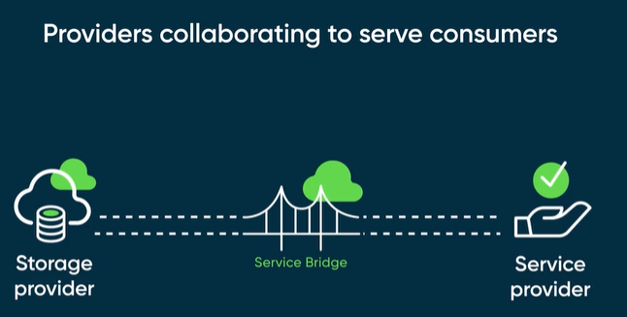
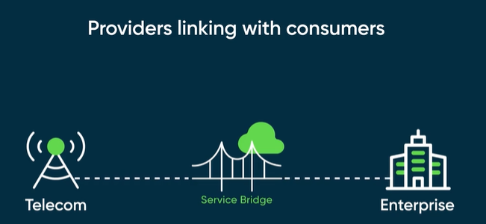
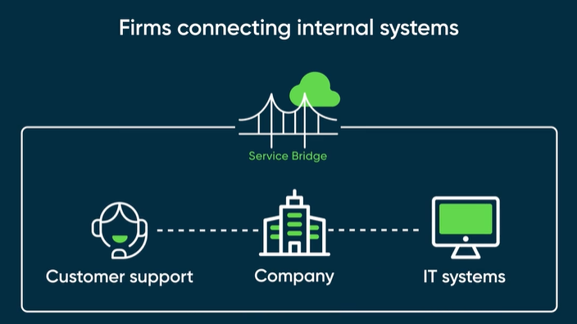
Service Bridge Scenarios
Docs Link - Video

