Slide 1

Basics

Slide 2
CSA
This course is geared towards the Certified System Administrator (CSA) credential
There are 6 major sections to the 90-minute, 60-question exam:
Platform Overview & Navigation – 6%
Instance Configuration – 10%
Configuring Applications for Collaboration – 19.5%
Self-Service & Automation – 19.5%
Database Management and Platform Security – 30%
Data Migration and Integration – 15%

Slide 3
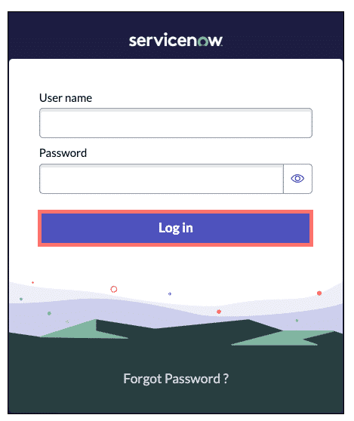
Instance
Definition: An instance is a singular implementation of the ServiceNow platform
Every customer organization gets a minimum of 2 instances
Production
Sub-production
To access your instance, your organization will have a unique URL: https://<instance-name-here>.service-now.com
Definition: A Baseline implementation is a set of installed applications on a ServiceNow instance before any configuration or customization has been done

Slide 4
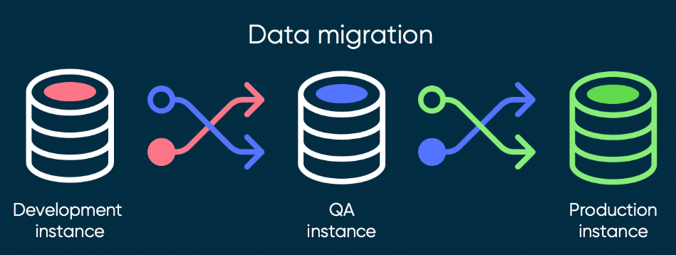
Updates
Every six months there is a new SNOW release
Vancouver, Washington DC, Xanadu
Updates are made on a per instance basis
You must update your dev instances to match production, build features, then ship to production

Slide 5
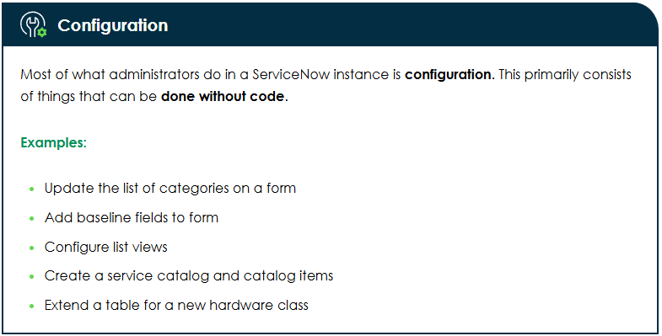
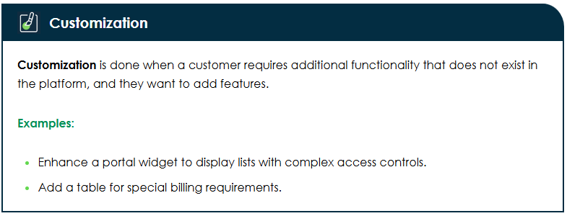
Configuration vs Customization

Slide 6
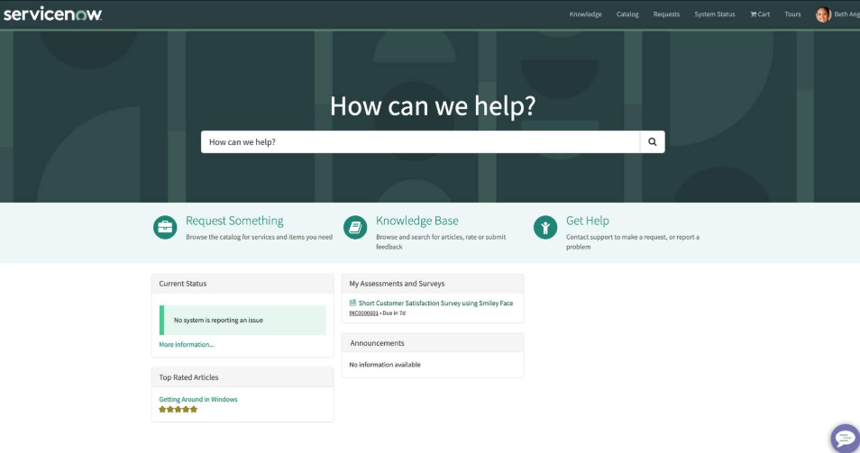
How Users Interact with ServiceNow
The Next Experience Unified Navigation – is the primary way to interact with apps and records within ServiceNow
The Now Mobile App – allows users to submit incidents, sign documents, take surveys, and more
The Service Portal – is a user-friendly UI for external customers to use the platform and view its data
https//<instance-name-here>.service-now.com/sp
The Employee Center – is a dynamic portal for internal employees for communication, engagement, and shared content, free for all ServiceNow customers
https//<instance-name-here>.service-now.com/esc

Slide 7
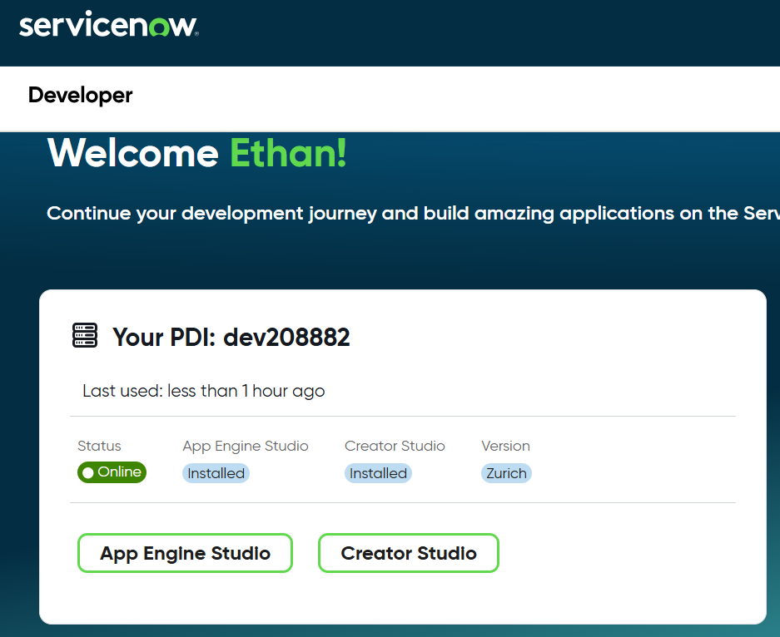
App Engine Studio & Creator Studio
Definition: App Engine Studio is a tool for citizen developers to implement basic scripting or workflow customization using low-code tools
Design data tables, build flows, build forms, and more
Definition: Creator Studio is a tool for citizen developers that simplifies app creation even further, using no code at all
Prebuilt templates, no access to scripting or custom tables, governed by App Engine Management Center (AEMC)

Slide 8
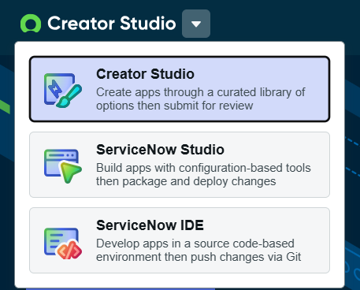
To Further Complicate Matters…
Creator Studio Shouldn’t be confused with ServiceNow Studio
Definition: ServiceNow Studio is a powerful application that runs on the platform to build complex applications and integrations
Definition: ServiceNow IDE is a way for us to render our instance changes as metadata and back up to source control

Slide 9
The Next Experience UI
This is how most users interact with the applications and data within a ServiceNow instance
All – lists our applications and modules
Favorites – displays our favorited items
History – displays recently viewed forms, lists, catalog items, and more
Workspaces – the list of workspaces we have access to (such as Service Operations Workspace)
Contextual App Pill – where we are in the instance (click the start to favorite an item)
Global Search – search for information across applications and records
Notifications – user notifications
User Menu – change personalization settings

Slide 10
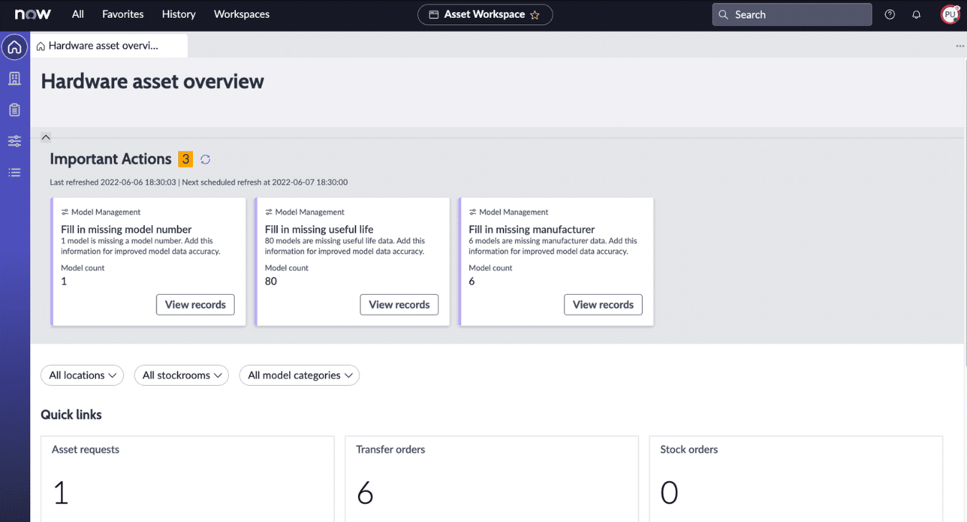
Common User Interfaces
Definition: A workspace is a role-based, task-focused user interface designed to streamline the experience for end-users or agents performing specific tasks
Customer Service reps, HR agents, field techs, etc.

Slide 11
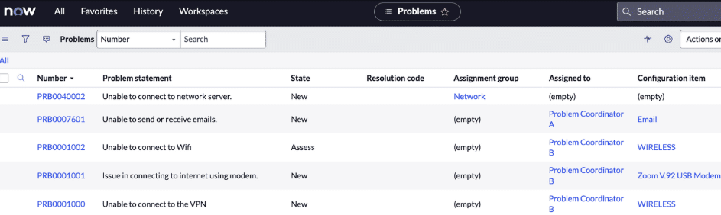
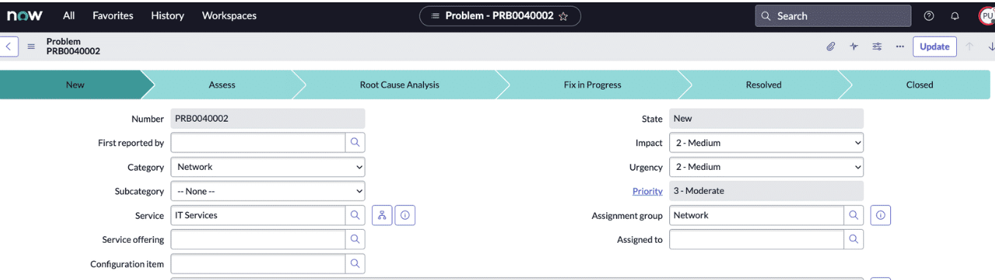
Common User Interfaces
Lists
Forms
Dashboards
Knowledge Articles

Slide 12
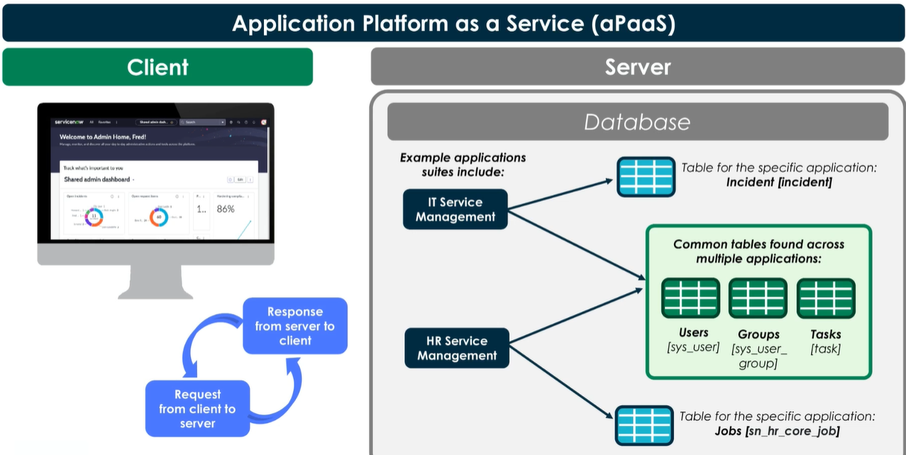
ServiceNow Architecture

Slide 13
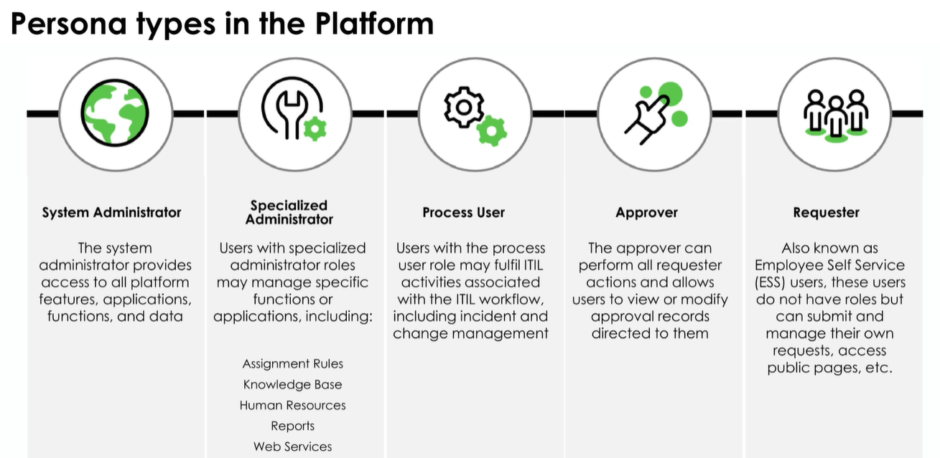
Personas
Admins – that’s us
Specialized Admin - Report Administrator, Form Administrator, etc.
Process User – a customer service rep with the itil user role
Approver – a user listed as an approver for change requests
Requester – Users that may make use of the ESS portal to ask for IT services such as requesting a new work laptop

Slide 14
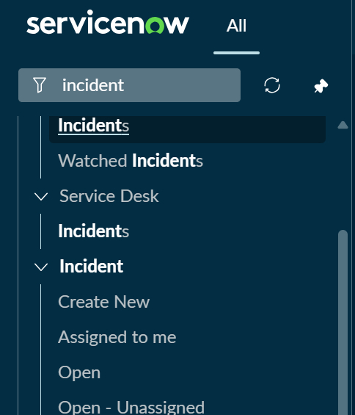
Applications & Modules
Definition: An application is a container for related functionality within the ServiceNow platform
Groups together tables, forms, workflows, business rules, scripts, and modules
Applications have scope, which controls access to app data
Definition: An application menu is a navigation element that structures modules
Definition: A module is a navigation item inside an app
Can point to a form, a list of records, reports, dashboards, UI pages

Slide 15
Users & Groups
Users are represented by a record on the User [sys_user] table.
Update Records
Import Data
Request Items
Implement Flows
Approve Knowledge Content
Run Reports
Develop Applications
BEST PRACTICE: Never delete user records, we just mark as inactive
A group is represented by a record on the Group [sys_user_group] table.
Groups share a common purpose, such as users approving change requests or users receiving email notifications
Examples: service desk, knowledge base authors, HR admins

Slide 16
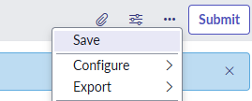
When Saving Records
Right click + Save = save record but stay on record page
Submit/Update = save record and return to list view

Slide 17
Challenge
Goal:
Create a new user and add them to a new group
Scenario:
Add a fictional character to your instance as a user
Create a group called ‘ITSM Agents’
Add your new user to the user group

Slide 18
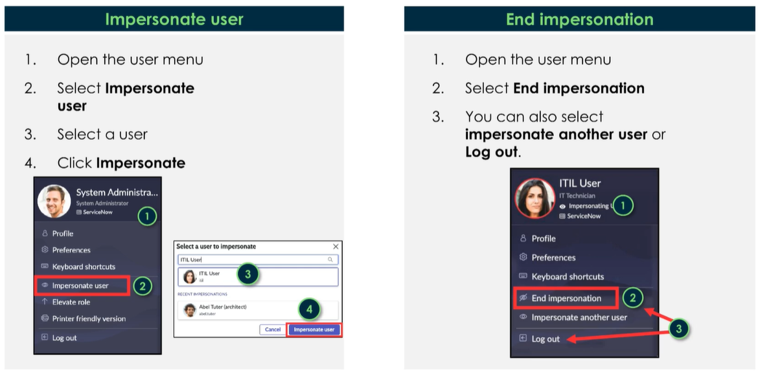
User Impersonation

Slide 19
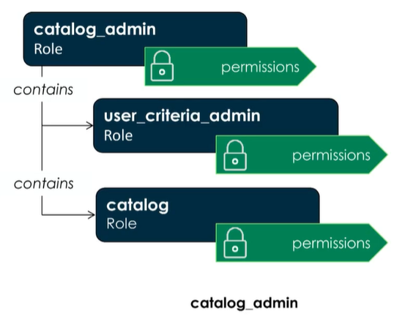
Roles
Definition: A role is used to define access at the application, module, and/or Access Control List (ACL)
Roles can be:
Assigned to groups or to individuals
Nested inside other roles
A user can have more than one role
Roles are represented as records on [sys_user_role]
BEST PRACTICE: Rather than adding roles to individual users, add the user to a group and assign the role to the group

Slide 20
Challenge
Goal:
Assign the ITIL role
Scenario:
Impersonate your fictional character. Do they have access to the Service Operations Workspace? Do they have access to Problem records?
End impersonation
Assign the ‘ITIL’ role to the ‘ITSM Agents’ user group
Impersonate your fictional character once more. How about now?

Slide 21
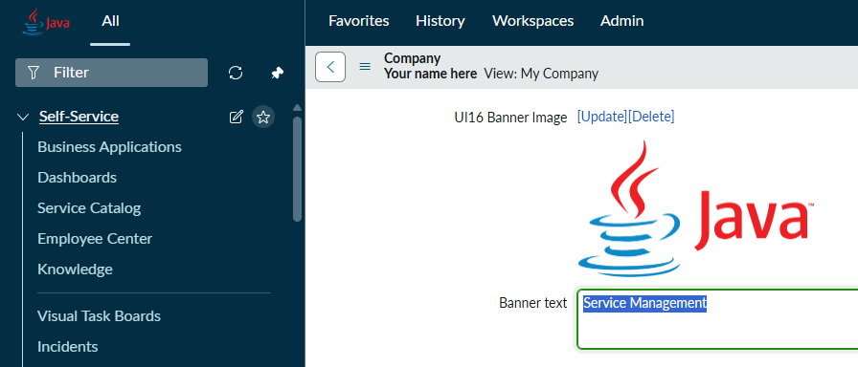
Customize the Logo
Navigate to All > System Properties > My Company to change your logo

Slide 22
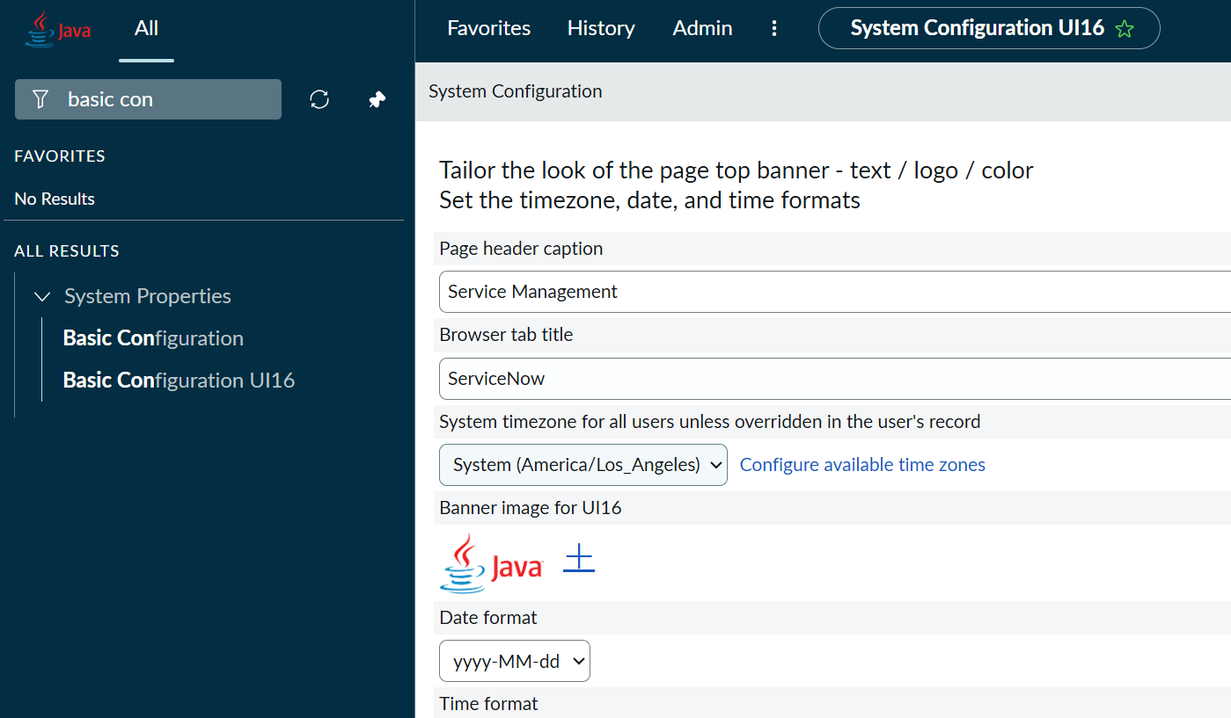
More Customizations
Navigate to All > System Properties > Basic Configuration UI16 to find more:
Set instance time zone
Set browser tab title
Color scheme
UI16 was the last user interface version before the Next Experience, the system property changes still work
‘Basic Configuration’ is a set of even older system properties

Slide 23
Challenge
Goal:
Customize your instance
Scenario:
Change your organization logo within your instance
Set your browser tab to display ‘YourCompanyName’ while in your instance

Slide 24
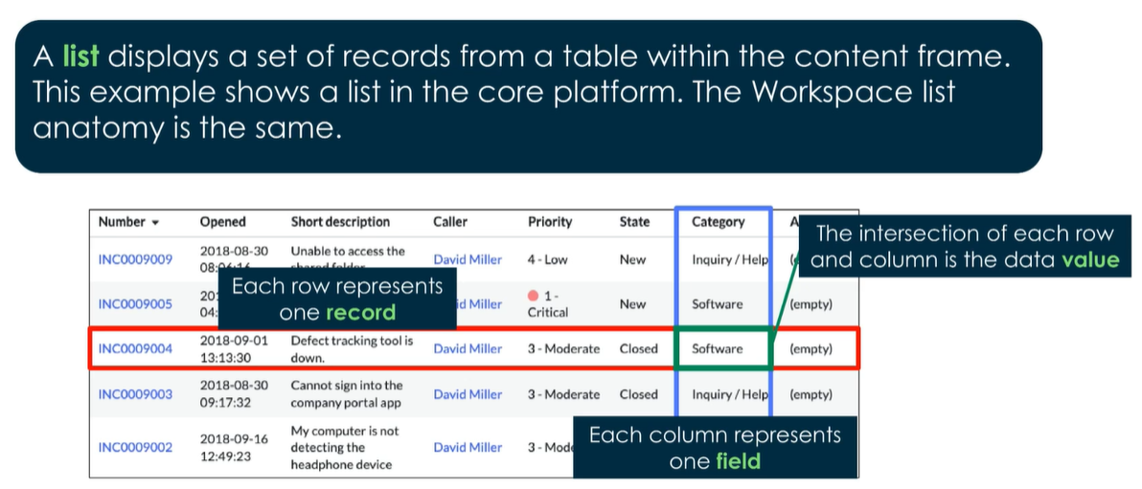
Lists, Records, & Fields

Slide 25
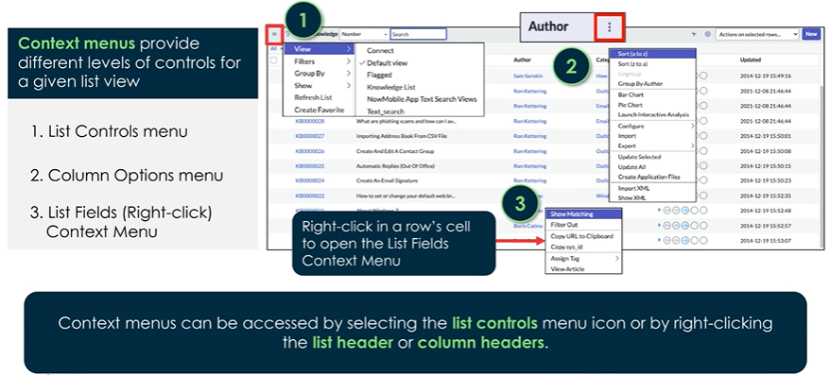
Context Menus

Slide 26
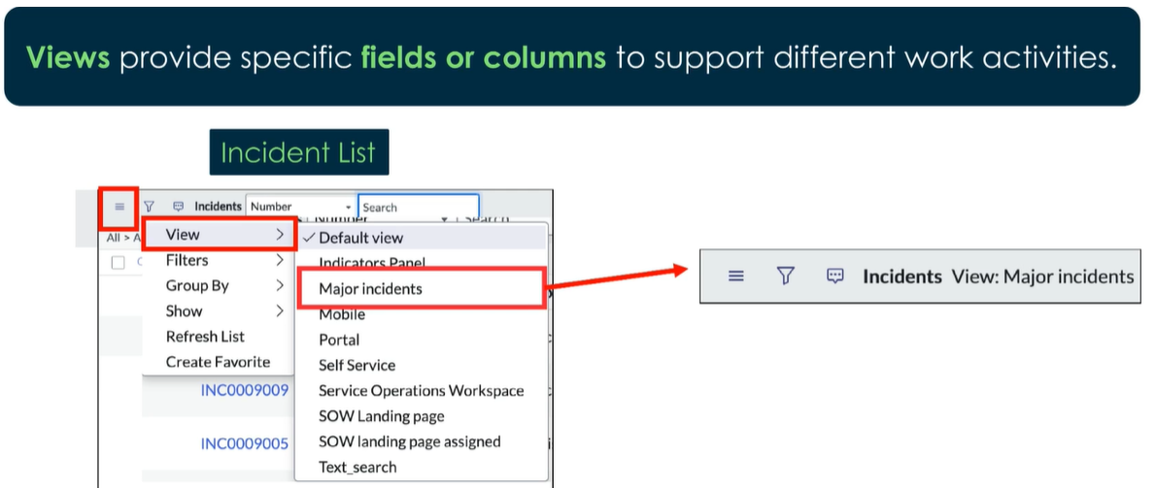
List Views
Definition: A list view is a customizable display of records from a table
We may create different views for different user roles
Each view may display different fields, or the order of displayed fields may be different

Slide 27
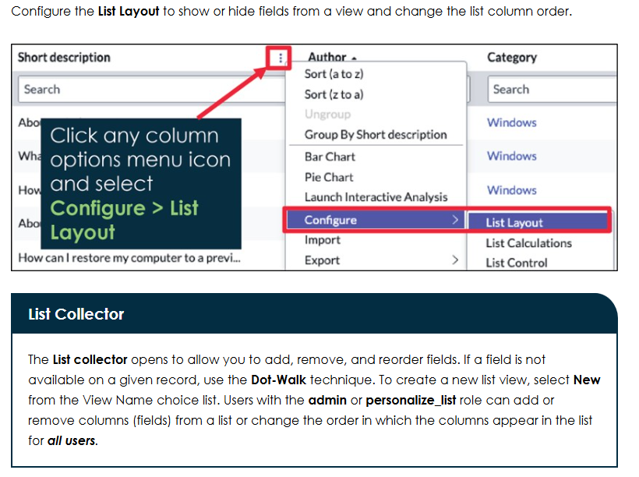
List Layout

Slide 28
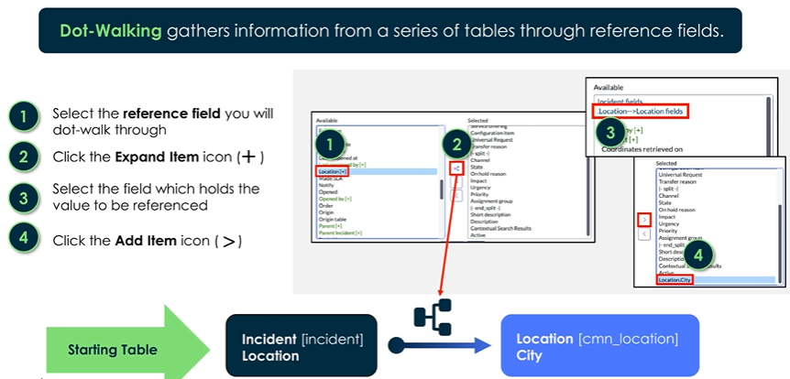
Dot-Walking

Slide 29
Challenge
Goal:
Customize the default incident list view
Scenario:
Ensure that the company name of the caller is displayed as a column next to the caller

Slide 30
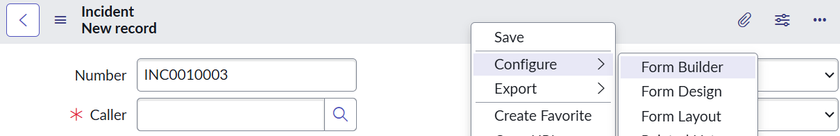
Form Layout & Form Builder
Definition: Form Layout is the older, traditional tool for configuring forms, fields, and sections
As of the Zurich release, you rarely need to use this
Definition: Form Design is a slightly less old tool for configuring forms, fields, and sections
This has a drag-and-drop interface like Form Builder, but is lacking modern features
Definition: Form Builder is the newer tool for configuring forms, fields, sections, and more
Add and remove fields from forms
Create sections and reorder content in one or two columns
Conditionally show or hide fields
BEST PRACTICE: Never place the same editable field in multiple sections.

Slide 31
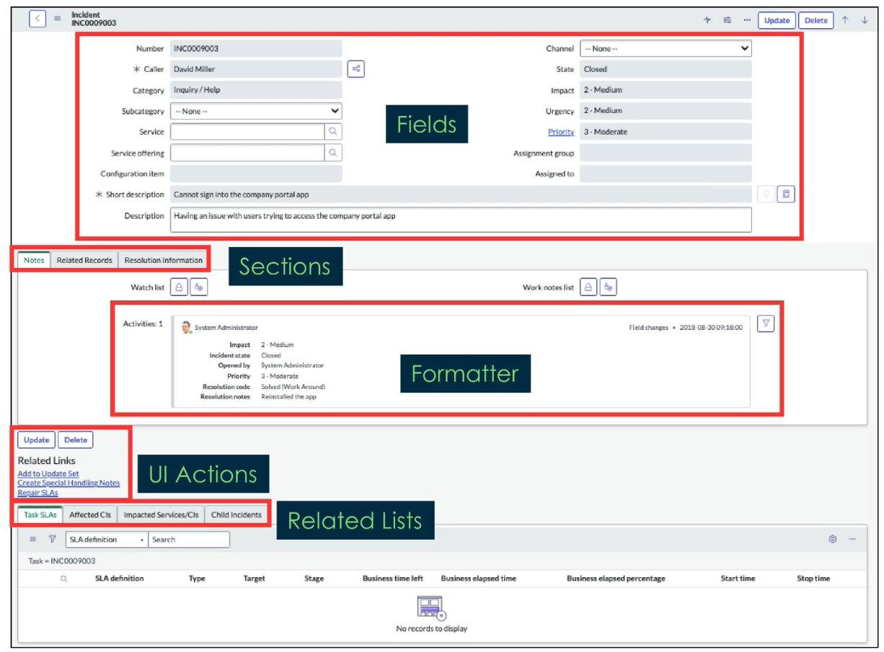
Anatomy Of a Form
Sections group up content
Formatters can structure and aggregate data in an organized way
UI Actions run scripts
Related lists display records from related tables

Slide 32
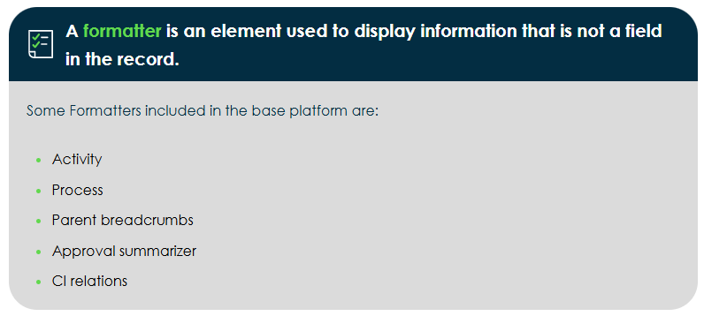
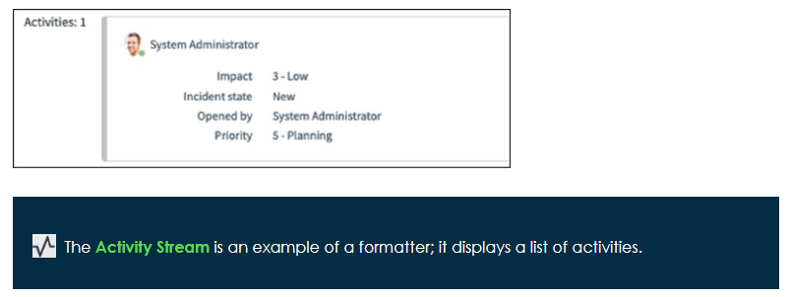
Formatters
Activity formatter: Displays the list of activities, or history, on a task form. It provides an easy way to track items not saved with a field in the record, for example, journal fields like comments and work notes.
Process flow formatter: Displays the different stages in a linear process flow across the top of a record (ex: problem records)
Parent breadcrumbs formatter: Provides breadcrumbs to show the parent or parents of the current task
Approval summarizer formatter: Displays dynamic summary information about the request being approved
CI relations formatter: Displays on the CI form and allows for the viewing of relationships between the current CI and related CIs

Slide 33
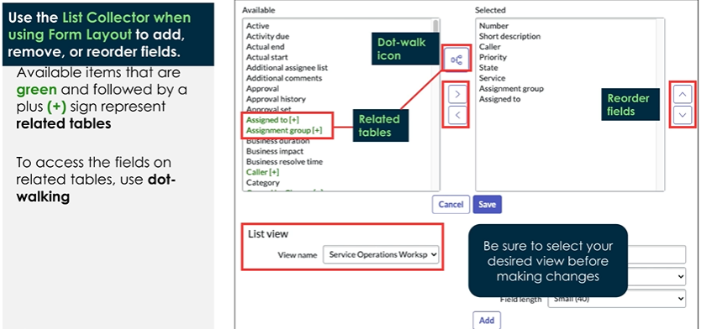
Form Layout

Slide 34
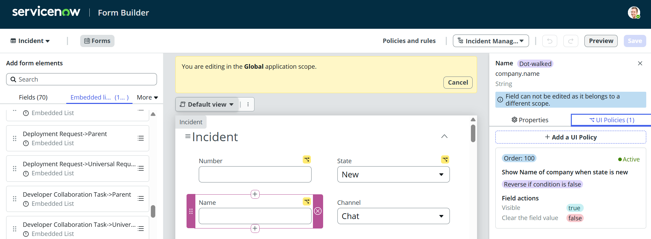
Form Builder
With Form Builder we can create new fields, edit fields, and remove fields
We can conditionally hide fields with a UI Policy

Slide 35
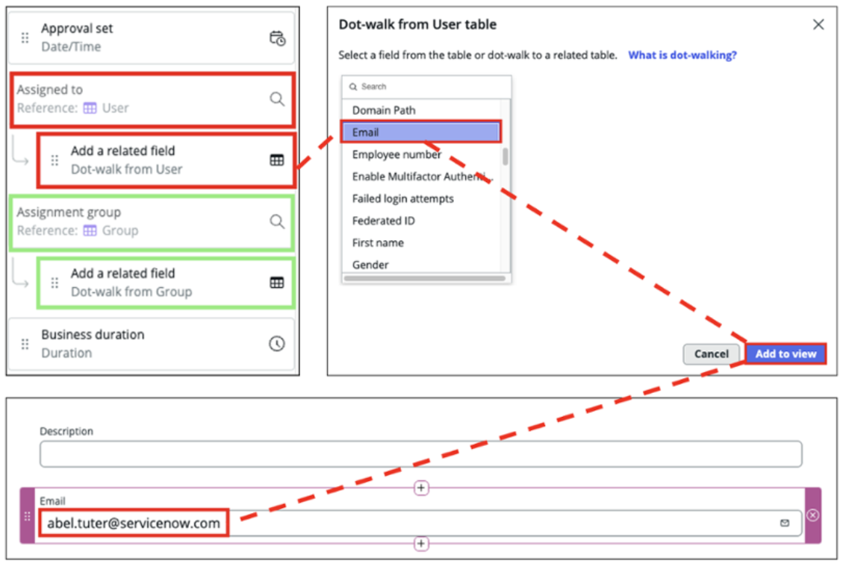
Using Reference Fields

Slide 36
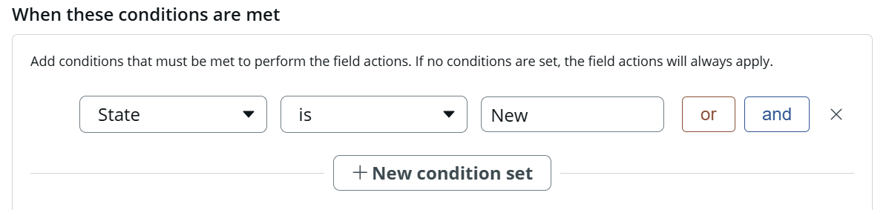
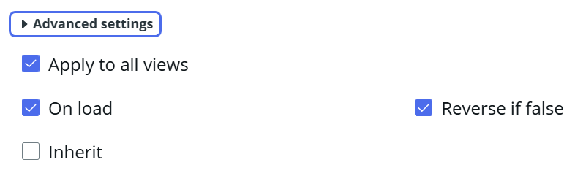
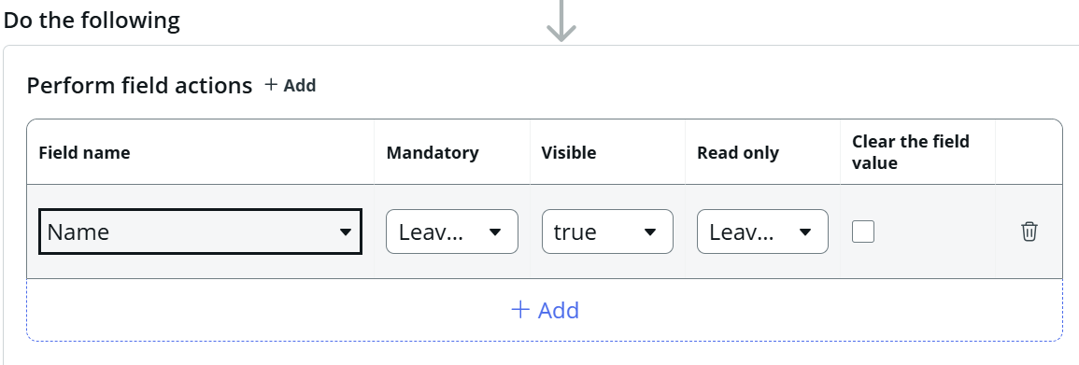
Conditionally Render a Field

Slide 37
Challenge
Goal:
Conditionally render a field
Scenario:
The caller of an incident refers to the one who submitted it. Display the name of the company the caller works for on the incident form.
The field should display under the ‘Caller’ field
The field should only display if the ‘State’ of the incident is ‘New’

Slide 38
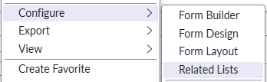
Configure Related Lists From Context Menu

Slide 39
Challenge
Goal:
Add a related list
Scenario:
For the ‘Major Incident’ view, on incident forms, add the Affected CIs related list

Slide 40
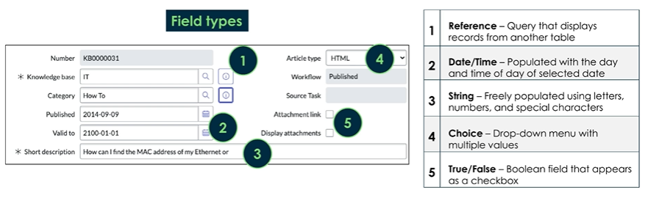
Field Types
Fields are stored as ‘Dictionary Entries’ on the [sys_dictionary] table
There are over 30 field types
https://www.servicenow.com/docs/bundle/zurich-platform-administration/page/administer/reference-pages/reference/r_FieldTypes.html

Slide 41
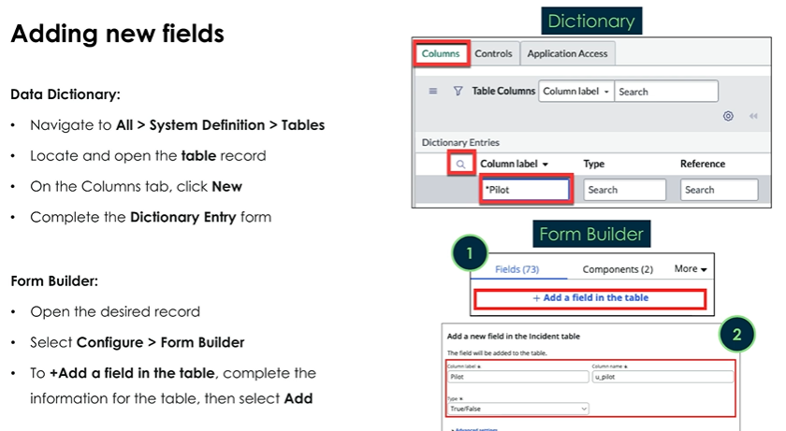
Adding New Fields
Custom fields we add will have a column name that starts with ‘u_’
Column Name: u_root_cause_analysis
Column Field: Root Cause Analysis
BEST PRACTICE: Remember to never place the same field in multiple sections on a form.

Slide 42
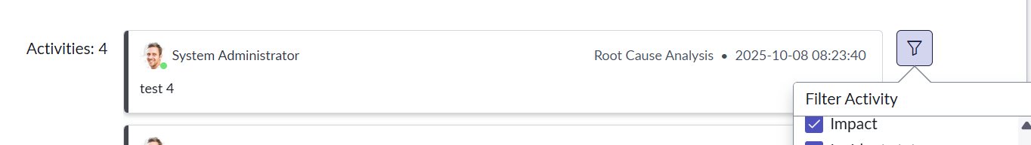
Journal Input
The journal input data type doesn’t store a permanent value to its input field. Instead, each saved value gets saved to the [sys_journal_field] table
The is how work notes and comments work
Items display in the activity stream, but you may need to update the filter

Slide 43
Challenge
Goal:
Create a new field
Scenario:
Add a new field called: ‘Root Cause Analysis’
Make sure it appears in the ‘Default’ incident view
The field type should be ‘Journal Input’
Place it next to your ‘Work Notes’

Slide 44
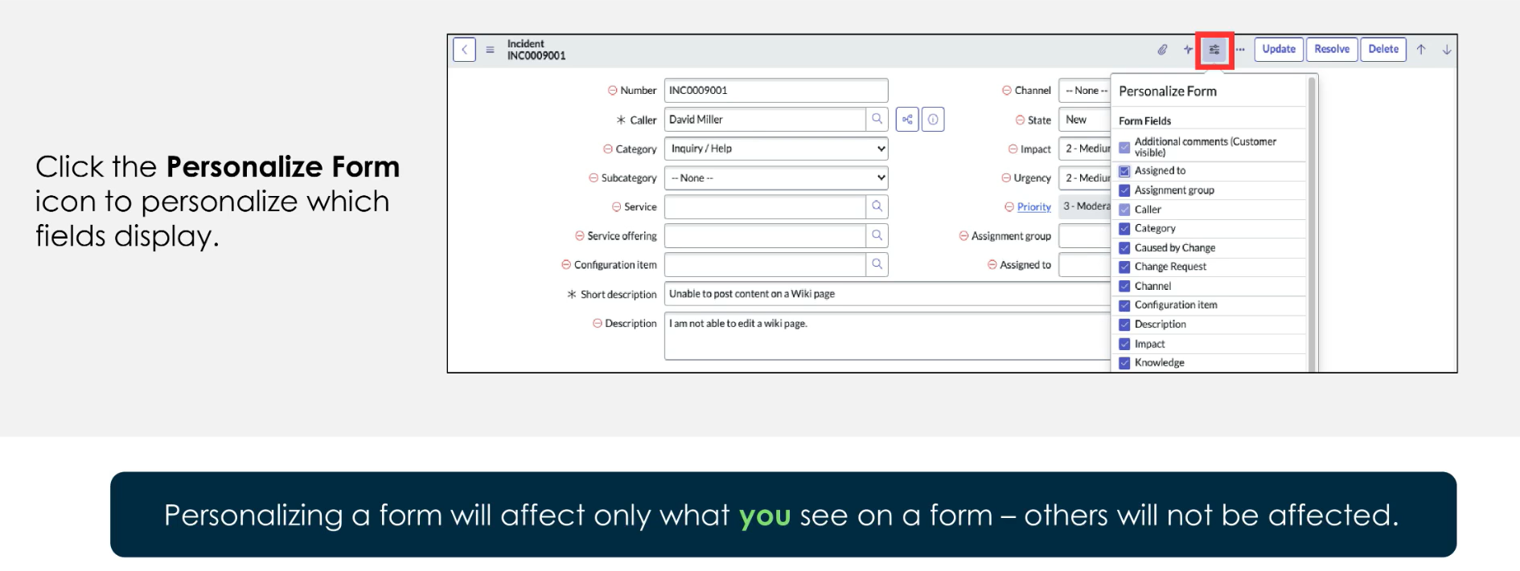
Personalize Forms

Slide 45
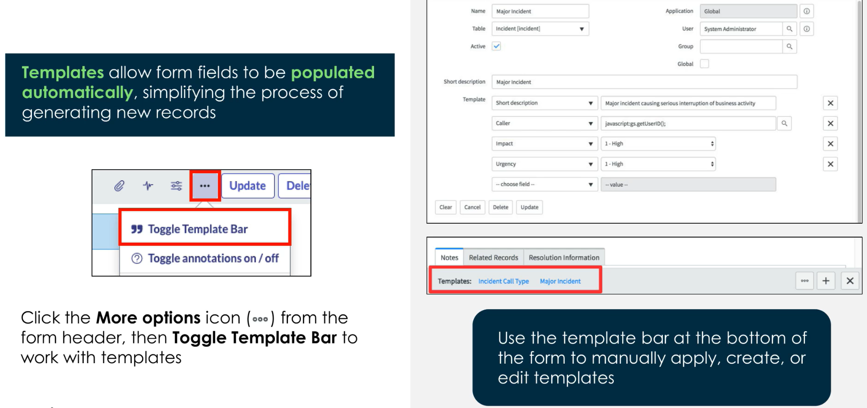
Form Templates
BEST PRACTICE: Take care with templates and who has access to create them. They can set fields that users may not have access to.

Slide 46
Challenge
Goal:
Edit a form template
Scenario:
Edit the ‘Major Incident’ form template so that the Assignment Group field is set to ‘ITSM Agents’

Slide 47
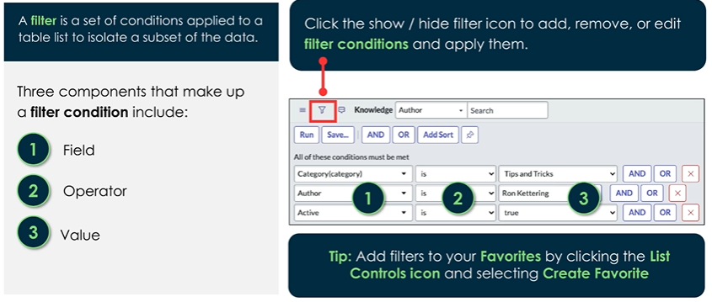
Filters
Anyone with the ‘admin’ or ‘personalize_list’ role may create list filters used by all

Slide 48
Filter Wildcards
% - exactly one character
* - zero or more characters

Slide 49
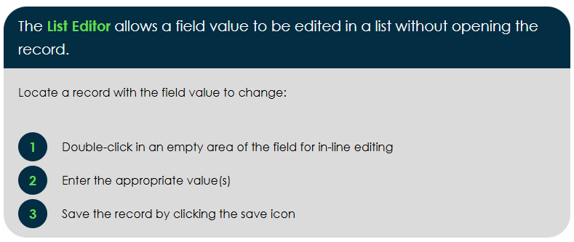
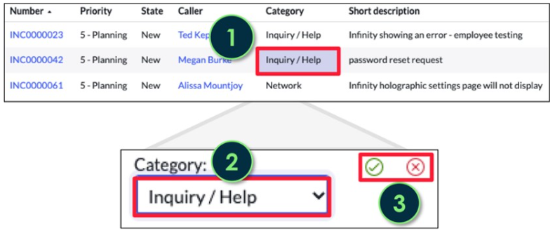
Inline Edit Lists
The list editor is the quickest way to edit a field on multiple records

Slide 50
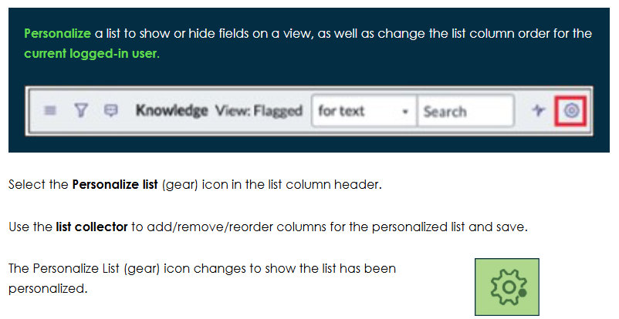
Personalize Lists
When you personalize a list, it is only active for you
If changes are made to the global list layout, then you wouldn’t see it unless you revert to default

Slide 51
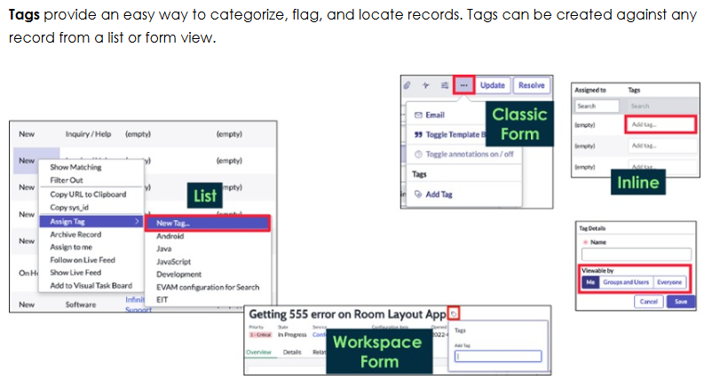
Tags
Anyone with the ‘admin’ or ‘tags_admin’ role can make tags that everyone can see

Slide 52
Challenge
Goal:
Create a tag and filter
Scenario:
Create a tag for incident records called ‘Needs Follow-Up’
Create a filter usable by all that filters incident records to only show incidents that need a follow-up

Slide 53
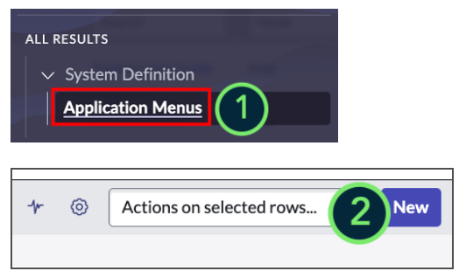
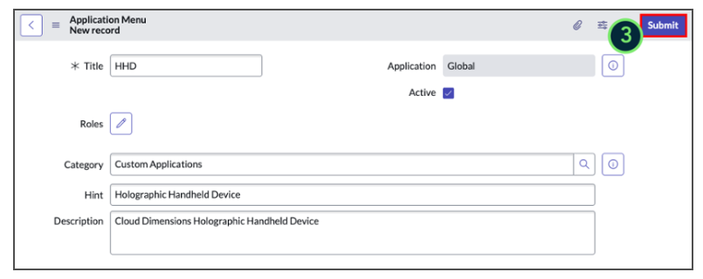
Create Application Menus

Slide 54
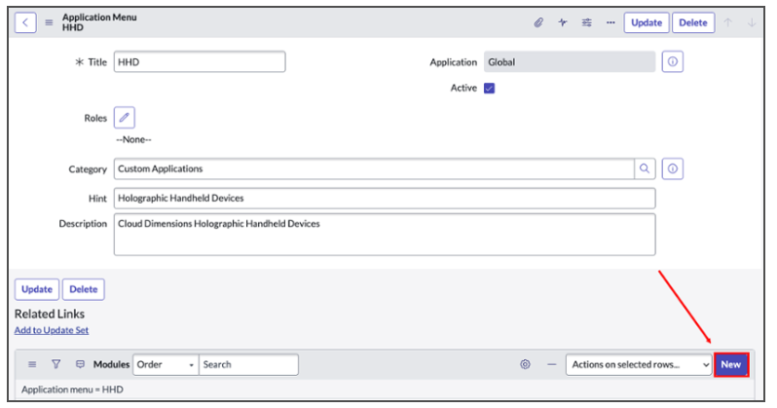
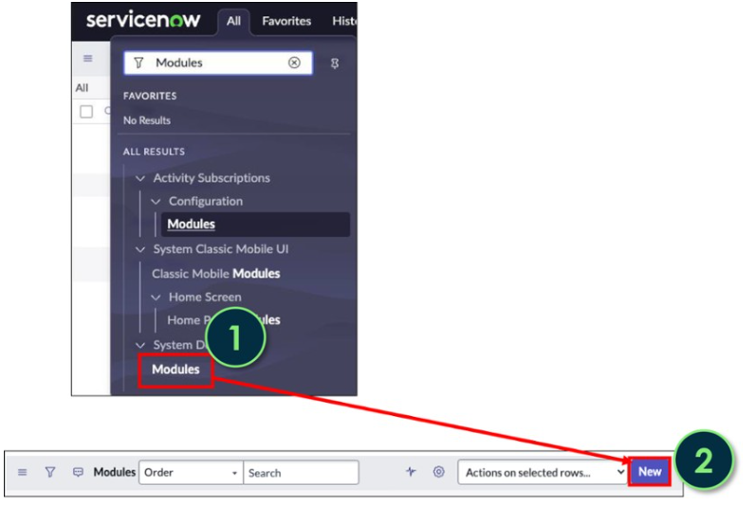
Create Modules

Slide 55
Challenge
Goal:
Create an application menu and module
Scenario:
Create an application menu called ‘ITSM Agent Center’
Create a module in the ‘ITSM Agent Center’ called ‘Critical Incidents’ that displays all incidents that have a critical priority

Slide 56
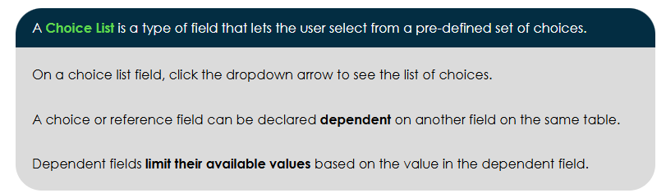
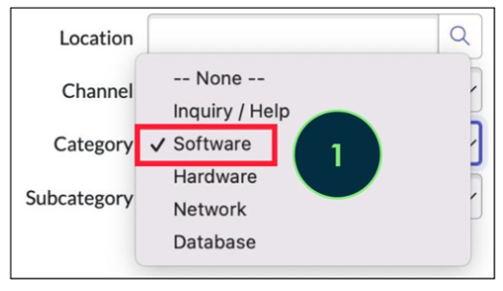

Choice lists & Choice List Dependency

Slide 57

Adding Choices
Choices are on the [sys_choice] table
You can manage choices there or right click on a choice list from a form to ‘Show Choice List’ or ‘Configure Choices’
Show – takes you to the list of choice records
Configure – takes you to edit the options directly

Slide 58
Challenge
Goal:
Add a new choice
Scenario:
Create a new choice for the subcategory field called ‘General Question’
The new choice should be dependent on ‘Category’ and only display if ‘Category’ is set to ‘Inquiry’

