Slide 1
Incident Management

Slide 2
What is Incident Management?
Definition: Incident Management in ServiceNow is the process and supporting application used to restore normal service operation as quickly as possible after an unplanned interruption or reduction in quality of IT service — minimizing the impact on business operations.
Make sure service disruptions are resolved quickly
Work is assigned automatically to the right teams
Customers and support staff can track progress transparently
Finding a cause is not the concern of incidents, restoring service quickly is

Slide 3
Key Incident Management Features
The Incident record – a form for capturing details such as caller, category, impact, urgency, and description
Assignment Rules – automatically routes incidents to the correct support group or individual
Priority Matrix – priority = impact + urgency
SLAs – track resolution and response targets
Work Notes & Comments – facilitate collaboration between support teams and communicate with the user
Knowledge Integration – Create knowledge articles for faster resolution in the future

Slide 4
The Incident Lifecycle – ITIL Concepts
Incident Detection & Logging
Detection: Incidents are identified through monitoring, user reports, or automated systems
Logging: The incident is recorded in a system (incident record)
Categorization & Prioritization
Categorization: The incident is classified by type (category, subcategory fields)
Prioritization: The incident is assigned a priority level based on its urgency and business impact (Priority Matrix)
Assignment & Escalation
Assignment: The incident is assigned to a support team or individual who can solve it (Assignment Rules)
Escalation: If the initial support team cannot resolve the issue quickly, the incident is escalated to more specialized technical teams or even management, depending on severity (Escalations)
Investigation, Diagnosis, & Resolution
Investigation/Diagnosis: assigned team investigates cause and determines fix
Resolution: The team impalements the fix
Closure
The incident record status is set to ‘Closed’

Slide 5
Roles & Responsibilities
Service Desk – First-line support, logging, & communication (itil role)
Incident Manager – Oversees process, coordinates escalations (incident_manager role)
Support Teams (L2/L3) – Technical resolution and root cause (itil role)
Problem Manager – Investigates recurring incidents (problem_manager role)
Change Manager – Approves changes for permanent fixes (change_manager role)

Slide 6
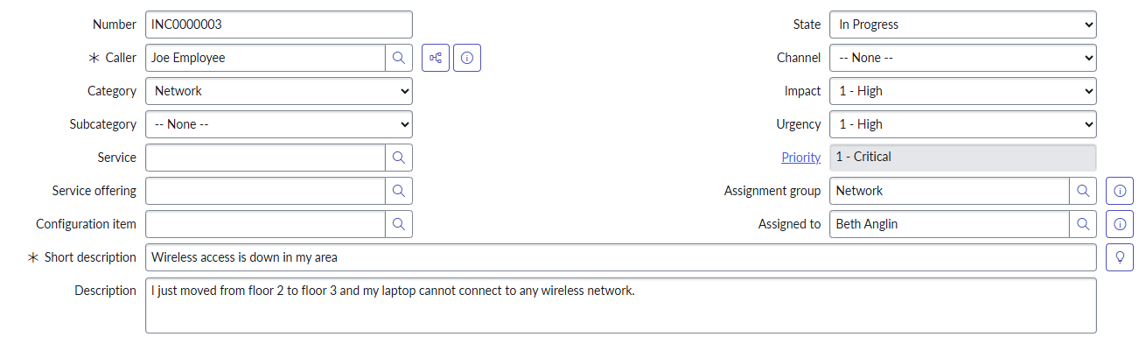
The Incident Record
State – New, In Progress, Resolved, On Hold, Cancelled, Closed
Category/Subcategory – classification of the incident
Service/Service Offering – ties into Service Portfolio Management

Slide 7
Priority Matrix
Impact ↓ / Urgency → | High Urgency | Medium Urgency | Low Urgency
High Impact | P1 | P2 | P3
Medium Impact | P2 | P3 | P4
Low Impact | P3 | P4 | P5

Slide 8
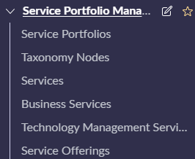
Service Portfolio Management
Services – IT services we provide
Service Offerings – variants or individual components of a service
Service: Email
Service Offerings: Bronze Email Plan, Silver Email Plan, Gold Email Plan
If we set the ‘Support Group’ field on both a Service Offering and its parent Service record, then baseline configurations will kick in to automatically set an incident assignment group

Slide 9
Challenge
Goal:
Create a new service and offering
Scenario:
Create a new Service called ‘Training’
Create a related Service Offering called ‘Online Training’
Set the ‘Support Group’ field on both records to ‘ITSM Agents’
Create a new incident record with your new service and offering to test

Slide 10
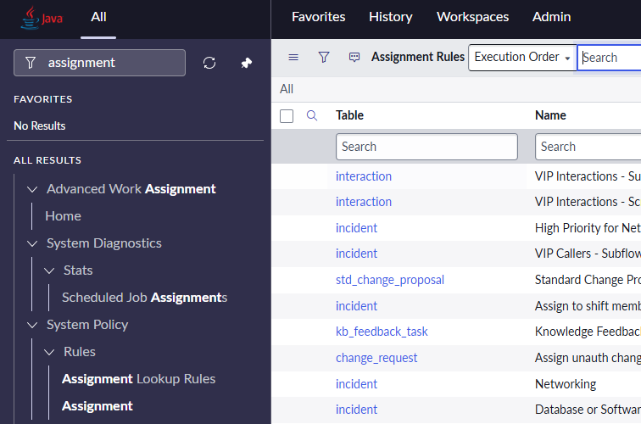
Assignment Rules
System Policy > Rules > Assignment
Definition: Assignment Rules are a set of automated instructions that determine how incidents are routed to the appropriate support group or individual
Only works if both the ‘assigned_to’ and ‘assignment_group’ fields are already empty
Available on Task-based tables (many tables such as incidents inherit from Task)

Slide 11
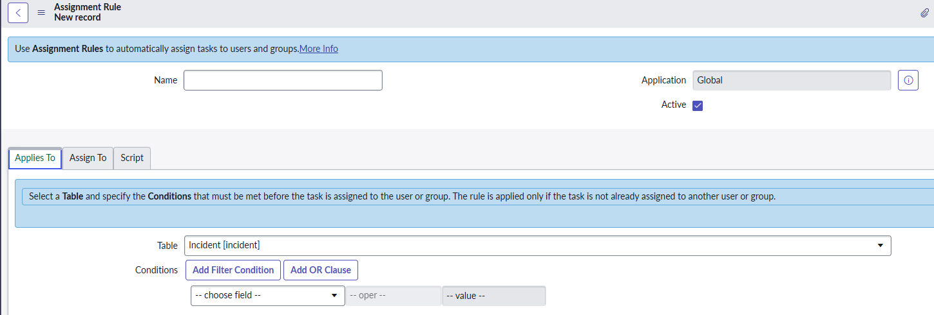
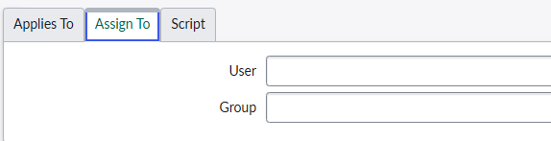
Assignment Rules
Provide a name
Applies To – determines what table and field conditions must be met to trigger
Assign To – the user or group to route the incident

Slide 12
Best practice Note
Many process automations/scripts can change the ‘assigned_to’ and ‘assignment_group’ fields
Choose only one solution/script/automation to centralize all logic for these fields
This is a best practice because it helps us debug issues better and provides more consistent results

Slide 13
Challenge
Goal:
Create a new Assignment Rule
Scenario:
All critical priority incidents, where the ‘Channel’ is ‘Walk-In’, should be routed to our ‘ITSM Agents’ group
Test the functionality and then deactivate this Assignment Rule

Slide 14
Problem Management

Slide 15
What is Problem Management?
Definition: Problem Management is the ITIL practice focused on reducing the likelihood and impact of incidents by finding and addressing their underling causes, and by managing workarounds and known errors.
Reduce the number of incidents
Identify root causes

Slide 16

Workaround & Known error
Definition: A workaround restores service without a full fix
Definition: A known error is a problem that has a documented root cause and a workaround
Stored in the Known Error Database (KEDB)

Slide 17
Reactive vs Proactive
Definition: Reactive Problem Management is triggered after an incident has occurred, and its goal is to identify and remove the root cause
Problem records created from existing incidents
Definition: Proactive Problem Management aims to identify and prevent problems before they cause incidents
Use trend analysis, monitoring data, and continuous improvement to detect issues early

Slide 18
Key Problem Management Features
The Problem record – link related incidents; log problem details; handle resolution/closure
Assignment Rules – automatically routes problems to the correct support group or individual
Priority Matrix – priority = impact + urgency
Work Notes & Comments – facilitate collaboration between support teams and communicate with the user
Communicate Workarounds – tell related incident owners about the fix
Known Errors – Identify root causes and find solutions; create knowledge base articles

Slide 19
The Problem Lifecycle – ITIL Concepts
Detection & Identification – problem is created; incidents are linked to the problem (problem record lifecycle)
Logging – problem has a number, short description, category, CI (problem record lifecycle)
Categorization & Prioritization – problem has assigned category/subcategory fields and priority is calculated (problem record fields)
Investigation & Diagnosis – problem is assigned; root cause analysis performed using techniques like the ‘5 whys’ (assignment rules)
Workaround – develop temporary solutions while a permanent fix is being prepared (share workarounds)
Known Error Creation – document the problem, root cause, and workaround in the Known Error Database (share known error knowledge articles)
Resolution & Change Implementation – Resolution notes filled out before close; implement the fix while engaging Change Management (problem record lifecycle)
Closure – finished; conduct any post-review (problem record lifecycle)

Slide 20
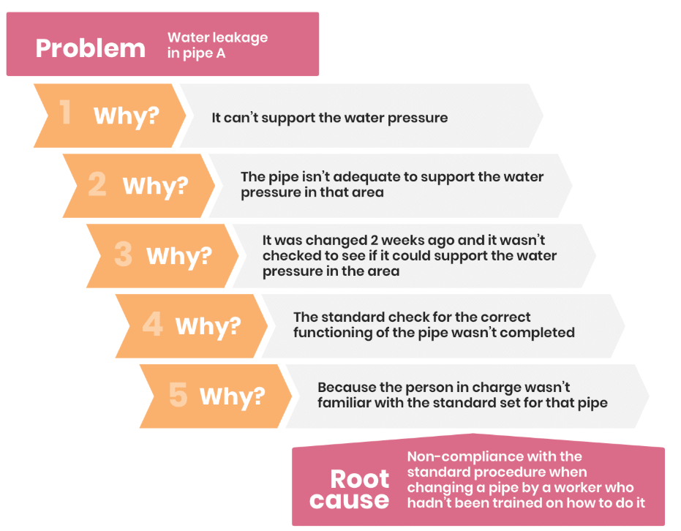
The 5 Whys – Root Cause Identification

Slide 21
Roles & Responsibilities
Service Desk – First-line support, logging, & communication (itil role)
Incident Manager – Oversees process, coordinates escalations (incident_manager role)
Support Teams (L2/L3) – Technical resolution and root cause (itil role)
Problem Manager – Investigates recurring incidents (problem_manager role)
Problem Coordinator – manages the lifecycle of the problem (problem_coordinator)
Change Manager – Approves changes for permanent fixes (change_manager role)

Slide 22
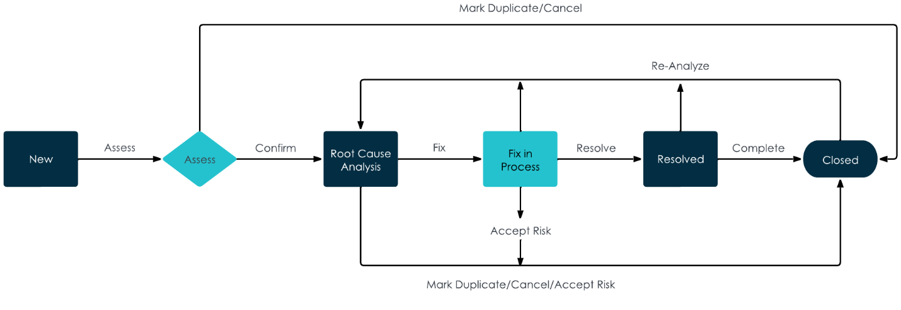





Problem Lifecycle In ServiceNow

Slide 23
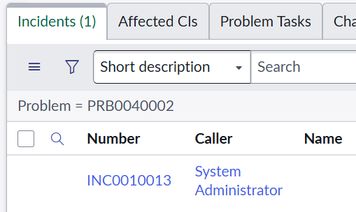
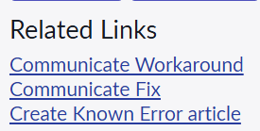
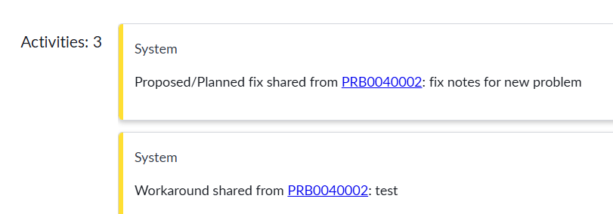
Communicate Workarounds/Fixes
Fill out the workaround/Fix field and save the record
Link incidents
Click ‘Communicate Workaround’ or ‘Communicate Fix’ to share
On the incident record, you will see the workaround or fix posted

Slide 24
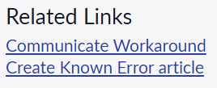
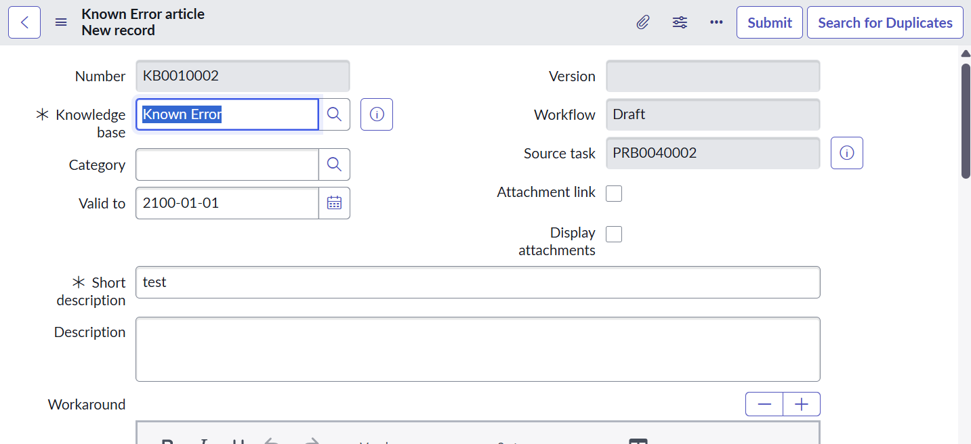
Create Known Errors
Click ‘Create Known Error Article’ from the incident record
Find duplicates first
Fill out the record and submit new article if needed

Slide 25
Challenge
Goal:
Create a new incident & problem
Scenario:
Create a new incident and link it to a new problem
Create and share a workaround with the related incident
Create and share a knowledge base article with the related incident

Slide 26
Change Management

Slide 27
What is Change Management?
We don’t call it change management anymore in ITIL version 4.
ITIL V3 = Change Management
ITIL V4 = Change Enablement
Definition: Change enablement is the management practice of ensuring that changes to IT services and the IT infrastructure are implemented in a way that minimizes risk and disruption while maximizing value
You may see an even older term ‘change control’. In day-to-day practice, you could see or hear all 3.
Change Control, Change Management, Change Enablement (Newest)

Slide 28
Change Types
Definition: Standard Changes are pre-authorized changes that are low-risk and don’t need to be assessed or authorized
Example: provisioning a new employee’s email using a script
Definition: An Emergency Change is a change that must be implemented as soon as possible
Example: Deploying a zero-day security hotfix
Definition: A Normal Change is any service change that is not a standard or emergency change
Example: Upgrading our database from v12 to v13
Changes are stored on [change_request]

Slide 29
Governance Roles
ITIL V4 introduced the Change Authority terminology, but CAB is still used too
Definition: A Change Authority is any mechanism by which change approval is granted
A delegated team within the organization
A peer review
Automated approval processes in CI/CD pipelines
Business stakeholders
Definition: A Change Advisory Board (CAB) is a committee that provides guidance and oversight on proposed changes, evaluating their impact and risks before approving
Definition: An Emergency Change Advisory Board (ECAB) is a flexible, rapid-response decision making group that is convened to assess and authorize emergency changes

Slide 30
Key Change Enablement Features
The change request record on the [change_request] table
Definition: Risk Conditions automatically calculate the risk field of a change record
Bulit-in by default
Risk Assessment plugin is an optional alternative. It calculates a weighted score from assessment questions (com.snc.change_management.risk_assessment)
Definition: Change Schedules show us a calendar view that overlays our planned changes with blackout & maintenance windows
Helps spot conflicts
Definition: Change Approval Policies decide who must approve a change, when, and under what conditions
Definition: The CAB Workbench is a built-in place to manage CAB meetings

Slide 31
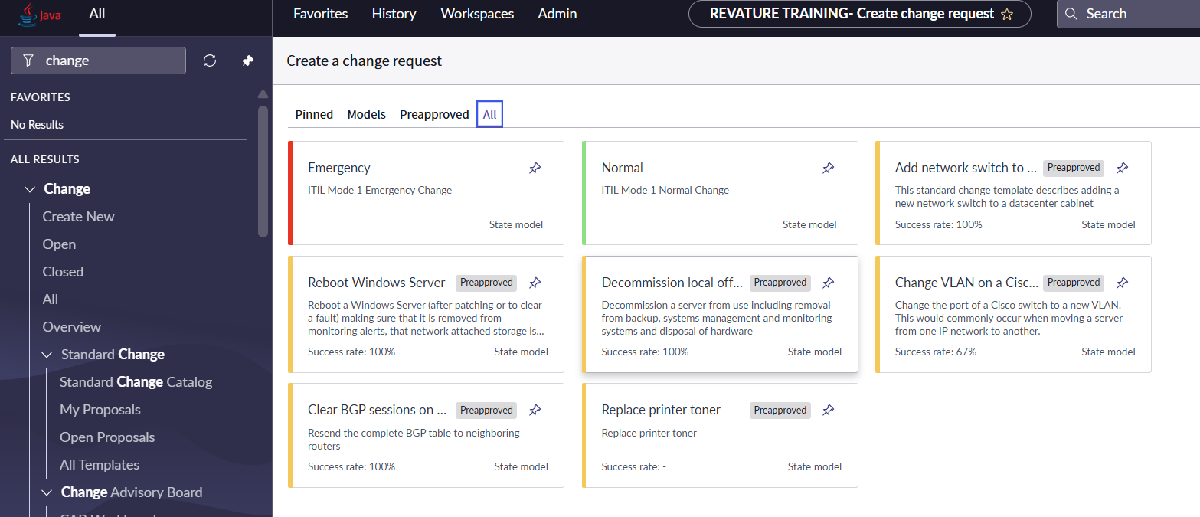
Creating Change Requests
Change > Create New

Slide 32
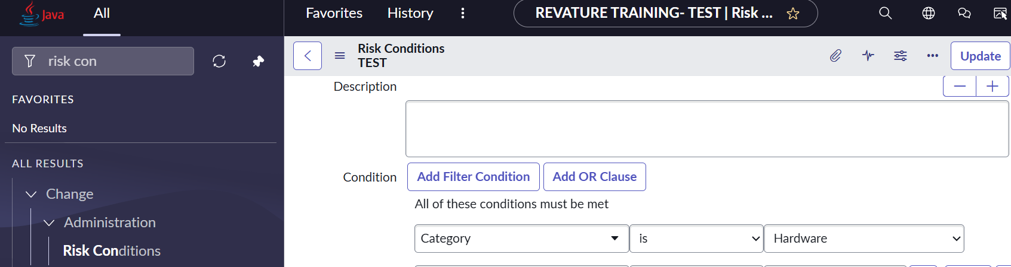
Risk Conditions
Find ‘Risk Conditions’ with the filter navigator
Set the conditions that a change record must meet
Determine what risk and impact to set as a result

Slide 33
Challenge
Scenario:
When a change request is made and category is ‘Hardware’ and the service offering is ‘Training’, set the risk and impact to ‘High’
Goal:
Create a new risk condition

Slide 34
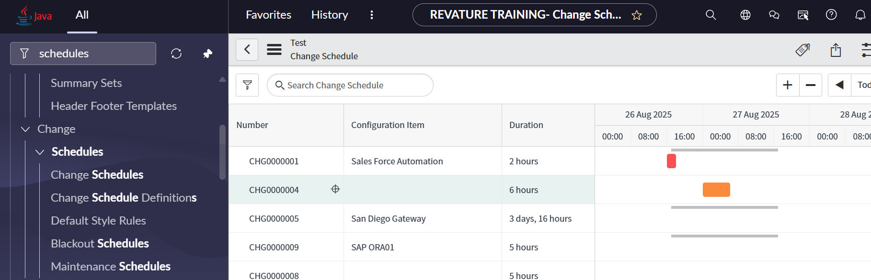
Change Schedules
Set blackout & maintenance windows
View them on your change schedule to detect conflicts

Slide 35
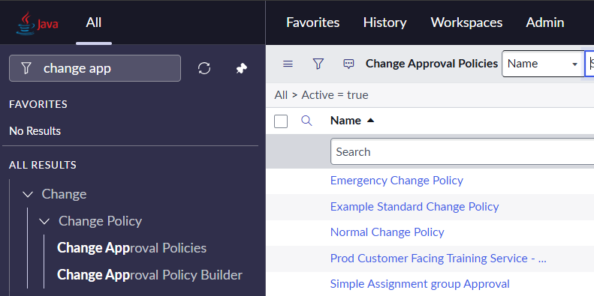
Change Approval Policies
Define rules to automate change approvals
Policy Inputs – the data that the change approval policy will evaluate
Decisions – conditions that when met trigger an answer
Approval Definitions (Answers) – what to create: user/group approvals, auto-approve, or auto-reject

Slide 36
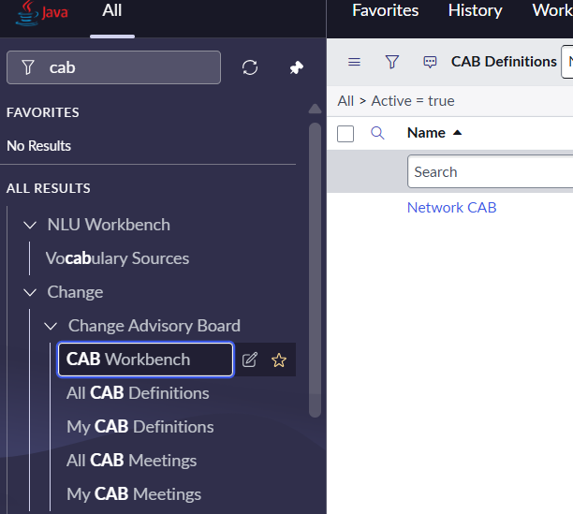
The CAB Workbench
Create CAB definitions and related CAB meeting records
The records display on the CAB Workbench calendar

Slide 37
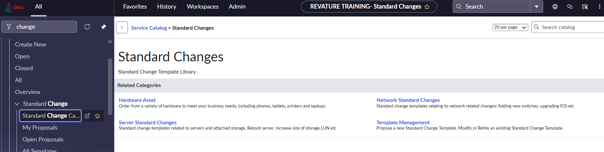
Creating New Standard Changes
Create new standard changes through the Standard Change Catalog

Slide 38
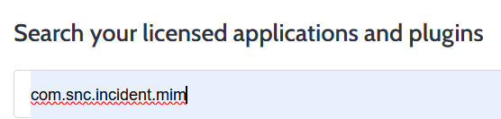
Emergency Changes, Major Incidents, Problems
Major Incident is detected
Workaround involves a system update
Change Manager creates an Emergency Change linked to the incident
ECAB convenes and gives approval for emergency change
Change implemented and incident closed
Post-Implementation Review
Output: A problem record is initiated to perform root cause analysis
A normal change is implemented from the problem
The Major Incident plugin needs to be installed

Slide 39
Challenge
Scenario:
Install the plugin: com.snc.incident.mim
Create a Major Incident
Create a related Emergency Change
Goal:
Create a new Major Incident and link it to an emergency change

Slide 40
Knowledge Management

Slide 41
What is Knowledge management?
Definition: Knowledge Management is the practice of effective, efficient, and convenient use of information and knowledge across the organization
Helps people make better decisions
Resolve issues faster
Reduce backtracking over work

Slide 42
Roles & Access
knowledge_admin – full KM administration
knowledge_manager – administer assigned knowledge bases; approve, curate, manage categories & contributors

Slide 43
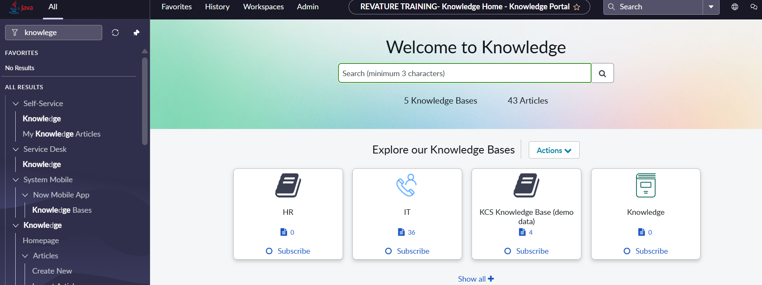
The Knowledge Homepage
The Knowledge Homepage provides a space for self-serve users to get assistance

Slide 44
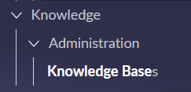
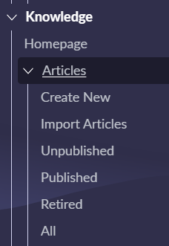
Knowledge Base vs Knowledge Article
Definition: The knowledge base is a governed repository of knowledge articles
Example: Known Error
Table name: kb_knowledge_base
Definition: A knowledge article is a single, reusable unit of content that answers a question or solves a specific problem
Table name: kb_knowledge

Slide 45


Knowledge Article States
Draft – in the process of being created
Review – draft version sent to reviewers to approve or reject, we can recall to send back to draft
Scheduled for publish – draft version of knowledge article is scheduled at future date
Published – article is approved and published we can checkout to create new version in draft
Pending retirement – published article is selected for retirement, pending approval
Retired – published article is retired
Outdated – more recent version of the article has been published

Slide 46
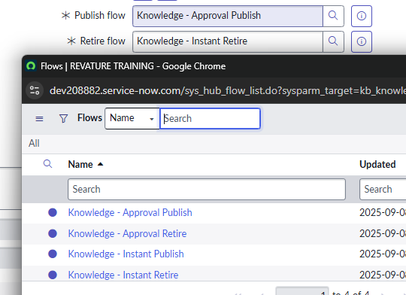
Knowledge Flows
Knowledge Flows are process automations that control the state of our articles all the way from Draft to Published and everything in between

Slide 47
Challenge
Scenario:
HR needs their own knowledge base
Create a new knowledge base called ‘HR’ and make sure only members of the HR department can read articles from it
Create the first knowledge article
You can use dummy data where necessary
Goal:
Create a new knowledge base and article

