Slide 1
Integrations

Slide 2
Integration Options
Definition: Inbound integrations are when our ServiceNow instance accepts requests from external systems
Definition: Outbound integrations are when our ServiceNow instance makes requests to external systems

Slide 3
Inbound Options
REST APIs
REST API Explorer – discover and test ServiceNow’s REST APIs
Scripted REST APIs – build your own endpoints with custom logic
SOAP APIs
Scripted SOAP APIs – build your own SOAP endpoints with custom logic
Import Sets – batch or schedule data imports into ServiceNow tables (REST – IntegrationHub option available)
Email Inbound Actions – use scripts to interpret received email and then create or update records
IntegrationHub (Flow Designer) – use REST triggers to launch a flow from a REST request
IntegrationHub (Import Tool) – schedule batched record imports from files or external systems
MID Server – bridge ServiceNow and on-premises systems
Application Registry – these records define our authentication scheme for OAuth 2.0
Any external system will need to pass through our Application Registry to get an authorization token and an access token

Slide 4
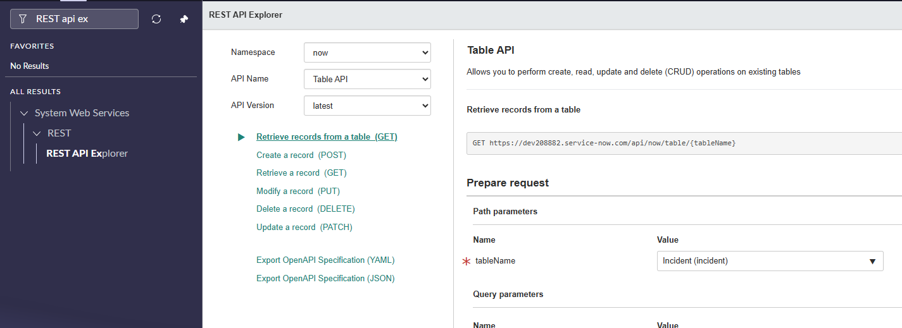
REST API Explorer
Use the REST API Explorer to test REST endpoints on your instance
Offers guidance on how to construct requests

Slide 5
Challenge
Goal:
Find an endpoint to use
Scenario:
Use the Table API as an aid
What endpoint should I hit to create an incident record? What does your request body look like?
We should be able to set the impact, urgency, and short description.
After the record is created, we should get a 201 status code returned
The incident number should be returned to the client after it is created

Slide 6
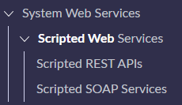
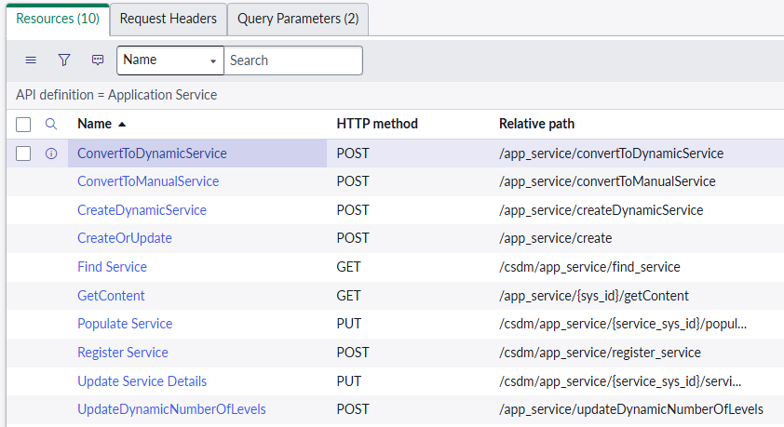
Scripted Web Services
Scripted REST APIs & Scripted SOAP Services both contain logic to handle custom requests
These are endpoints that developers define, and we use scripts to determine how to handle the request and what we send back as the response

Slide 7
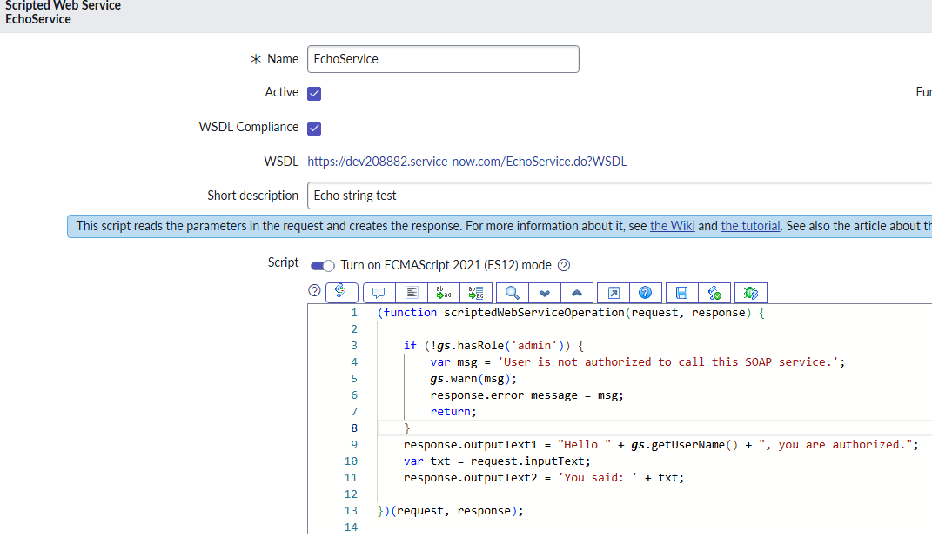
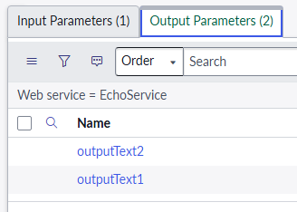
SOAP Example
We must set input/output parameters in the related lists
Make sure you authenticate users by checking roles
The generated WSDL file is shared to consumers (click on the link and download file as xml)

Slide 8
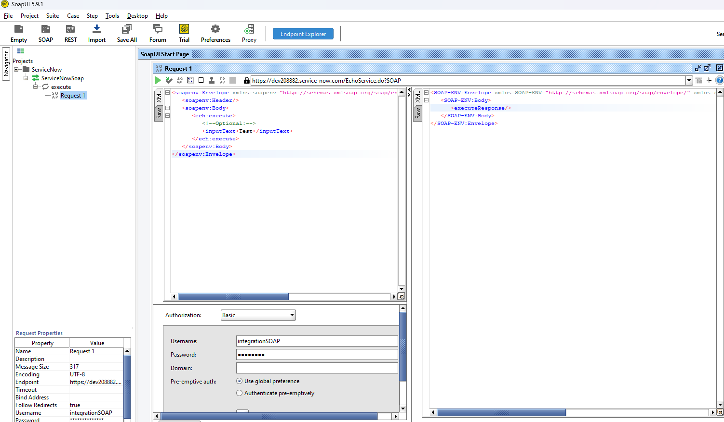
Using SOAP UI To test
We can use SOAP UI to test our service – just bring your WSDL file!
Create an integration user, click the checkbox for it*, and give them the ‘soap’ user role
We can use their username/password to authenticate the request in SOAP UI

Slide 9
Challenge
Goal:
Create a SOAP scripted webservice
Scenario:
Create a SOAP webservice that accepts the impact, urgency, and short description for incidents and then create the record
Notes:
UI Policy = because the tool’s main purpose is to make fields required, read-only, or mandatory, and it does that job well without needing any code

Slide 10
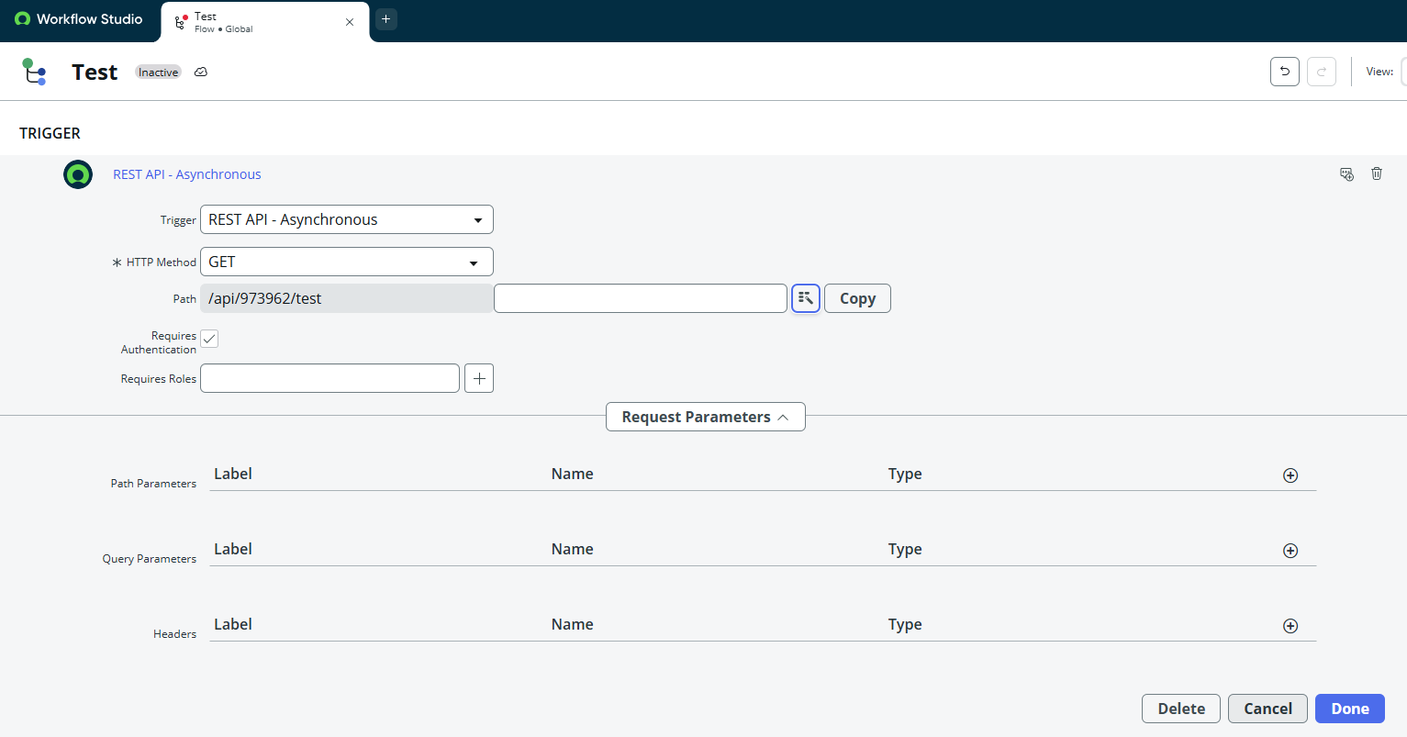
IntegrationHub Enterprise License - REST API Trigger
Requires IntegrationHub Enterprise License
Install from developer site for PDIs
Launch Flows from a REST request

Slide 11
Challenge
Goal:
Create a REST API triggered flow
Scenario:
Ensure you have the IntegrationHub – Enterprise package installed
Create a REST API triggered flow that takes in impact, urgency, and short description
Create an incident record from the input data
Notes:
UI Policy = because the tool’s main purpose is to make fields required, read-only, or mandatory, and it does that job well without needing any code

Slide 12
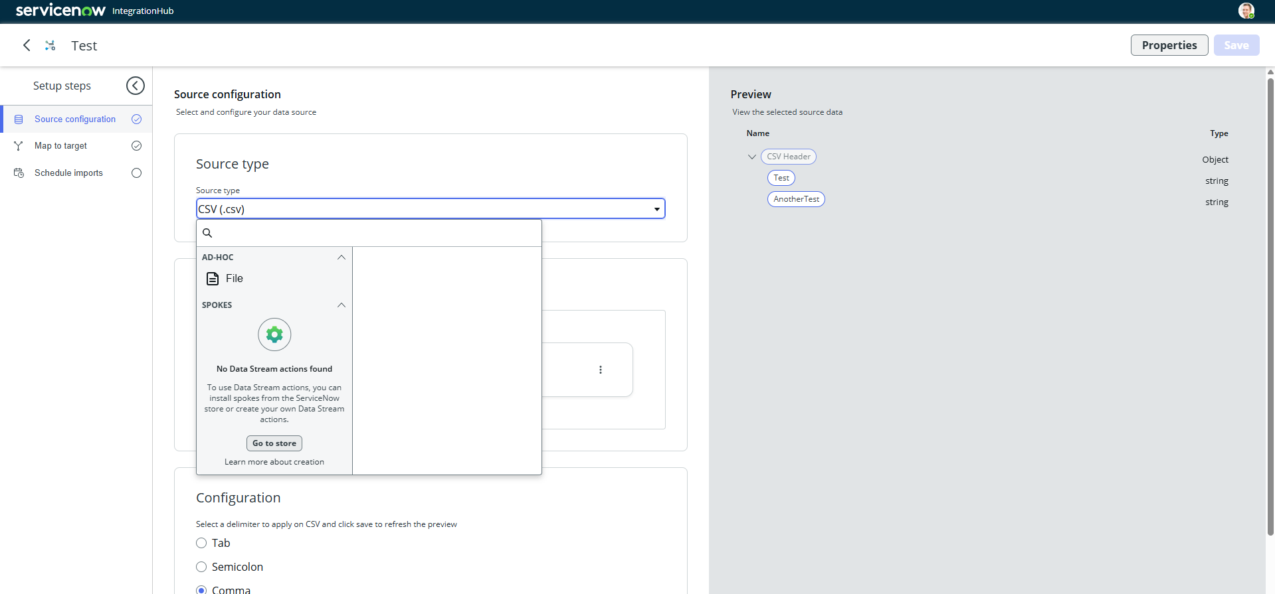
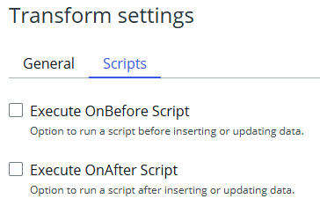
IntegrationHub Import Tool
Map external data to tables via transform mapping, just like Import Sets
We can use Spokes to import record data
Uses the underlying Import Set features but has a more modern UI
Executes scripts before or after imports

Slide 13


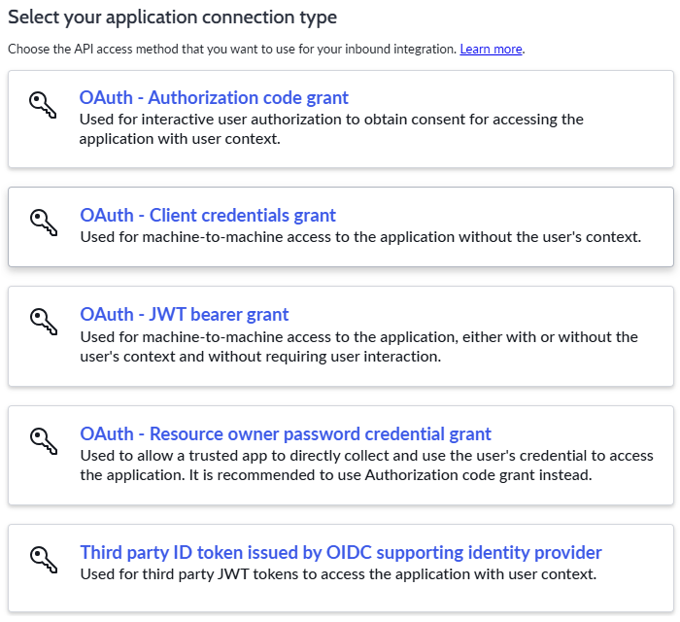
Application Registry & Oauth Grant Types
Application Registries define how external system may authenticate with our instance
Authorization – directs user to instance for login; respects user ACLs
Client credentials – allows us to get an access token with only the client secret and ID; usually used for machine-to-machine communication

Slide 14
Proof Key for Code Exchange
Definition: Proof Key for Code Exchange (PKCE) is an extension to the OAuth 2.0 flow that makes it more secure
Pronounced as ‘pixie’
Used on SPAs or mobile apps where we can’t safely store a client secret
Required in OAuth 2.1
Not a language or specific code – it’s a standard to be implemented in our code

Slide 15
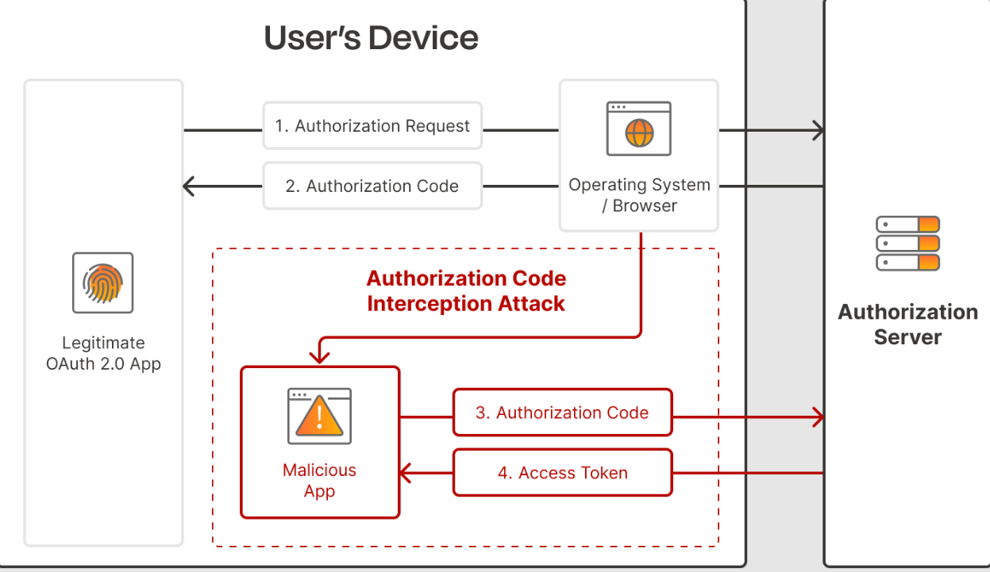
When Not Using PKCE
User is susceptible to a man-in-the-middle attack

Slide 16
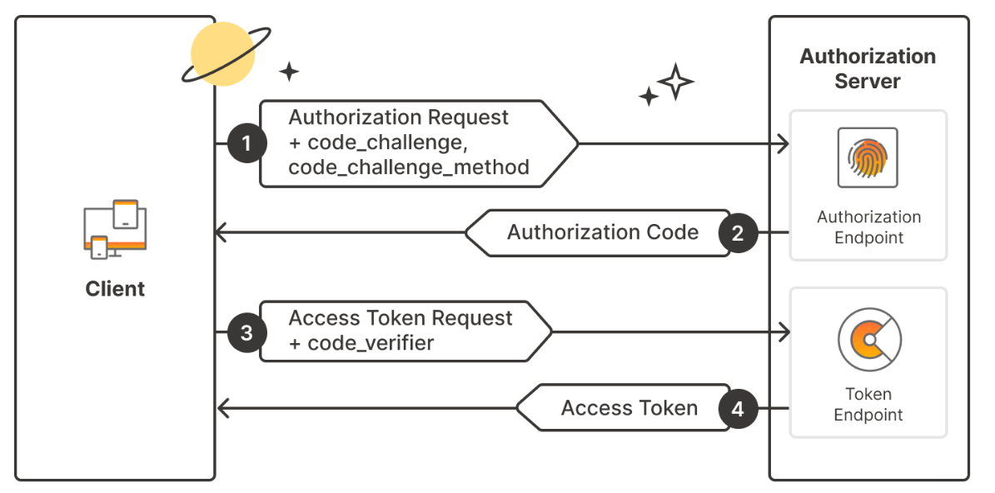
Using PKCE
Even if attackers get the authorization code, they won’t have the code_verifier = no access!
The access token will be shorter lived, but it is still not 100% safe to store in the client (XSS attacks)…

Slide 17
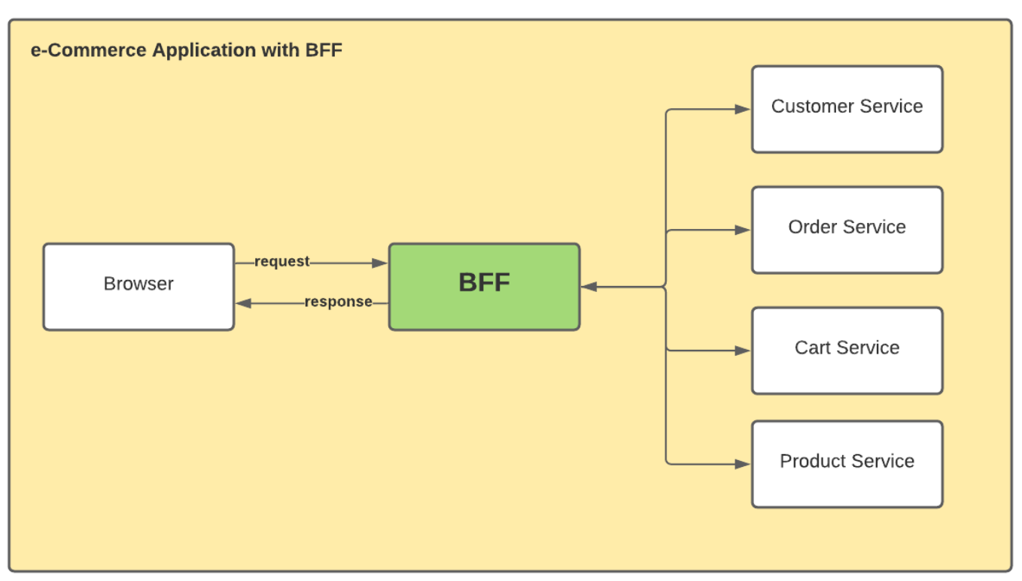
Want a BFF?
Definition: A Backend for Frontend design pattern provides a tailored backend interface for different types of clients
Could have one for web and another for mobile apps
Acts as a proxy layer in between the client and backend
Auth tokens are stored on the BFF so no chance of XSS attacks, the client only ever see what we return in the BFF (likely record data)

Slide 18
What is Express?
Definition: Express.js aka Express, is a free open-source back-end web application framework for node.js
Support for middleware
Routing
Unopinionated – bring your own design pattern

Slide 19

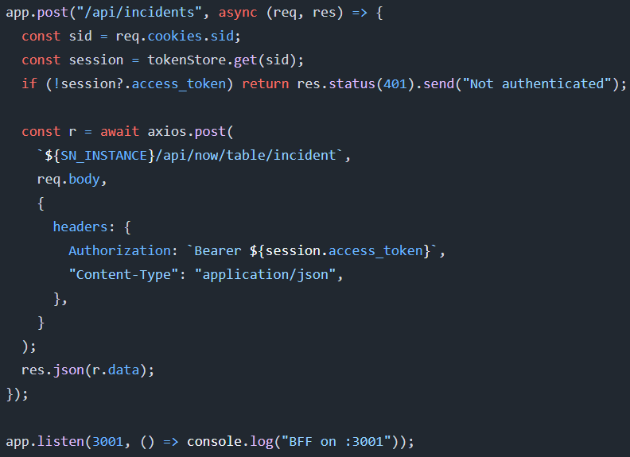
Express Basics
We create the express app by first installing with ‘npm install express’
Import into a js file to instantiate the app
Add routes & define route logic before setting the response
Start listening to requests with .listen()
Start Express server with ‘node server.js’

Slide 20
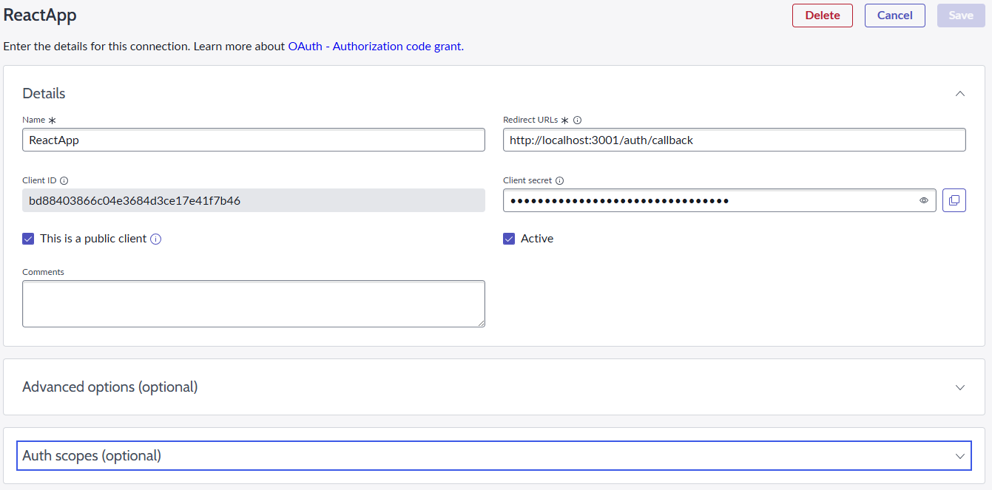
Application Registry - Oauth Client Setup
RedirectURL – the URL that ServiceNow will direct the client to while sending the authorization token (Part 2 of the PKCE Auth Flow)
Client ID/Secret – used in authentication steps
This is a public client – required to use the PKCE flow

Slide 21
ServiceNow PKCE Login Flow with BFF
ServiceNow receives request and sends access token + refresh token to BFF
Client Login Request
ServiceNow:
Authorization Code
BFF:
INSTANCEURL/oauth_auth.do
response_type
client_id
redirect_uri
code_challenge
code_challenge_method
state
BFF:
INSTANCEURL/oauth_token.do
grant_type
Authorization Code
redirect_uri
client_id
code_verifier
client_secret

Slide 22
Outbound Options
Outbound REST Messages – call external REST APIs from ServiceNow
Configured at: System Web Services > Outbound > Rest Message
Can be called from scripts
Outbound SOAP Messages – communicate with SOAP-based external systems using XML and WSDL
IntegrationHub (Flow Designer) – use REST actions and script steps to call out to APIs
Outbound Email Notifications – send email messages from ServiceNow to users or external systems
Mid Server (Outbound bridge) – allows ServiceNow to communicate securely with on-premise or restricted systems

Slide 23
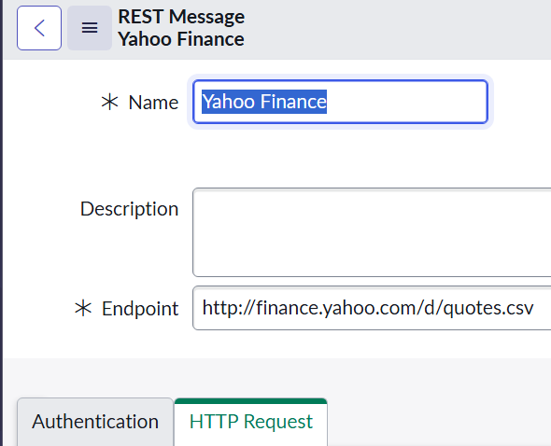
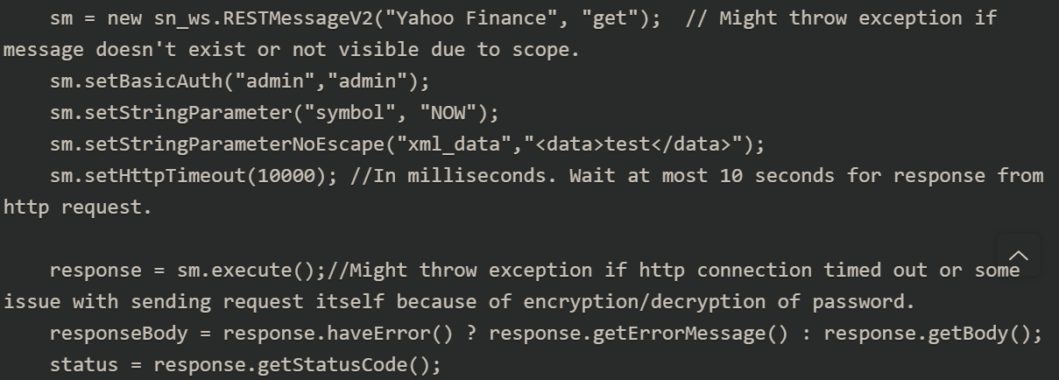
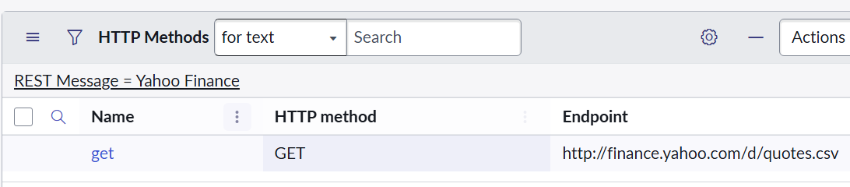
Outbound Rest Messages
Create a message, add methods, and set headers
Call the Message via scripts

Slide 24
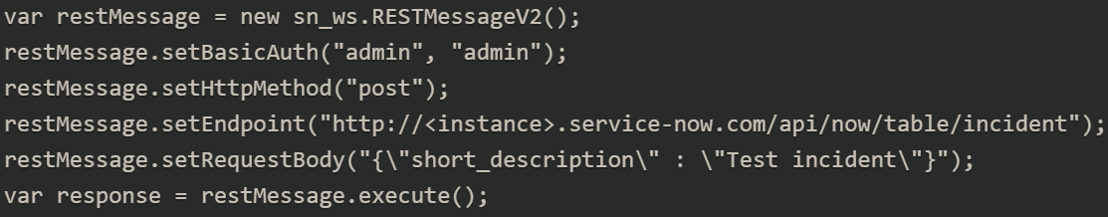
RecordLess Outbound REST Messages
We can also define a REST message 100% within a script:

Slide 25
Challenge
Goal:
Create an Outbound REST Message
Scenario:
Create a REST Message that gets a random joke from: https://api.chucknorris.io/
Call the REST Message and print the results to your system logs via a background script
Notes:
UI Policy = because the tool’s main purpose is to make fields required, read-only, or mandatory, and it does that job well without needing any code

Slide 26
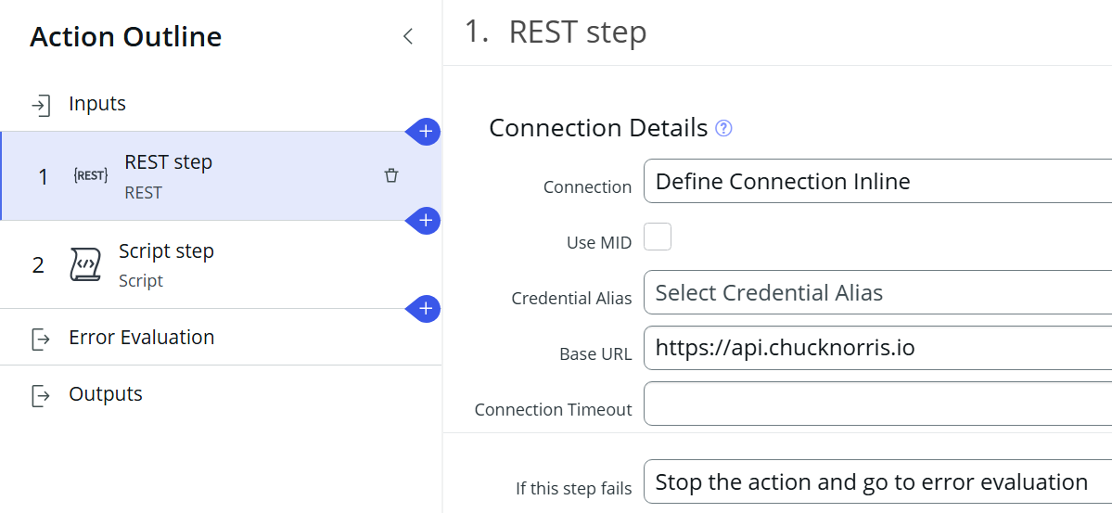
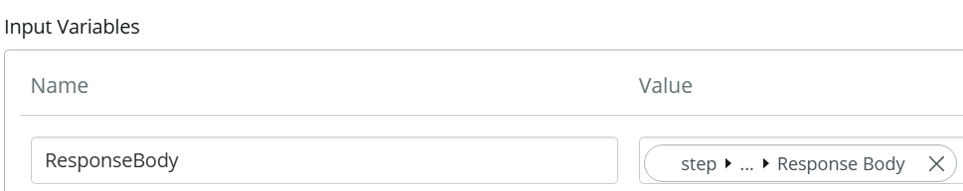
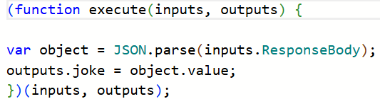
IntegrationHub (Flow Designer)
Rest actions let us make callouts to APIs (note this is a custom action)
We can then use a script step to take in the response as an input
Outputs are then defined and will be returned from the Script Step
Rest Step:
Script Step:

Slide 27
Challenge
Goal:
Create a Flow that calls an API
Scenario:
After a new user is created we should do the following:
Execute a flow that will set a new text field on sys_user: Astrology Info
Our flow should use a public API to get astrology info about the user – use a birthday field to determine their sign
Notes:
UI Policy = because the tool’s main purpose is to make fields required, read-only, or mandatory, and it does that job well without needing any code

