Slide 1
Database Management

Slide 2
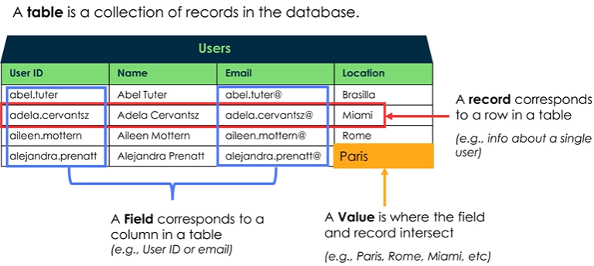

Tables
Each record has a unique 32-character sys_id
You can read it in the URL or by right-clicking the form header and selecting ‘Copy sys_id’
The ‘Tables’ module is a list of all tables, we can create new ones here as well
Tables & Columns allows us to quickly view or manage tables, columns, and column attributes

Slide 3
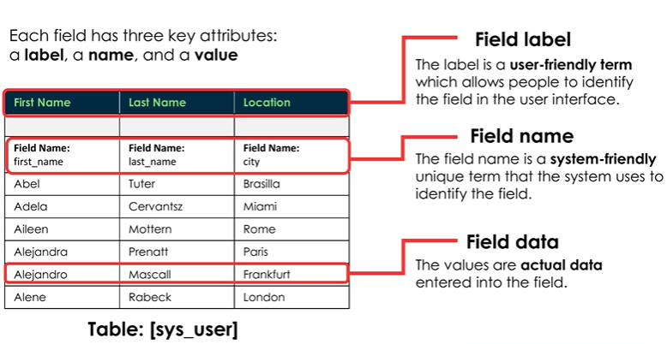
Field Attributes

Slide 4
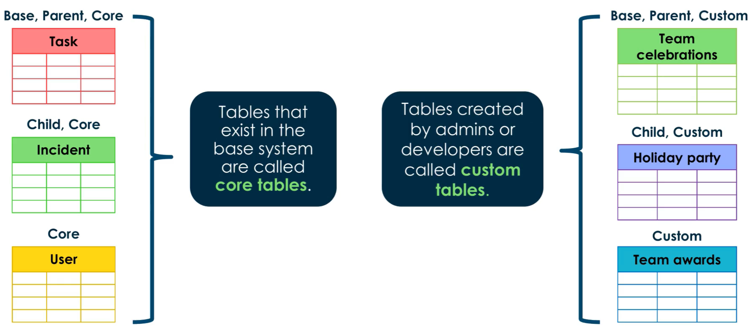
Core Tables vs Custom tables

Slide 5
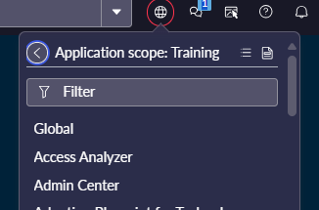
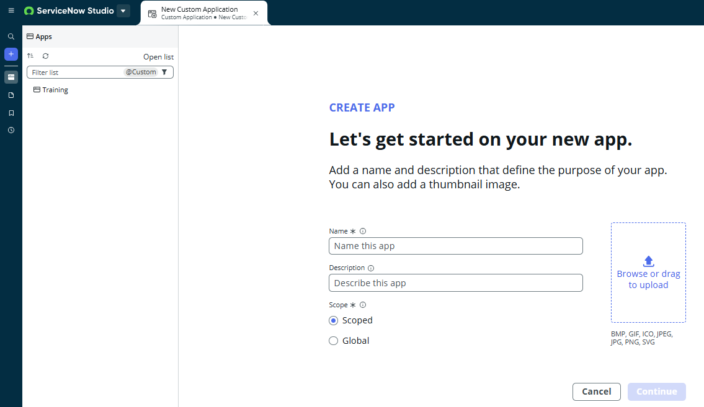
Application Scopes
Definition: Applications are containers for configuration metadata

Slide 6

Application Scope Api Names
You can rename the scope but the autogenerated format follows ServiceNow convention:
x_ - tells us this is a scoped app
973962 – the developer code
app – our app name

Slide 7
Challenge
Goal:
Create a new application scope
Create a new table
Scenario:
Create a new application scope called ‘Training’ with two roles: Trainer & Training Manager
Create a new table called ‘Capability’
Only Training Managers should have access
Create 2 fields and add them via Form Builder:
A string display field called ‘Name’, mark it as the display field
A choice list called ‘Type’ which options are COTS & Full Stack
Create a new Application Menu called ‘Training’ and new module named ‘Capability’ which shows our list of Capabilities
Customize the List Layout so our Capability names are shown

Slide 8
When to use a scoped app vs global?
Scoped Apps are the most used
Enhanced security, isolated from other apps
Our unique namespace means no conflicts with other apps over EVERY ServiceNow instance
This lets us package our apps on the ServiceNow Store
Use Global when:
Modifying core platform features or existing global applications

Slide 9
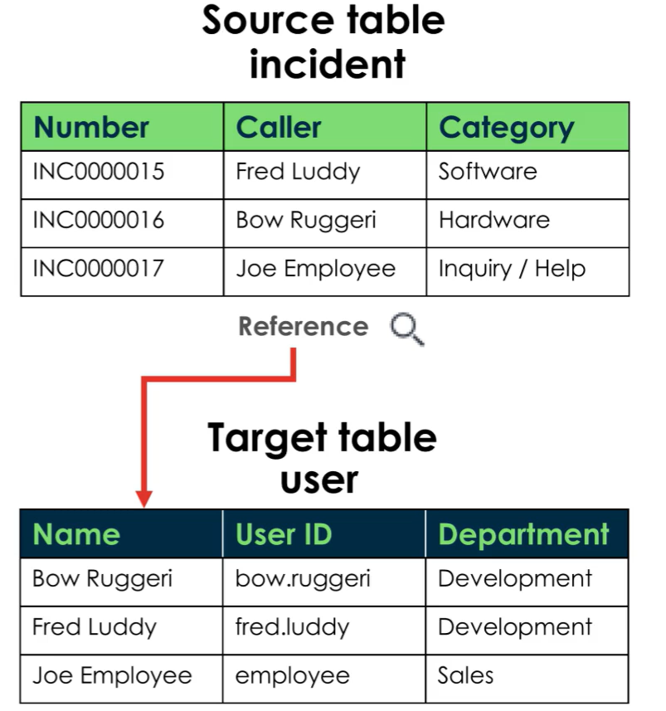
Reference Fields
Reference fields help us build table relationships

Slide 10
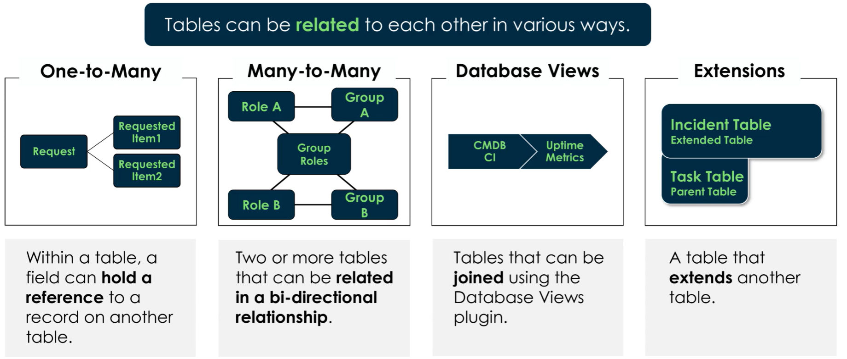
Table Relationships

Slide 11
Challenge
Goal:
Create a new table and relate it to ‘Capability’
Scenario:
Create a new table called ‘Delivery’ which uses an auto-number field
You should have 2 reference fields:
Assigned Trainer, that references sys_user
Capability, which references our other custom table
Add a list of deliveries as a module to our ‘Training’ application menu
Customize the list layout for Deliveries so we see the delivery number, assigned trainer, and capability
Customize the related lists of Capability so we can see our related Deliveries

Slide 12
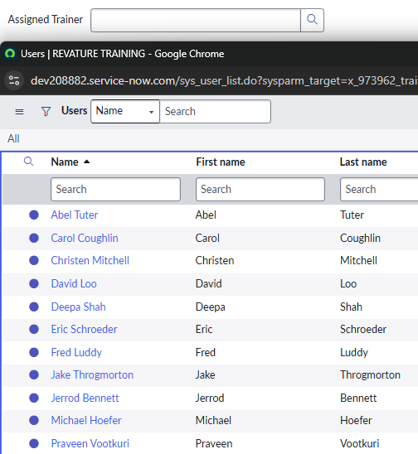
Reference Qualifiers
Definition: Reference qualifiers allow us to filter the records available to choose in a reference field
For example, in our ‘Assigned Trainer’ field, we are currently showing ALL users
This isn’t what we want, we should only show trainers here!

Slide 13
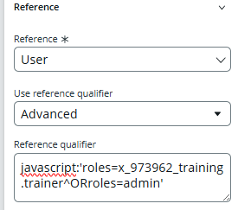
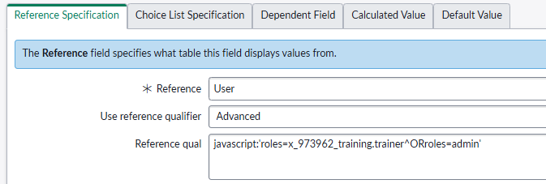
Reference Qualifiers
You can manage Reference Qualifiers from the dictionary entry or via Form Builder
We can inject JavaScript to evaluate values

Slide 14
Challenge
Goal:
Create a Reference Qualifier
Scenario:
Create a reference qualifier on ‘Assigned Trainer’ so that only users with our trainer role may get access
Create a new user group called ‘Trainers’ and assign someone to it, also add our custom trainer role to the group

Slide 15

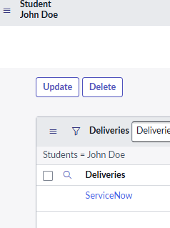
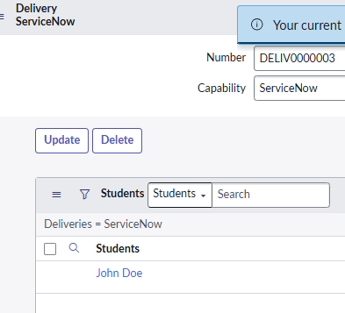
Many-to-Many Relationships
Definition: A junction table allows us to create many-to-many relationships
Navigate to the ‘Many to Many Definitions’ table to setup this type of relationship (there isn’t a module for it, use the shortcut)

Slide 16
Challenge
Goal:
Create a many-to-many relationship
Scenario:
Create a new table called ‘Student’
You should create a string field called ‘Name’ that is set as the display field, also create an email field called ‘Email’
Students and Deliveries should have a many to many relationship
Display the Deliveries related list on Student records, and vice versa

Slide 17
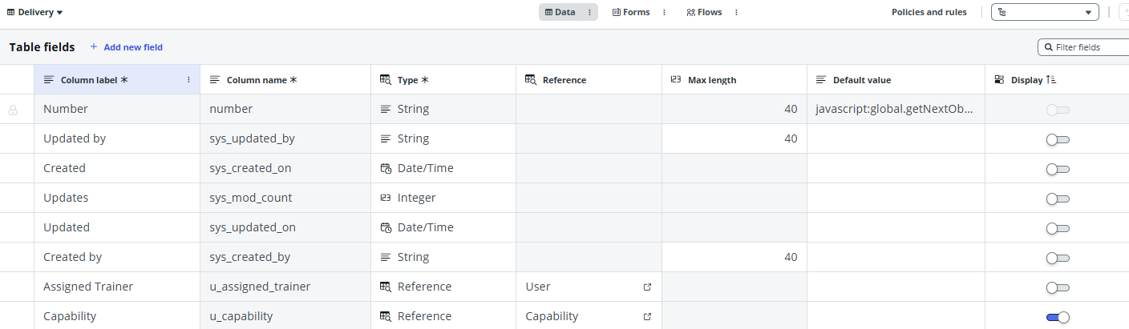
Display Fields
Definition: A display field is the primary field chosen to display when this record is being shown in a reference field or on related lists
View from ServiceNow Studio:

Slide 18
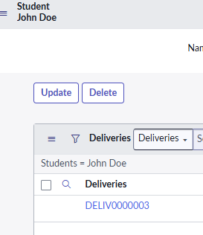
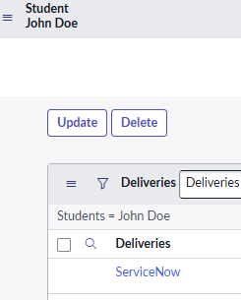
Challenge
Goal:
Set a display field
Scenario:
Set the display value of Deliveries to be our capability reference field
From this: To this:

Slide 19
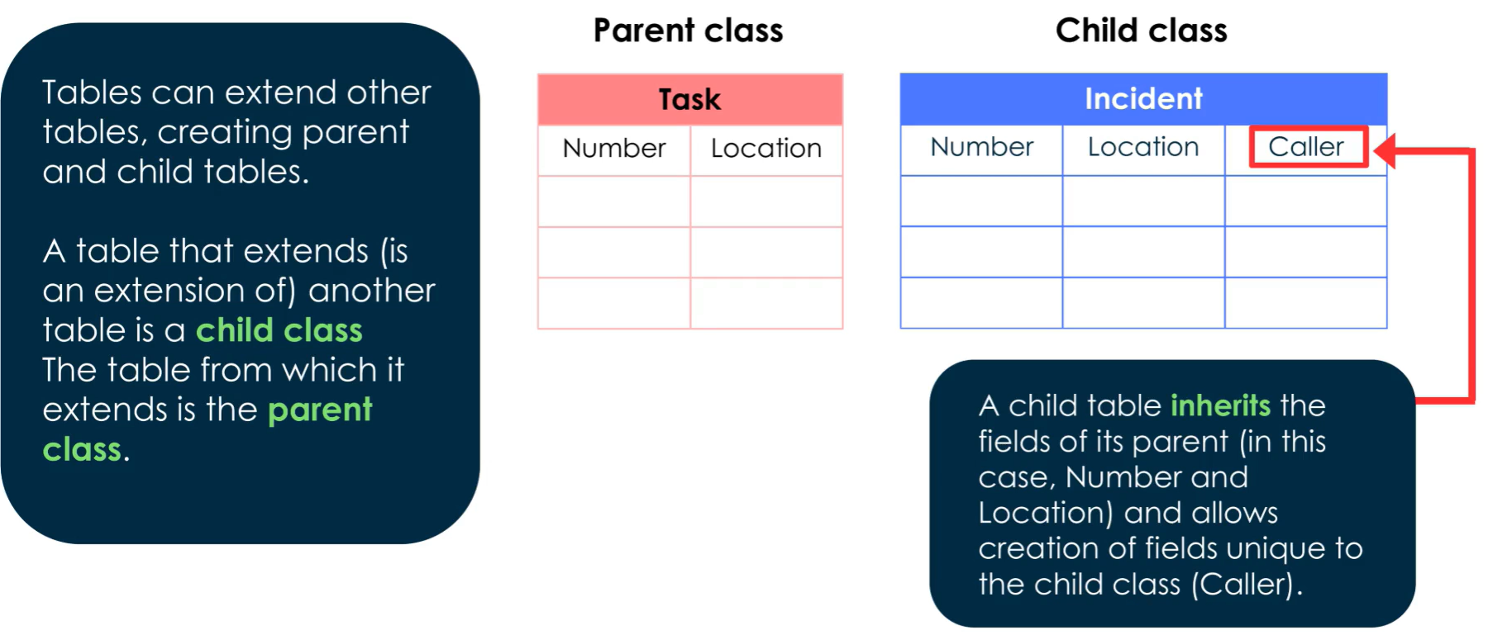
Extended Tables

Slide 20
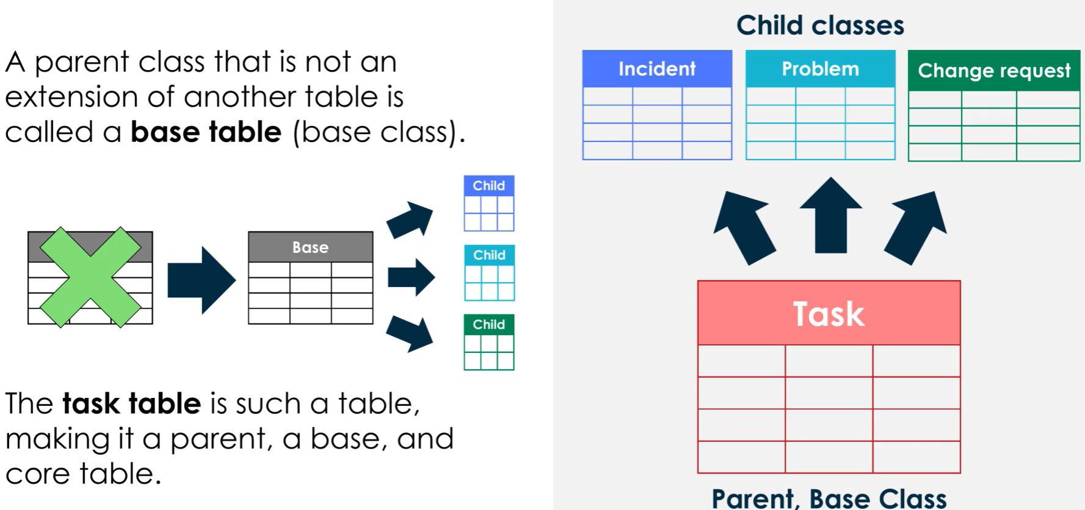
Base Tables

Slide 21
Challenge
Goal:
Create an extended table
Scenario:
Create a new table called ‘Training Request’ that extends from ‘Task’
Configure its forms to display: a two-column format with: number, priority, assigned to, state, actual start, actual end, and active
Create a new reference field that points to a Delivery
Add a module to view these records to our ‘Training’ application menu

Slide 22
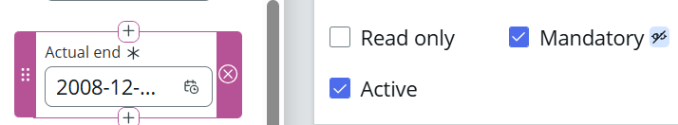
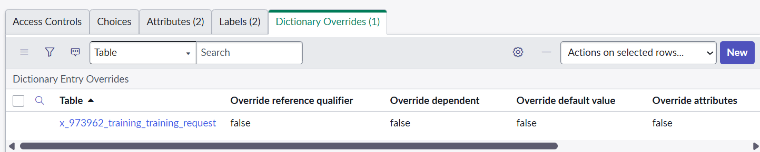
Dictionary Overrides
Definition: Dictionary overrides allow us to override the attributes from an extended table, without affecting the base or parent table
This can be done from Form Builder or from the related list on Dictionary Entry records

Slide 23
Challenge
Goal:
Add Dictionary Overrides
Scenario:
Add Dictionary Overrides to the ‘Actual Start’ and ‘Actual End’ fields so that they are both mandatory on ‘Training Request’ records

Slide 24
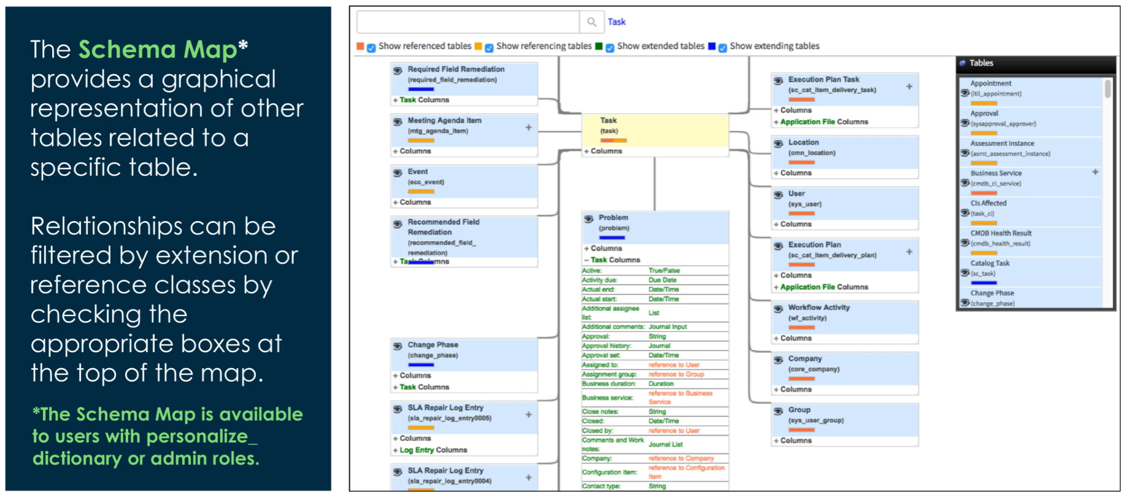
Schema Map
Accessible on the record for the table or from the Tables & Columns module

Slide 25
Platform Security

Slide 26
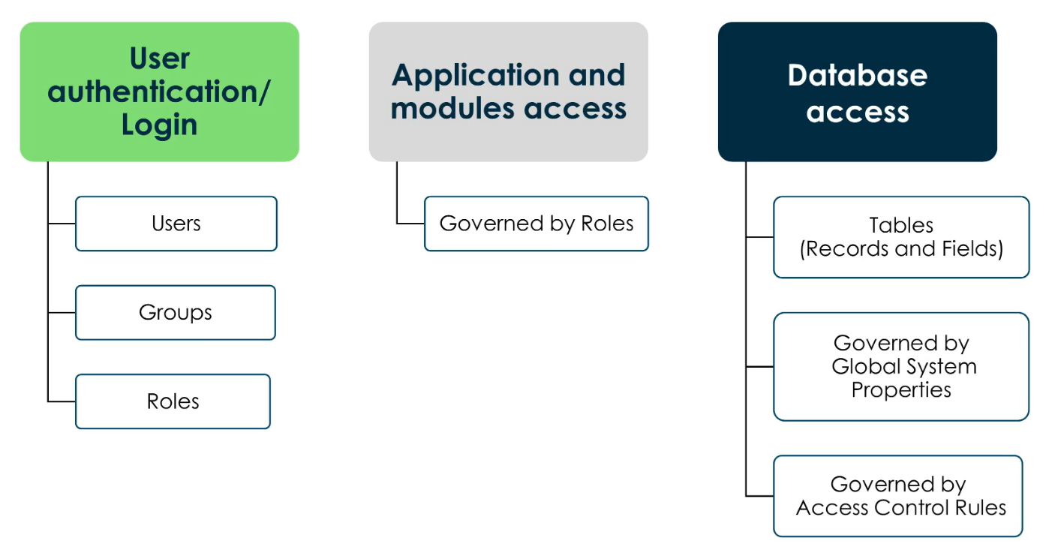
How ServiceNow Manages User Access

Slide 27


Key Security Modules to Know
Security – system properties related to instance security
Security Center – enhances your instance security posture using built-in recommendations and security best practices
Access Control (ACL) – define CRUD on tables and fields
High Security Settings – contains critical security system properties

Slide 28
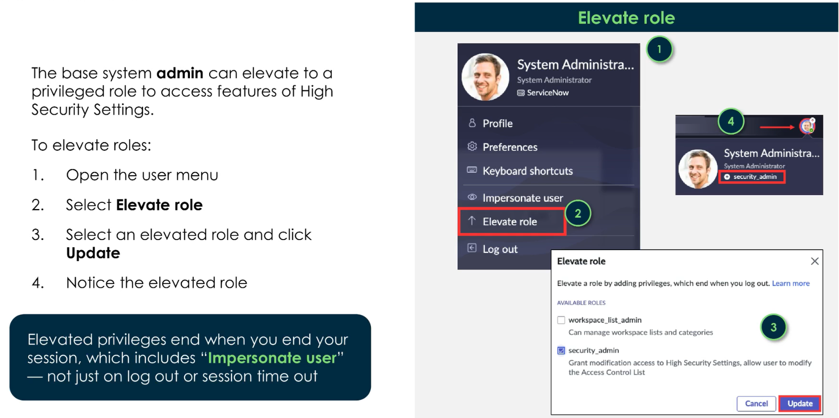
Elevate Role
Modifying ACLs require elevating our role to ‘security_admin’
Only the default System Admin gets this, but can be granted to other admins

Slide 29
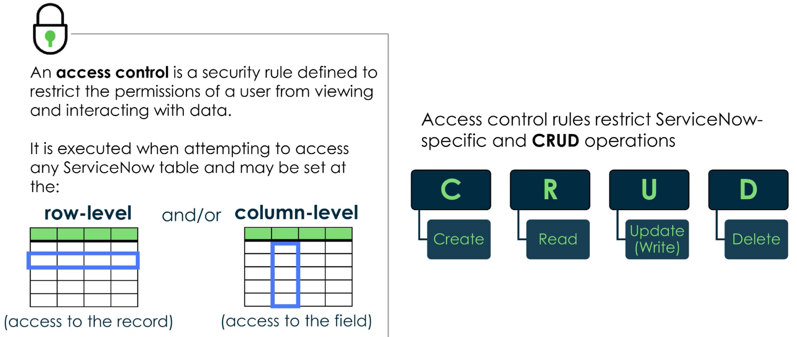
Access Control
Table Name: sys_security_acl

Slide 30
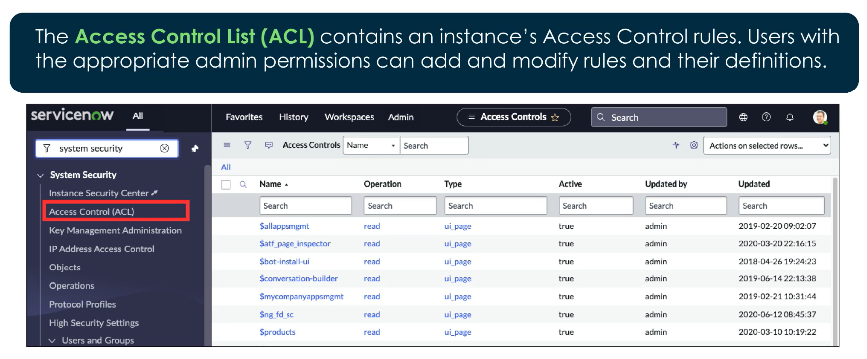
Access Control List (ACL)

Slide 31
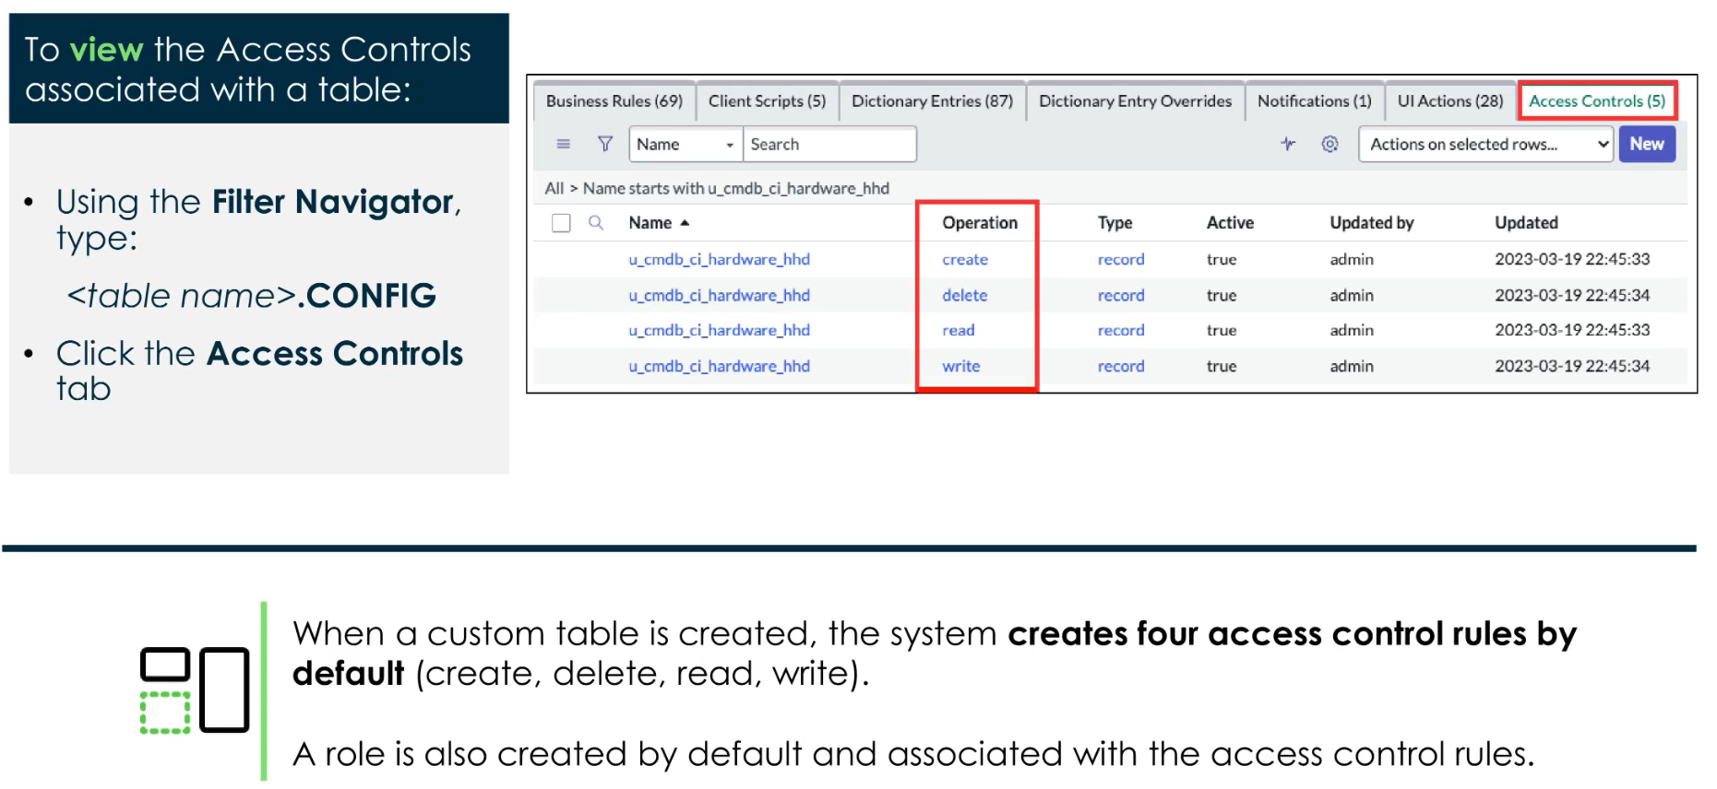
System Created Access Controls

Slide 32
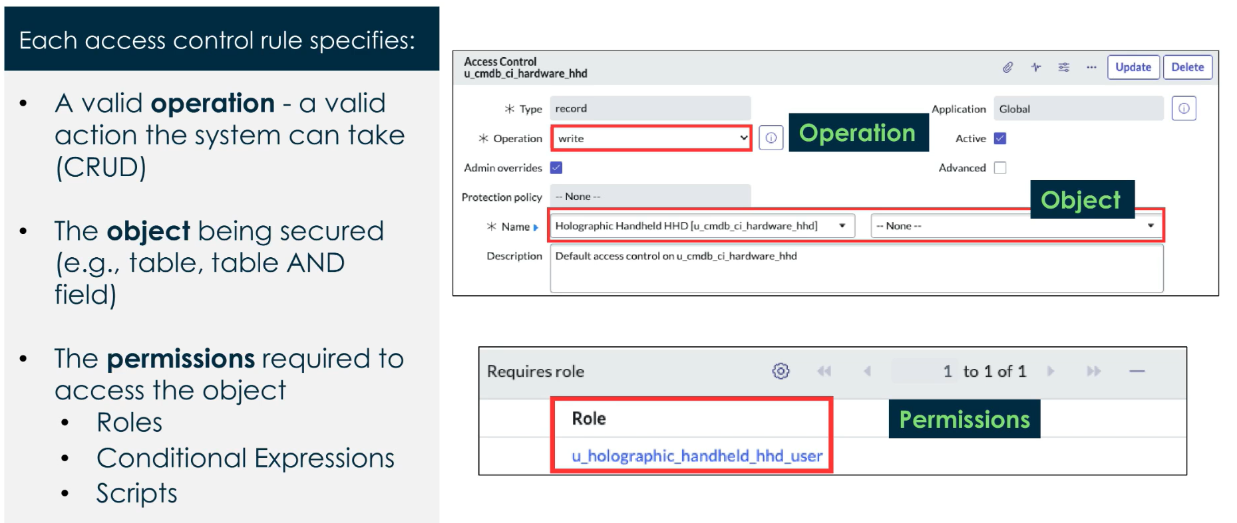
ACL Definition

Slide 33
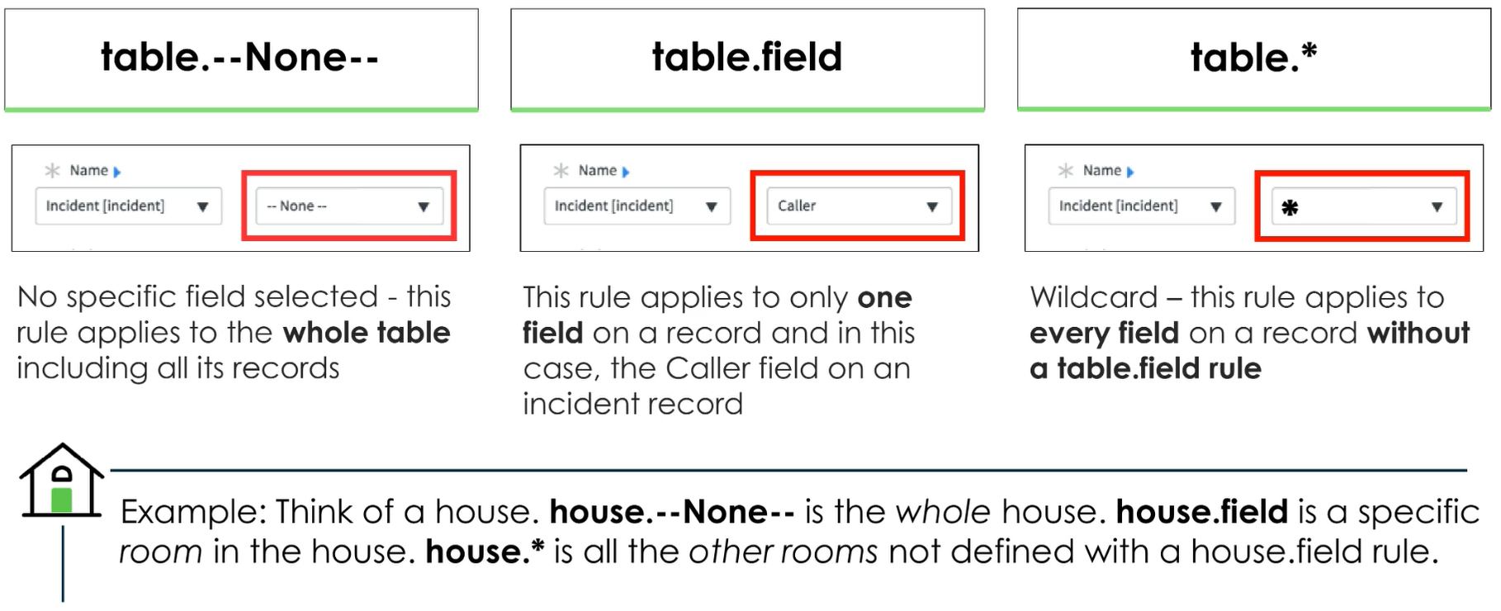
Rule Types

Slide 34
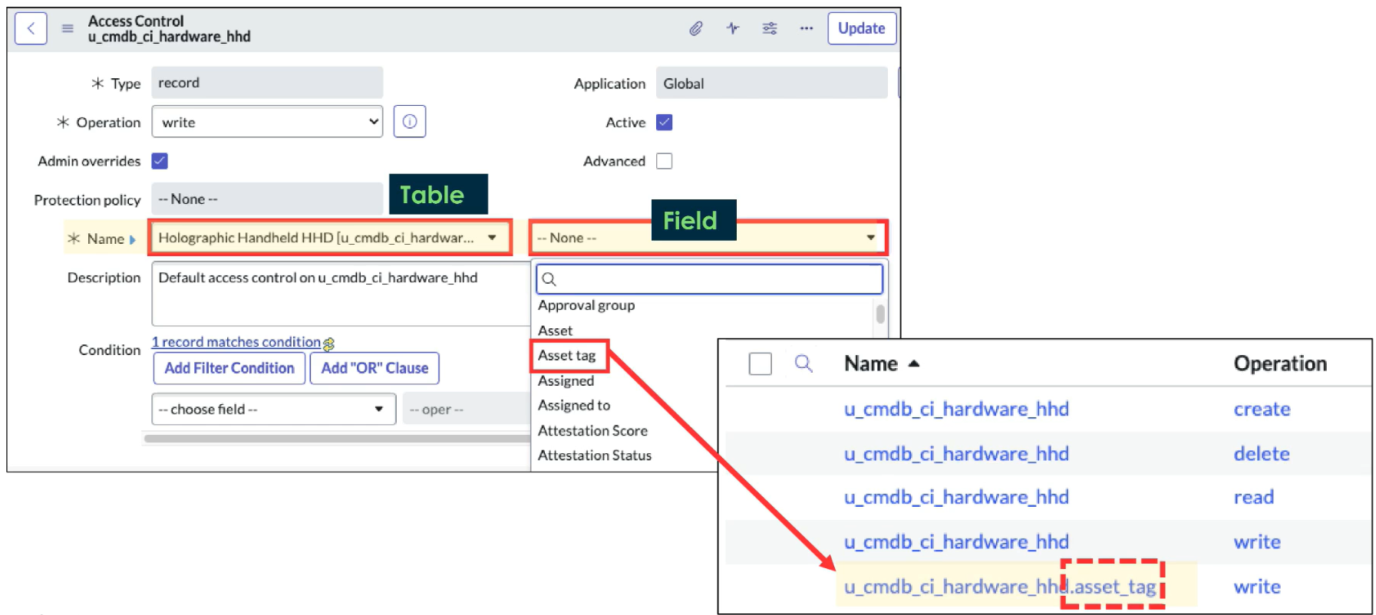
Rule Types
Setting field to ‘none’ is misleading, it means ‘No Restrictions’

Slide 35
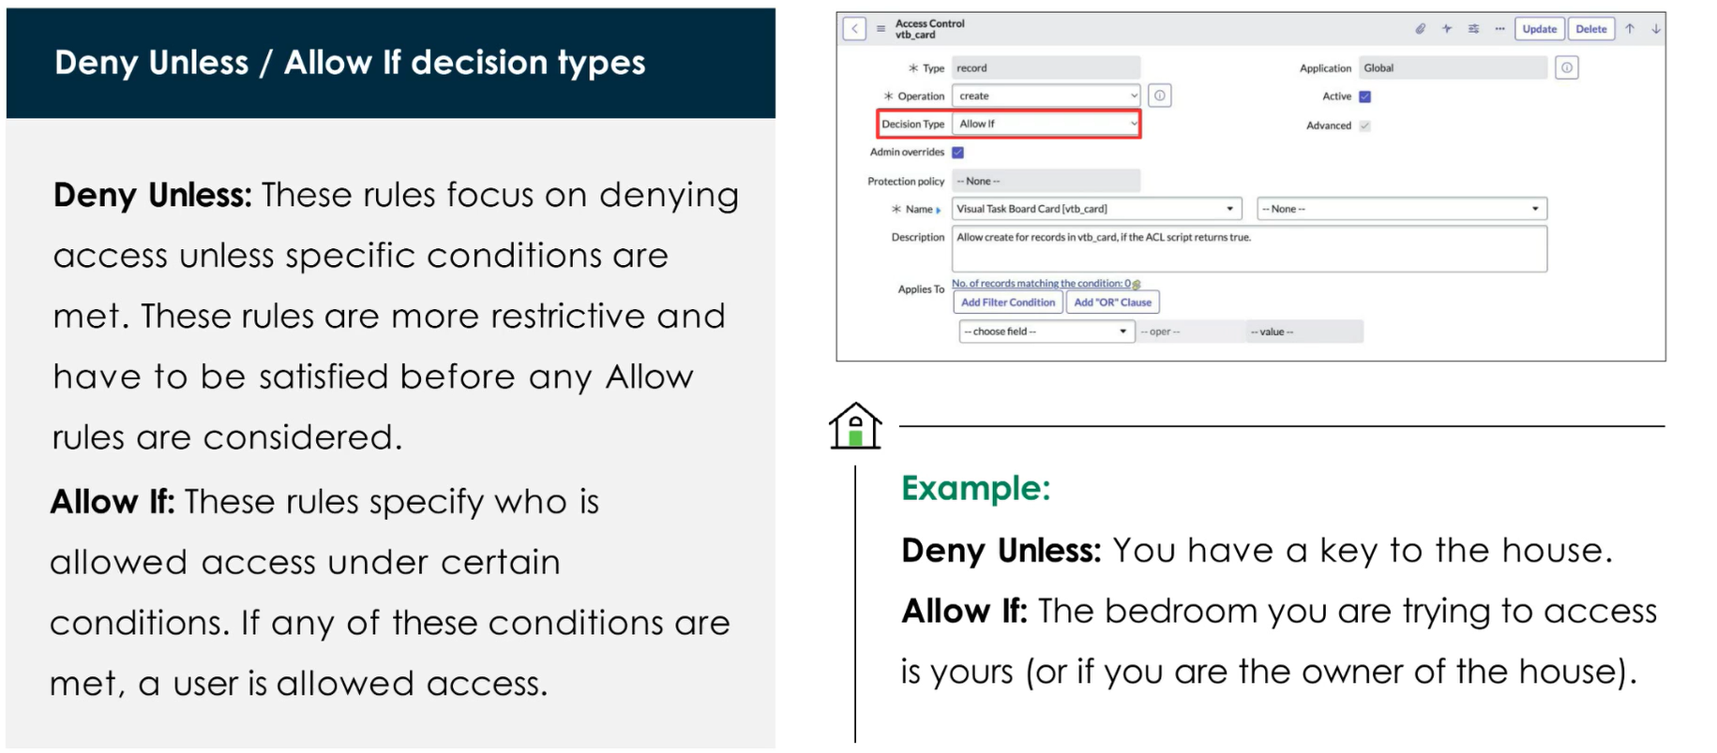
Access Control Decision Types

Slide 36
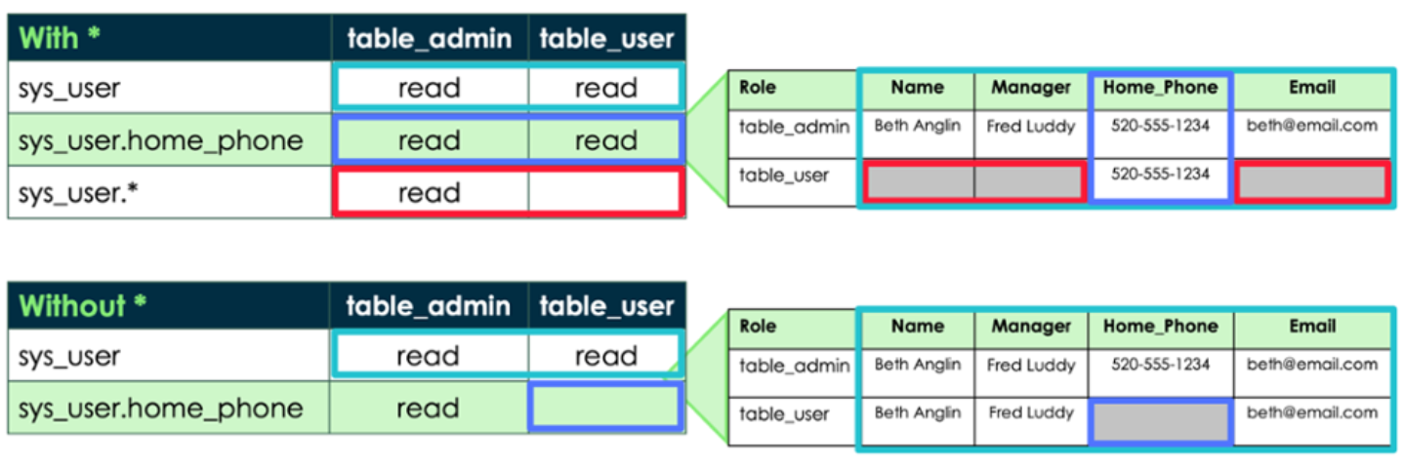
With Or without Wildcards

Slide 37
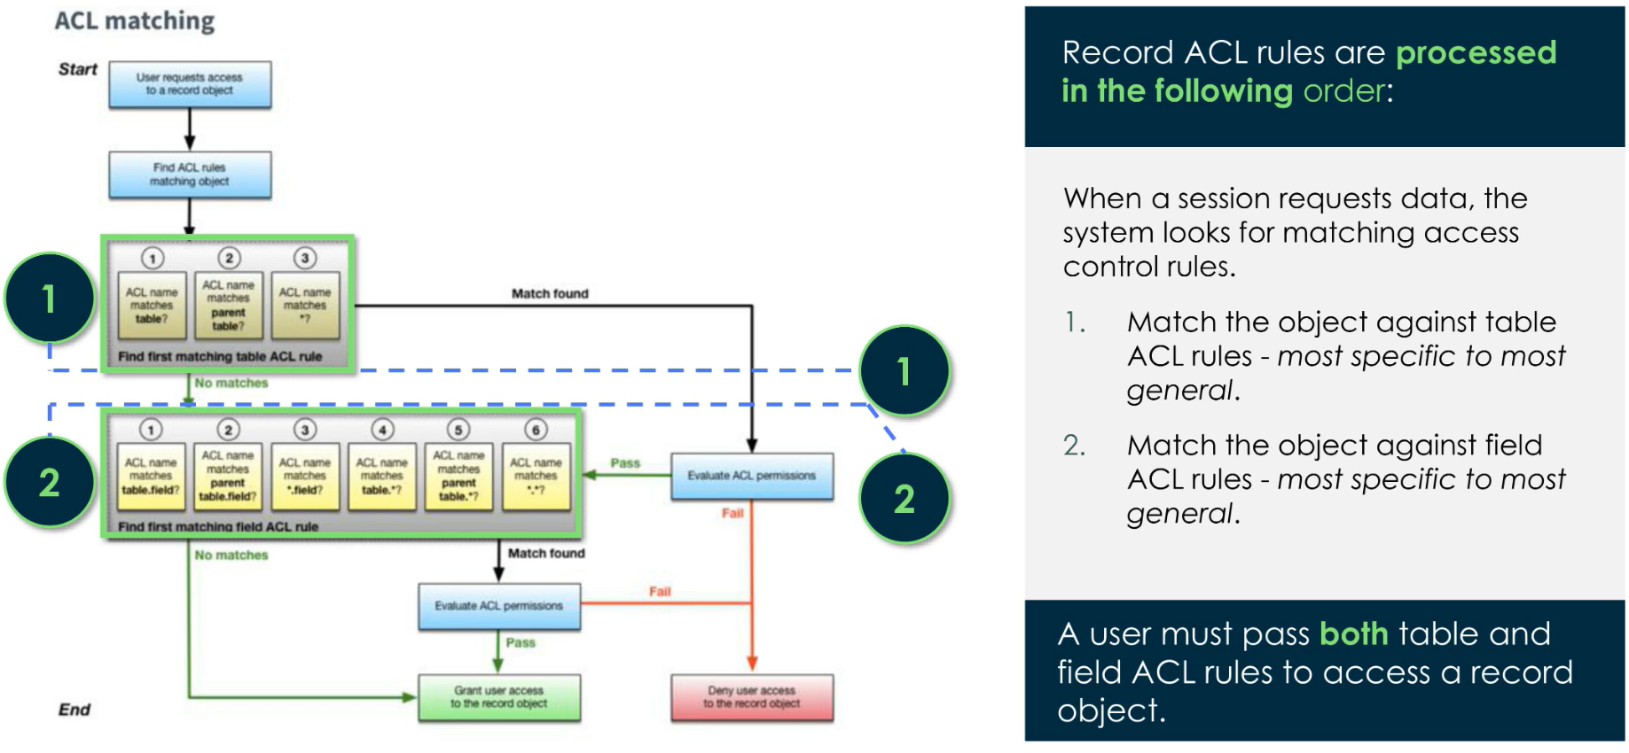
Access Control Evaluation

Slide 38
Challenge
Goal:
Create an ACL rule
Scenario:
Add an ACL so that Trainers can read Capability records

Slide 39
Import Data

Slide 40
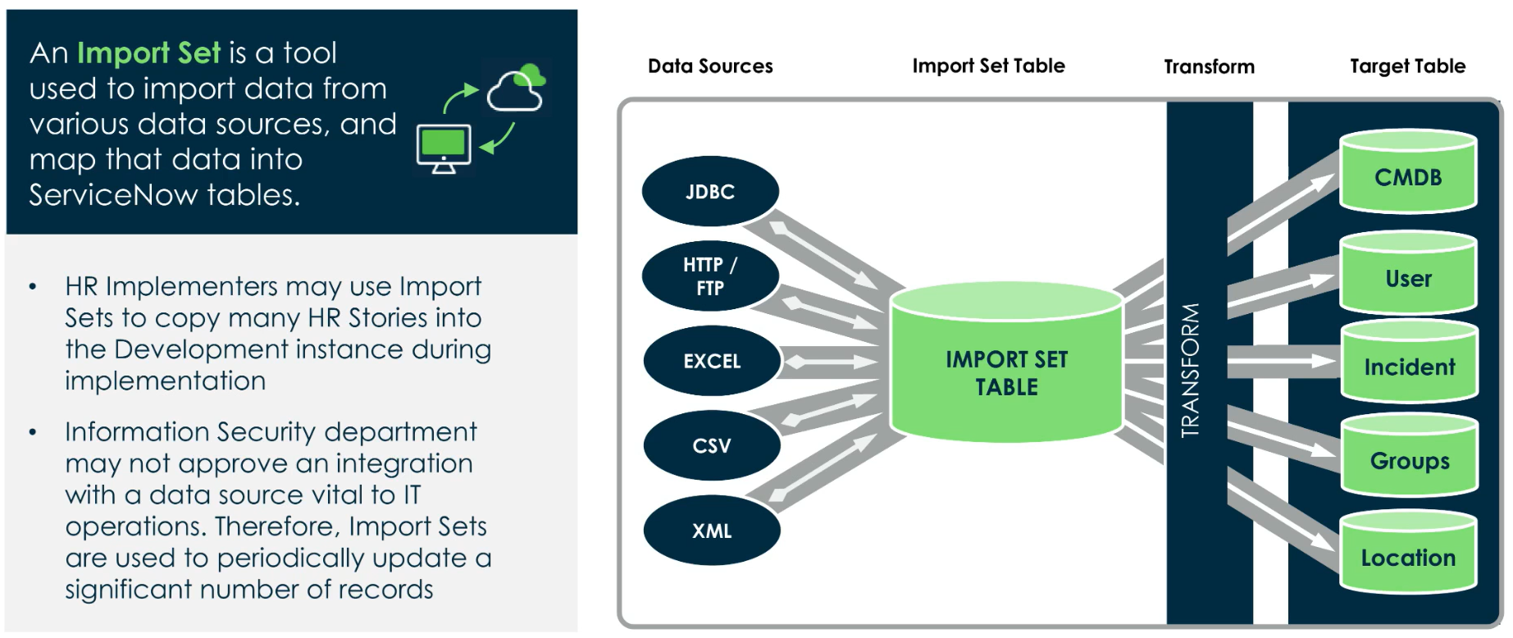
Import Sets

Slide 41
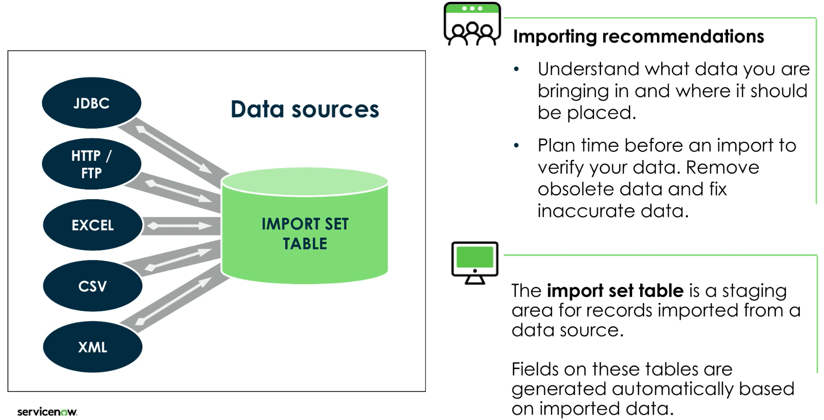
Import Se t Table

Slide 42
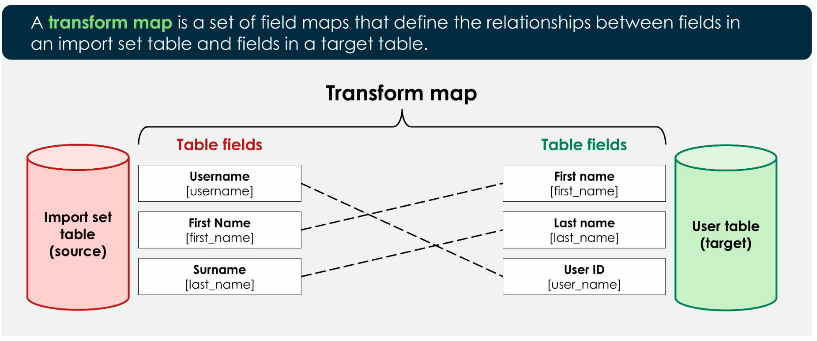
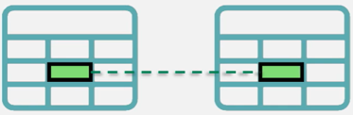
Transform Maps

Slide 43
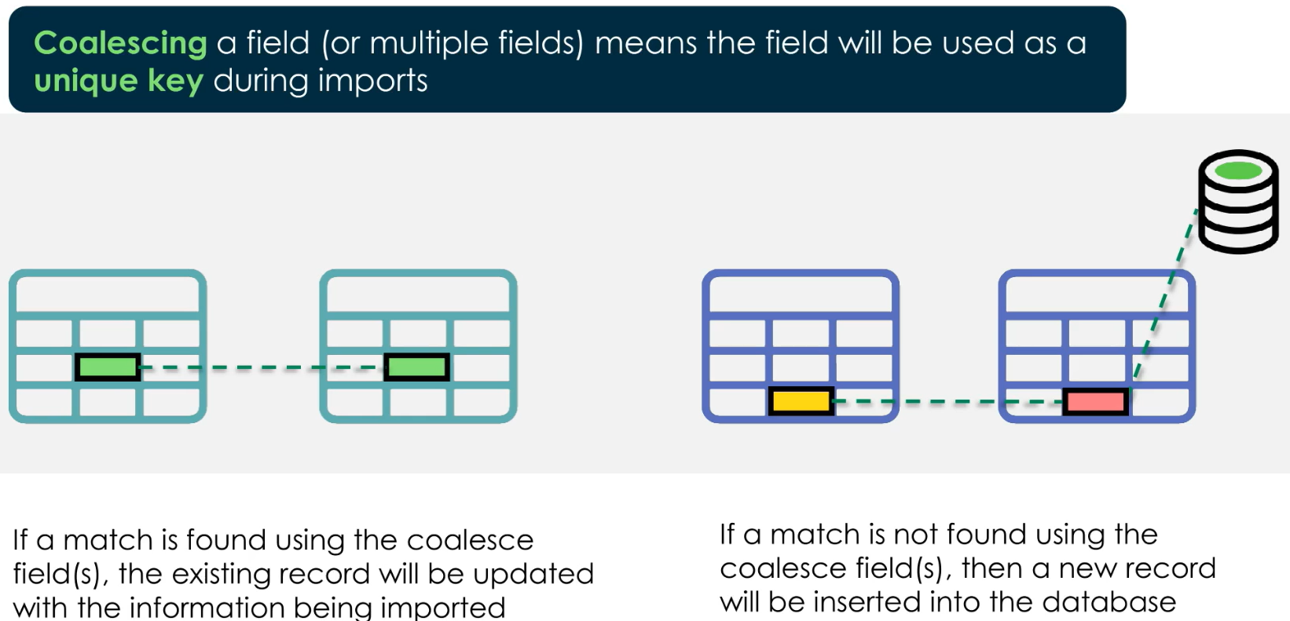
Coalesce Fields

Slide 44
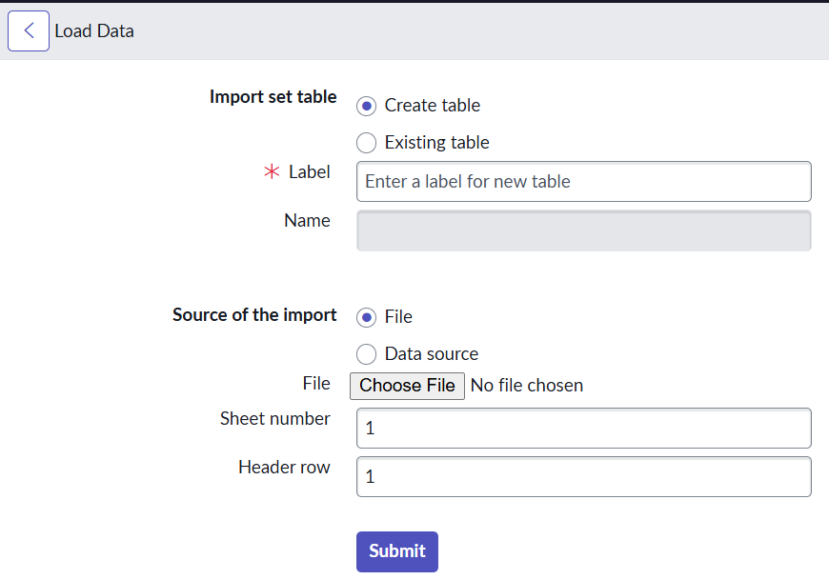
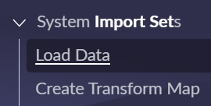
All The steps:
1. Create an import set table from: System Import Sets > Load Data
2. When we click ‘Submit’ the form will create a [sys_import_set] record
Found at: System Import Sets > Advanced > Import Sets
3. We need to create a transform map if we haven’t yet, or use an existing one

Slide 45
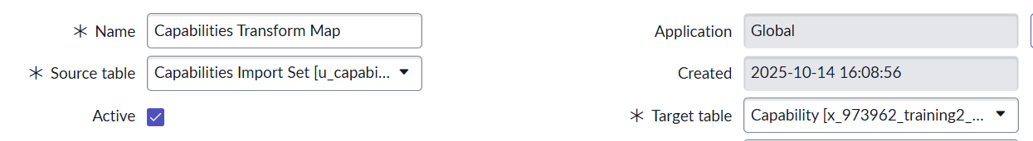
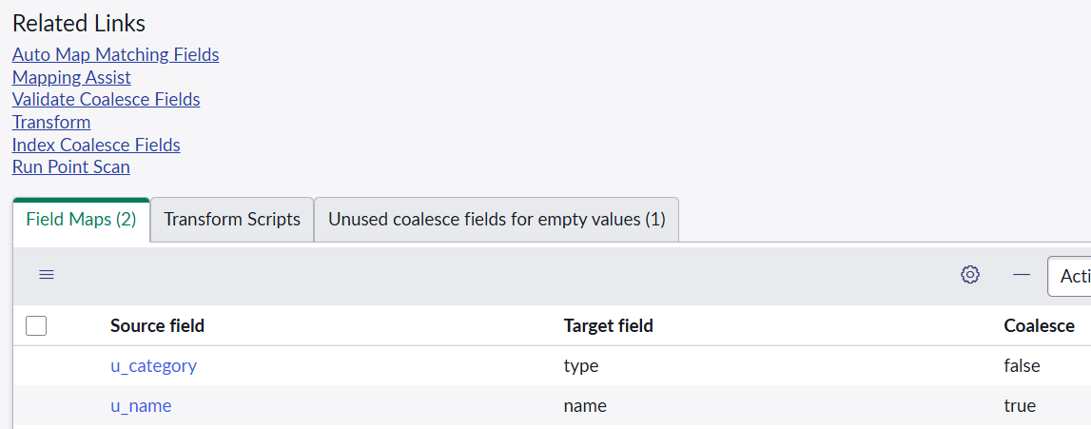
All The steps:
3a.
Source Table – The data from our import set
Target Table – The production table to insert/edit records
Field Maps – Map induvial fields from our source to the target table
Auto Map Matching Fields – attempts to automatically create mappings
Mapping Assist – allows us to manually select mappings

Slide 46
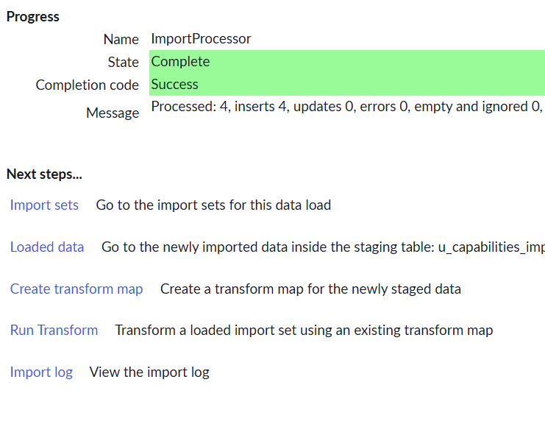

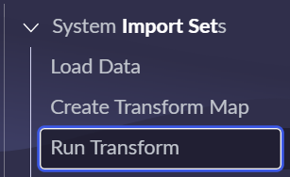
All The steps:
4. Run the transform
From the module
Right after using ‘Load Data’
Opening the import set record and using the ‘Transform’ related link

Slide 47
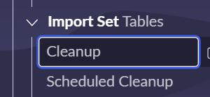
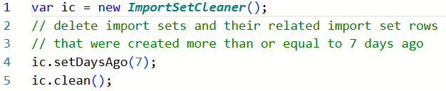
Sidenote
You can manually cleanup tables
Or just let the baseline implementation script clean it up

Slide 48
Challenge
Goal:
Use Import Sets
Scenario:
Use the provided CSV or Excel document as a data source to upload as records
These records will populate your ‘Capability’ table

Slide 49
CMDB

Slide 50
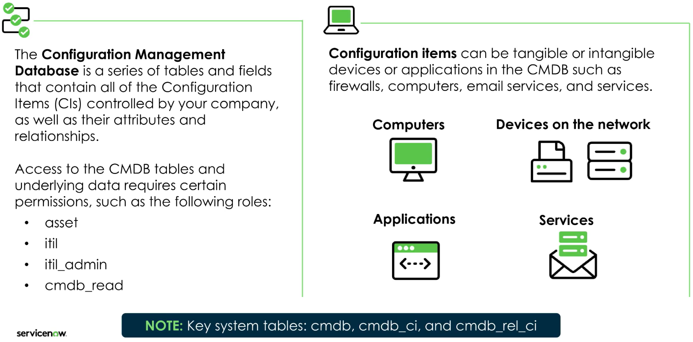
CMDB

Slide 51
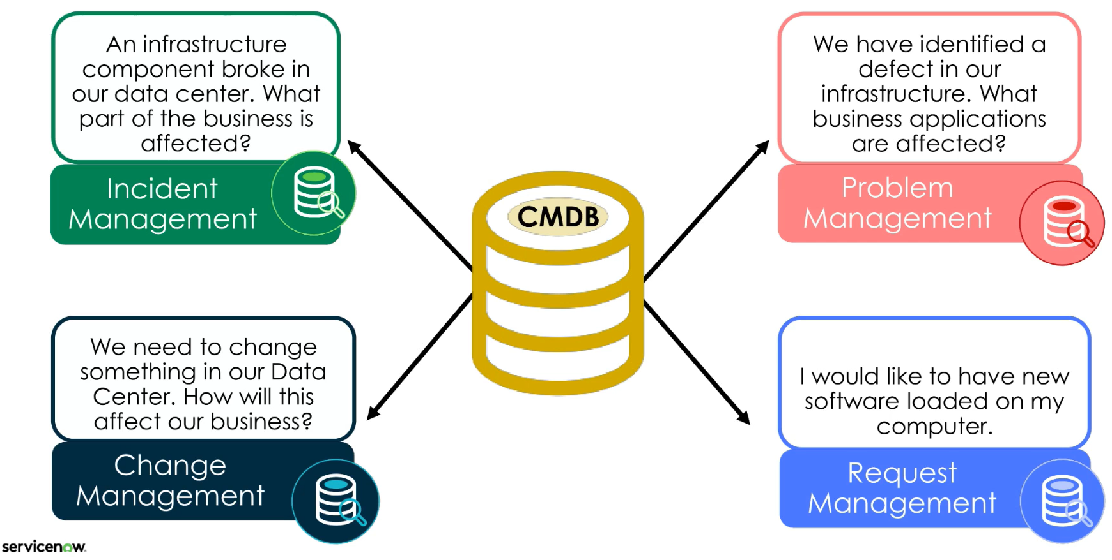
CMDB USE in ITSM Processes
The CMDB in ITIL 4 falls under the practice of Service Configuration Management

Slide 52
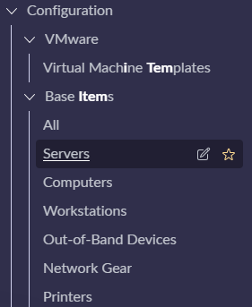
Examples
From Configuration > Base Items > All we can see every CI
Many tables(classes) extend from each other
cmdb – base class
cmdb_rel_ci – relationship records between CIs
cmdb_ci – base CI class
cmdb_ci_server – CI class for servers

Slide 53
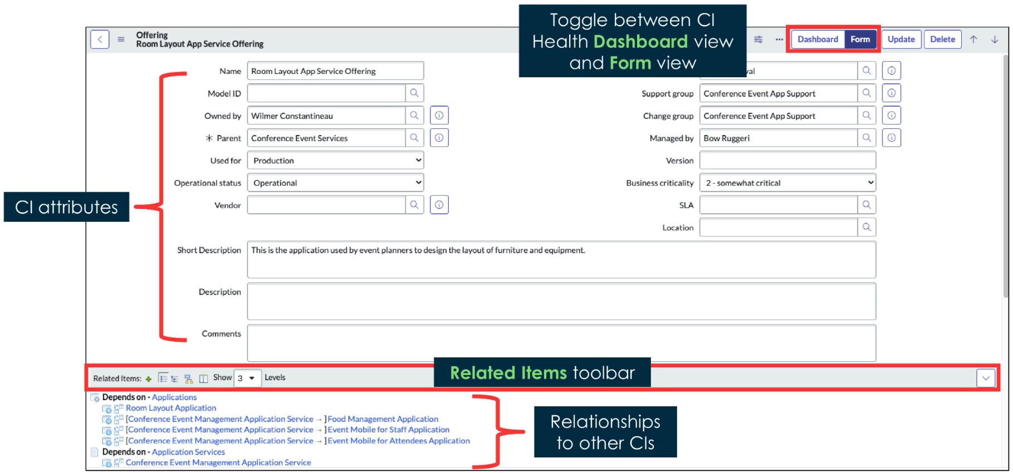
Configuration Item Form

Slide 54
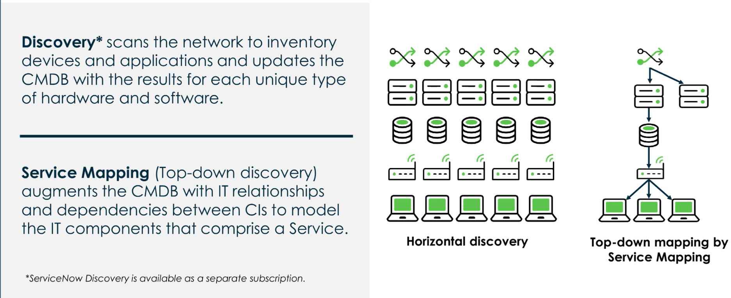
Discovery & Service Mapping
Discovery MID Server – runs a java process on a customer’s windows/Linux server

Slide 55
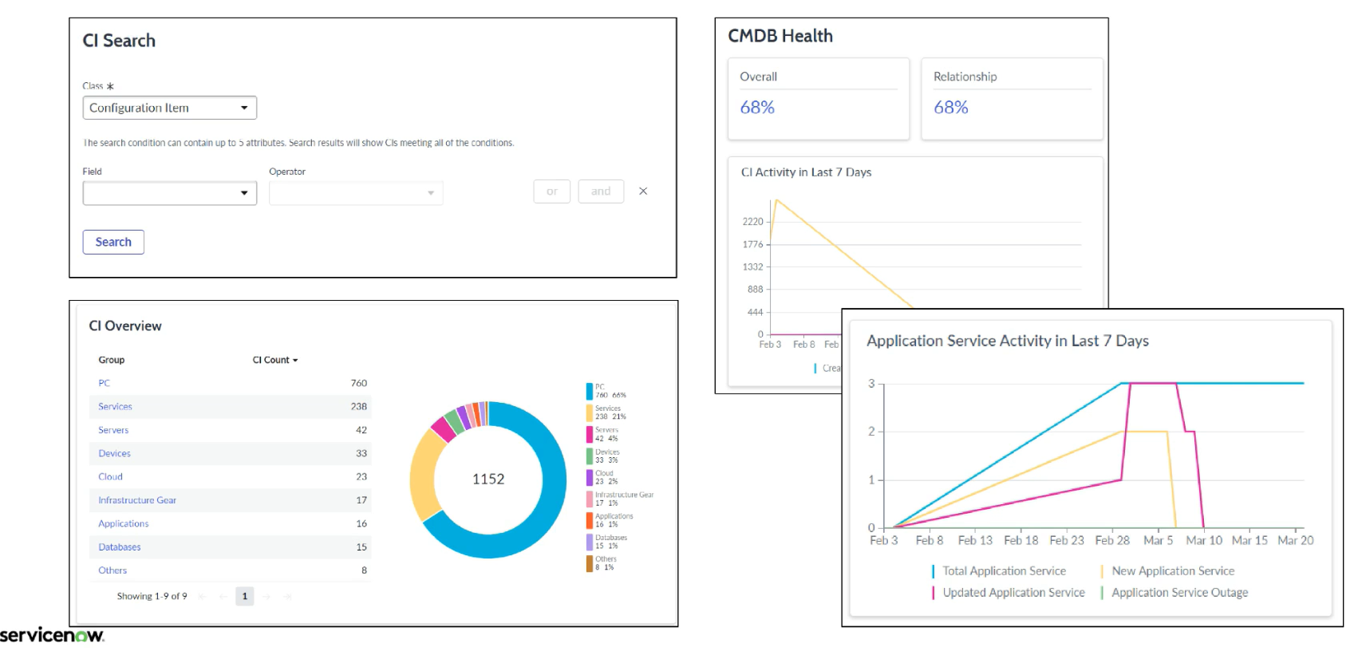
CMDB Workspace
Check system health and recent activity
View tasks related to CIs
Access Dependency Views

Slide 56


Dependency Views Map
Dependency Views may be accessed from the CMDB Workspace – from the quick links, or by clicking the button on the CI record either in the workspace or regular form

Slide 57

Dependency View: Map Icons

Slide 58

CI Class Manager

Slide 59

Ci Class Manager

Slide 60

CI Class Manager attributes Tab

Slide 61

CI Class Manager suggested Relationships

Slide 62


CSDM

Slide 63

CSDM

Slide 64

Adding a new CI Class
Create a new table to represent our new CI
Make sure you extend from the correct table, follow the CSDM
Note the naming convention

Slide 65
Challenge
Goal:
Add a new CI Class
Scenario:
Add a new CI class called ‘Training Tablet’
Explore your new class with the CI Class Manager

Slide 66

Connect ServiceNow Studio & GitHub
On GitHub:
Create a new fine-grained personal access token
Settings > Developer Settings > Personal Access Tokens
Limit exposed repos & limit permissions (select only ‘contents’ for basic pull/push repo management)
On ServiceNow:
Create a new ‘Basic Auth’ credential at Connections & Credentials > Credentials
Username is your github username & password is your personal access token
Select ‘Link to source control’, fill out the form, and submit – a new branch is created in your repo

