Slide 1
TSM

Slide 2
Overview
What is TSM?
Main Components of TSM
Account Lifecycle Events
Proactive Service Experience Workflows
Service Bridge

Slide 3
What is TSM?
TSM or Telecommunications Service Management is a suite of plugins on the ServiceNow platform that enhance operations for telecommunications companies.
We can:
Onboard and track customer accounts
Deploy process automations to resolve network outages
Connect customer issues, work requests, and more to drive process automations and promote efficiency

Slide 4
Main Components of TSM
There are 3 applications that come with the TSM plugins:
Account Lifecycle Events – provides an onboarding experience for customers
Proactive Service Experience Workflows – provides process automations to automatically resolve issues and notify customers of outages
Service Bridge – Collaborate with partners and vendors on incidents, tasks, and more

Slide 5

Account Lifecycle Events
The playbook helps drive this entire process.

Slide 6
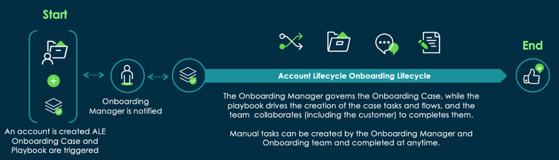
Account Lifecycle Event Workflow
The playbook helps drive this entire process.

Slide 7
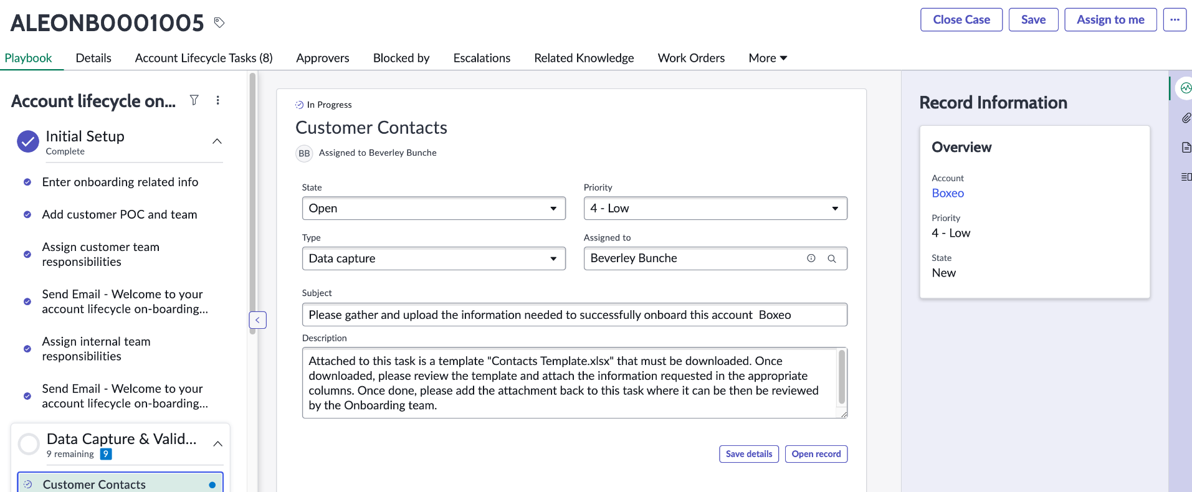
Playbook – Account Lifecycle Events application

Slide 8
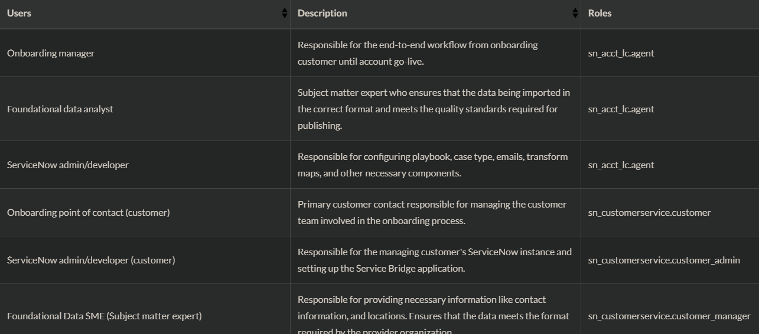
Account Lifecycle Events User Roles

Slide 9
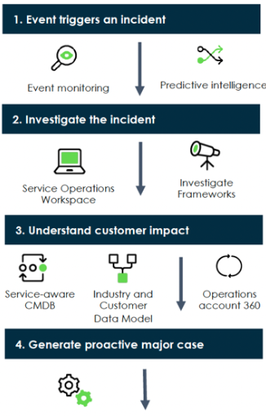
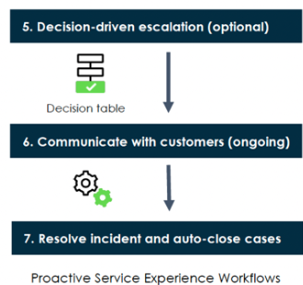
Proactive Service Experience Workflows
This application focuses on providing end-to-end customer support and analyzing customer impact.
Docs Link

Slide 10
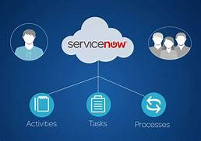
Service Bridge
Service Bridge provides a nearly turn-key experience for connecting multiple ServiceNow instances

Slide 11
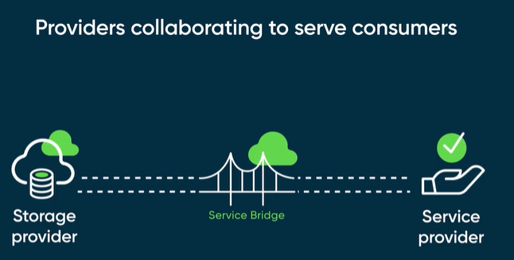
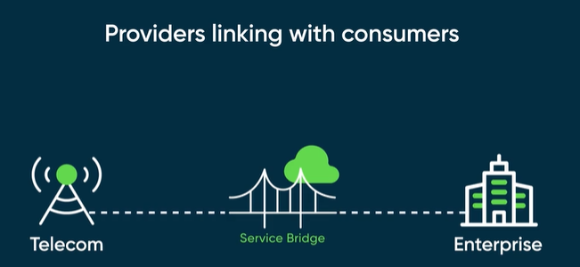
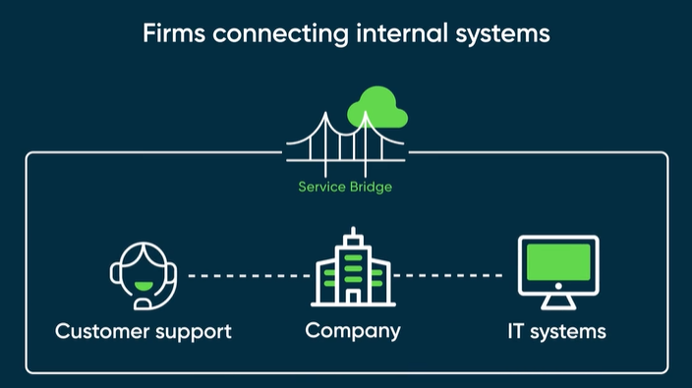
Service Bridge Scenarios
Docs Link - Video

Slide 12
TSM Challenge 1

Slide 13
OAuth
The OAuth 2.0 standard lets users access instance data via a token, rather than needing a username/password combo for each request. If the token hasn’t expired, we can keep using it to make subsequent requests.
You must have the ‘security_admin’ role to manage OAuth integrations.
There are 2 types of OAuth communications within an instance:
Inbound : Our instance provides an endpoint for third-party clients
Outbound : Our instance retrieves data from a third-party provider

Slide 14
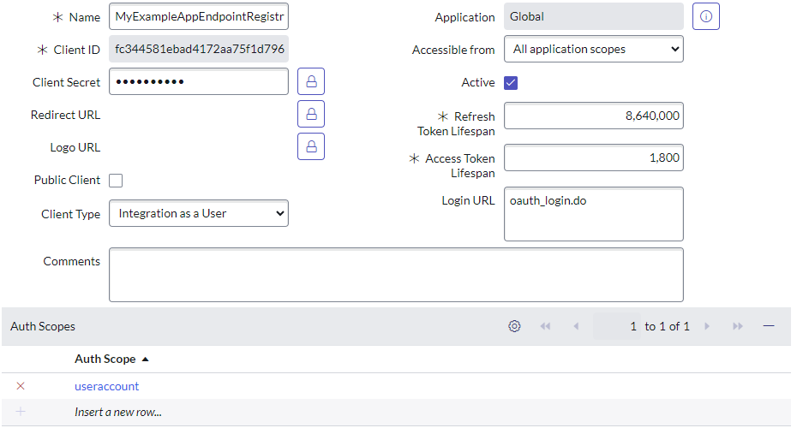
OAuth
Application Registries are responsible for registering external apps to our ServiceNow instance.
This allows external apps to affect changes to our instance via REST APIs once authenticated.

Slide 15
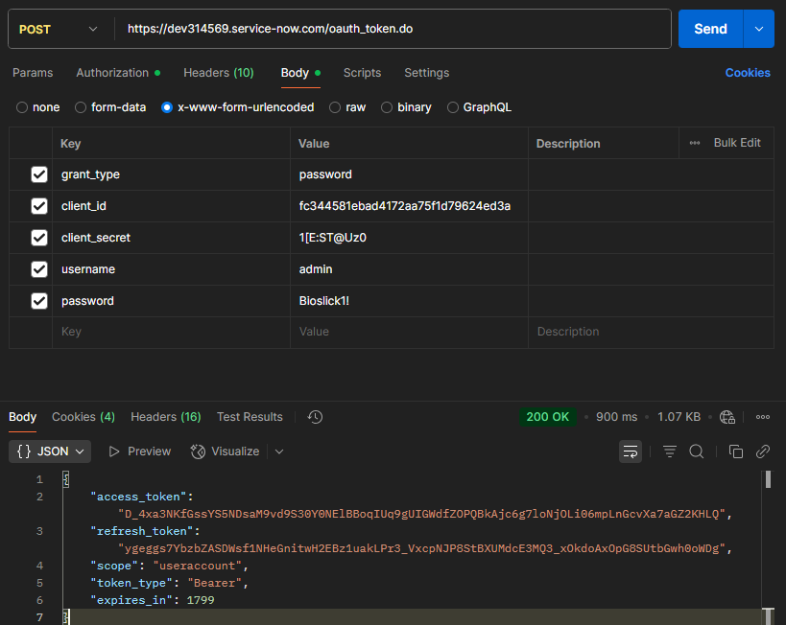
OAuth
External Apps receive:
Access Token – send along in our request headers; provides authorization to perform an action.
Refresh Token – Has a longer expiration than an Access Token; is used to request another Access Token

Slide 16
Oauth Challenge
Part 1: Get your access and refresh tokens via Postman.
Part 2: Use the Table API to create an incident record. Then, query for the record you just created. (All using postman)
ServiceNow Community Post with step-by-step instructions.

