Slide 1
Flows

Slide 2
What is a Flow?
Flow automations is a feature that allows us to create process automations in a graphical user interface.
Flows can be triggered by:
Record Inserts/Updates
A schedule
Service catalog requests
Inbound emails
SLAs
MetricBase (requires the metricbase plugin, not available in PDIs)

Slide 3
What is a Flow?
When a Flow is triggered, it will fire off each of its actions in sequential order. ServiceNow provides out-of-the-box actions such as:
Ask for approvals
Create records
Query Records
Send emails
And much more…

Slide 4
What is a Flow?
We use the Flow Designer to create or edit Flows.
Relevant user roles:
flow_designer = create and edit flows
Flow_operator = view the flow exeution details, dashboards, and flow system logs
Action_designer = create and edit custom actions
Helpful Flow system properties:
com.glide.hub.flow_engine.debug = enable/disable flow debug logs within our system logs
sn_flow_designer.max_actions = determines maximum number of actions that can be used in a Flow (default: 50)
sn_flow_designer.max_iterations = determines maximum number of itrations that a loop can perform within a Flow (default: 1000)

Slide 5
Flow Properties
Flow name: A unique name for the flow.
Description: A field to document what the flow does.
Application: The Application scope for the flow.
Protection: The option to make a flow read-only.
Run As: The context in which the flow runs. Can be the user who initiates the flow or the System user.
Run with role(s): Specify a role or roles to apply when the flow executes. Run with role(s) is only available when Run As is set to User who initiates session.

Slide 6
ServiceNow Flows Challenge 1
Goal:
View/Test a Flow.
Scenario: 5 min
View and test the VTB Sample Flow. Explore the Flow properties.
Notes:
Navigate to UI policies from the quick find menu and create a new one on the incident table
Under ‘when to apply’, use the logic for (Urgency == High && Priority == Critical)
Right-click the header and click save to save the record and stay on the record page. Then on the same record page for the UI policy, create a new UI policy action from the related list at the bottom of the page
Set the assignment group field to be mandatory and save the UI policy action

Slide 7
Flow Types
Flow Designer has three types of triggers:
Record = execute the Flow when a record is created or updated.
Created
Updated
Created or Updated
Date = execute the Flow at a specific time or interval.
Daily
Weekly
Monthly
Run Once
Repeat
Application = execute the Flow from an application.
SLA Task
Inbound Email
Service Catalog

Slide 8
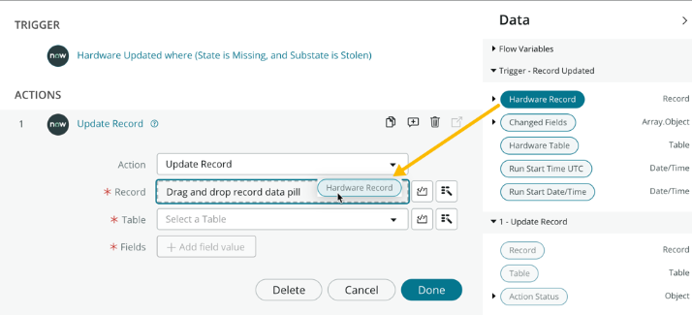
Data Pills
Tip: If a data pill from a previous action is unavailable, save the Flow to make it available.

Slide 9
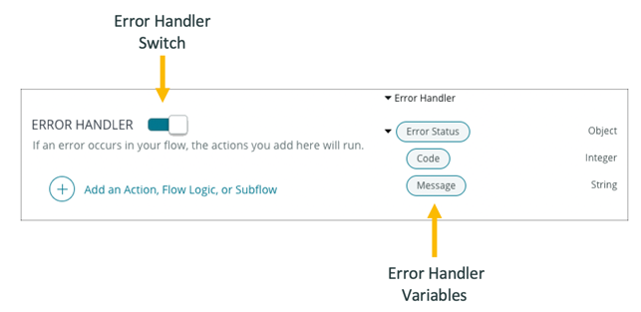
Error Handling

Slide 10
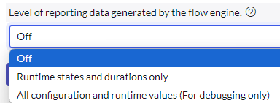

Flow Settings

Slide 11
ServiceNow Flows Challenge 2
Goal:
Create a Flow.
Scenario: 10 min
Deactivate our previous Business Rule: Auto-Create Problem for Recurring CI INC.
We will create a Flow that will complete the same task. We will also include error handling by printing out error info to our system logs.
Notes:
Navigate to UI policies from the quick find menu and create a new one on the incident table
Under ‘when to apply’, use the logic for (Urgency == High && Priority == Critical)
Right-click the header and click save to save the record and stay on the record page. Then on the same record page for the UI policy, create a new UI policy action from the related list at the bottom of the page
Set the assignment group field to be mandatory and save the UI policy action

Slide 12
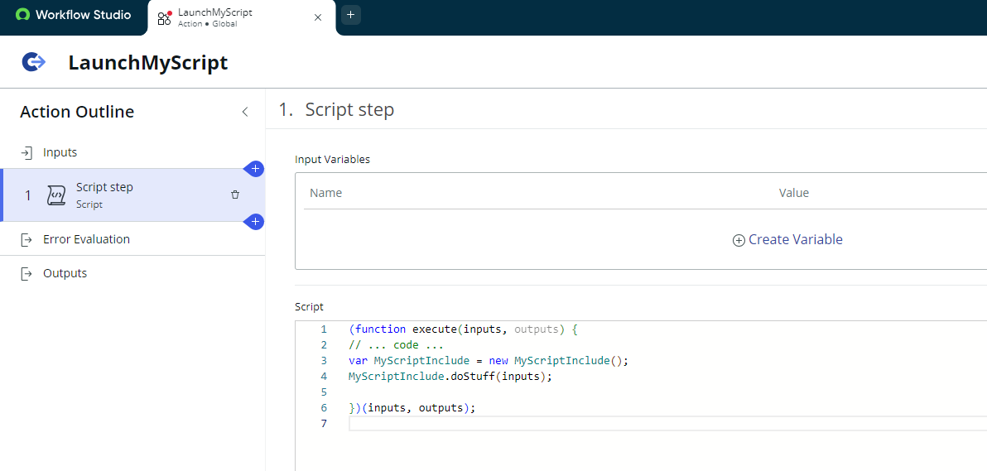
Custom Actions

Slide 13
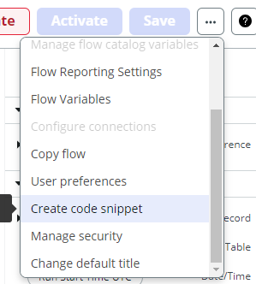
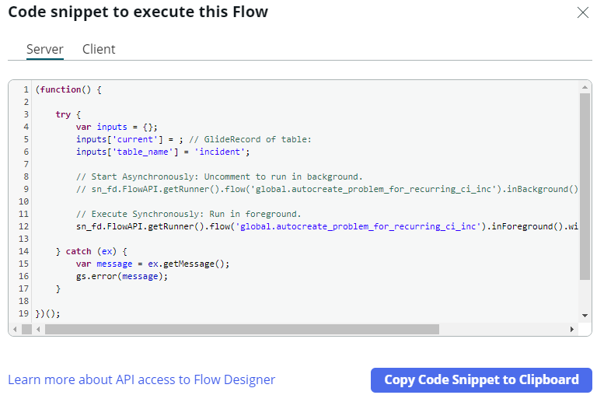
Calling Flows from Scripts

Slide 14
Multi-Tenant Architecture
Shared Servers
Isolated Environment
All Salesforce customer orgs are in the cloud, so they share server space.
Each org is an isolated environment from other orgs on the cloud.
Shared Resources
Governor Limits
Because orgs share server space, they also share the physical hardware that keeps the server running. i.e. ram, cpu time, ect.
Limits are in place so that no one org can overuse resources and degrade the performance for everyone else.

Slide 15
MVC
Model
View
Controller
Database Tables, field definitions, ect.
UI elements
Business Logic

Slide 16
MVC
No-Code
Pro-Code
Objects, fields, relatioships
Model
APIs
Apps, Pages, Actions
View
Visualforce, LWC, Aura
Flows, approvals, validation rules
Controller
Apex

Slide 17
No-Code vs Pro-Code
01
Pro-Code
Faster than coding
01
Flexibility
02
Easy to maintain
02
Pixel perfect UI
03
Automatic Updates
03
Integrations
No-Code

Slide 18
Agenda
01
02
03
04
05
06
Getting Started
Admin Foundations
UI
Platform Overview
Data Model
Data Management
Security
Lightning Apps and Pages
Buttons, Links, Actions
Record Types
Process Automation
Process Automation 2
Deployment
Flow Basics & Screen Flows
Record Triggered Flows
Flow Best Practices
Legacy Process Automation tools
Approvals
Save Order of Execution
Sandboxes
App Deployment

Slide 19
01
Platform Overview

