Slide 1

Change Management

Slide 2
Overview
What is Change Management?
How does a change come to be?
ITIL Workflow of Change Management
The Change Management Process
Types of Changes
Questions

Slide 3
What is change management?
Helps organizations understand and work to minimize risks of changes to the IT environment.
Provides processes to create, assess, approve, and implement changes to your environment.
Tasks are assigned to appropriate change management team members, who will deal with the task.

Slide 4
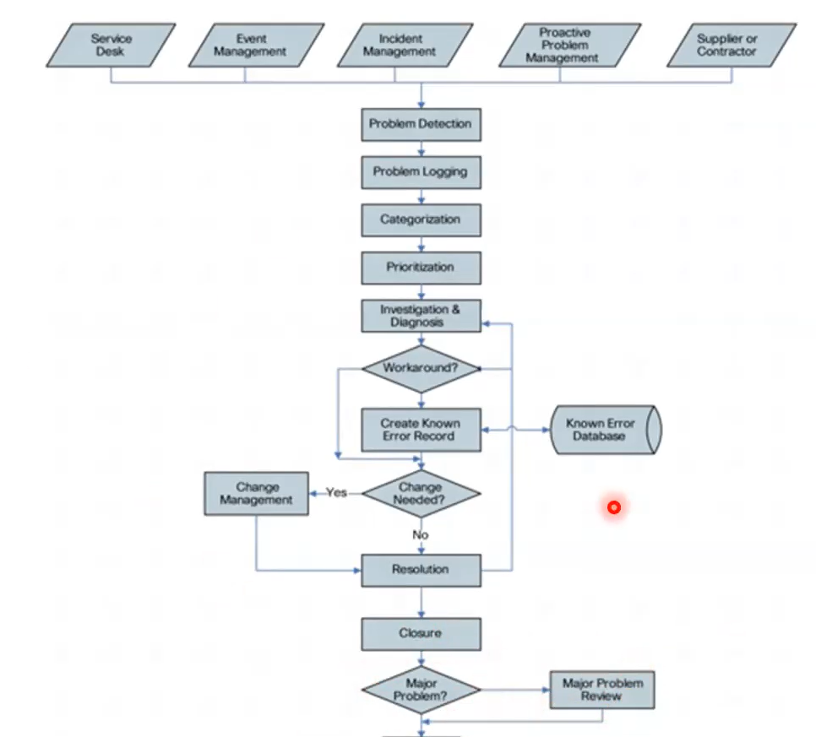
Incidents/problems may cause a change
End

Slide 5
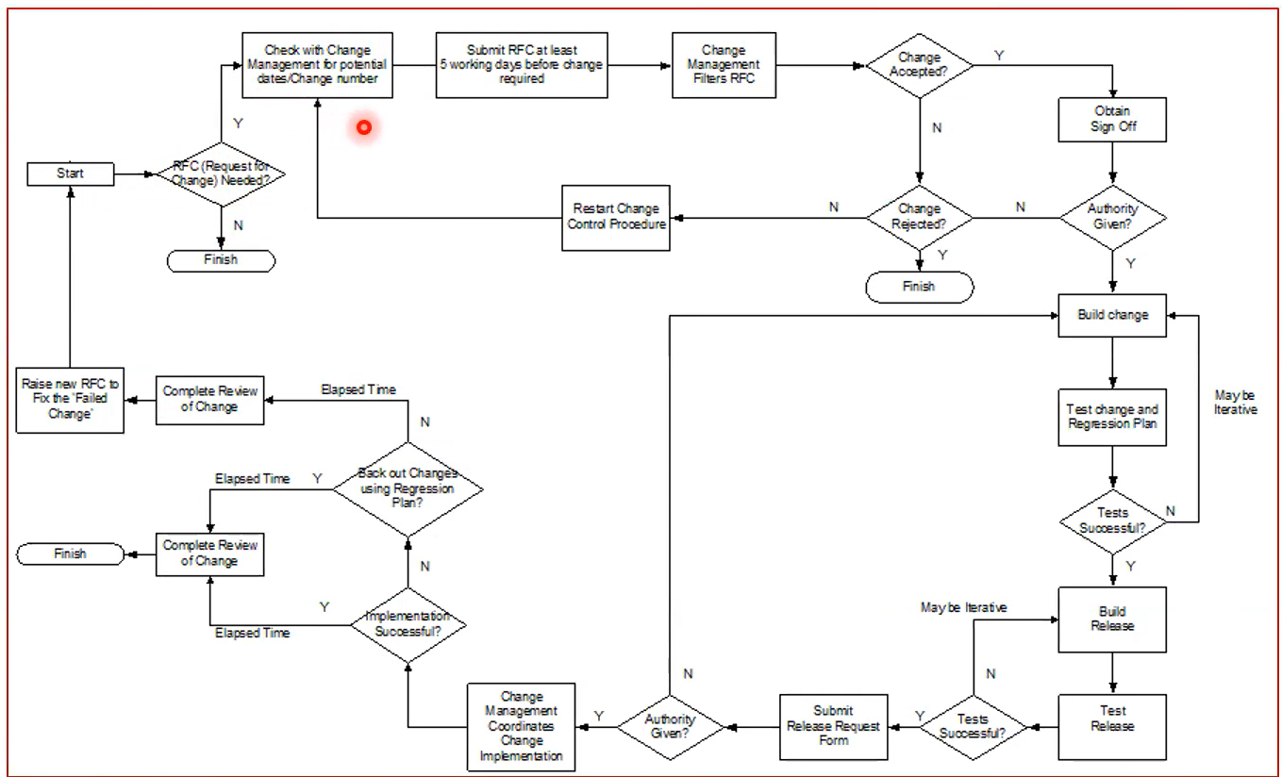


Slide 6
Change Management Process
Raising and Recording Changes – A new change record can be generated in a number of ways:
An IT team member (role: itil) can generate a change by hand through clicking ‘new’ on the record list.
An IT team member (role: itil) can request a change through the Service Catalog.
A change can be requested from an incident.
A change can be requested from a problem.

Slide 7
Change Management Process
Assessing and Evaluating Changes – Once a change request is in place, the change management team must populate the change request with as much information as possible to fully assess the requested change.
Planning Changes – Changes can be planned directly in the change record, but for complex, multi-step changes, Project Management allows specificity of planning. Projects in the Project Management plugin can organize many layers of tasks, and present tasks as a Gantt chart timeline.
Authorizing Changes – Specified by hand using the approvers related list. Can be generated using a approval rule or workflow.
Closing Changes – The state field of the change record will be set to close. If the change was generated from an incident or problem, a business rule can be configured to automatically close them upon closing the change.

Slide 8
Types of changes
Normal – An intermediate-risk change that is not urgent or pre-approved. Will include a thorough review process, a rollback plan, etc.
Emergency – Urgent changes that may present high risks if not addressed promptly. E.g. security threats, power outages
Standard – Predefined changes that are common to the organization and are pre-approved. E.g. service desk request for IT service
A Change Advisory Board (CAB) will decide on to approve or reject any changes. (cab_manager role)
An Emergency Change Advisory Board (eCAB) will handle emergency changes.

Slide 9
Types of changes
Aside from the 3 ITIL change types, other organizations may implement their own:
Major – Big change that will affect the entire system
Latent – Smaller changes that may not have an immediate or even perceptible impact

Slide 10
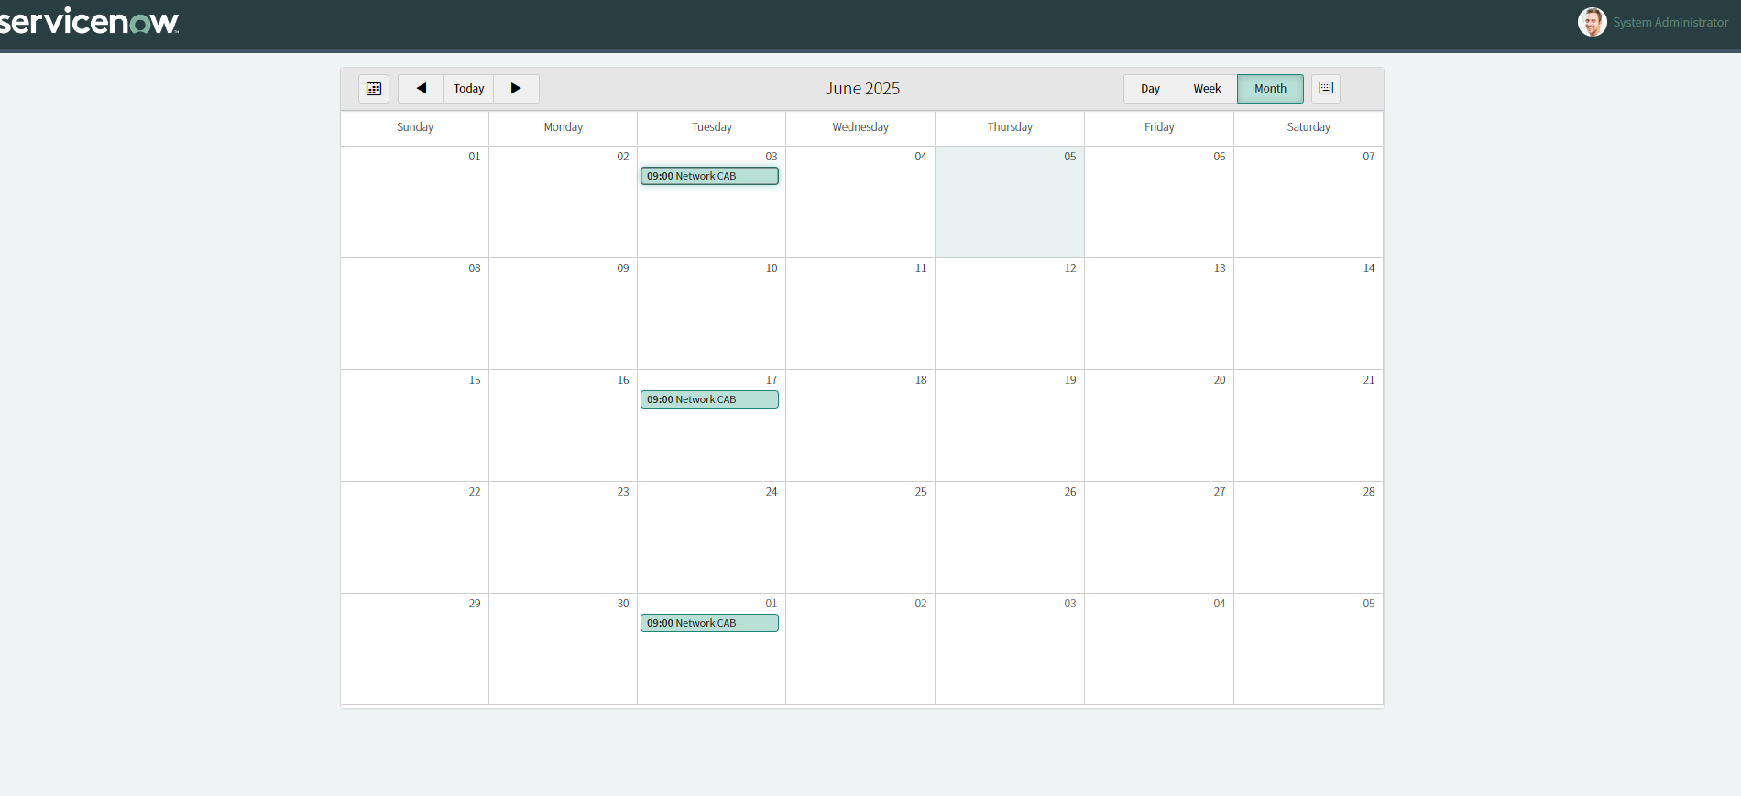
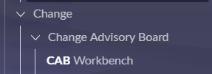
CAB Workbench

Slide 11
Question Time
Which type of change is pre-approved?
What user role is responsible for changes (can be added to the assigned_to field)?
Who decides to approve or reject any changes?
How do changes come to be?

Slide 12
Question Time
Which type of change is pre-approved?
Standard
What user role is responsible for changes (can be added to the assigned_to field)?
itil
Who decides to approve or reject any changes?
CAB or eCAB
How do changes come to be? Through a problem or incident

Slide 13
Key Benefits of Service Now
Simplified experiences
Empower everyone inside and outside the organization using a simplified layer of engagement with data unified from any system
Purposeful automation
We can take the digital sprawl across the enterprise and deliver an automated, intelligent System of Action
Organizational agility
A low-code and intelligent platform helps meet business needs and is able to pivot and adapt quickly in today's changing environment

Slide 14
Features of Service Now
Key features of ServiceNow are:
Simple and Consistent
Flexible
Secure
Lower Total Cost
Easy to Intergate
Speed Time to Production

Slide 15
What is Service Now suitable for?
Education
Energy and utilities
Financial services
Government
Healthcare
Logistics
Manufacturing
Retail
Service providers
Telecommunications, media, and technology

Slide 16






Some Service Now Customers

Slide 17
Service Now Architecture
As previously stated, SNOW can be considered a Paas, Iaas, or Saas
Paas – platform as a service
To the developer, it is a platform for developing applications
Iaas – infrastructure as a service
To the business, it is infrastructure maintained by Service Now
Saas – software as a service
To the customer, it is a software to interact with
There are 4 pillars of Service Now architecture:
ServiceNow Datacenters – this is where all our data and database tables live
ServiceNow Firewall – think of this as backend security
Customer Firewall – think of this as frontend security
User Interface – this is how users interact with the application/platform

Slide 18
Service Now Instances
When developing an application, development will happen on a separate instance from testing and production
Service Now uses this separation of environments as well
Typically, development exists in a dev instance and a dev instance cannot be used as a production instance (it cannot be published)
https://<xxxdev>.service-now.com/
A test environment will allow for various tests to take place, such as load testing, regression testing, and QA (Quality Assurance)
https://<xxxtest>.service-now.com/
A UAT (user acceptance testing) environment will ensure that the application meets quality standards and best practices for users
https://<xxxuat>.service-now.com/
Finally, a production environment is where the live application lives
https://<xxxprod>.service-now.com/

Slide 19
Break
Stop Here

Slide 20
SNOW Docs & Community
Training will provide the core principles, but YOU are responsible for ensuring a deep understanding
The SNOW documentation site will be your reference guide for finding information about SNOW products, apps, and releases
Product Documentation | ServiceNow
The SNOW community site is great for asking questions, getting/giving advice, and connecting with other SNOW professionals
Home - ServiceNow Community
The SNOW Learning site provides asynchronous learning modules that will be great for supplementing your learning!
Use this in conjunction with training to solidify your knowledge and better prepare for your certification exam
Bookmark the Certified System Administrator (CSA) learning path for a quick link

Slide 21
Personal Developer Instance
To start building applications and get hands-on with the platform, you will need to spin up a personal developer instance
Go to the SNOW Developer site to spin up your instance
Home | ServiceNow Developers
This is where you will access your instance each day
Exists entirely on the cloud
You will also receive an email with a link to your instance along with a dev instance password
It should look something like this: https://<<customdevinstancename>>.service-now.com/login
SAVE YOUR DEV INSTANCE PASSWORD SOMEWHERE SAFE
Each day you will need to wake up your instance and this may take a few minutes, so get it up and running first thing each day

Slide 22
SNOW Plugins
Plugins are software components that provide features and functionalities within a ServiceNow instance
Plugins add features or extend the functionality of the Now Platform
Applications are standalone pieces of code that implements a collection of features on the Now Platform that may include a number of active plugins
All plugins are provided by ServiceNow
A set of plugins are active by default, but you can activate additional plugins if needed
Some plugins require activation by ServiceNow personell

Slide 23
Hands-on Demo
Tour the Service Now Platform
Let's add a custom logo to our platform that will span across all of our applications

Slide 24
Your Task
Read through this document on Plugins
ServiceNow plugins
Practice navigating the SNOW platform in your developer instance

Slide 25
Terminology
ISTM – IT Service Management is a set of practices, policies, and processes designed to manage and deliver IT services to meet the needs of an organization and its customer
ITIL – IT Infrastructure Library that serves as an ITSM framework with a 5-stage lifecycle
Banner – Contains the app logo, contextual app pill, global search bar, and logged in user that spans the top of the page in the SNOW platform
Contextual App Pill – A user interface element that dynamically changes to show the name of the current page that the user is on
Global Search – A search bar user widget that searches the entire platform
Filter Navigator – allows us search and filter the list of applications and modules under 'all' to quickly find the one we need

