Slide 1
Platform Analytics

Slide 2
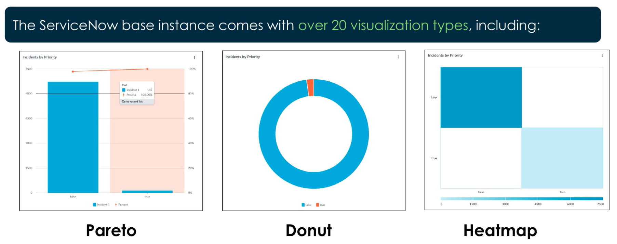
Data Visualizations

Slide 3
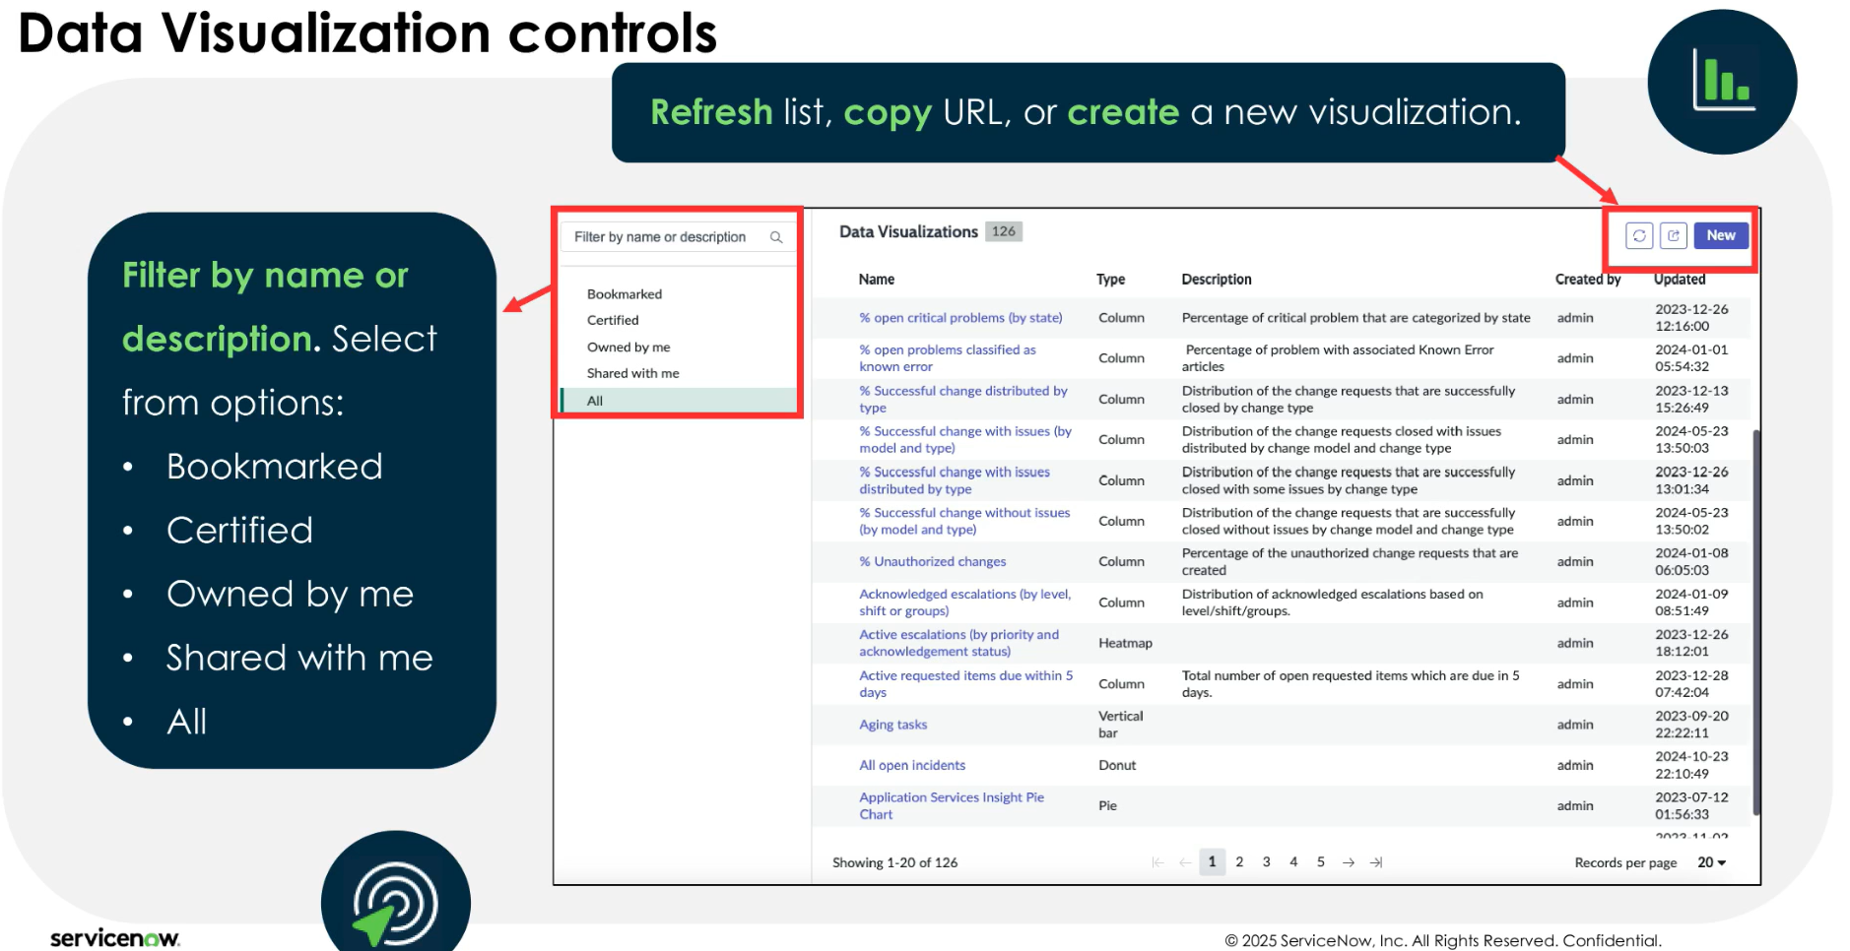
Data Visualizations
All > Platform Analytics > Library > Data Visualizations

Slide 4
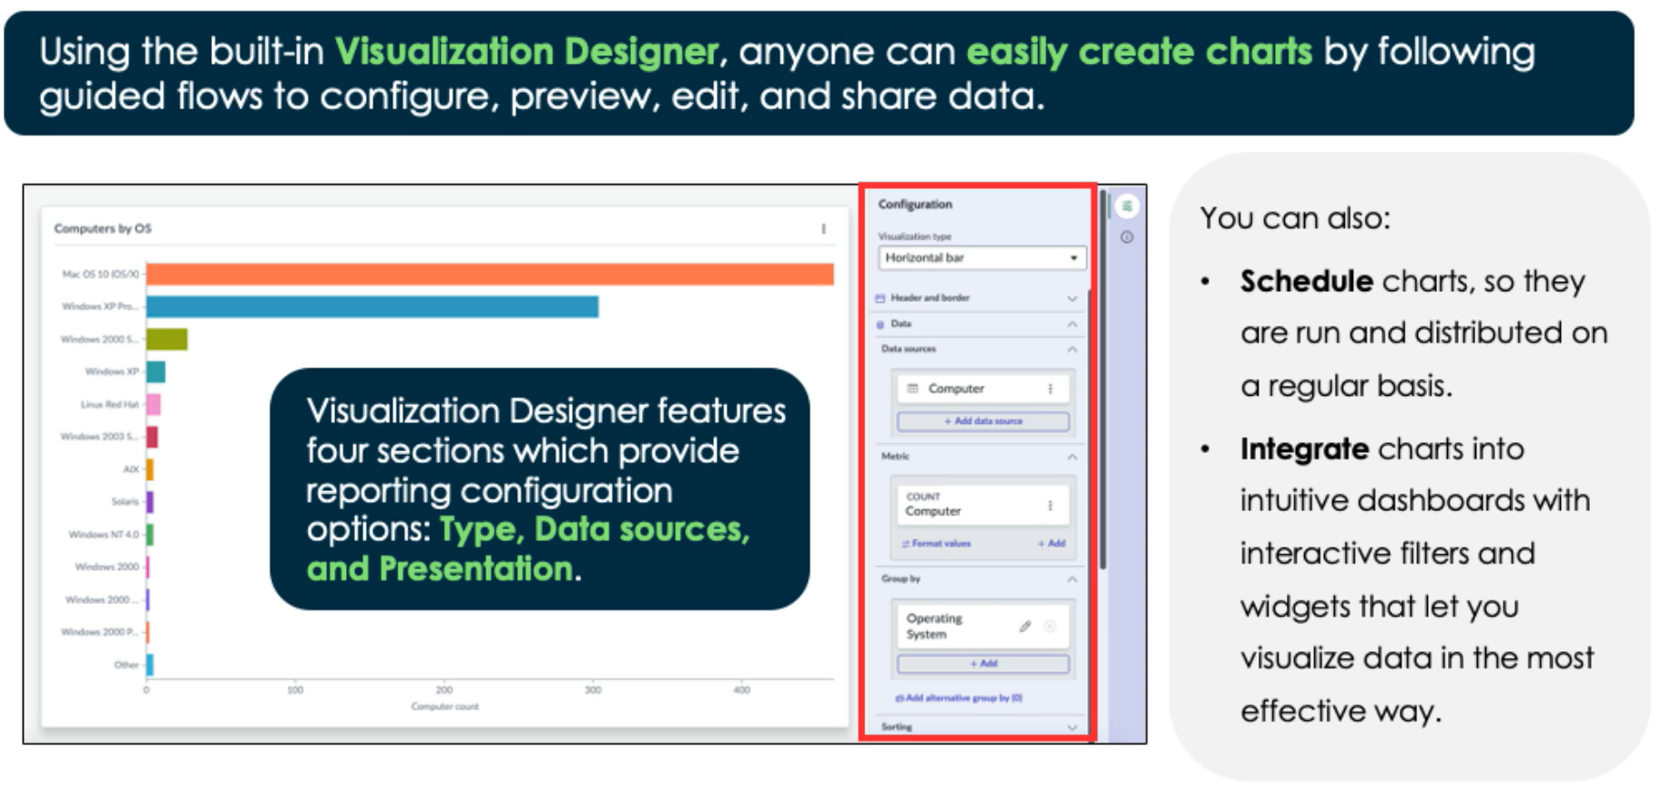
Visualization Designer

Slide 5
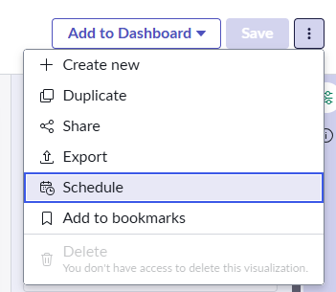
Scheduling Reports
We schedule our reports to be emailed to others
Reports can be exported as powerpoint, png, and more
View scheduled reports at: Platform Analytics > Library > Scheduled Export

Slide 6
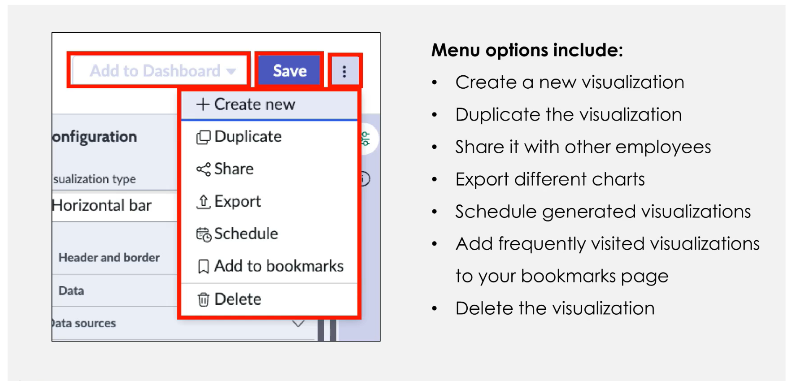
Visualization Designer

Slide 7
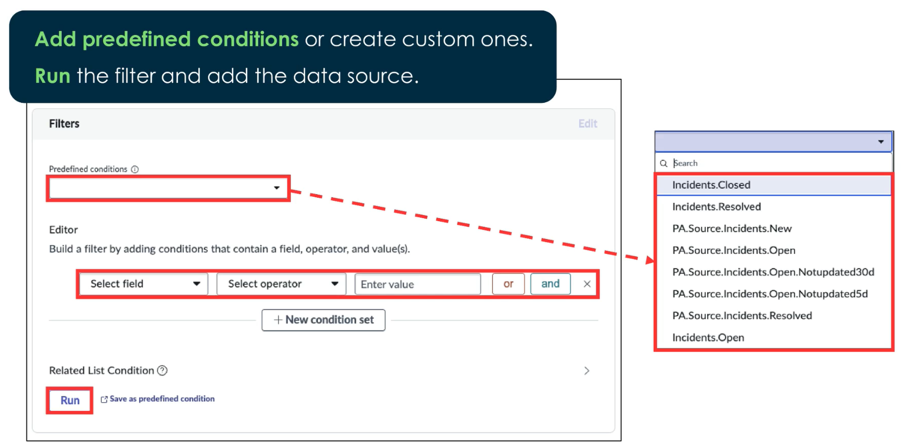
Filters & Predefined Conditions

Slide 8
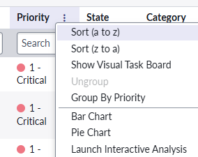
Other ways to Create Visualizations
Don’t forget you can quickly create charts right from the column context menu

Slide 9
Challenge
Goal:
Create a Data Visualization
Scenario:
Create a Data Visualization that displays a dial
The dial should have the count of all Incident records within the last 3 months that have a critical priority
Max count on dial should be 20
Set different dial colors based on the record count:
Default: 0-10, Yellow: 10-15, Red: 15-20
Schedule to share your report as a PowerPoint file every month on the 1rst

Slide 10
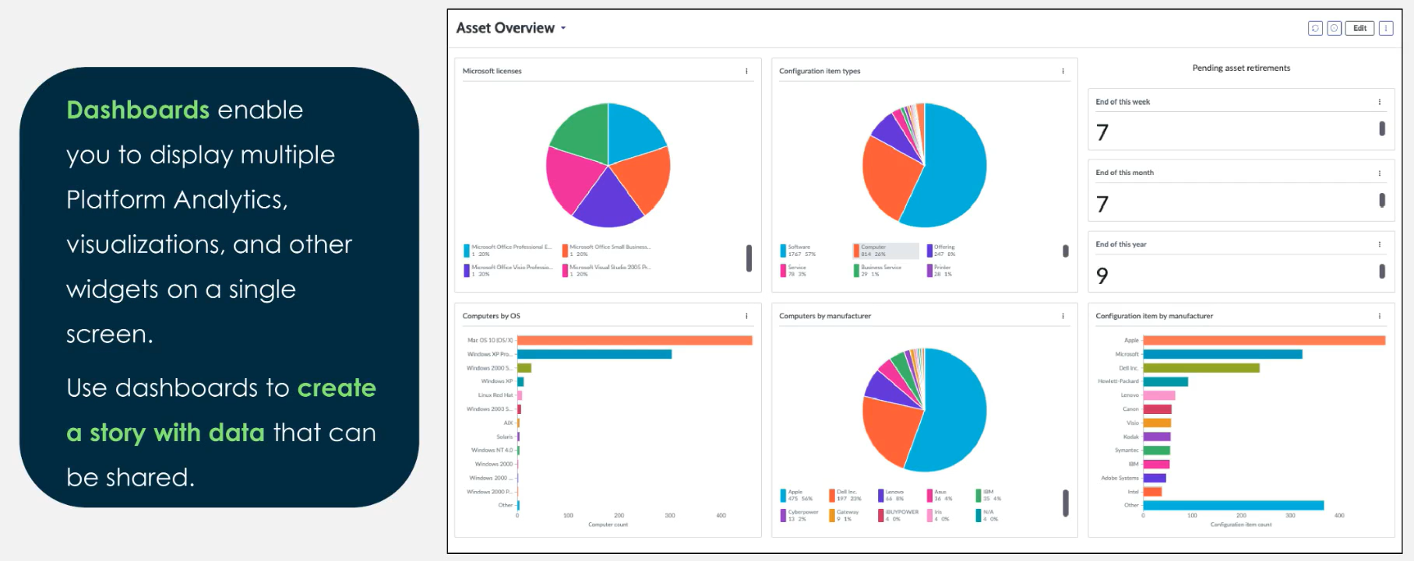
Dashboards
Another example: The Incident Management dashboard at ‘Incident > Overview’

Slide 11
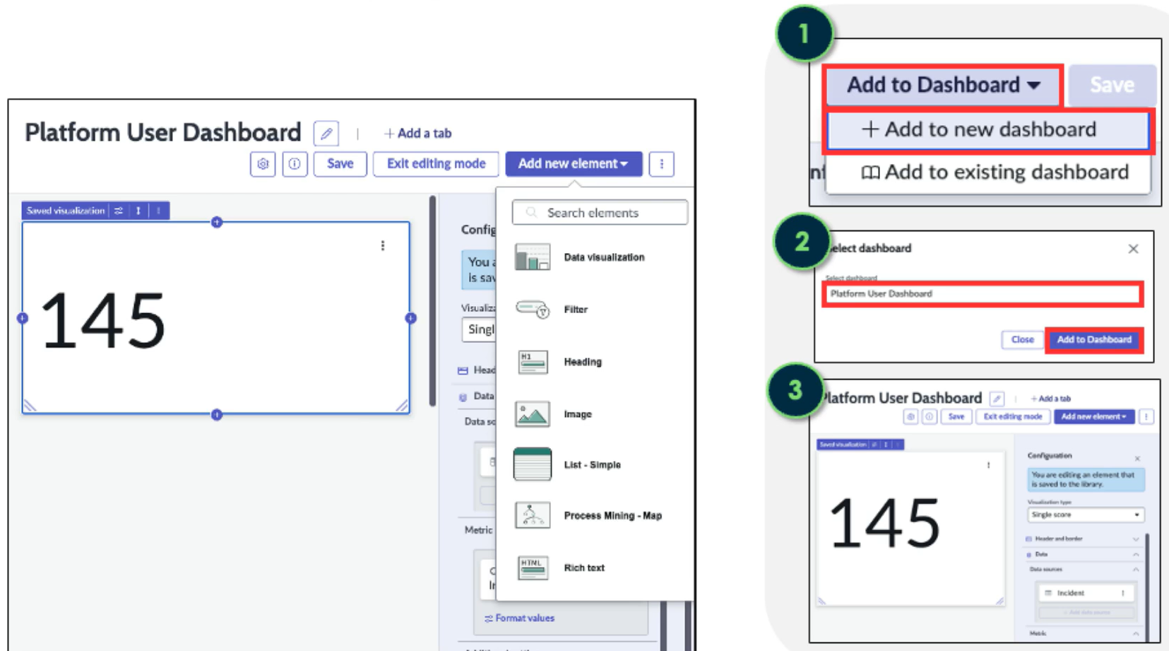
Add Visualizations to Dashboards

Slide 12
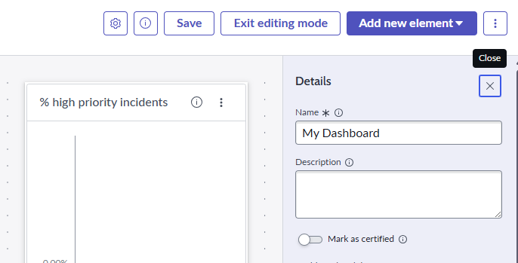
Certified Dashboards/Visualizations
Certified Dashboards or Data Visualizations represent high quality
The certification may only be applied by an admin and this status appears in the Analytics Center module

Slide 13
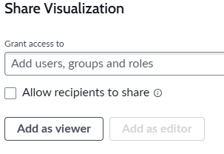
Sharing Dashboards/Visualizations
Sharing access to Data Visualizations & Dashboards is very similar
They both allow you to share with users, groups, or roles
Permissions on both are on a ‘Viewer’ or ‘Editor’ basis

Slide 14
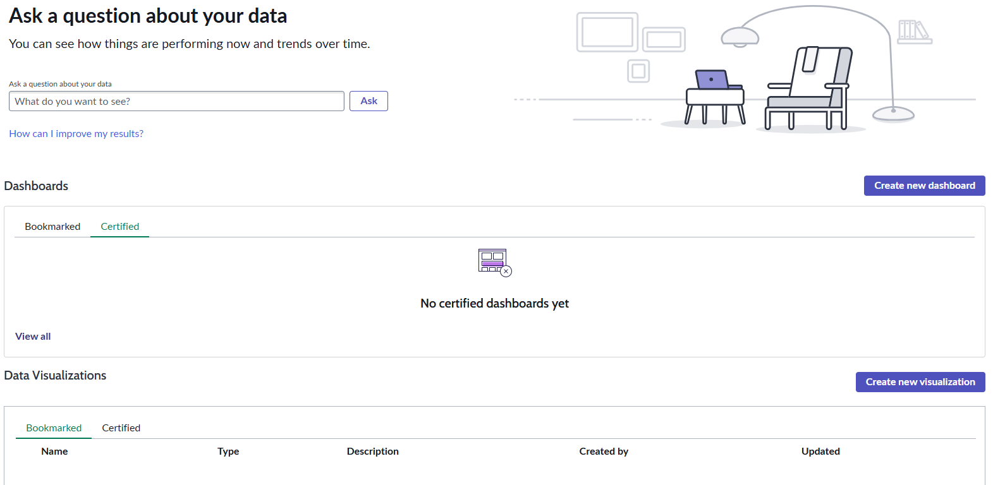
Analytics Center Module
All > Platform Analytics > Analytics Center

Slide 15
Challenge
Goal:
Create a Dashboard
Scenario:
Create a Dashboard, and include your Data Visualization on it
Create a report_view incident ACL for trainers
Share the dashboard with a Trainer

Slide 16
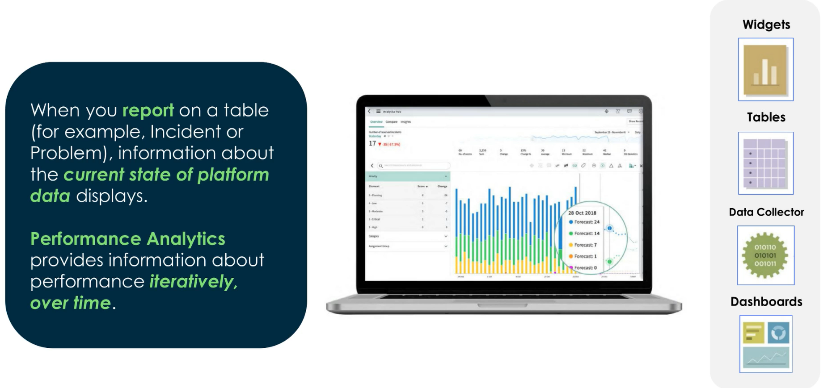
One-Time Reporting vs Performance Analytics
This is a paid feature but may come up in CSA
Remember: One-time reporting shows, where are we today? While performance analytics reveals trends over time.

Slide 17
Notifications

Slide 18
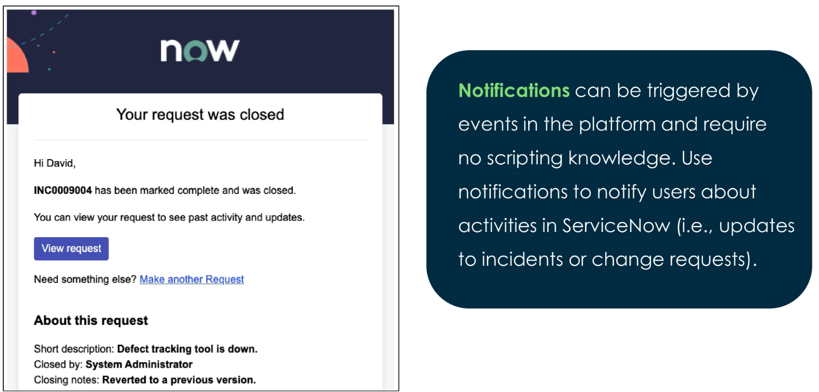
Email Notifications
All > System Notifications > Email > Notifications
All > System Mailboxes > Outbound > Outbox

Slide 19
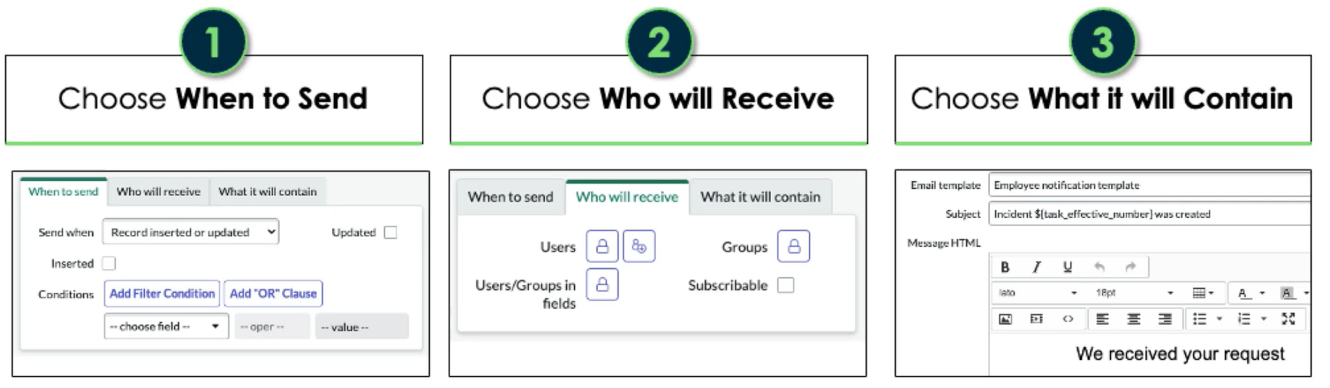
Creating Notifications

Slide 20
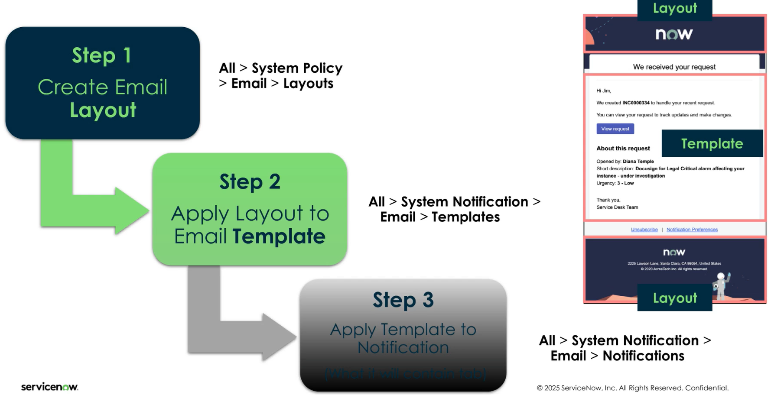
Email Templates

Slide 21
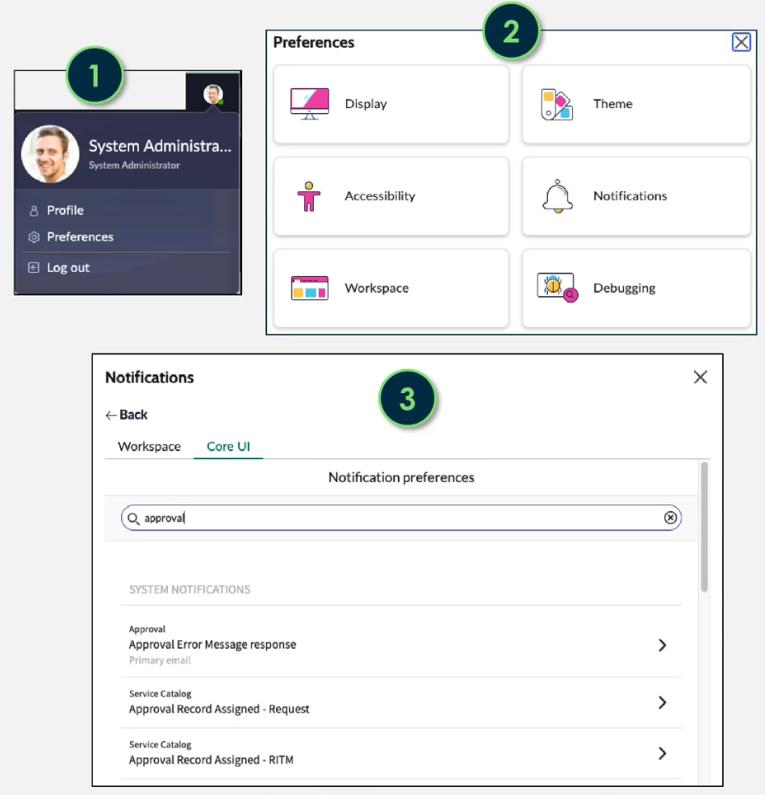
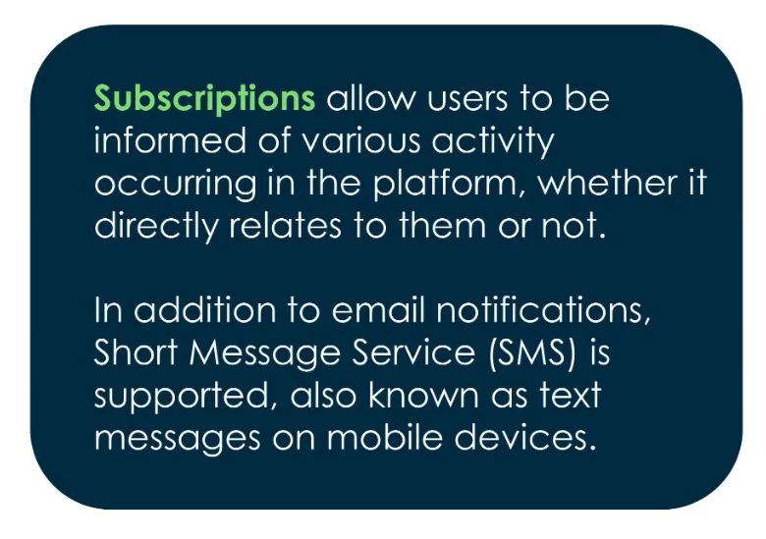
Subscriptions

Slide 22
Challenge
Goal:
Create an Email Notification
Scenario:
The admin should get a notification whenever a major incident has been created
Check the outbox to verify the notification was sent

Slide 23
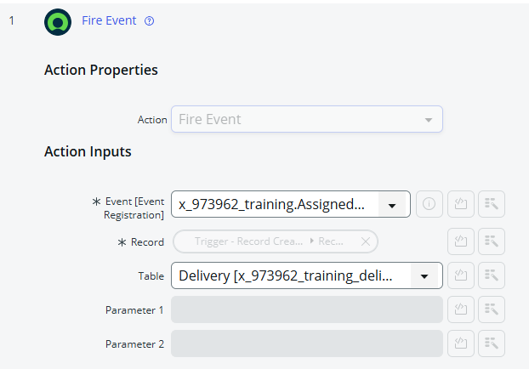
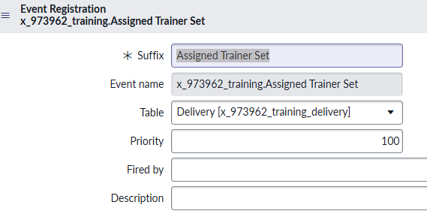
Event Registry
Events are created and managed at the event registry
These can be fired from a Flow
Found at: All > System Policy > Events > Registry

Slide 24
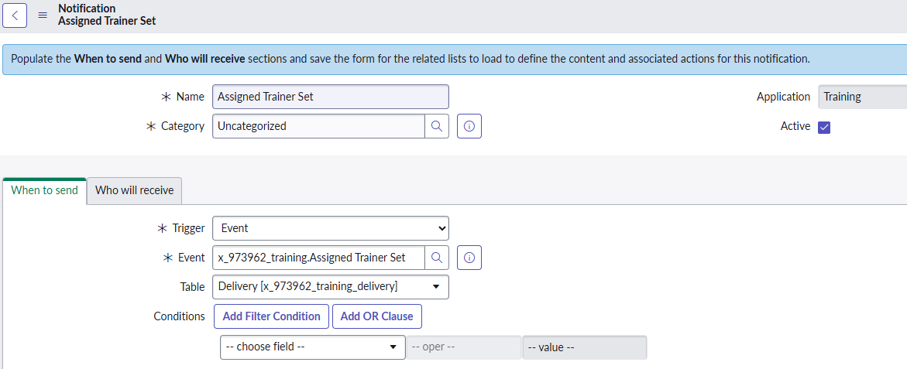
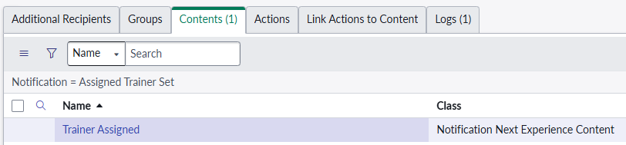
System Notifications
System Notifications are different than email notifications
System Notifications integrate with the Next Experience, and can be triggered from system events
[sys_notification] vs [sysevent_email_action]
System Notifications found at: All > System Notification > Provider > Notifications

Slide 25
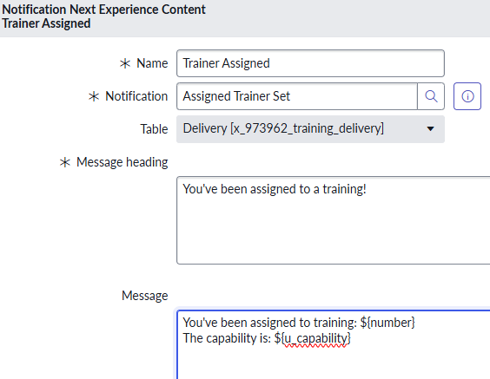
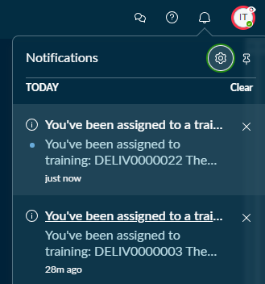
Dynamic Field Data in Notifications
We can inject field data into the content of our notification

Slide 26
Challenge
Goal:
Create a Next Experience notification
Scenario:
Once a trainer has been assigned to a delivery, they should get a custom bell notification in the next experience
The notification should tell the trainer:
The delivery number
The capability

