Slide 1

Welcome to Service Now
An Introduction

Slide 2
Overview
ITSM
ITIL
What is Service Now?
SNOW Architecture
SNOW Docs & Community
Personal Developer Instance
Plugins

Slide 3
Intro to ITSM
Definition: IT Service Management (ITSM) is the practice of managing IT services in a structured and process-driven way.
Definition: IT Services are the various technologies and support that an organization provides to its employees, customers, or partners
Larger Concept: Instead of IT being reactive (‘something’s broken, fix it), ITSM focuses on delivering IT as a service that aligns with business goals.

Slide 4
ITSM Core Concepts
Services over technology
ITSM isn’t just about servers, networks, or software – it’s about how those things help people and the business
Processes over chaos
Instead of only solving issues as they pop up, ITSM uses structured processes to prevent, manage, and improve IT services
Framework-driven
Organizations often use frameworks like ITIL (Information Technology Infrastructure Library), COBIT, or ISO/IEC 20000 as guides

Slide 5
Key ITSM Processes
Some common processes (from ITIL) include:
Incident Management = restore service quickly when something breaks (Example: Fixing a crashed email server)
Problem Management = find root causes of recurring issues to prevent future incidents (Example: Discovering that email crashes happen due to low storage)
Change Management = control and minimize risks when making updates to systems (Example: Testing before rolling out a new version of software)
Service Request Management = handle routine requests (Example: Employee requests a new laptop)
Configuration Management (CMDB) = keep track of all IT assets and their relationships (Example: knowing which apps are running on which servers)
Service Level Management (SLM) = define and measure service quality through SLAs (Service Level Agreements)

Slide 6
Benefits of ITSM
Standardizes IT processes
Improves service quality & customer satisfaction
Reduces downtime
Aligns IT with business needs
Provides measurable metrics for IT performance

Slide 7
Common ITSM Tools
ServiceNow
Jira Service Management
BMC Helix (Remedy)
Freshservice
ManageEngine ServiceDesk Plus

Slide 8
What is ITIL again?
Definition: ITIL (The Information Technology Infrastructure Library) is the most widely used framework for ITSM.
It is not a tool or software – it’s a set of best practices
Created in the 80s by the UK government, ITIL has evolved for years
The latest version is ITIL 4 (2019)

Slide 9
ITSM vs ITIL
ITSM = the practice of managing IT as a service
ITIL = the most popular framework for ITSM, providing best practices and processes

Slide 10
THE ITIL Service Value System (SVS)
Definition: The Service Value System (SVS) describes how all the pieces of ITSM fit together to create value for the business
The SVS includes:
Guiding principles – shape decisions and behaviors everywhere
Governance – ensures accountability, policies, and direction
Service Value Chain – the engine of value delivery (Plan => Engage => Design => Build => Deliver => Improve)
Practices (formerly called processes) – the tools in the toolbox (like Incident, Problem, Change)
Continuous Improvement – the glue that keeps everything evolving

Slide 11
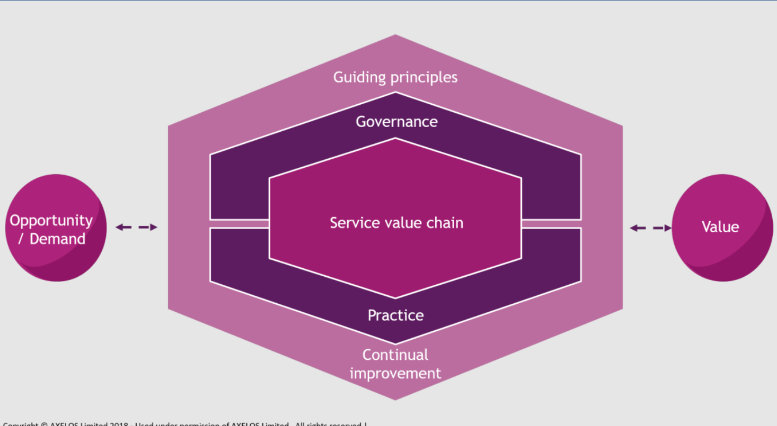
SVS Interaction Model
The SVS is not linear, it’s a system of interactions
An Incident (Practice) triggers engagement (Value Chain) guided by ‘focus on value’ (Principle)
Governance checks if changes align with business objectives
Continuous Improvement feeds back into all of it

Slide 12
Guiding Principles
Focus on Value
Always ask: Who is the customer, and what is value to them?
Example: Deploying a flashy new dashboard that users don’t need ≠ value.
Start Where You Are
Don’t throw away existing processes, tools, or knowledge.
Assess what you already have before making changes.
Progress Iteratively with Feedback
Deliver improvements in small, testable steps instead of giant projects.
Feedback loops help you adapt quickly.
Collaborate and Promote Visibility
Break silos, involve stakeholders, and keep work transparent.
“No hidden queues” — everyone should see progress and blockers.
Think and Work Holistically
IT services are complex systems — a change in one area can affect many others.
Always consider people, processes, technology, and partners.
Keep It Simple and Practical
If a process or control adds no value, drop it.
Don’t over-engineer.
Optimize and Automate
Streamline processes before automating them.
Use automation to handle repetitive tasks, but don’t lose human oversight.

Slide 13
Governance
Definition: Governance in ITIL is the way an organization is directed and controlled while aligning with strategy, policies, and compliance needs.
Sits above the Service Value Chain
Influences decisions and controls outputs of the Service Value Chain and Practices
Provides Direction – set priorities, vision, and goals
Provides Oversight – makes sure activities are aligned and compliant
Provides Accountability – ensures roles, responsibilities, and decision-making are clear

Slide 14
Governance Main Activities
Evaluate
Assess the current and future needs of stakeholders
Check risks, opportunities, and resources
Example: Board reviews IT’s cloud strategy
Direct
Set priorities, strategies, and policies
Example: Approve a new IT security policy to mandate compliance with GDPR
Monitor
Track performance against strategy and policies
Example: Audit reports, SLA dashboards, compliance checks

Slide 15
Service Value Chain
Definition: The Service Value Chain (SVC) describes the key activities an organization performs to create value through services
Transforms inputs (opportunities and demand) into outputs (value for customers)

Slide 16
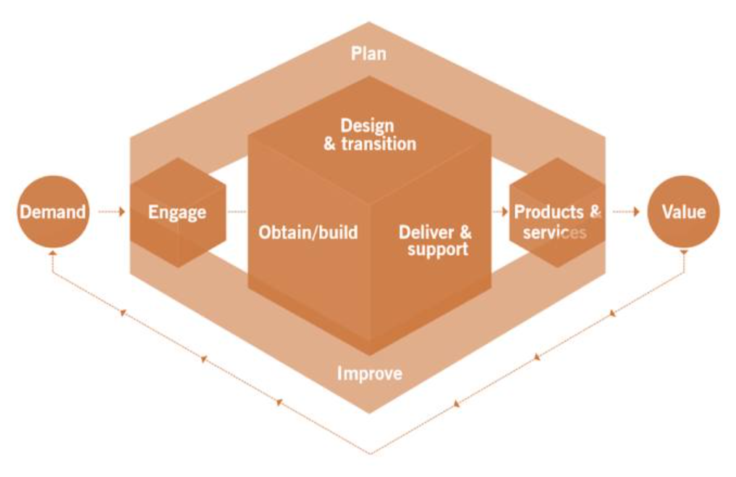
6 Key Value Chain Activities
Plan – Ensures a shared understanding of the vision, current status, and improvement direction. Aligns organizational strategy with the work being done.
Example: Strategic planning sessions, portfolio management
Engage – Interactions with stakeholders to understand demand, expectations, and feedback
Example: Service desk interactions, customer surveys
Design & Transition – Ensures that products and services are designed and transitioned to meet requirements and quality expectations
Example: Developing a new service, implementing changes, deploying updates
Obtain/Build – Focuses on acquiring or building components required to deliver services
Example: Procuring cloud infrastructure, coding an app, or integrating 3rd party tools
Deliver & Support – Ensures services are available, reliable, and supported
Example: Running a SaaS platform, managing incidents, providing helpdesk support
Improve – Continually identifies and implements improvements across services, practices, and the value chain itself
Example: Regular service reviews, performance analysis, continual improvement initiatives

Slide 17
ITIL Practices (formerly processes)
Definition: Practices are sets of organizational resources designed for performing work or accomplishing an objective
Practices are how the SVC executes activities
34 practices grouped into 3 categories
Practices are flexible – we don’t follow a process rigidly, we use it as guidance

Slide 18
General Management Practices
Practice | Purpose
Continual Improvement | Ongoing improvement of services, practices, and value
Architecture Management | Designing and maintaining organizational architectures
Strategy Management | Aligning strategy with value creation
Portfolio Management | Managing investments, services, and products
Project Management | Planning and executing projects effectively
Relationship Management | Maintaining stakeholder relationships
Risk Management | Identifying and managing organizational risks
Knowledge Management | Making information accessible and usable
Organizational Change Management | Managing change in organizational culture
Workforce and Talent Management | Managing skills and people capabilities
Measurement and Reporting | Measuring and reporting performance
Information Security Management | Protecting information assets
Supplier Management | Managing third-party providers
Financial Management | Managing budgeting, accounting, and costs

Slide 19
Service Management Practices
Practice | Purpose
Service Desk | Single point of contact for users
Incident Management | Restoring normal service operation quickly
Problem Management | Identifying root causes of issues
Change Enablement | Managing risk associated with changes
Service Level Management | Defining and monitoring service quality
Service Request Management | Handling user requests efficiently
Availability Management | Ensuring services meet agreed availability
Capacity and Performance Management | Optimizing resources for performance
IT Asset Management | Managing IT assets through lifecycle
Monitoring and Event Management | Detecting and responding to events
Service Continuity Management | Ensuring service availability under disruption
Release Management | Planning and deploying releases
Deployment Management | Deploying components into environments
Service Configuration Management | Maintaining accurate service information
Service Validation and Testing | Ensuring services meet requirements
Knowledge Management | Capturing and sharing knowledge
Service Financial Management | Managing costs of services

Slide 20
Technical Management Practices
Practice | Purpose
Deployment Management | Technical deployment of components and releases
Infrastructure & Platform Management | Managing IT infrastructure and platforms
Software Development & Management | Building, maintaining, and supporting software

Slide 21
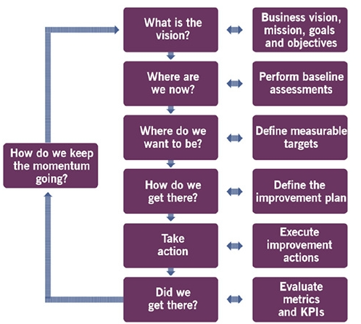
Continuous Improvement
1
Definition: The Continuous Improvement model is a 7-step, iterative, and circular process for continuously improving services, processes, and practices to align with changing business needs and stakeholder expectations
2
3
7
4
5
6

Slide 22
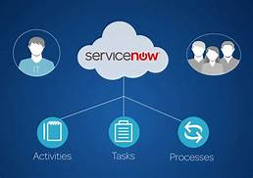
What is Service Now?
A provider of cloud-based services that automate IT processes and operations
An ITSM tool
Can be considered SaaS / PaaS / aPaaS
ServiceNow Inc is the American company that built the Now Platform and was founded in 2004
Known for ITSM, ITOM, and CSM product offerings

Slide 23
ITSM, ITOM, CSM
We should know what ITSM is by now
Definition: IT Operations Management (ITOM) supports the performance and availability of IT infrastructure and services, including networks, servers, and applications
Definition: Customer Service Management (CSM) is used to deliver a personalized customer service experience across all communication mediums, i.e. email or phone

Slide 24
Key Benefits of Service Now
Simplified experiences
Empower everyone inside and outside the organization using a simplified layer of engagement with data unified from any system
Purposeful automation
We can take the digital sprawl across the enterprise and deliver an automated, intelligent System of Action
Organizational agility
A low-code and intelligent platform helps meet business needs and is able to pivot and adapt quickly in today's changing environment

Slide 25
Features of Service Now
Key features of ServiceNow are:
Simple and Consistent
Flexible
Secure
Lower Total Cost
Easy to Intergate
Speed Time to Production

Slide 26
What is Service Now suitable for?
Education
Energy and utilities
Financial services
Government
Healthcare
Logistics
Manufacturing
Retail
Service providers
Telecommunications, media, and technology

Slide 27






Some Service Now Customers

Slide 28
Service Now Architecture
As previously stated, SNOW can be considered a PaaS, SaaS, or aPaaS
PaaS – platform as a service
To the developer, it is a platform for developing applications
SaaS – software as a service
To the customer, it is a software to interact with
aPaaS – Application Platform as a Service
There are 4 pillars of Service Now architecture:
ServiceNow Datacenters – this is where all our data and database tables live
ServiceNow Firewall – think of this as backend security
Customer Firewall – think of this as frontend security
User Interface – this is how users interact with the application/platform

Slide 29
Service Now Instances
When developing an application, development will happen on a separate instance from testing and production
Service Now uses this separation of environments as well
Typically, development exists in a dev instance and a dev instance cannot be used as a production instance (it cannot be published)
https://<xxxdev>.service-now.com/
A test environment will allow for various tests to take place, such as load testing, regression testing, and QA (Quality Assurance)
https://<xxxtest>.service-now.com/
A UAT (user acceptance testing) environment will ensure that the application meets quality standards and best practices for users
https://<xxxuat>.service-now.com/
Finally, a production environment is where the live application lives
https://<xxxprod>.service-now.com/

Slide 30
SNOW Docs & Community
Training will provide the core principles, but YOU are responsible for ensuring a deep understanding
The SNOW documentation site will be your reference guide for finding information about SNOW products, apps, and releases
Product Documentation | ServiceNow
The SNOW community site is great for asking questions, getting/giving advice, and connecting with other SNOW professionals
Home - ServiceNow Community
The SNOW Learning site provides asynchronous learning modules that will be great for supplementing your learning!
Use this in conjunction with training to solidify your knowledge and better prepare for your certification exam
Bookmark the Certified System Administrator (CSA) learning path for a quick link

Slide 31
Personal Developer Instance
To start building applications and get hands-on with the platform, you will need to spin up a personal developer instance
Go to the SNOW Developer site to spin up your instance
Home | ServiceNow Developers
This is where you will access your instance each day
Exists entirely on the cloud
You will also receive an email with a link to your instance along with a dev instance password
It should look something like this: https://<<customdevinstancename>>.service-now.com/login
SAVE YOUR DEV INSTANCE PASSWORD SOMEWHERE SAFE
Each day you will need to wake up your instance and this may take a few minutes, so get it up and running first thing each day

Slide 32
SNOW Plugins
Plugins are software components that provide features and functionalities within a ServiceNow instance
Plugins add features or extend the functionality of the Now Platform
Applications are standalone pieces of code that implements a collection of features on the Now Platform that may include a number of active plugins
All plugins are provided by ServiceNow
A set of plugins are active by default, but you can activate additional plugins if needed
Some plugins require activation by ServiceNow personell

Slide 33
Challenge
Goal:
Initialize your developer instance
Scenario:
Read through this document on Plugins
ServiceNow plugins
Practice navigating the SNOW platform in your developer instance

