Slide 1
Self Service

Slide 2

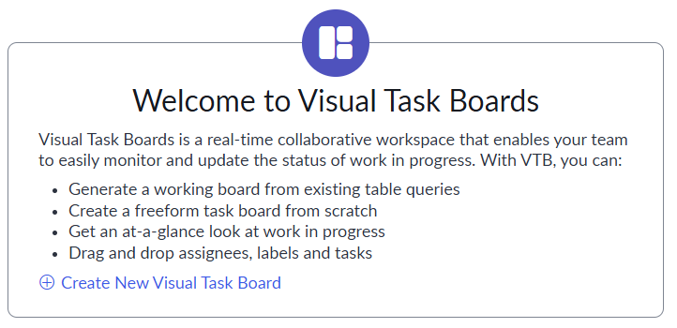
Visual Task Boards
Definition: Visual Task Boards are a customizable, kanban-like, interface that visually represent and manage task-type records
No required roles – any user can create/share/view VTBs
BUT: they can only see cards based on their ACLs, i.e. they only see what they have access to
3 types: Data-Driven, Flexible, and Freeform

Slide 3
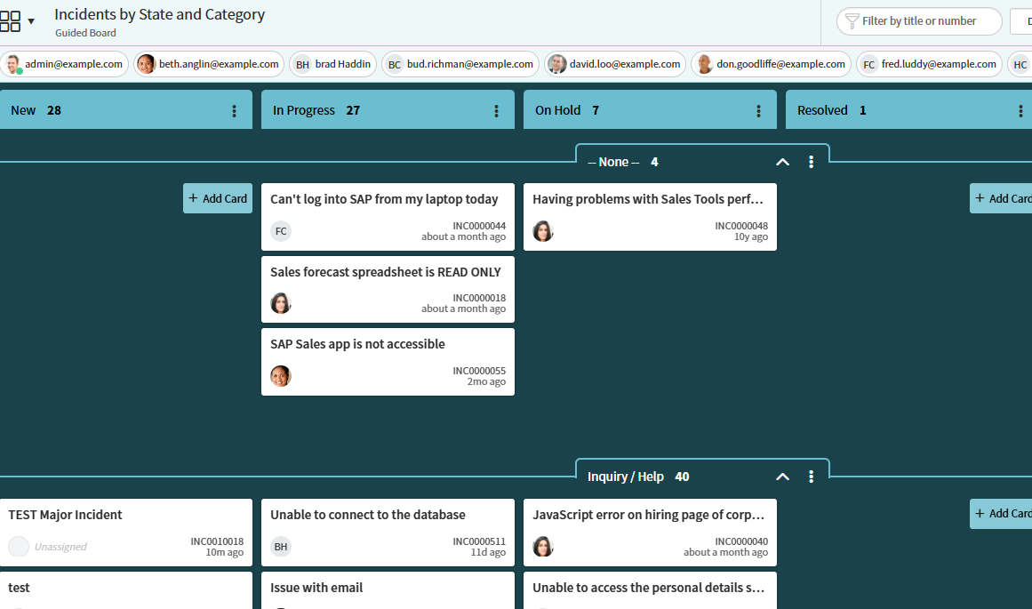
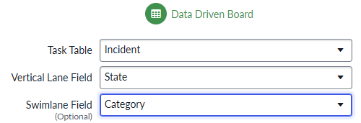
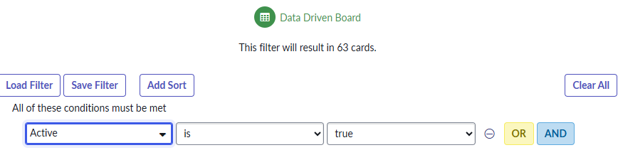
Data-Driven Task Boards
Notice we can always filter by caller
We can move cards; will update underlying data
First, choose a table & lane fields
Next, filter any records you wish

Slide 4
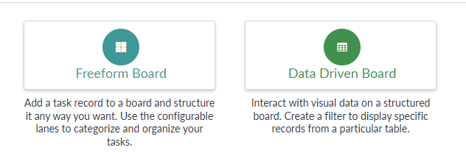
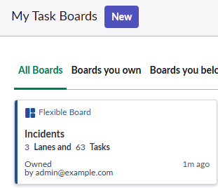
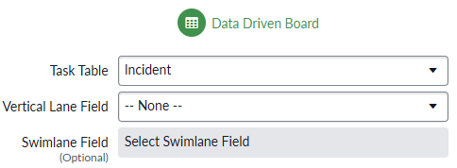
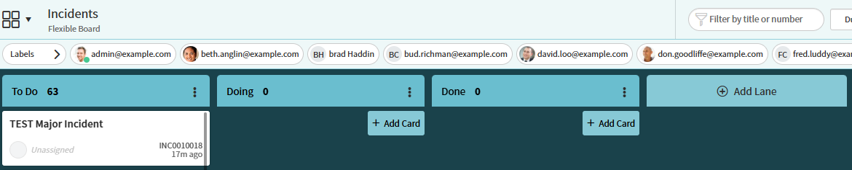
Flexible Task Boards
Flexible VTBs allows us to pull data down, like a Data-Driven board, but allows us to customize the vertical lane
Doesn’t affect the underlying data of the records
Create by selecting ‘Data Driven Board’ with ‘None’ as the vertical lane – it will show up as a ‘Flexible Board’ in the main module
We can still filter any records we wish

Slide 5
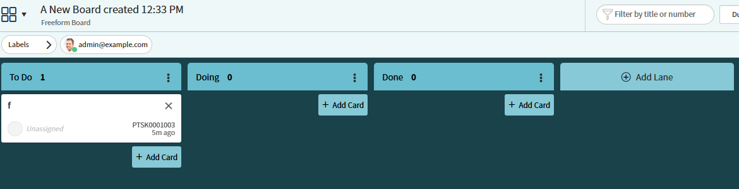
Freeform Task boards
Use freeform boards to easily customize lanes and configure the board to your liking
generates [vtb_task] records (Private Tasks)
Create relationships to other tables via reference field if you’d like to attach personal tasks to incidents, problems, etc.

Slide 6
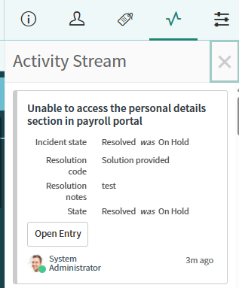
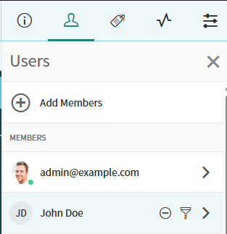
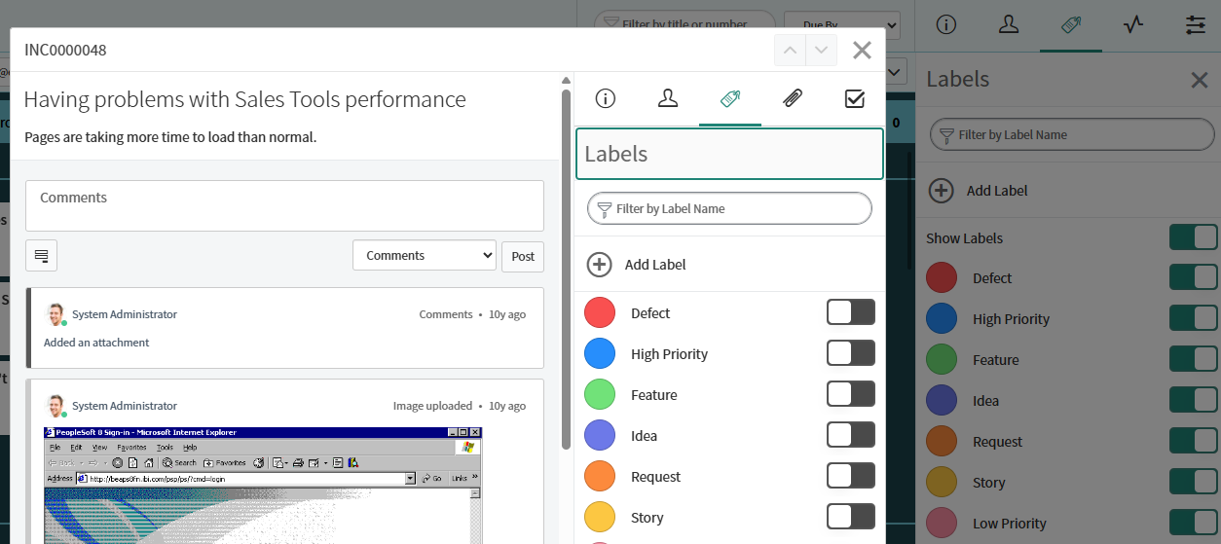
Collaborate with VTBs
Add and remove members easily, they can still only see cards they have access to
Add custom labels to organize cards further
Use the Activity Stream to see all changes

Slide 7
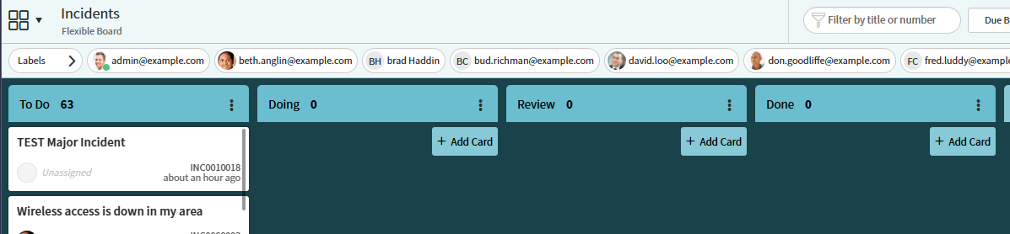
Challenge
Goal:
Create a VTB
Scenario:
Create a flexible VTB
Show Incident records
Create a new lane after ‘Doing’ called ‘Review’
Share the board with Abel Tuter

Slide 8
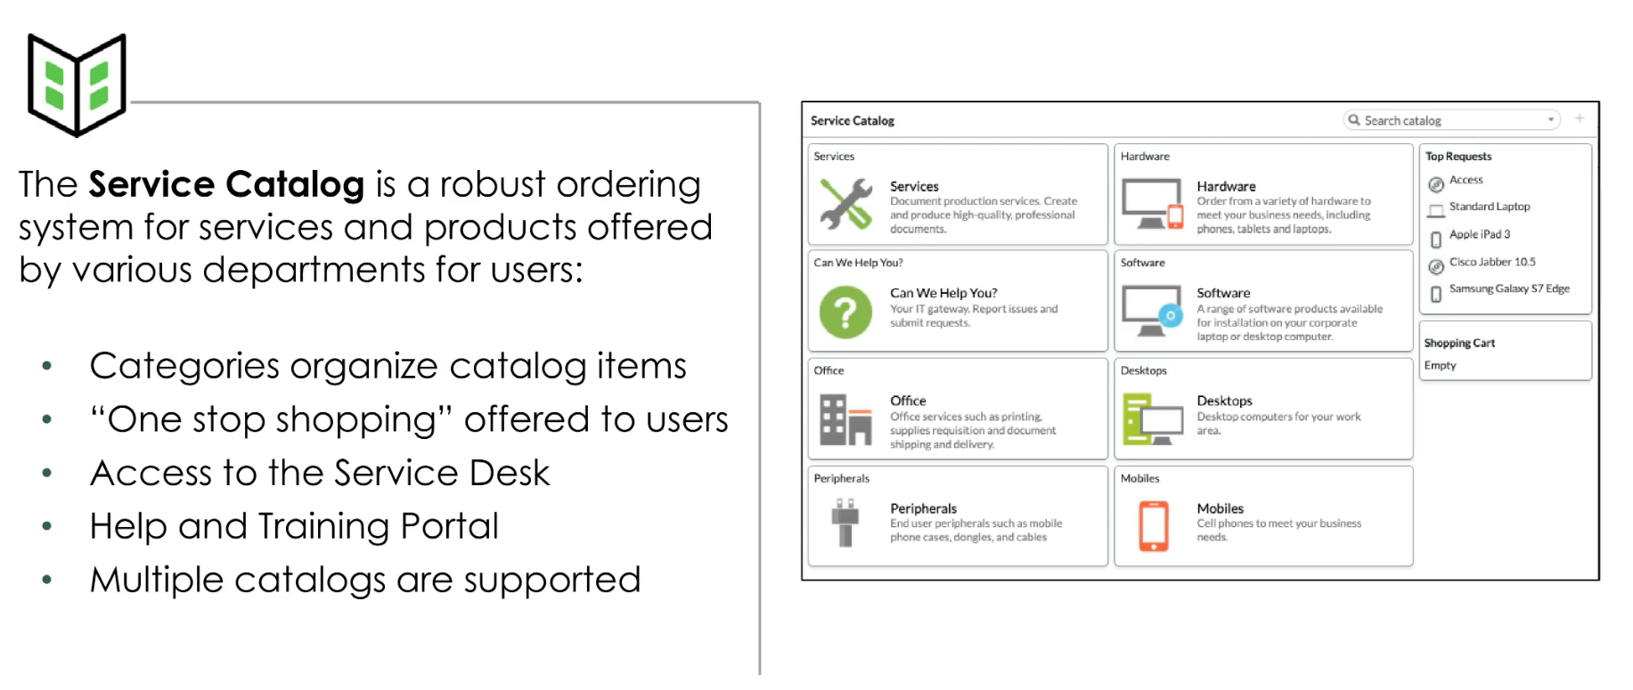
What is a Service Catalog?

Slide 9
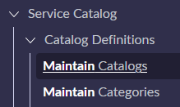
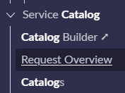
Maintain Catalogs/Categories
Create new catalogs and categories from their respective modules
From ‘Service Catalog > Catalogs’ you can build the catalog UI structure

Slide 10
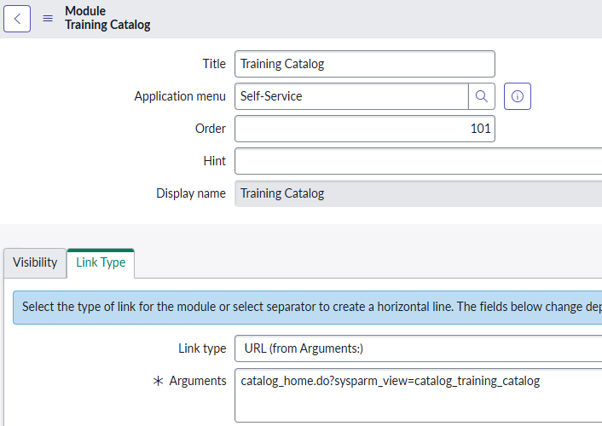
Adding Catalogs To Modules
You can add a Catalog as an application module by providing a link to the catalog
This part of the URL is assumed: https://dev208882.service-now.com/now/nav/ui/classic/params/target/
Everything in your arguments will attach after that base URL

Slide 11
Challenge
Goal:
Create a new Catalog and Category
Scenario:
Create a new Catalog called ‘Training Catalog’
Create 2 new Categories for our Training Catalog called ‘Training Hardware’ & ‘Training Help’
Add our new Catalog as a module under ‘Self-Service’

Slide 12
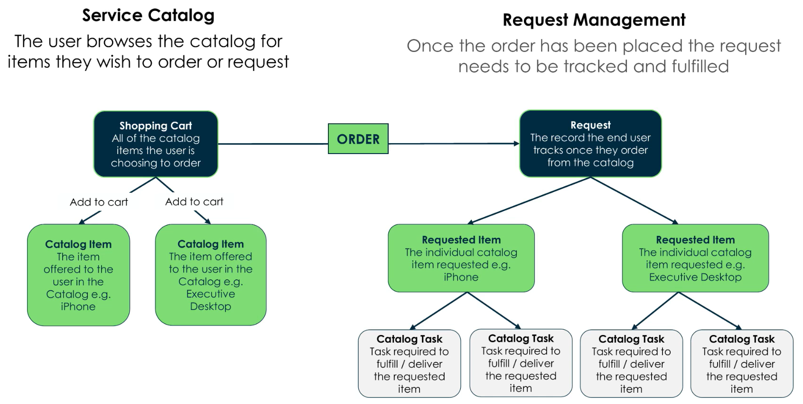
Service Catalog and Request Management

Slide 13
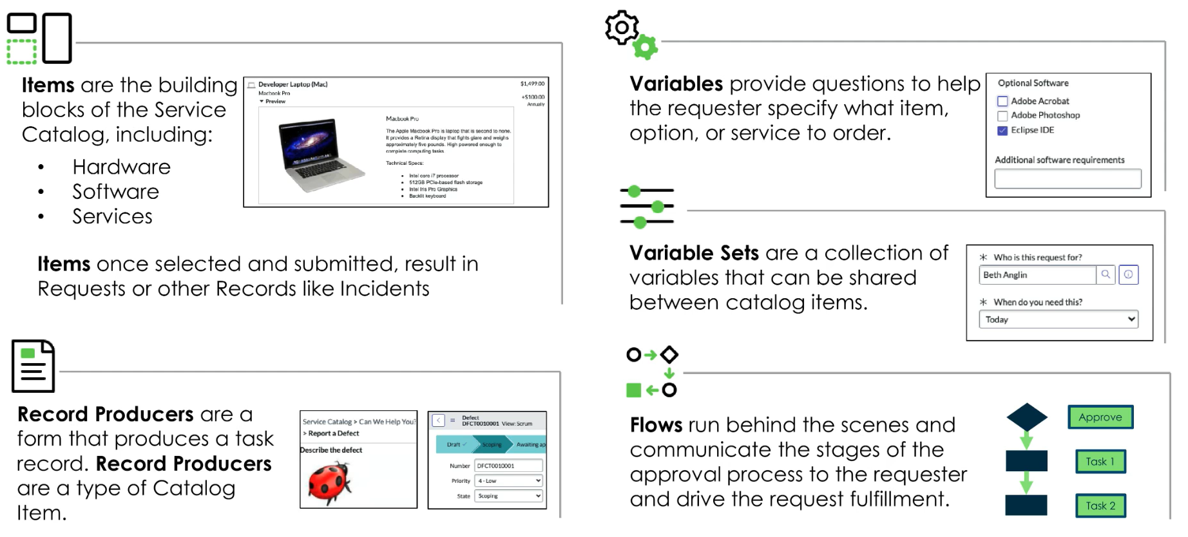
Service Catalog Components

Slide 14
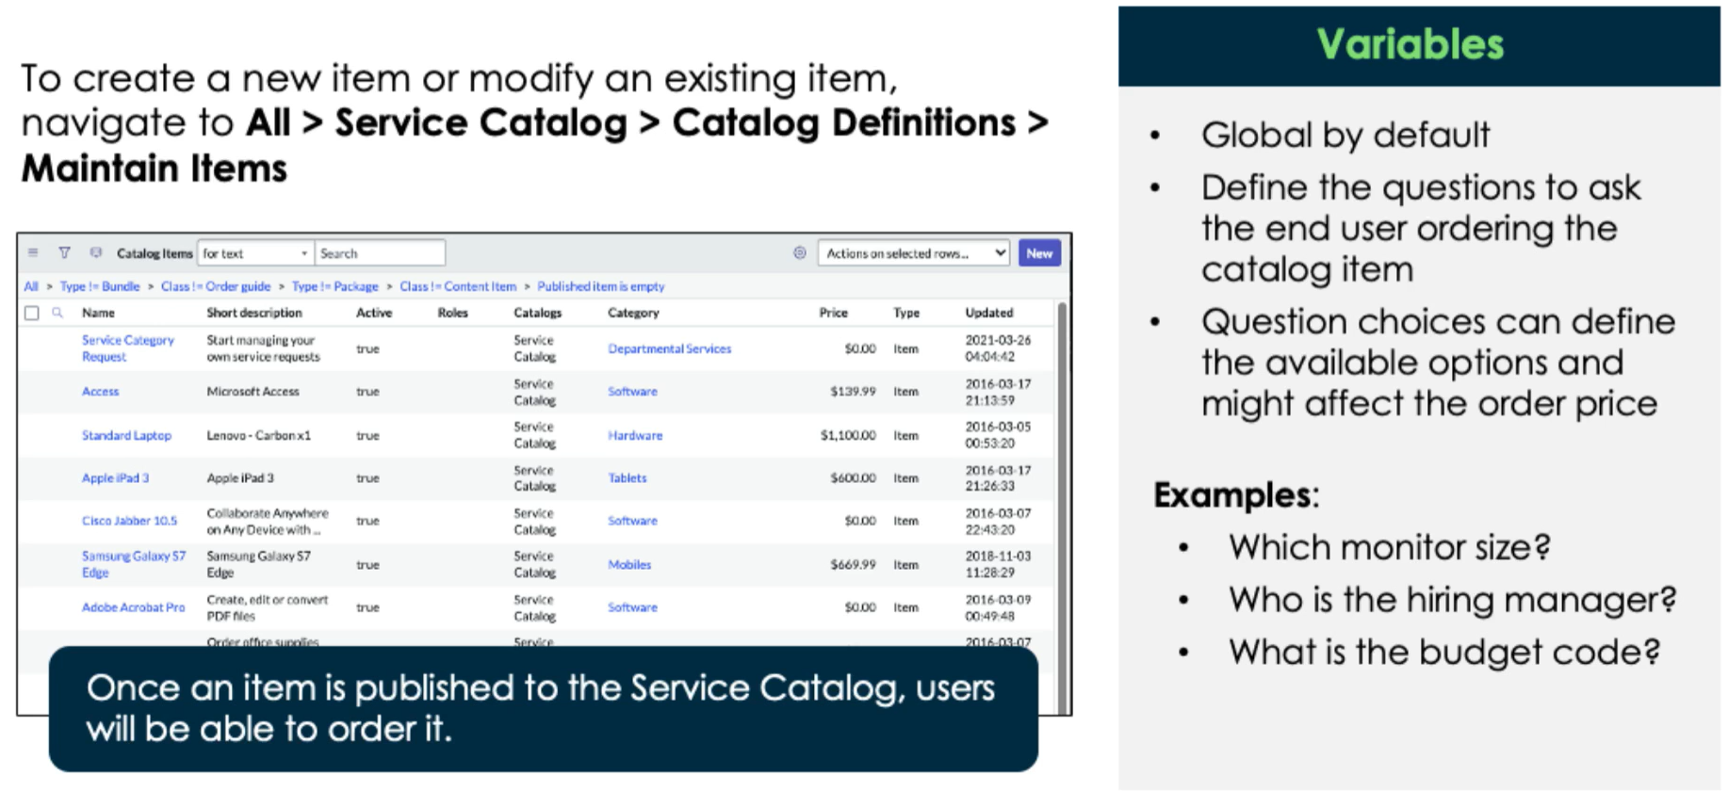
Service Catalog Items & Variables

Slide 15
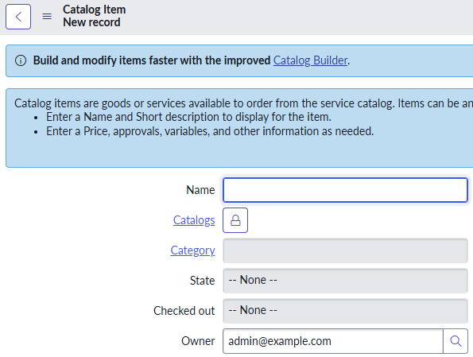
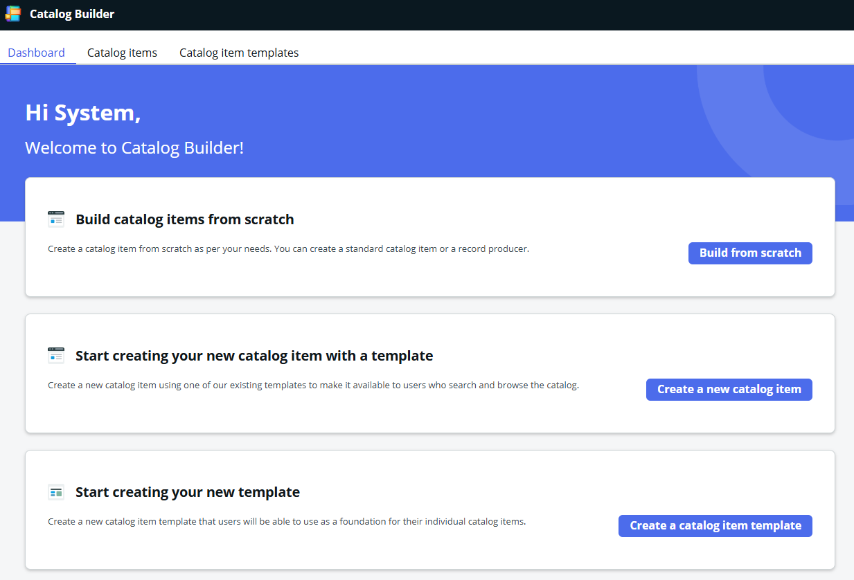
Creating Catalog Items
You can use the normal form, but you should really get used to Catalog Builder
Definition: Catalog Builder is a graphical, guided workflow for building catalog items and record producers – either manually or through customizable templates
You may still need to use the regular form to set automatic prices**

Slide 16
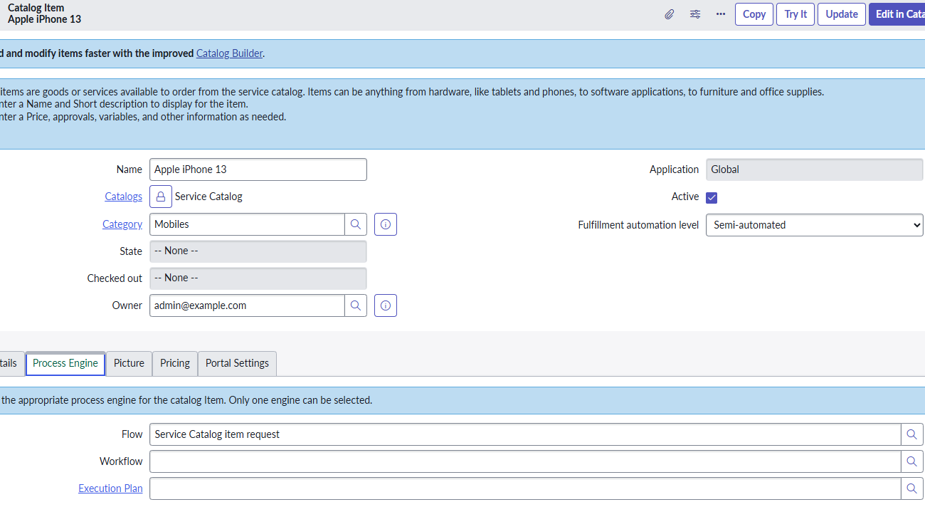
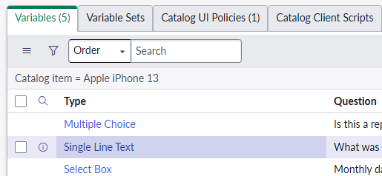
Creating Catalog Items
Associate a catalog & category
Process Engine – which process automation to run when someone requests the catalog item
Variables – The questions we ask the user; e.g. device color or size; can affect pricing
Variable Sets – groups of variables we can reuse in multiple catalog items

Slide 17
Challenge
Goal:
Create a new Catalog Item
Scenario:
Create a new Catalog Item called ‘Revature Tablet’
It should be part of our Training Catalog in the Training Hardware Category
Set the Process Engine > Flow to ‘Procurement Process Flow – Hardware’
You should have a single choice variable to select the hard drive size of the device:
128gb (normal price $1000)
256gb (costs $2000)
You should have a variable set with two variables:
Single line text: “Why do you need this?”
Date: “When do you need this?”

Slide 18
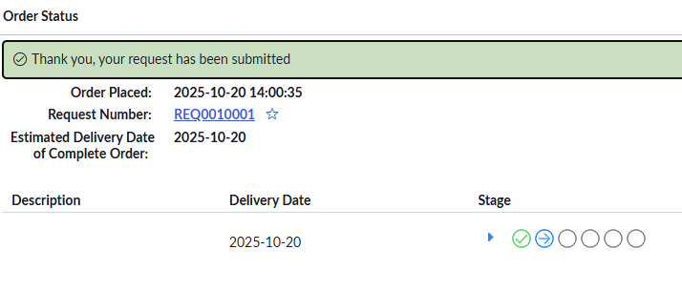
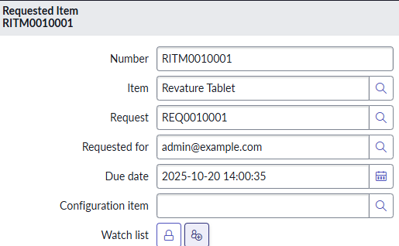
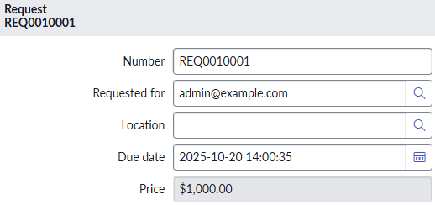
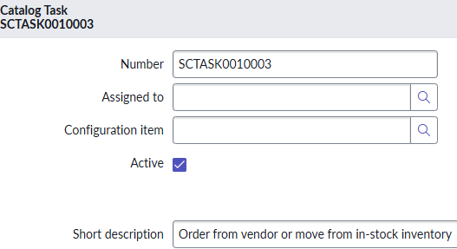
Once A user Makes a request…
All coming in from our Flow: sc_request > sc_req_item > sc_task
1
2
3

Slide 19
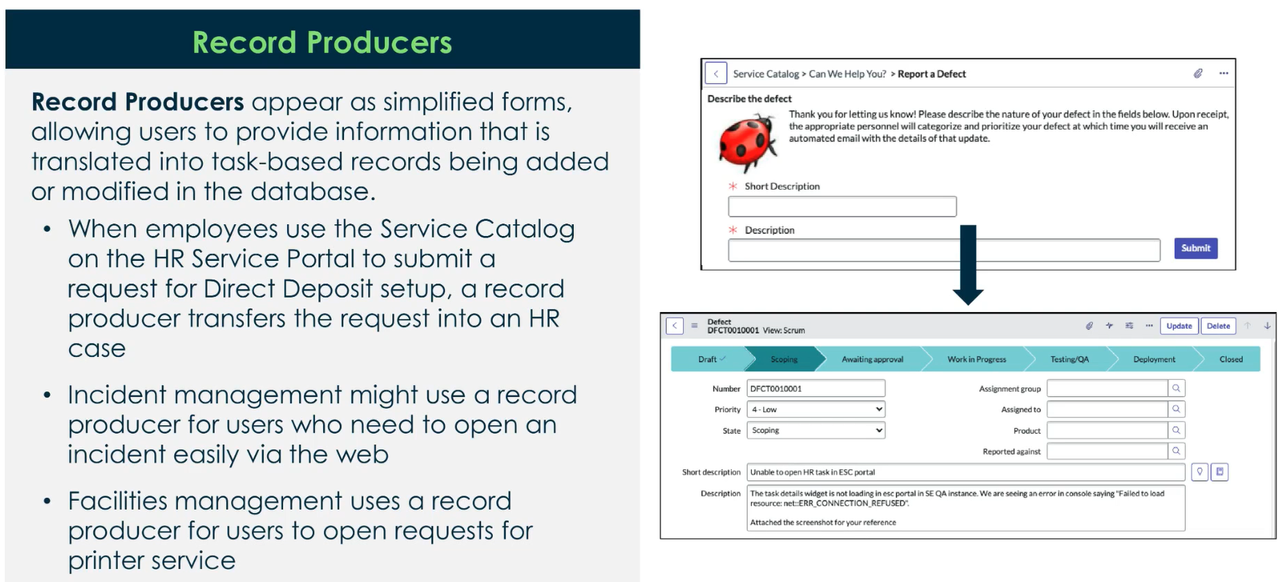
Record Producers

Slide 20
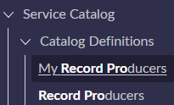
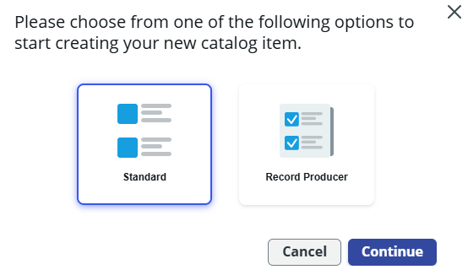
Creating Record Producers
We can create record producers form the module or via Catalog Builder

Slide 21
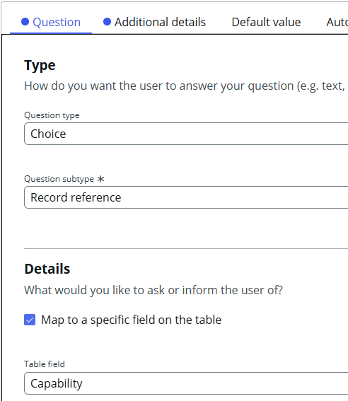
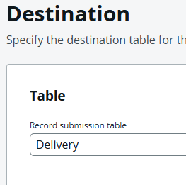
Creating Record Producers
We specify a submission table, i.e. where our record producer will produce records
We can include reference fields in our record producers, complete with reference qualifiers if we wish

Slide 22
Challenge
Goal:
Create a new Record Producer
Scenario:
Create a new Record Producer called ‘Training Request’
It should create training delivery records
Ask the user to pick an assigned trainer & capability
Include your Record Producer in the ‘Training Help’ category within our ‘Training Catalog’

Slide 23
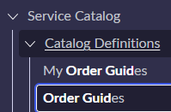
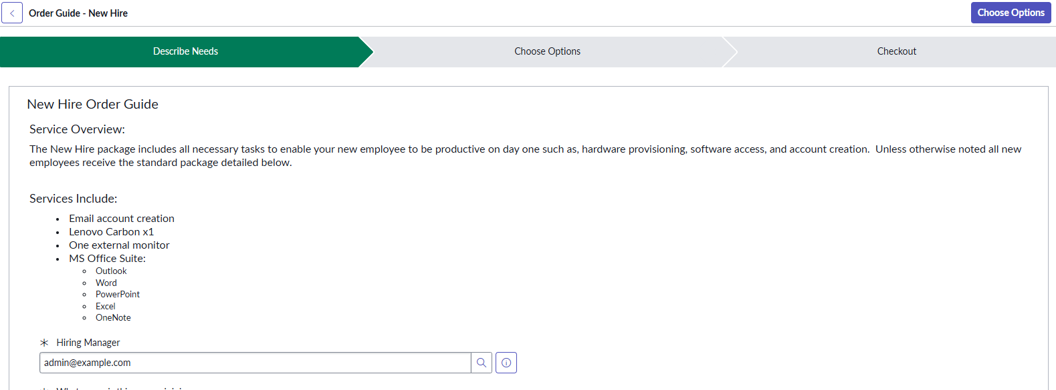
Order Guides
Definition: Order Guides let users request multiple related items at once, and help them decide what they need
Describe Needs – displays variables for use by the order guide
Choose Options – displays all Catalog Items and their variables
Checkout – confirm choices and submit multiple requests at once

Slide 24
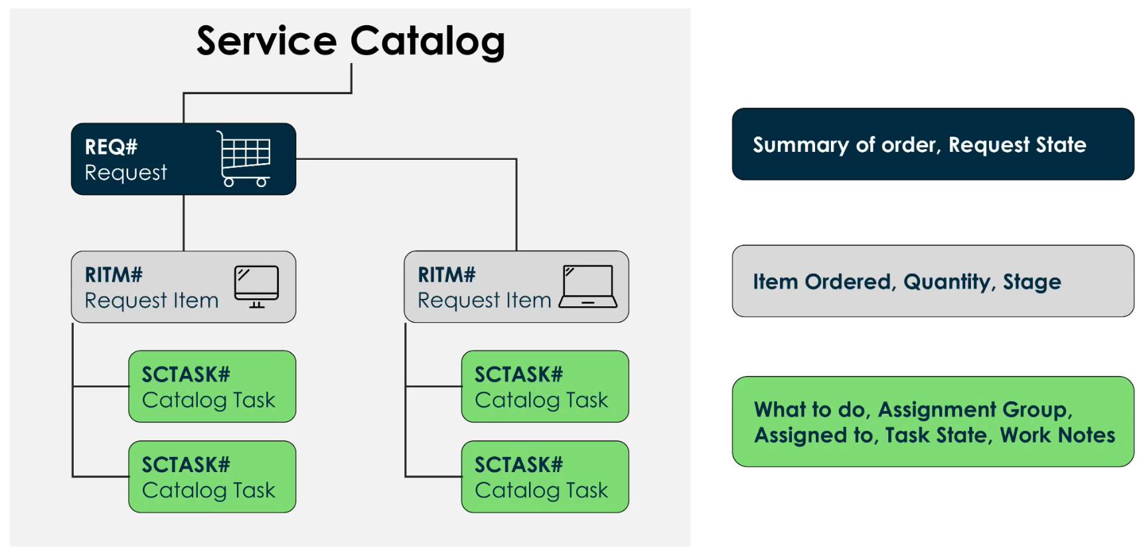
Requests may have Multiple Items & Items multiple tasks

Slide 25
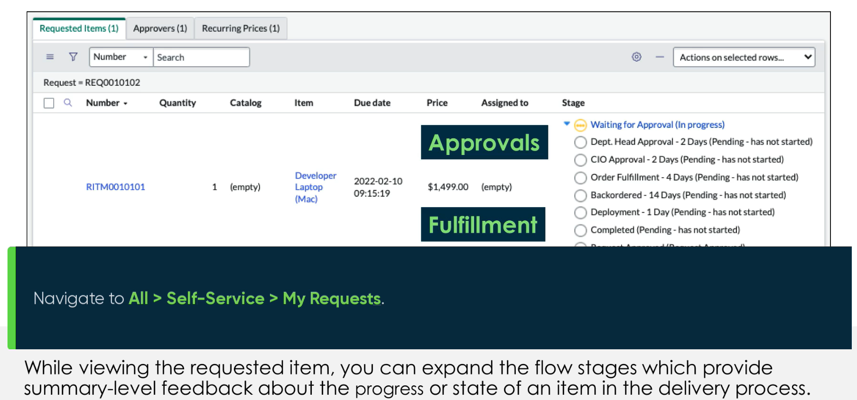
View Active Requests

Slide 26
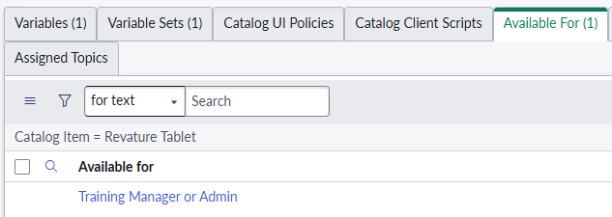
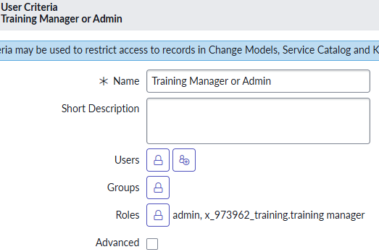
Catalog Item Access
When viewing a Catalog Item record, the ‘Available For’ related list sets criteria for who can view the item
We can define individual users, groups, or select users by roles

Slide 27
Challenge
Goal:
Set security for our new record producer
Scenario:
For the ‘Training Request’ Record Producer – make sure it is only available to admins and users with the ‘Training Manager’ role

Slide 28
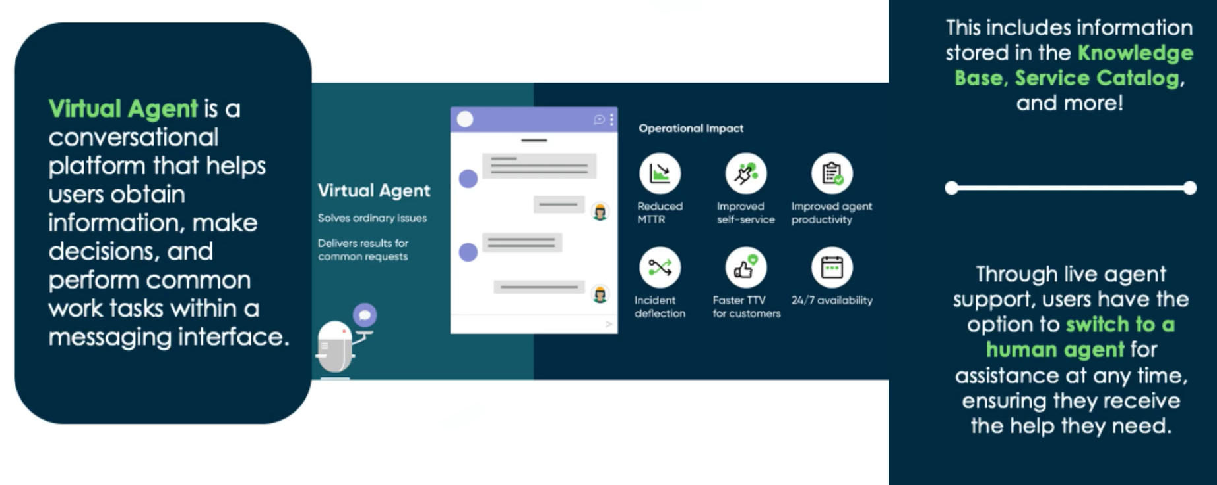
Virtual Agent
Definition: The Virtual Agent is an AI powered conversational platform that assists users on ServiceNow

Slide 29
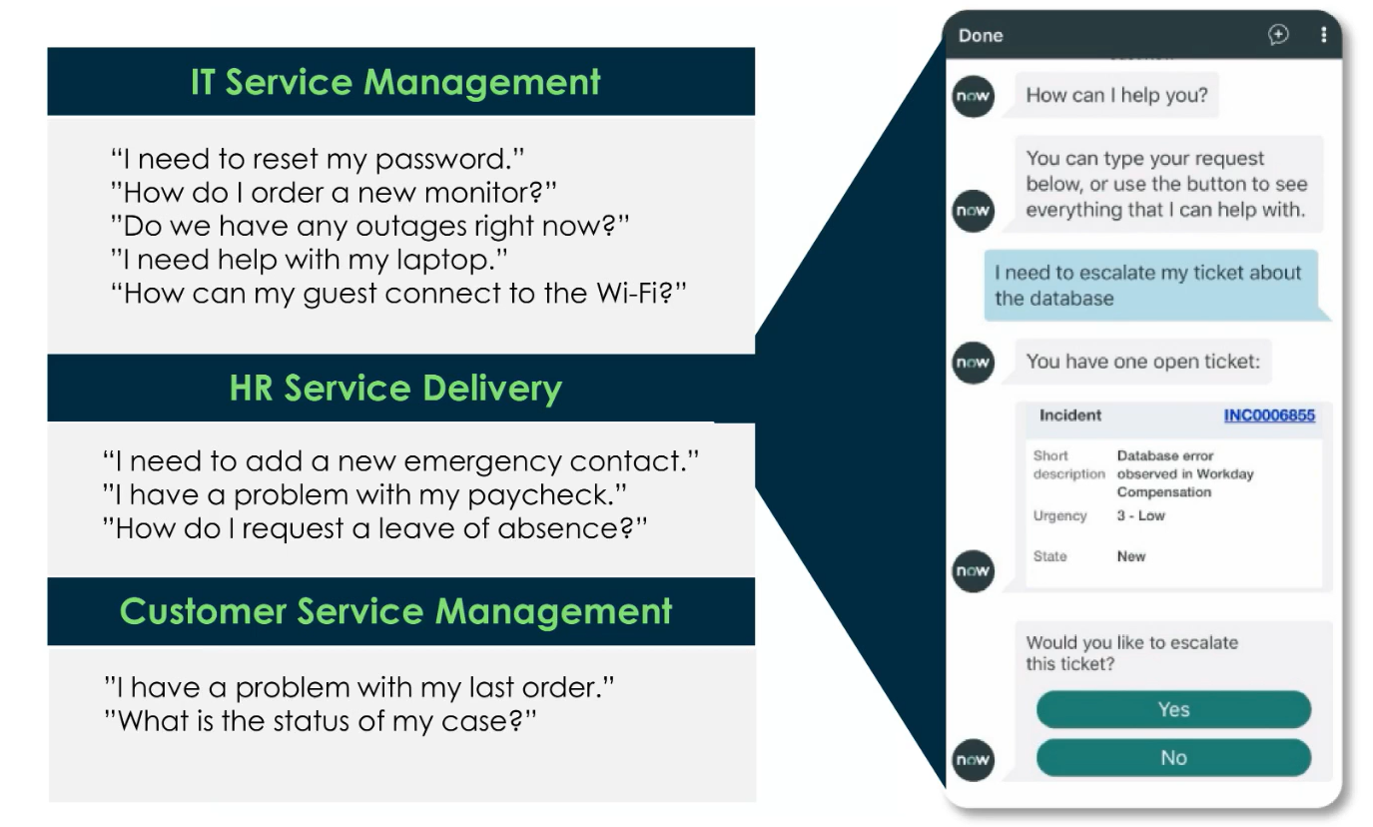
Virtual Agent

Slide 30
Automation

Slide 31
Workflows Vs Flows
Definition: Workflow is a legacy application that provided a drag-and-drop interface for automating multi-step processes across the platform
As of the Zurich release, new customers no longer receive OOB workflows created by ServiceNow, all legacy workflow functionality is replaced with flows
Only customers who upgraded from prior versions retain the ability to use and edit existing legacy workflows
We should use flows instead
Definition: A Flow is an automated process consisting of a sequence of actions and an initiating trigger

Slide 32
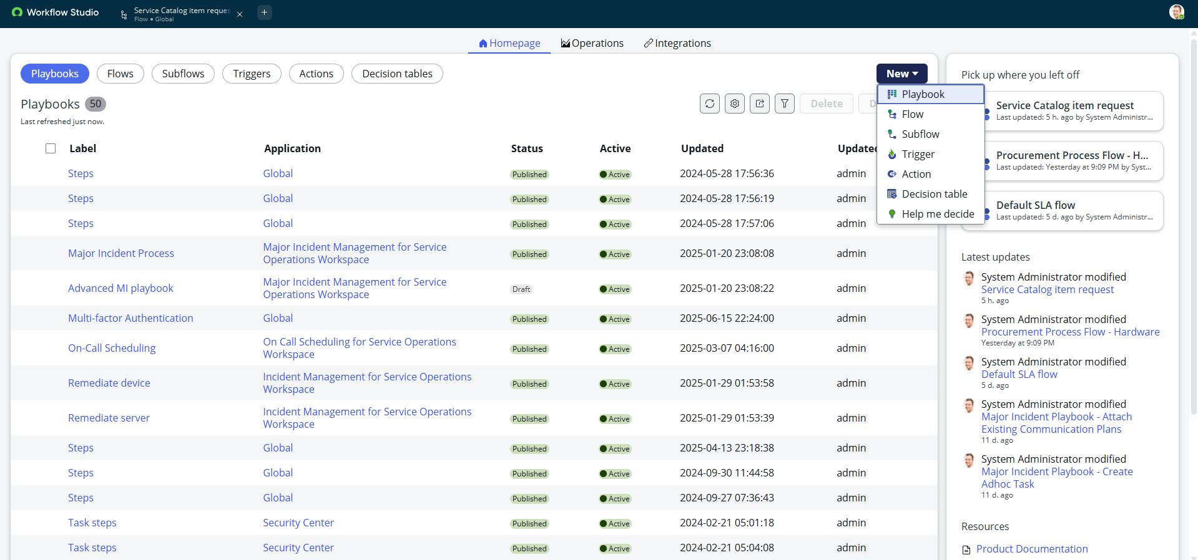


Workflow Studio
Definition: Workflow Studio is the main interface in ServiceNow that brings multiple automation tools together

Slide 33
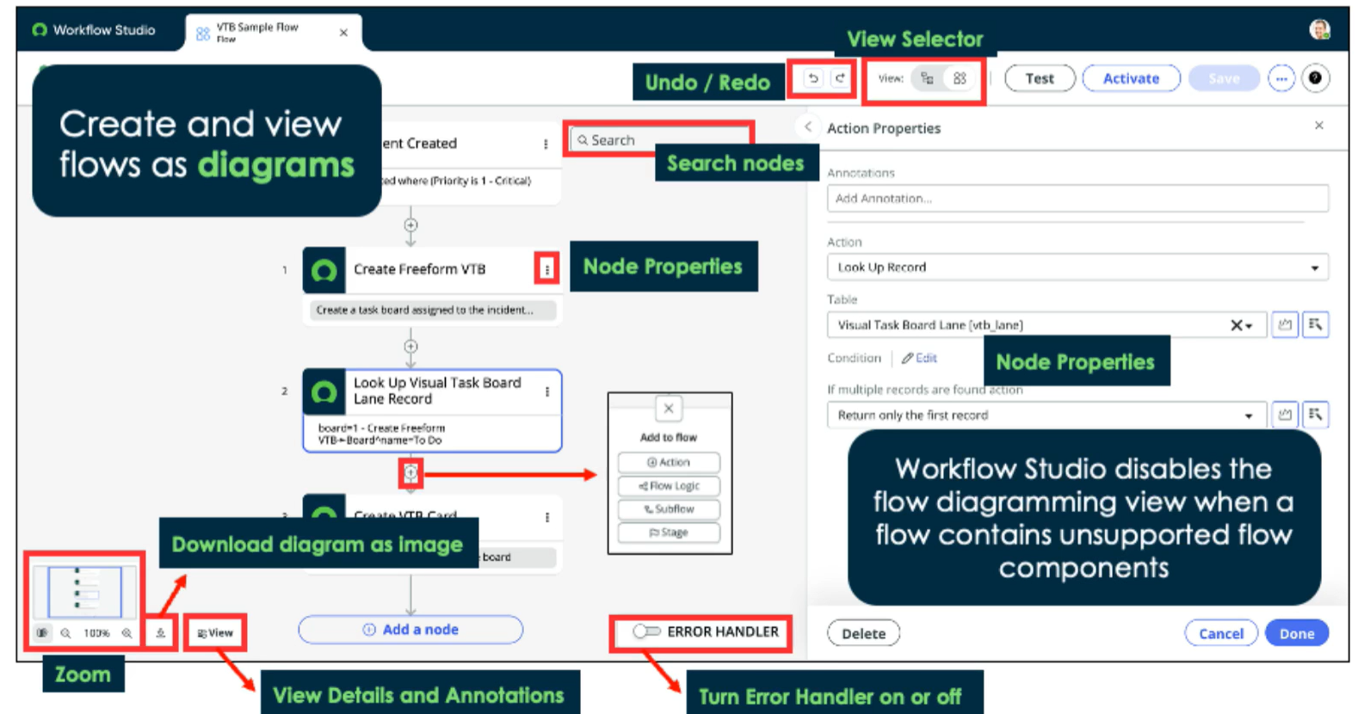
Flow Diagram View

Slide 34
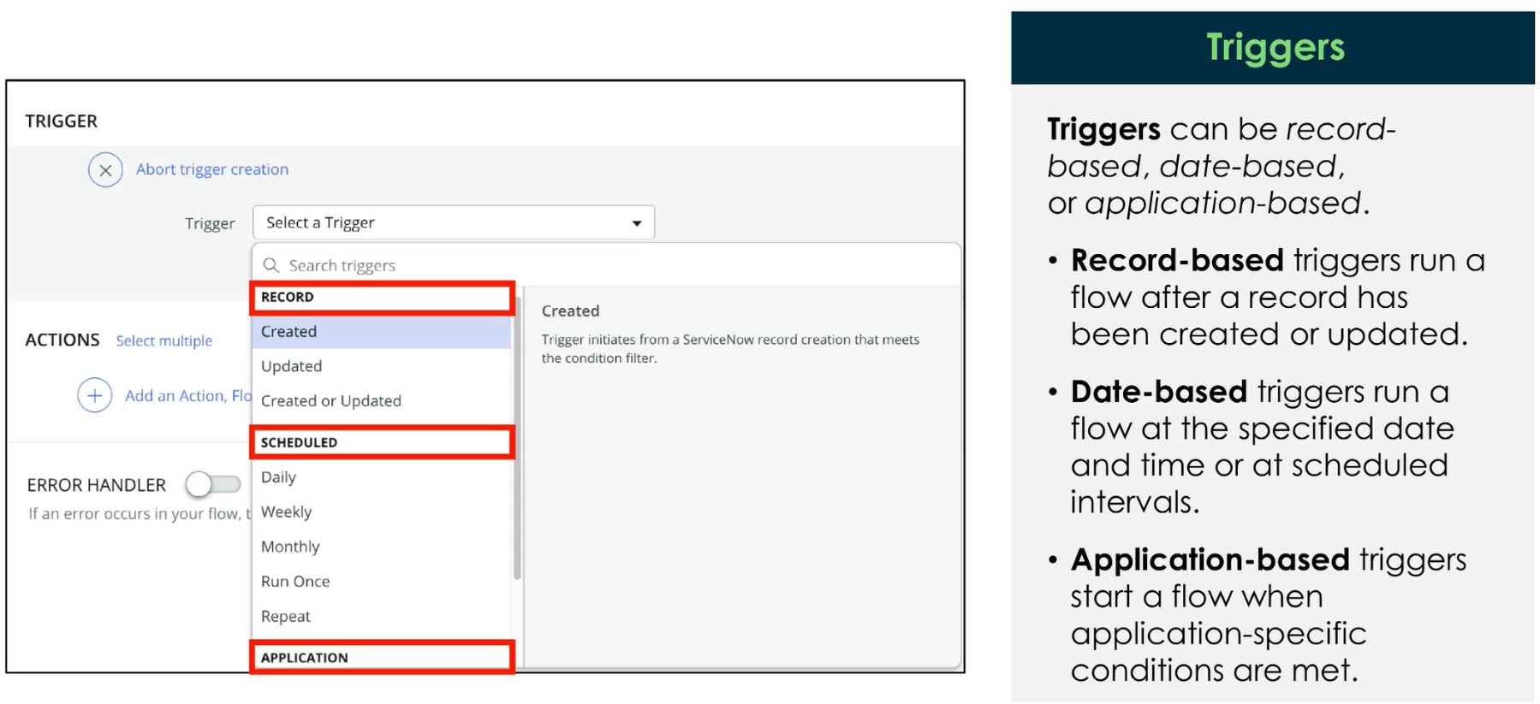
Triggers

Slide 35
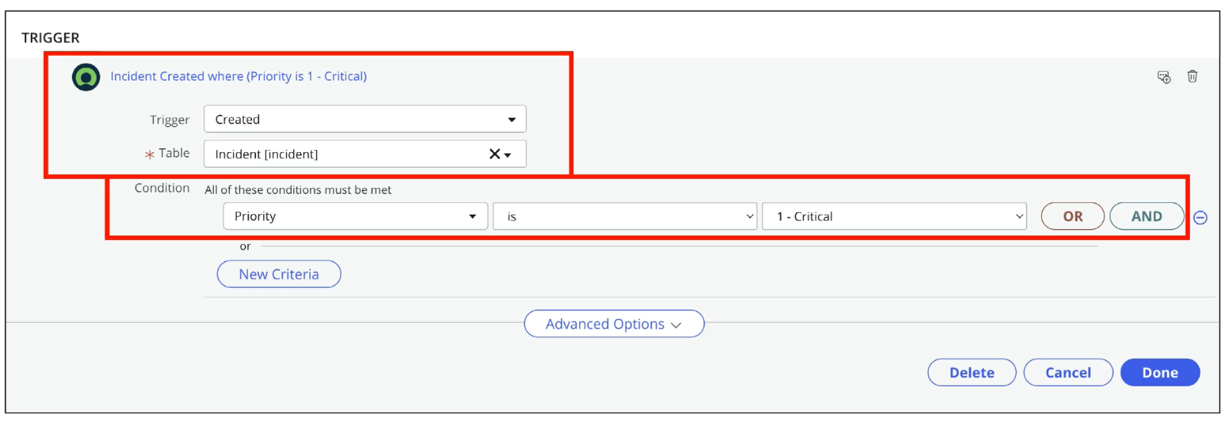
Triggers

Slide 36
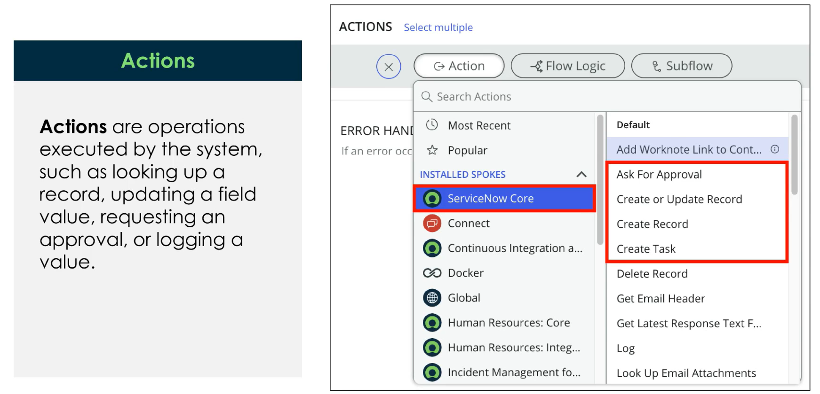
Actions

Slide 37
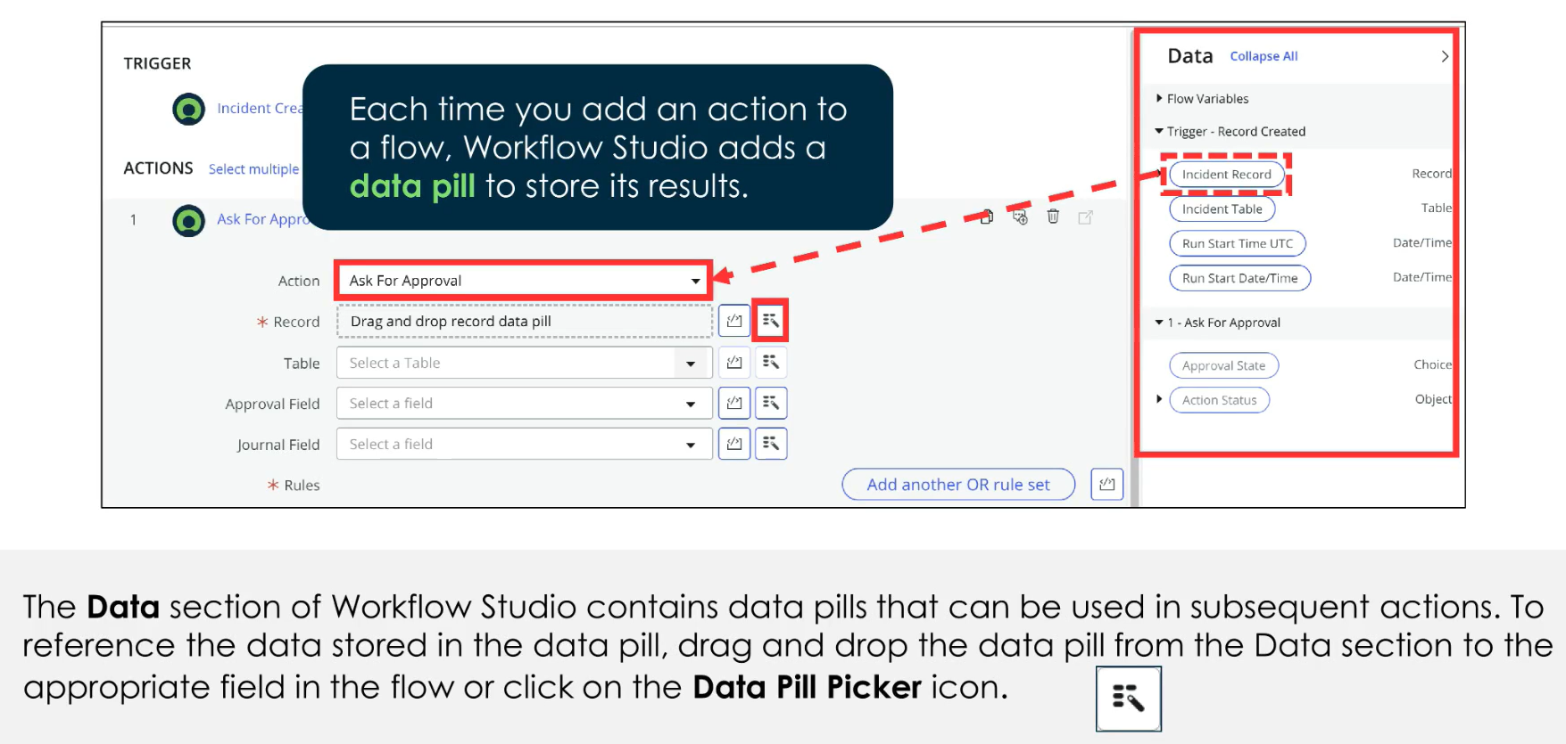
Data Pills

Slide 38
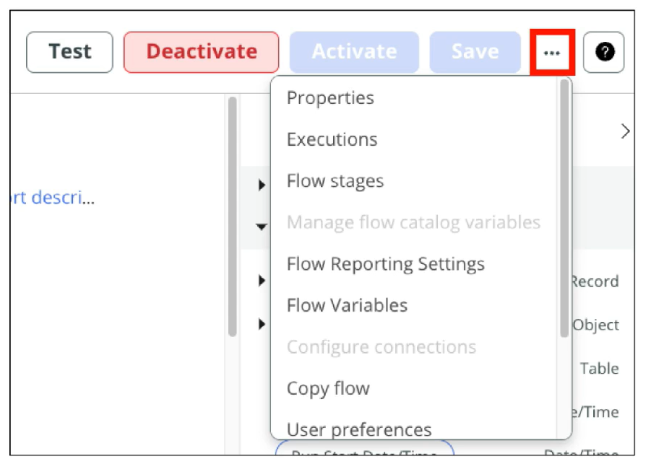
Settings
Change the name of the flow
Set Flow stages
Copy the Flow
And more…

Slide 39
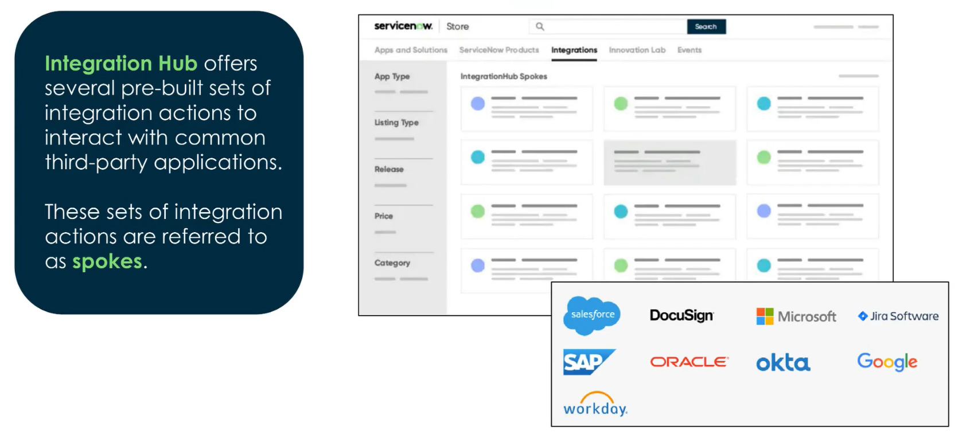
Integration Hub

Slide 40
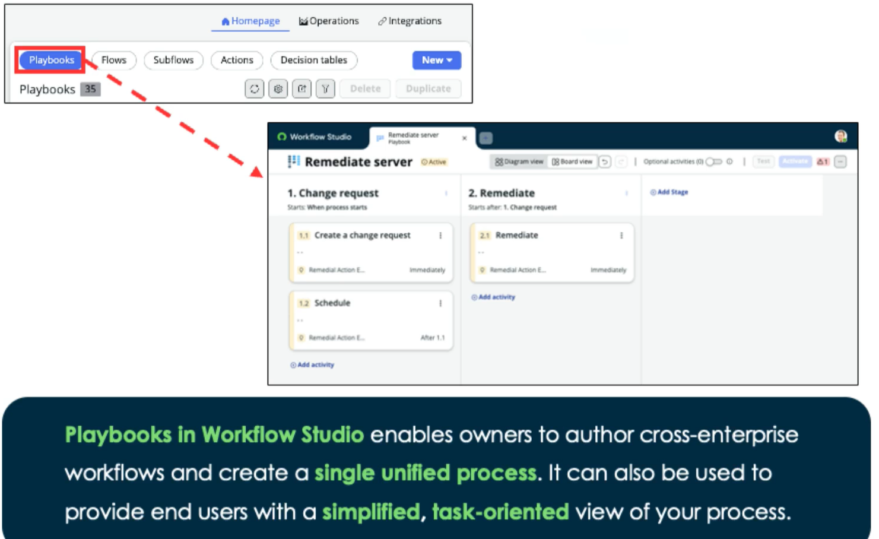
Playbooks

Slide 41

Decision Tables
Definition: Decision Tables simplify complex logic statements and can be used in flows, playbooks, and scripts
Specify inputs
Evaluate conditions
Produce results as output
Often used to replace if/else logic

Slide 42
Challenge
Goal:
Create a Flow
Scenario:
Create a Flow that triggers when Incidents are created
Check to see if any other incidents were created in the last 7 days that have the same CI
If more than 2 Incidents with the same CI have been created in the last 7 days, then create a problem record
Associate all these incidents with the new problem record

