Slide 1
Data Migration

Slide 2
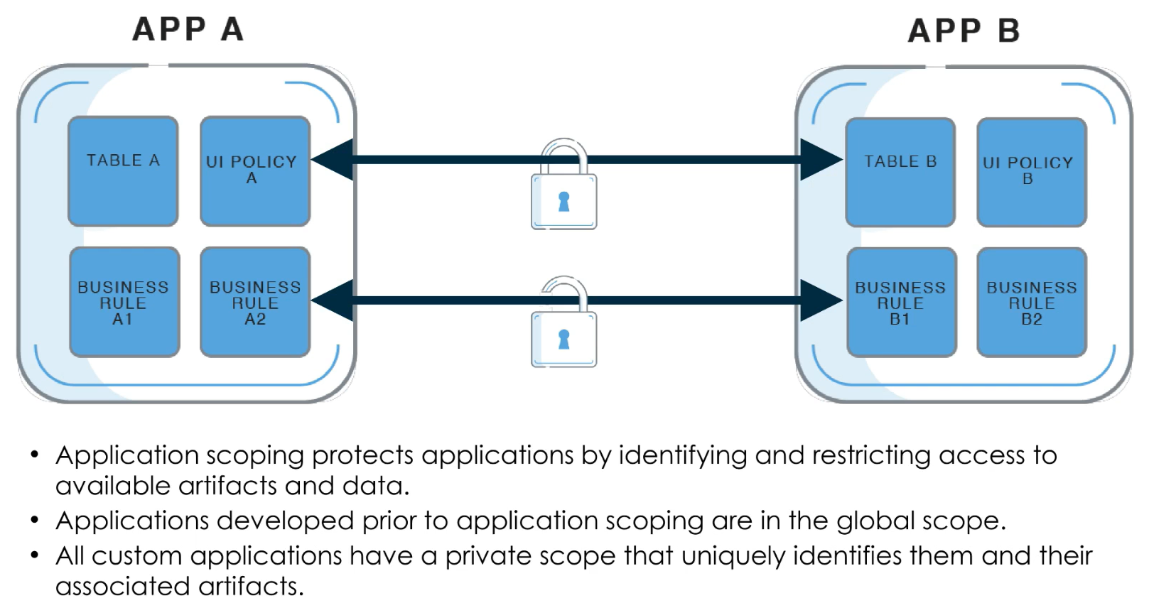
Application Scopes

Slide 3
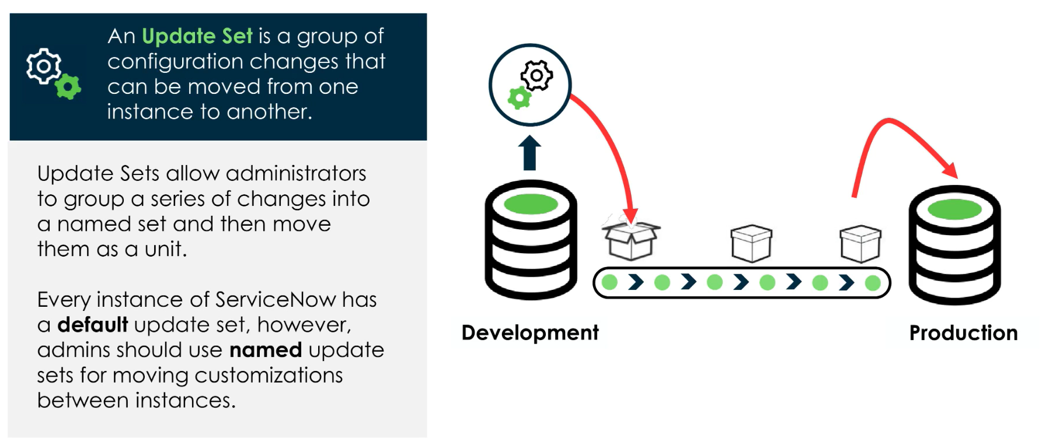

System Update Sets

Slide 4
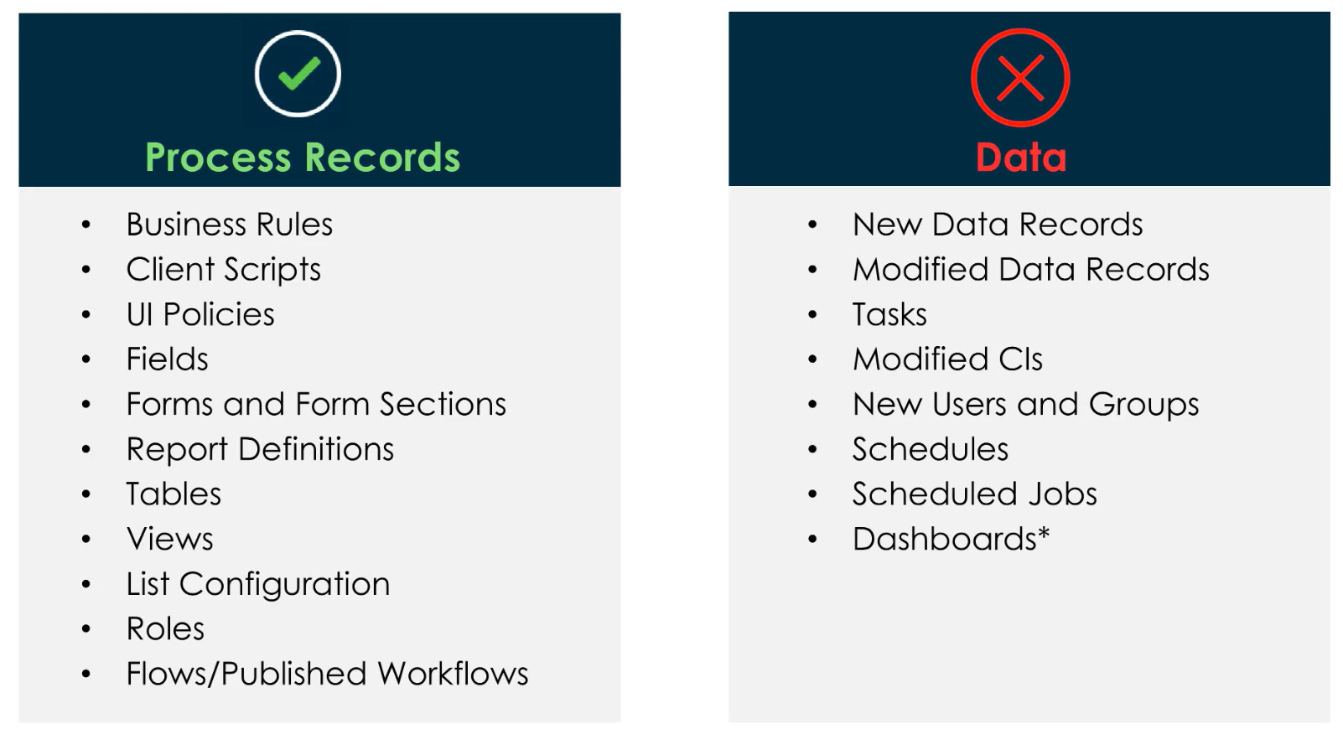
What is Captured in an update Set?

Slide 5
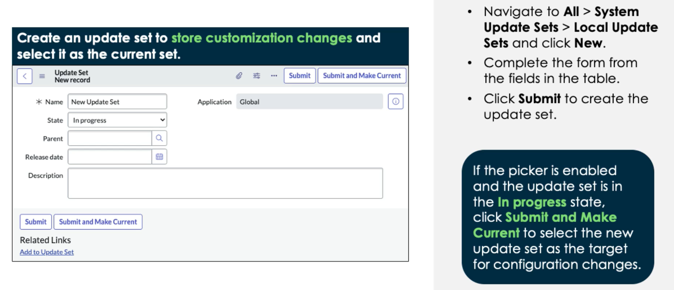
Create & Select an Update Set
BEST PRACTICE: Follow your organizations naming convention!
One common example: Story Number + Description + Username STRY00123_IncidentNewFIelds_EWIL

Slide 6
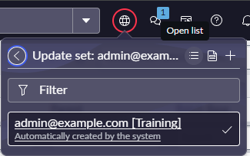
Update Set Picker
We can also use the update set picker to:
Create a new update set quickly
View the current update set record
Or view the list of all local update sets

Slide 7
Challenge
Goal:
Create an Update Set
Scenario:
Create a new Update Set on the global app scope
Name it: STRY001_IncidentNewFIeld_YOURNAME
Ensure you are on the global app scope and have your update set selected, then create a new True/False field on Incident forms called ‘Partner Customer’

Slide 8
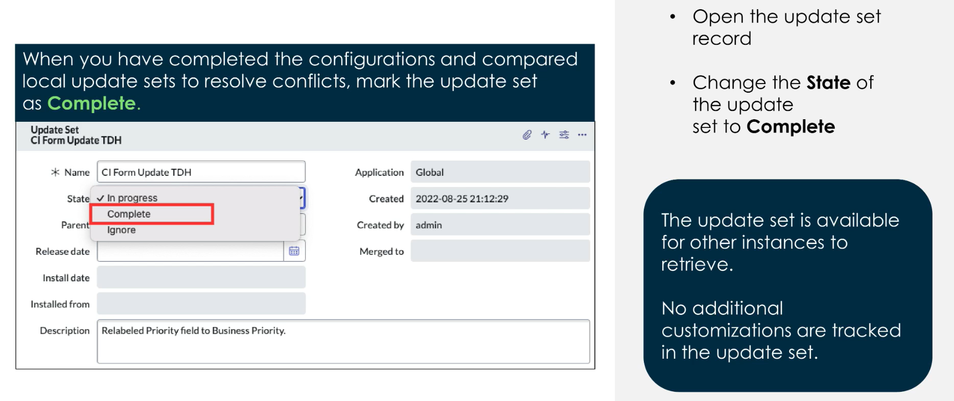
Mark an Update Set Complete

Slide 9
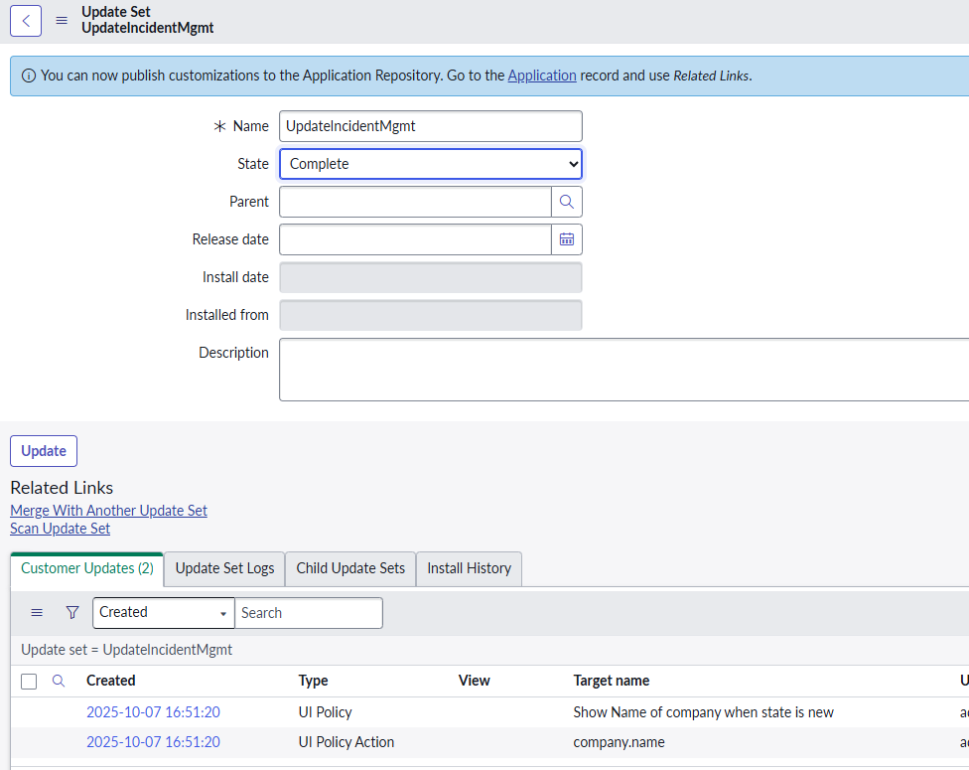
BEST Practices
NEVER mark the ‘Default’ Update Set as complete
This Update Set is a ‘catch-all’ that collects stray updates
We should ALWAYS use a NAMED Update Set to catch configuration changes
If some configurations are in ‘Default’ by mistake, we can manually move ‘Customer Updates’ to a new Update Set
NEVER revert an Update Set from ‘Complete’ back to ‘In Progress’
If more customizations are required, we should create a new Update Set, make our changes there, and then commit them in the order they were created

Slide 10

Export as XML
Once an Update Set is complete:
We can export our set as an XML file
This allows us to manually use the file to bring our customizations into another instance

Slide 11
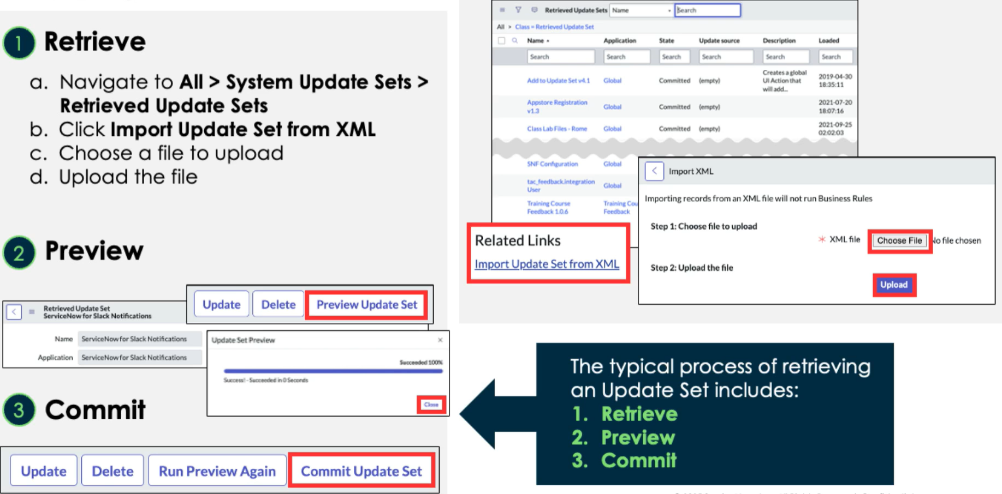
Apply an Update Set
NOTE: We can load older release update sets into newer releases, but loading newer sets into older releases needs testing for compatibility!

Slide 12
Challenge
Goal:
Practice applying Update Sets from XML
Scenario:
Mark your Update Set created earlier as complete
Export your Update set as XML
Import your Update Set from XML
Preview your Update Set

Slide 13
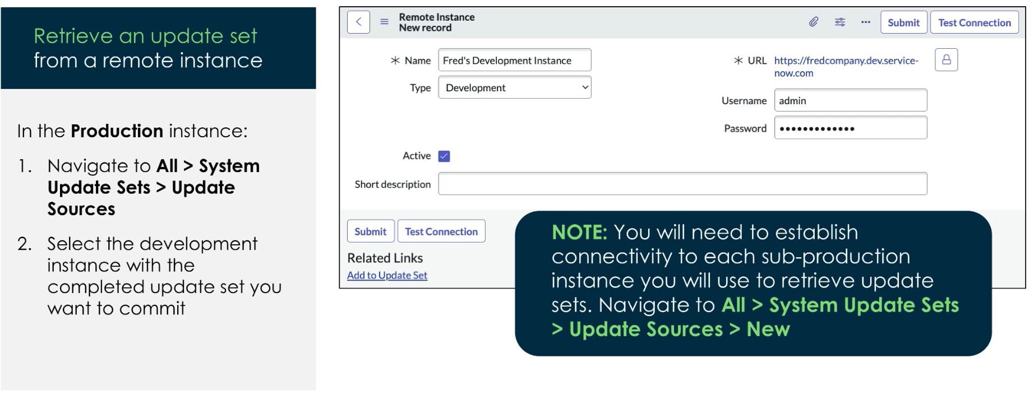
Retrieve from a Remote Instance

Slide 14
Challenge
Goal:
Team up with a partner and remotely apply your update set
Scenario:
Pair up into groups of two
One of you choose to ‘send’ the Update Set and the other will ‘Retrieve’ it
Practice testing the remote connection and applying the update set between the two instances

Slide 15
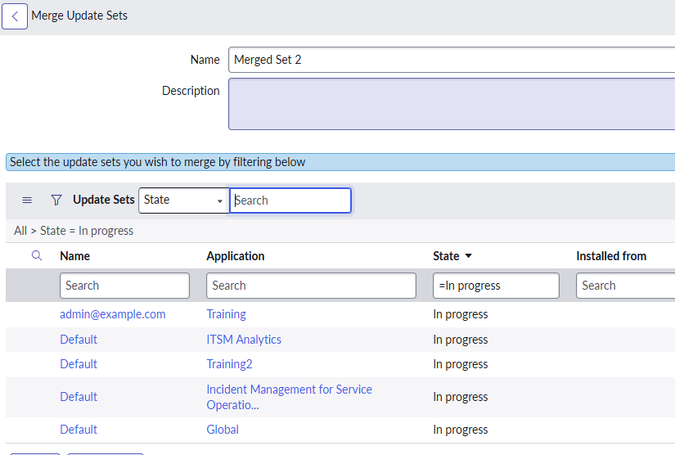
Merge Update Sets
Merge two or more Update Sets into a third, brand-new set
All the ‘Customer Updates’ in merged sets are moved to the new merged set

Slide 16
Scripts

Slide 17
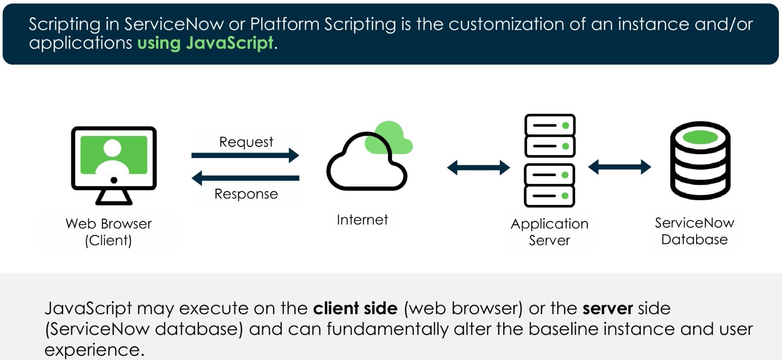
What is scripting?

Slide 18
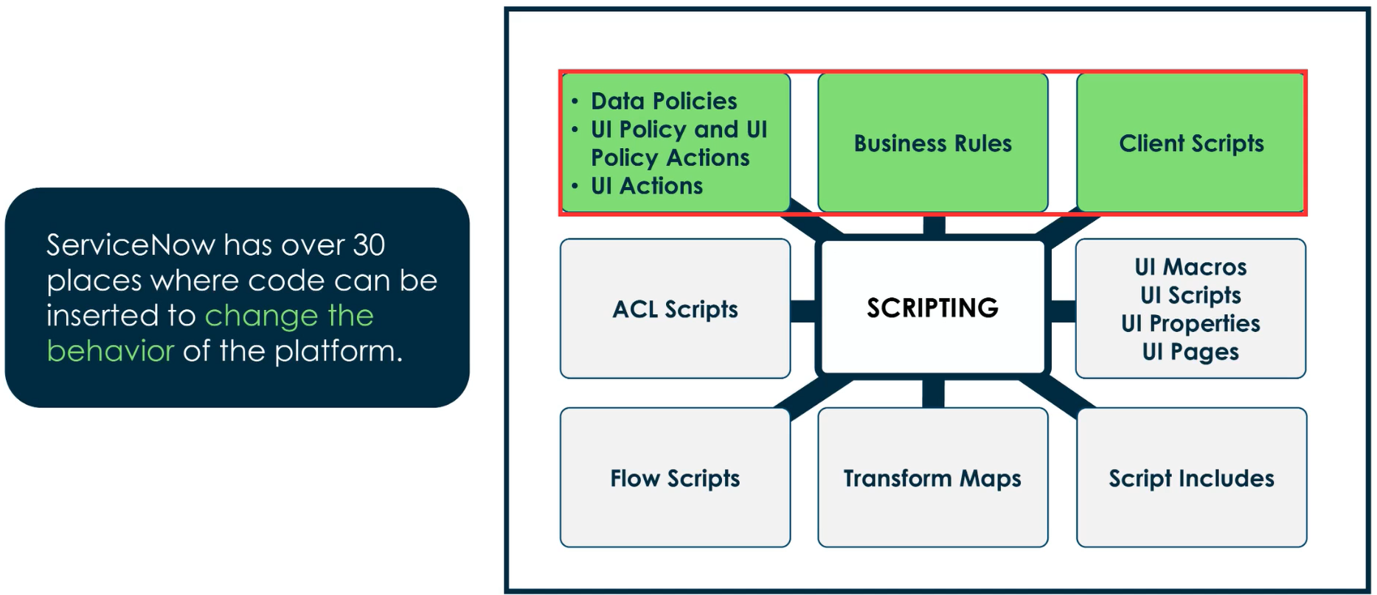
Scripts in ServiceNow

Slide 19
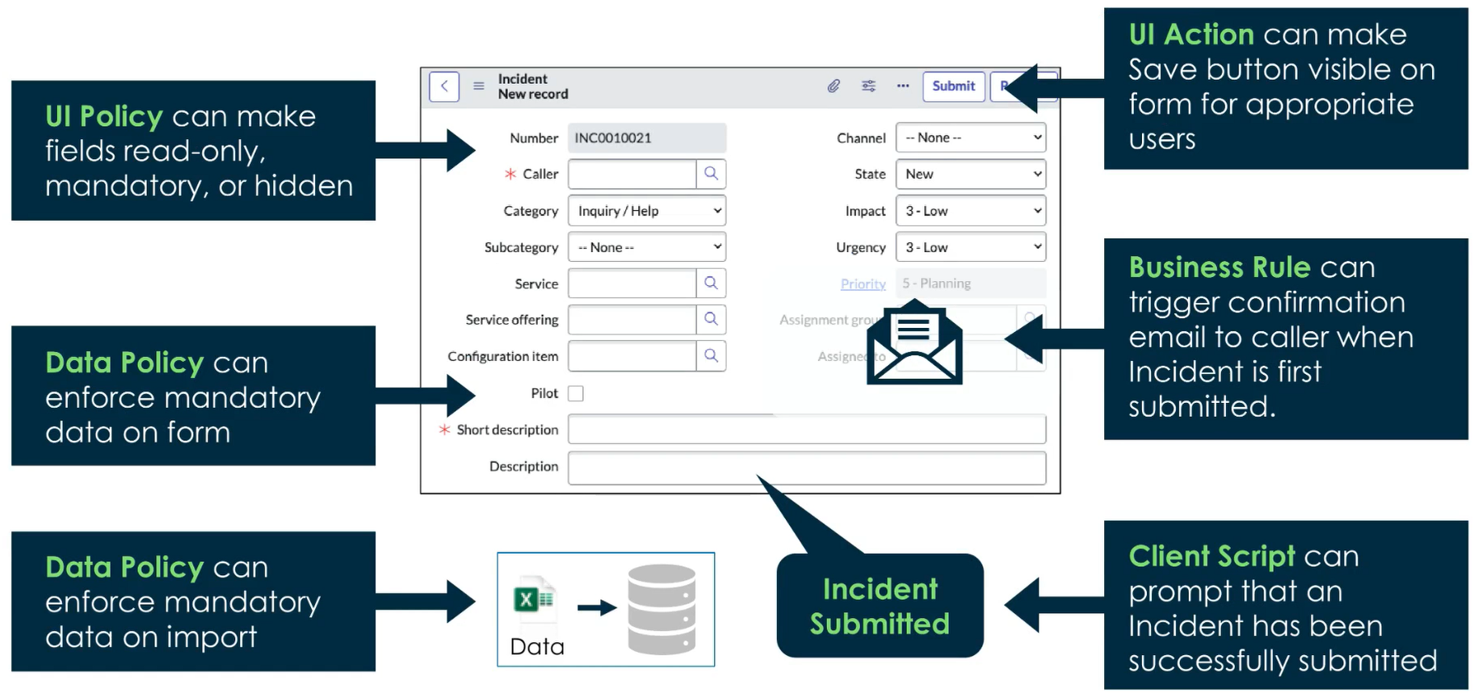
Samples

Slide 20
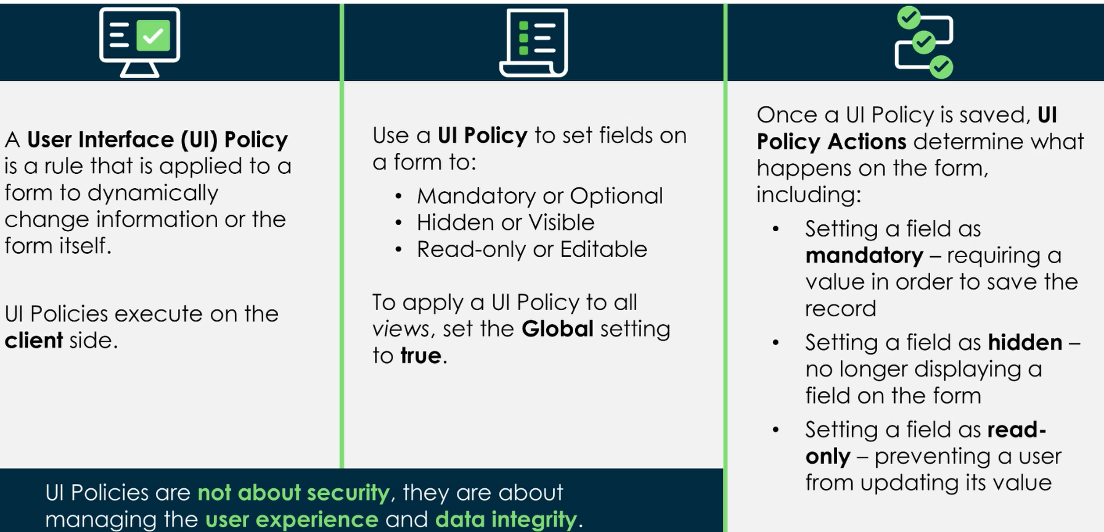
UI Policies

Slide 21
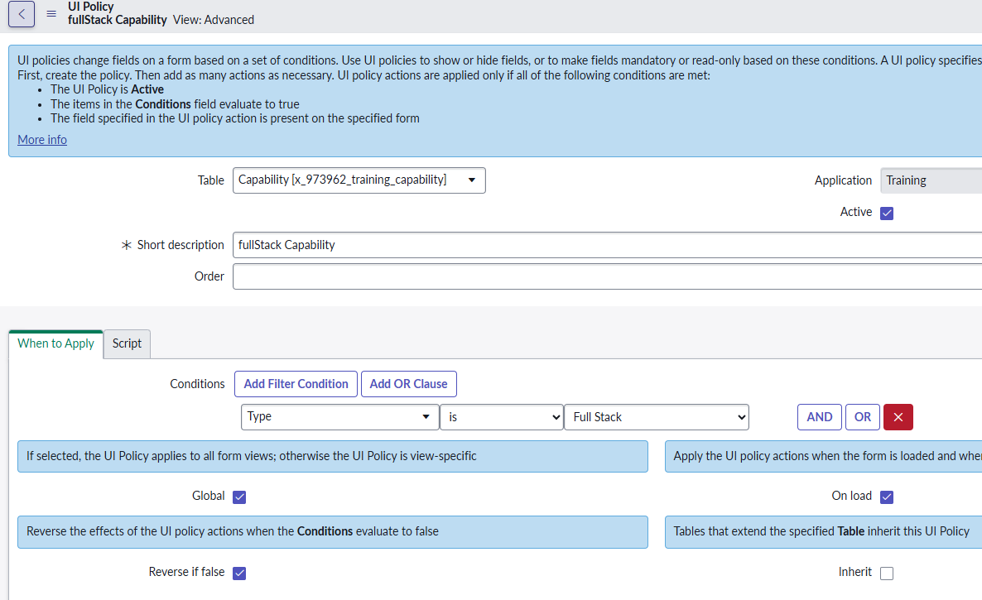
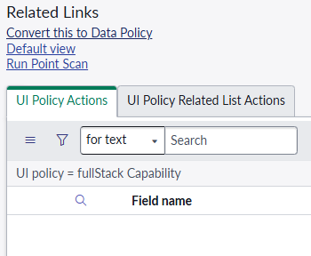
UI Policies
All > System UI > UI Policies
Actions appear as a related list
Note we can also conditionally hide related lists
UI Policies are supported in Form Builder (everything except scripts/related list functionality)

Slide 22
Challenge
Goal:
Create a UI Policy
Scenario:
On the Capability form:
If the ‘Type’ field is set to ‘Full Stack’, then the string ‘Description’ field should be marked as mandatory

Slide 23
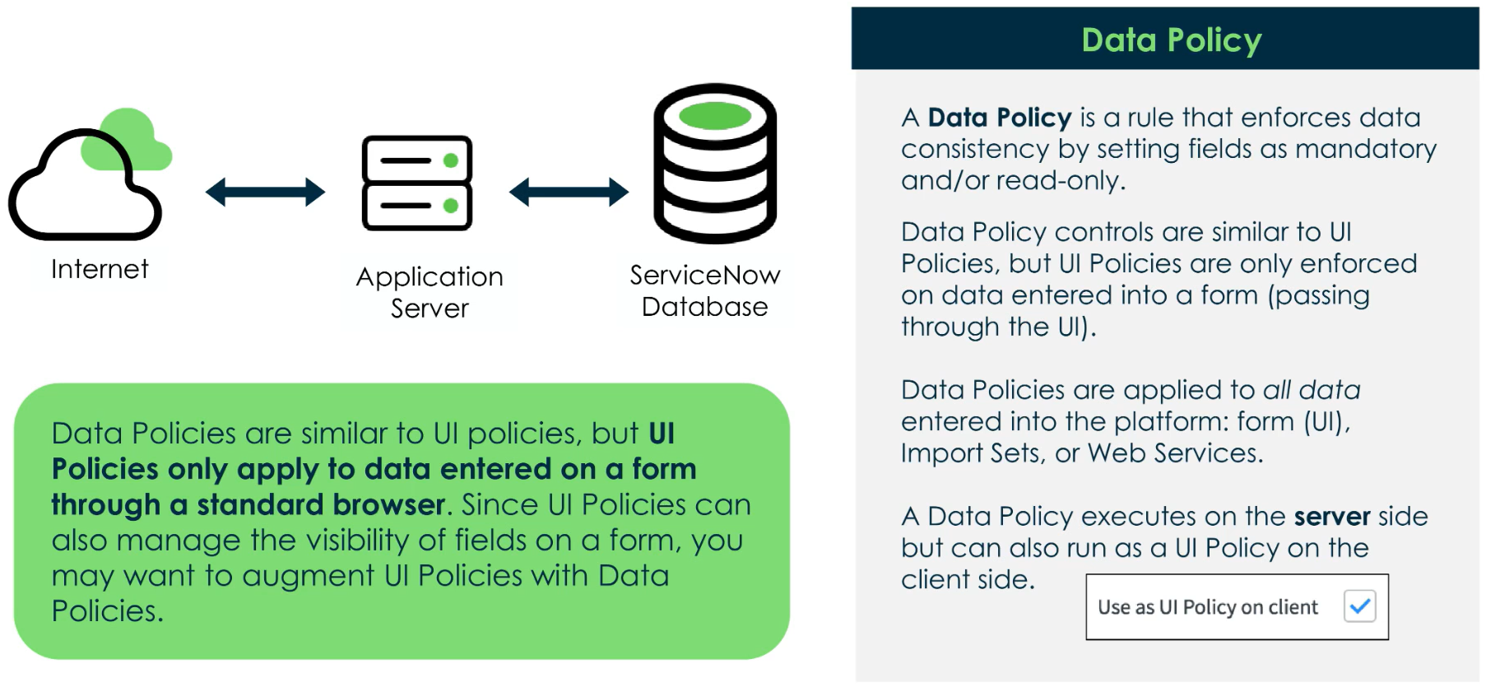
Data Policies

Slide 24

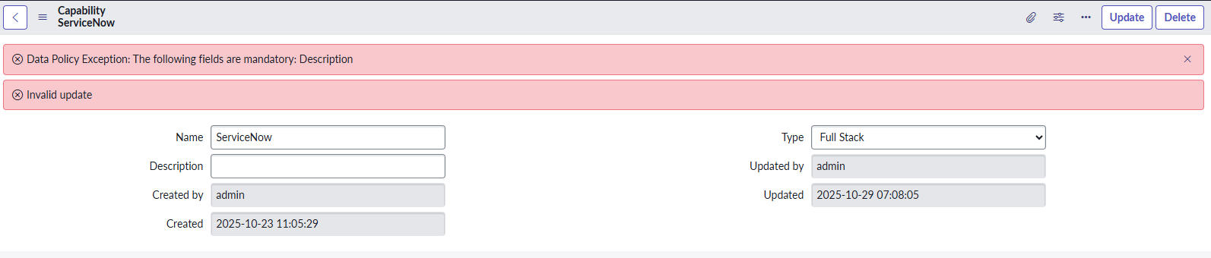
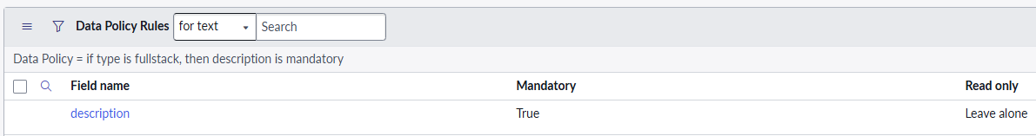
Data Policies
Note the option to force Data Policies to also behave as a UI Policy
If this box isn’t checked, then the user wouldn’t get any error until after they try and save the record
Once a Data Policy is saved, you add Data Policy Rules to determine which fields should be mandatory/read-only

Slide 25
Challenge
Goal:
Create a Data Policy
Scenario:
If a user record ‘Department’ field is not empty, then make the following fields mandatory:
Zip code
Business Phone
Email
Does making a field mandatory through a data policy automatically put the field on the form?

Slide 26
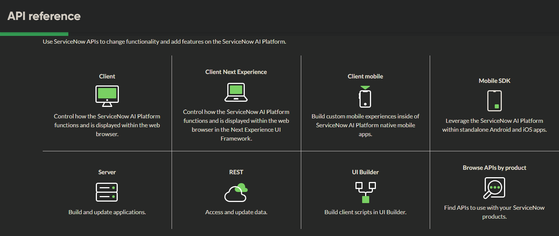
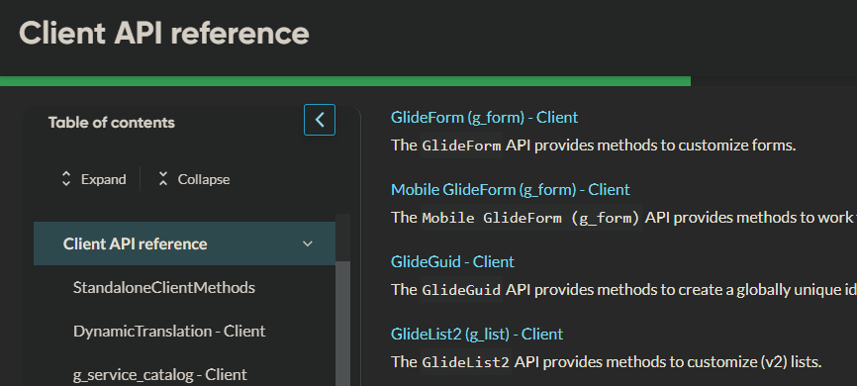
Intro To Glide Classes
We have out-of-the-box classes that expose underlying ServiceNow functionality
Client-Side Classes
(GlideForm) g_form – provides methods to work with forms
g_form.addErrorMessage('This is an error');
Server-Side Classes
(GlideSystem) gs – provides methods to work with the system
gs.getUserId(), gs.getUserName(), etc.

Slide 27
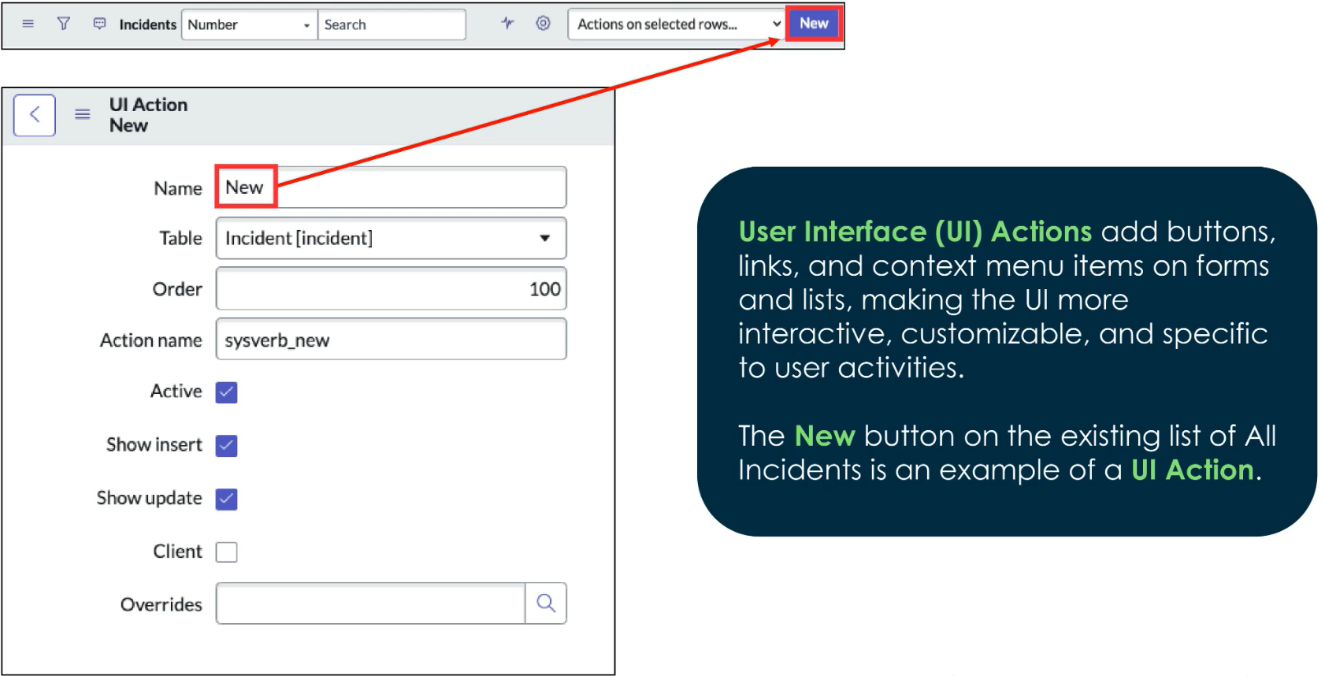
UI Actions

Slide 28
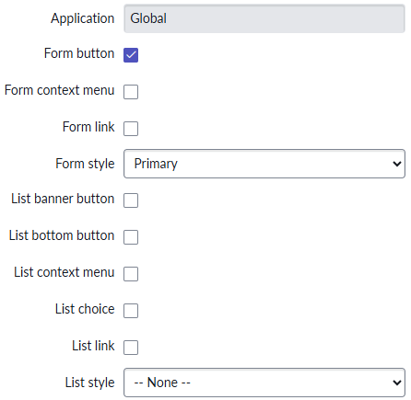
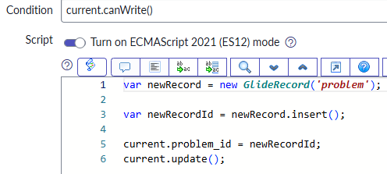
UI Actions
We have many UI elements we can create actions for
We then use scripts to set our UI Action into motion

Slide 29
Challenge
Goal:
Create a UI Action
Scenario:
Create an incident form button called ‘Create Problem’
The button should create a problem record and link the current incident to the problem

Slide 30
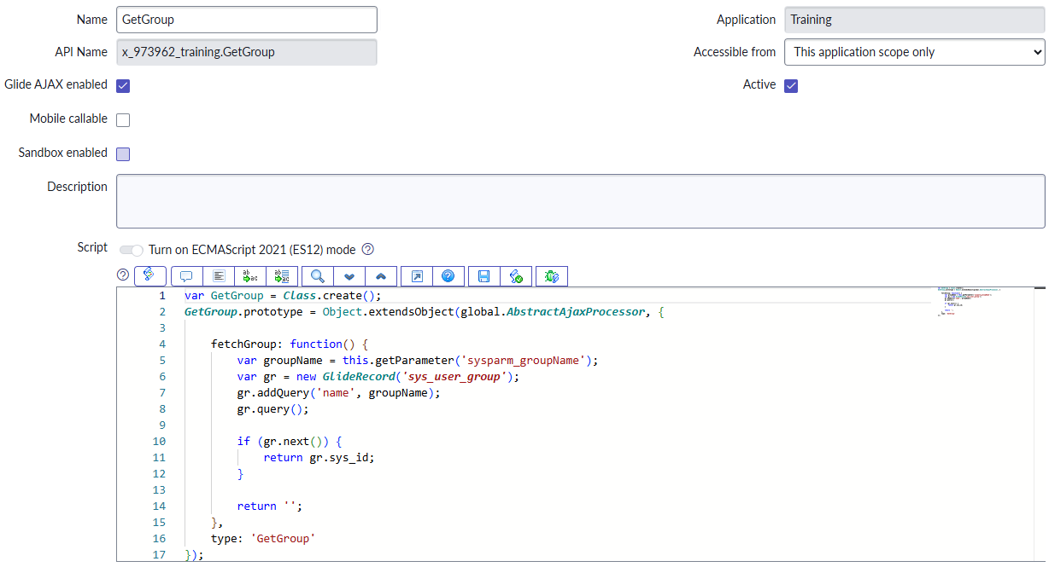
Script Includes
Definition: A Script Include is a JavaScript class or function that runs server-side
Helps us organize logic
Promotes DRY principles
Triggered by other scripts on the server or client
Can take in parameters to be used in the script

Slide 31
Challenge
Goal:
Create a Script Include
Scenario:
Create a Script Include that takes in the string value of a sys_user_group ‘name’ field
The script should query for and then return the sys_id of the record that matches our query

Slide 32
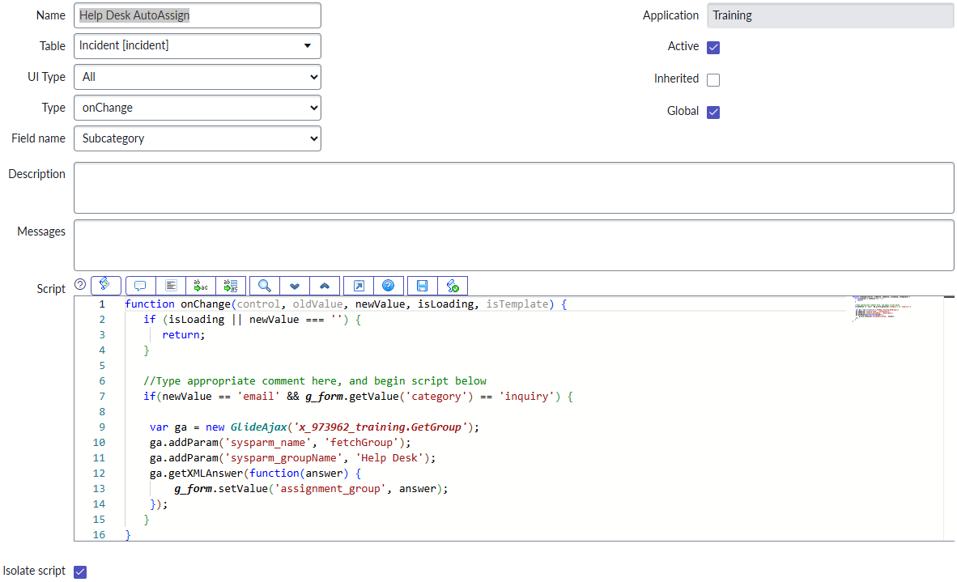
Client Scripts
Definition: A Client Script is used to make real-time changes to the appearance and behavior of UI elements, usually forms
Runs client-side
Make fields visible based on conditions
Auto-populate fields based on conditions
4 types: onCellEdit, onChange, onload, onSubmit

Slide 33
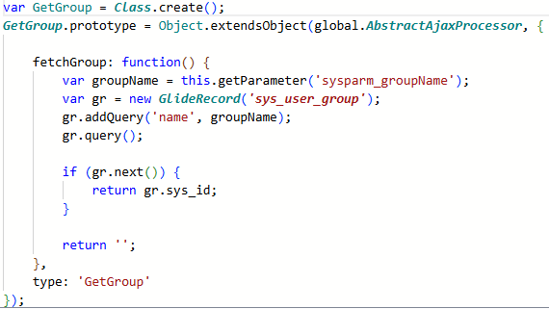
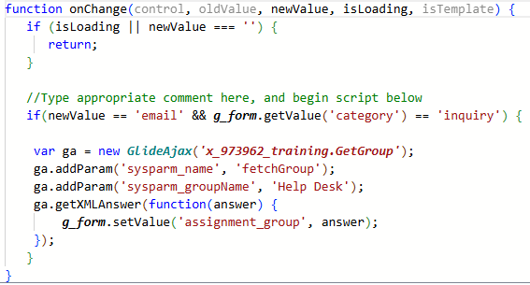
GLideAjax
Definition: GlideAjax is used to call server-side script includes from client-side scripts
Notice how we pass parameters – ‘sysparm_name’ represents the function in the script include
Script Include:
Client Script:

Slide 34
Challenge
Goal:
Create a Client Script
Scenario:
Create a Client Script that runs when incident ‘Category’ is ‘Inquiry/Help’ and ‘Subcategory’ is ‘Email’
The Assignment Group should be set to ‘Help Desk’

Slide 35
Execution Order
DOCS Reference
Before Business Rules (with order less than 1000)
Before Engines: i.e. assignment rules, escalations, role assignments
Before Business Rules (with order over 1000)
The database operation (insert, update, delete)
After Business Rules (with order less than 1000)
After Engines: i.e. role check again here, Flow triggers
Email Notifications & Events
After Business Rules (with order greater than 1000)

Slide 36
Business Rules
Definition: A Business Rule runs when a CRUD trigger occurs, it will then set a field value
Can be configured to trigger when a record is viewed, inserted, updated, deleted, or when a table is queried
Sets field values based on criteria provided
Runs server-side
There are 4 types of Business Rules:
Before – executes before a record is inserted, updated, etc.
After – executes after a record is inserted, updated, etc.
Async – executes when resources become available, so the client isn’t waiting on the server
Display – executes before the record is displayed
BEST PRACTICES:
Consider if you can use a Flow instead!
If using scripts, avoid current.update() to avoid recursive business rule!

Slide 37
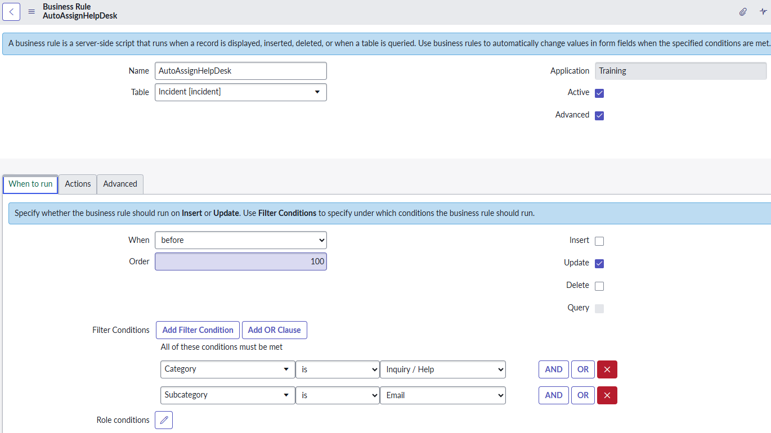
Business Rules
If no roles are set it will run for everyone
Set fields on the ‘Actions’ tab
Create scripts on the ‘Advanced’ tab

Slide 38
Challenge
Goal:
Create a Business Rule
Scenario:
Create a Business Rule that runs when incident ‘Category’ is ‘Inquiry/Help’ and ‘Subcategory’ is ‘Email’
The Assignment Group should be set to ‘Help Desk’
What’s the difference between this and the client script + script include?
Impersonate a user with the ITIL role. Do both the client script & business rule work? Why or why not?

Slide 39
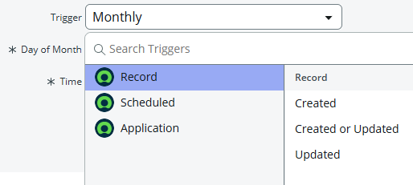
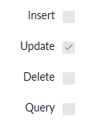
Best Practice Review
Use Assignment Rules for core, reusable “who should own this ticket” logic (but other tools may be better suited because assignment rules don’t work unless assignment fields are empty)
Use Client Scripts for form-level interactivity only (don’t rely on them for actual record data integrity)
Use Flows when logic depends on record inserts or updates, advanced workflow conditions, or integrations
Use Business Rules when logic depends on record inserts, updates, deletions, advanced workflow conditions, or integrations (we can just call a flow from the business rule via script as a workaround)
Never mix ‘assigned_to’ or ‘assignment_group’ setting logic in multiple places for the same condition — pick one place to avoid confusion.
Flow:
Business Rule:

Slide 40
Challenge
Goal:
Solve a business case
Scenario:
The CAB team wants to ensure that high-risk changes require a documented backout plan
What tool should we use? Why?
Hint: The change table is [change_request]
Notes:
UI Policy = because the tool’s main purpose is to make fields required, read-only, or mandatory, and it does that job well without needing any code

Slide 41
Challenge
Goal:
Solve a business case
Scenario:
The Service Operations team wants the department of an incident caller to populate on the incident record when the caller is selected
Not just the text value of the department, this should be a reference field that directly links to the department record
Hint: We should NOT use a dot-walked field via Form Builder, that would break a best practice of having 2 of the same referenced record in a form. i.e. having both caller_id AND caller_id.department on the form
What tool should we use? Why?
Notes:
Business rule = we can do this without scripts at all using a business rule

Slide 42
Integrations

Slide 43
Integration Options
Definition: Inbound integrations are when our ServiceNow instance accepts requests from external systems
Definition: Outbound integrations are when our ServiceNow instance makes requests to external systems

Slide 44
Inbound Options
REST APIs
REST API Explorer – discover and test ServiceNow’s REST APIs
Scripted REST APIs – build your own endpoints with custom logic
SOAP APIs
Scripted SOAP APIs – build your own SOAP endpoints with custom logic
Import Sets – batch or schedule data imports into ServiceNow tables (REST – IntegrationHub option available)
Email Inbound Actions – use scripts to interpret received email and then create or update records
IntegrationHub (Flow Designer) – use REST triggers to launch a flow from a REST request
IntegrationHub (Import Tool) – schedule batched record imports from files or external systems
MID Server – bridge ServiceNow and on-premises systems
Application Registry – these records define our authentication scheme for OAuth 2.0
Any external system will need to pass through our Application Registry to get an authorization token and an access token

Slide 45
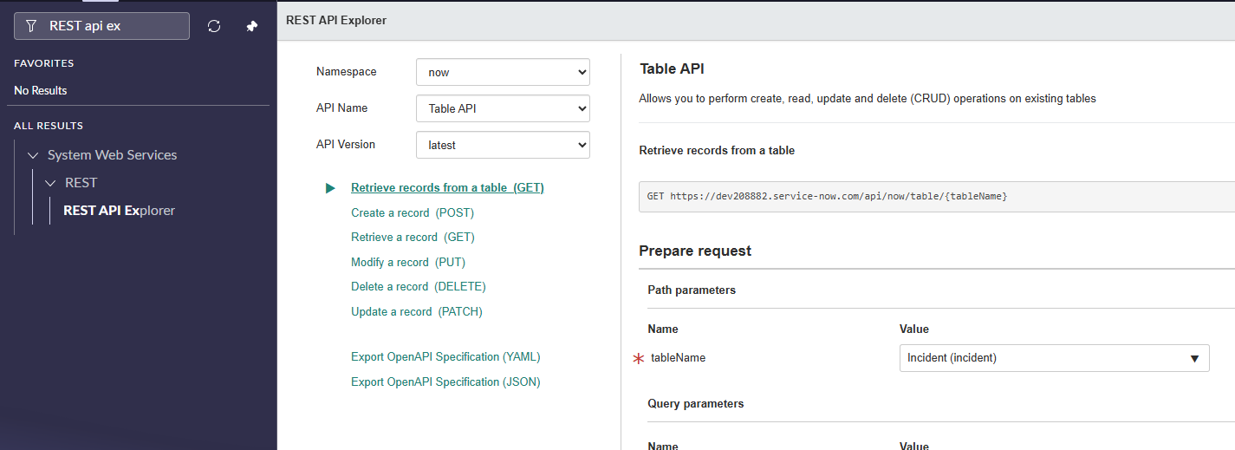
REST API Explorer
Use the REST API Explorer to test REST endpoints on your instance
Offers guidance on how to construct requests

Slide 46
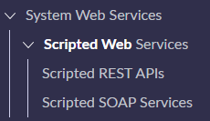
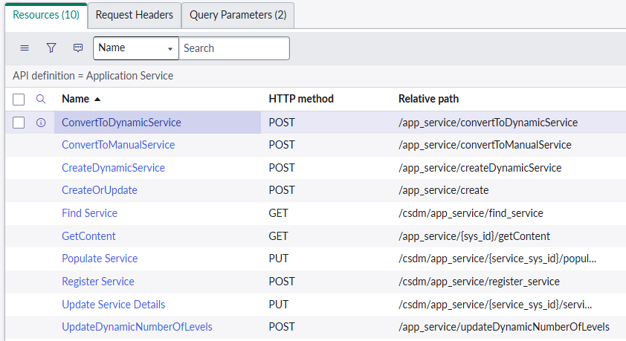
Scripted Web Services
Scripted REST APIs & Scripted SOAP Services both contain logic to handle custom requests
These are endpoints that developers define, and we use scripts to determine how to handle the request and what we send back as the response

Slide 47
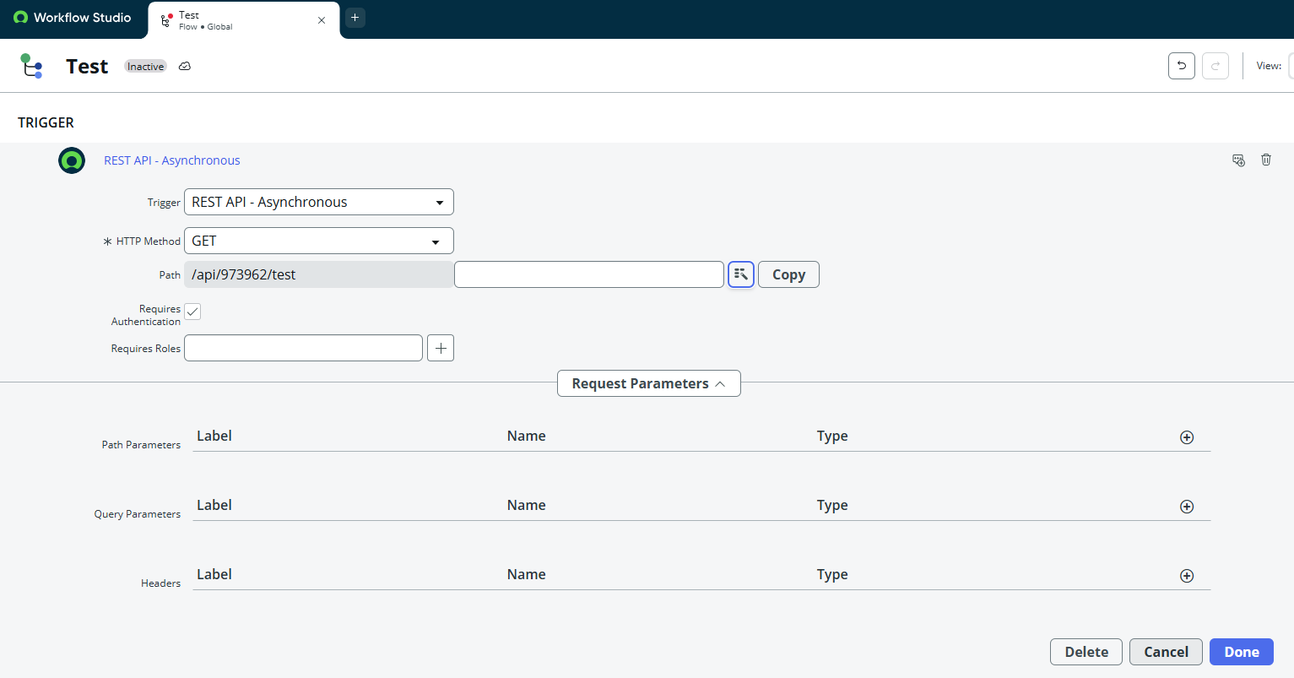
IntegrationHub Enterprise License - REST API Trigger
Requires IntegrationHub Enterprise License
Install from developer site for PDIs
Launch Flows from a REST request

Slide 48
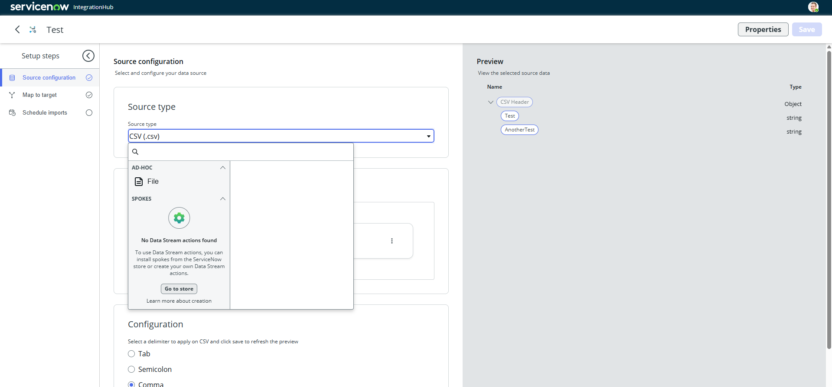
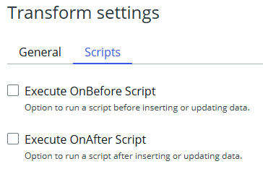
IntegrationHub Import Tool
Map external data to tables via transform mapping, just like Import Sets
We can use Spokes to import record data
Uses the underlying Import Set features but has a more modern UI
Executes scripts before or after imports

Slide 49


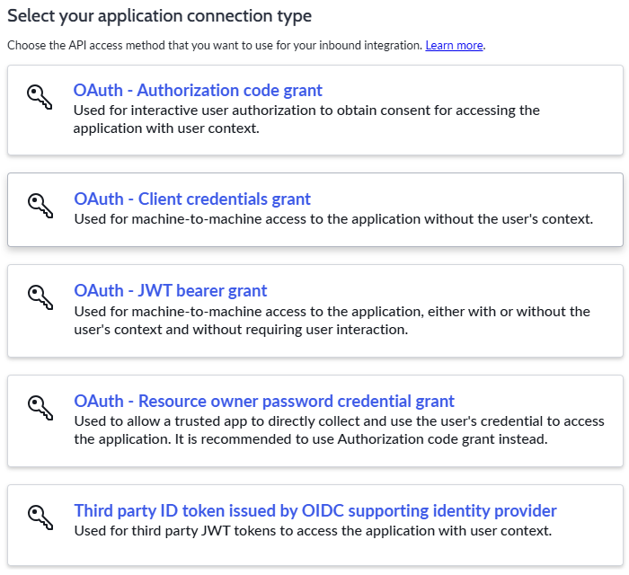
Application Registry & Oauth Grant Types
Application Registries define how external system may authenticate with our instance
Authorization – directs user to instance for login; respects user ACLs
Client credentials – allows us to get an access token with only the client secret and ID; usually used for machine-to-machine communication

Slide 50
Proof Key for Code Exchange
Definition: Proof Key for Code Exchange (PKCE) is an extension to the OAuth 2.0 flow that makes it more secure
Pronounced as ‘pixie’
Used on SPAs or mobile apps where we can’t safely store a client secret
Required in OAuth 2.1
Not a language or specific code – it’s a standard to be implemented in our code

Slide 51
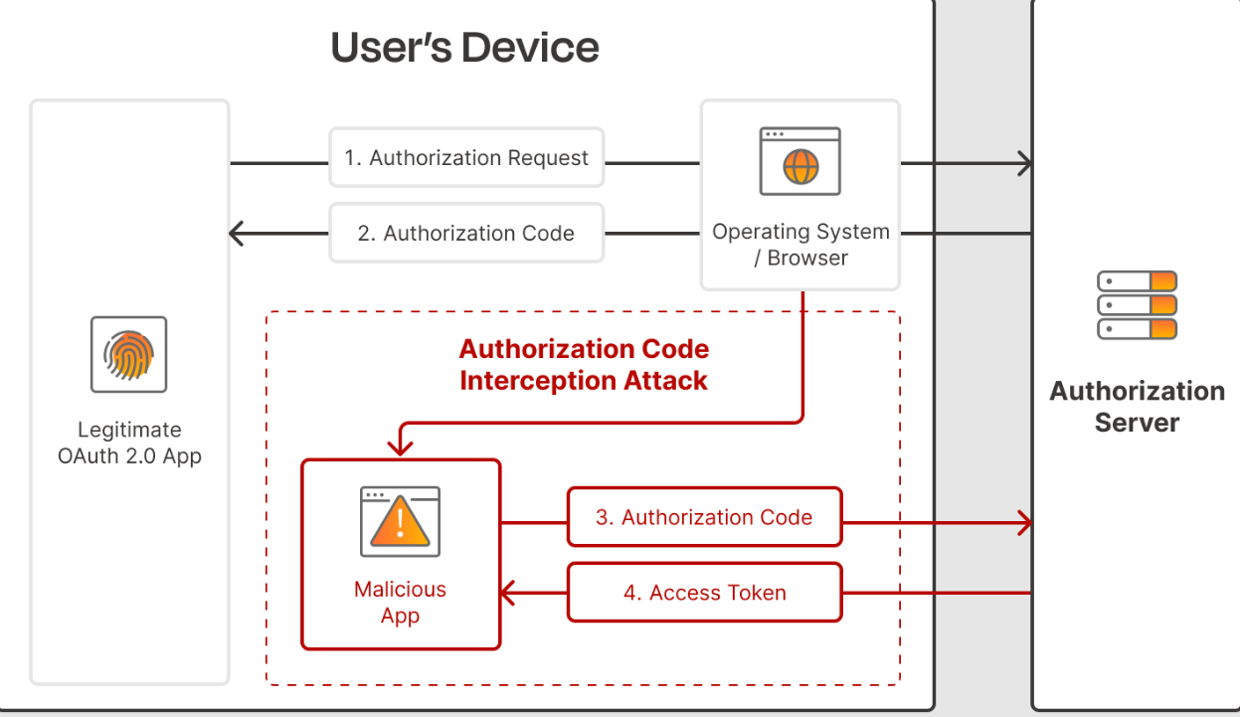
When Not Using PKCE
User is susceptible to a man-in-the-middle attack

Slide 52
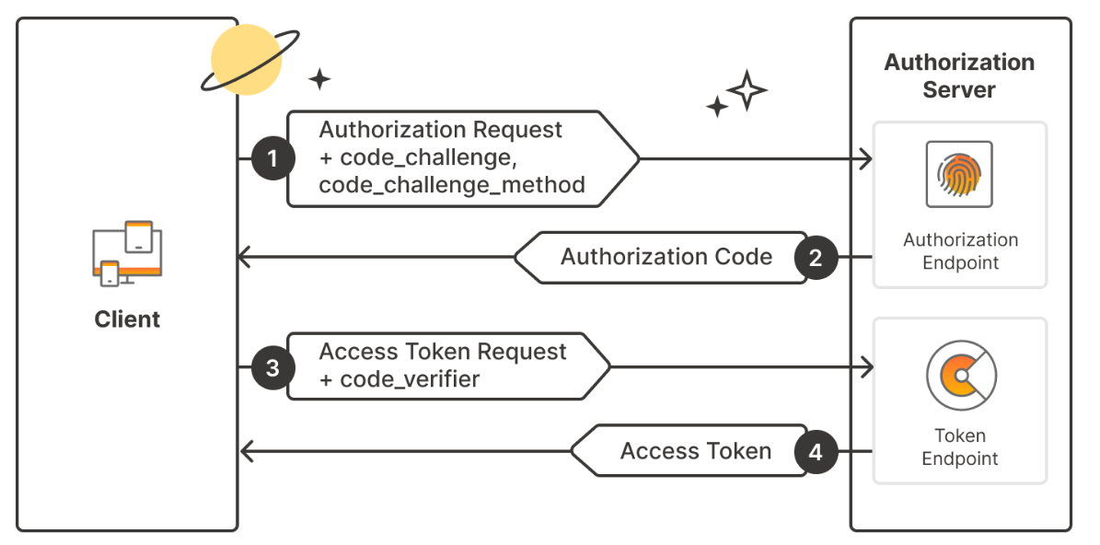
Using PKCE
Even if attackers get the authorization code, they won’t have the code_verifier = no access!
The access token will be shorter lived, but it is still not 100% safe to store in the client (XSS attacks)…

Slide 53
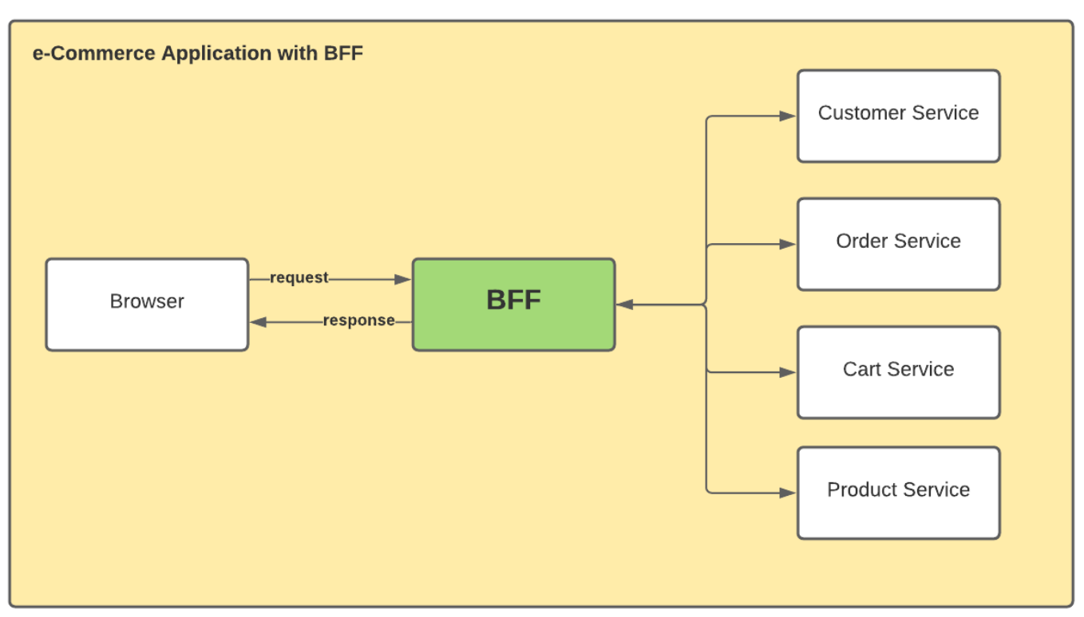
Want a BFF?
Definition: A Backend for Frontend design pattern provides a tailored backend interface for different types of clients
Could have one for web and another for mobile apps
Acts as a proxy layer in between the client and backend
Auth tokens are stored on the BFF so no chance of XSS attacks, the client only ever see what we return in the BFF (likely record data)

Slide 54
What is Express?
Definition: Express.js aka Express, is a free open-source back-end web application framework for node.js
Support for middleware
Routing
Unopinionated – bring your own design pattern

Slide 55

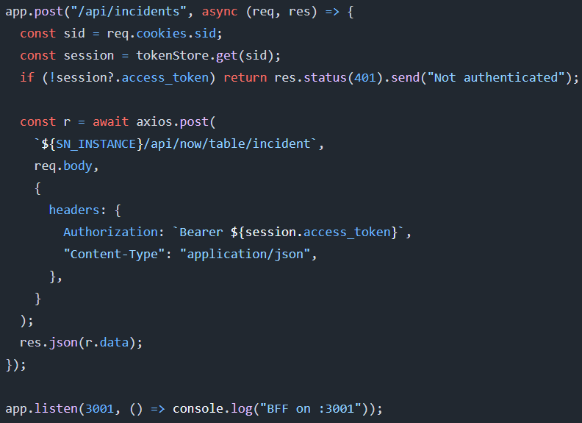
Express Basics
We create the express app by first installing with ‘npm install express’
Import into a js file to instantiate the app
Add routes & define route logic before setting the response
Start listening to requests with .listen()
Start Express server with ‘node server.js’

Slide 56
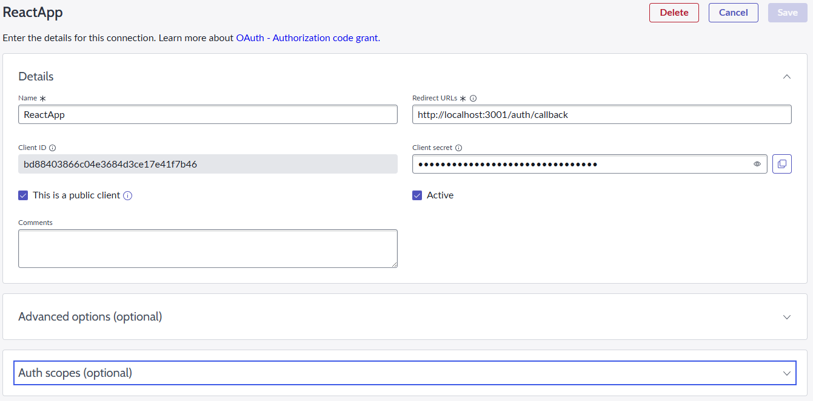
Application Registry - Oauth Client Setup
RedirectURL – the URL that ServiceNow will direct the client to while sending the authorization token (Part 2 of the PKCE Auth Flow)
Client ID/Secret – used in authentication steps
This is a public client – required to use the PKCE flow

Slide 57
ServiceNow PKCE Login Flow with BFF
ServiceNow receives request and sends access token + refresh token to BFF
Client Login Request
ServiceNow:
Authorization Code
BFF:
INSTANCEURL/oauth_auth.do
response_type
client_id
redirect_uri
code_challenge
code_challenge_method
state
BFF:
INSTANCEURL/oauth_token.do
grant_type
Authorization Code
redirect_uri
client_id
code_verifier
client_secret

