Slide 1
Service Level Management

Slide 2
What is Service Level Management?
Definition: The purpose of Service Level Management is to set clear business-based targets for service performance, so that the delivery of a service can be properly assessed, monitored, and managed against these targets

Slide 3
Types of Agreements
Definition: An SLA (Service Level Agreement) is a contract between a service provider and customer
Definition: An OLA (Operational Level Agreement) is an internal agreement between teams within the service provider organization
Definition: A UC (Underpinning Contract) is an agreement with external suppliers that supports delivery of a service

Slide 4
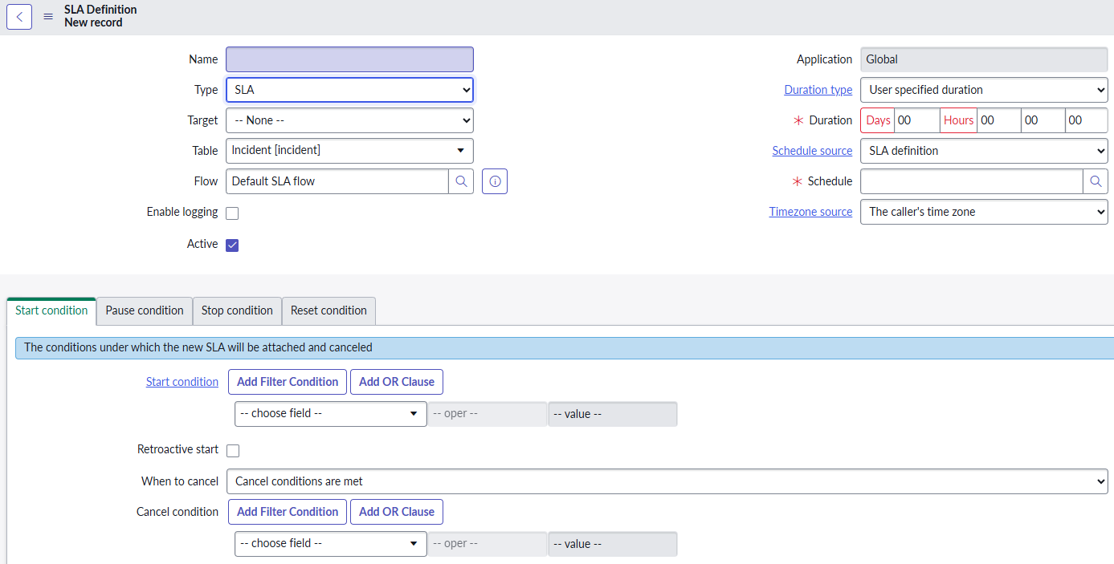
Contract_sla
SLA Definitions – define the timings, conditions, workflows, and other information required to create and progress task_sla records
Start Condition – begins timing towards the defined duration
Pause Condition – pauses timing
Stop Condition – stops timing and determines whether the SLA was ‘Achieved’ or ‘Breached’

Slide 5
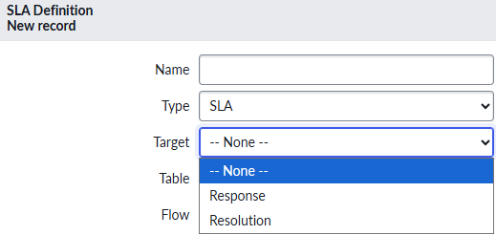
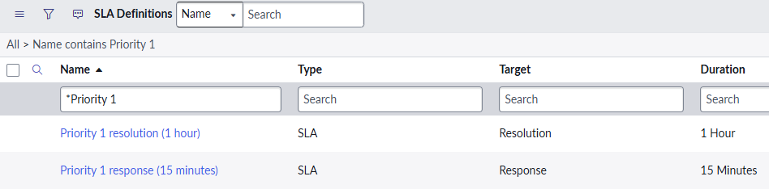
Response Vs Resolution
Definition: Response SLA means that the caller has been informed that their issue is being addressed
Definition: Resolution SLA is the time after the response until the issue is completely resolved

Slide 6
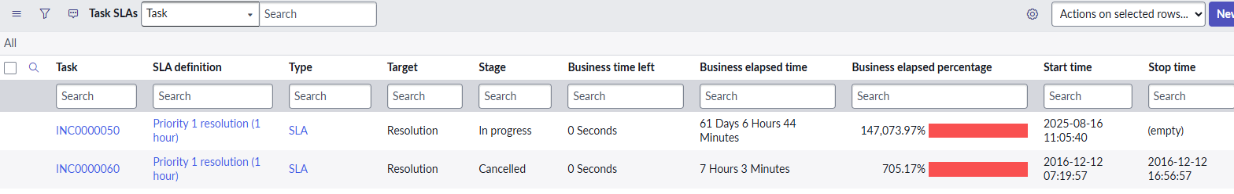
Task_sla
task_sla records represent each individual instance of a running SLA
These records record the timing information
These records are generated when one of our SLA Definitions are met

Slide 7

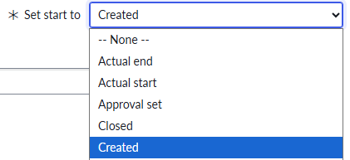
Retroactive Start/Pause
Retroactive Start – allows us to start timing our SLA based not on the creation of the task_sla, but on an even earlier time, such as when the incident record was created
Retroactive Pause – includes pauses from previous SLAs in the timing calculation.
Ex: the incident was assigned to group one and put on hold for an hour before being assigned to group two
Group two is now not penalized for the hour of hold time

Slide 8
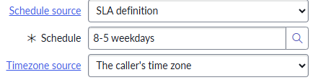
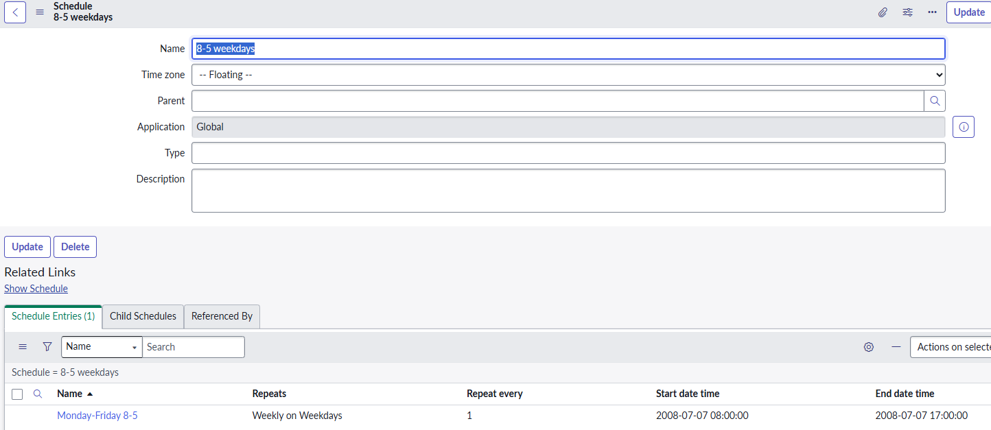

Schedules
When a schedule is set on an SLA, the timings will only count down within the scheduled window
The cmn_schedule table houses our schedule records; there is also a module for it

Slide 9
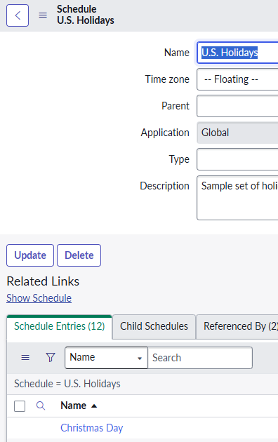
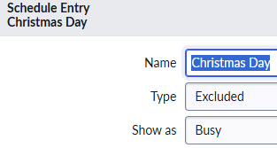

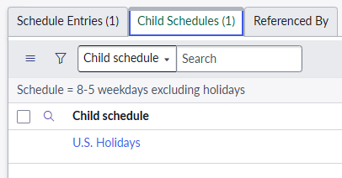
Child Schedules & Holidays
8-5 weekdays excluding holidays > U.S. Holidays > Christmas Day (Excluded, Busy)

Slide 10
Challenge
Goal:
Create new Priority 1 Response & Resolution SLA Definitions
Create a new schedule
Scenario:
Create a Response and Resolution for priority 1 incidents
Response = 30 minutes
Resolution = 1 hour 30 minutes
Be sure to properly put the SLA on hold, and close it, when needed
Create a new 9-4 weekday schedule that excludes the nearest holiday (Diwali)

