Slide 1
AWS
Solutions Architect – Associate (SAA-CO3)

Slide 2
Resources & Exam Basics
Ramp-up guide
Skillbuilder.aws
SAA-CO3 docs
Mix of multiple choice + multiple response
65 questions (15 do not count towards score)
$150 (each attempt, unlimited retakes with 14-day waiting period)
720 out of 1000 is passing
The exam has the following content domains and weightings:
Content Domain 1: Design Secure Architectures (30% of scored content)
Content Domain 2: Design Resilient Architectures (26% of scored content)
Content Domain 3: Design High-Performing Architectures (24% of scored content)
Content Domain 4: Design Cost-Optimized Architectures (20% of scored content)

Slide 3
Domain 1 – Design Secure Architectures
Applying AWS security best practices to IAM users and root users (for example, multi-factor authentication [MFA])
Designing a flexible authorization model that includes IAM users, groups, roles, and policies
Designing a role-based access control strategy (for example, AWS STS, role switching, cross-account access)
Designing a security strategy for multiple AWS accounts (for example, AWS Control Tower, service control policies [SCPs])
Determining the appropriate use of resource policies for AWS services
Determining when to federate a directory service with IAM roles
Design secure access to AWS resources:
Access Controls and management across multiple accounts
AWS federated access and identity services (IAM, AWS IAM Identity Center)
AWS global infrastructure (availability zones, AWS regions)
AWS security best practices (ex least privilege)
AWS shared responsibility model
Design secure workloads and applications
Application configuration and credential security
AWS service endpoints
Control ports, protocols, and network traffic on AWS
Secure application access
Security services with appropriate use cases (AWS cognito, AWS GuardDuty, AWS Macie)
Threat vectors external to AWS (DDoS, SQL injection)
Determine appropriate security controls
Data access and governance
Data recovery
Data retention and classification
Encryption and appropriate key management
Designing VPC architectures with security components (for example, security groups, route tables, network ACLs, NAT gateways)
Determining network segmentation strategies (for example, using public subnets and private subnets)
Integrating AWS services to secure applications (for example, AWS Shield, AWS WAF, IAM Identity Center, AWS Secrets Manager)
Securing external network connections to and from the AWS Cloud (for example, VPN, AWS Direct Connect)
Aligning AWS technologies to meet compliance requirements
Encrypting data at rest (for example, AWS KMS)
Encrypting data in transit (for example, AWS Certificate Manager [ACM] using TLS)
Implementing access policies for encryption keys
Implementing data backups and replications
Implementing policies for data access, lifecycle, and protection
Rotating encryption keys and renewing certificates

Slide 4
Domain 2 – Design Resilient Architectures
Design scalable and loosely coupled architectures
API creation and management (for example, Amazon API Gateway, REST API)
AWS managed services with appropriate use cases (for example, AWS Transfer Family, Amazon SQS, AWS Secrets Manager)
Caching strategies
Design principles for microservices (for example, stateless workloads compared with stateful workloads)
Event-driven architectures
Horizontal scaling and vertical scaling
How to appropriately use edge accelerators (for example, content delivery network [CDN])
How to migrate applications into containers
Load balancing concepts (for example, Application Load Balancer [ALB])
Multi-tier architectures
Queuing and messaging concepts (for example, publish/subscribe)
Serverless technologies and patterns (for example, AWS Fargate, AWS Lambda)
Storage types with associated characteristics (for example, object, file, block)
The orchestration of containers (for example, Amazon ECS, Amazon EKS)
When to use read replicas
Workflow orchestration (for example, AWS Step Functions)
Design highly available and/or fault-tolerant architectures
AWS global infrastructure (for example, Availability Zones, AWS Regions, Amazon Route 53)
AWS Managed Services (AMS) with appropriate use cases (for example, Amazon Comprehend, Amazon Polly)
Basic networking concepts (for example, route tables)
Disaster recovery (DR) strategies (for example, backup and restore, pilot light, warm standby, active-active failover, recovery point objective [RPO], recovery time objective [RTO])
Distributed design patterns
Failover strategies
Immutable infrastructure
Load balancing concepts (for example, ALB)
Proxy concepts (for example, Amazon RDS Proxy)
Service quotas and throttling (for example, how to configure the service quotas for a workload in a standby environment)
Storage options and characteristics (for example, durability, replication)
Workload visibility (for example, AWS X-Ray)

Slide 5
AWS Cloud Use Cases
AWS enables you to build sophisticated, scalable applications
Applicable to a diverse set of industries
Use cases include:
Enterprise IT, Backup & Storage, Big Data Analytics
Website Hosting, Mobile & Social Apps
Gaming/Game servers

Slide 6
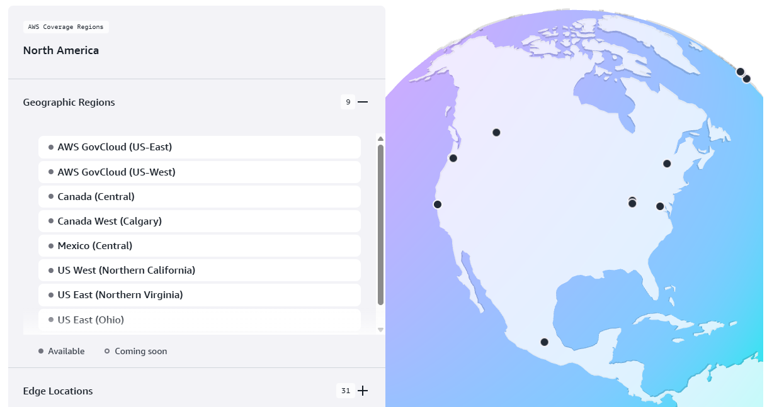
AWS Global Infrastructure
AWS Regions
us-east-1, eu-west-2, etc
A region is a cluster of data centers
Most services are region scoped
Choose based on compliance, latency, and available services
Pricing varies region to region
AWS Availability Zones
One or more discrete data centers with redundant power, networking, and connectivity
Each region has 3 or more zones. E.g. us-east-2a, us-east-2b, etc.
AWS Data Centers
AWS Edge Locations / Points of Presence
Edge location: AWS managed PoP used for content delivery
PoP: A physical networking site where providers connect its network to users
User > ISP > PoP > AWS backbone (global network layer) > AWS Region
https://infrastructure.aws/

Slide 7
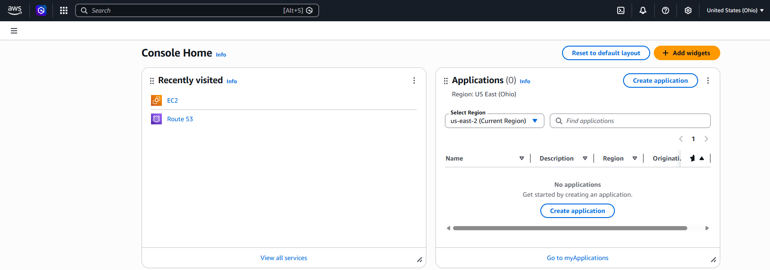
Global vs Region Scoped services
Global Services:
Identity and Access Management (IAM)
Route 53 (DNS Service)
CloudFront (Content Delivery Network - CDN)
WAF (Web Application Firewall)
Most AWS services are region-scoped:
Amazon EC2 (Infrastructure as a service)
Elastic Beanstalk (Platform as a service)
Lambda (Function as a service)
Rekognition (Software as a service)
Region Selector
AWS Services by Region

Slide 8
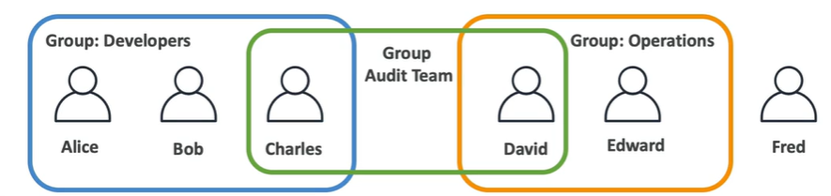
IAM: Users & Groups
IAM: Identity and access management (Global Service)
Root account created by default, shouldn’t be used or shared
Users are people within your organization, and can be grouped
Group only contain users, not other groups
Users don’t have to belong to a group, and users can belong to multiple groups

Slide 9
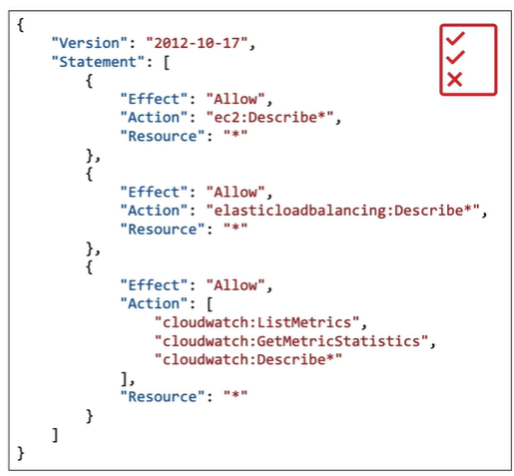
IAM: Permissions
Users or groups can be assigned JSON documents called policies
These policies define the permissions of the users
In AWS we should apply the least privilege principle: don’t give more permissions than a user needs

Slide 10
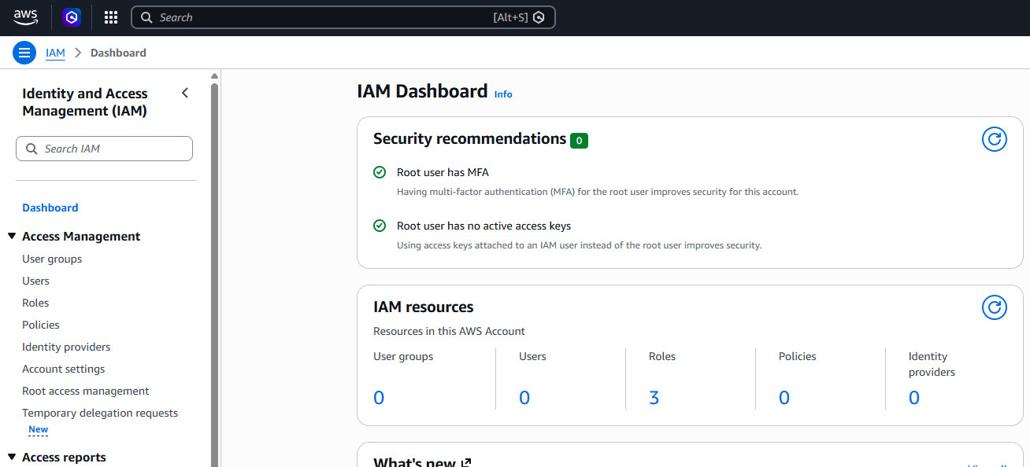

IAM: Create Users
Navigate to the IAM global service to create users and groups
We can also assign permissions to users and groups from here (best practice is to assign permissions to groups instead of users)
Scope auto-set to global since IAM is a global service:

Slide 11
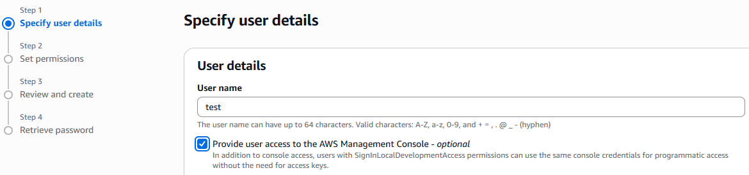
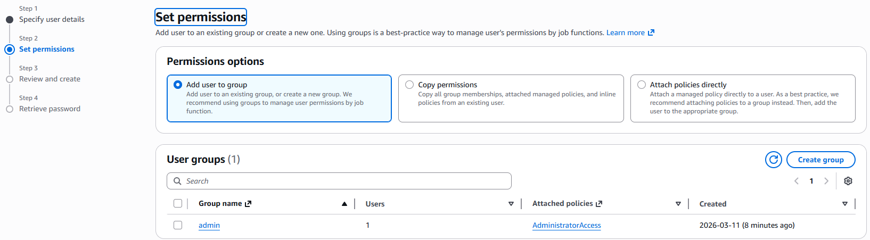
IAM: Create Users
Check the box so the user can get access to the console via GUI
We can create a new group and assign, or attach an already existing group to a user
We use the ‘AdministratorAccess’ permission to give users admin access

Slide 12
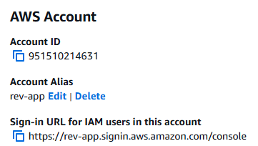
IAM: Account Alias
On the IAM Dashboard we can create an account alias
This changes the sign in URL for users, making it more human-friendly and easier to remember

Slide 13


Multi-Session Support
Click the user dropdown in the top-right and select ‘Turn on mutli-session support’
Click ‘Add session’ to login to another user account
You can now be signed in to multiple accounts within the same browser (without having to use incognito windows)

Slide 14
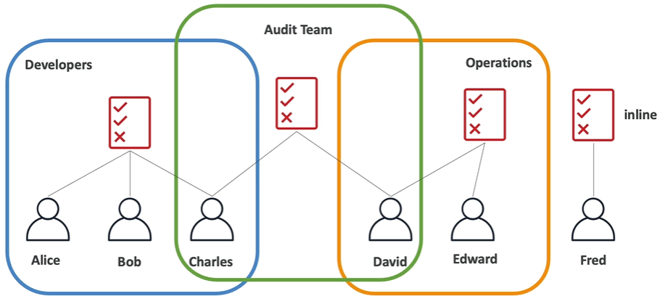
IAM Policies Inheritance
Policies may be intended for multiple users within groups
Policies may be inline for individual users

Slide 15
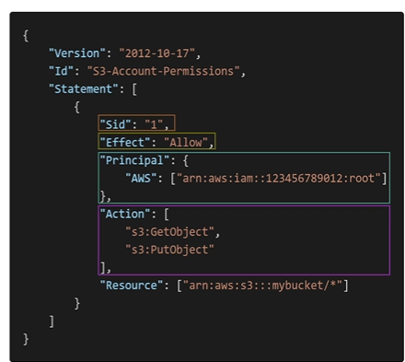
IAM Policies Structure
Consists of:
Version: policy language version, usually ‘2012-10-17’
Id: an optional identifier for the policy
Statement: one or more individual statements
Statements consist of:
Sid: an optional identifier for the statement
Effect: whether the statement allows or denies access (Allow/Deny)
Principle: account/user/role to which the policy is applied to
Action: list of actions this policy allows or denies
Resource: list of resources to which the actions applied to
Condition: optional conditions for which the policy is in effect

Slide 16


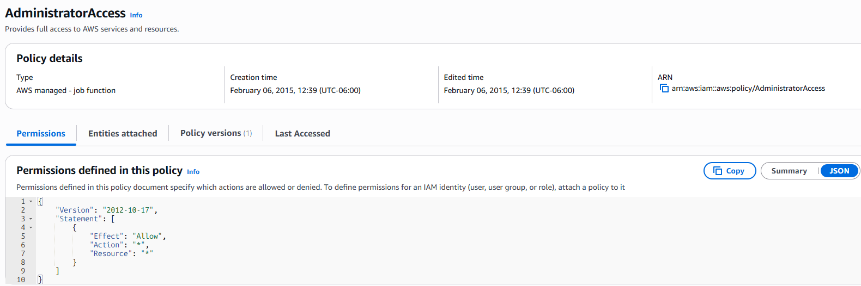
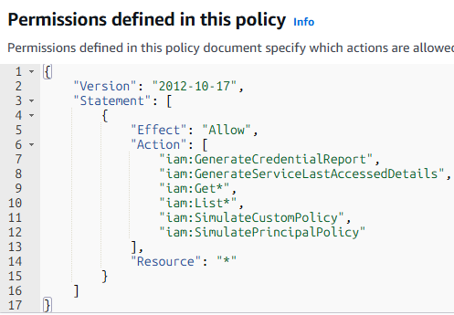
IAM: Permission Policy Examples
Found at IAM > Policies > Click on a policy
View the summary or in JSON format
* = wildcard
Iam:Get* = is equivalent to GetUser, GetGroup, etc; in this case, it will allow all ‘Get’ permissions
List = view a collection; Get = view a single item; this pattern is common among many policies

Slide 17
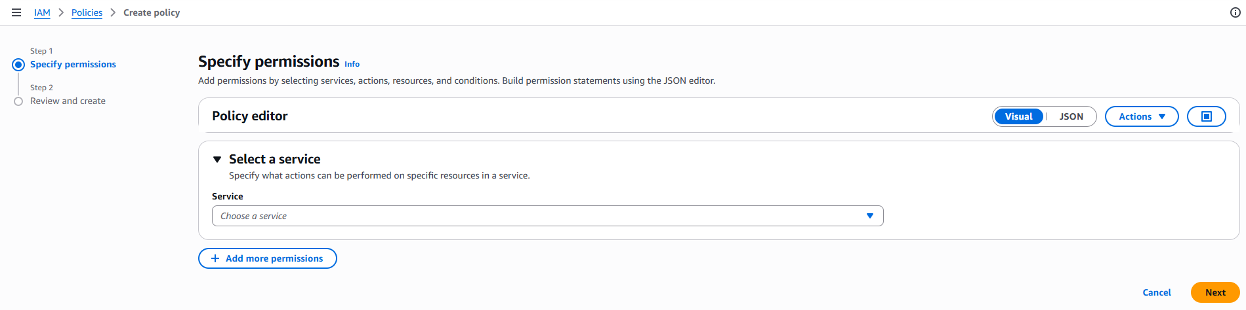
IAM: Create Policies
Navigate to ‘IAM > Policies > Create Policy’
Both visual and JSON editor available

Slide 18
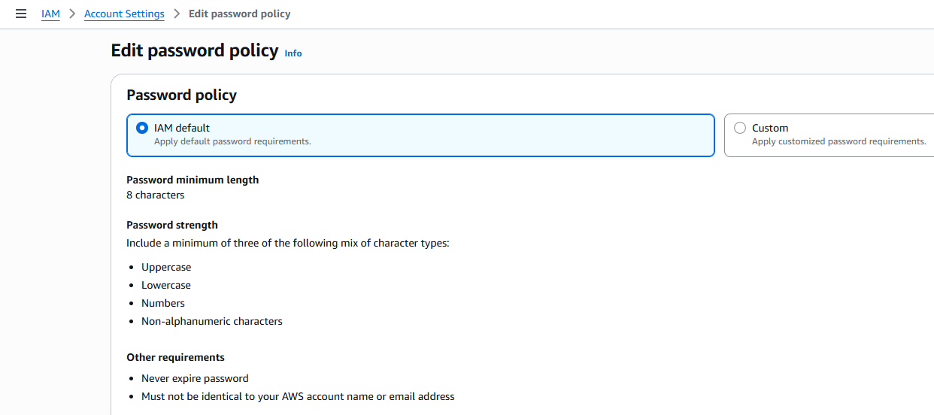
IAM: Password Policy
IAM > Account Settings > Click ‘Edit’

Slide 19
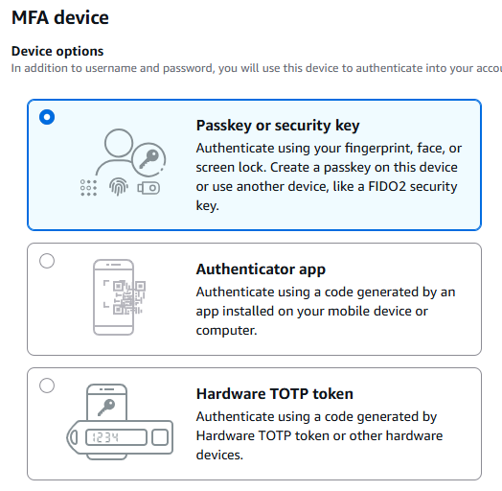
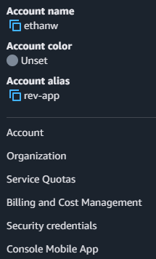
IAM: MFA
Click account name in top-right
Click ‘Security credentials’
Click ‘Assign MFA’

Slide 20
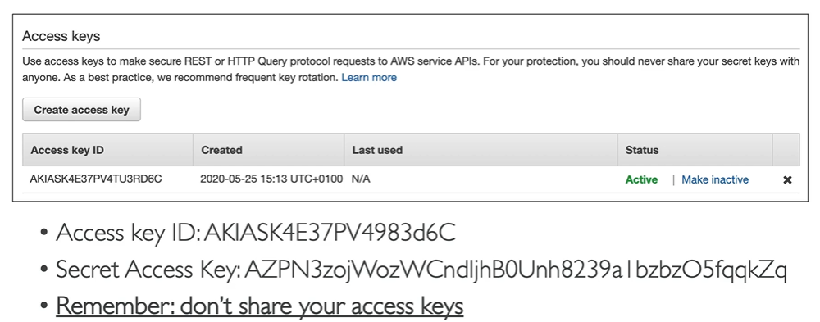
Various ways to access AWS
AWS Management Console – protected by MFA + Password
AWS Command Line Interface (CLI) – protected by access keys
AWS Software Development Kit (SDK) – for code; protected by access keys
Access Keys are generated through the AWS Console
Users manage their own access keys
Access keys are secret, don’t share them!
Access Key ID ~= username
Secret Access Key ~= password

Slide 21
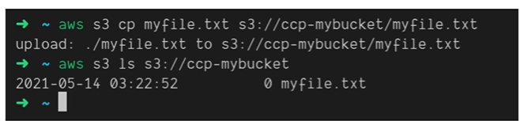
What is the AWS CLI?
A tool that enables you to interact with AWS services using commands in your command-line shell
Direct access to public APIs of AWS services
You can develop scripts to manage resources
It’s open source: http://github.com/aws/aws-cli
Alternative to using AWS Management Console

Slide 22
What is the AWS SDK?
Software Development Kit
Language-specific APIs (set of libraries)
Enables you to access and manage AWS services programmatically
Embedded within your application
Supports:
SKDs (JavaScript, Python, PHP, .NET, Ruby, Java, Go, Node.js, C++)
Mobile SDKs (Android, iOS)
IoT Device SDKs (Embedded C, Arduino, etc.)

Slide 23
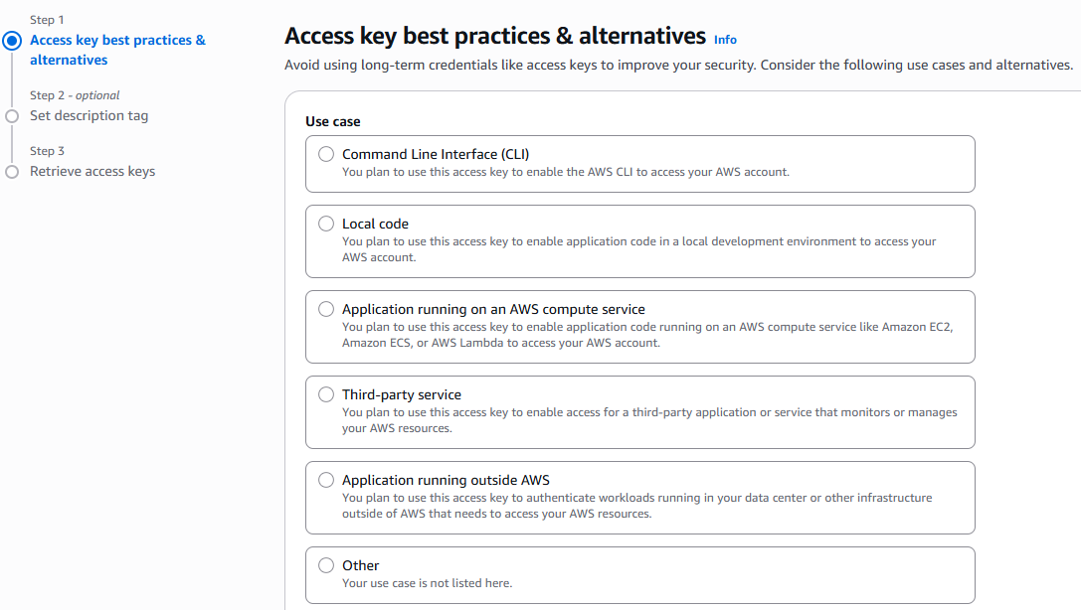
Create Access Keys
Navigate to IAM > Users > (user) > Create Access Key
Choose CLI
Copy details/download csv

Slide 24
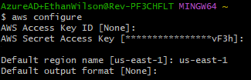
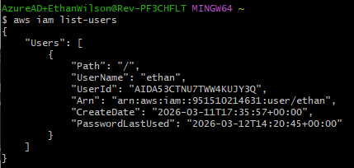
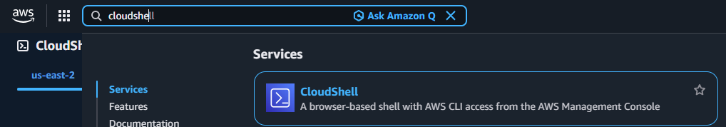
Setup AWS CLI
Run aws configure (output format may be left blank)
Now we can run commands, such as getting a list of our users
CloudShell available for browser-based CLI access

Slide 25
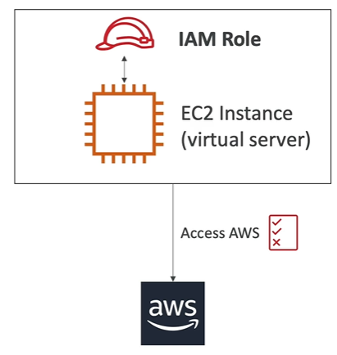
IAM Roles
Some AWS services will need to perform actions on our behalf
We assign permissions to AWS services with IAM Roles
Common roles:
EC2 instance roles
Lambda function roles
Roles for CloudFormation

Slide 26
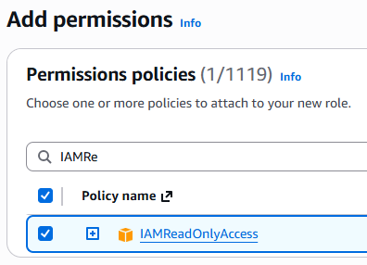
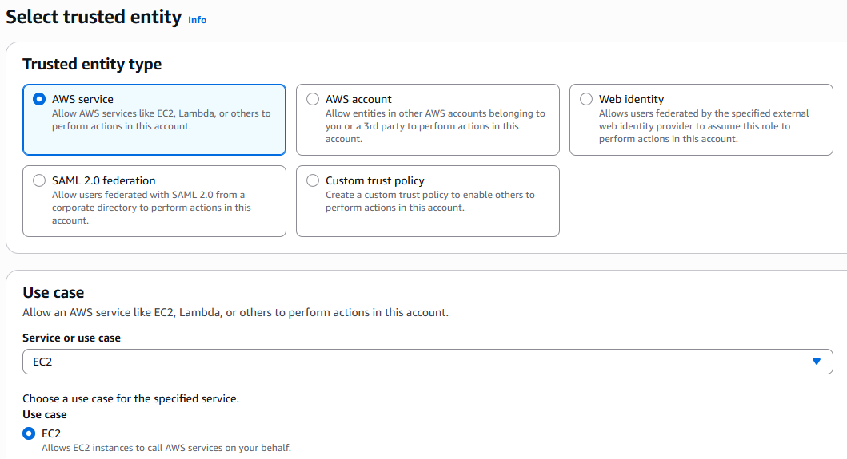
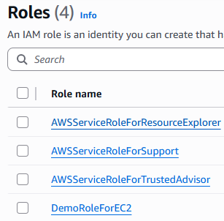
Creating Roles
IAM > Roles > Create Role
Add permissions, click next
Provide a name, verify details, click ‘create role’

Slide 27
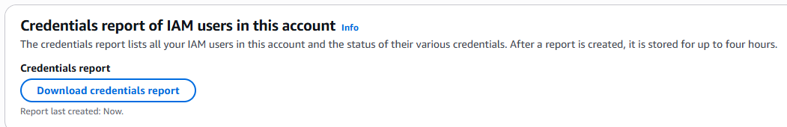
IAM Security Tools
IAM Credential Report (account-level)
A report that lists all your account’s users and the status of their various credentials
IAM > Credential Reports

Slide 28
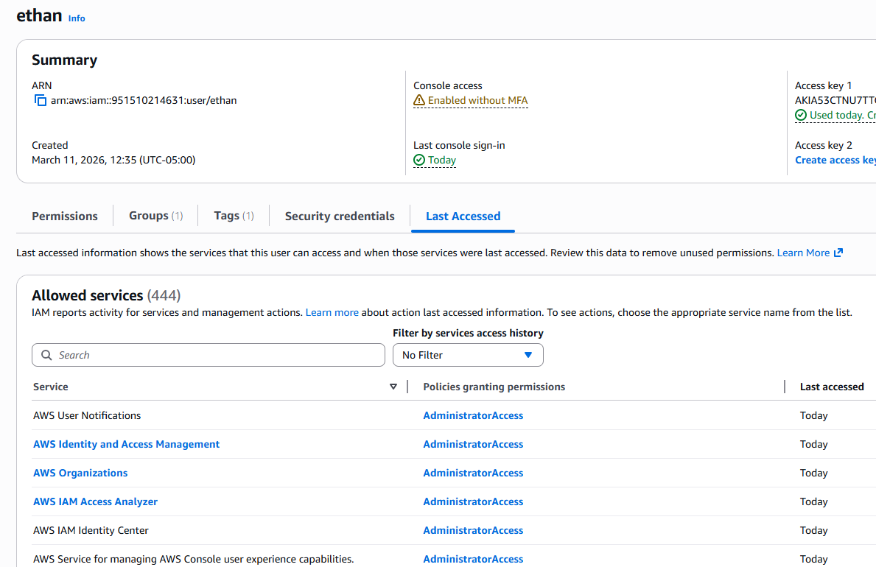
IAM Security Tools
IAM Last Accessed (user-level)
Last Accessed shows the service permissions granted to a user and when those services were last accessed
You can use this information to revise your policies
(Formerly called Access Advisor)

Slide 29
IAM Guidelines & Best Practices
Don’t use the root account except for AWS account setup
One physical user = One AWS user
Assign users to groups and assign permissions to groups
Create a strong password policy
Use and enforce the use of MFA
Create and use roles for giving permissions to AWS services
Use access keys for programmatic access (CLI/SDK)
Audit permissions of your account using IAM Credentials Report & IAM Last Accessed
Never share IAM users & access keys

Slide 30
IAM Summary
Users: mapped to a physical user, has a password for AWS console
Groups: contains users only
Policies: JSON document that outlines permissions for users, groups, and roles
Roles: permissions for EC2 instances or other AWS services
Security: MFA, Password policies
AWS CLI: manage your AWS services via command line
AWS SDK: manage your AWS services via a programming language
Access Keys: access AWS using the CLI or SDK
Audit: IAM Credential Reports & IAM Last Accessed (formerly Access Advisor)

Slide 31
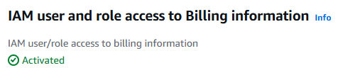
IAM Billing Access
Click top-right account dropdown while logged in as root user
Scroll down to find the following option
Click edit to make the change:

Slide 32
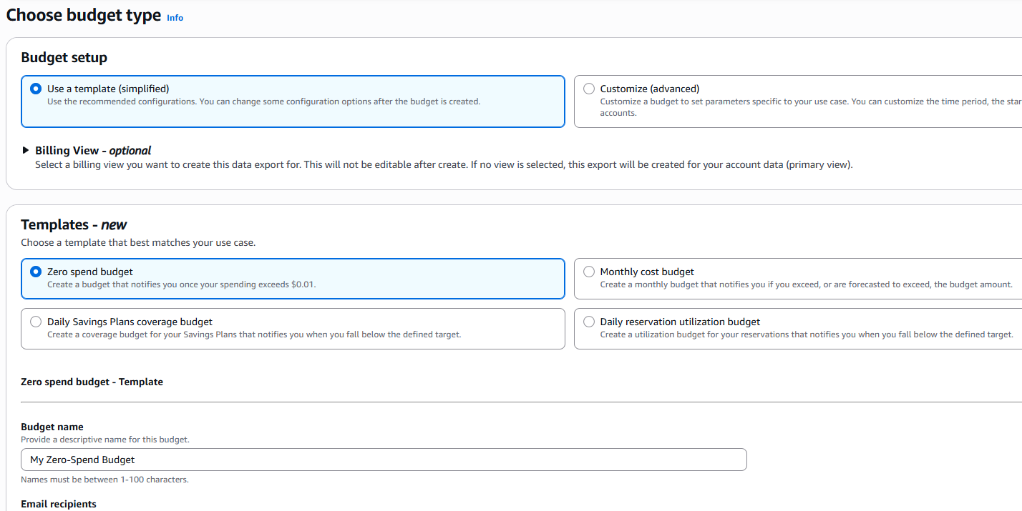
Budgets
Click top-right account dropdown
Select Billing & Cost Management
Select Budgets from left-hand pane
Click ‘Create Budget’

Slide 33
EC2
EC2 is one of the most popular of AWS’ offerings
EC2 = elastic compute cloud (Infrastructure as a service)
EC2 capabilities (and supporting services):
Run virtual machines (EC2)
Store data on virtual drives (EBS – elastic block store)
Distribute load across machines (ELB – elastic load balancer)
Scale services (ASG – auto-scaling group)
Knowing EC2 is fundamental to understand how the cloud works

Slide 34
EC2 sizing & Configuration Options
OS: Linux, Windows, or MacOS
CPU, RAM
Storage:
Network-attached (EBS & EFS)
Hardware (EC2 Instance Store)
Network card: speed of the card & public IP address
Firewall Rules: security group
Bootstrap script (configure at first launch): EC2 User Data

Slide 35
EC2 User Data
It is possible to bootstrap our instances using an EC2 User Data script
Bootstrapping means launching commands when a machine starts
That script is run only once when the instance firsts starts
EC2 user data is used to automate tasks such as:
Installing updates
Installing software
Downloading common files from the internet
Anything you can think of
The EC2 User Data Script runs with the Root User

Slide 36
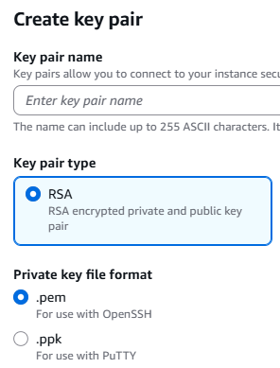

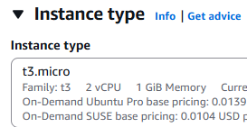
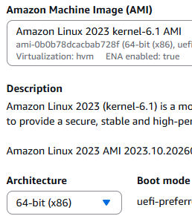
Launch EC2 Instance running Linux
EC2 > Instances > Launch Instance
Provide a name, choose the image, set instance type, create a key pair

Slide 37
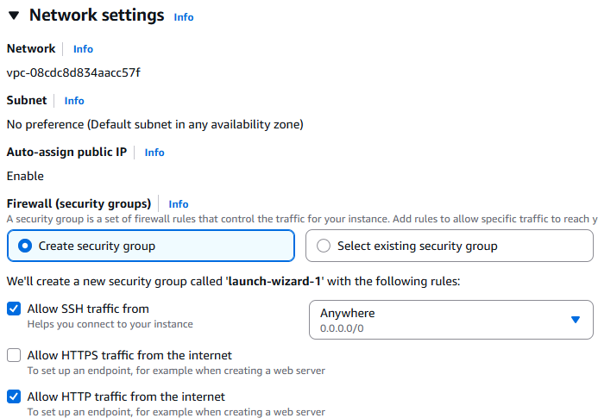
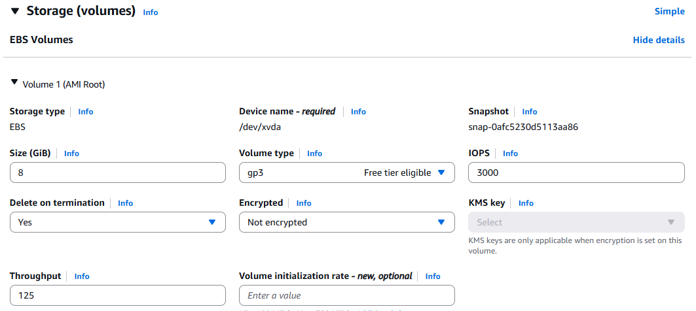
Launch EC2 Instance running Linux
Set network settings
Setup volume storage (note that the advanced mode shows ‘Delete on termination’)

Slide 38
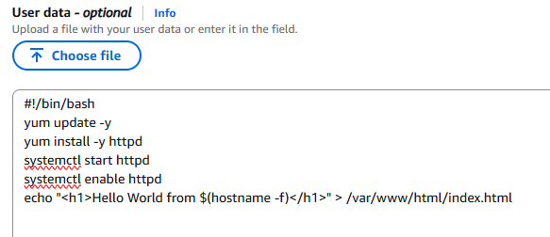
Launch EC2 Instance running Linux
We can set our user data script in the advanced details section
This script will update our image, install the httpd web server, start the server, and serve up a simple html page
Click Launch Instance

Slide 39
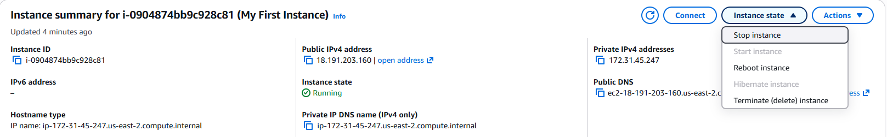
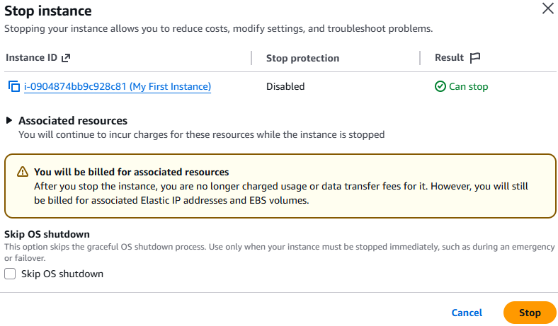
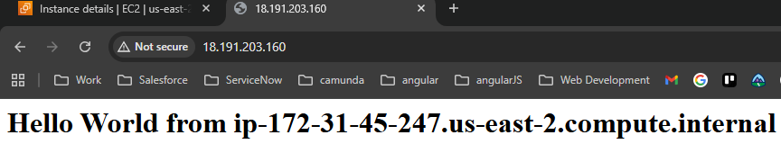
Access Our live site
We can use our public IPv4 address to access it
http://[IPv4 address here]

Slide 40
Challenge Demo – How to Excel in this course
Goal:
Scenario: 5 min
Complete a hands-on challenge
Your organization needs to relay technical concepts to you. Clients often need to do the same. Take a few moments to get some pen and paper ready to take notes.

