Slide 1
Snowflake
COF-CO3

Slide 2

COF-co3
Access the study guide and get more info here

Slide 3
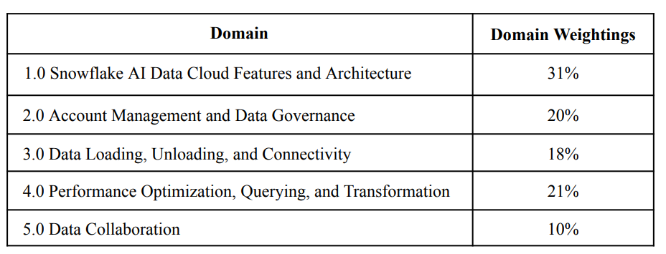
Exam Weights

Slide 4
Exam details
Not required for our training
$175
100 questions
115 minutes
That’s about 1 minutes 9 seconds per question
Multiple choice
75% is passing – use the question flagging feature

Slide 5
Cert exam tips (for any technical cert exam)
Use the 60-second rule. If you don't have a strong idea after about a minute, eliminate what you can, choose your best answer, flag it, and move on. Spending 3–4 minutes on one question is usually a net loss.
Answer every question. There's typically no penalty for incorrect answers on certification exams, so never leave one blank.
Eliminate before choosing. Often you can remove two clearly incorrect options, improving your odds from 25% to 50%.
Don't overthink familiar topics. Your first instinct is often correct when you recognize the concept. Only change an answer during review if you can identify a concrete reason it was wrong.
Keep an eye on the clock every 20–25 questions. Small adjustments are much easier than realizing you're 15 minutes behind near the end.

Slide 6
Section 1
Snowflake ai data cloud features & architecture – 31% of the exam

Slide 7
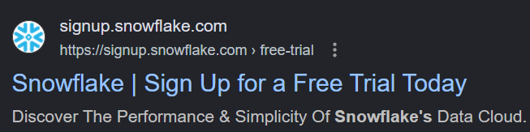
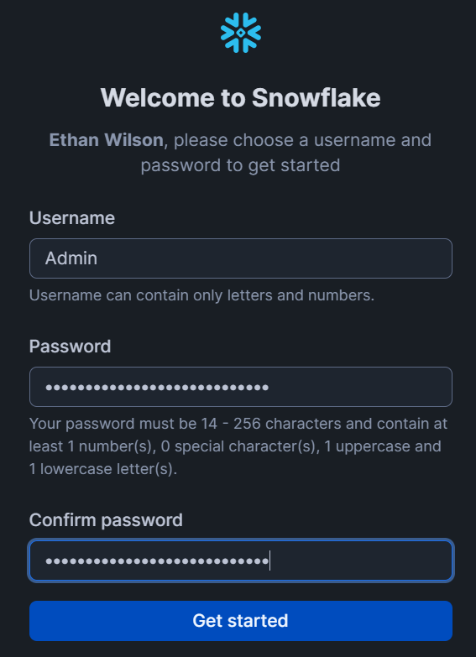
Trial Signup
Signup for the 30-day trial
We will get $400 in free credits
Click the link they send to your email to create our first user, Admin

Slide 8
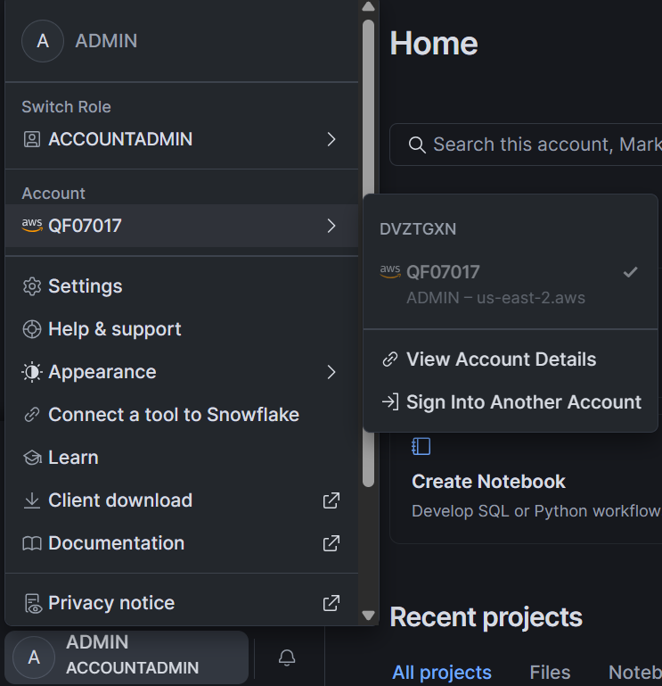
Take note of your account number & Account Identifier
Account Number in Snowsight UI – used for billing, etc.
Account Identifier (used to login, and many other things)

Slide 9
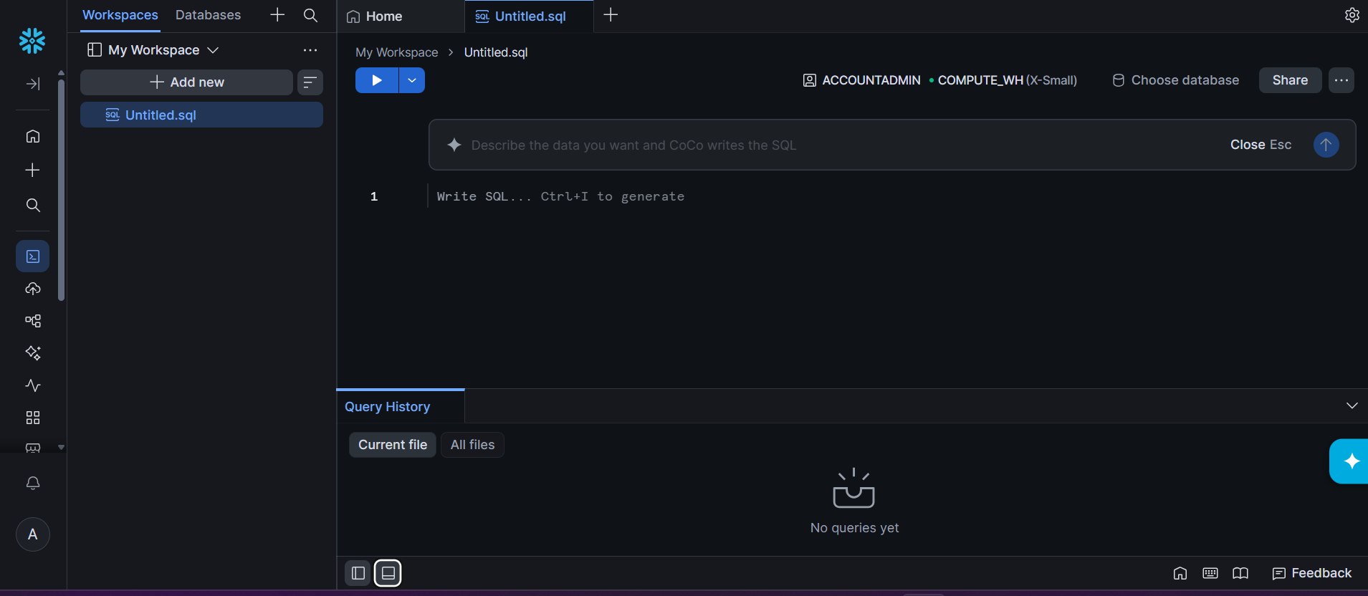
UI - Workspaces
A workspace is an environment within the Snowsight user interface that organizes and stores development and analytical assets—such as SQL worksheets, notebooks, and dashboards.
Workspaces enable users to manage, access, and collaborate on these assets independently of the underlying Snowflake data objects (databases, schemas, and warehouses).
Workspaces can be private or shared.

Slide 10
Data Warehouse vs Data lake
Feature | Data Warehouse | Data Lake
Purpose | Supports business reporting and analytics | Stores large amounts of raw data for various uses
Data Type | Primarily structured data (tables, rows, columns) | Structured, semi-structured, and unstructured data
Data Processing | Data is cleaned and transformed before loading ("schema-on-write") | Data is stored in its raw form and structured when read ("schema-on-read")
Users | Business analysts, executives, BI teams | Data scientists, data engineers, ML engineers, analysts
Performance | Optimized for fast SQL queries and dashboards | Optimized for scalable storage and advanced analytics
Storage Cost | Typically higher | Typically lower because it uses inexpensive object storage
Examples | Financial reporting, sales dashboards, KPI tracking | Machine learning, log analysis, IoT data, clickstream analysis

Slide 11
What is snowflake?
A cloud native, data platform, that is a SaaS
Cloud Native: under the hood it runs: AWS (native), Azure (2018), Google (2020)
Data Platform
data lake + data warehouse = lakehouse approach; snowflake is more than that
Integrated AI and ML capabilities
Supports ingestion, transformation, orchestration, streaming, and pipelines within the same platform, reducing the need for separate ETL infrastructure
Governance and Security
SaaS – software as a service; many things are managed for us;
Pay as you go model

Slide 12
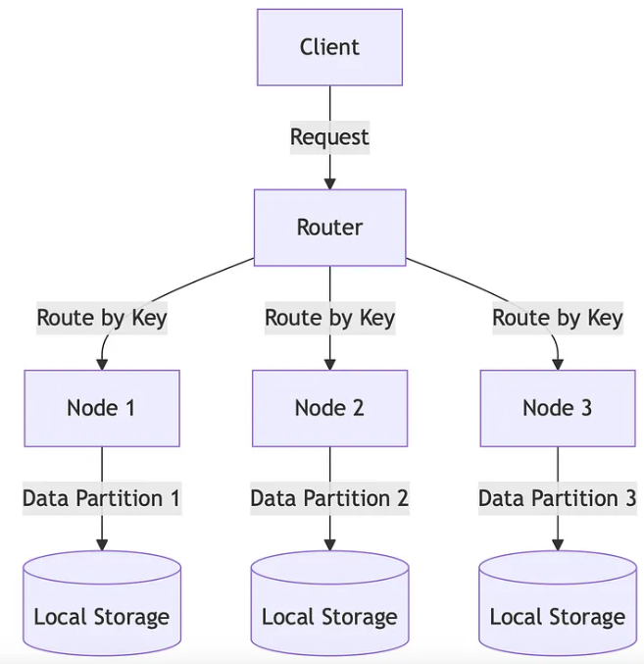
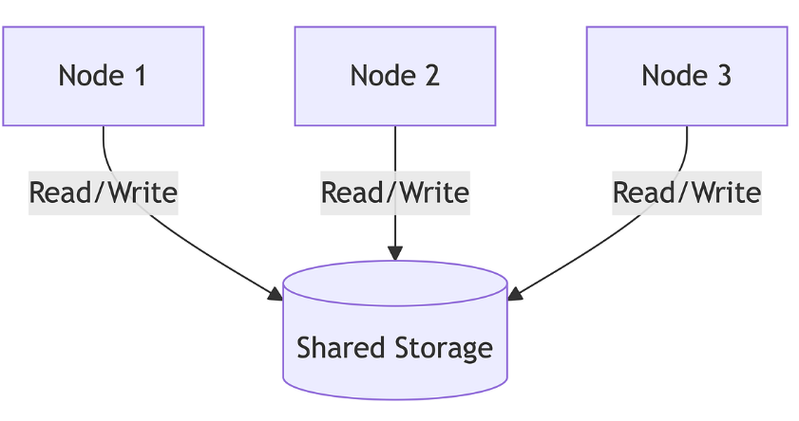
Distributed Architectures
Shared Disk – not scalable due to throughput
Shared Nothing – has throughput, but joins are expensive

Slide 13
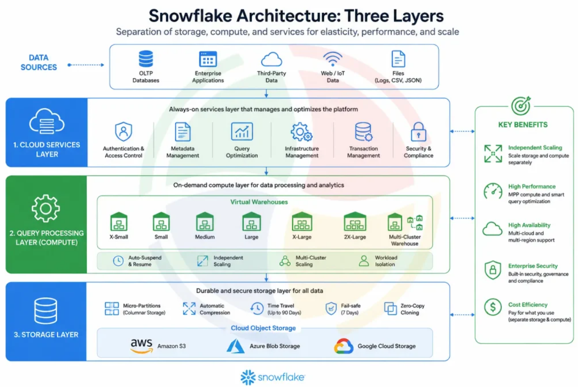
Multi-cluster shared data architecture

Slide 14
Storage Layer
Persistent and infinitely scalable cloud storage residing in cloud providers blob storage service, such as AWS S3
Both structured and semi-structured data files can be loaded and stored in Snowflake: CSV, Json, ORC, Avro, XML, Parquet
Proprietary compressed columnar data format inside of multi-partitions
stores data values of the same column physically next to each other on disk, unlike a CSV file which stores its data in a row-oriented manner where each data value of a row is stored next to each other.
Storing our table data in a columnar file format is great for OLAP queries because it effectively allows you to skip past columns which are not needed for a query.
This is what we call read optimization, reducing the amount of data needed to be fetched. The data files are also compressed during the loading process. Compression is particularly good in a columnar file format, as columns usually contain the same type of data, so a compression algorithm can be more efficient.
Billed at a flat rate per TB used a month

Slide 15
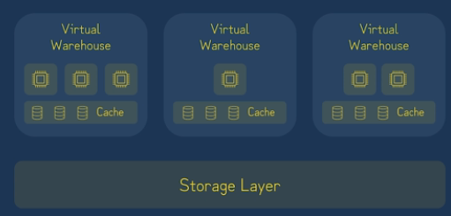
Query Processing layer
The query processing layer consists of Virtual Warehouses that execute the processing tasks required to return results for most SQL statements
A Virtual Warehouse is a named abstraction for a cluster of cloud-based compute instances that Snowflake manage
CREATE WAREHOUSE MY_WH WAREHOUSE_SIZE=LARGE;
Underlying nodes of a Virtual Warehouse cooperate in a similar way to shared-nothing compute clusters making use of local caching

Slide 16
Query Processing layer
Virtual Warehouses can be created or removed instantly
Virtual Warehouses can be paused or resumed
Virtually unlimited Virtual Warehouses can be created each with its own configuration
Virtual Warehouses come it multiple t-shirt sizes indicating their relative compute power
All running Virtual Warehouses have consistent access to the same data in the storage layer

Slide 17
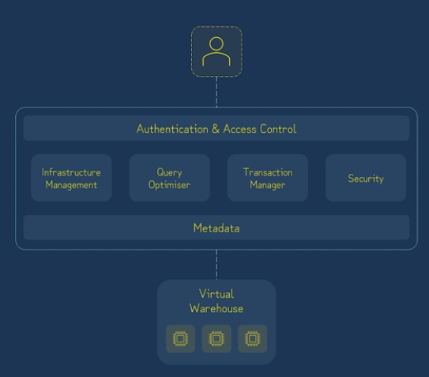
Services Layer
The services layer is a collection of highly available and scalable services that coordinate activities such as authentication and query optimization across all Snowflake accounts.
Similar to underlying virtual warehouse resources, the services layer also runs on cloud compute instances
Services managed by this layer include:
Authentication & Access Control
Infrastructure Management
Transaction Management
Metadata Management
Query parsing and optimization
Security

Slide 18
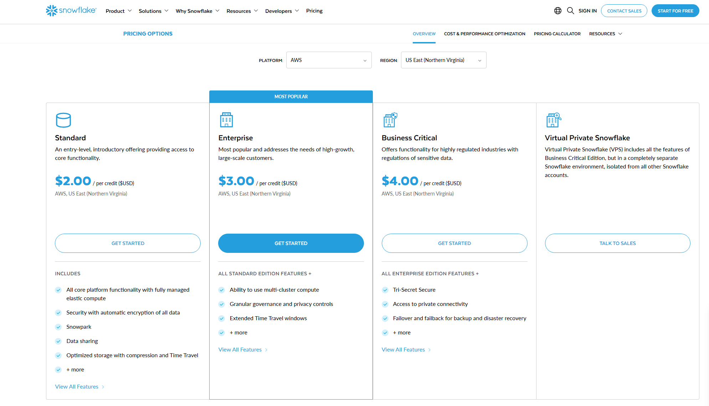
Snowflake Editions
More info here!

Slide 19
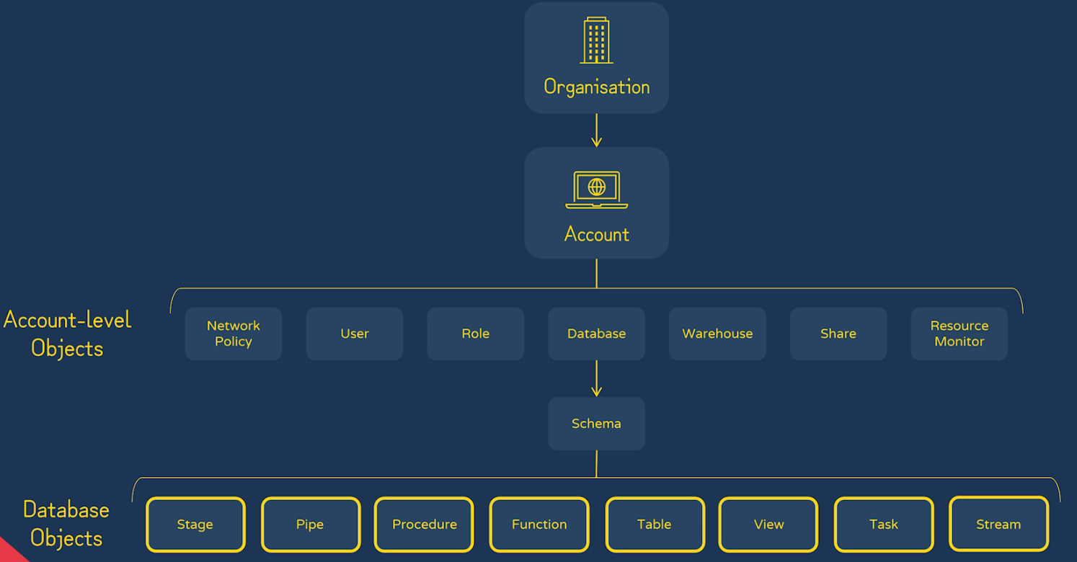

Snowflake Object Model
- Organization = an administrative snowflake account that manages all the standard Snowflake accounts it owns
- Account = a private, isolated Snowflake environment for your own use, accessible through a unique URL that combines your organization and account identifiers

Slide 20
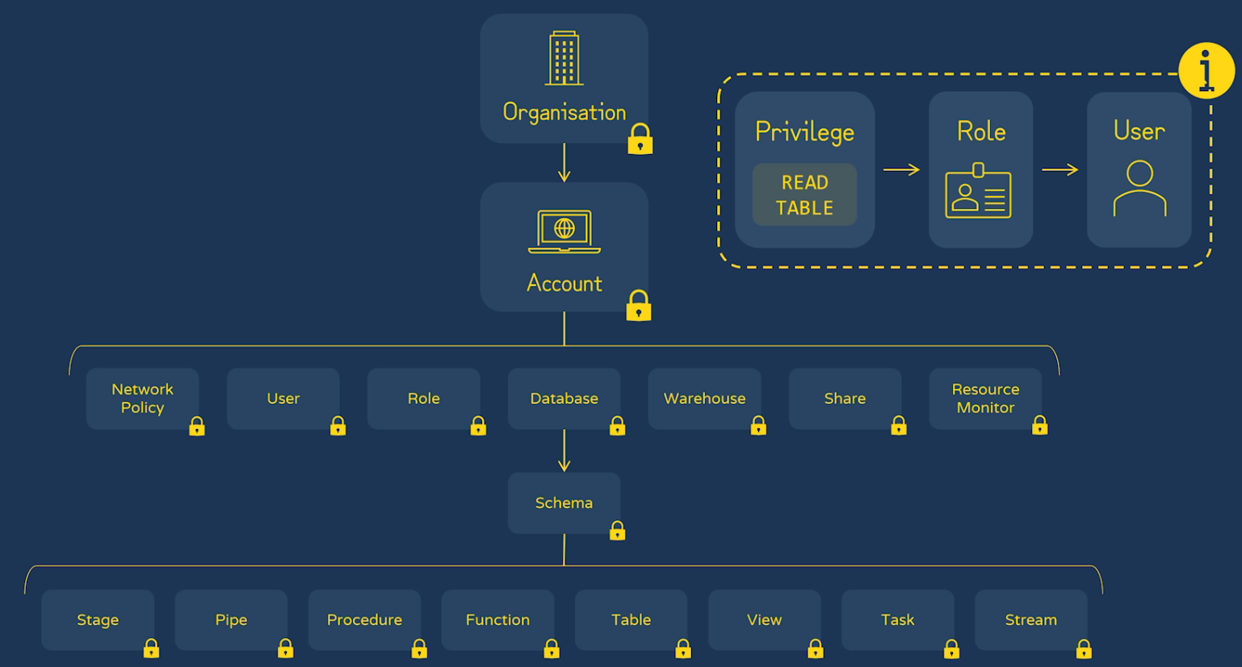
Snowflake Object Model – security high-level overview
-

Slide 21
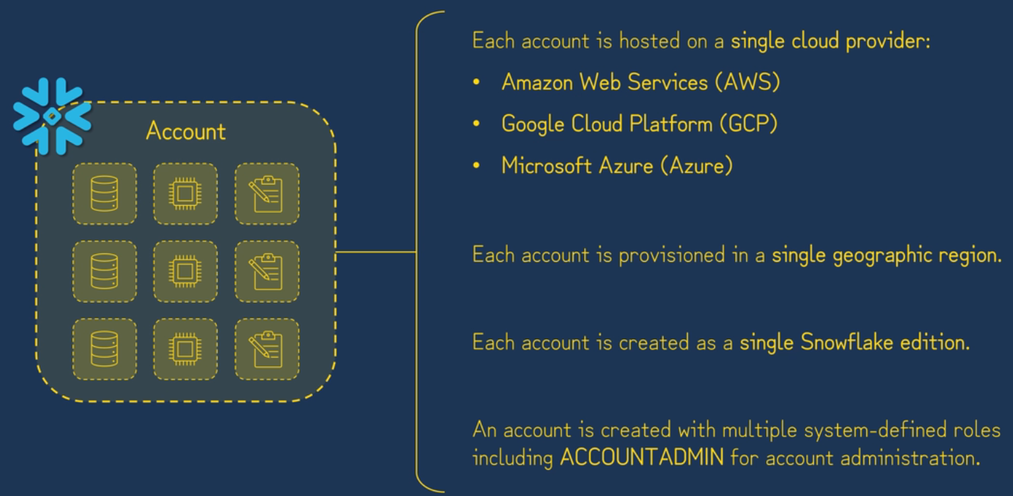
Account Overview

Slide 22
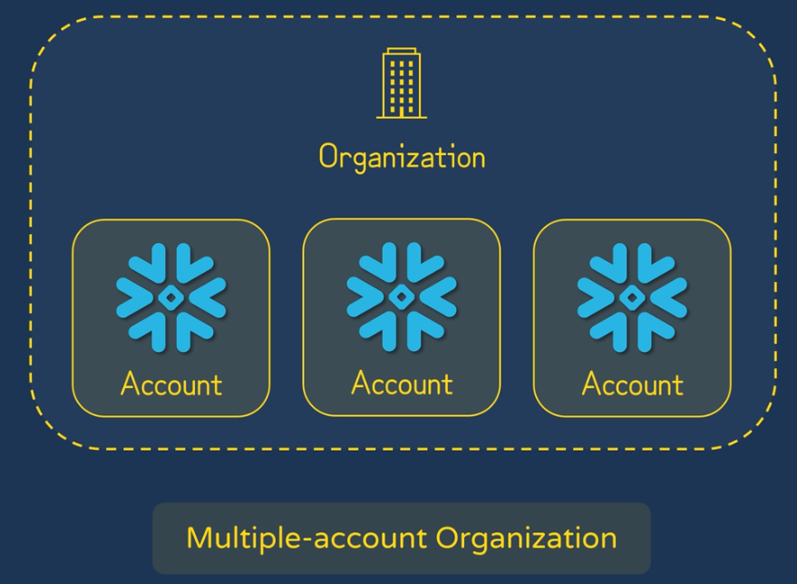
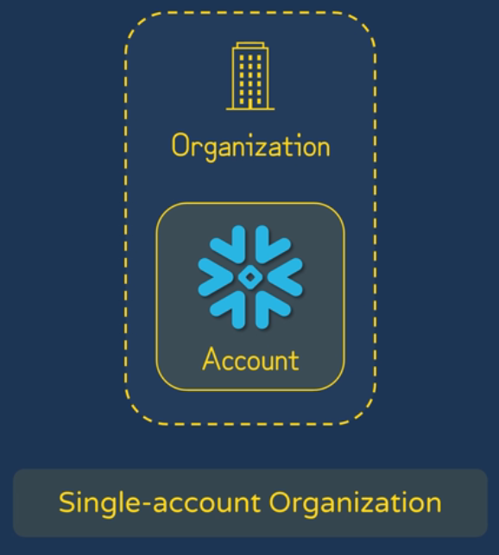
Organization Overview
This is what we start with on trial accounts. An org was created automatically:

Slide 23
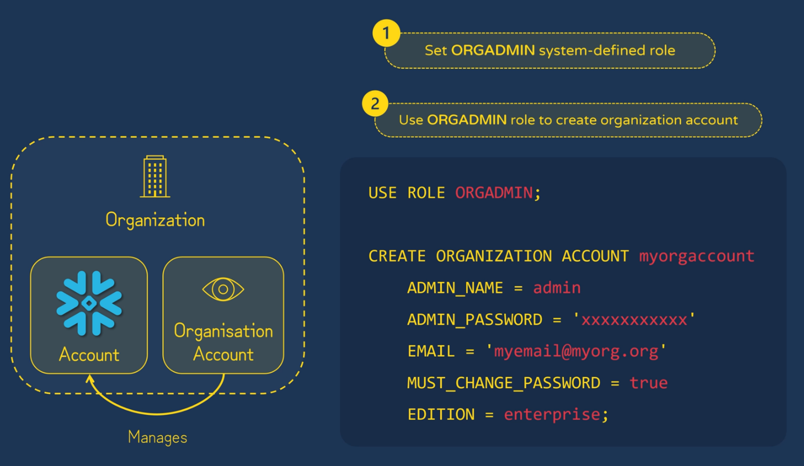
Organization Overview

Slide 24
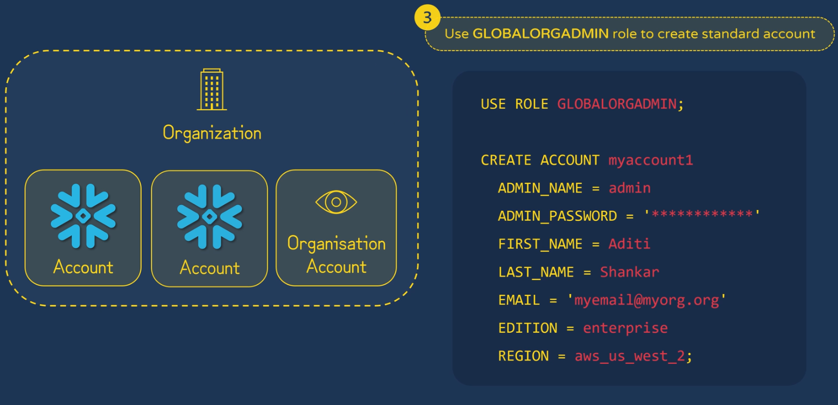
Organization Account

Slide 25
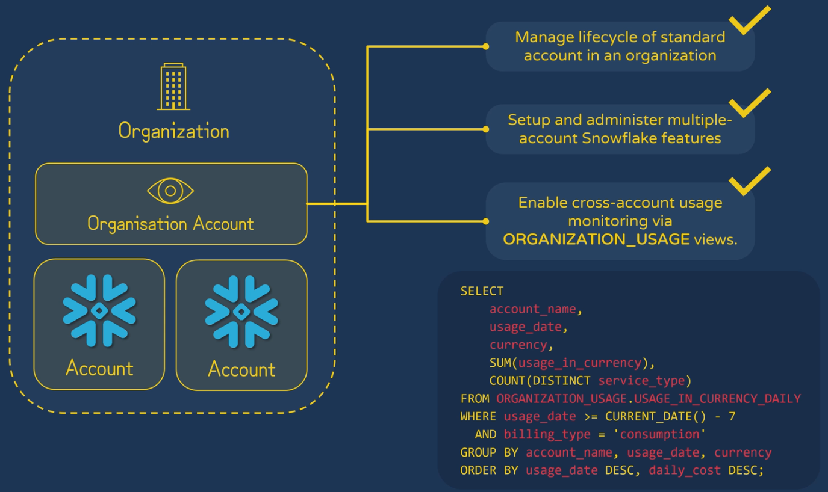
Organization Account Features

Slide 26
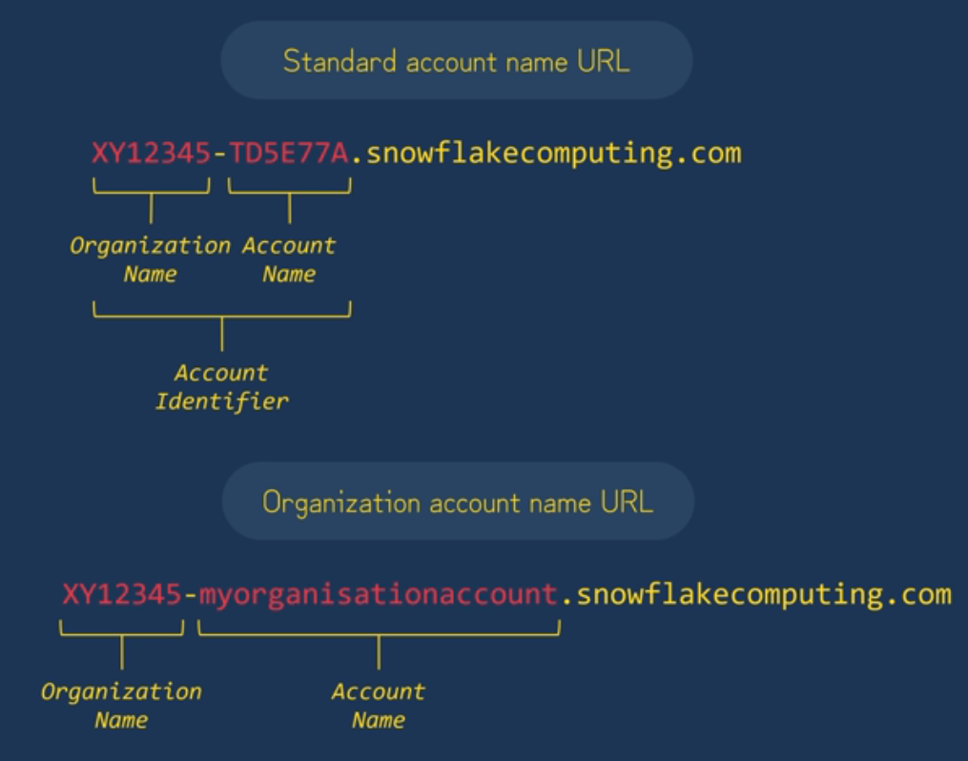
Account URLs

Slide 27
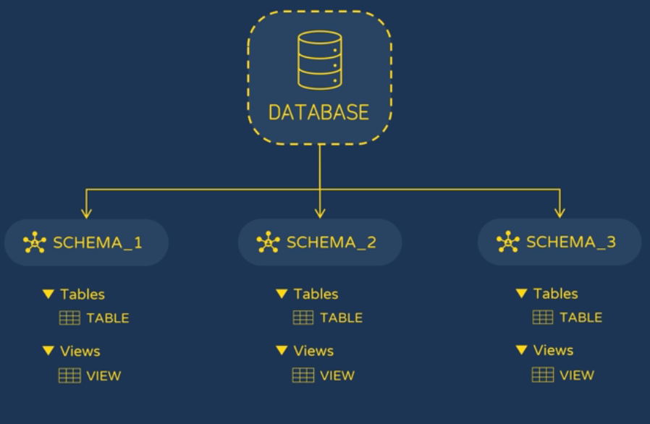
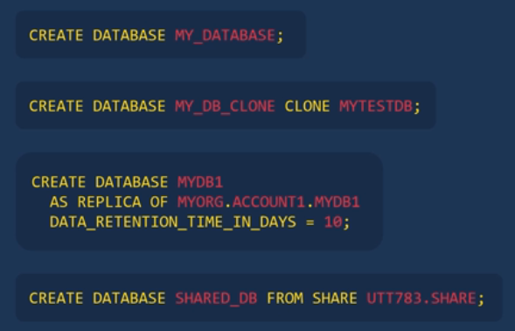
Databases & schemas
Databases must have a unique identifier in an account.
A database must start with an alphabetic character and cannot contain spaces or special characters unless enclosed in double quotes.

Slide 28
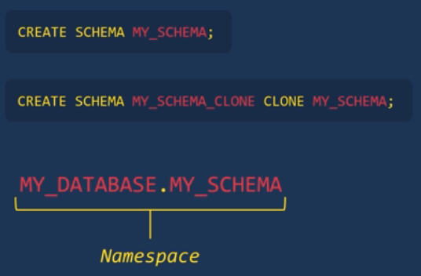
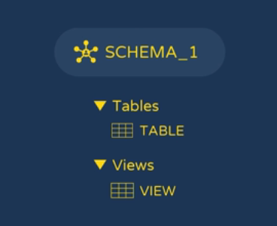
Databases & Schemas
Schemas are logical groupings of database objects such as tables, views, & stages
1 database can contain many schemas
Schemas must have a unique identifier in a database.
A schema must start with an alphabetic character and cannot contain spaces or special characters unless enclosed in double quotes.

Slide 29
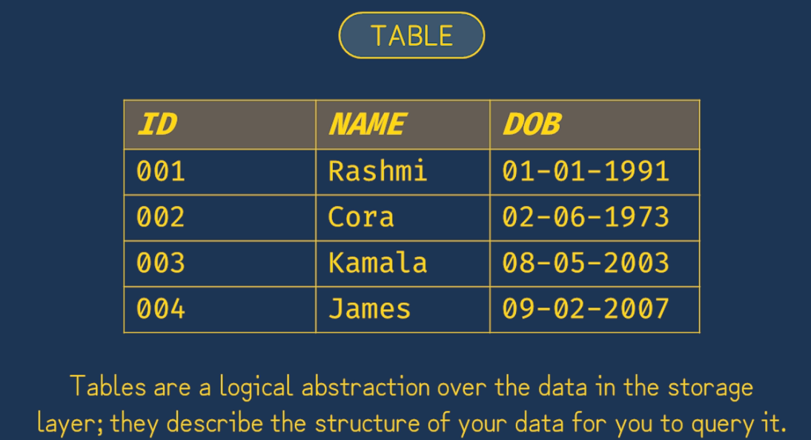
Table Types

Slide 30
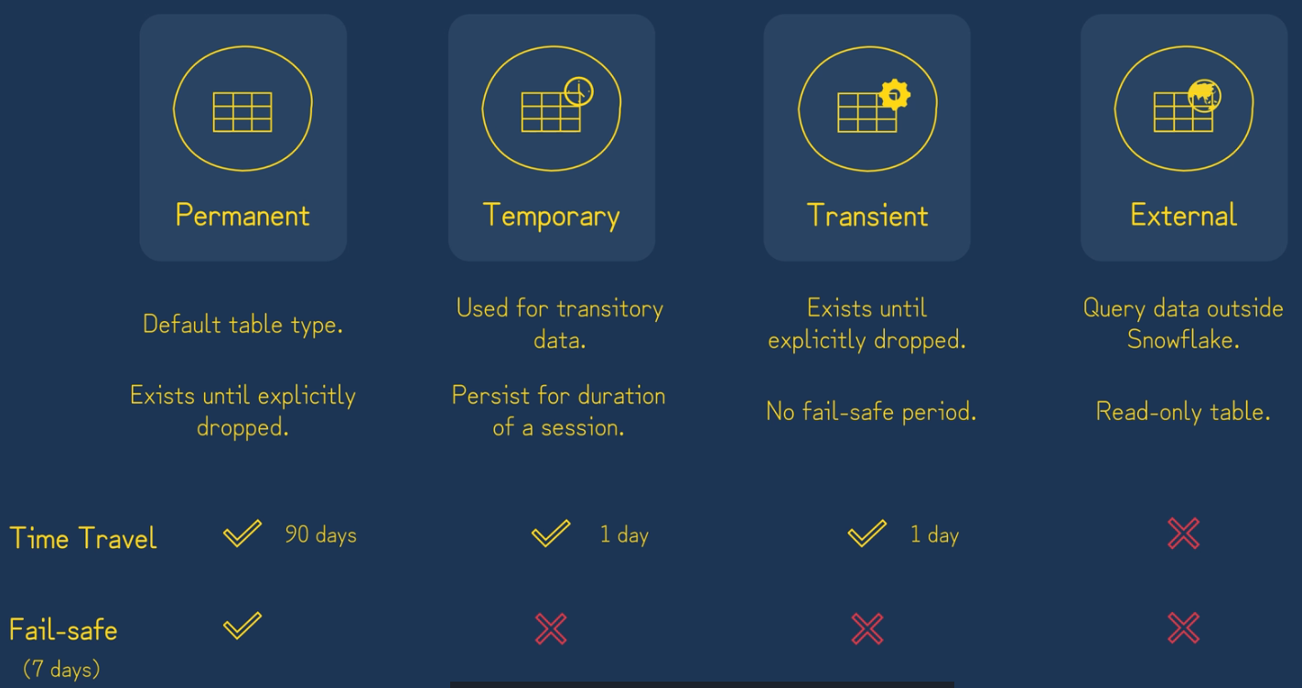
Table Types
A permanent table can set the time travel retention period up to 90 days if we're on an enterprise edition or higher Snowflake account. If on a standard edition, the max is one day.
Time travel = undo table drops, deletes, etc.
Fail-safe = disaster recovery if time travel is no longer an option. Requires Snowflake customer support, and is not intended for routine restores.

Slide 31
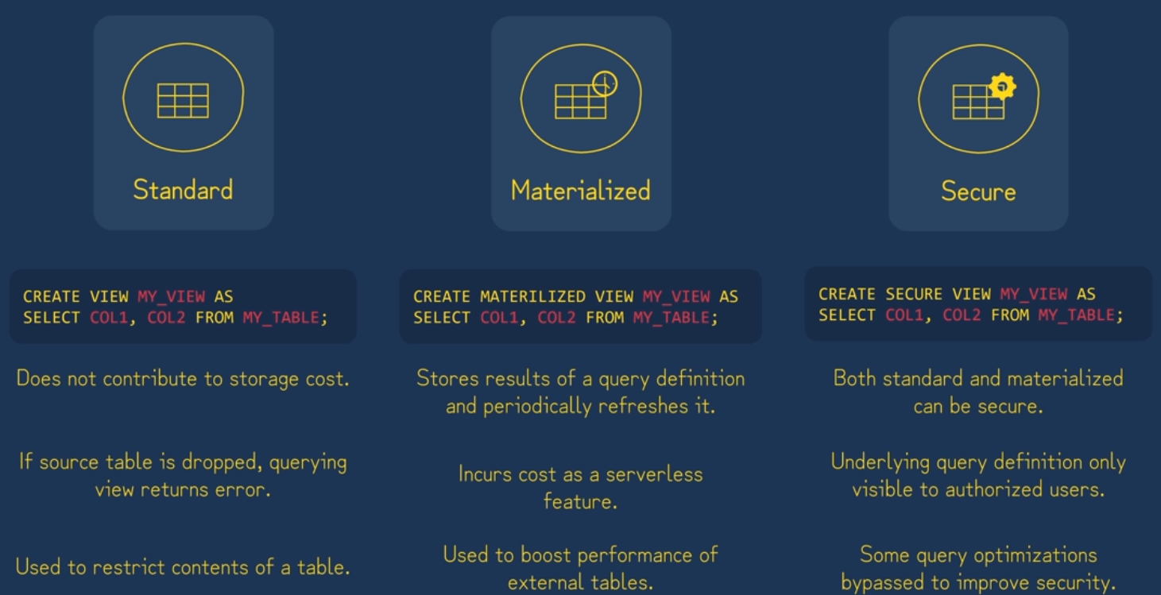
View Types
Views can be used much like a table, they can be joined to tables or other views
You can reference views in subqueries and you can use order by, group by, and where clauses with views
Materialized view may also be called a ‘pre-computed dataset’ on the exam!

Slide 32
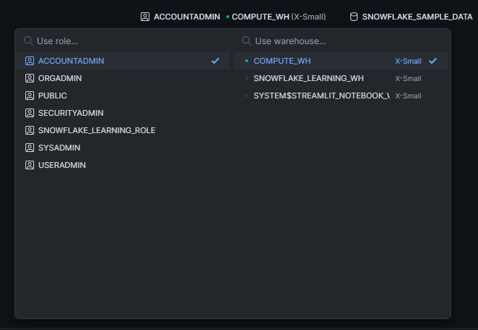
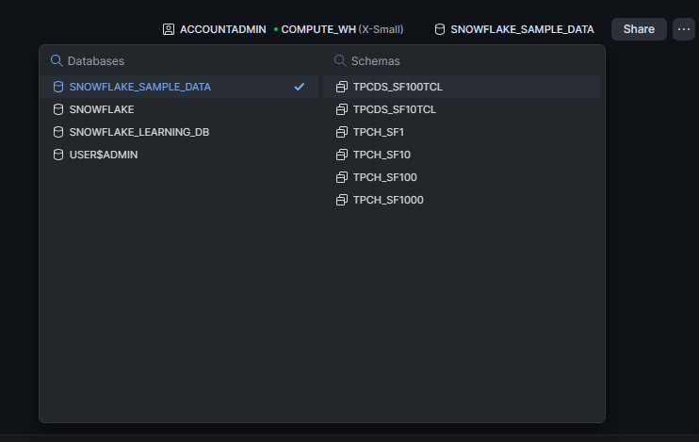
Workspaces - databases/Schemas & Role/Warehouse selection
Top right of the screen in the Snowsight UI:

Slide 33
Walkthrough
Let’s create some databases, schemas, tables, insert rows, and create views to query our data
The relevant code is found in your course materials. The file is: ‘Databases_Schemas_Tables_&_Views.sql’

Slide 34
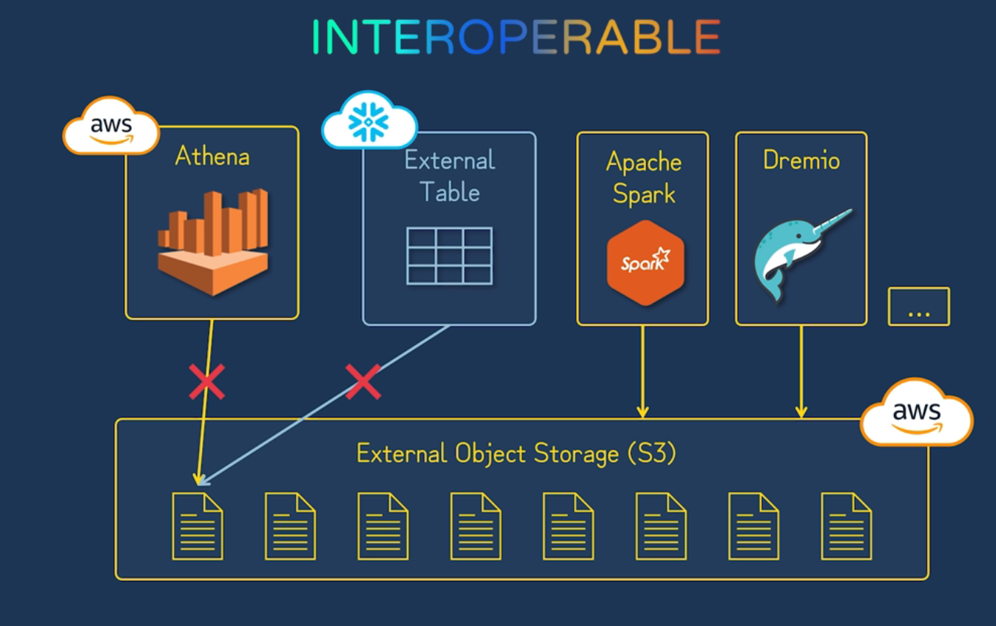
Open table formats – The problem they solve
Athena or External Tables could be used to connect to a S3 acting as a data lake, but these tools are not interoperable; i.e. not ACID compliant and no Time-Travel support

Slide 35
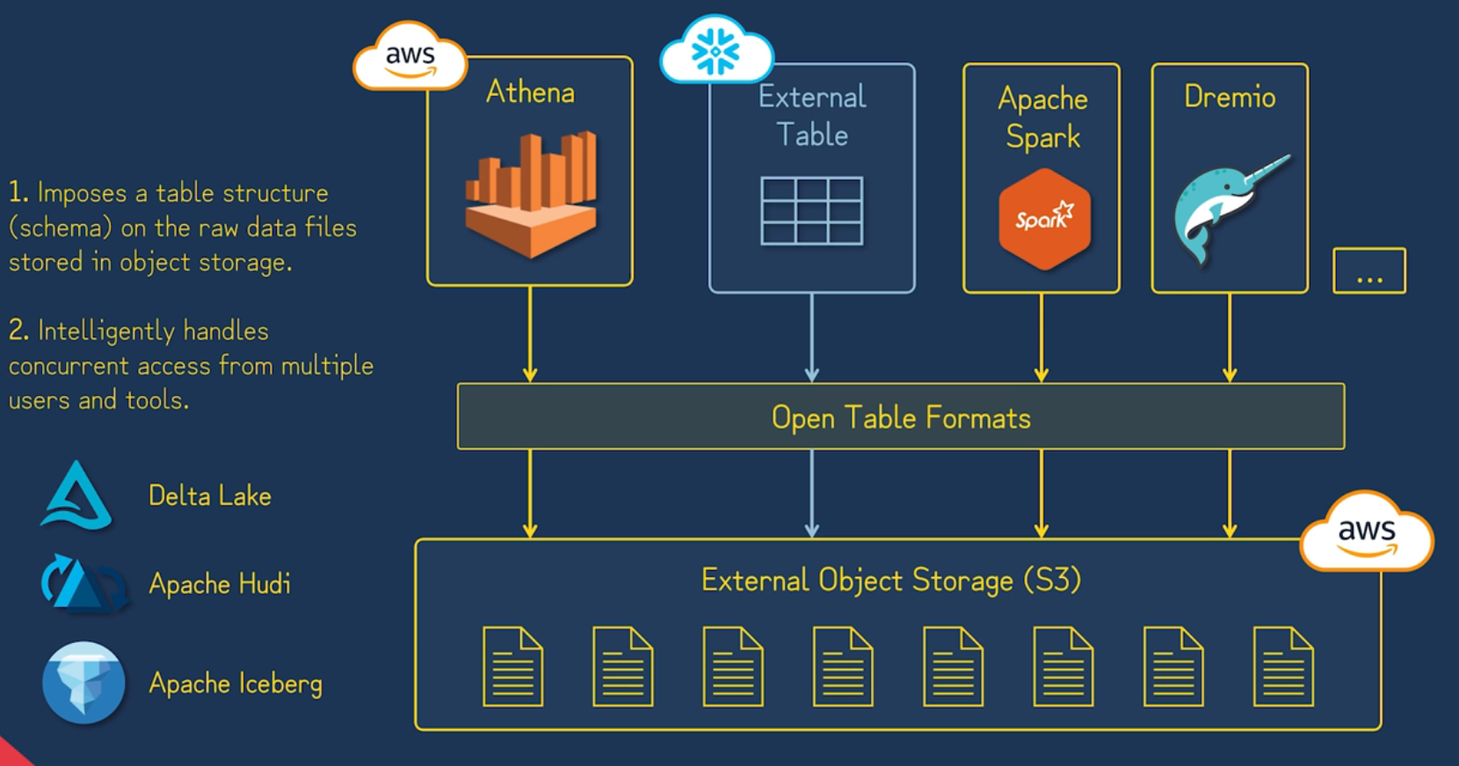
Open table formats – Apache Iceberg is what we will use

Slide 36
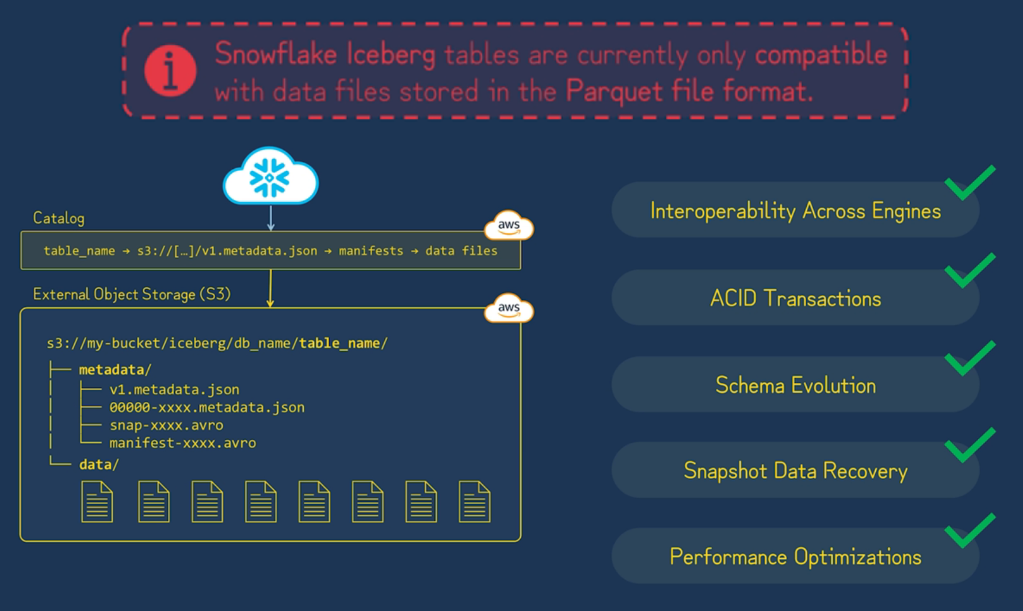
Open table formats – Apache iceberg in snowflake
Catalog – table registry, which stores information about what tables exist, where a table’s data files reside, and the version of the table; It also handles transactions and ensures ACID compliance; AWS Glue is an example
This allows us to read from ‘data’ directory (typically parquet) and get snapshots of the db

Slide 37
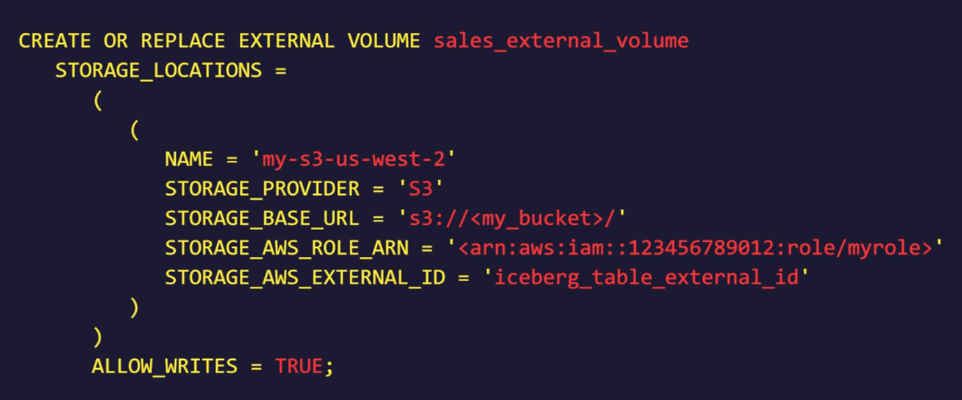
Creating external volume to connect to s3
EXTERNAL_VOLUME = an account level object that stores our cloud storage credentials

Slide 38
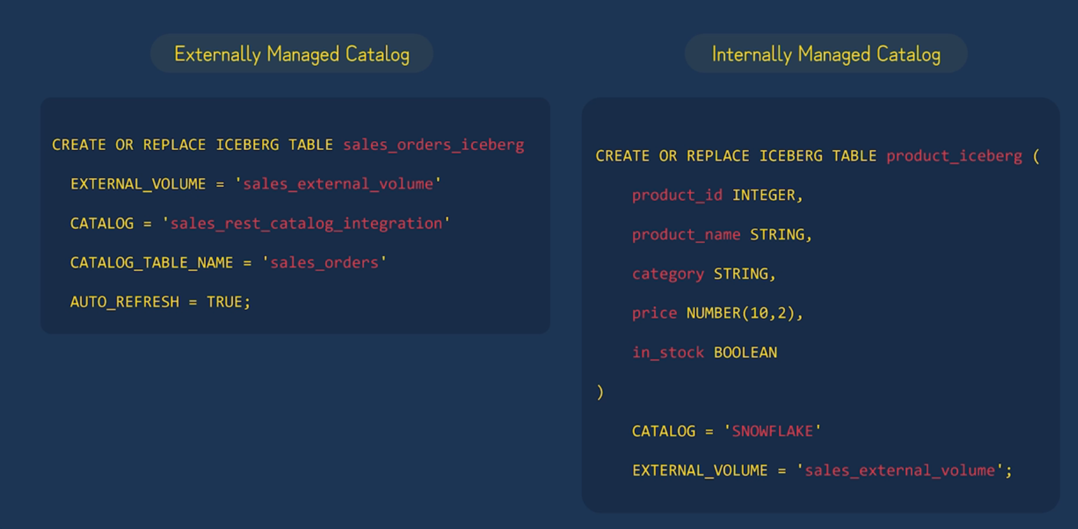
External vs internal managed catalogs
There are tradeoffs for each option
Internal – supports snowflake table replication feature; External engines can read but not write, snowflake can read/write
External – no table replication; external engines like spark can read/write iceberg table data, but snowflake can only read; time travel is limited to iceberg snapshot history

Slide 39
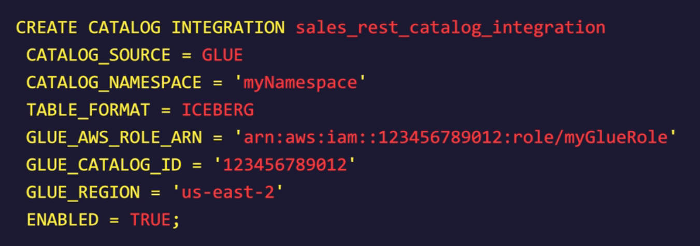
External Catalog – Catalog Integration Object
Catalog integration object = sets up access to external catalog service
Using an external service is useful if our iceberg tables were created elsewhere, such as spark
This example uses AWS Glue

Slide 40
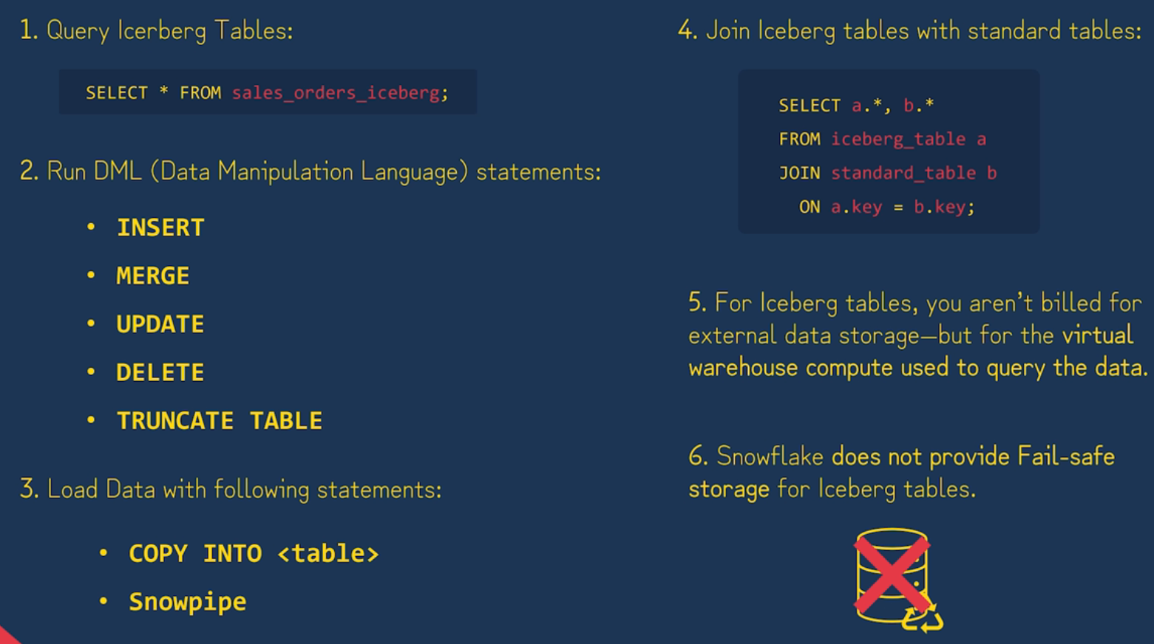
What we can do with iceberg tables

Slide 41
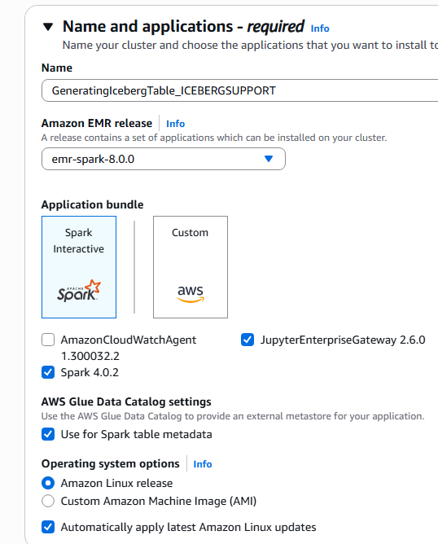
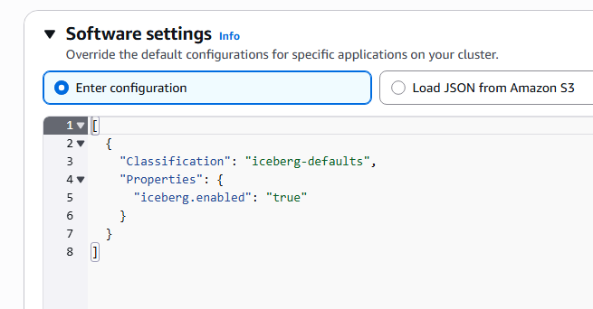
Walkthrough – external catalog AWS GLUE
In your course materials, please see the following files:
titanic.parquet
spark_iceberg_AWS_Glue_S3.py
We will run the py file on Amazon EMR, so we can see how pyspark can create iceberg tables into S3 from parquet
We will need to assign Glue/AWS permissions to our role on our master node
When creating the cluster, make sure to enable ‘AWS Glue Data Catalog settings’ & set the software settings as shown:

Slide 42
Walkthrough – external catalog Aws glue
In your course materials, please see the following files:
Snowflake_to_S3_with_external_catalog_AWS_Glue_V2.sql
We will now configure Snowflake by creating our required objects and finally making a query to our table

Slide 43
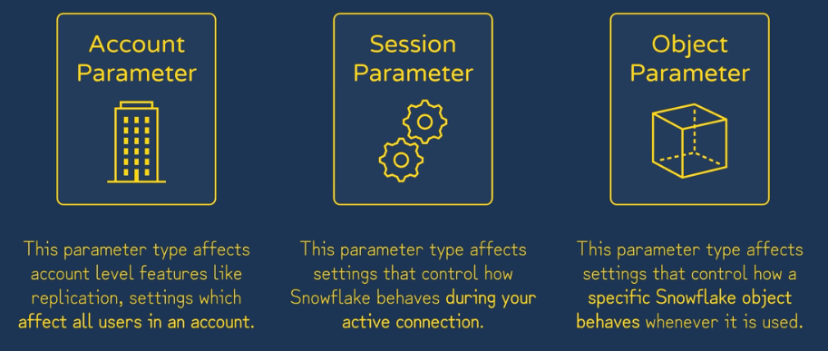
Parameters
Parameters are settings Snowflake provides us to tune and modify the behavior of our account
There are 3 broad categories of parameters
Paramaeters DOCS

Slide 44
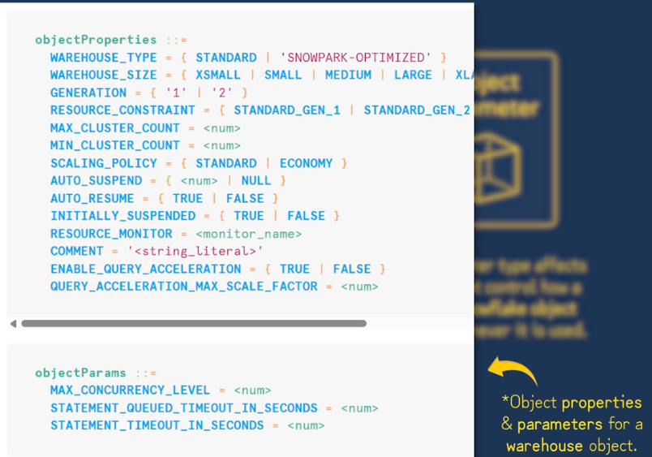
Object Properties vs Object parameters
Properties - define an object's static characteristics or resources, what it is or how it's configured, such as warehouse_size, max_cluster_count, or auto_suspend.
Parameters - control an object's runtime behavior, how it acts when it's used, such as max concurrency level or statement timeout in seconds.

Slide 45
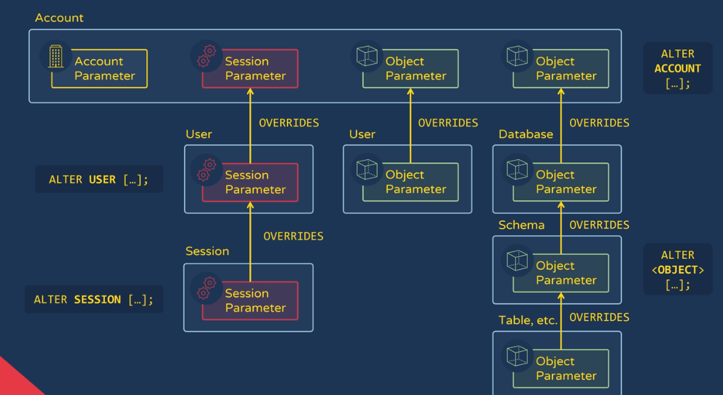
Parameter precedence

Slide 46
Walkthrough
Please see ‘Parameters.sql’ in the course materials

Slide 47
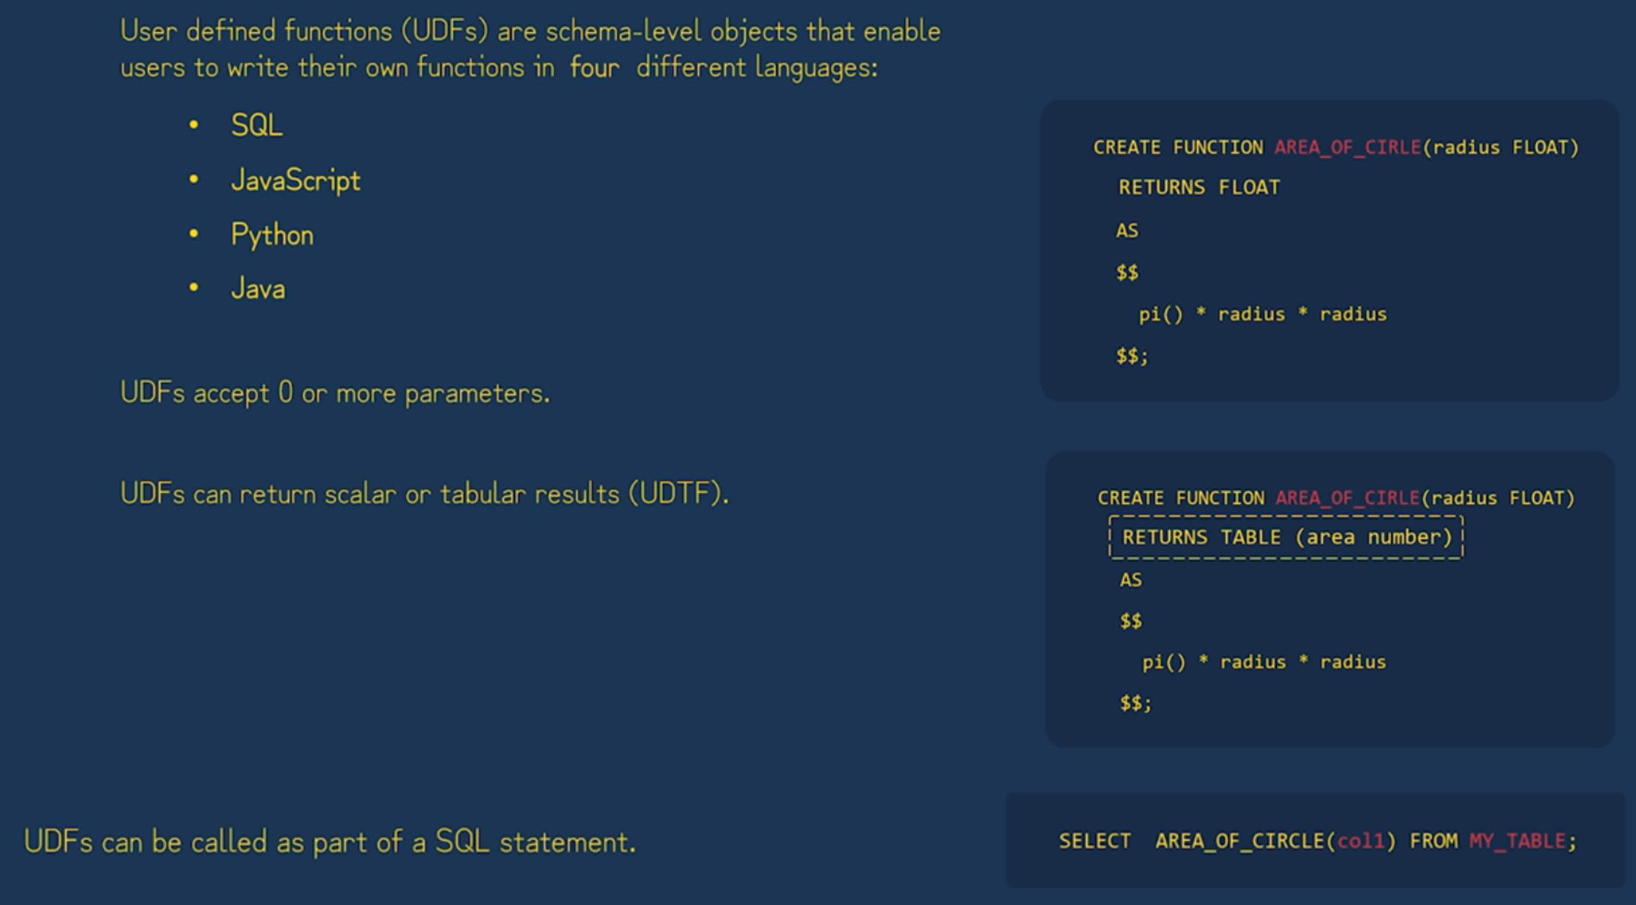

UDF & udft

Slide 48
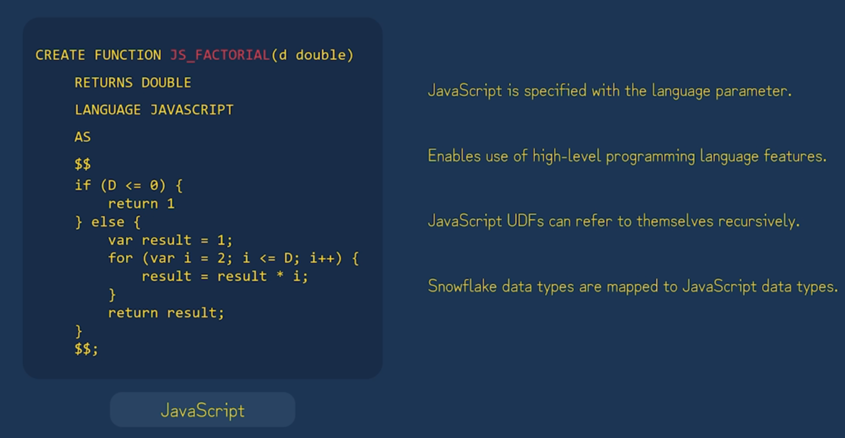
JavaScript UDF
Another limitation: only base JavaScript is usable; no libraries

Slide 49
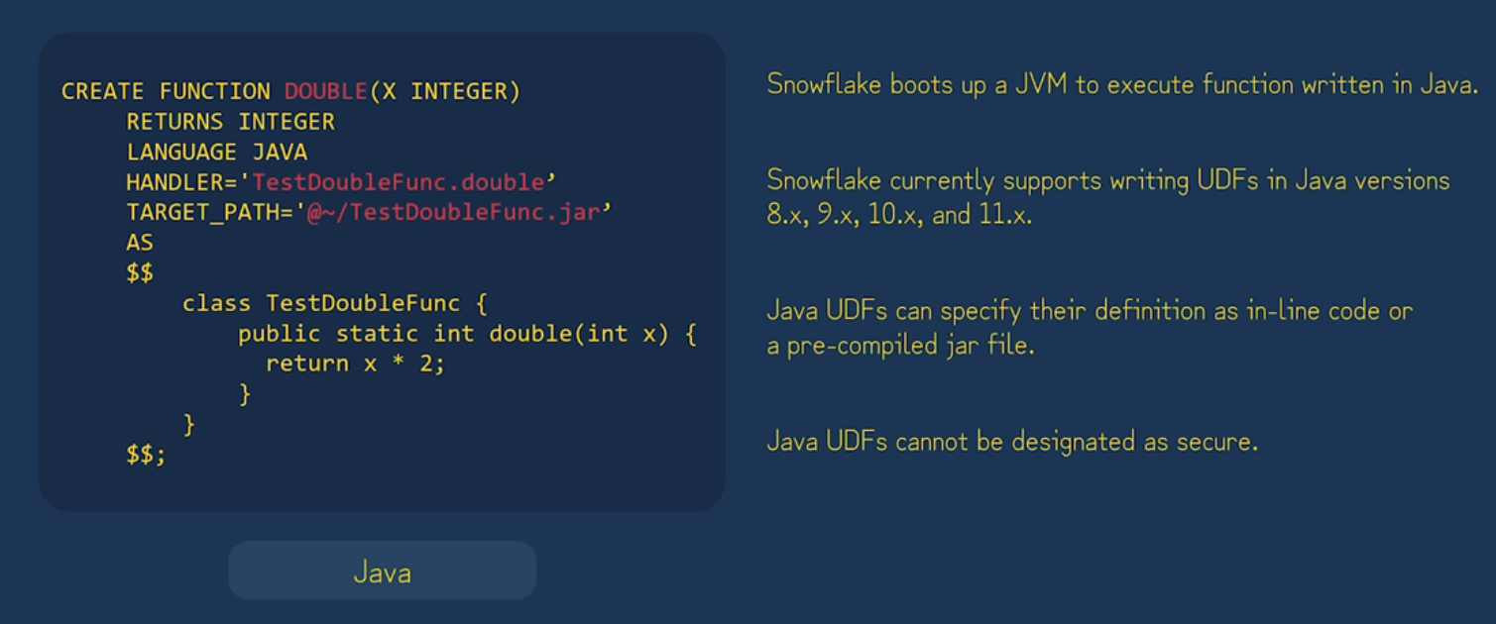
Java UDF
Another limitation: only base java classes are usable; no libraries

Slide 50
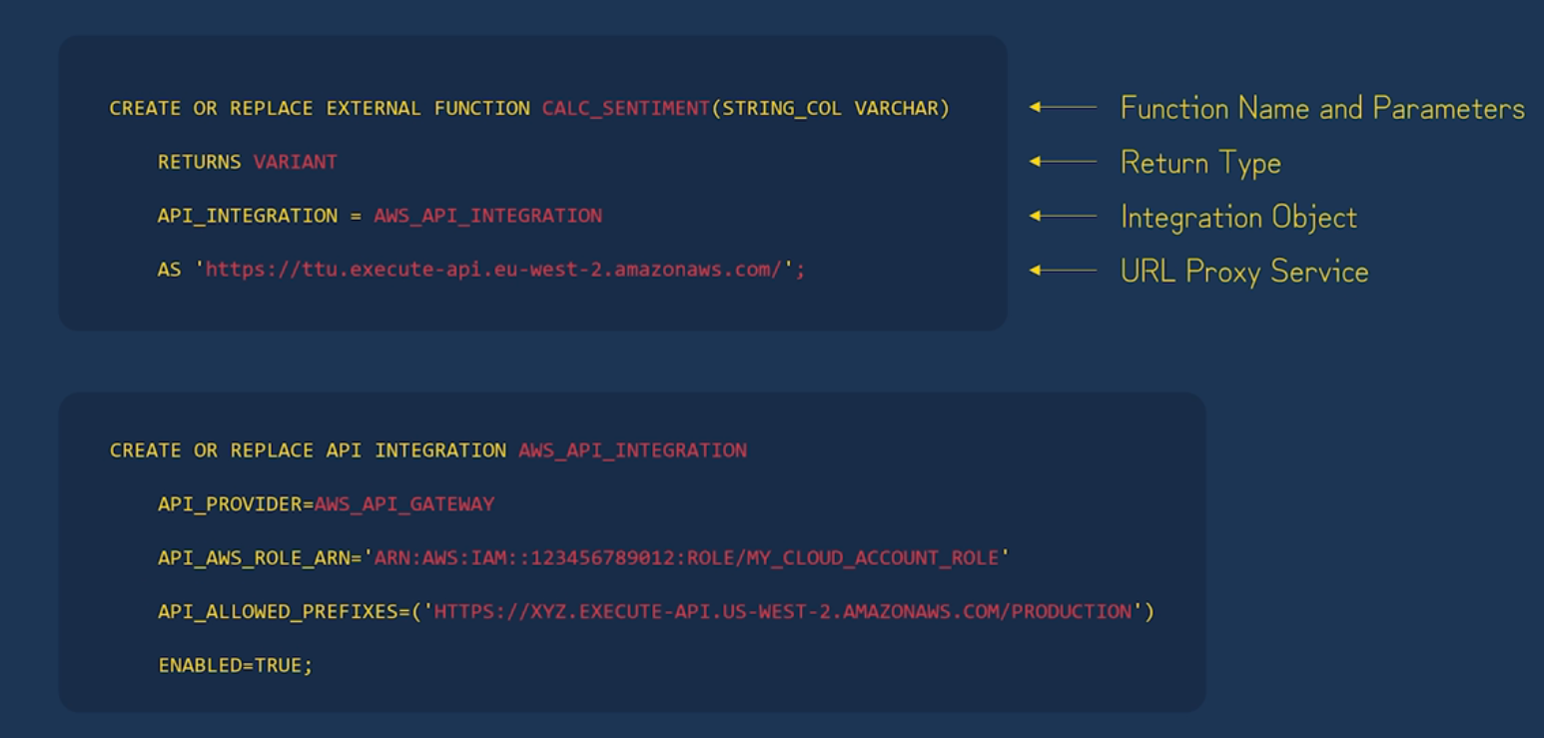
External Functions
Since we can’t use external libraries with snowflake UDFs, we could call an external function instead that could be in any language we wish. For example, we could setup Amazon API Gateway to take requests and execute an AWS lambda function, which could be in many languages and utilize 3rd party libraries. The following showcases this:

Slide 51
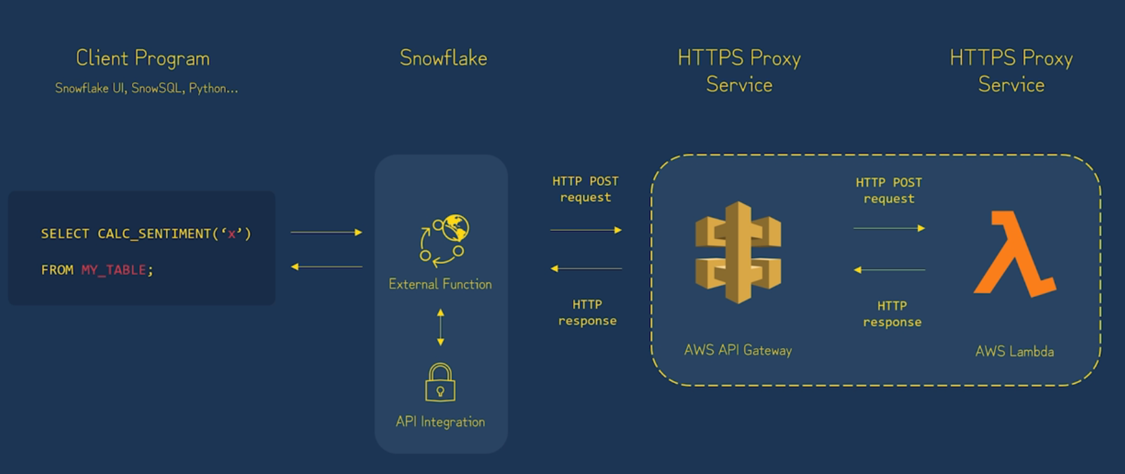
External function call lifecycle

Slide 52
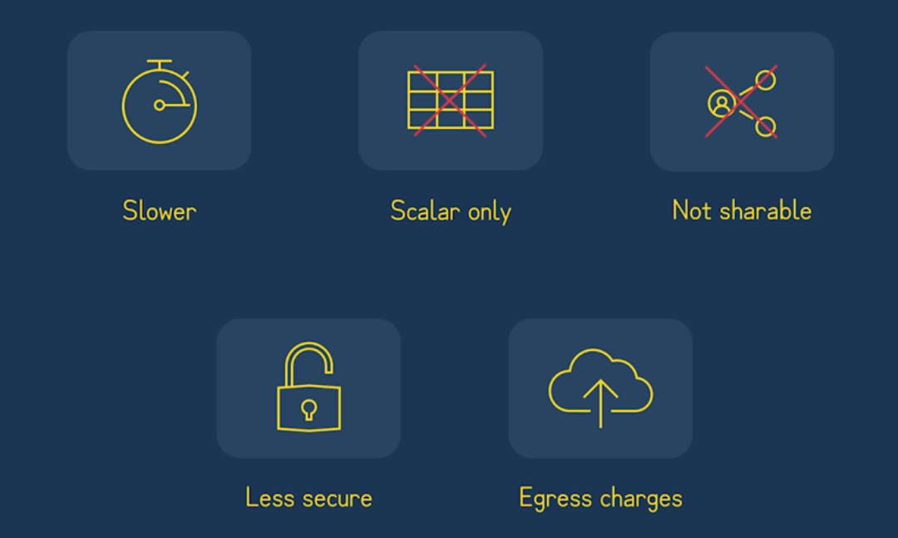
External Function Limitations

Slide 53
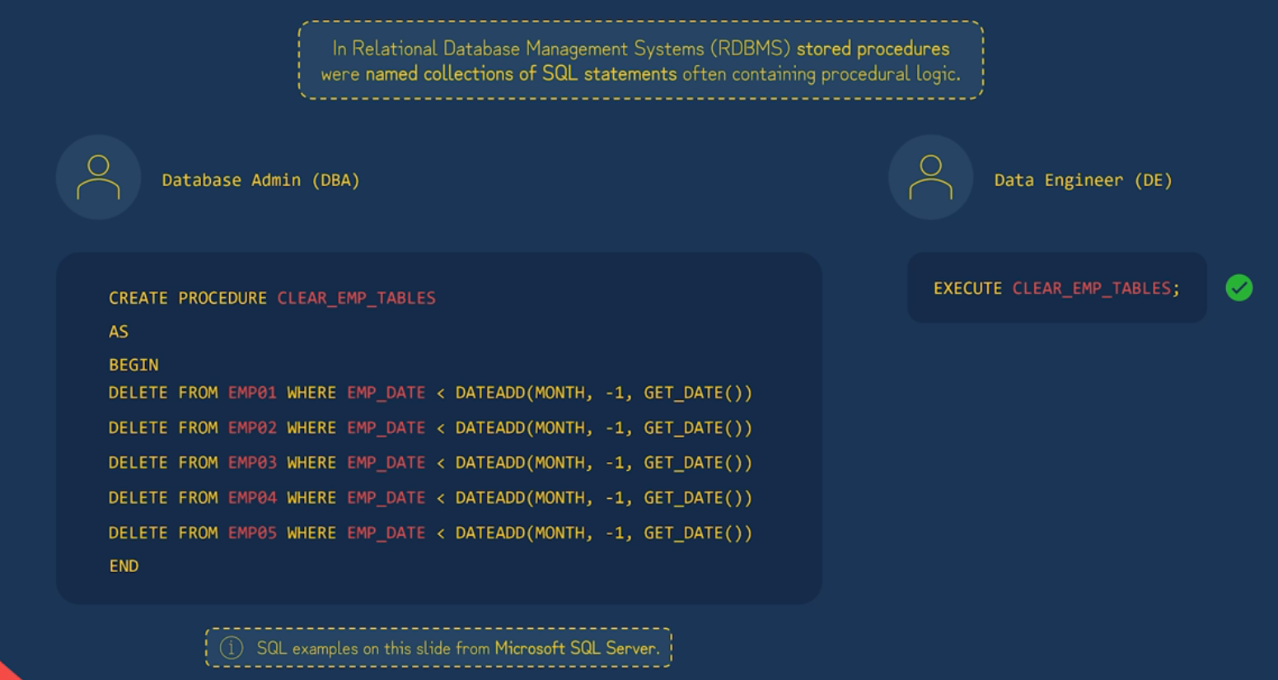
Stored Procedures – the why

Slide 54
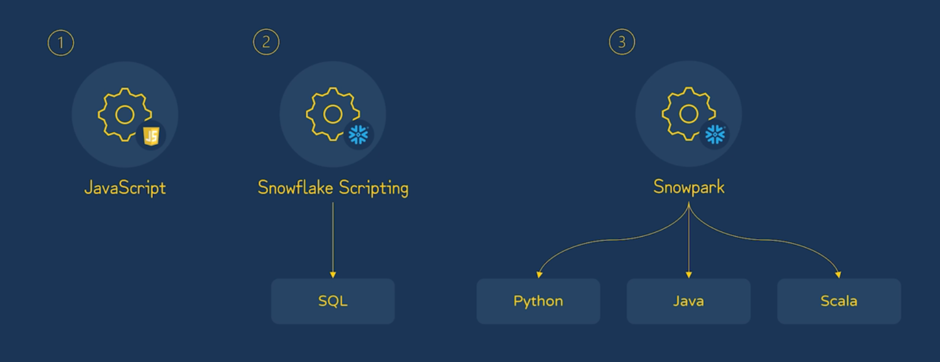
Snowflake stored procedures
The JavaScript option is well established, and Snowflake provides their own API to support its usefulness

Slide 55
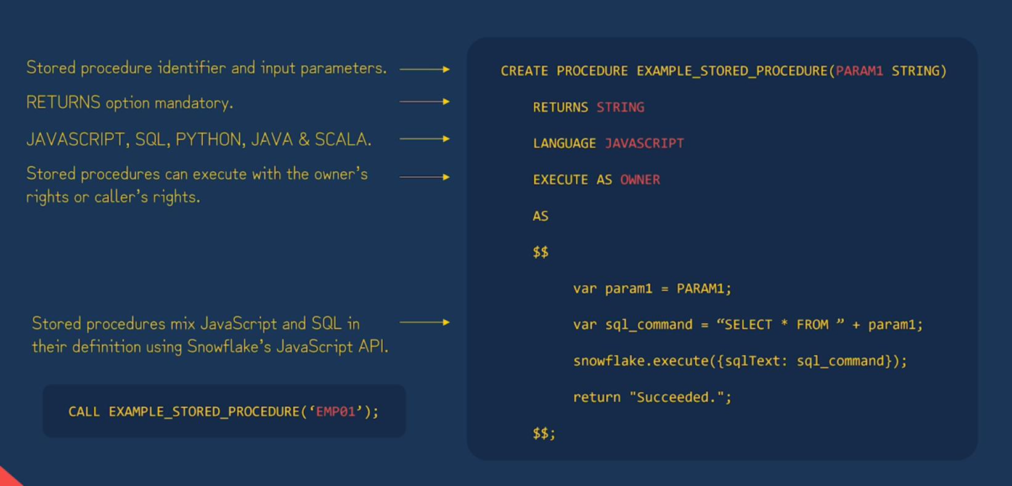
JavaScript Stored Procedures
The DOCS

Slide 56

Compare and contrast: UDF vs Stored Procedure

Slide 57
Walkthrough
Please see the file ‘UDFs_External_Functions_&_Stored_Procedures.sql’ within your course materials

Slide 58

Sequences

Slide 59

Sequences
Sequences cannot guarantee their values will be gap free
If you were to re-run this, our next starting value would be 35
(multiplying increment by # of NEXTVAL operations)

Slide 60

Sequences – Common use case

Slide 61

Sequences – common use case

Slide 62

Tasks

Slide 63

Streams
Action will show INSERT or DELETE
Updates to rows in the source table are represented by a pair of delete and insert records in the stream, with the IsUPDATE column set to true

Slide 64

Streams
Tasks & Streams together form one way to achieve a continuous transformation pipeline

Slide 65

Dynamic Tables
Dynamic tables automatically keep themselves up to date, based on a query we define
This is simpler than Tasks/Streams for creating a transformation pipeline. Instead of maintaining a DAG of tasks, we simply write what we want via SQL and then Snowflake handles the orchestration

Slide 66

Dynamic Tables
From the Snowsight UI, we can view our Dynamic Tables
This UI feature will even show the dependencies of our Dynamic Tables in a graph, so we can clearly see each step of the pipeline

Slide 67

Snowsql
https://www.snowflake.com/en/developers/downloads/snowsql/

Slide 68

Snowsql

Slide 69
Walkthrough
Please see ‘SnowSQL.md’ in your course materials

Slide 71
Overview
Introductions
What to Expect
How to Excel in this Course

Slide 72

Introductions
I’ve been at Revature 4 years
I teach Salesforce, ServiceNow, & .NET
Currently hold the CSA certification
Current favorite game: WoW

Slide 73


What to Expect
13-week course
First 8 weeks is ServiceNow
Remaining 5 weeks will focus on Java
Various Assessment Types
Exams – Multiple Choice, Multiple Select, Short Answers
QC – Panel-Type Live Interviews
1-on-1s – Evaluations completed by the trainer (Loom or face-to-face)
Projects – Assigned project work that covers discussed topics (keep up day-to-day and you won’t be behind)

Slide 74
How to Excel in this Course
We will use slide decks throughout the course.
If it is on the slide deck, it is important, and you should consider writing it down.
Sometimes, you may see a definition, like this:
Definition: ServiceNow – A cloud-based, ITSM platform that helps organizations manage and automate their work processes across IT, HR, Customer Service, and more.
If you see a definition:
Write it down
Write down what its context is in the larger scope
E.G. ServiceNow is often just one piece in an enterprise system. An organization may have many off-the-shelf software products that may integrate with ServiceNow.

Slide 75
Challenge Demo – How to Excel in this course
Goal:
Scenario: 5 min
Complete a hands-on challenge
Your organization needs to relay technical concepts to you. Clients often need to do the same. Take a few moments to get some pen and paper ready to take notes.

