Slide 1
pySpark

Slide 2
Curriculum
Week | Topic | What it solves
1-2 | PySpark | Transform/Process Data
3 | Snowflake | Store and Query Data
4 | Airflow | Orchestration for Data Pipelines (batch processing)
5 | Kafka | Real-Time Processing (streaming processing)
6 | Power BI + DataOps + Governance | Turns data into viewable/actionable insights for decision makers

Slide 3
SPARK vs PySpark
Apache Spark
Apache Spark is an open-source distributed computing framework designed for processing large datasets across clusters of computers.
Key features:
Distributed data processing
In-memory computation for speed
Supports batch processing, streaming, machine learning, and graph analytics
Runs on clusters managed by systems like Hadoop YARN, Kubernetes, or standalone Spark clusters
Core APIs are written in Scala and Java
Scala is most popular and new features/libraries tend to be Scala-first
Example Spark use cases:
ETL (Extract, Transform, Load) pipelines
Data warehousing
Real-time analytics
Machine learning at scale

Slide 4
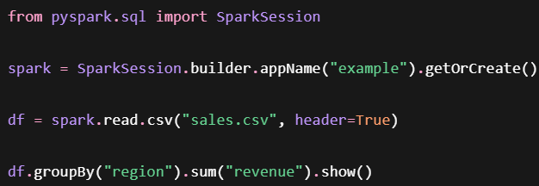
Spark vs PySpark
PySpark
PySpark is the Python API for Apache Spark.
It allows Python developers to write Spark applications using Python instead of Scala or Java.
Under the hood:
You write Python code.
PySpark translates operations to Spark's execution engine.
Spark executes the work across the cluster.
Results are returned to Python.
This Python code creates a spark job that may execute across dozens or hundreds of machines

Slide 5
Apache Hadoop
Apache Hadoop is an open-source software framework for distributed storage and large-scale data processing. Developed by Apache Software Foundation, it enables reliable, fault-tolerant computation across clusters of commodity servers.
Apache Hadoop is not just one thing. Historically it included:
Storage: Hadoop Distributed File System (HDFS)
Resource management (job scheduling layer): Yet Another Resource Negotiator (YARN)
Processing (compute engine): Hadoop MapReduce
In modern workflows, Spark has come to replace Hadoop MapReduce as the compute engine layer, but will still make use of the HDFS, and can run on YARN
“Run programs up to 100x faster than Hadoop MapReduce in memory, or 10x faster on disk.”
Under the hood: DAG Engine (directed acyclic graph) optimizes workflows

Slide 6
PySpark Setup
Install wsl
‘wsl’ to start ‘logout’ to exit
Update refreshes package index; upgrade installs all packages to latest versions
You can search for available packages / install packages
Let’s also install the JDK

Slide 7




Other Apt Commands
Remove uninstalls packages; purge uninstalls and deletes any config files
List can show installed packages
Autoclean will delete downloaded package data only needed during installation
Auto remove will remove any packages that were previously needed as dependencies, but are no longer required

Slide 8


PySpark Setup
Mkdir = create directory/folder
Cd = change directory
Create a python3 virtual environment with latest installed version / create venv from specific version:
We can use chmod to make ‘activate’ executable:

Slide 9
PySpark Setup
Activate the venv before installing any packages (deactivate to exit venv):
Install packages via pip
Jupyter provides UI / workspace for taking notes and testing code

Slide 10
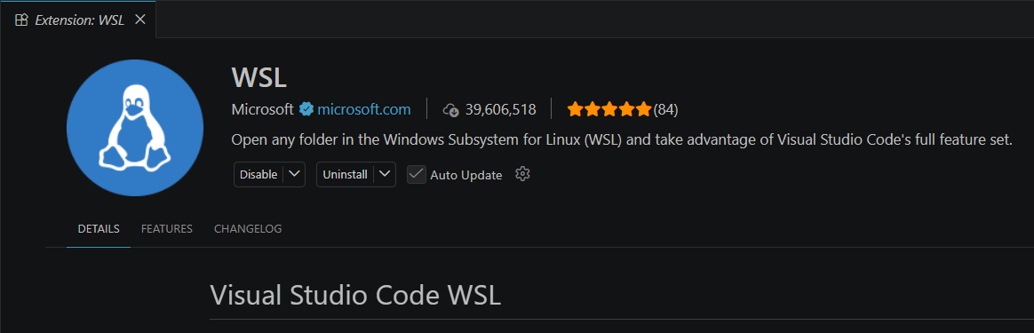


VSCODE – Recommended Extensions

Slide 11
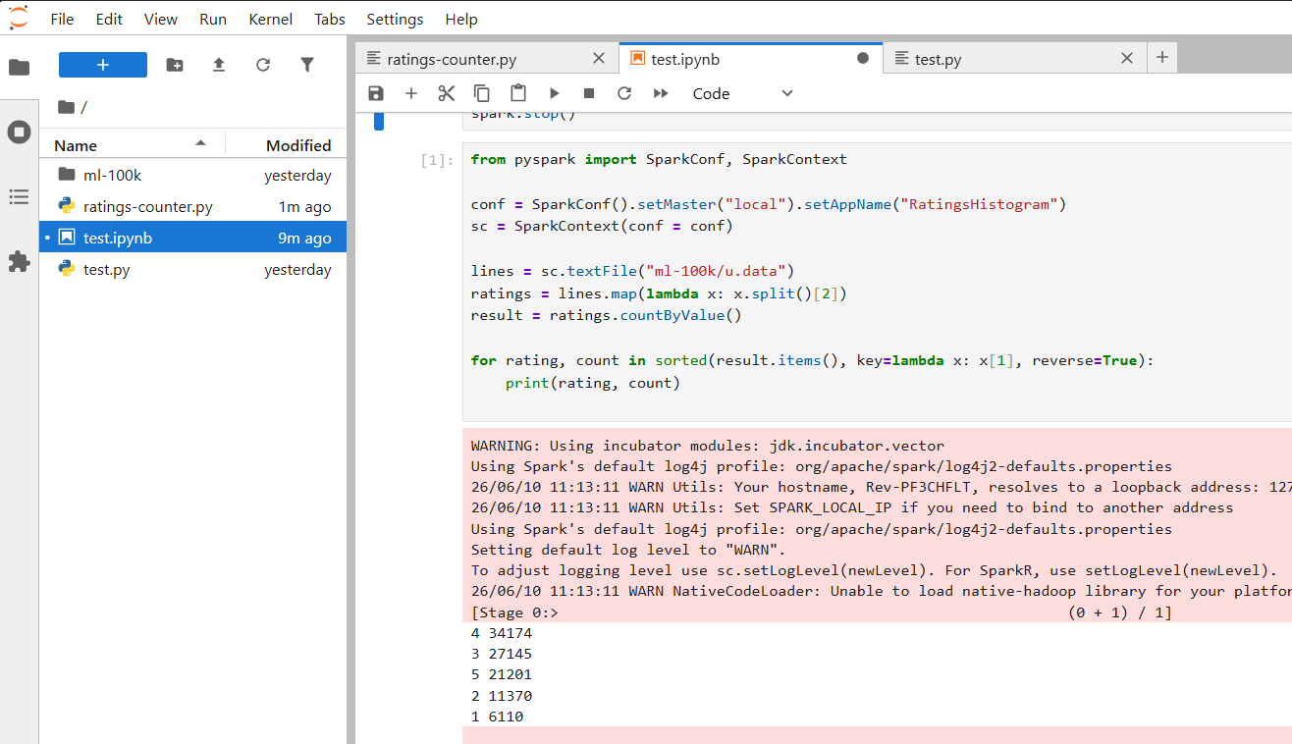
PySpark Example
Uses data from grouplens
MovieLens 100k Dataset
u.data columns:
userId, ItemId, Rating, Timestamp

Slide 12
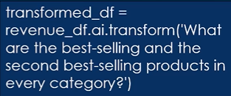
Spark 3.5 features
Spark connect
Client / server architecture for Apache Spark
Expanded SQL functionality
User-Defined table functions (UDTFs)
Apache Arrow-optimized UDFs
More SQL functions supported (150+) in DataFrames APIs
English SDK for Apache Spark
Debugging features
Enhanced error messages
Testing API (DataFrame equality testing)
DeepSpeed Distributor
Distributed training or PyTorch models on Spark clusters

Slide 13
SPARK 4 features – Ansi mode by default
Better error handling in SQL-style queries
Invalid casts, division by zero, ect will result in a detailed error
Before, things would silently proceed, usually with NULL values
Missing data might also trigger errors now
A None value where something is expected will raise an error
For example, the expression salary + 100 won’t be allowed at all if your salary column contains empty values
Example: SELECT CAST(‘some string’ AS FLOAT)
Spark 3: returns a NULL value
Spark 4: Error: Cannot cast ‘some string’ to FLOAT
You can set spark.sql.ansi.enabled to ‘false’ if you need backwards compatibility

Slide 14
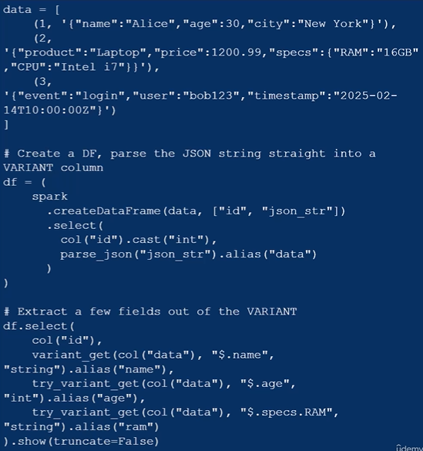
SPARK 4 features – Variant data type
Better support for semi-structured data: JSON, XML
parse_json functions allows you to convert raw json to VARIANTs
variant_get, try_variant_get, cast lets us extract them
Or just use VARIANT SQL syntax:
CREATE TABLE customers (
id INT,
name STRING,
data VARIANT
);

Slide 15

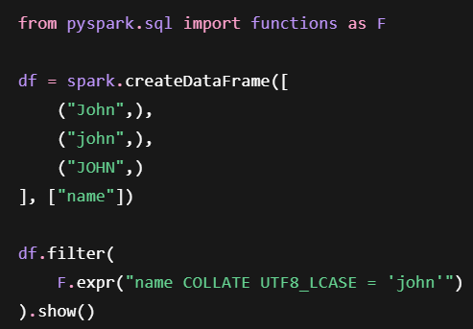
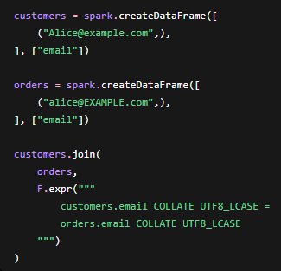
SPARK 4 features – Collation support
Collations bring SQL-standard string comparisons to Spark
Case-insensitive comparisions without LOWER() everywhere
Locale-aware sorting and comparisions, build into Spark SQL
Choose how strings compare, not just what they contain

Slide 16
SPARK 4 features – Data Source API’s
The Data Source API is a JVM (Java/Scala) API only
A data source is simply anything spark can read from or write to: CSV, Parquet, JDBC, Kafka, Snowflake, etc.
We typically only use these in PySpark, we won’t make our own: ‘spark.read.format()’
The new Data Source APIs are primarily for developers who want to build custom data sources (connectors for databases, APIs, cloud storage, proprietary formats, etc.)

Slide 17
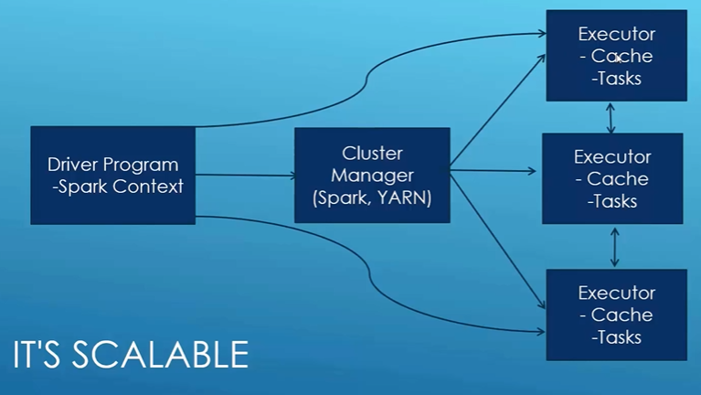
Spark Architecture
Spark takes our driver program, i.e. our scripts, and figures how best to distribute the work
Has built-in cluster manager, but we can also use Amazon EMR (Elastic MapReduce)

Slide 18

Components of Spark
Spark streaming: analyze real-time data streams
Spark SQL: run SQL on top of Spark
MlLib: library for simplifying machine learning tasks
GraphX: Gain insights in data with many relationships/correlations

Slide 19
Components of Pyspark
Your python code (the driver)
PySpark API (DataFrame, SQL, RDD APIs)
Py4J Bridge (Python-to-Java Communication)
Spark JVM
Optimizes queries via the Catalyst by building logical plans
Schedules tasks
Cluster Manager (optional but important)
Standalone, YARN, Kubernetes
Spark Executors (JVMs on the worker nodes)
Execute tasks
Store cached data
Python workers (for Python UDFs and RDD operations)
Spawned by executors when Python code must run

Slide 20
RDD – The Resilient Distributed Dataset
A Resilient Distributed Dataset (RDD) is the fundamental data structure in Apache Spark. It is an immutable, distributed collection of objects that can be processed in parallel across a cluster of computers. (DataFrame API is typically prefferred)
Resilient
RDDs are fault-tolerant.
If a partition is lost due to a node failure, Spark can automatically reconstruct it using the lineage (the sequence of transformations used to create the RDD).
Distributed
Data is split into partitions and stored across multiple nodes in a cluster.
This enables parallel processing of large datasets.
Immutable
Once an RDD is created, it cannot be modified.
Operations on an RDD create a new RDD rather than changing the existing one.
Lazy Evaluation
Transformations (such as map() and filter()) are not executed immediately.
Spark builds a logical execution plan and performs the computation only when an action is called.
Parallel Processing
Multiple partitions can be processed simultaneously, improving performance for big data workloads.

Slide 21
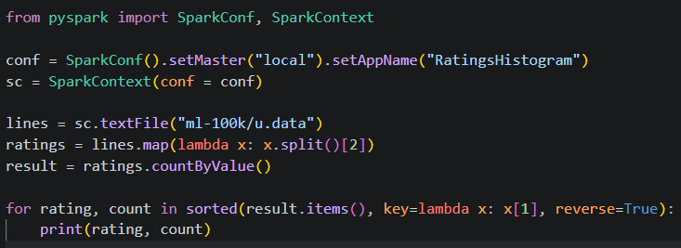
The Sparkcontext
Created by our driver program
Is responsible for making RDDs resilient and distributed
Creates RDDs
The spark shell creates an ‘sc’ object for us
I.e. when we run ‘pyspark’ from our CLI

Slide 22
Creating Rdd’s
nums = parallelize([1, 2, 3, 4])
sc.textFile(“file:///c:/users/ethan/something.txt”)
OR: s3n:// OR hdfs://
hiveCtx = HiveContext(sc) rows = hiveCtx.sql(“SELECT name, age FROM users”)
Can also create from:
JDBC
Cassandra
Hbase
Elastisearch
JSON, CSV, sequence files, object files, various compressed formats

Slide 23
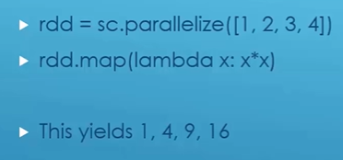
Transforming RDD’s
Transformations will produce a new RDD
Not a complete list (but most common):
map – give a function that transforms each entry in RDD
mapValues – same as above but may only act on the values, keys unaffected (but still returned)
flatmap /flatMapValues – similar to map, but can produce multiple values or none for every entry
filter – get an RDD with values filtered out
distinct – get unique values in RDD and throw away duplicates
sample – get smaller sub-dataset from RDD
union, intersection, subtract, cartesian

Slide 24
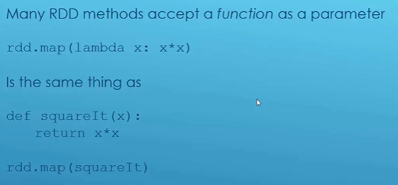
Python Lambdas

Slide 25
Actions on Rdd’s
collect – returns all data from the RDD to the driver as a list.
count – returns the total number of elements in the RDD.
countByValue – returns a dictionary of {value: count} showing how many times each unique value appears in the RDD.
take – returns the first n elements of the RDD as a list.
top – returns the largest n elements in the RDD according to the default or specified ordering.
reduce – aggregates all elements of the RDD into a single value by repeatedly applying a user-defined binary function (e.g., summing all numbers)

Slide 26
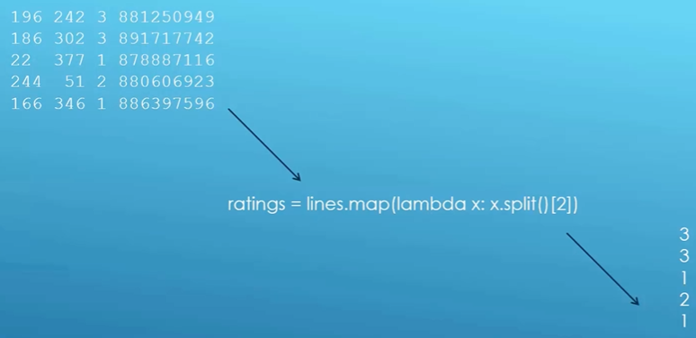
Sample Breakdown
We import what we need
SparkConf helps setup our configuration for the SparkContext
setMaster(“local”) – run locally as opposed to in a cluster in the cloud for example
setAppName() – gives our process a name; best practice
lines = RDD made from sc.textFile()
ratings = RDD made from lines.map()
Split() returns list of elements in-between whitespace/tabs/newlines/etc.
lines (each row) = UserId, MovieId, Rating, Timestamp
result is a python dict, so we can call items() against it

Slide 27
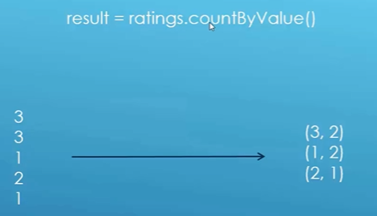
Sample Breakdown
This is an Action, NOT a transformation, so we don’t get back an RDD, we get values Dict[str, int]:

Slide 28
Sample Breakdown
Items() returns a set of tuples: (rating, count)
key: provided lambda to sort on the second column (rating counts)
reverse: set to true to sort in descending order

Slide 29

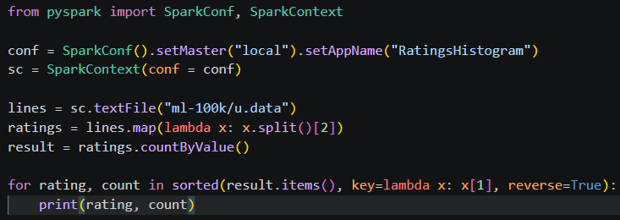
Spark-submit

Slide 30
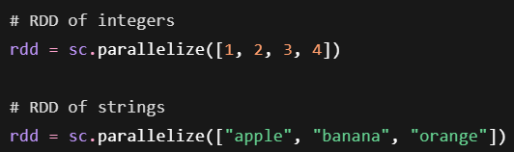
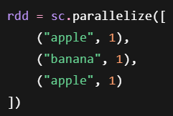
Key / Value RDD
Key / Value RDDs are a list of tuples that have at least 2 elements:
reduceByKey(): combine values with the same key using some function
rdd.reduceByKey(lambda x, y: x + y) ← x is the accumulator; y is current value
groupByKey(): group values with the same key (no reduction/accumulation)
sortByKey(): sort RDD by key values
keys(), values(): create an RDD of just the keys, or just the values

Slide 31
SQL-style Joins on 2 key/value RDD’s
join, rightOuterJoin, leftOuterJoin, cogroup, subtractByKey

Slide 32
RDD Best Practices
With key/value data, use mapValues() and flatMapValues() if your transformation doesn’t affect the keys
The key will still exist, we just won’t have edit access
It’s more performant under the hood

Slide 33
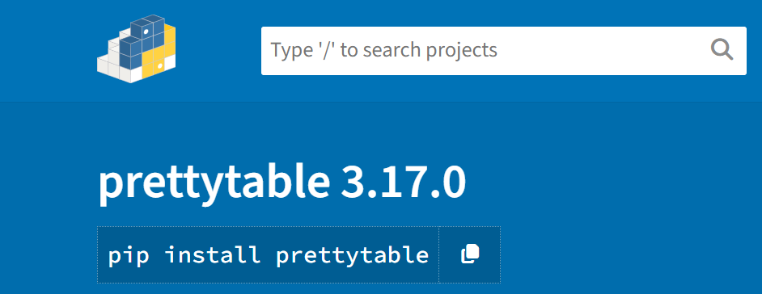
PrettyTable

Slide 34
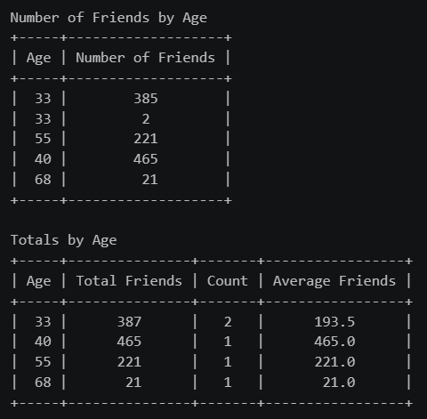
Friends by Age Example
Input data: ID, name, age, number of friends
0,Will,33,385
1,Jean-Luc,33,2
2,Hugh,55,221
3,Deanna,40,465
4,Quark,68,21

Slide 35
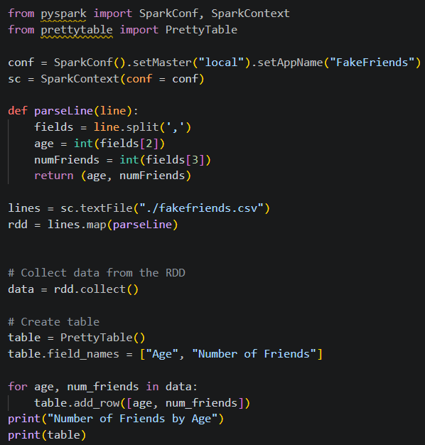
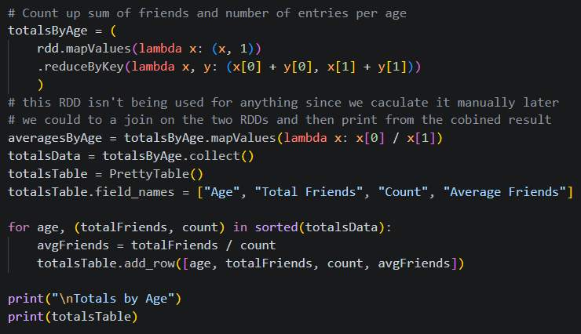
Friends by age Example

Slide 36
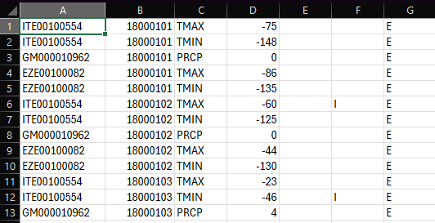
Filter() – 1800s weatherstation data
filter() removes data from your RDD
Takes a function that returns a Boolean
minTemps = parsedLines.filter(lambda x: ‘TMIN’ in x[1])
WeatherStationID, Date, ObservationType, ObservationValue (tenth degree C), (ignore others)

Slide 37
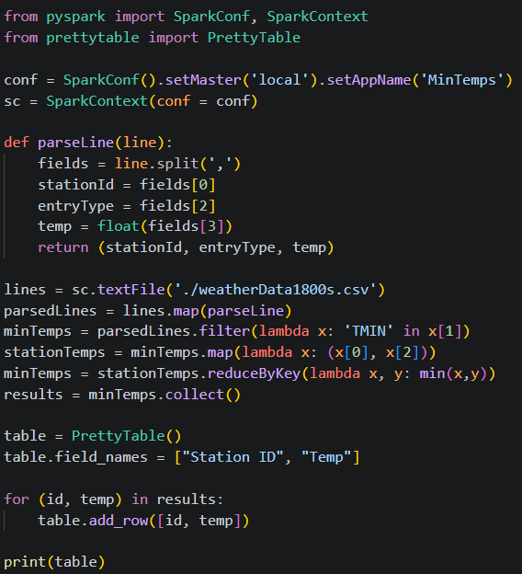
Measure Minimum Temps

Slide 38
Challenge – Find Maximum temps
Goal:
Scenario: 5 min
Find Maximum temps
Find maximum temps for each station

Slide 39
Map vs Flatmap
Map – returns single item for each entry
Wouldn’t be the choice here, each line is a single entry
flatmap – possibly returns many items for each entry
For each entry (line), we can split() and get each word (multiple values per entry)

Slide 40
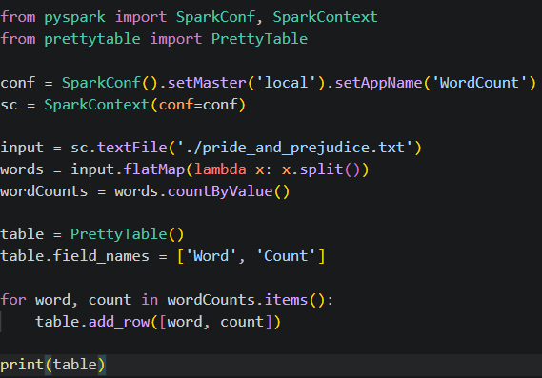
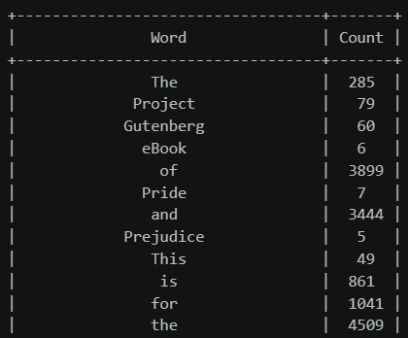
Word Count Example

Slide 41

Text Normalization
Problem: word variants with different capitalization, punctuation, etc
There are fancy natural language processing toolkits like: natural language toolkit (NLTK)
But we’ll keep it simple, and use a regular expression to fix this

Slide 42
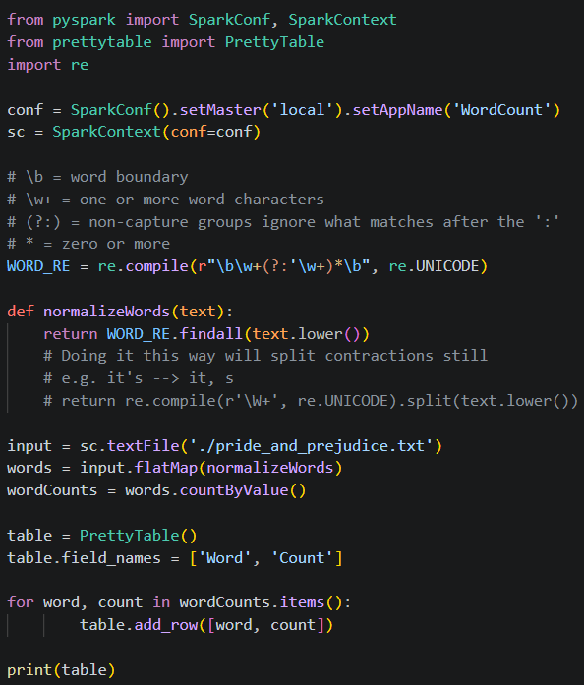
Improved Word Count Example
Creating a tokenized regex via compile() is ideal for performance
We include Unicode support so we can also catch words with unique letters
á: U+00E1 (Alt + 0225)
é: U+00E9 (Alt + 0233)
í: U+00ED (Alt + 0237)
ó: U+00F3 (Alt + 0243)
ú: U+00FA (Alt + 0250)
ü: U+00FC (Alt + 0252)
ñ: U+00F1 (Alt + 0241)
Ñ: U+00D1 (Alt + 0209)
¡: U+00A1 (Alt + 0161)
¿: U+00BF (Alt + 0191)

Slide 43
Sort Word Count Example
countByValue() returns a python dict, we could do sorting in-memory, but this isn’t scalable
Let’s instead use map() and reduceByKey() to recreate the same data in a RDD instead

Slide 44
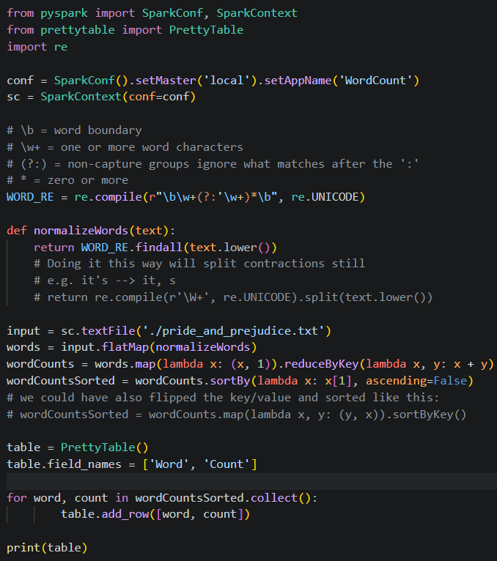
Sort Word Count Example

Slide 45
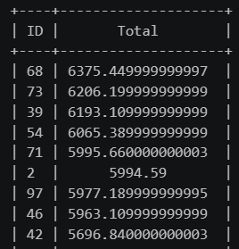
Challenge – Customer totals sorted
Find and sort customer IDs and the total spent
Goal:

Slide 46
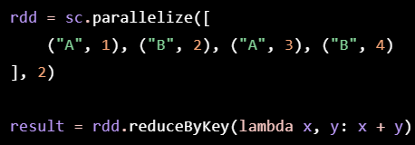
Shuffling
Shuffling in Apache Spark is the process of redistributing data across partitions so that records with the same key (or related data) end up on the same executor or partition
It is one of the most expensive operations in Spark because it involves moving data over the network, writing intermediate data to disk, and sorting.
Initially, records with key "A" and "B" may be spread across different partitions. Spark shuffles the data so all "A" records are together and all "B" records are together before performing the reduction.

Slide 47
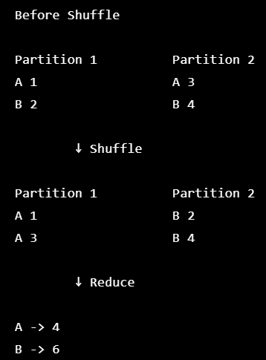
Shuffling
Each executor processes its local partition.
Spark partitions the output based on a partitioning function (typically a hash of the key).
Data is written to local disk as intermediate shuffle files.
Executors transfer the appropriate data to other executors over the network.
The receiving executors merge, sort (if necessary), and process the shuffled data.

Slide 48
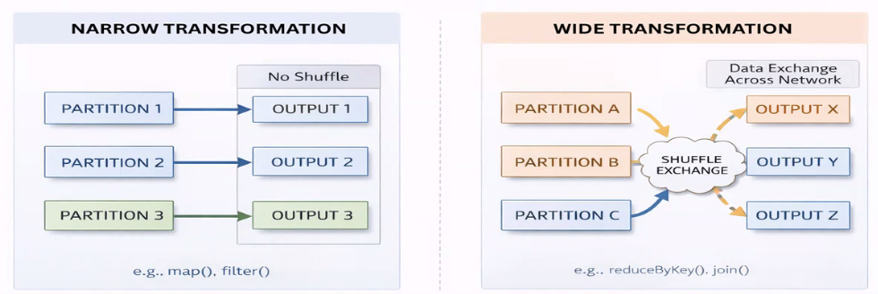
Narrow vs wide transformations
Narrow Transformation | Wide Transformation
map() | groupByKey()
filter() | reduceByKey()
flatMap() | join()
mapValues() | distinct()

Slide 49
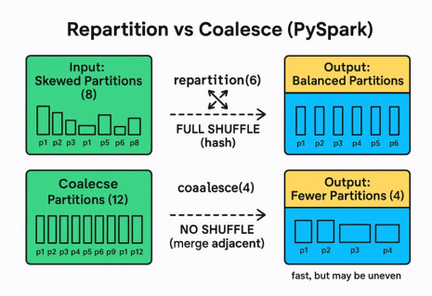
Repartition vs coalesce

Slide 50
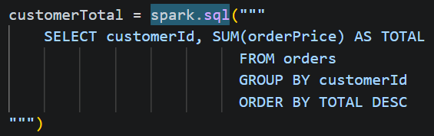
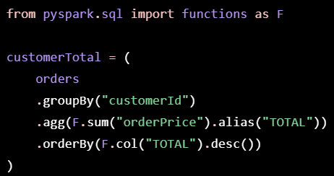
Spark SQL
Extends RDD to a DataFrame object
Can often write string SQL or use native Spark functions to complete the same task
Under the hood, the Catalyst Optimizer creates an execution plan (that will be the same for string SQL and native spark functions. i.e. same performance)
DataFrames:
Contain Row objects
Can run SQL queries
Can have a schema (store as correct datatype instead of all strings)
Read and write to JSON, Hive, parquet, csv…
Communication with JDBC/ODBC, Tableau

Slide 51
Using Spark SQL in Python
from pyspark.sql import SparkSession, Row
spark = SparkSession.builder.addName(‘SparkSQL’).getOrCreate()
inputData = spark.read.json(datafile)
inputData.createOrReplaceTempView(‘TableNameUsually’)
myResultDataFrame = spark.sql(‘SELECT ‘something’ FROM tableName ORDER BY ‘something’)

Slide 52
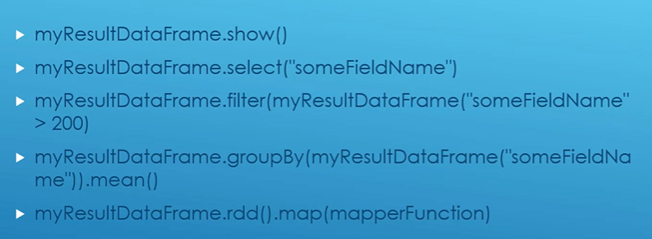
Other stuff you can do with dataframes

Slide 53
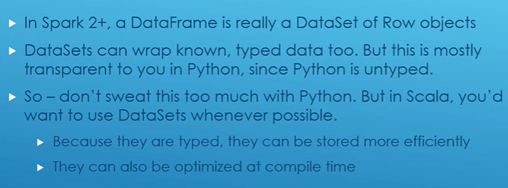
DataFrames vs Datasets

Slide 54
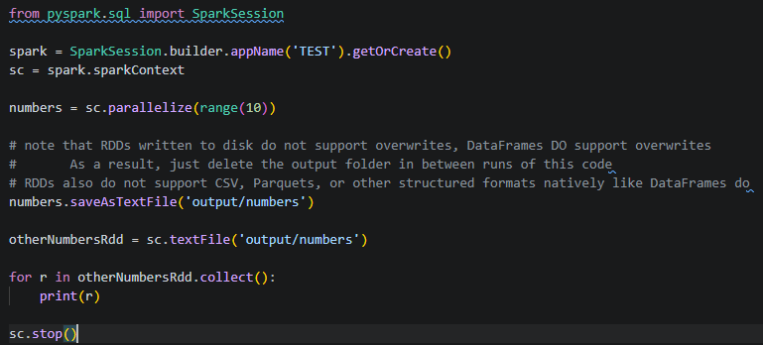
I/o – RDDs & DataFrames

Slide 55
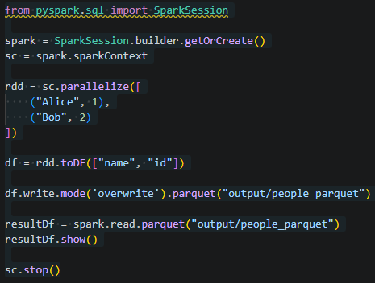
Parquet
Often first choice for spark workflows
Stores data column by column
Column pruning: spark only reads columns needed for the query
Predicate pushdown: filters can be applied at the file level

Slide 56
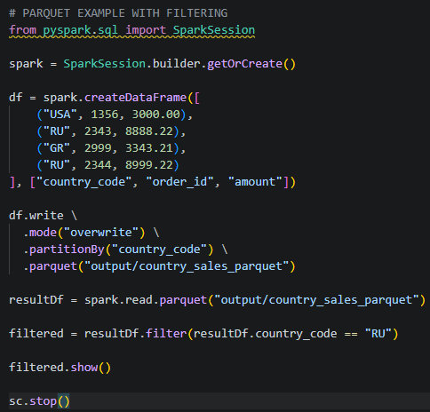
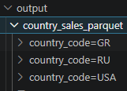
Parquet – optimizing filters
Filters are optimized because we can jump straight to the folder that matches our condition

Slide 57
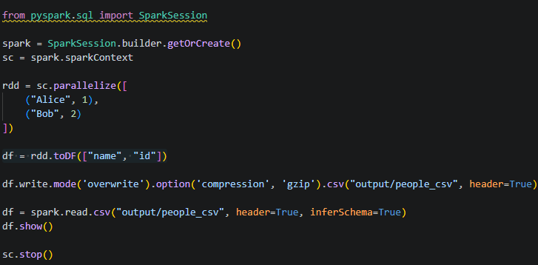
CSV, compression, headers, schemas
(Header = True) = Skip the first line because there is header information
(inferSchema=True) = infer the datatypes of each column so they won’t all be strings; we should just use a schema object instead

Slide 58
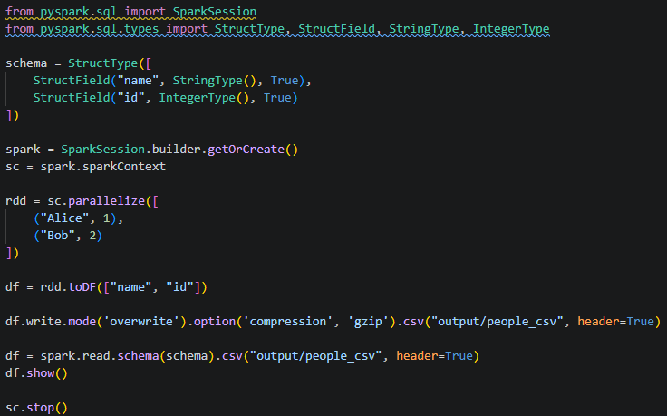
Csv, compression, headers, & Schemas

Slide 59
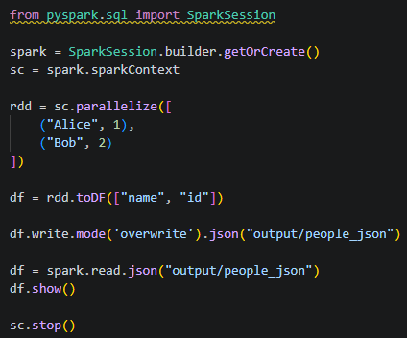
Json

Slide 60
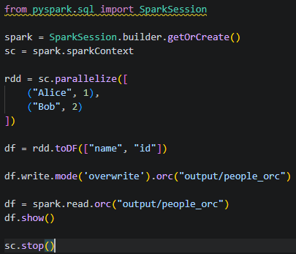

ORC
Optimized Row Columnar
Best in Hive-heavy environments
Predicate Pushdown – spark pushes filters down into ORC files, so filtering happens during scans, not after loading data

Slide 61
Dataframe reader options
For more on syntax permutations, please see ‘DataFrameReaderOptions.md’ in your course materials

Slide 62
So what format is used most often?
See more here

Slide 63
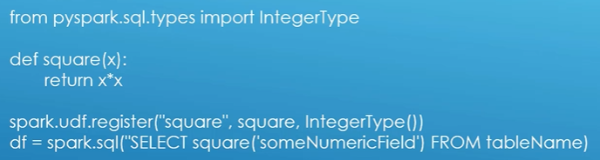
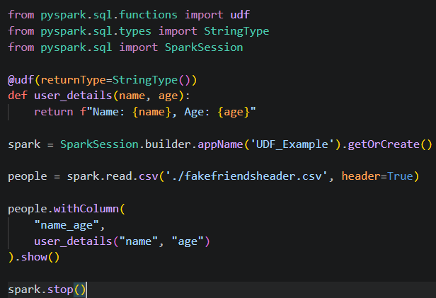
User-Defined Functions - udf
It’s recommended to use the decorator pattern with UDFs:
Note that we need to ‘spark.udf.register’ only for spark sql, if calling the method on a dataframe, we do not

Slide 64
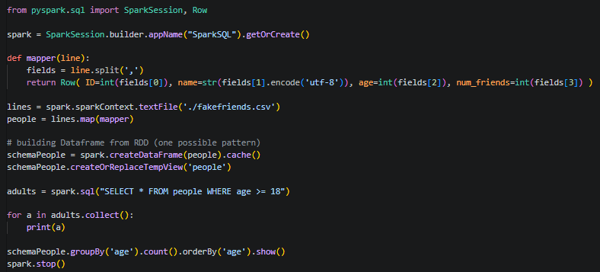
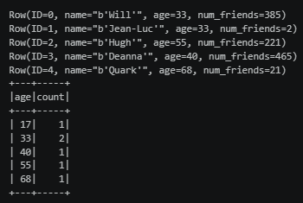
Cache() - # of people by age example
Note here that we are creating a dataframe from an RDD (there are many other possible ways to create a dataframe):
.cache() ← remember spark uses lazy evaluation, and computation only happens when an action occurs. If using multiple actions, caching improves performance by storing the dataframe in memory

Slide 65
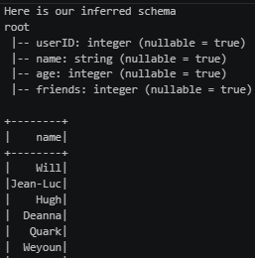
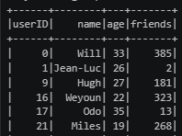
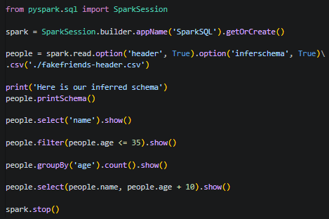


Inferring Schema datatypes
Without ‘header = true’, spark would name columns like: _c0, _c1, _c2, etc.

Slide 66

Challenge – Friends by age with dataframes
Goal:
Print a dataframe of the name and age for each entry
of fakefriends-header.csv

Slide 67


Solution + Further Examples with AGG()
functions contains many spark SQL methods we can use with agg()
Use agg() when we need multiple aggregations in a result set
That is because the following is NOT VALID: df.groupBy(‘age’).avg(‘friends’).sum(‘friends’).show()

Slide 68


Word Count With dataframes

Slide 69
We can use both RDD and DataFrames
RDDs are still around for a reason
As you have seen, we can use both DataFrames and RDDs for solutions
Use the tool best suited for the task
SQL style problem? DataFrames
Map or Reduce type operations? RDD
We can convert between the two, as we have seen

Slide 70


Min temps with dataframes & Creating Schemas

Slide 71

Challenge – Add up amount spent by customer Id
Goal:
Print the id for a customer and the total of all their orders from ‘customer-orders.csv’ in descending order
CustomerId, OrderId, Amount
(yeah this isn’t sorted like it’s asking for in the goal)

Slide 72
Pandas on Spark
Pandas – Python library for data manipulation and analysis
Pandas has its own DataFrames, apart from Spark
Pandas can do many of the thing's spark can do, many features overlap
Pandas will run on the same machine as your driver code, i.e. not scalable
We can use Pandas on PySpark to use Panda's syntax in a distributed environment
Note: as of 6/26 I had to downgrade pandas for interoperability with spark 4 (issues with pandas 3)

Slide 73

Examples – provided materials

Slide 74

Udf – user defined functions -- Review
UDF’s allow custom logic to be applied row by row in Spark SQL/DataFrames
One row at a time
Each row must be serialized/deserialized
Annotation syntax preferred
Need to register with spark using ‘spark.udf.register()’ only if used in spark sql

Slide 75

Udtf – user defined table functions
One input row may return multiple output rows and columns
Useful for transforming nested or structured data
Expanding JSON, arrays, hierarchical data
More efficient on large tables

Slide 76



UDF/UDTF examples

Slide 77



Challenge – Get log information
Goal:
With the provided ‘access_log.txt’ file:
List IP addresses + sum of their requests
List requested endpoints + count of number of time they have been called
List HTTP status codes + count from all requests

Slide 78

Challenge – Find the most popular movies
Goal:
Find the top 10 most popular movies in the ML-100k movielens dataset
Hint:
You will need a schema, and this file uses ‘Tab’ as separators, so we specify that as an option:
Only return 10 rows:

Slide 79
Broadcast Variables
Allows us to broadcast objects to the executors, such that they’re always available
Just use sc.broadcast() to ship off whatever you want
Then use .value() to get the object back
Use the broadcasted object however you want – map functions, UDFs, etc.

Slide 80

Example – Top 10 movies with title
Broadcast() – sends a dictionary to all executors
.value() – get the dictionary value back
See the provided example in our repo: ‘popular-movies-nice-dataframe.py’
This example is a bit contrived; we will talk about performance concerns after
See ‘popular-movies-nice-dataframe.py’ in course materials

Slide 81

Example – top 10 movies with title (join)
This approach would be preferred with larger datasets

Slide 82


Working with a node Dictionary + Graph Adjacency list
Data comes in many shapes
In our next example with superheroes we will work with 2 files
MarvelNames.txt – Id + name of hero
MarvelGraph.txt – graph adjacency list; the first value is the hero, and every following value on the same line is a relation

Slide 83

Example – Find the most popular superhero

Slide 84
Challenge – Find the most obscure heroes
Goal:
Find all obscure heroes (there may be ties)
Hint code snippets:
Dataframename.agg(func.min(‘columnName’).first()[0]
Dataframename.filter(func.col(‘columnName’) == someValue)
Dataframename.join(otherDataframeWithACommonColumnName, ‘commonColumnName’)

Slide 85

Breadth-First search
Good for problems that use a graph of relationships
Social networks
Degrees of separation problems (our example)
Network graphs
Recommendation systems
Etc.

Slide 86
Implementing BFS in Pyspark
Represent each line as a node with connections, a color, and a distance
For example:
5983 1165 3836 4361 1282
Becomes
(5983, (1165, 3836, 4361, 1282), 9999, WHITE)
Our initial condition is that a node is infinitely distant (9999) and WHITE

Slide 87

Map function to convert graph to bfs nodes

Slide 88




BFS in action
See ‘degrees-of-separation.py’ in provided materials for full example

Slide 89

Item-Based collaborative filtering
Simple recommendation pattern; If sally and joe like both star wars movies, then John, only having seen the second one, will probably like the first one too
Find every pair of movies that were watched by the same person
Measure the similarity of their ratings across all users who watched both
Sort by movie, then by similarity strength
This is just one design pattern for making recommendations, there are many

Slide 90
Making it a spark problem
Select userID, movieID, and rating columns
Find every movie pair rated by the same user
This can be done with a ‘self-join’ operation
At the point we have movie1, movie2, rating1, rating2
Filter out duplicate pairs (movie1, movie2) is same as (movie2, movie1)
Compute cosine similarity scores for every pair
Add x^2, y^2, xy columns
Group by (movie1, movie2) pairs
Compute similarity score for each aggregated pair
Filter, sort, and display results

Slide 91


Caching datasets
In this example, we’ll query the final dataset of movie similarities a couple of times
Any time you will perform more than one action on a dataframe, you should cache it!
Otherwise, spark may re-evaluate the entire dataframe all over again
Use .cache() or .persist()
What’s the difference?
Persist() lets you cache it to disk instead of just memory, just in case a node fails
=

Slide 92
Example – item based collaborative filtering & Caching
See the ‘movie-similarities-dataframe.py’ script in the course materials

Slide 93

SQL Endpoint for jdbc/odbc
Intended for BI tools and SQL clients

Slide 94

Spark Connect
Client/Server Architecture for Spark
Spark Connect API only supports DataFrames
Spark Driver is remote and centralized
Clients are then and lightweight
Standalone Python / Go / R scripts
Great for IDE’s and notebooks
Standalone applications
Under the hood:
Clients send logical parse plans via gRPC / probuf
Results streamed from server to clients via gRPC / Apache Arrow

Slide 95
Why Spark connect
Applications are isolated and less likely to bring down your entire Spark server
Applications require less memory and start faster
This also speeds up development and prototyping
Easier to upgrade Spark versions (just upgrade the server, not the clients / application)
Easier to debug applications that aren’t wound into Spark itself
Centralizing Spark can save resources
Executors are better utilized (as they can run multiple client apps)

Slide 96
Using Spark Connect
Install Spark as usual on the server
Start it with the sbin/start-connect-server.sh script
start-connect-server.sh –packages org.apache.spark:spark-connect_2.13:4.0.0 (substitute your own spark/scala versions)
Python client: install pyspark[connect] package
Construct your SparkSession like this:
spark = SparkSession.builder.remote(“sc://hostname.company.com:15002”).appName(“MyApp”).getOrCreate()
Can’t use RDD’s or SparkContext APIs
(and some others like SessionState, but the list is always changing)

Slide 97
Amazon EMR – elastic Map Reduce
Very quick and easy way to rent time on a cluster of your own
Sets up a default spark configuration for you on top of Hadoop’s YARN cluster manager
Spark also has a built-in standalone cluster manager, and scripts to set up its own EC2 based cluster
The AWS console makes this even easier
Spark on EMR isn’t really expensive, but it’s also not cheap
You need to remember to shut down your clusters when done or else…
You may want to make sure things run locally on a subset of the data first

Slide 98
Partitions ON clusters
The self-join in the movie similarity script is very expensive as-is
If there were more records our local PC may crash and an Amazon EMR would also
We need to use partitions to make our operation more efficient
Use partitionBy() on an RDD before running an operation that benefits from partitioning
Join(), cogroup(), groupWith(), leftOuterJoin(), rightOuterJoin(), groupByKey(), reduceByKey(), combineByKey(), and lookup()

Slide 99
Choosing a partition size
Too few partitions won’t take advantage of your cluster
Too many results in too much overhead from shuffling data
At least as many partitions as you have cores, or executors that fit within your memory
partitionBy(100) is usually a reasonable place to start for a large operation

Slide 100
Specifying Memory per executor
Just use an empty, default SparkConf in your driver – this way, we’ll use the default EMR sets up instead, as well as any command-line options you pass into spark-submit from your master node
For example, the default executor memory budget of 512 mb is sometimes insufficient for processing many records. So instead, we can do:
spark-submit –executor-memory 1g MovieSimilarities1M.py 260 (from the master node of our cluster)
You will get a sense for how much memory you may need, and warnings if memory was insufficient on a job

Slide 101
Specifying a cluster manager
Can use –master yarn to run a YARN cluster
EMR sets this up by default

Slide 102
Running on a cluster
Get your scripts & data someplace where EMR can access them easily
AWS’s S3 is a good choice – just use s3n:// URL’s when specifying file paths, and make sure your file permissions make them accessible
We could also use HDFS, but S3 is the standard industry choice
HDFS requires self managed persistent storage and has other drawbacks
Typically, just read/write parquet files to S3, as it is highly efficient
Spin up an EMR cluster for Spark using the AWS console
Billing starts now!
Get the external DNS name for the master node, and log into it using the “Hadoop” user account and your private .PEM file
Copy your driver program and any files it needs
I.e. using aws s3 cp s3://bucket-name/filename ./
Run spark-submit and watch the output!
REMEMBER TO TERMINATE YOUR CLUSTER WHEN YOU’RE DONE!!!

Slide 103
AWS - IAM Guidelines & Best Practices
Don’t use the root account except for AWS account setup
One physical user = One AWS user
Assign users to groups and assign permissions to groups
Create a strong password policy
Use and enforce the use of MFA
Create and use roles for giving permissions to AWS services
Use access keys for programmatic access (CLI/SDK)
Audit permissions of your account using IAM Credentials Report & IAM Last Accessed
Never share IAM users & access keys

Slide 104
AWS - IAM Summary
Users: mapped to a physical user, has a password for AWS console
Groups: contains users only
Policies: JSON document that outlines permissions for users, groups, and roles
Roles: permissions for EC2 instances or other AWS services
Security: MFA, Password policies
AWS CLI: manage your AWS services via command line
AWS SDK: manage your AWS services via a programming language
Access Keys: access AWS using the CLI or SDK
Audit: IAM Credential Reports & IAM Last Accessed (formerly Access Advisor)

Slide 105

AWS - IAM Billing Access
Click top-right account dropdown while logged in as root user
Scroll down to find the following option
Click edit to make the change:

Slide 106
Stop here
Create a new aws user with admin permissions
Create a zero-sum budget – we will edit later to add an action

Slide 107

Various ways to access AWS
AWS Management Console – protected by MFA + Password
AWS Command Line Interface (CLI) – protected by access keys
AWS Software Development Kit (SDK) – for code; protected by access keys
Access Keys are generated through the AWS Console
Users manage their own access keys
Access keys are secret, don’t share them!
Access Key ID ~= username
Secret Access Key ~= password

Slide 108

What is the AWS CLI?
A tool that enables you to interact with AWS services using commands in your command-line shell
Direct access to public APIs of AWS services
You can develop scripts to manage resources
It’s open source: http://github.com/aws/aws-cli
Alternative to using AWS Management Console

Slide 109

Create Access Keys
Navigate to IAM > Users > (user) > Create Access Key
Choose CLI
Copy details/download csv

Slide 110



Setup AWS CLI
Download and run the installer (google it)
Run aws configure (output format may be left blank)
Now we can run commands, such as getting a list of our users
CloudShell available for browser-based CLI access

Slide 111

S3
It’s easy to setup cloud storage with the Simple Storage Service (S3)

Slide 112


S3 – uploading files
We can use either the web UI (upload button) or the AWS CLI
Copying over our script and the dataset into S3

Slide 113

EC2 Instance Types
https://aws.amazon.com/ec2/instance-types/
AWS has the following naming convention:
M5.2xlarge
M: instance class
5: generation (AWS improves/updates over time)
2xlarge: size within the instance class

Slide 114

EC2 Instance Types – General Purpose
Great for diverse workloads such as web servers or code repos
Balance between:
Compute
Memory
Networking
In this course we will use t2.micro/t3.micro which is a general purpose EC2 instance

Slide 115

EC2 Instance Types – Compute Optimized
Great for compute-intensive tasks that require high performance processors
Batch processing workloads
Media transcoding
High performance web servers
High performance computing
Scientific modeling and machine learning
Dedicated gaming servers

Slide 116

EC2 Instance types – memory optimized
Fast Performance for workloads that process large data sets in memory
Use cases:
High performance, relational/non-relational databases (in memory)
Distributed web scale cache stores
In-memory databases optimized for BI (Business Intelligence)
Applications performing real-time processing of big unstructured data

Slide 117
EC2 Instance Types – Storage Optimized
Great for storage intensive tasks that require high, sequential read and write access to large data sets on local storage
Use cases:
High frequency online transactional processing (OLTP) systems
Relatioinal & NoSQL databases
Case for in-memory databases (ex: Redis)
Data warehousing applications
Distributed file systems
There are more types beyond what we have discussed. These are just the most important to know about right now!
Here is a resource to help compare specs: https://instances.vantage.sh/

Slide 118

Aws – Key Pair
The pem file may only be downloaded once, as a security measure
This file will let us SSH into an EC2 instance (our master node)

Slide 119



AWS - Creating Roles (we will instead create roles automatically when creating the cluster; this is here for edification) – what is a role???
IAM > Roles > Create Role
Add permissions, click next
Provide a name, verify details, click ‘create role’ (we will use this role later)

Slide 120

EMR
Just search for EMR
Click ‘Create cluster’
AWS has built-in preconfigured settings for Spark

Slide 121


Emr setup
Default settings are mostly fine
Set cluster size manually so that we don’t blow up our budget – i.e. only the core + Task 1
Choose the EC2 key/pair we created earlier – this is so we can SSH into our master node later

Slide 122


Emr setup
We need to select or create a new role and EC2 instance profile
For now it’s easier to create a new one and select the default options
For EC2 instance profile, we also give read/write access to our S3 bucket
Click ‘Create cluster’

Slide 123

Intro To security Groups
Security Groups are a fundamental of network security in AWS
They control how traffic is allowed into or out of our EC2 instances
Security groups only contain ‘allow’ rules
Security groups rules can reference by IP or by security group

Slide 124

Intro to Security Groups
Security groups act as a firewall on EC2 instances
The regulate:
Access to ports
Authorized IP ranges – IPv4 and IPv6
Control of inbound traffic (from external into the instance)
Control of outbound traffic (from instance to external)

Slide 125

Security Groups Diagram

Slide 126
Security Groups – Things to keep in mind
Can be attached to multiple instances (and instances can have multiple groups)
Locked down to a specific region / VPC combination (more on VPC later)
Security groups live outside the EC2 – if traffic is blocked the EC2 will never even see it
Tip: it’s good to maintain one separate security group for SSH access
If your application is not accessible (time out), then it’s likely a security group issue
If your application gives a ‘connection refused’ error, then it’s likely an application error or it’s not launched
All inbound traffic is blocked by default
All outbound traffic is authorized by default

Slide 127

Referencing other security groups
Security groups 1 and 2 are authorized for inbound, group 3 is not!

Slide 128
Standard ports to know
22 = SSH (secure shell) – log into a linux instance
21 = FTP (file transfer protocol) – upload files into a file share
22 = SFTP (secure shell transfer protocol) – upload files using SSH
80 = HTTP – access unsecured websites
443 = HTTPS – access secured websites
3389 = RDP (remote desktop protocol) – log into a windows instance

Slide 129

Manage EC2 Security Groups
EC2 > Network & Security > Security Groups

Slide 130

Edit the security group on the primary emr node
On the security group attached to our primary node, we add a new inbound rule
Use ‘SSH’ port ‘22’ so we can get SSH access to our primary node

Slide 131

SSH Options - summary

Slide 132


SSH – Windows 10+
We should use the ‘hadoop’ user instead of ‘ec2-user’ when connecting to spark primary nodes!
We can get the instance connection information by clicking the ‘primary’ instance ID on the cluster page!

Slide 133

EC2 Instance Connect
EC2 > Click ‘Connect’

Slide 134

Putting it all together…
Log in, submit the job, get results!

Slide 135



Bucketing
See ‘bucketingExample.py’ in course materials
Only works with saveAsTable(), you can NOT use it when savings files directly. i.e. df.write.bucketBy(4, ‘something’).parquet(‘something’) ← will not work
If both tables are bucketed by ‘customer_id’ into 8 buckets, then
Customer 101 always goes to the same bucket for both tables
Customer 102 also goes into the corresponding bucket for both tables
When spark performs a join, it can match corresponding buckets directly instead of shuffling all the data across the cluster

Slide 136



Bucketing vs Partitioning
Feature | Partitioning | Bucketing
Based on | Column values | Hash of column
Directory structure | Yes | No
Number decided by | Distinct values | Fixed number of buckets
Good for | Filtering | Joins and aggregations
Handles high-cardinality columns well | No | Yes

